Slide 1
Section 7.4
The Binomial Distribution

Slide 2
Binomial Experiment
Definition
A binomial experiment is a random experiment which satisfies all of the following conditions.
There are only two outcomes on each trial of the experiment. (One of the outcomes is usually referred to as a success, and the other as a failure.)
The experiment consists of n identical trials as described in condition 1.

Slide 3
Binomial Experiment
Definition (cont.)
The probability of success on any one trial is denoted by p and does not change from trial to trial. (Note: The probability of a failure is 1 − p and also does not change from trial to trial.)
The trials are independent.
The binomial random variable is the count of the number of successes in n trials.

Slide 4
Example 7.4.1
Toss a coin 4 times and record the number of heads. Is the number of heads in 4 tosses a binomial random variable?
Solution
There are only two outcomes, heads or not heads.
The experiment will consist of 4 tosses of a coin. (Hence, n = 4.)
The probability of getting a head (success) is
and does not change from trial to trial.
(Hence, p = .)

Slide 5
Example 7.4.1 (cont.)
The outcome of one toss will not affect other tosses.
The variable of interest is the count of the number of heads in 4 tosses.
All the conditions of a binomial experiment are met, so the number of heads in 4 tosses of a coin is a binomial random variable. The probability distribution for this experiment is given in the following table.

Slide 6
Example 7.4.1 (cont.)
Tossing a Coin
Events | Number of Heads | Probability
TTTT | 0 | 1 16
HTTT, THTT, TTHT, TTTH | 1 | 4 16
HHTT, HTHT HTTH, THHT, THTH, TTHH | 2 | 6 16
THHH, HTHH, HHTH, HHHT | 3 | 4 16
HHHH | 4 | 1 16

Slide 7
Binomial Probability Distribution Function
Formula
The binomial probability distribution function is
Where represents the number of possible combinations of n objects taken x at a time (without replacement) and is given by

Slide 8
Binomial Probability Distribution Function
Definition (cont.)
where n! = n(n − 1)(n − 2)…2⋅1
and 0! = 1;
n = the number of trials,
p = the probability of a success, and
x = the number of successes in n trials.

Slide 9
Binomial Experiment
Note
An alternate notation often used is

Slide 10
Example 7.4.2
Roll a single six-sided die 4 times and record the number of sixes observed. Does the number of sixes rolled in 4 tosses of a die meet the conditions required of a binomial random variable? Construct the probability distribution for this experiment.
Solution
The experiment either produces a six or not, and thus satisfies the two-outcome requirement. (At first glance, there appears to be a problem.

Slide 11
Example 7.4.2 (cont.)
There are six sides to a die and there would appear to be six possible outcomes rather than the two required for a single trial of a binomial experiment.)
The experiment is repeated 4 times. Hence, the number of trials equals four (n = 4).
The probability of getting a six, a success, is (This probability assumes that the die is fair.)
The probability remains constant from trial to trial. (One roll of the die does not affect other rolls.)

Slide 12
Example 7.4.2 (cont.)
If X is the “number” of sixes in 4 rolls, then it has a binomial distribution. To obtain the probability distribution for X, use the binomial probability distribution function with parameters n = 4 and

Slide 13
Example 7.4.2 (cont.)

Slide 14
Example 7.4.2 (cont.)
Throwing a Die
x | 0 | 1 | 2 | 3 | 4
Probability | 0.4823 | 0.3858 | 0.1157 | 0.0154 | 0.0008
The calculations required to produce the distribution were reasonably simple in this case. However, if there had been forty cases rather than four, the determination of the probabilities would have been rather burdensome, at best. Binomial tables containing a large collection of binomial distributions have been constructed in order to avoid tedious calculations. These tables are found in Appendix A, Table E.

Slide 15
Example 7.4.3
The US Land Management Office regularly holds a lottery for the lease of government lands. Your company has won the rights to 12 leases. Historically, about 10% of these lands possess sufficient oil reserves for profitable operation. Construct the distribution for the number of leases that will be profitable. What is the probability that at least one of the leases will be profitable?

Slide 16
Example 7.4.3 (cont.)
Solution
Instead of laboriously computing the distribution, use the binomial tables in Appendix A, Table E.
Binomial Table n = 12, p = 0.10
x | P(X = x) | x | P(X = x)
0 | 0.2824 | 7 | 0.0000
1 | 0.3766 | 8 | 0.0000
2 | 0.2301 | 9 | 0.0000
3 | 0.0852 | 10 | 0.0000
4 | 0.0213 | 11 | 0.0000
5 | 0.0038 | 12 | 0.0000
6 | 0.0005

Slide 17
Example 7.4.3 (cont.)
The binomial parameters are n = 12 and p = 0.10. Let X equal the number of profitable leases. The table above shows the binomial distribution for X. Note that the probabilities for 7 through 12 are given as 0.0000. This does not mean that the probability is 0, because it is possible that 7 or more of the leases could be profitable, albeit a rather small probability. (The probability, however, is so small that it is not significant in the fourth decimal place.)

Slide 18
Example 7.4.3 (cont.)
The probability that none of the leases will be profitable is equal to the probability that X = 0, which is 0.2824. Hence, the probability that at least one of the leases will be profitable is one minus the probability that none of the leases will be profitable or 1 − 0.2824 = 0.7176.

Slide 19
Example 7.4.4
According to a recent national poll, about 40% of Americans believe in ghosts. Assuming this percentage is accurate, if 20 people were randomly selected and asked if they believed in ghosts, what is the probability that 12 or more would say they do?
Solution
For this problem n = 20, p = 0.4, and x ranges from 12 to 20. So, nine probabilities must be calculated and added together to answer the question.

Slide 20
Example 7.4.4 (cont.)
This could be done using the binomial probability distribution function, but it would be cumbersome. Instead, use one of the binomial tables in Appendix A. Table E contains binomial probabilities for each value of x where p ranges from 0.1 to 0.9 and n ranges from 1 to 20.
To determine the answer, find the following individual probabilities in Table E and add them together.

Slide 21
Example 7.4.4 (cont.)
Alternately, use the cumulative binomial probability table (Table E) to find the cumulative probability where x = 11, n = 20, and p = 0.4, and subtract this probability from 1.

Slide 22
Example 7.4.4 (cont.)
Technology such as Microsoft Excel or the TI-83/84 Plus calculator can also be used to obtain the probability. Note that if the value of p does not appear in the tables, then you must use technology or the binomial probability distribution function to calculate the probability.

Slide 23
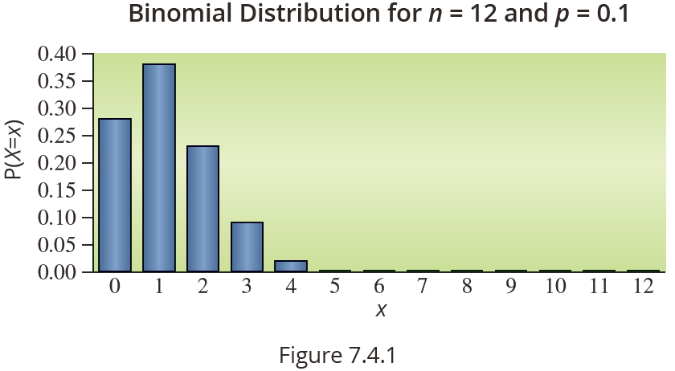
The Shape of a Binomial Distribution
The shape of the distribution depends upon the parameters n and p. If p is small, the distribution tends to be skewed with a tail on the right.

Slide 24
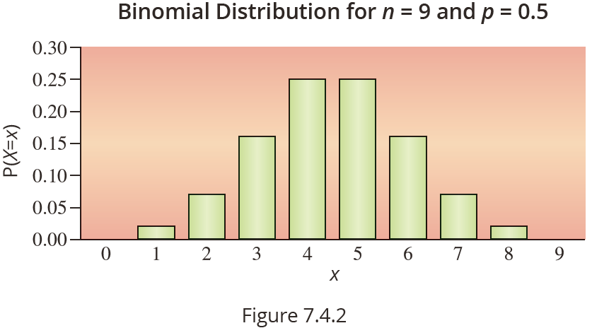
The Shape of a Binomial Distribution
If p is near 0.5, the distribution is symmetrical.

Slide 25
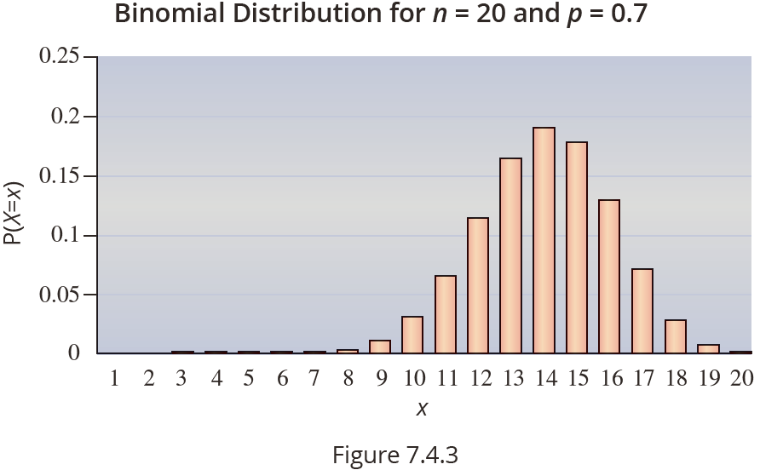
The Shape of a Binomial Distribution
If p is large, the distribution tends to be skewed with a long tail on the left.

Slide 26
Expected Value of a Binomial Random Variable
Formula
The expected value of a binomial random variable can be computed using the expression
μ = E(X) = np,
where n and p are the parameters of the binomial distribution.

Slide 27
Variance and Standard Deviation of a Binomial Random Variable
Formula
To find the variance of a binomial random variable, use the expression
Therefore, the standard deviation of a binomial random variable is given by

Slide 28
Example 7.4.5
Compute the expected value and the variance of the number of profitable leases in Example 7.4.3.
Solution
Since the random variable is binomial, we can use the shortcuts given on the previous page. Since n = 12 and p = 0.1, the expected value is given by the following expression.

Slide 29
Example 7.4.5 (cont.)
The variance is
which implies that the standard deviation is
Thus, if groups of 12 oil leases were purchased with the same probability of success (0.10 probability of a profitable lease), then the average number of profitable leases per group of 12 would be 1.2 and the standard deviation would be 1.039 leases.

