Slide 1
Section 7.5
The Poisson Distribution

Slide 2
Poisson Random Variable
Definition
In order to qualify as a Poisson random variable an experiment must meet two conditions.
Successes occur one at a time. That is, two or more successes cannot occur at exactly the same point in time or at exactly the same point in space.
The occurrence of a success in any interval is independent of the occurrence of a success in any other interval.

Slide 3
Poisson Probability Distribution Function
Formula
The Poisson probability distribution function is given by
Where
e = 2.71828…, and
λ = the mean number of successes.

Slide 4
Poisson Distribution
The Poisson distribution has only one parameter, , pronounced lambda. One peculiar feature of the distribution is that the variance of the distribution is equal to the mean. That is and .

Slide 5
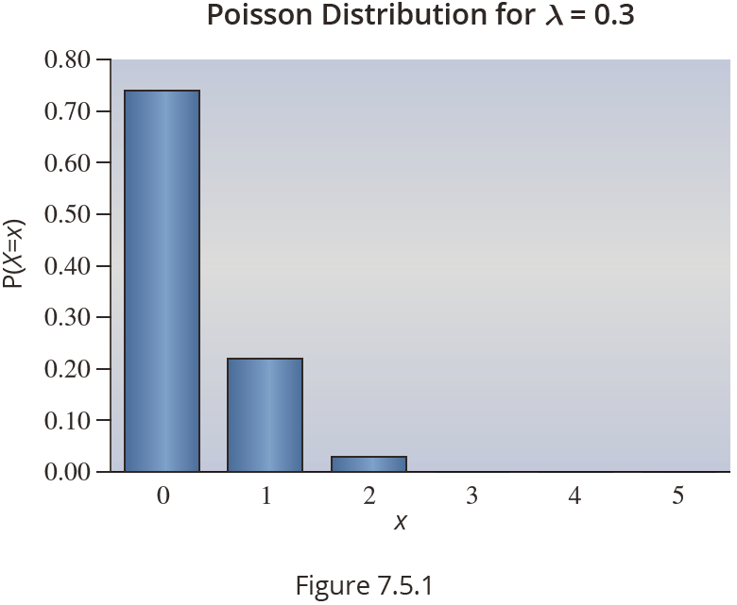
The Shape of the Poisson Distribution
The shape of the Poisson distribution varies dramatically with the parameter λ.
Example where λ is small:

Slide 6
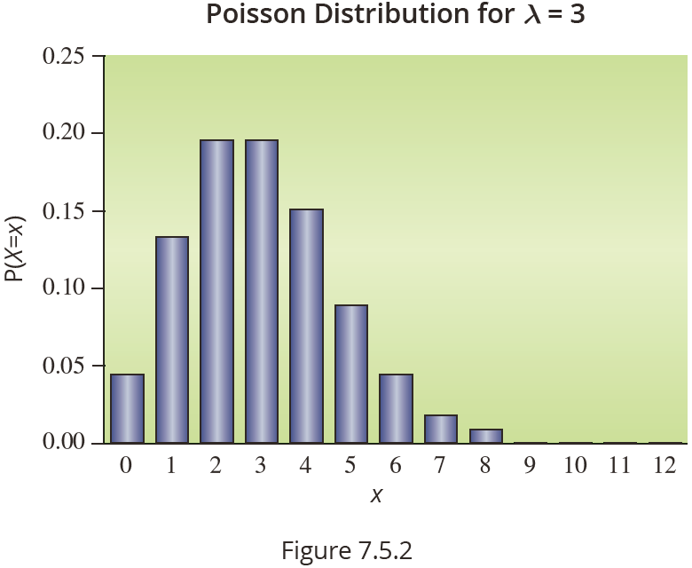
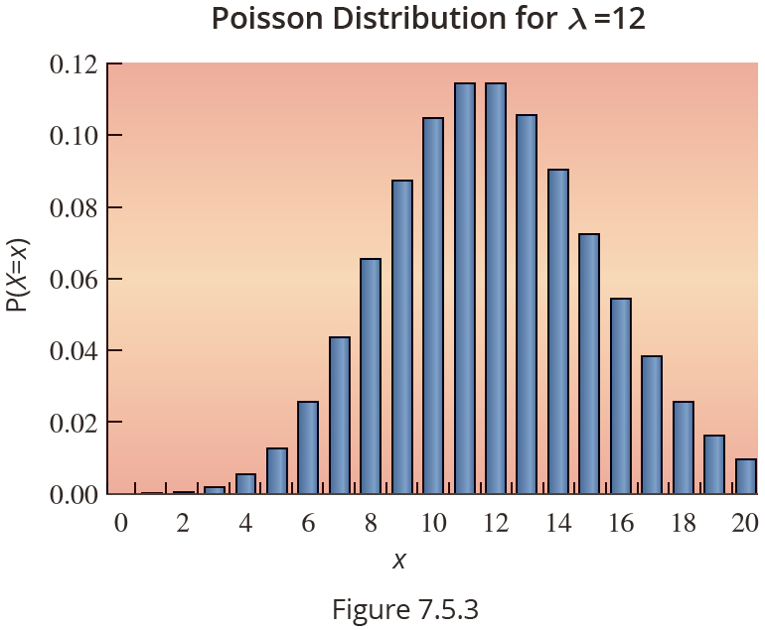
The Shape of the Poisson Distribution
As λ increases: As λ increases further:

Slide 7
Example 7.5.1
Suppose a bank has one automatic teller machine. Customers arrive at the machine at a rate of 20 per hour and according to a Poisson pattern.
What is the probability that no one will arrive in a 15-minute interval?
What is the probability that in a 15-minute period at least 3 persons will use the automated teller machines?

Slide 8
Example 7.5.1 (cont.)
Solution
Let X = the number of arrivals in a 15-minute period.
This problem contains one of the standard techniques used in working with Poisson random variables, that is, translating the arrival rate to correspond to the desired time interval. In this problem, the rate is given at 20 per hour which
corresponds to a rate of 5 per

Slide 9
Example 7.5.1 (cont.)
Thus, λ = 5 and the desired probability is
The probability could also have been found directly by using the table in Appendix A or technology.

Slide 10
Example 7.5.1 (cont.)
What is the probability that in a 15-minute period at least 3 persons will use the automated teller machines?
(using the Poisson table)

Slide 11
Example 7.5.2
The telephone company is considering purchasing optical cable from Optica, Inc. The company wishes to replace approximately 100,000 feet of conventional cable with optical fiber. Since optical fiber is very difficult to repair, it is important that the number of optical cable defects are minimized. Optica claims that on average there is one defect per 200,000 feet of cable. What is the probability that the replaced cable will contain no defects?

Slide 12
Example 7.5.2 (cont.)
Solution
Let X = the number of defects in 100,000 feet of optical cable.
Based on previous experience, we assume that the number of defects are approximated by a Poisson distribution with Poisson parameter as follows.
Using the tables provided in Appendix A, Table F,
(the average number of defects per 100,000 feet of cable)

