Slide 1
Section 8.1
The Uniform Distribution

Slide 2
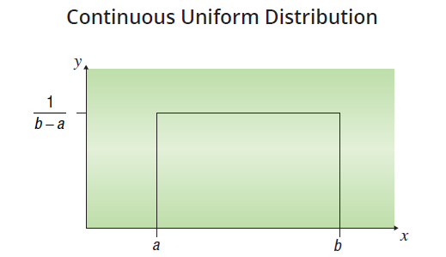
Continuous Uniform Distribution
There are two types of uniform distributions, discrete and continuous. Conceptually both uniform distributions distribute probability evenly across a sample space. For the continuous uniform distribution, the probability density is spread out over some range from a to b.

Slide 3
Uniform Probability Density Function
Formula
The uniform probability density function is given by
The mean and standard deviation are given by the following expressions.

Slide 4

Example 8.1.1
The fire department records how long it takes each of its trucks to reach the scene of a fire. Suppose that distribution of arrival times is uniform with the minimum time being 2 minutes and the maximum 15 minutes. Let X equal the time it takes a truck to arrive at the scene of a fire after being called.

Slide 5
Example 8.1.1 (cont.)
What is the probability that a truck will reach a fire scene within 5 to 10 minutes?
What is the expected time until arrival of the fire truck?
What is the standard deviation of truck arrival times?

Slide 6
Example 8.1.1 (cont.)
Solution
For the uniform distribution, the probability is simply calculated using the formula for the area of a rectangle.
Area = Height ⋅ Width
and Width = 10 – 5 = 5,
therefore

Slide 7
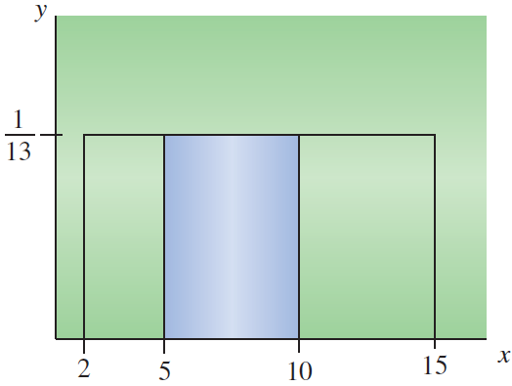
Example 8.1.1 (cont.)
and the
This is shown in the figure below.

Slide 8
Example 8.1.1 (cont.)
The expected value of a continuous uniform random variable is given by
Therefore, the expected time until arrival of the fire truck is 8.5 minutes.

Slide 9
Example 8.1.1 (cont.)
The standard deviation of a continuous uniform random variable is given by
Therefore, the standard deviation of truck arrival times is approximately 3.753 minutes.

