Slide 1
Section 8.2
The Normal Distribution

Slide 2
Normal Distribution
The normal distribution originally called the Gaussian distribution, was named after Karl Gauss who published a work in 1833 describing the mathematical definition of a distribution.
Normal distributions are bell-shaped, but the bells come in various shapes and sizes. Since all normal distributions are symmetric, the mean, mode, and median are all equal.

Slide 3
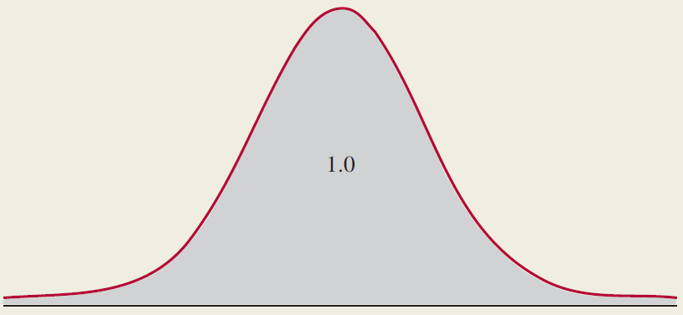
Properties of the Normal Distribution
Properties
The total area under any normal curve equals one.

Slide 4
Properties of the Normal Distribution
Properties (cont.)
Within a fixed number of standard deviations from the mean, all normal distributions contain the same fraction of their probability.
The probability of a normal random variable being in some interval corresponds to the area under the curve bounded by the specified interval.

Slide 5
The Normal Distribution
Caution
Although a normal distribution has a bell shape, a bell shape does not imply a normal distribution.

Slide 6
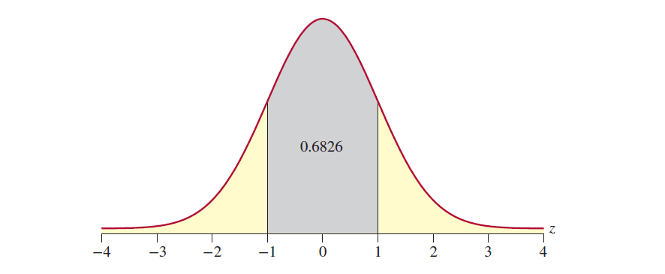
Standard Deviations Around the Mean
In the figure below, the shaded area represents the probability of being within of the mean. Regardless of the shape of the normal distribution, the area under the curve and the probability of being within one standard deviation ( ) of the mean equals 0.6826.

Slide 7
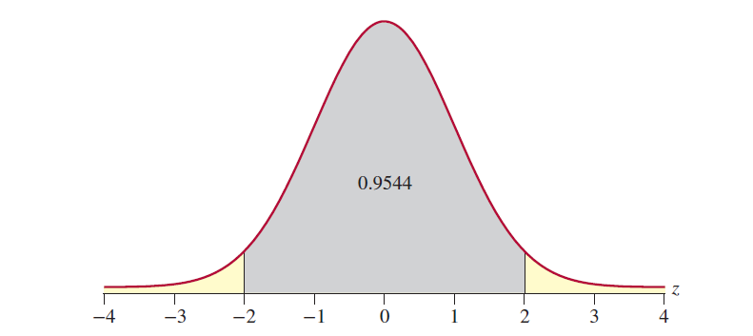
Standard Deviations Around the Mean
The figure below illustrates the area under the curve within two standard deviations of the mean. The probability of being within of the mean equals 0.9544 for every normal distribution.

Slide 8
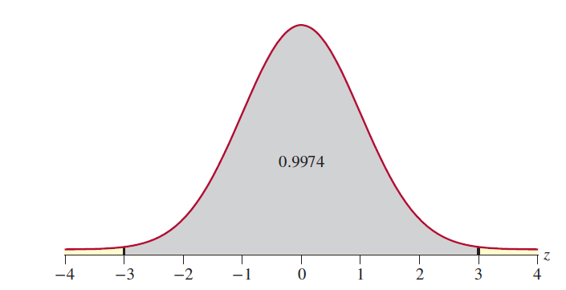
Standard Deviations Around the Mean
The figure below illustrates the area under the curve within three standard deviations of the mean. As you can see, virtually all the area under the curve is within three standard deviations of the mean. The probability of being within of the mean equals 0.9974.

Slide 9
Normal Probability Density Function
Formula
The normal probability density function is given by the following.

Slide 10
Looking at Data from Normal Distributions
The normal distribution is a theoretical construct with a bell shape. Therefore, it would not be unreasonable to expect data drawn from a normal population to exhibit the bell-shaped characteristic. In two small samples taken from a normal population on the next slides the data does show a faint resemblance of a bell shape. But as you can see, the shapes of the histograms developed from these small samples are somewhat unpredictable, even though the bell-shaped pattern is to some extent apparent.

Slide 11
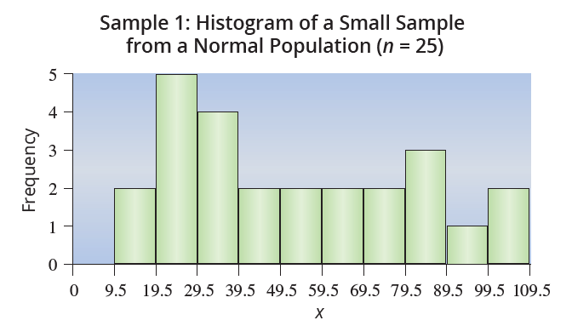
Sample 1: Histogram of a Small Sample from a Normal Population (n = 25)

Slide 12
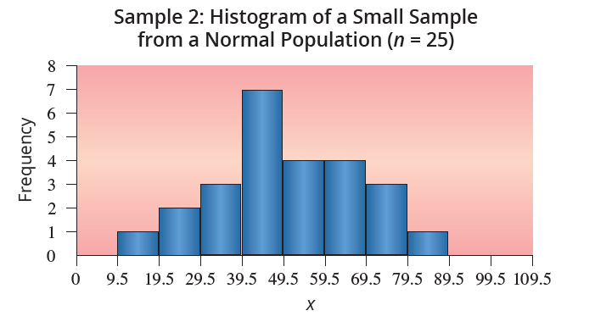
Sample 2: Histogram of a Small Sample from a Normal Population (n = 25)

Slide 13
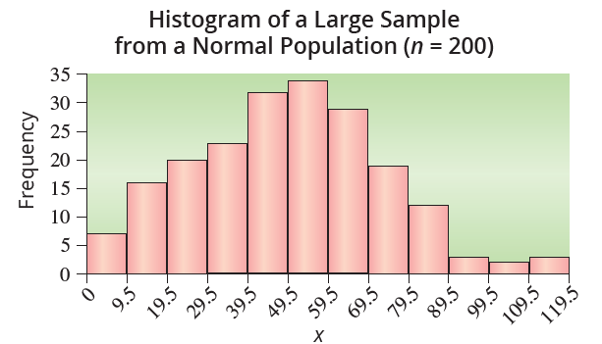
Histogram of a Large Sample from a Normal Population (n = 200)
For large samples, the representation of the bell curve is usually more visible. While the large sample (n = 200) certainly is not a perfect bell curve, it is recognizable.

Slide 14
Looking at Data from Normal Distributions
Note
There is an Appendix lesson on learn.hawkeslearning.com called Name that Distribution that provides practice in recognizing a probability model from sample data.

Slide 15
Standard Normal
Using the probability density to determine the probability of some interval would be complicated. Fortunately, there is an easier way. A special normal distribution, called the standard normal, can be used to determine probabilities for any normal random variable. The standard normal is discussed in a later section.

