Slide 1
Section 8.4
Applications of the Normal Distribution

Slide 2
Standardizing a Normal Random Variable
Properties
The following formula can transform any normal random variable into a standard normal random variable, z.
where x is a normal random variable with mean μ and standard deviation σ.

Slide 3
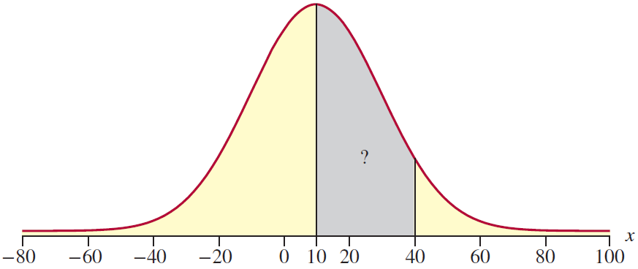
Example 8.4.1
Find the probability that a normal random variable with a mean of 10 and a standard deviation of 20 will lie between 10 and 40.

Slide 4
Example 8.4.1 (cont.)
Solution
Standardizing the random variable X yields the following.

Slide 5
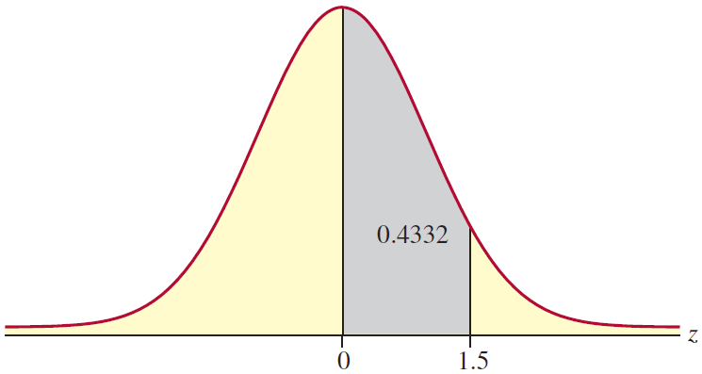
Example 8.4.1 (cont.)
Once the problem has been converted to a problem involving z (see the figure above), the appropriate probability can be determined from the standard normal tables in Appendix A. From Table C,

Slide 6
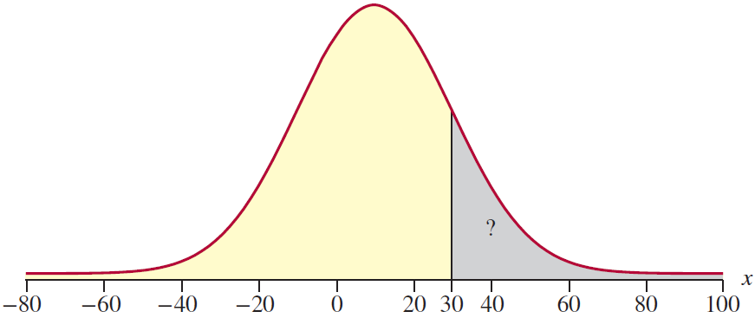
Example 8.4.2
Find the probability that a normal random variable with a mean of 10 and standard deviation of 20 will be greater than 30.

Slide 7
Example 8.4.2 (cont.)
Solution
Standardizing the random variable, we have the following.

Slide 8
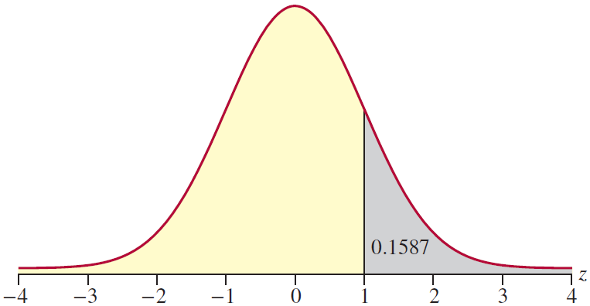
Example 8.4.2 (cont.)
Note that the x-value of 30 transformed into the z-value of 1. In other words, 30 is one standard deviation away from the mean.

Slide 9
Example 8.4.3
Suppose that a national testing service gives a test in which the results are normally distributed with a mean of 400 and a standard deviation of 100. If you score a 644 on the test, what fraction of the students taking the test exceeded your score?
Solution
Let X = a student’s score on the test.

Slide 10
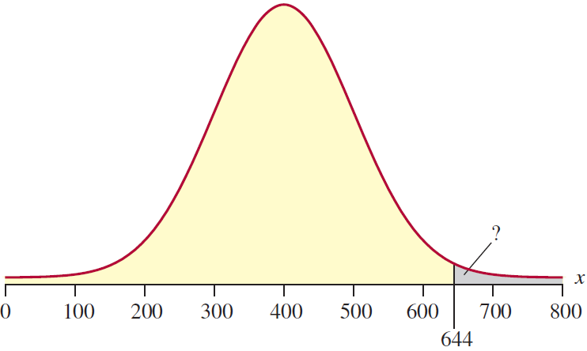
Example 8.4.3 (cont.)
The first step is to standardize the random variable.

Slide 11
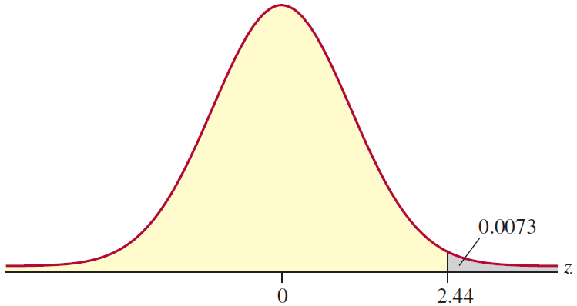
Example 8.4.3 (cont.)
Thus, only 0.73% of the students scored higher than your score of 644.

Slide 12
Example 8.4.4
Suppose that for 132 shoppers making a purchase at a clothing store, the total each shopper will spend follows a normal distribution with a mean of $234 and a standard deviation of $94. What is the probability that the next purchase total will be between $100 and $150?
Solution
Let X = the purchase total. We are interested in the probability that x is between $100 and $150. Writing this probability statement and then standardizing the random variable x, we have the following.

Slide 13
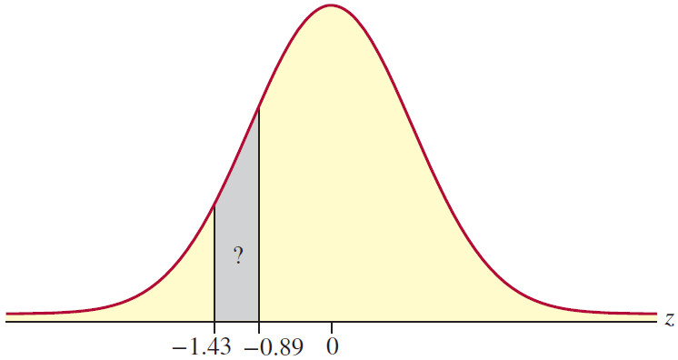
Example 8.4.4 (cont.)

Slide 14
Example 8.4.4 (cont.)
To find the probability that z is between −1.43 and −0.89, we will need to find the probability that z is less than −0.89 and subtract the probability that z is less than −1.43. Using Table A in Appendix A, we have the following.
Thus, there is approximately an 11% chance that the purchase will be between $100 and $150.

Slide 15
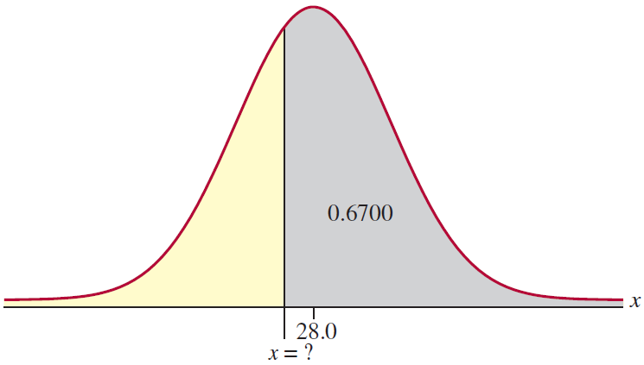
Example 8.4.5
If a normal distribution has a mean of 28.0 and a standard deviation of 2.5, what is the value of the random variable X that has an area to its right equal to 0.6700?
Solution
Remember that we need to use the steps in reverse. Begin by using the given area to find the value of z.

Slide 16
Example 8.4.5 (cont.)
Since we know that the area to the right of x is 0.6700, we also know the area to the left of x is 1 − 0.6700 = 0.3300. Using Table A in Appendix A, we find the z-value corresponding to this area is z ≈ −0.44. The final step is to use this z-score, along with the given values of the mean and standard deviation, to solve for x. Substituting these values into the formula for x we have the following.

Slide 17
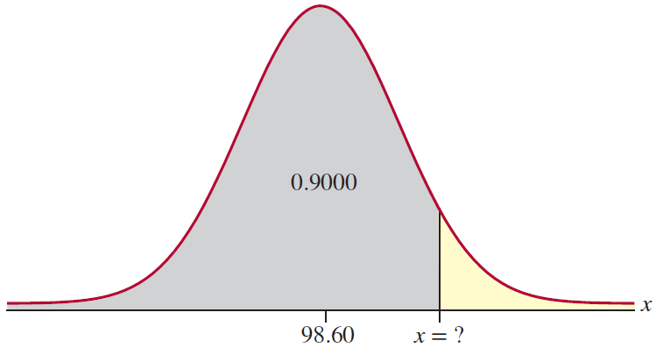
Example 8.4.6
The body temperatures of adults are normally distributed with a mean of 98.60 °F and a standard deviation of 0.73 °F. What temperature represents the 90th percentile?
Solution
In order to determine the temperature that represents the 90th percentile, we first need to find the z-value that represents the 90th percentile.

Slide 18
Example 8.4.6 (cont.)
Using technology, we determine this value to be z ≈ 1.281552. Once we have the value of z, we can substitute into the formula given above to find x.
Thus, a temperature of approximately 99.54 °F represents the 90th percentile.

