Slide 1
Section 8.6
Approximation to the Binomial Distribution

Slide 2
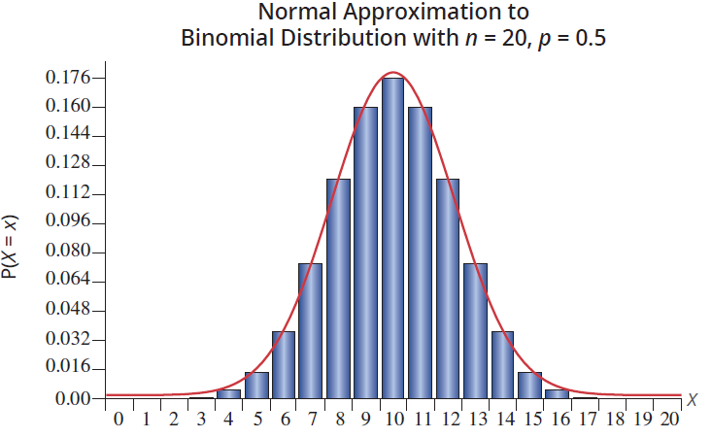
Approximation to the Binomial Distribution
To approximate other distributions, the normal distribution can be very useful. Although it is a continuous distribution, it is used to approximate discrete distributions, specifically the binomial.

Slide 3
When to Use the Normal Distribution to Approximate the Binomial Distribution
Generally, the approximation is reasonable when the mean of the binomial, np, is greater than or equal to 5 and n(1 – p) is greater than or equal to 5. The approximation becomes quite good when np is greater than or equal to 10 and n(1 – p) is greater than or equal to 10.

Slide 4
The Binomial Distribution
Note
The method of approximating the binomial with the normal distribution was developed in the 18th century before something like a calculator existed. Now it is practical to find the true probabilities using technology. However, it is still important to understand the normal approximation concept as we will use this idea later.

Slide 5
Continuity Correction
Definition
Continuity correction is used when a discrete distribution is approximated using a continuous distribution. To apply continuity correction, subtract or add 0.5 (depending on the question at hand) to a selected value in order to find the desired probability.

Slide 6
Example 8.6.1
Assuming n = 20 and p = 0.5, use a normal random variable (Y) to approximate the probability that a binomial random variable (X) is 5 or less.
Using a normal distribution to approximate, find the probability that X is greater than 4.

Slide 7
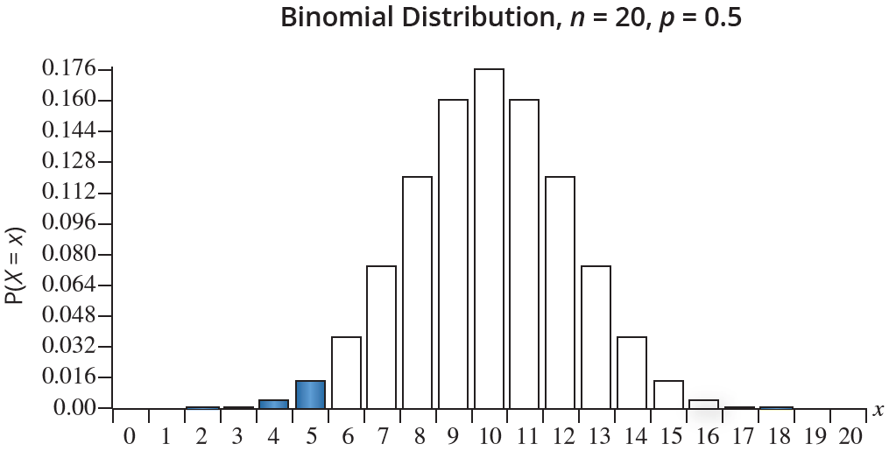
Example 8.6.1 (cont.)
Solution
This implies finding the area of the rectangles for 0, 1, 2, 3, 4, and 5.

Slide 8
Example 8.6.1 (cont.)
Instead of using the normal approximation P(Y ≤ 5) use the continuity correction P(Y ≤ 5.5), in order to accumulate all of the probabilities under the normal curve that correspond to the region X ≤ 5.
To use the normal approximation the mean and standard deviation of the binomial must be calculated.

Slide 9
Example 8.6.1 (cont.)
Using the normal random variable Y with a mean of 10 and a standard deviation of 2.2361 to approximate the binomial using continuity correction,

Slide 10
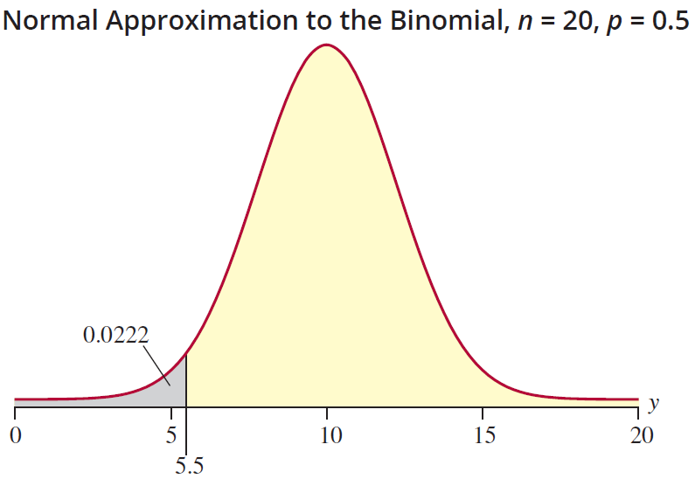
Example 8.6.1 (cont.)
Thus, the probability that the binomial random variable is 5 or less is approximately 0.0222.

Slide 11
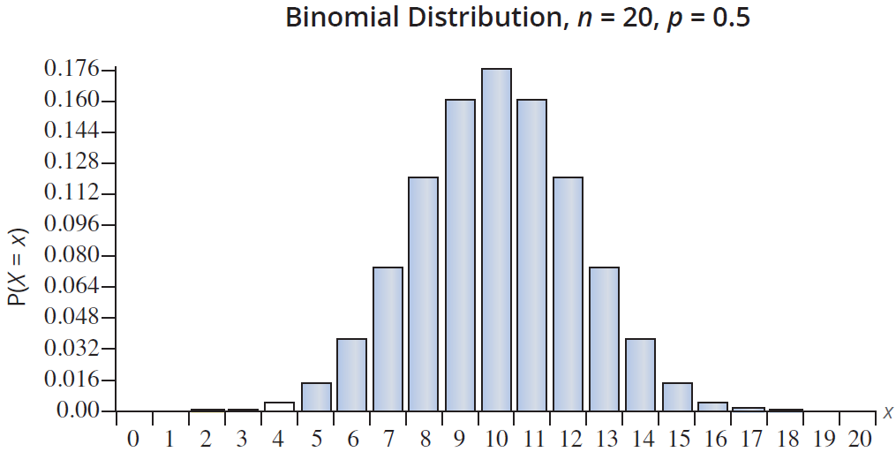
Example 8.6.1 (cont.)
We are interested in the probability that a binomial random variable, X, is greater than 4.

Slide 12
Example 8.6.1 (cont.)
Since this is a discrete distribution, the probability that X is greater than 4 is equal to the probability that X is greater than or equal to 5. Thus, when using the normal approximation, we need to apply continuity correction and consider the probability that the normal random variable is greater than or equal to 4.5.
Using the normal random variable Y with a mean of 10 and a standard deviation of 2.2361 to approximate the binomial using continuity correction,

Slide 13
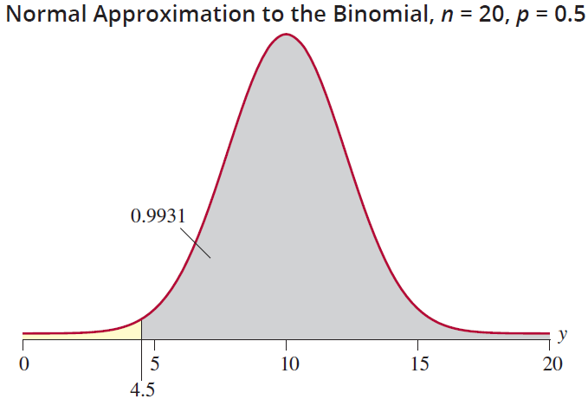
Example 8.6.1 (cont.)
Thus, the probability that the binomial random variable is greater than 4 is 0.9931.

Slide 14
Example 8.6.2
An advertising agency hired on behalf of Tech’s development office conducted an ad campaign aimed at making alumni aware of their new capital campaign. Upon completion of the new campaign, the agency claimed that 20% of alumni in the state were aware of the new campaign. To validate the claim of the agency, the development office surveyed 1000 alumni in the state and found that 150 were aware of the campaign. Assuming that the ad agency’s claim is true, what is the probability that no more than 150 of the alumni in the random sample were aware of the new campaign?

Slide 15
Example 8.6.2 (cont.)
Solution
Let X = the number of alumni that were aware of the campaign.
X is a binomial random variable with n = 1000 and p = 0.20.
So, np = 200 and n(1 – p) = 800. Therefore, the normal distribution is appropriate to use as an approximation to the binomial distribution.
The mean is μ = np = 200 and the standard deviation is

Slide 16
Example 8.6.2 (cont.)
We are interested in the probability that no more than 150 of the alumni in the sample were aware of the campaign, or P(X ≤ 150). However, since we are using the normal distribution to approximate the binomial, continuity correction must be applied.
Let Y be a normally distributed random variable with a mean of 200 and a standard deviation of 12.6491.

Slide 17
Example 8.6.2 (cont.)
Applying continuity correction, we are interested in the following probability.
Thus, if the marketing agency’s claim is true, the probability that 150 or fewer alumni are aware of the campaign is practically zero. This would lead the development office to believe that the agency’s claim is false.

Slide 18
The Binomial Distribution
Note
The z-value −3.91 is not listed in the tables given in Appendix A. However, using technology such as a calculator or computer software, it can be calculated that the actual probability is approximately 0.000046.

Slide 19
Example 8.6.3
A popular restaurant near Tech’s campus accepts 200 reservations on Saturdays, often the day of a home Tech football game. Given that many of the reservations are made weeks in advance of game day, the restaurant expects that about eight percent will be no-shows. What is the probability that the restaurant will have no more than 20 no-shows on the next Saturday of a football weekend?

Slide 20
Example 8.6.3 (cont.)
Solution
Let X = the number of no-shows.
X is a binomial random variable with n = 200 and p = 0.08.
Since np = 16 and n(1 – p) = 184 are both greater than 10, the normal distribution can be used to approximate the binomial probability.
For the binomial, μ = np = 16 and

Slide 21
Example 8.6.3 (cont.)
Using the normal random variable Y with a mean of 16 and a standard deviation of 3.8367 to approximate the binomial without continuity correction results in
Using continuity correction,

Slide 22
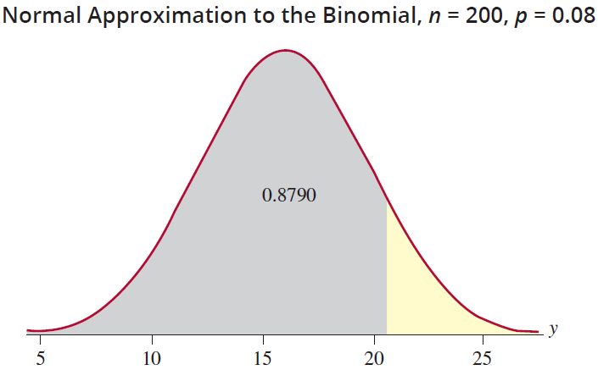
Example 8.6.3 (cont.)
Thus, using the normal
approximation and continuity correction, the probability that the restaurant will have no more than 20 no-shows is 0.8790. Notice that the continuity correction has a significant impact on the accuracy of the approximation. Using the binomial distribution, the exact probability is 0.8775.

