Slide 1
Section 9.3
The Distribution of the Sample Mean and the Central Limit Theorem

Slide 2
Unbiased
Definition
If the average value of an estimator equals the population parameter being estimated, the estimator is said to be unbiased.

Slide 3
What is the Central Value of ?
Note
The sample median is an unbiased estimator of the population median if the distribution of the population is symmetric.

Slide 4
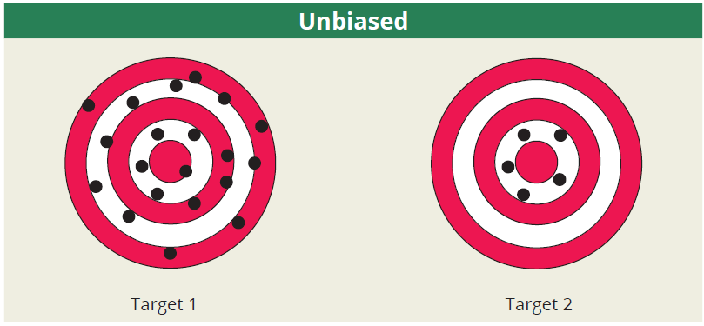
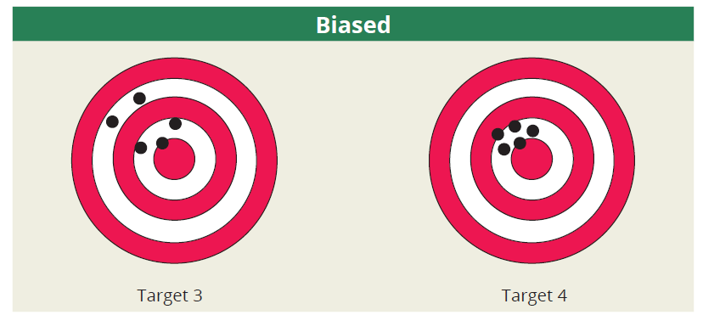
Unbiased vs. Biased Estimators

Slide 5
Unbiased Estimators
Properties
The sample mean, is an unbiased estimator of μ.
The sample proportion, is an unbiased estimator of p.
The sample variance, s², is an unbiased estimator of σ ².

Slide 6
Variance and Standard Deviation of the Sample Mean: Infinite Population
Formula
It can be shown that for a population of infinite size the variance of equals
and the standard deviation is
where σ ² is the population variance and n is the sample size.

Slide 7
Standard Error of the Mean
We refer to as the standard error of the mean, generally called the standard error, which is the standard deviation of a point estimator. We will use the standard error of the mean to indicate how far the sample mean is from the population mean.

Slide 8
Infinite vs. Finite Populations
When we apply the Central Limit Theorem, we assume that the population has an infinite number of members. When we sample with replacement, the population becomes essentially infinite. However, in reality there are applications that involve sampling without replacement. For these finite populations, an adjustment needs to be made for .

Slide 9
Variance and Standard Deviation of the Sample Mean: Finite Population
Formula
For a finite population the variance of is
and the standard deviation is
where N = the size of the population and n = the size of the sample.

Slide 10
What is the Variability of ?
Note
The finite population correction factor should be used if n is greater than 5% of the finite population size, N.

Slide 11
Characteristics of the Sample Mean
Properties
If an estimate of the population mean is required, the sample mean seems to possess two good characteristics.
The mean of sample means is the population mean. Another way of expressing this concept is to say that the expected value of is equal to the population mean. Symbolically, this can be expressed as
(unbiasedness)

Slide 12
Characteristics of the Sample Mean
Properties (cont.)
If the sample size is increased, the variability of the sample mean decreases. This implies that the quality of the estimator tends to improve as the sample size increases.

Slide 13
The Central Limit Theorem
The Central Limit Theorem is a very important theorem which summarizes the distribution of the sample mean. The distribution of the sample mean becomes closer to a normal distribution as the sample size becomes larger, regardless of the shape of the population for which the sample is drawn.

Slide 14
The Central Limit Theorem
Definition
If a sufficiently large random sample (i.e., n > 30) is drawn from a population with mean μ and standard deviation σ, the distribution of the sample mean will have the following characteristics.
An approximately normal distribution regardless of the distribution of the underlying population.
(The mean of the sample means equals the population mean.)

Slide 15
The Central Limit Theorem
Definition (cont.)
(The standard deviation of the sample
means equals the standard deviation of the population divided by the square root of the sample size.)

Slide 16
Using the z-transformation to Apply the Central Limit Theorem
Once we have determined that the sample size is sufficiently large, we can use the z-transformation we studied previously to calculate probabilities about the random variable . We can adapt the z-transformation as follows.

Slide 17
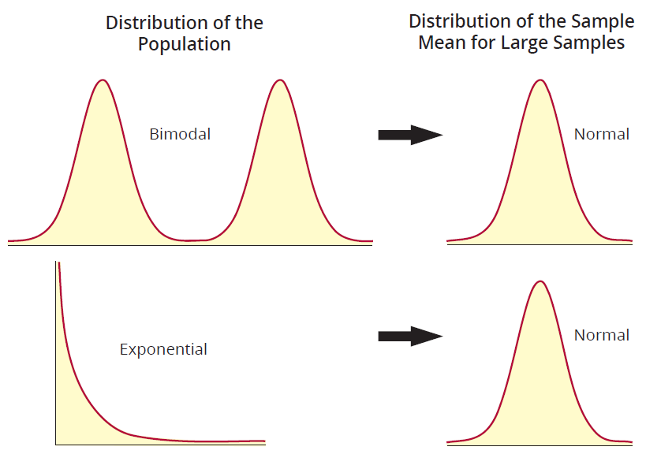
Distributions of the Sample Mean for Large Samples

Slide 18
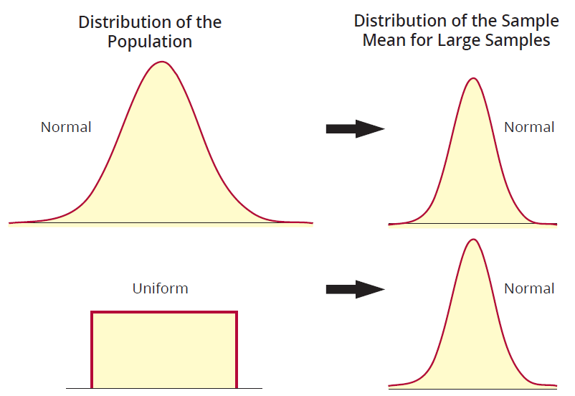
Distributions of the Sample Mean for Large Samples (cont.)

Slide 19
Example 9.3.1
Suppose a population has a mean of 30 and a variance of 25. If a sample size of 100 is drawn from the population, what is the probability that the sample mean will be larger than 31?
Solution
The information given in the problem is
In order to solve this problem, the sampling distribution of must be determined.

Slide 20
Example 9.3.1 (cont.)
Using the Central Limit Theorem, the distribution of will be normal with a mean equal to the population mean, 30, and a standard deviation given by
The question that is being asked can be stated as follows:

Slide 21
Example 9.3.1 (cont.)
Since is a normal random variable, the probability that is greater than 31 is determined using a z-transformation. The objective is to find the area under the normal curve corresponding to an greater than 31.

Slide 22
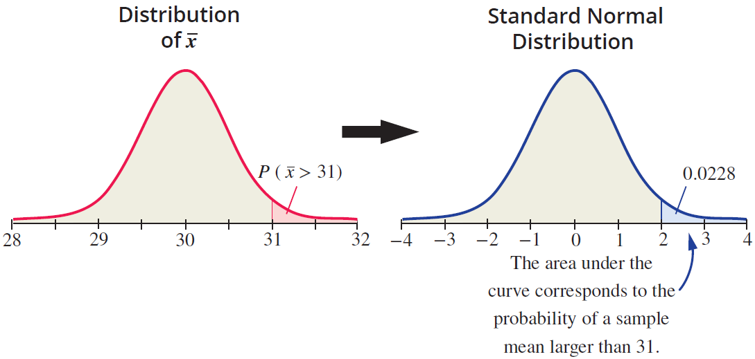
Example 9.3.1 (cont.)

Slide 23
Example 9.3.2
Consider the same scenario as in Example 9.3.1 except that the mean is unknown. If the sample mean is used as an estimate of the population mean, what is the probability that the sample mean will be in error by at most one unit from the true mean?
Solution
The concept of using a statistic to estimate a population parameter introduces the concept of sampling error. In general, the sampling error is the difference between a sample statistic and the parameter that it is estimating.

Slide 24
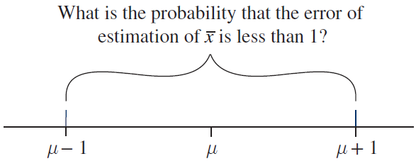
Example 9.3.2 (cont.)
In the problem at hand, the error is given by since we will be using to estimate μ.
However, we are just as interested in negative errors as positive errors. Thus, to satisfy the condition that an error of less than one unit has been made, the condition must be satisfied.

Slide 25
Example 9.3.2 (cont.)
An interesting and almost magical phenomenon happens when we use the z-transformation.
Since σ_{x} = 0.5.

Slide 26
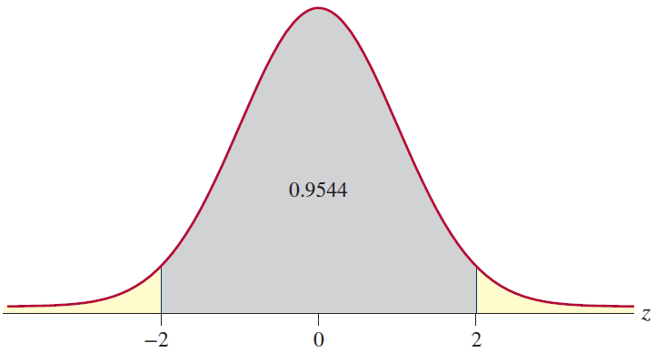
Example 9.3.2 (cont.)

