Slide 1
Section 9.4
The Distribution of the Sample Proportion

Slide 2
Sample Proportion
Formula
The sample proportion is given by
where x is the number of observations in the sample possessing the characteristic of interest and n is the total number of observations in the sample.

Slide 3
Determining the Sample Proportion
Note
is pronounced p-hat.

Slide 4
Standard Deviation of the Sample Proportion
Formula
The standard deviation of is given by
where p is the population proportion and n is the sample size.

Slide 5
Sampling Distribution of the Sample Proportion
Definition
If the population is infinite and the sample is sufficiently large, the distribution of has the following characteristics:
An approximately normal distribution.
(The mean of the sample proportions equals the population proportion.)

Slide 6
Sampling Distribution of the Sample Proportion
Definition (cont.)
If the population is finite and the sample is sufficiently large, the distribution of has the following characteristics:
An approximately normal distribution.
where N is the size of the population.

Slide 7
Example 9.4.1
Suppose a sample of 400 persons is used to perform a taste test. If the true fraction in the population that prefers Pepsi is really 0.5, what is the probability that less than 0.44 of the persons in the sample will prefer Pepsi?
Solution
Assume the population from which the sample is drawn is extremely large and the finite population correction factor is not applicable. The distribution of would then be normal with E( )= 0.5,

Slide 8
Example 9.4.1 (cont.)
The probability that the sample proportion is less than 0.44 is given by

Slide 9
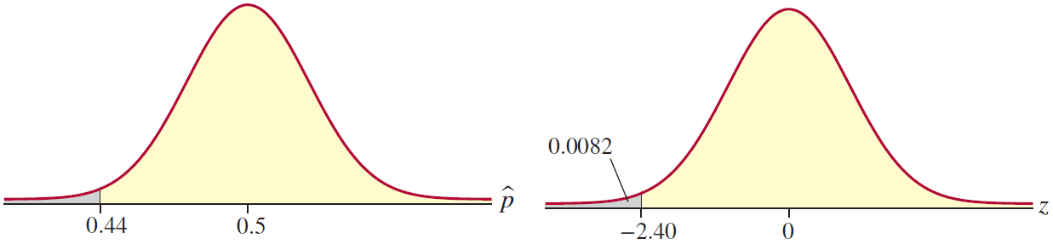
Example 9.4.1 (cont.)
With the information we have developed thus far we can begin to draw conclusions (make inferences). If the true fraction of people in the population who prefer Pepsi is really 0.5, it is extremely unlikely (0.0082 is less than 1 in 100) to observe a sample proportion as low as 0.44.

Slide 10
Example 9.4.1 (cont.)
Suppose that you had to make a decision as to whether cola drinkers were indifferent between Pepsi and Coke. If they were indifferent, the fraction who prefer Pepsi should be around 0.5. If you used a sample of 400 people and observed a sample proportion of 0.438 that preferred Pepsi, which of the conclusions would you believe?
The indifference hypothesis
Conclusion A: Cola drinkers are indifferent between Pepsi and Coke. Stated another way, the proportion of persons that favor Pepsi is about 0.5.

Slide 11
Example 9.4.1 (cont.)
The difference hypothesis
Conclusion B: Cola drinkers are not indifferent between Pepsi and Coke.
The likelihood of observing a sample with less than 0.44 is very rare (0.0082) given that the true proportion who prefer Pepsi is p = 0.5. Most people would doubt the indifference hypothesis, Conclusion A, and select Conclusion B. The decision-making problem given above is really a statistical inference problem.

Slide 12
Example 9.4.1 (cont.)
Although the procedure for analyzing inference problems will be presented in a subsequent chapter, the problem illustrates the connection between probability and inference. To reach a decision (make the inference) we used the fact that if the true proportion is really 0.5, a proportion below 0.44 is highly improbable for a sample of 400.

Slide 13
Example 9.4.2
Suppose a sample of 500 is used to estimate the fraction of voters that favor a particular candidate. If the population proportion that favors the candidate is really 0.4, what is the probability that the error of estimation will be less than 0.05?
Solution
Since the true value of the population proportion is assumed to be 0.4, the value of must fall between 0.35 and 0.45 in order for the error of estimation to be less than 0.05.

Slide 14
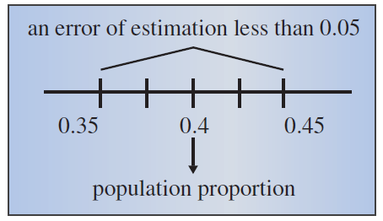
Example 9.4.2 (cont.)
In order to determine the probability that will fall in this interval, its distribution must be determined. Since the distribution of is approximately normally distributed for large samples, the distribution of will be approximately normal with

Slide 15
Example 9.4.2 (cont.)
To find the probability that is within 0.05 of the true mean, we must find

Slide 16
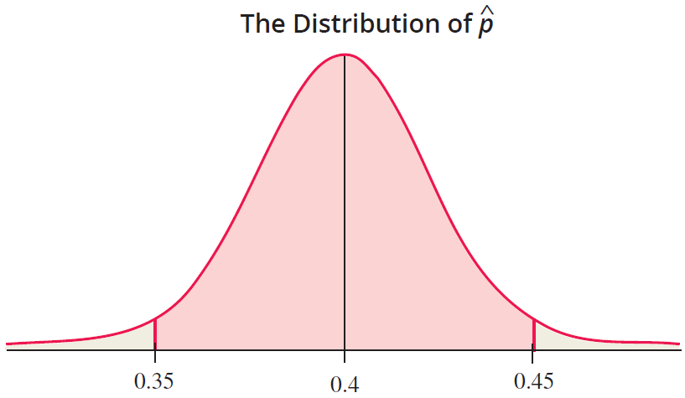
Example 9.4.2 (cont.)

Slide 17
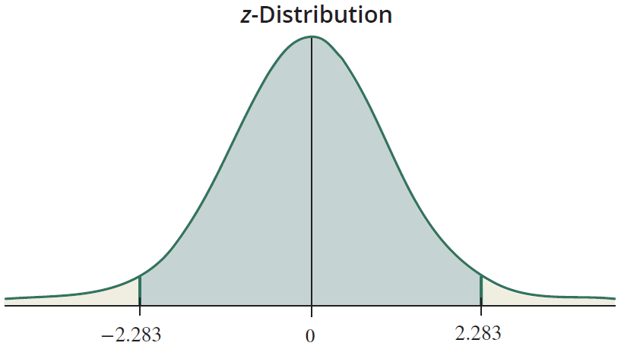
Example 9.4.2 (cont.)
Using the z-transformation,

Slide 18
Example 9.4.2 (cont.)
For a sample of 500, it is very probable (0.9774) that the error of estimation will be less than 0.05.

