Slide 1
HAWKES LEARNING
Taking Notes and Annotating Texts

Slide 2
Lesson Goals
Building skills in active listening
Effective note-taking methods
Annotating texts for active reading

Slide 3
Listening Skills
information
listening
effective notes

Slide 4
Listening Skills
Active listening
Preparation
Prior knowledge

Slide 5
Note-Taking Guidelines
Neat handwriting
Abbreviations and phrases
Your own words

Slide 6
Note-Taking Methods
Outlining
Cornell Method
Mind mapping

Slide 7
Outlining
Forms of Exercise
1. Endurance
  a. Benefits
    i. Circulation
  ii. Fitness
  b. Options
    i. Jogging
    ii. Dancing
2. Flexibility
  a. Benefits
    i. Stretched muscles
    ii. Limber body
  b. Options
    i. Yoga
    ii. Pilates
HAWKES LEARNING

Slide 8
Cornell Method
Class
Date
Topic
Terms Notes
and
Questions
Summary
HAWKES LEARNING

Slide 9
Mind Mapping
Endurance Training
Options
Benefits
Circulation
Jogging
Dancing
Fitness
HAWKES LEARNING

Slide 10
Annotating
Key terms
Main ideas
Unfamiliar words
Questions

Slide 11
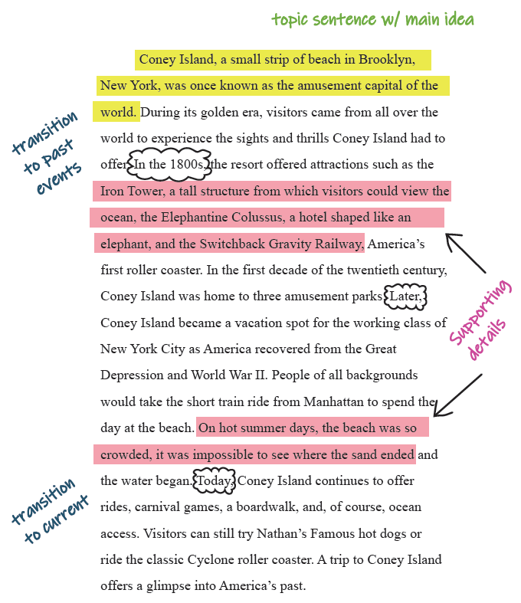
Annotating

Slide 12




HAWKES LEARNING

