Slide 1
HAWKES LEARNING
Preparing Yourself to Read

Slide 2
Lesson Goals
Scan the title, table of contents, and major headings
Make predictions and find connections
Create a plan to start reading

Slide 3
Title, Table of Contents, and Headings
Title
Topic
Table of contents
Major headings
HAWKES LEARNING

Slide 4
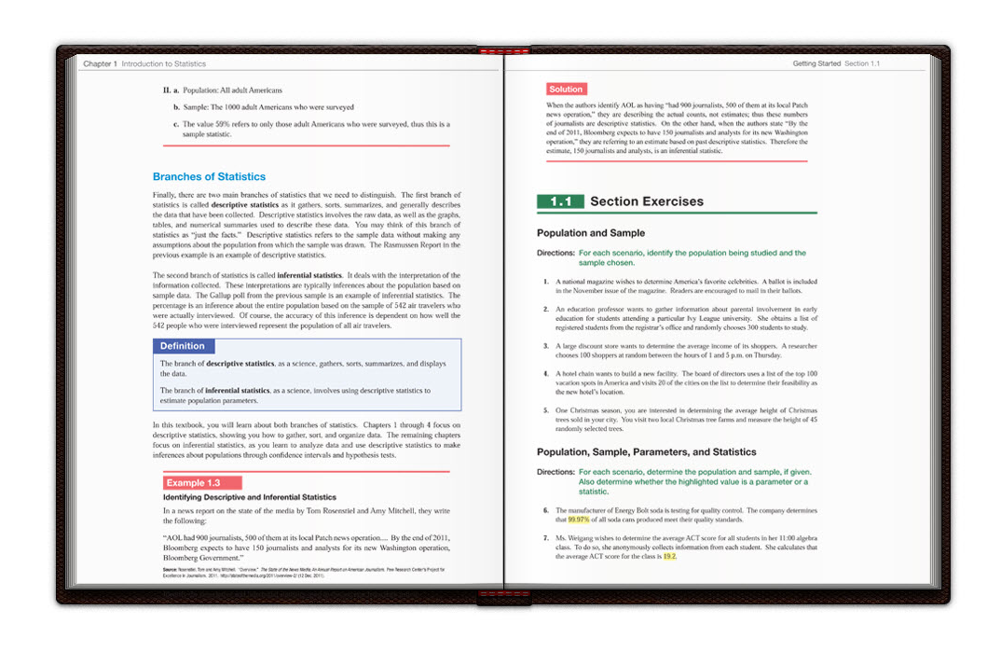
Title, Table of Contents, and Headings
HAWKES LEARNING

Slide 5
Make Predictions
Who?
What?
Where?
When?
Why?
How?
HAWKES LEARNING

Slide 6
Make Connections
What I Know
What I Want to Know
What I Learned
→
→
HAWKES LEARNING

Slide 7
Make a Reading Plan
What are the details of the assignment?
How much time will I need to read the full text?
What supplies or materials will I need?
HAWKES LEARNING

Slide 8




HAWKES LEARNING

