Slide 1
HAWKES LEARNING
Writing with Technology

Slide 2
Lesson Goals
Saving your work
Using grammar and spell check
Formatting the page
Using keyboard shortcuts

Slide 3
Saving Your Work
Prevents loss of your assignment
Don’t wait until the end of writing
Save every 15 minutes
HAWKES LEARNING

Slide 4
Saving Your Work
Additional space
External hard drive
Portable USB
Cloud service
HAWKES LEARNING

Slide 5
Keeping Your Files Organized
➔
Keep separate folders for each class
➔
Keep two versions of a document
➔
Name files with date of your last edit
HAWKES LEARNING

Slide 6
Spell Check
Scans writing for basic spelling errors
Show amount, time, or position.
HAWKES LEARNING

Slide 7
Spell Check
Scans writing for basic spelling errors
Show amount, time, or position.
Words out of place
Wrong word being used
Proper nouns misspelled
+
+
Tone
HAWKES LEARNING

Slide 8
Spell Check
Scans writing for basic spelling errors
Spell check should never replace proofreading!
HAWKES LEARNING

Slide 9
Formatting
essential part of writing
HAWKES LEARNING

Slide 10
Formatting
essential part of writing
MLA style
HAWKES LEARNING

Slide 11
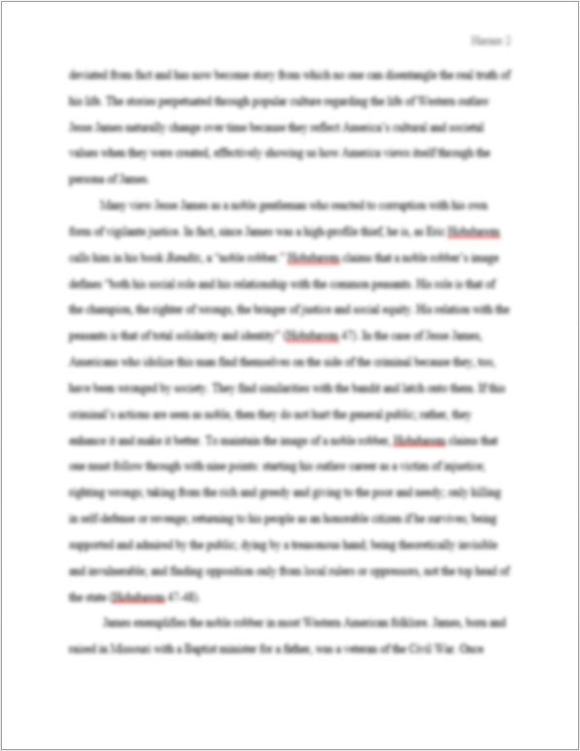
Page Margins

Slide 12
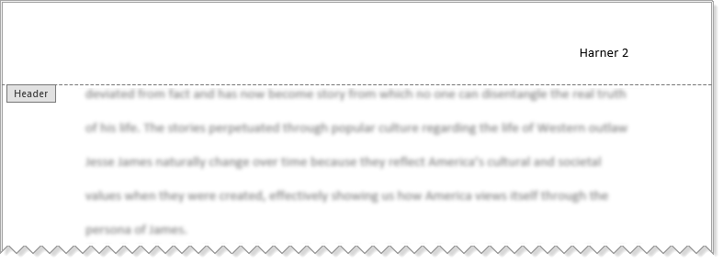
Headers

Slide 13
Page Numbers
Helps audience find information

Slide 14
Keyboard Shortcuts
Command | Windows | Mac
Save your work | Ctrl + S | Cmd + S
Undo your last action | Ctrl + Z | Cmd + Z
Cut text | Ctrl + X | Cmd + X
Copy text | Ctrl + C | Cmd + C
Paste cut/copied text | Ctrl + V | Cmd + V

Slide 15




HAWKES LEARNING

