Slide 1
HAWKES LEARNING
Identifying Types of Sources

Slide 2
Lesson Goals
Primary and Secondary
Popular and Scholarly

Slide 3
Primary and Secondary
vs.
Information is not original to source
Original source

Slide 4
Primary and Secondary
Original documents
Speeches
Works of literature
Firsthand accounts
Works of art
Research findings

Slide 5
Primary and Secondary
Works of literature
The Giver by Lois Lowry
Historic documents
Declaration of Independence
Firsthand accounts
Interview with eyewitness
Painting
The Mona Lisa by Leonardo da Vinci

Slide 6
Primary and Secondary
Primary
Secondary
Original source
Reference original source

Slide 7
Primary and Secondary
Primary
Secondary
The Giver
An essay that analyzes imagery in The Giver

Slide 8
Primary and Secondary
Research papers
Websites
Film documentaries
News articles

Slide 9
Primary and Secondary
Newspaper article about a proposed piece of legislation
Original piece of legislation

Slide 10
Primary and Secondary
Authorship
Credibility

Slide 11
Popular and Scholarly
Expertise
+
Audience

Slide 12
Popular and Scholarly
not an expert
→
general public

Slide 13
Popular and Scholarly
Book
Call Us What We Carry
by Amanda Gorman
Podcast
Office Ladies
hosted by Jenna Fischer and Angela Kinsey
Movie
Spider-Man: No Way Home
directed by Jon Watts
Website
The Poetry Foundation

Slide 14
Popular and Scholarly
expert
→
other experts

Slide 15
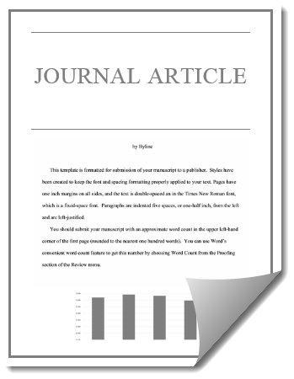
Popular and Scholarly

Slide 16




HAWKES LEARNING

