Slide 1
Section 0.1
Real Numbers and Number Lines

Slide 2
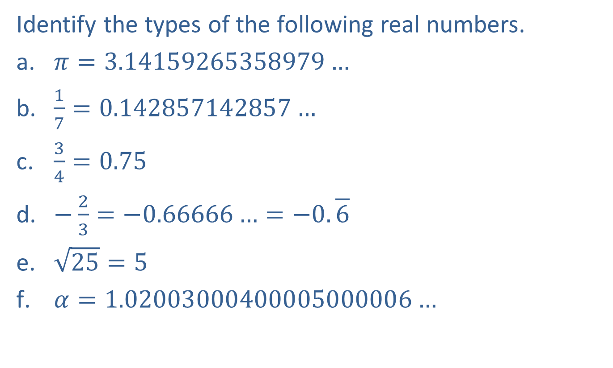
Example 1: Types of Real Numbers
Identify the types of the following real numbers.
​$π=3.14159265358979…$
​$\frac{1}{7}=0.142857142857…$
​$\frac{3}{4}=0.75$
​$−\frac{2}{3}=−0.66666…=−0.\overline{6}$
​$\sqrt{25}=5$
​$α=1.02003000400005000006…$

Slide 3
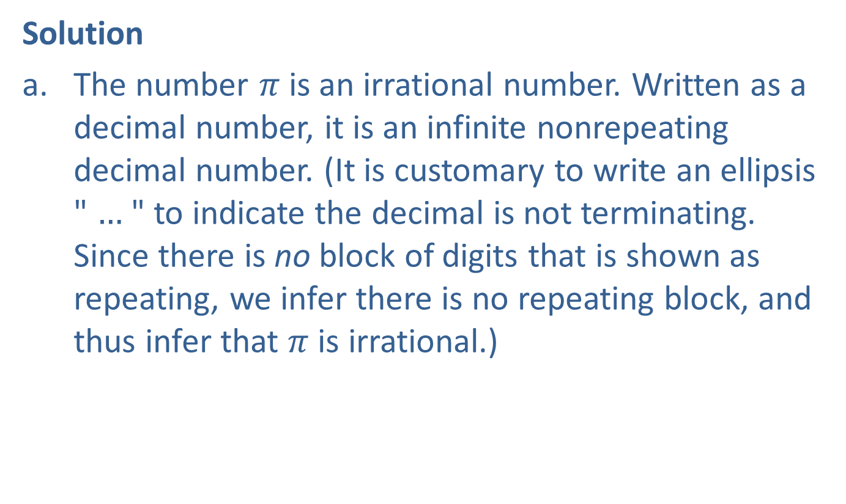
Example 1: Types of Real Numbers (cont.)
Solution
​The number $π$ is an irrational number. Written as a decimal number, it is an infinite nonrepeating decimal number. (It is customary to write an ellipsis " $…$ " to indicate the decimal is not terminating. Since there is no block of digits that is shown as repeating, we infer there is no repeating block, and thus infer that $π$ is irrational.)

Slide 4
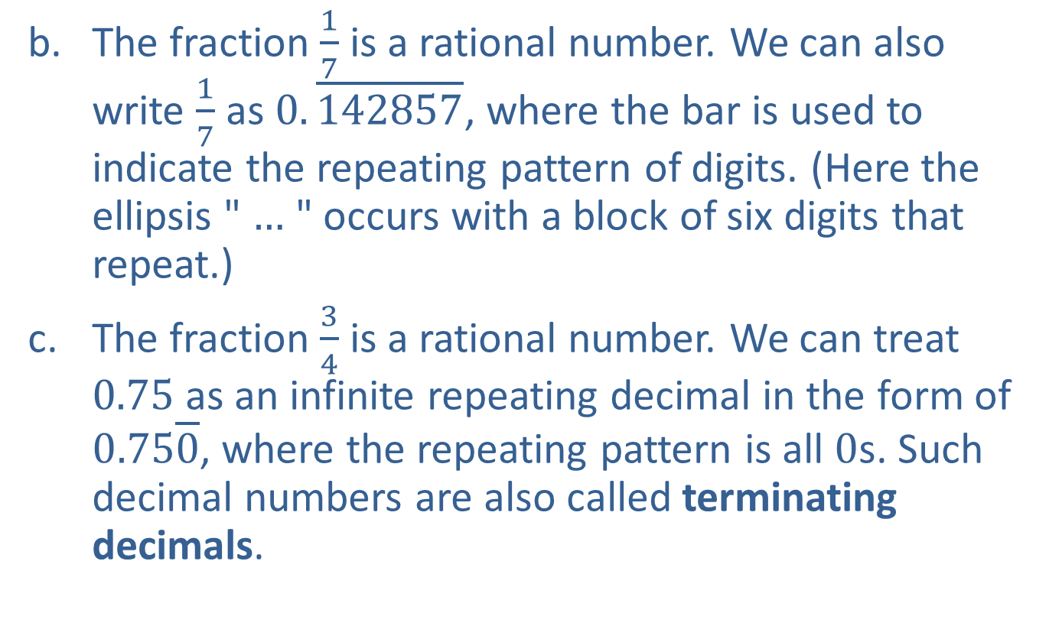
Example 1: Types of Real Numbers (cont.)
​The fraction $\frac{1}{7}$ is a rational number. We can also write $\frac{1}{7}$ as $0.\overline{142857}$, where the bar is used to indicate the repeating pattern of digits. (Here the ellipsis " $…$ " occurs with a block of six digits that repeat.)
​The fraction $\frac{3}{4}$ is a rational number. We can treat 0.75 as an infinite repeating decimal in the form of $0.75\overline{0}$, where the repeating pattern is all 0s. Such decimal numbers are also called terminating decimals.

Slide 5
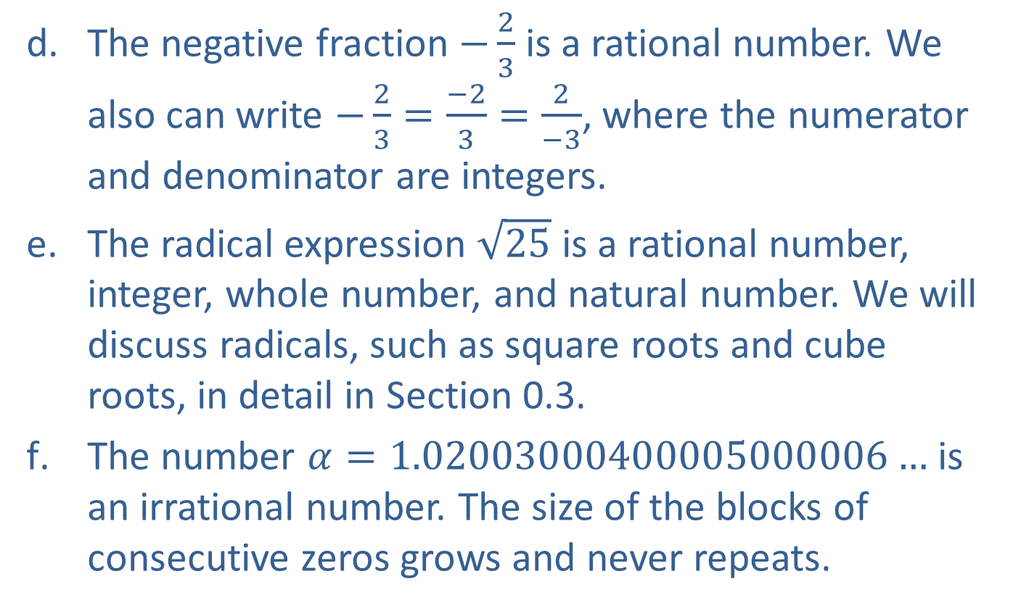
Example 1: Types of Real Numbers (cont.)
​The negative fraction $−\frac{2}{3}$ is a rational number. We also can write $−\frac{2}{3}=\frac{−2}{3}=\frac{2}{−3}$, where the numerator and denominator are integers.
​The radical expression $\sqrt{25}$ is a rational number, integer, whole number, and natural number. We will discuss radicals, such as square roots and cube roots, in detail in Section 0.3.
​The number $α=1.02003000400005000006…$ is an irrational number. The size of the blocks of consecutive zeros grows and never repeats.

Slide 6
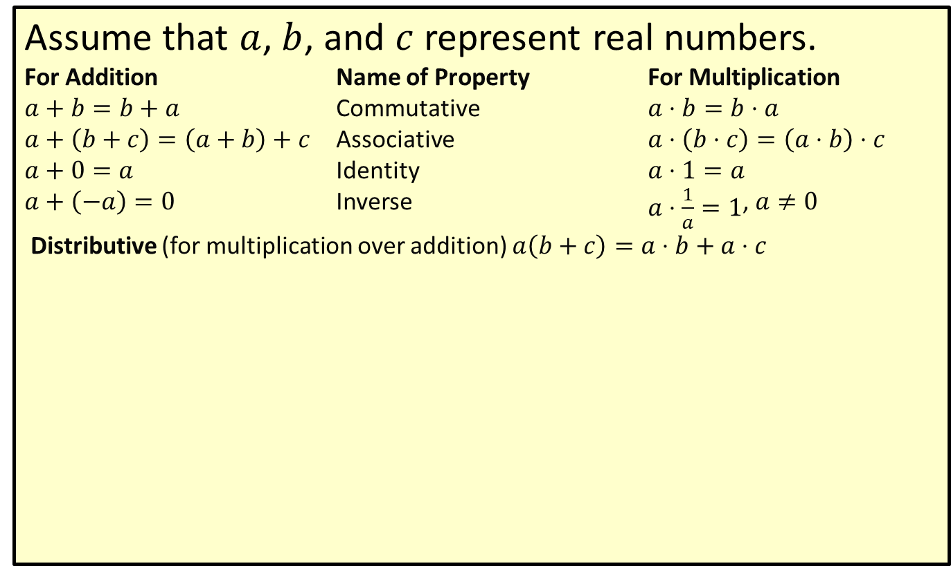
Properties of Addition and Multiplication
Assume that $a$, $b$, and $c$ represent real numbers.
For Addition Name of Property For Multiplication
$a+b=b+a$ Commutative​ $a⋅b=b⋅a$
​$a+\left(b+c\right)=\left(a+b\right)+c$ Associative ​$a⋅\left(b⋅c\right)=\left(a⋅b\right)⋅c$
​$a+0=a$ Identity ​$a⋅1=a$
​$a+\left(−a\right)=0$ Inverse ​$a⋅\frac{1}{a}=1$, $a≠0$
Distributive (for multiplication over addition) $a\left(b+c\right)=a⋅b+a⋅c$

Slide 7

Example 2: Number Line
Graph the numbers in the given set $A$ on a number line. Use heavy dots and estimate the placement of points that are not integers.
$$A=\left\{−\sqrt{25}\text{, }−3\text{, }−1.5\text{, }0\text{, }\frac{3}{4}\text{, }\sqrt{3}\text{, }π\text{, }4\right\}$$

Slide 8
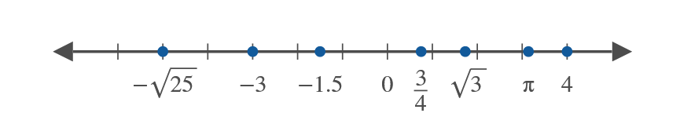
Example 2: Number Line (cont.)
Solution

Slide 9
Symbols for Order
< is less than > is greater than
≤ is less than or equal to ≥ is greater than or equal to

Slide 10

Example 3: Symbols for Order
Arrange the following numbers in order from smallest to largest using the most appropriate of the four symbols for order: 17, 1.7, $−1.7$, $−17$, 0, $\frac{20}{3}$, $\frac{40}{6}$, 20, and $−20$.

Slide 11

Example 3: Symbols for Order (cont.)
Solution
$$−20<−17<−1.7<0<1.7<\frac{20}{3}≤\frac{40}{6}<17<20$$

Slide 12
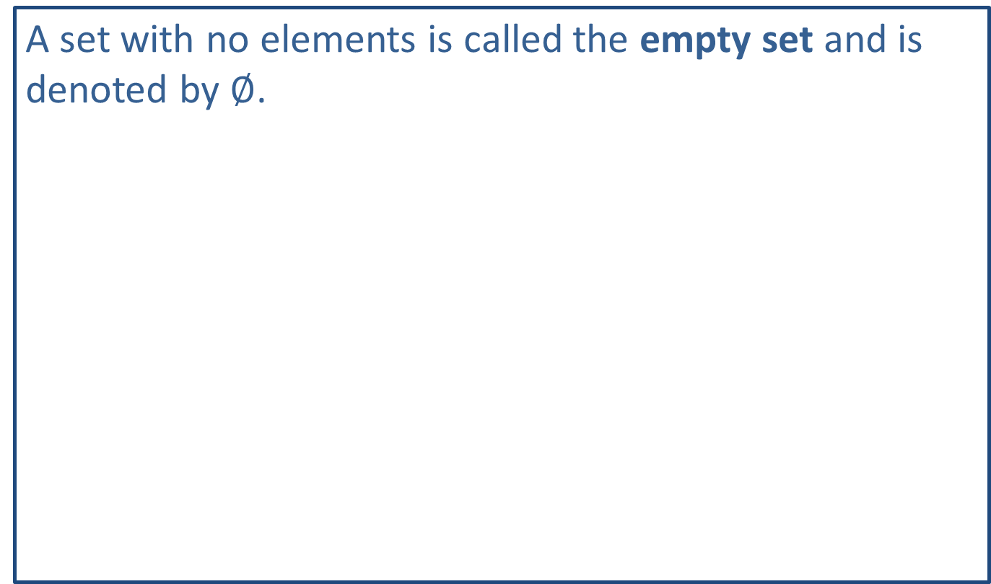
Note:
A set with no elements is called the empty set and is denoted by $∅$.

Slide 13

Example 4: Set-Builder Notation
Graph the following sets of real numbers.
​$\left\{x|x<3\right\}$
​$\left\{x|x≥−1.5\right\}$

Slide 14

Example 4: Set-Builder Notation (cont.)
Solution
​
The open circle indicates that 3 is not included in the set.

Slide 15
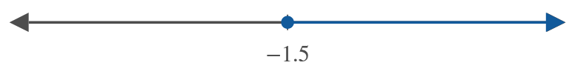
Example 4: Set-Builder Notation (cont.)
​
The closed circle indicates that −1.5 is included in the set.

Slide 16
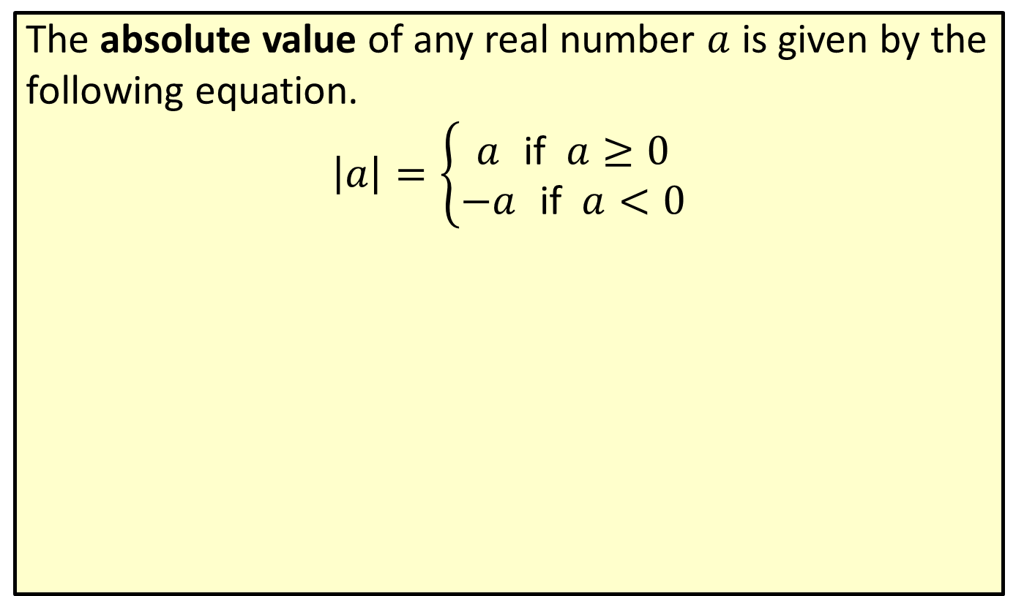
Absolute Value
The absolute value of any real number $a$ is given by the following equation.
$$\left|a\right|=\left\{\begin{aligned}a \text{if} a≥0 \\ −a \text{if} a<0\end{aligned}\right.$$

Slide 17

Example 5: Absolute Value
Find the absolute value of each of the numbers
​$−10$
​$−2.3$
​ 4.5, and
​ 0.

Slide 18

Example 5: Absolute Value (cont.)
Solution
​$\left|−10\right|=−\left(−10\right)=10$
​$\left|−2.3\right|=−\left(−2.3\right)=2.3$
​$\left|4.5\right|=4.5$
​$\left|0\right|=0$

Slide 19

Example 6: Absolute Value Equations
Determine what real numbers satisfy each of the following equations.
​$\left|x\right|=4$
​$\left|x\right|=−1.7$

Slide 20

Example 6: Absolute Value Equations (cont.)
Solution
​Since $\left|4\right|=4$ and $\left|−4\right|=4$, $x$ can be either 4 or $−4$.
​This equation has no solution $\left(∅\right)$ because the absolute value of any real number is nonnegative.

