Slide 1
Section 0.2
Integer Exponents

Slide 2
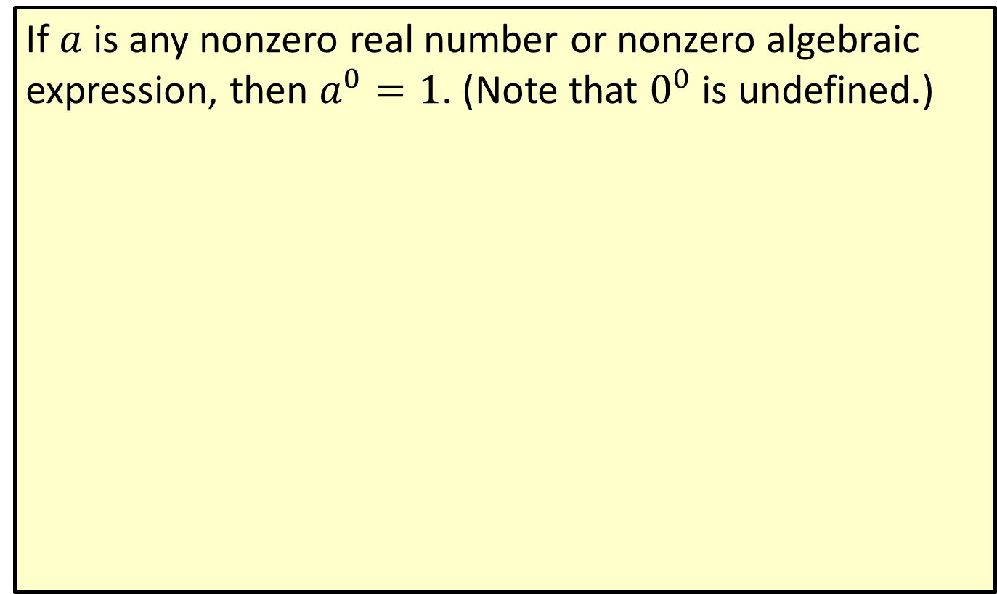
Zero Exponent
If $a$ is any nonzero real number or nonzero algebraic expression, then $a^{0}=1$. (Note that $0^{0}$ is undefined.)

Slide 3
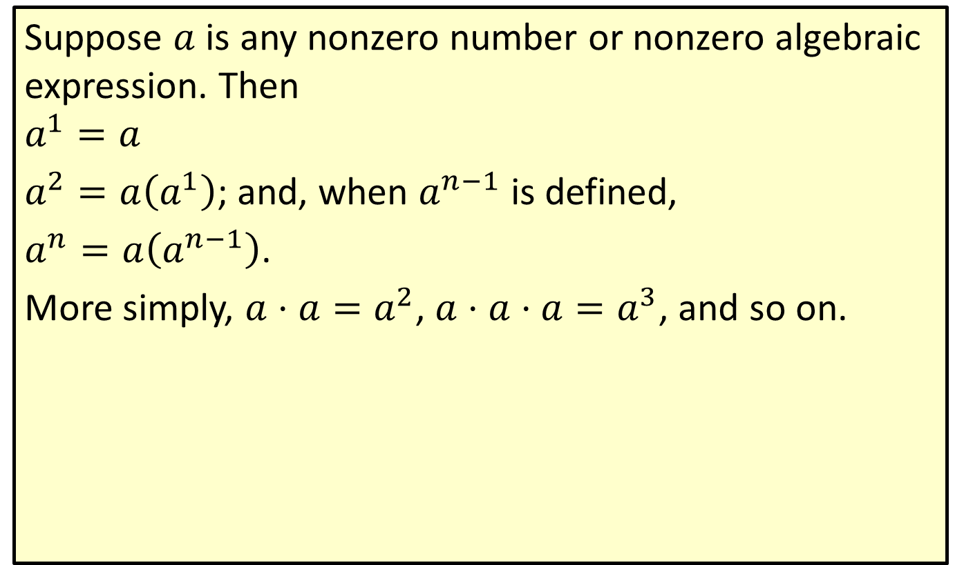
Positive Integer Exponents
Suppose $a$ is any nonzero number or nonzero algebraic expression. Then
$$a^{1}=a$$
$a^{2}=a\left(a^{1}\right)$; and, when $a^{n−1}$ is defined,
$a^{n}=a\left(a^{n−1}\right)$.
More simply, $a⋅a=a^{2}$, $a⋅a⋅a=a^{3}$, and so on.

Slide 4
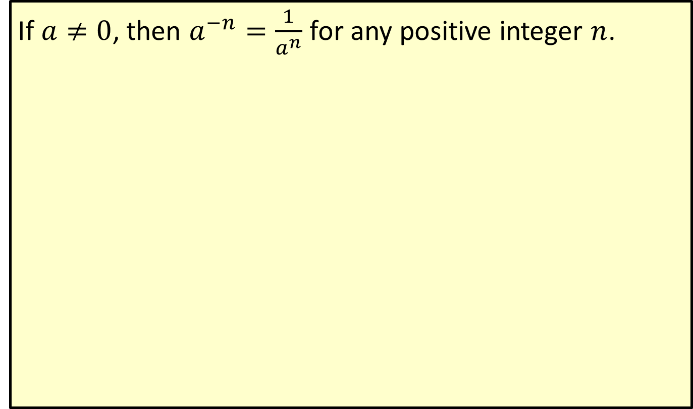
Negative Integer Exponents
If $a≠0$, then $a^{−n}=\frac{1}{a^{n}}$ for any positive integer $n$.

Slide 5
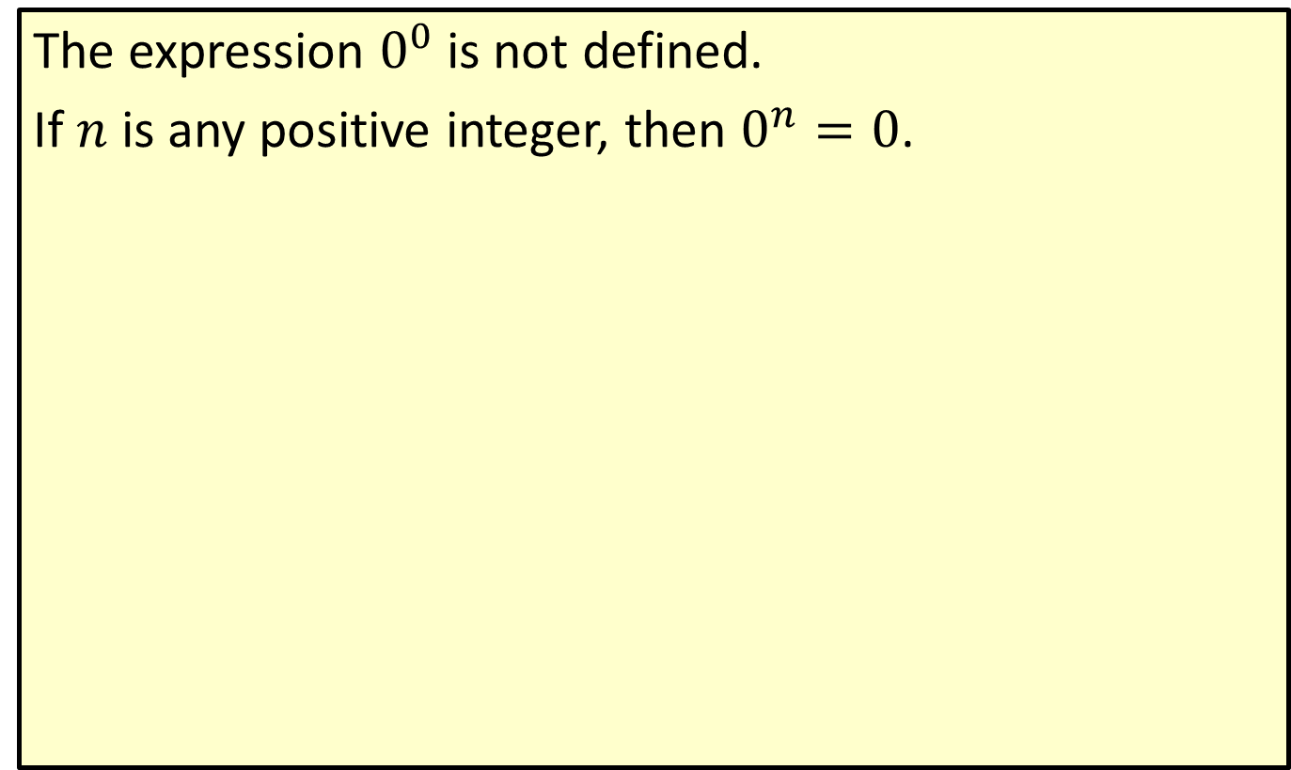
Exponents with the Number Zero
The expression $0^{0}$ is not defined.
If $n$ is any positive integer, then $0^{n}=0$.

Slide 6

Example 1: Evaluating Exponents
Write the following expressions as numbers without exponents.
​$3^{4}$
​$2^{−3}$
​$\frac{4}{5^{−1}}$
​${\left(−4\right)}^{4}$
​$−4^{4}$

Slide 7
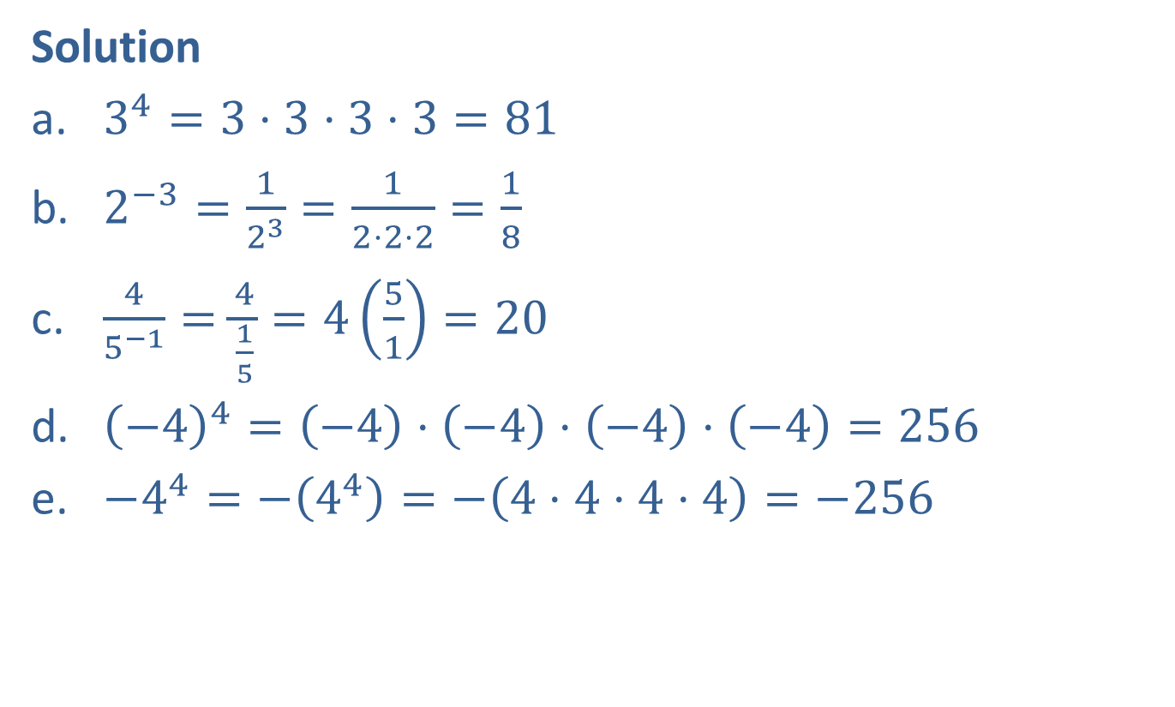
Example 1: Evaluating Exponents (cont.)
Solution
​$3^{4}=3⋅3⋅3⋅3=81$
​$2^{−3}=\frac{1}{2^{3}}=\frac{1}{2⋅2⋅2}=\frac{1}{8}$
​$\frac{4}{5^{−1}}=\frac{4}{\frac{1}{5}}=4\left(\frac{5}{1}\right)=20$
​${\left(−4\right)}^{4}=\left(−4\right)⋅\left(−4\right)⋅\left(−4\right)⋅\left(−4\right)=256$
​$−4^{4}=−\left(4^{4}\right)=−\left(4⋅4⋅4⋅4\right)=−256$

Slide 8
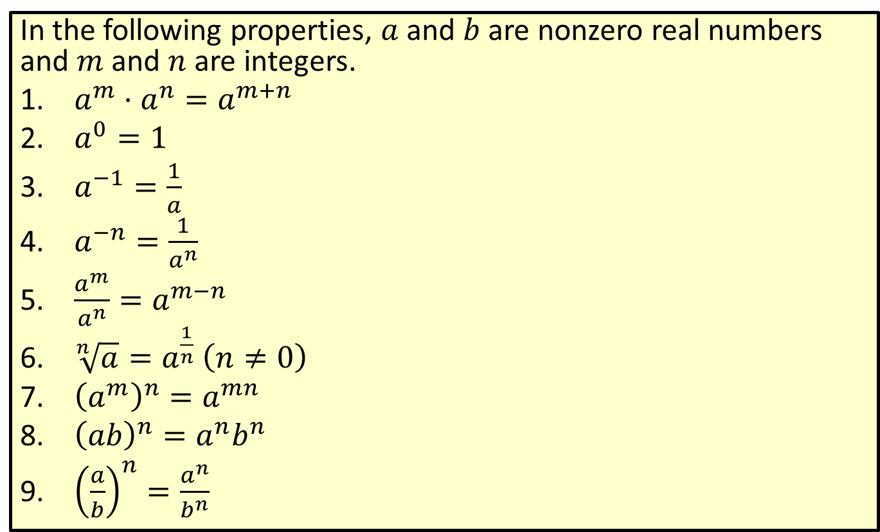
Properties of Exponents
In the following properties, $a$ and $b$ are nonzero real numbers and $m$ and $n$ are integers.
​$a^{m}⋅a^{n}=a^{m+n}$
​$a^{0}=1$
​$a^{−1}=\frac{1}{a}$
​$a^{−n}=\frac{1}{a^{n}}$
​$\frac{a^{m}}{a^{n}}=a^{m−n}$
​$\sqrt[n]{a}=a^{\frac{1}{n}}$ $\left(n≠0\right)$
​${\left(a^{m}\right)}^{n}=a^{mn}$
​${\left(ab\right)}^{n}=a^{n}b^{n}$
​${\left(\frac{a}{b}\right)}^{n}=\frac{a^{n}}{b^{n}}$

Slide 9
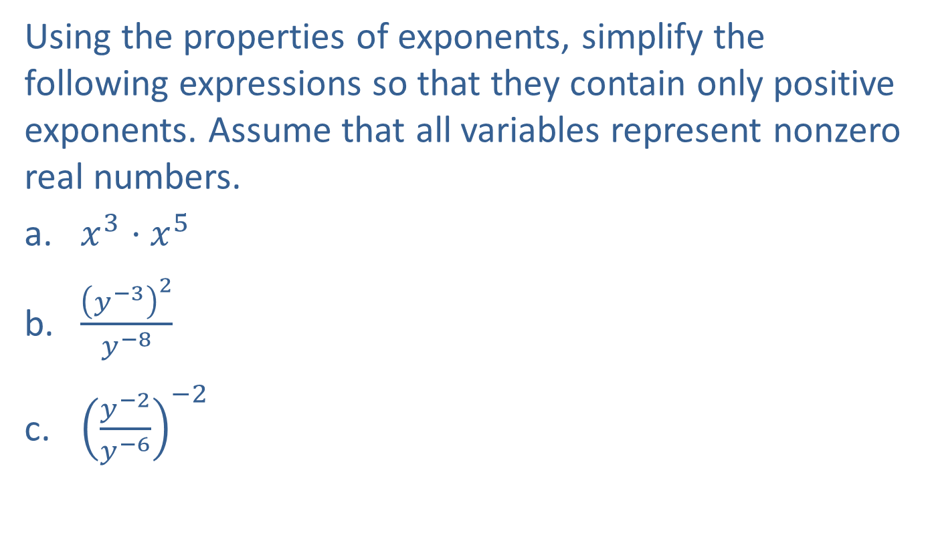
Example 2: Simplifying Expressions with Exponents
Using the properties of exponents, simplify the following expressions so that they contain only positive exponents. Assume that all variables represent nonzero real numbers.
​$x^{3}⋅x^{5}$
​$\frac{{\left(y^{−3}\right)}^{2}}{y^{−8}}$
​${\left(\frac{y^{−2}}{y^{−6}}\right)}^{−2}$

Slide 10
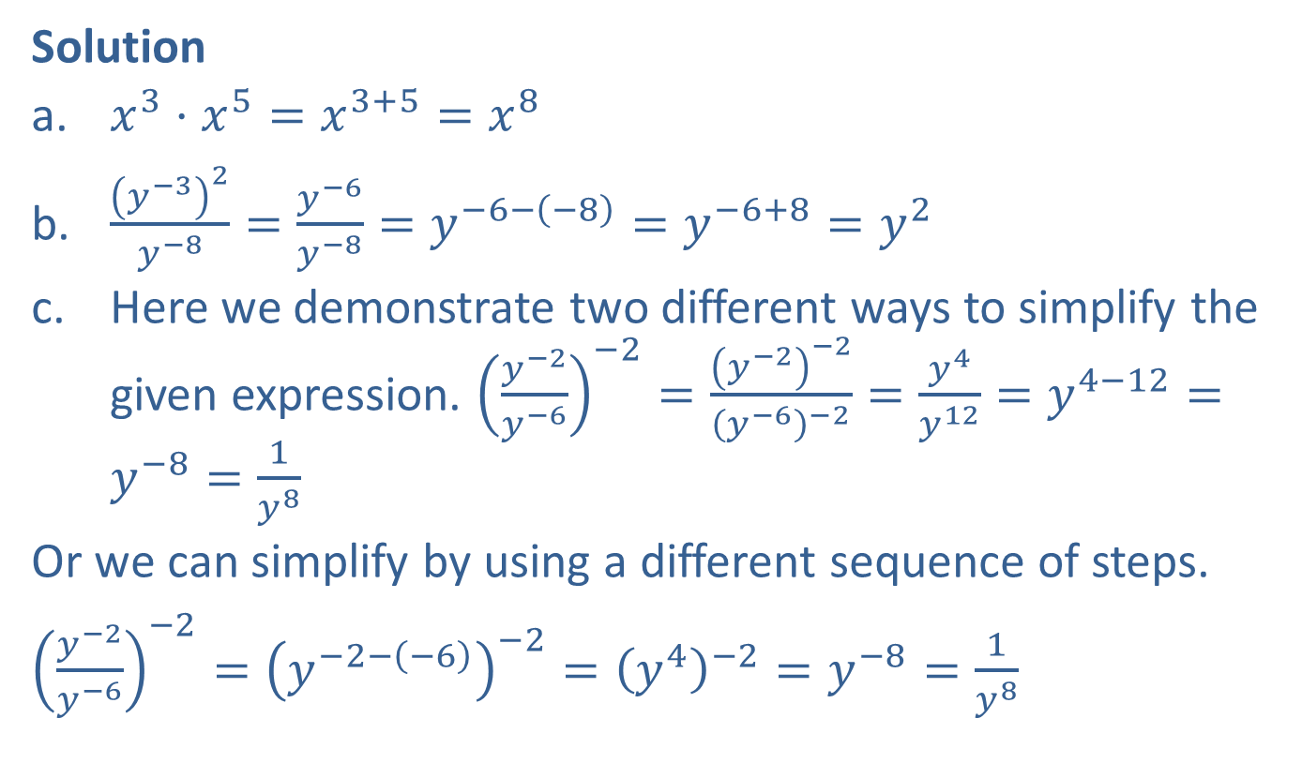
Example 2: Simplifying Expressions with Exponents (cont.)
Solution
​$x^{3}⋅x^{5}=x^{3+5}=x^{8}$
​$\frac{{\left(y^{−3}\right)}^{2}}{y^{−8}}=\frac{y^{−6}}{y^{−8}}=y^{−6−\left(−8\right)}=y^{−6+8}=y^{2}$
​Here we demonstrate two different ways to simplify the given expression. ${\left(\frac{y^{−2}}{y^{−6}}\right)}^{−2}=\frac{{\left(y^{−2}\right)}^{−2}}{{\left(y^{−6}\right)}^{−2}}=\frac{y^{4}}{y^{12}}=y^{4−12}=y^{−8}=\frac{1}{y^{8}}$
​Or we can simplify by using a different sequence of steps.
​${\left(\frac{y^{−2}}{y^{−6}}\right)}^{−2}={\left(y^{−2−\left(−6\right)}\right)}^{−2}={\left(y^{4}\right)}^{−2}=y^{−8}=\frac{1}{y^{8}}$

Slide 11
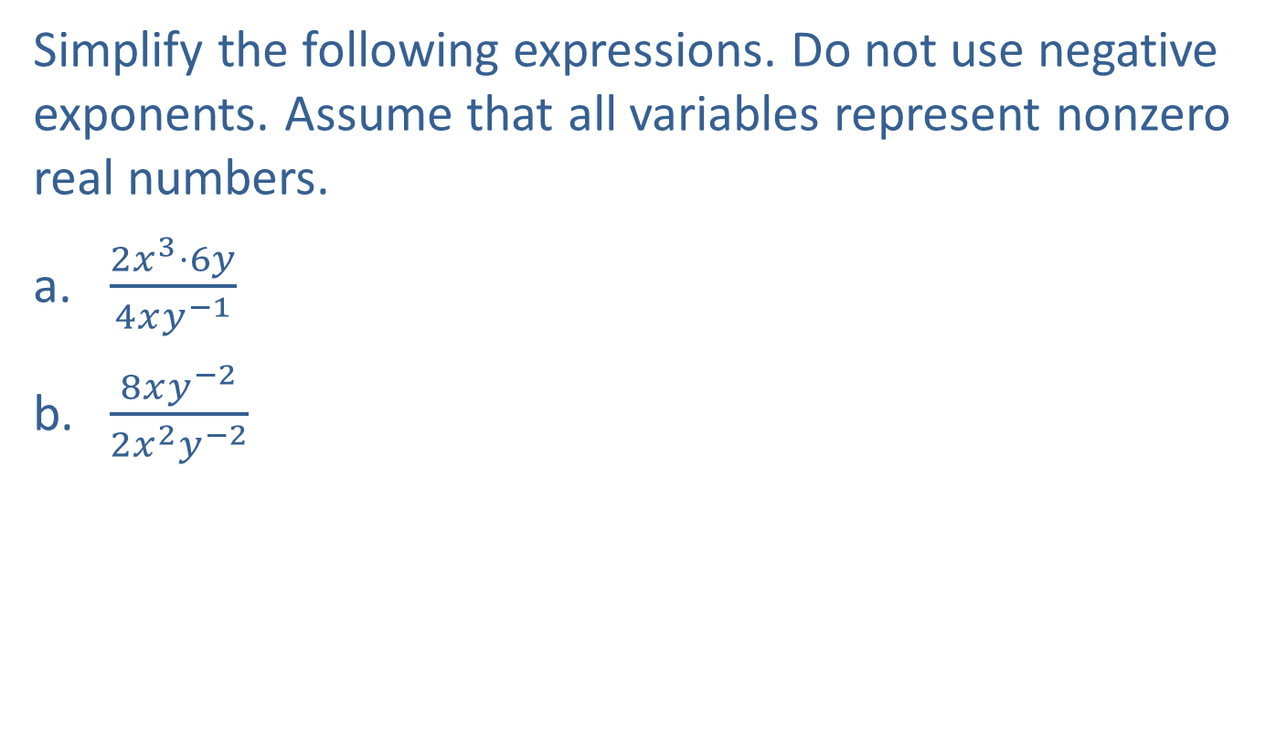
Example 3: Simplifying Expressions with Exponents
Simplify the following expressions. Do not use negative exponents. Assume that all variables represent nonzero real numbers.
​$\frac{2x^{3}⋅6y}{4xy^{−1}}$
​$\frac{8xy^{−2}}{2x^{2}y^{−2}}$

Slide 12

Example 3: Simplifying Expressions with Exponents (cont.)
Solution
​$\frac{2x^{3}⋅6y}{4xy^{−1}}=\frac{12x^{3}y}{4xy^{−1}}=3x^{3−1}y^{1−\left(−1\right)}=3x^{2}y^{2}$
​$\frac{8xy^{−2}}{2x^{2}y^{−2}}=4x^{1−2}y^{−2−\left(−2\right)}=4x^{−1}y^{0}=4x^{−1}⋅1=4x^{−1}=\frac{4}{x}$

Slide 13

Example 4: Simplifying Expressions with Exponents
Rewrite the expression ${\left(\frac{3ab^{−3}}{a^{−2}b^{3}}\right)}^{−3}$ without parentheses and with no variables in the denominator. Express constants without exponents.

Slide 14

Example 4: Simplifying Expressions with Exponents (cont.)
Solution
${\left(\frac{3ab^{−3}}{a^{−2}b^{3}}\right)}^{−3}={\left(3a^{3}b^{−6}\right)}^{−3}=3^{−3}{\left(a^{3}\right)}^{−3}{\left(b^{−6}\right)}^{−3}=3^{−3}a^{−9}b^{18}=\frac{1}{27}a^{−9}b^{18}$

