Slide 1
Section 0.3
Fractional Exponents and Radicals

Slide 2
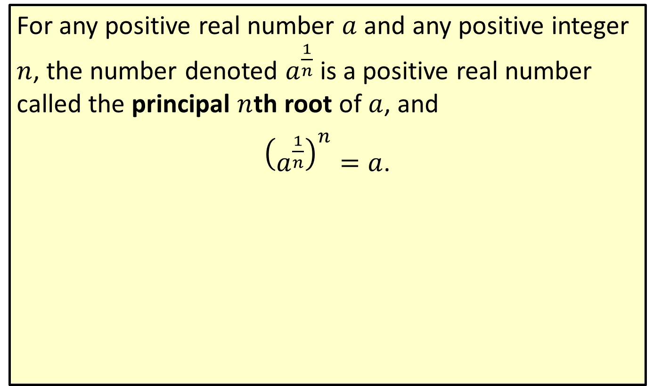

Principal $n$th Root
For any positive real number $a$ and any positive integer $n$, the number denoted $a^{\frac{1}{n}}$ is a positive real number called the principal $n$th root of $a$, and
${\left(a^{\frac{1}{n}}\right)}^{n}=a$.

Slide 3


Example 1: Evaluating Square Roots
Simplify ${81}^{\frac{1}{2}}$.
Solution
${81}^{\frac{1}{2}}=9$
If the exponent is $\frac{1}{2}$, the root is called the square root, with the understanding that it is nonnegative. Thus, 9 is the square root (or positive square root or principal square root) of 81. Since ${\left(−9\right)}^{2}=81$, 81 has two square roots, and $−9$ is called the negative square root of 81.

Slide 4
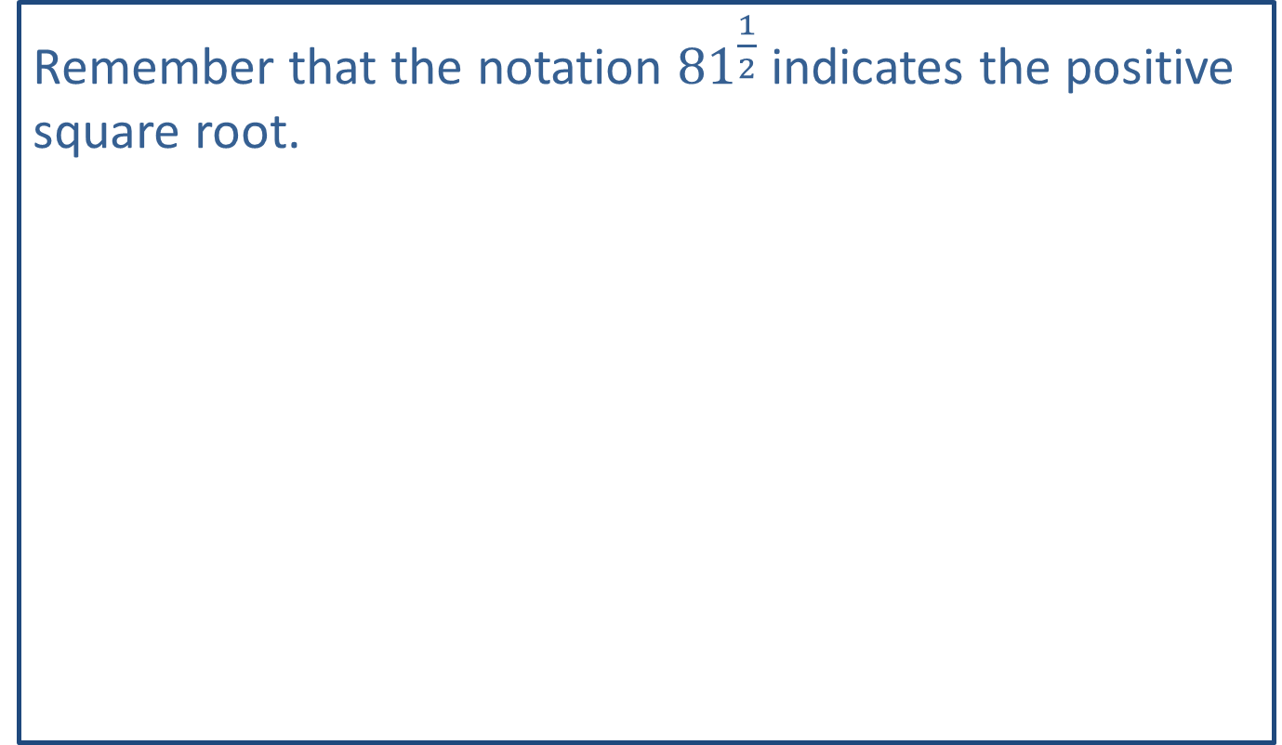
Note:
Remember that the notation ${81}^{\frac{1}{2}}$ indicates the positive square root.

Slide 5
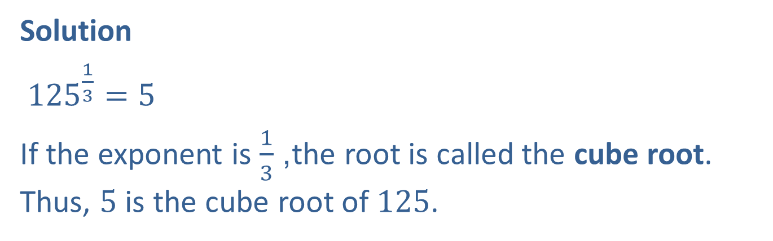

Example 2: Evaluating Cube Roots
Simplify ${125}^{\frac{1}{3}}$.
Solution
${125}^{\frac{1}{3}}=5$
If the exponent is $\frac{1}{3}$, the root is called the cube root. Thus, 5 is the cube root of 125.

Slide 6
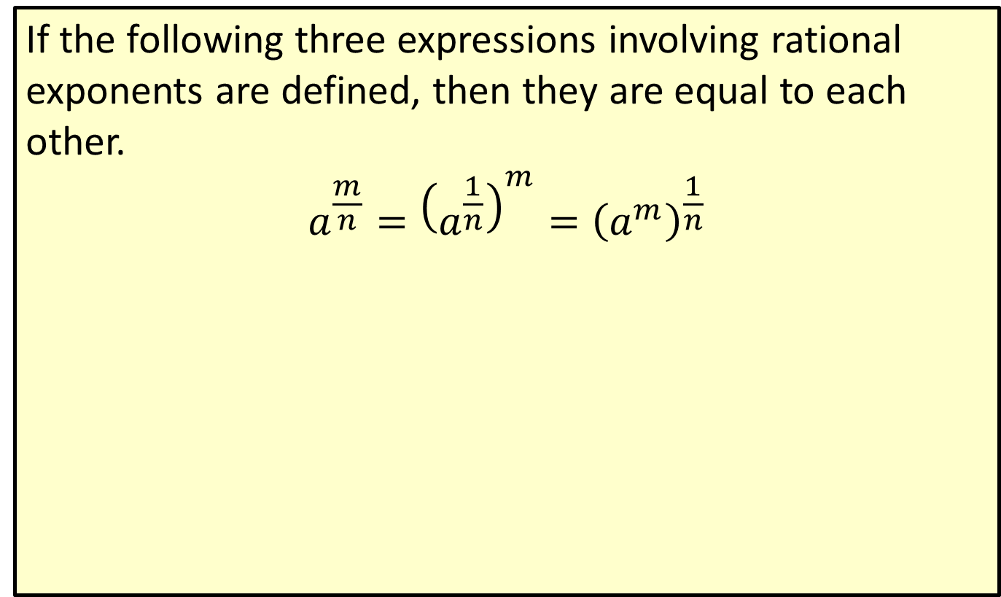

The General Form $a^{\frac{m}{n}}$
If the following three expressions involving rational exponents are defined, then they are equal to each other.
$$a^{\frac{m}{n}}={\left(a^{\frac{1}{n}}\right)}^{m}={\left(a^{m}\right)}^{\frac{1}{n}}$$

Slide 7

Example 3: Evaluating Expressions with Rational Exponents
Evaluate each expression.
​$8^{\frac{2}{3}}$
​${81}^{\frac{3}{4}}$

Slide 8
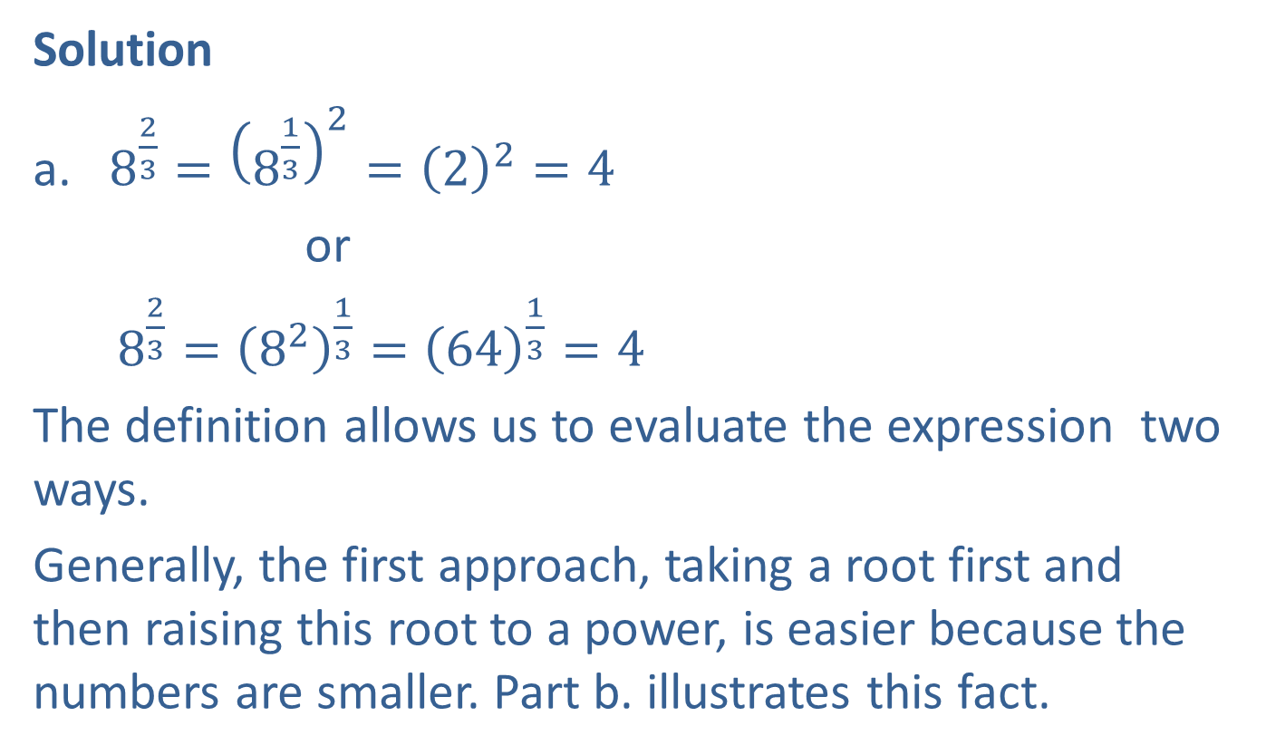
Example 3: Evaluating Expressions with Rational Exponents (cont.)
Solution
​$8^{\frac{2}{3}}={\left(8^{\frac{1}{3}}\right)}^{2}={\left(2\right)}^{2}=4$
or
$8^{\frac{2}{3}}={\left(8^{2}\right)}^{\frac{1}{3}}={\left(64\right)}^{\frac{1}{3}}=4$
The definition allows us to evaluate the expression two ways.
Generally, the first approach, taking a root first and then raising this root to a power, is easier because the numbers are smaller. Part b. illustrates this fact.

Slide 9
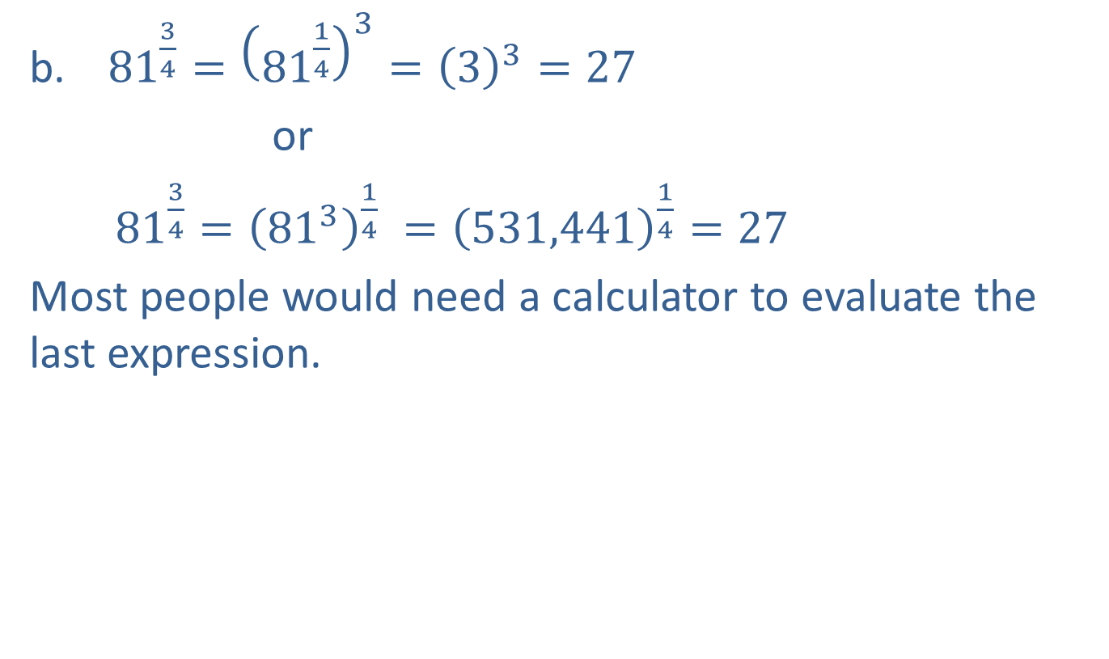
Example 3: Evaluating Expressions with Rational Exponents (cont.)
${81}^{\frac{3}{4}}={\left({81}^{\frac{1}{4}}\right)}^{3}={\left(3\right)}^{3}=27$
or
${81}^{\frac{3}{4}}={\left({81}^{3}\right)}^{\frac{1}{4}} ={\left(531,441\right)}^{\frac{1}{4}}=27$
Most people would need a calculator to evaluate the last expression.

Slide 10

Example 4: Simplifying Expressions with Rational Exponents
Simplify each expression. Assume that $x$ represents a positive real number.
​$x^{\frac{1}{3}}⋅x^{\frac{1}{6}}$
​${\left(x^{−\frac{3}{4}}⋅x^{\frac{1}{3}}\right)}^{2}$

Slide 11

Example 4: Simplifying Expressions with Rational Exponents (cont.)
Solution
​$x^{\frac{1}{3}}⋅x^{\frac{1}{6}}=x^{\frac{1}{3}+\frac{1}{6}}=x^{\frac{2}{6}+\frac{1}{6}}=x^{\frac{3}{6}}=x^{\frac{1}{2}}$
​${\left(x^{−\frac{3}{4}}⋅x^{\frac{1}{3}}\right)}^{2}={\left(x^{−\frac{9}{12}+\frac{4}{12}}\right)}^{2}={\left(x^{−\frac{5}{12}}\right)}^{2}=x^{−\frac{10}{12}}=x^{−\frac{5}{6}}$ or
$\frac{1}{x^{\frac{5}{6}}}$

Slide 12
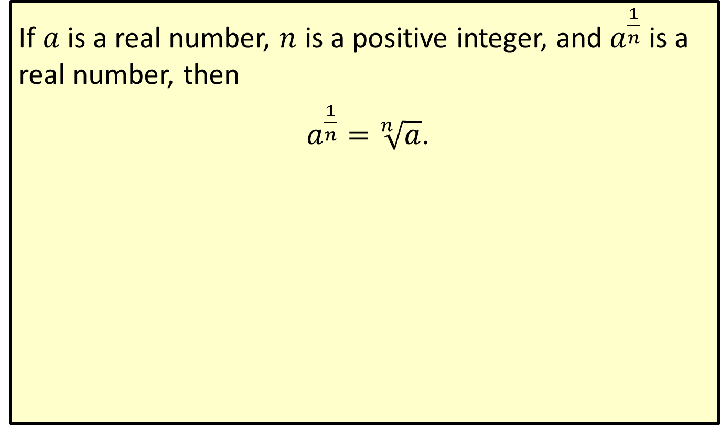
Radical Notation
If $a$ is a real number, $n$ is a positive integer, and $a^{\frac{1}{n}}$ is a real number, then
$a^{\frac{1}{n}}=\sqrt[n]{a}$.

Slide 13
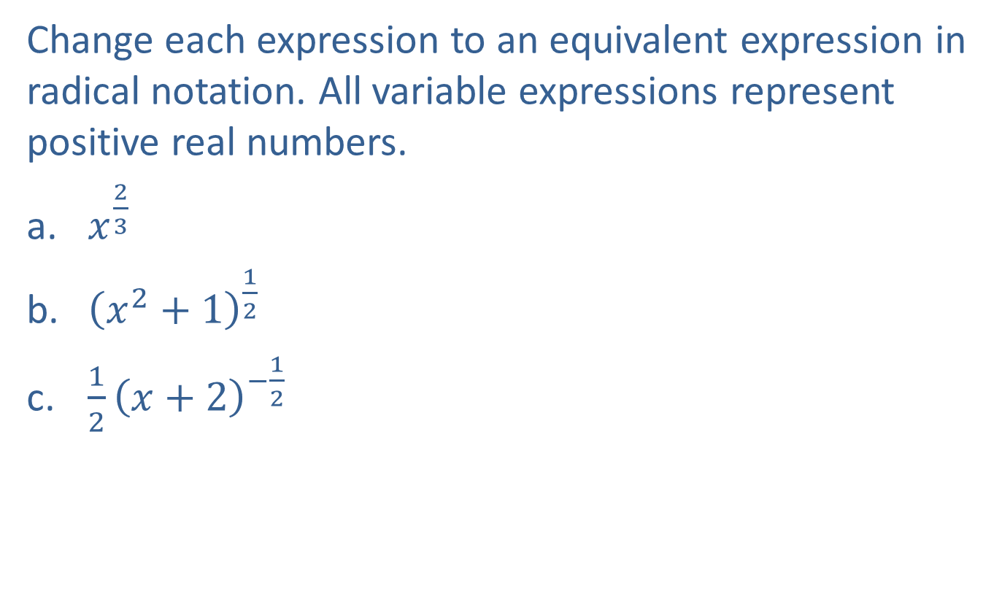
Example 5: Conversion to Radical Notation
Change each expression to an equivalent expression in radical notation. All variable expressions represent positive real numbers.
​$x^{\frac{2}{3}}$
​${\left(x^{2}+1\right)}^{\frac{1}{2}}$
​$\frac{1}{2}{\left(x+2\right)}^{−\frac{1}{2}}$

Slide 14

Example 5: Conversion to Radical Notation (cont.)
Solution
​$x^{\frac{2}{3}}=\sqrt[3]{x^{2}}$
​${\left(x^{2}+1\right)}^{\frac{1}{2}}=\sqrt{x^{2}+1}$
​$\frac{1}{2}{\left(x+2\right)}^{−\frac{1}{2}}=\frac{1}{2}⋅\frac{1}{{\left(x+2\right)}^{\frac{1}{2}}}=\frac{1}{2{\left(x+2\right)}^{\frac{1}{2}}}=\frac{1}{2\sqrt{x+2}}$

Slide 15
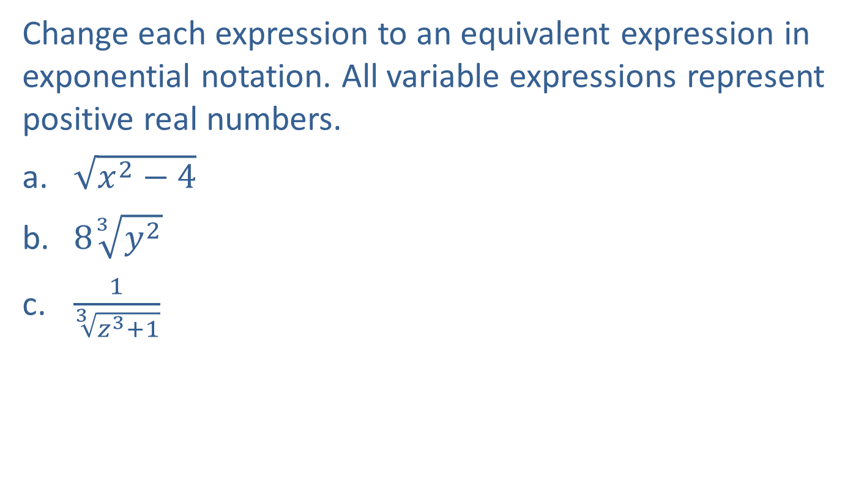
Example 6: Conversion to Exponential Notation
Change each expression to an equivalent expression in exponential notation. All variable expressions represent positive real numbers.
​$\sqrt{x^{2}−4}$
​$8\sqrt[3]{y^{2}}$
​$\frac{1}{\sqrt[3]{z^{3}+1}}$

Slide 16

Example 6: Conversion to Exponential Notation (cont.)
Solution
​$\sqrt{x^{2}−4}={\left(x^{2}−4\right)}^{\frac{1}{2}}$ Remember that because no index is given, the index is understood to be 2.
​$8\sqrt[3]{y^{2}}=8y^{\frac{2}{3}}$
​$\frac{1}{\sqrt[3]{z^{3}+1}}=\frac{1}{{\left(z^{3}+1\right)}^{\frac{1}{3}}}$ or ${\left(z^{3}+1\right)}^{−\frac{1}{3}}$

Slide 17
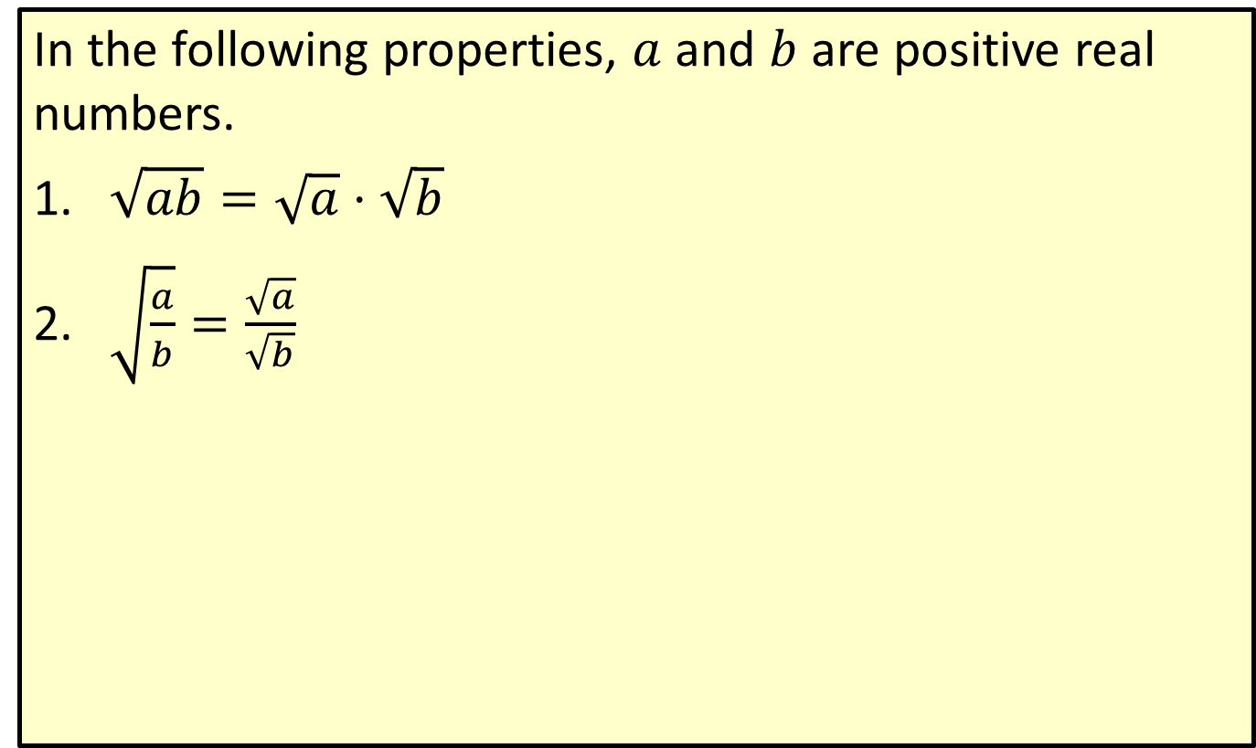
Properties of Square Roots
In the following properties, $a$ and $b$ are positive real numbers.
​$\sqrt{ab}=\sqrt{a}⋅\sqrt{b}$
​$\sqrt{\frac{a}{b}}=\frac{\sqrt{a}}{\sqrt{b}}$

Slide 18
CAUTION!
Note the following common errors. These equations are almost always false.

Slide 19
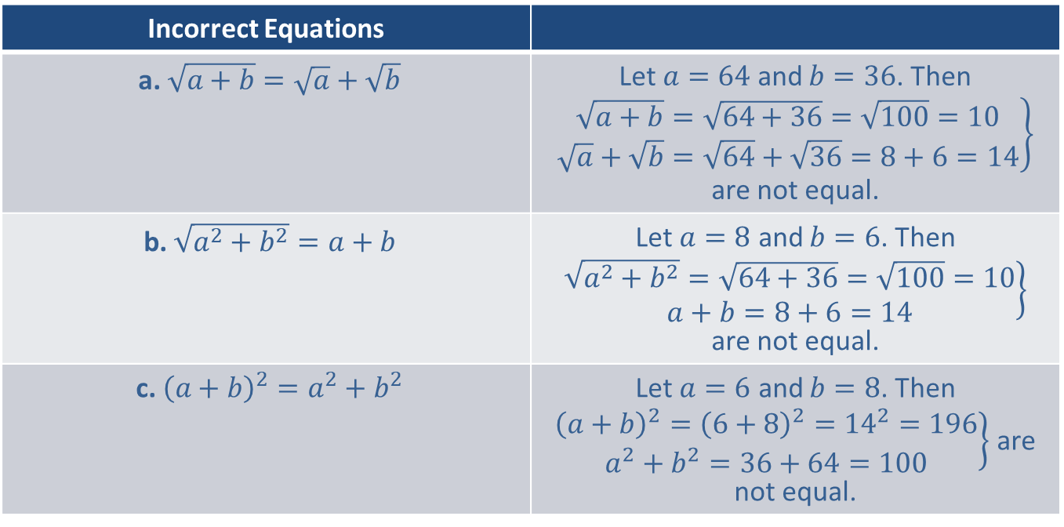
CAUTION! (cont.)
Incorrect Equations
a. $\sqrt{a+b}=\sqrt{a}+\sqrt{b}$ | Let $a=64$ and $b=36$. Then $\left.\begin{aligned}\sqrt{a+b}=\sqrt{64+36}=\sqrt{100}=10 \\ \sqrt{a}+\sqrt{b}=\sqrt{64}+\sqrt{36}=8+6=14\end{aligned}\right\}$ are not equal.
b. $\sqrt{a^{2}+b^{2}}=a+b$ | Let $a=8$ and $b=6$. Then $\left.\begin{aligned}\sqrt{a^{2}+b^{2}}=\sqrt{64+36}=\sqrt{100}=10 \\ a+b=8+6=14\end{aligned}\right\}$ are not equal.
c. ${\left(a+b\right)}^{2}=a^{2}+b^{2}$ | Let $a=6$ and $b=8$. Then $\left.\begin{aligned}{\left(a+b\right)}^{2}={\left(6+8\right)}^{2}={14}^{2}=196 \\ a^{2}+b^{2}=36+64=100\end{aligned}\right\}$ are not equal.

