Slide 1
Section 0.4
Polynomials and Factoring

Slide 2
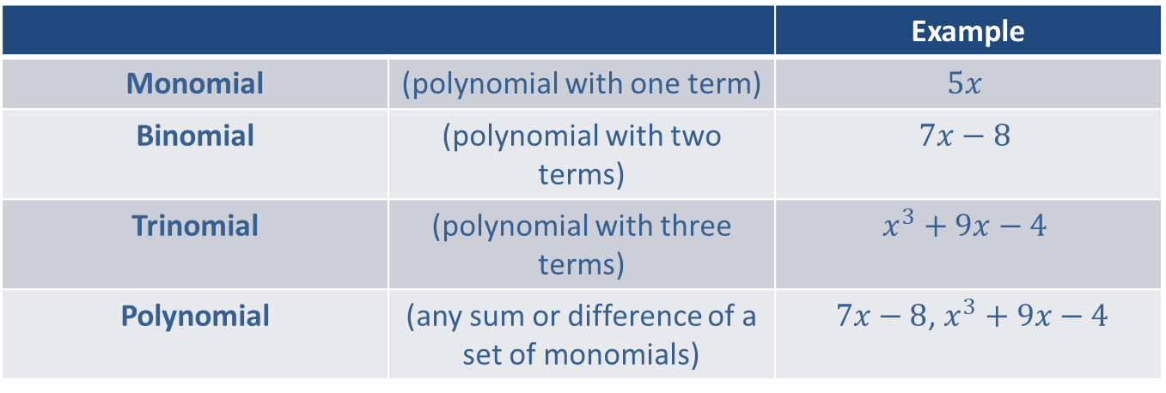
Classification of Polynomials

Slide 3

Example 1: Simplify Polynomials
Simplify the following polynomials by combining like terms.
​$5x^{2}+7x^{2}$
​$3x+4x−13x+1$
​$4x^{3}−x^{3}−5+3−3x^{3}$

Slide 4

Example 1: Simplify Polynomials (cont.)
Solution
​$5x^{2}+7x^{2}=\left(5+7\right)x^{2}=12x^{2}$
​$3x+4x−13x+1=\left(3+4−13\right)x+1=−6x+1$
​$4x^{3}−x^{3}−5+3−3x^{3}=\left(4−1−3\right)x^{3}−5+3=0⋅x^{3}−2=−2$

Slide 5
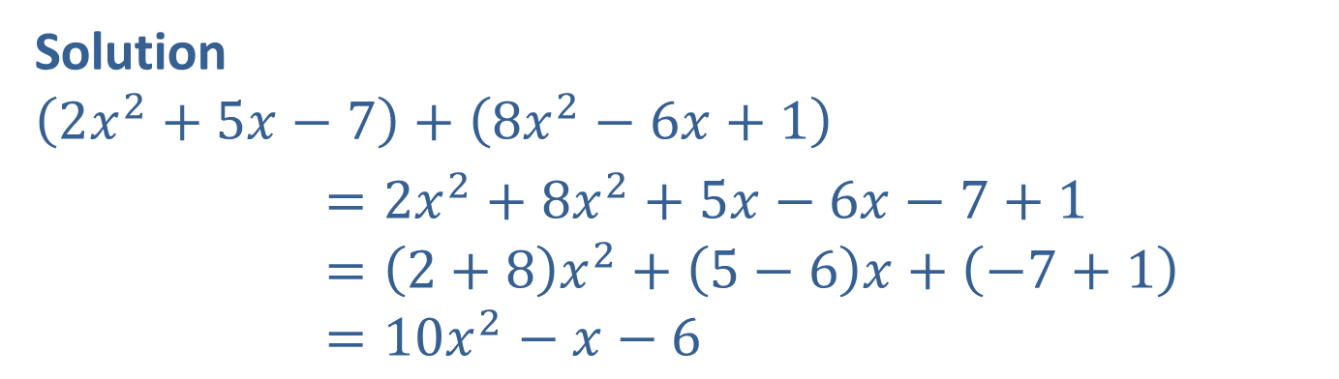

Example 2: Addition with Polynomials
Find the sum $\left(2x^{2}+5x−7\right)+\left(8x^{2}−6x+1\right)$.
Solution
$$\left(2x^{2}+5x−7\right)+\left(8x^{2}−6x+1\right)$$
$=2x^{2}+8x^{2}+5x−6x−7+1$ $=\left(2+8\right)x^{2}+\left(5−6\right)x+\left(−7+1\right)$ $=10x^{2}−x−6$

Slide 6
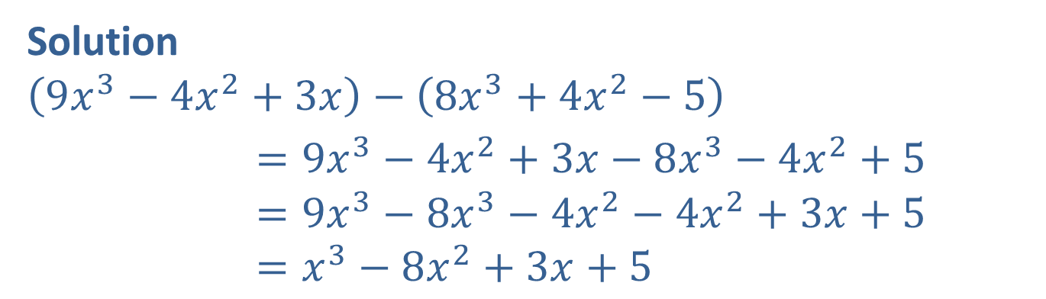

Example 3: Subtraction with Polynomials
Find the difference $\left(9x^{3}−4x^{2}+3x\right)−\left(8x^{3}+4x^{2}−5\right)$.
Solution
$$\left(9x^{3}−4x^{2}+3x\right)−\left(8x^{3}+4x^{2}−5\right)$$
$=9x^{3}−4x^{2}+3x−8x^{3}−4x^{2}+5$ $=9x^{3}−8x^{3}−4x^{2}−4x^{2}+3x+5$ $=x^{3}−8x^{2}+3x+5$

Slide 7
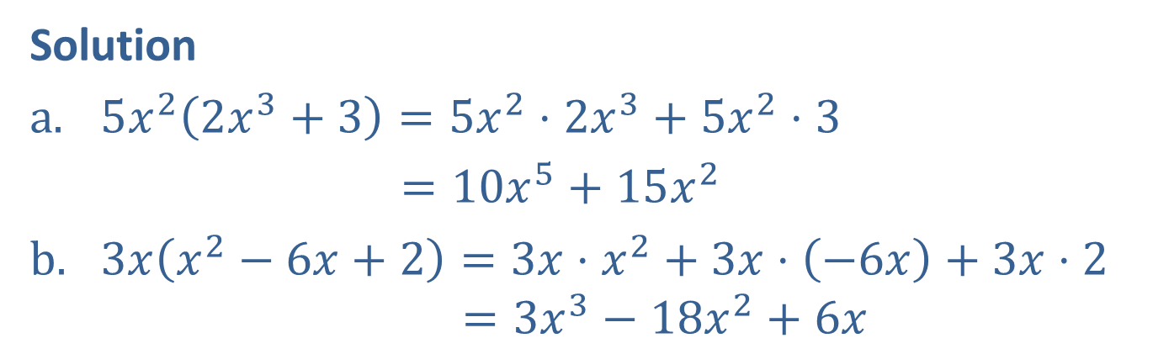

Example 4: Multiplication with Polynomials
Use the distributive property to find the products.
​$5x^{2}\left(2x^{3}+3\right)$
​$3x\left(x^{2}−6x+2\right)$
Solution
$5x^{2}\left(2x^{3}+3\right)=5x^{2}⋅2x^{3}+5x^{2}⋅3$
$=10x^{5}+15x^{2}$
$3x\left(x^{2}−6x+2\right)=3x⋅x^{2}+3x⋅\left(−6x\right)+3x⋅2$ $=3x^{3}−18x^{2}+6x$

Slide 8
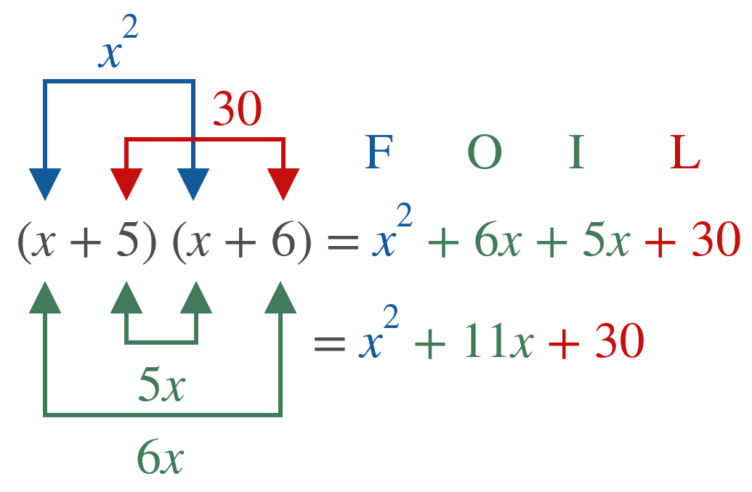

Example 5: Using the FOIL Method
Use the FOIL method to find the products.
​$\left(x+5\right)\left(x+6\right)$
​Solution
​

Slide 9
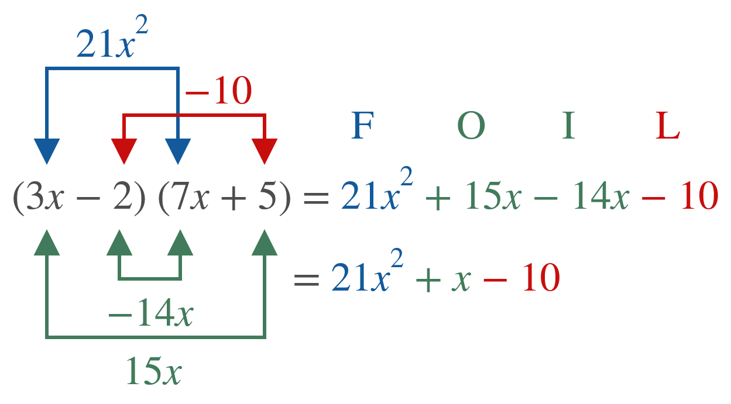

Example 5: Using the FOIL Method (cont.)
​$\left(3x−2\right)\left(7x+5\right)$
​Solution
​

Slide 10
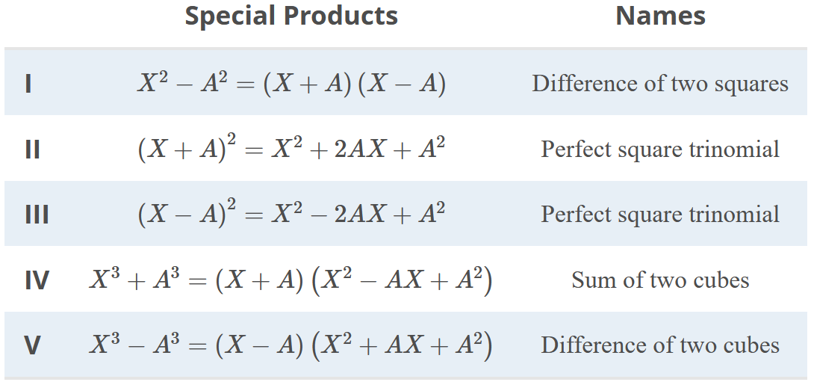
Special Products

Slide 11
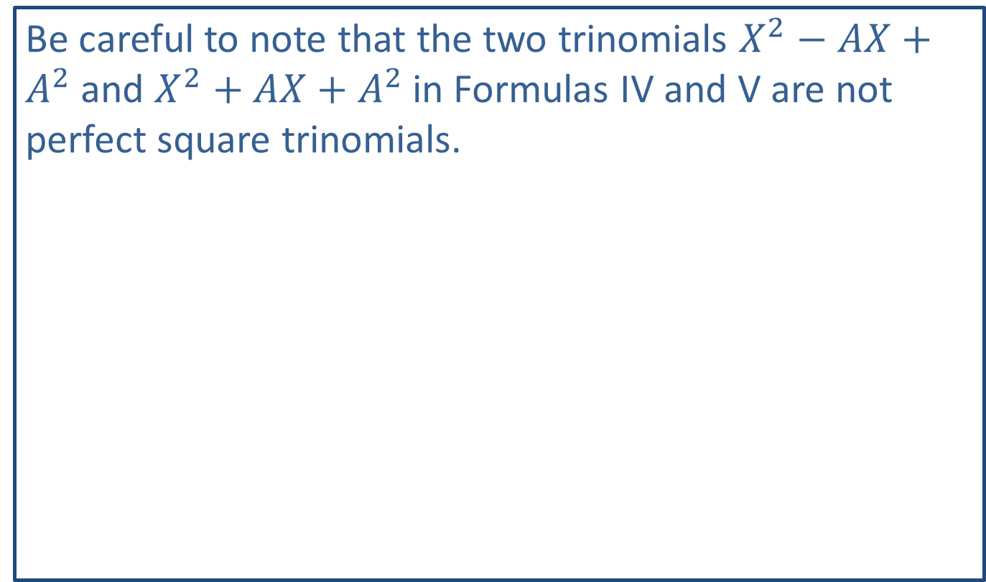
CAUTION!
Be careful to note that the two trinomials $X^{2}−AX+A^{2}$ and $X^{2}+AX+A^{2}$ in Formulas IV and V are not perfect square trinomials.

Slide 12

Example 6: Using Special Products
Find and name each of the following products.
​$9x^{2}−16$
​${\left(x+5\right)}^{2}$
​$\left(x+3\right)\left(x^{2}−3x+9\right)$

Slide 13
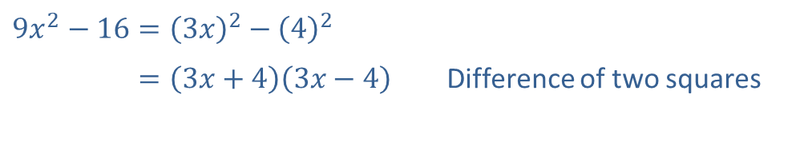
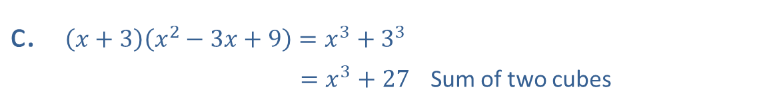
Example 6: Using Special Products (cont.)
Solution
​
​$9x^{2}−16={\left(3x\right)}^{2}−{\left(4\right)}^{2}$
​9𝑥2−16=3𝑥+43𝑥−4 Difference of two squares
​${\left(x+5\right)}^{2}=x^{2}+2⋅5⋅x+5^{2}$
​𝑥+52 =𝑥2+10𝑥+25 Perfect square trinomial
​$\left(x+3\right)\left(x^{2}−3x+9\right)=x^{3}+3^{3}$
​𝑥+3𝑥2−3𝑥+9 =𝑥3+27 Sum of two cubes

Slide 14
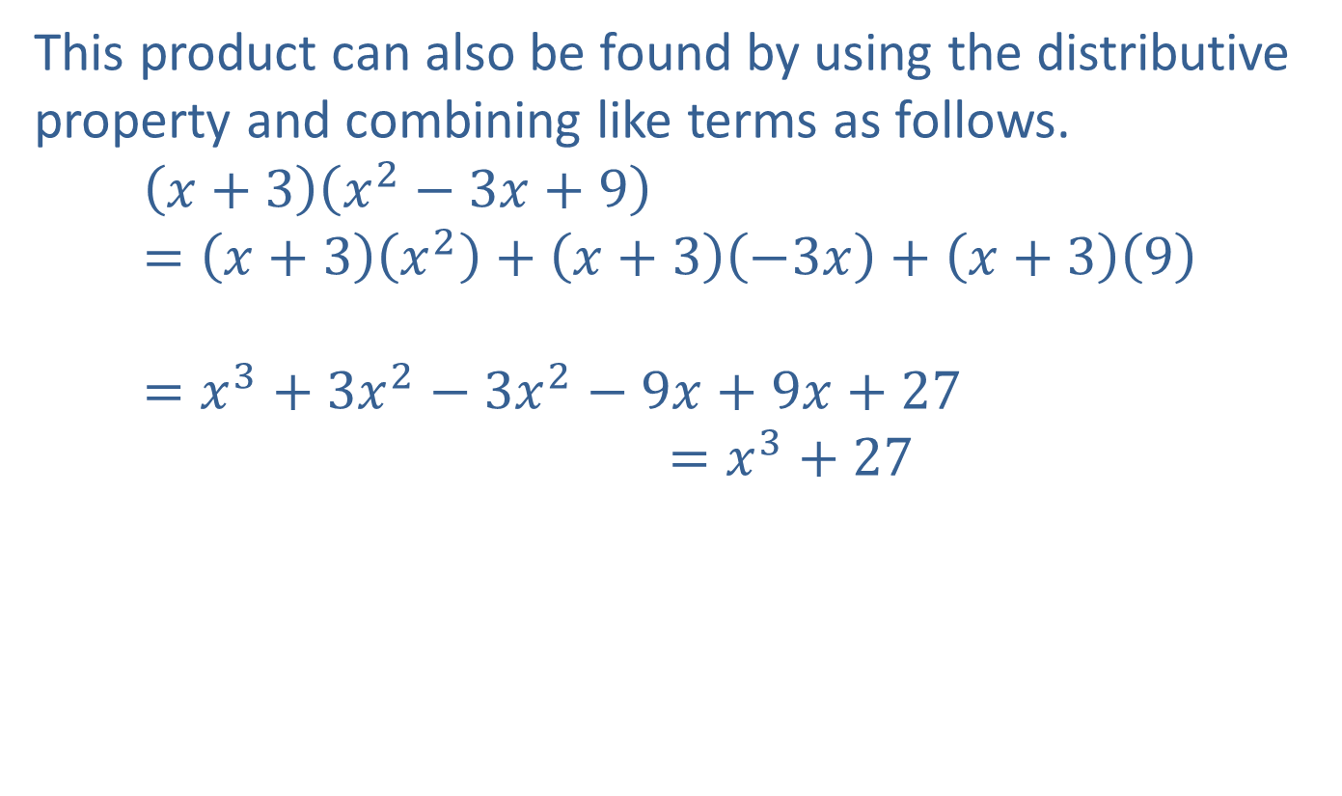
Example 6: Using Special Products (cont.)
This product can also be found by using the distributive property and combining like terms as follows.
𝑥+3𝑥2−3𝑥+9=𝑥+3𝑥2+𝑥+3−3𝑥+𝑥+39𝑥+3𝑥2−3𝑥+9=𝑥3+3𝑥2−3𝑥2−9𝑥+9𝑥+27𝑥+3𝑥2−3𝑥+9=𝑥3+27

Slide 15
Steps for Factoring Polynomials
​Look for any common factors (usually monomials or binomials).
​See if the product fits any of the special forms just listed.
​Try the reverse of the FOIL method if the product is a trinomial.

Slide 16
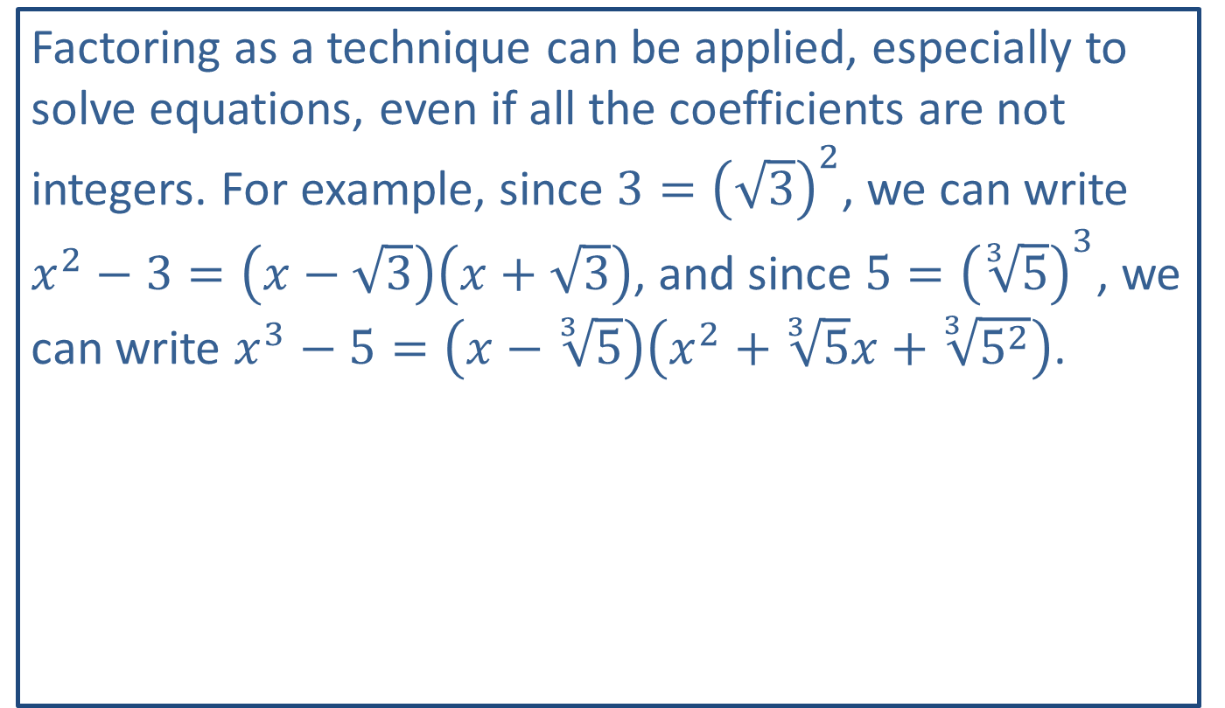
Note:
Factoring as a technique can be applied, especially to solve equations, even if all the coefficients are not integers. For example, since $3={\left(\sqrt{3}\right)}^{2}$, we can write $x^{2}−3=\left(x−\sqrt{3}\right)\left(x+\sqrt{3}\right)$, and since $5={\left(\sqrt[3]{5}\right)}^{3}$, we can write $x^{3}−5=\left(x−\sqrt[3]{5}\right)\left(x^{2}+\sqrt[3]{5}x+\sqrt[3]{5^{2}}\right)$.

Slide 17

Example 7: Factoring Polynomials
Factor out any common factors in each of the following polynomials.
​$3x^{3}+15x^{2}+21x$
​$x^{2}\left(x^{2}+2\right)+5x\left(x^{2}+2\right)+3\left(x^{2}+2\right)$

Slide 18
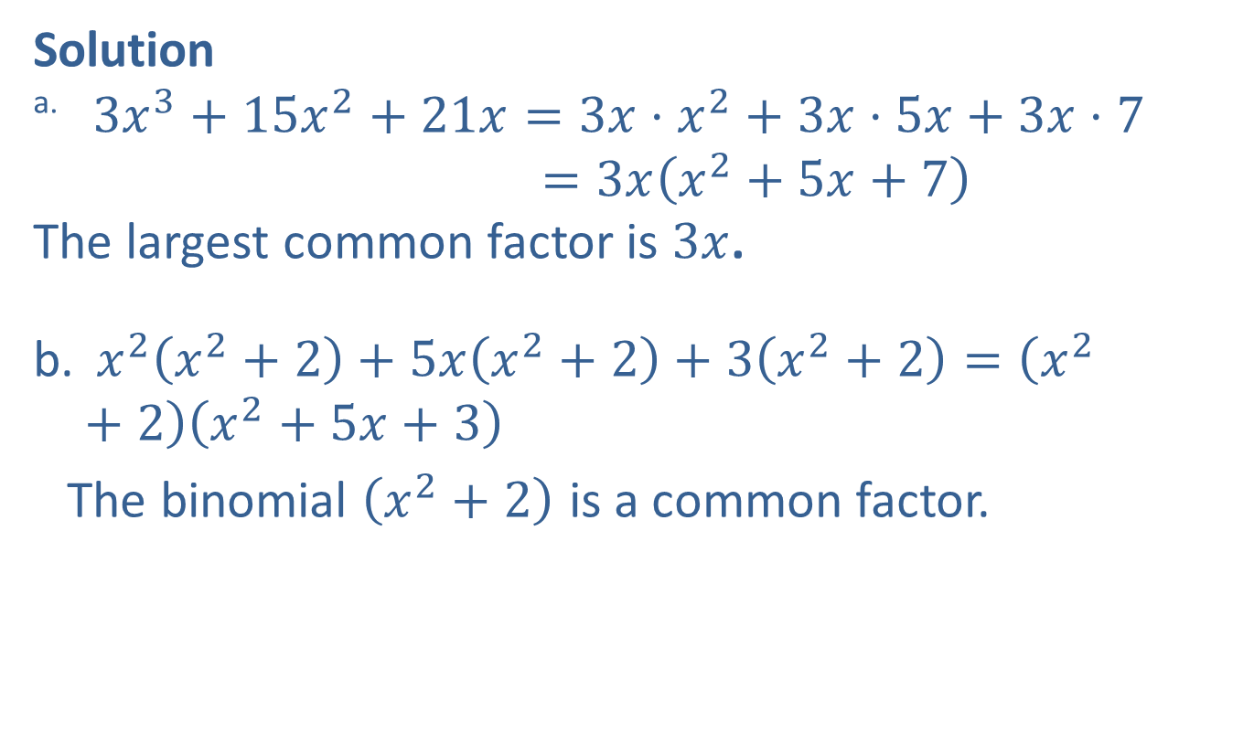
Example 7: Factoring Polynomials (cont.)
Solution
​ $3x^{3}+15x^{2}+21x=3x⋅x^{2}+3x⋅5x+3x⋅7$
​3𝑥3+15𝑥2+21𝑥 =3𝑥𝑥2+5𝑥+7
The largest common factor is $3x$.
$x^{2}\left(x^{2}+2\right)+5x\left(x^{2}+2\right)+3\left(x^{2}+2\right)=\left(x^{2}+2\right)\left(x^{2}+5x+3\right)$
The binomial $\left(x^{2}+2\right)$ is a common factor.

Slide 19

Example 8: Using the FOIL Method
Use the FOIL method to factor the following polynomials.
​$x^{2}+8x+12$
​$2x^{2}−13x−7$

Slide 20

Example 8: Using the FOIL Method (cont.)
Solution
​For $x^{2}+8x+12$, we have $F=x^{2}$ and $L=12$. Thus, in the following diagram, we want to find the two missing numbers such that $L=12$ and $O+I=8x$.

Slide 21
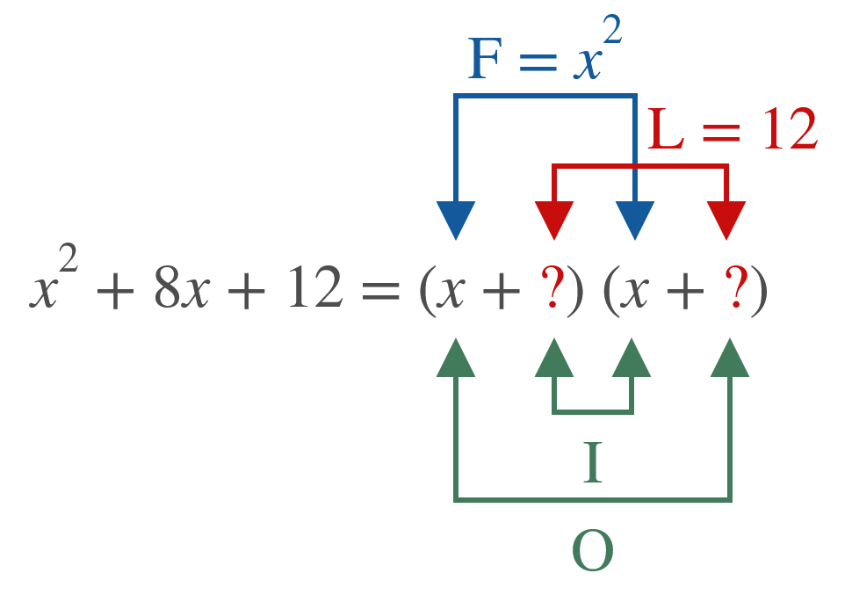

Example 8: Using the FOIL Method (cont.)
Since $6⋅2=12$ and $6+2=8$, we have $x^{2}+8x+12=\left(x+6\right)\left(x+2\right)$.

Slide 22

Example 8: Using the FOIL Method (cont.)
​For $2x^{2}−13x−7$, we have $F=2x^{2}$ and $L=−7$. In the following diagram we need factors of $−7$ such that $O+I=−13x$.

Slide 23
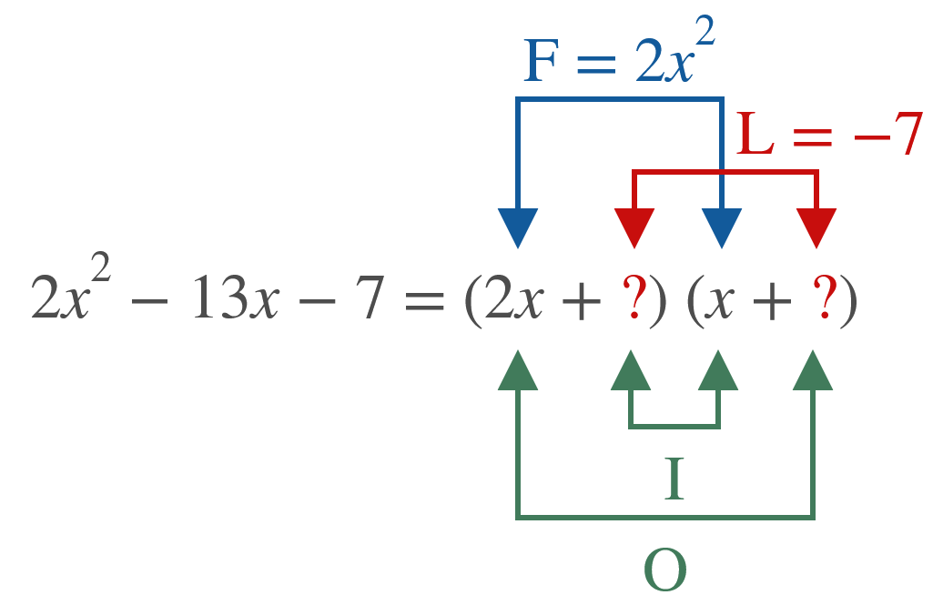

Example 8: Using the FOIL Method (cont.)
We want to fill in the question marks with $+1$ and $−7$ in that order. Doing so will result in $O=2x\left(−7\right)=−14x$, $I=1x$, and $O+I=−14x+1x=−13x$. Thus
$2x^{2}−13x−7=\left(2x+1\right)\left(x−7\right)$.

Slide 24

Example 9: Using Special Products
Factor each of the following polynomials by using the list of special products.
​$4x^{2}−25$
​$x^{2}+12x+36$
​$x^{3}−125$

Slide 25
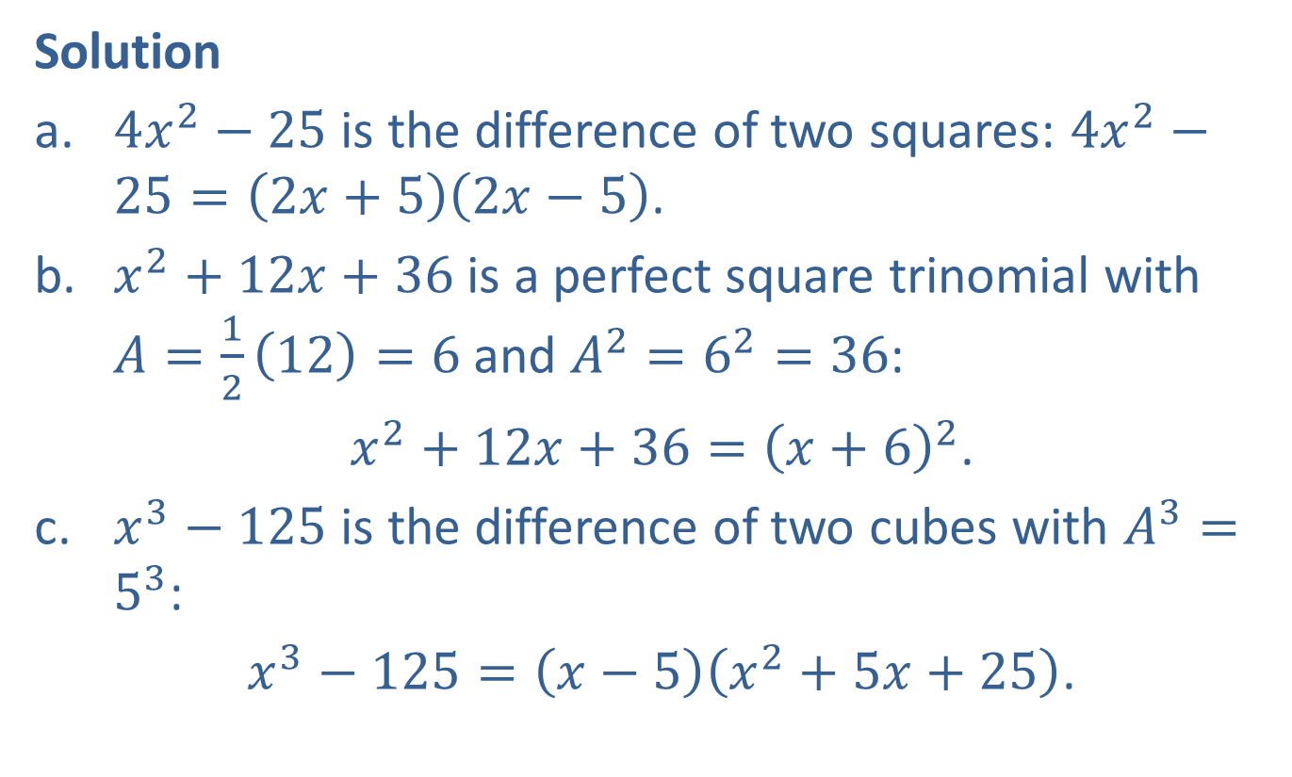
Example 9: Using Special Products (cont.)
Solution
​$4x^{2}−25$ is the difference of two squares: $4x^{2}−25=\left(2x+5\right)\left(2x−5\right)$.
​$x^{2}+12x+36$ is a perfect square trinomial with $A=\frac{1}{2}\left(12\right)=6$ and $A^{2}=6^{2}=36$:
$x^{2}+12x+36={\left(x+6\right)}^{2}$.
​$x^{3}−125$ is the difference of two cubes with $A^{3}=5^{3}$:
$x^{3}−125=\left(x−5\right)\left(x^{2}+5x+25\right)$.

