Slide 1
Section 0.5
Lines and Their Graphs

Slide 2
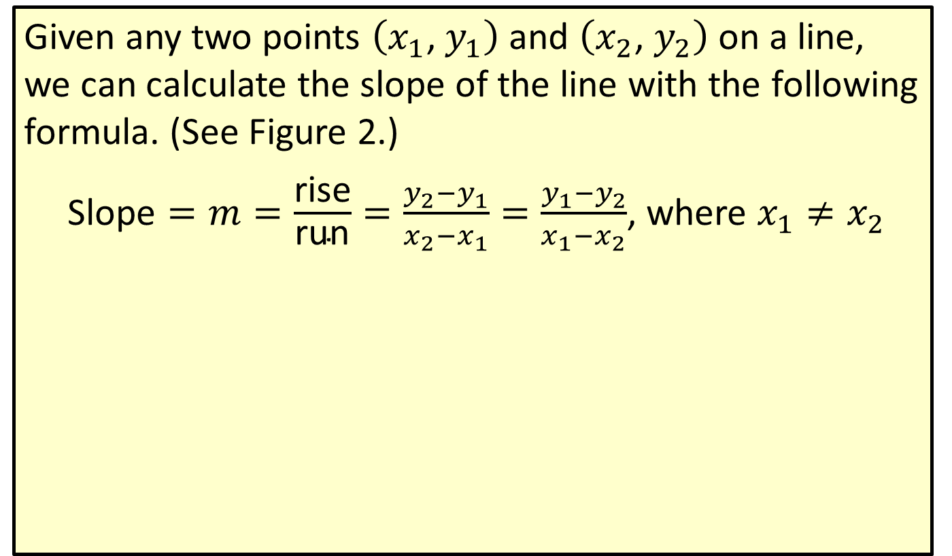
Slope of a Line
Given any two points $\left(x_{1}\text{, }y_{1}\right)$ and $\left(x_{2}\text{, }y_{2}\right)$ on a line, we can calculate the slope of the line with the following formula. (See Figure 2.)
$\text{Slope}=m=\frac{\text{rise}}{\text{run}}=\frac{y_{2}−y_{1}}{x_{2}−x_{1}}=\frac{y_{1}−y_{2}}{x_{1}−x_{2}}$, where $x_{1}≠x_{2}$

Slide 3
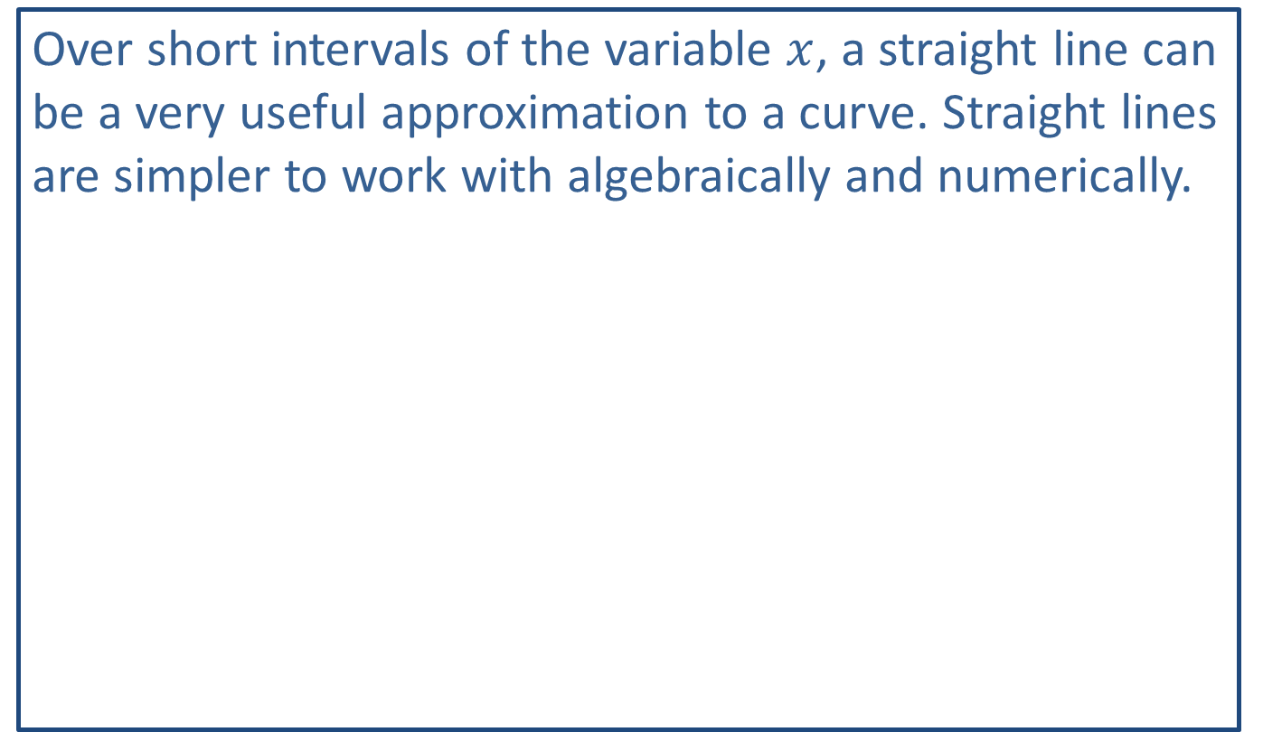
Note:
Over short intervals of the variable $x$, a straight line can be a very useful approximation to a curve. Straight lines are simpler to work with algebraically and numerically.

Slide 4

Example 1: Slope of a Line
Find the slope of the line that contains the two points $\left(−2\text{, }3\right)$ and $\left(5\text{, }−1\right)$ and then graph the line.

Slide 5
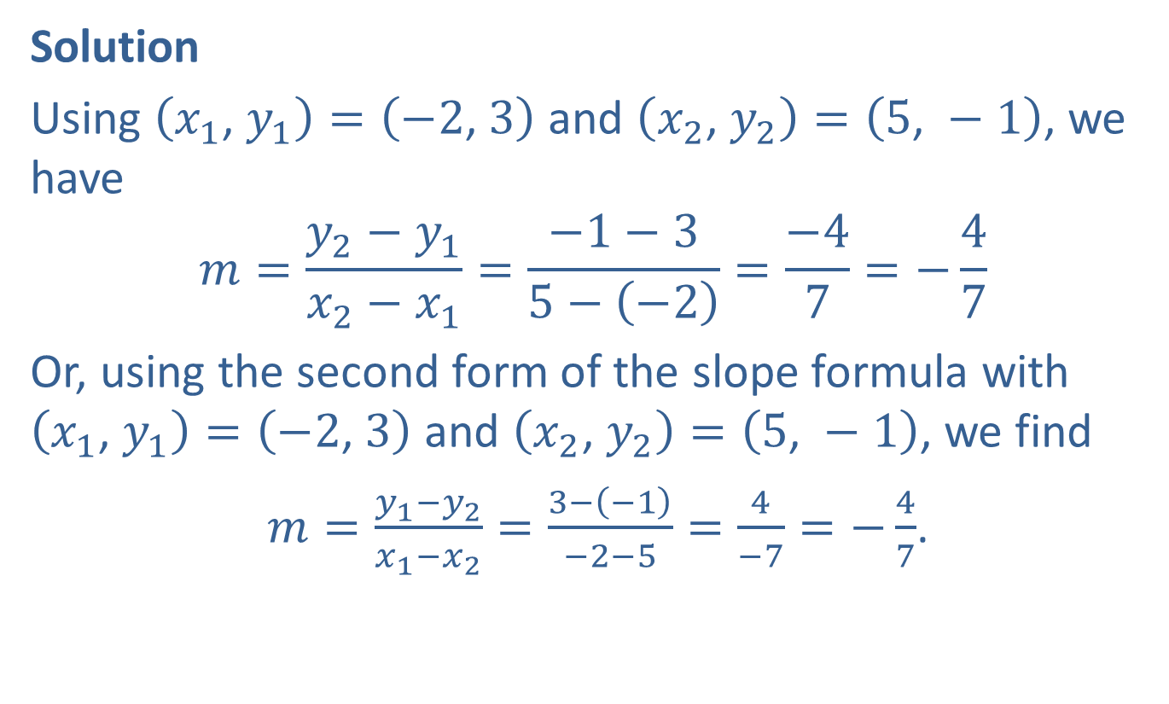
Example 1: Slope of a Line (cont.)
Solution
Using $\left(x_{1}\text{, }y_{1}\right)=\left(−2\text{, }3\right)$ and $\left(x_{2}\text{, }y_{2}\right)=\left(5\text{, }−1\right)$, we have
$$m=\frac{y_{2}−y_{1}}{x_{2}−x_{1}}=\frac{−1−3}{5−\left(−2\right)}=\frac{−4}{7}=−\frac{4}{7}$$
Or, using the second form of the slope formula with $\left(x_{1}\text{, }y_{1}\right)=\left(−2\text{, }3\right)$ and $\left(x_{2}\text{, }y_{2}\right)=\left(5\text{, }−1\right)$, we find
$m=\frac{y_{1}−y_{2}}{x_{1}−x_{2}}=\frac{3−\left(−1\right)}{−2−5}=\frac{4}{−7}=−\frac{4}{7}$.

Slide 6
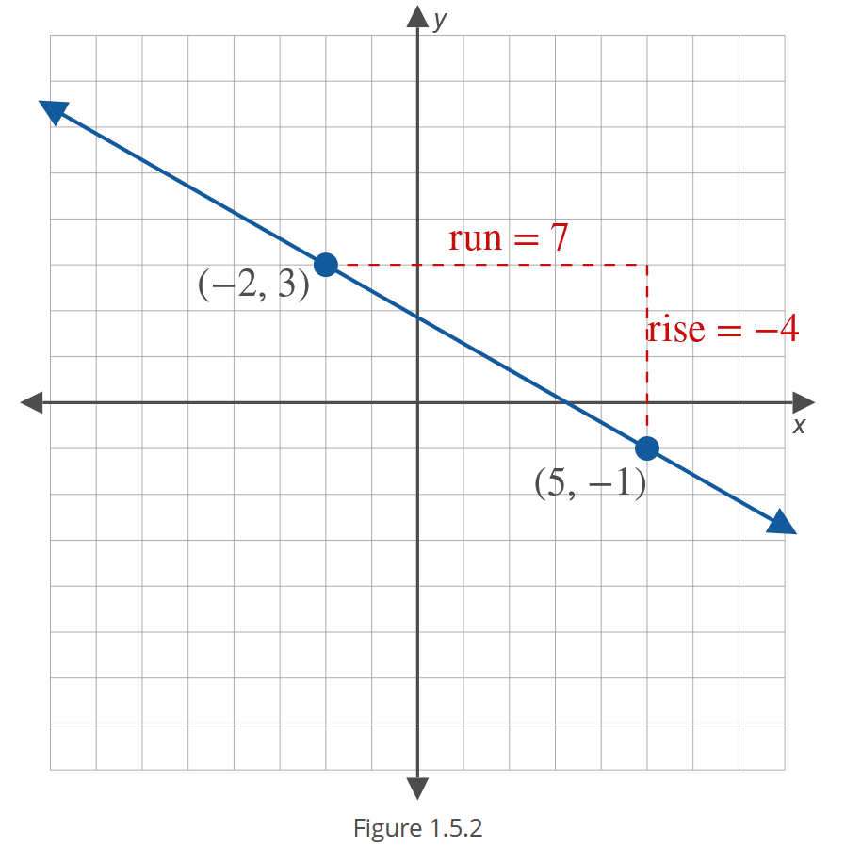
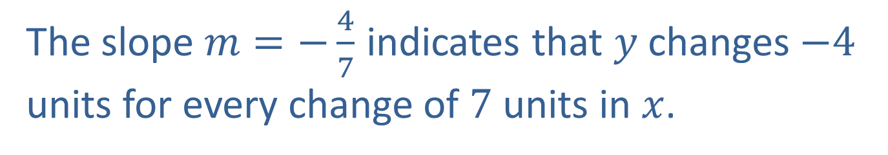
Example 1: Slope of a Line (cont.)
The slope $m=−\frac{4}{7}$ indicates that $y$ changes $−4$ units for every change of 7 units in $x$.

Slide 7
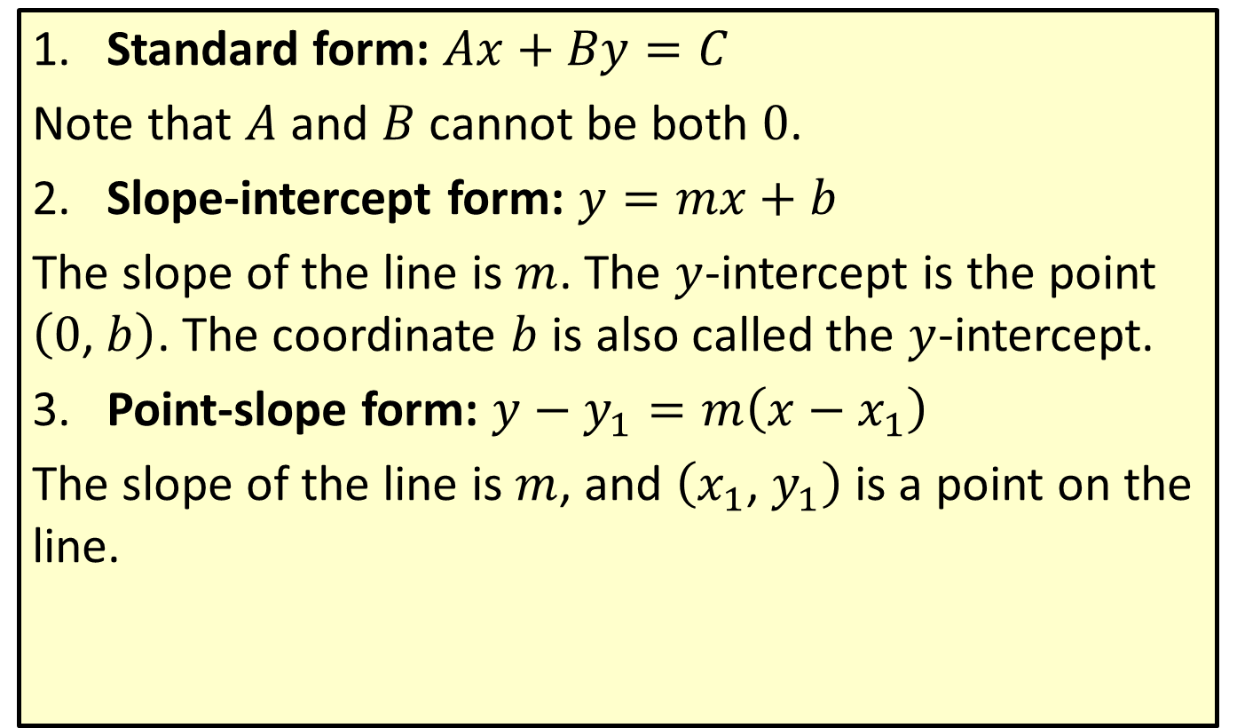
Forms of Equations of Lines
​Standard form: $Ax+By=C$
​Note that $A$ and $B$ cannot be both 0.
​Slope-intercept form: $y=mx+b$
​The slope of the line is $m$. The $y$-intercept is the point $\left(0\text{, }b\right)$. The coordinate $b$ is also called the $y$-intercept.
​Point-slope form: $y−y_{1}=m\left(x−x_{1}\right)$
​The slope of the line is $m$, and $\left(x_{1}\text{, }y_{1}\right)$ is a point on the line.

Slide 8
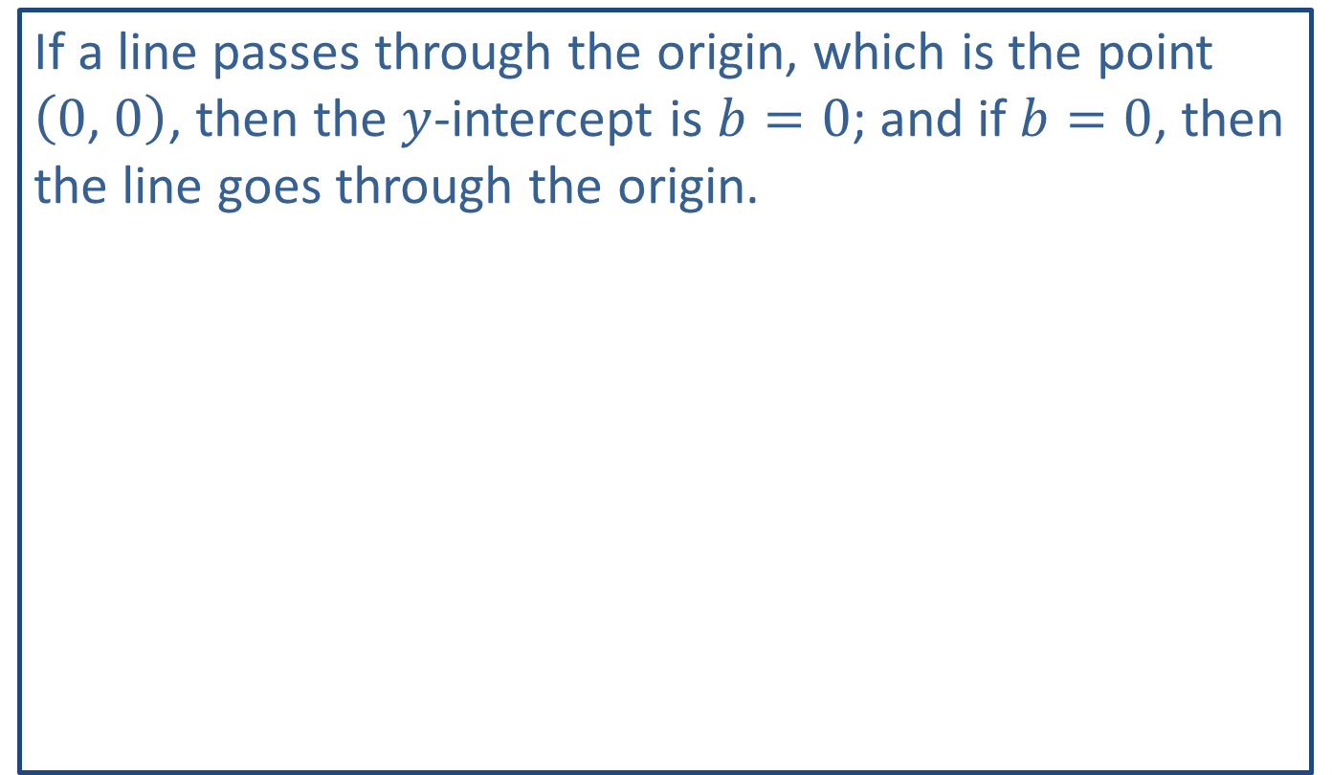
Note:
If a line passes through the origin, which is the point $\left(0\text{, }0\right)$, then the $y$-intercept is $b=0$; and if $b=0$, then the line goes through the origin.

Slide 9

Example 2: Equation of a Line
Find the slope-intercept form of the equation of the line containing the two points $\left(1\text{, }−5\right)$ and $\left(10\text{, }22\right)$.

Slide 10
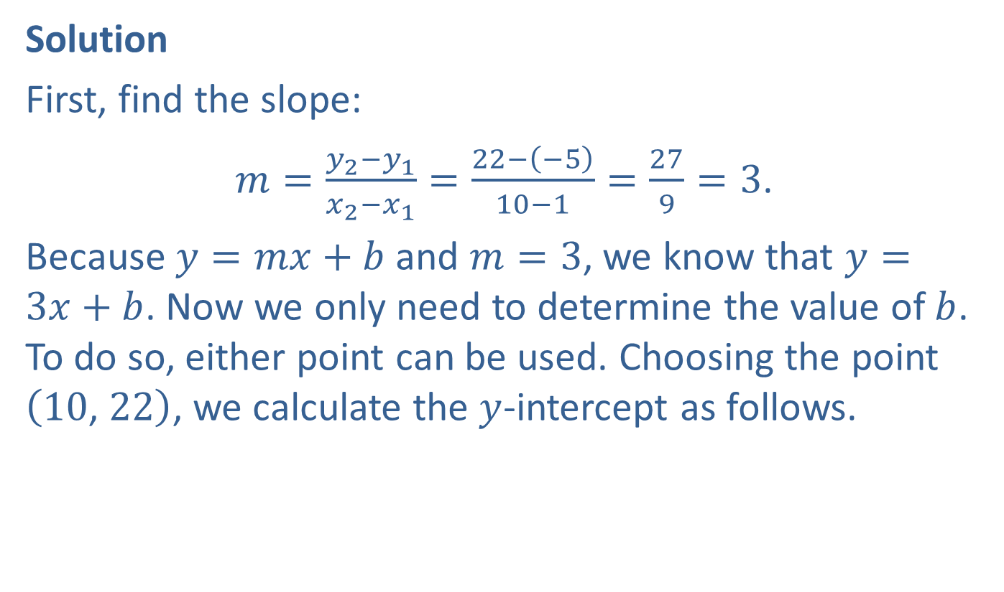
Example 2: Equation of a Line (cont.)
Solution
First, find the slope:
$m=\frac{y_{2}−y_{1}}{x_{2}−x_{1}}=\frac{22−\left(−5\right)}{10−1}=\frac{27}{9}=3$.
Because $y=mx+b$ and $m=3$, we know that $y=3x+b$. Now we only need to determine the value of $b$. To do so, either point can be used. Choosing the point $\left(10\text{, }22\right)$, we calculate the $y$-intercept as follows.

Slide 11
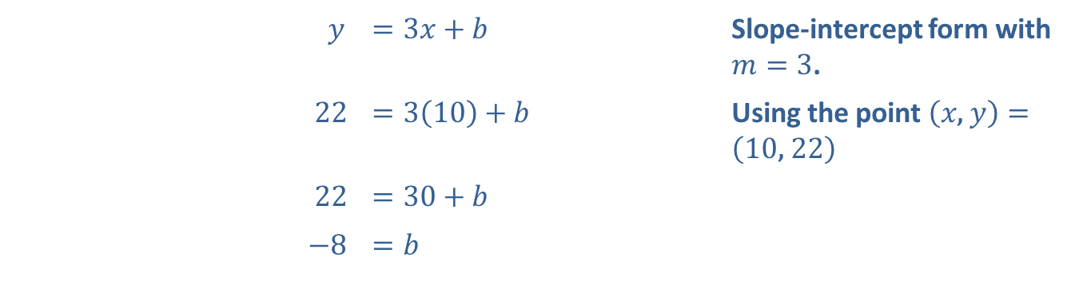
Example 2: Equation of a Line (cont.)
$y$ | ​$=3x+b$ | Slope-intercept form with $m=3$.
​ 22 | ​$=3\left(10\right)+b$ | Using the point $\left(x\text{, }y\right)=\left(10\text{, }22\right)$
​22 | ​$=30+b$
​ $−8$ | ​$=b$

Slide 12


Example 2: Equation of a Line (cont.)
Therefore, $y=3x−8$.
Check
We can check that the other point $\left(1\text{, }−5\right)$ satisfies the equation as follows.
$$y=3x−8$$
$−5$ $=$ $3$ $\left(1\right)$ $−8$
$−5$ $=$ $−5$

Slide 13
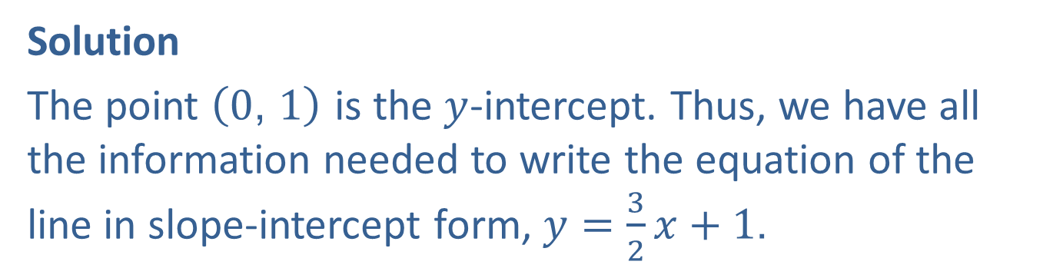

Example 3: Equation of a Line
Find the equation of the line with slope $\frac{3}{2}$ that passes through the point $\left(0\text{, }1\right)$. Graph the line.
Solution
The point $\left(0\text{, }1\right)$ is the $y$-intercept. Thus, we have all the information needed to write the equation of the line in slope-intercept form, $y=\frac{3}{2}x+1$.

Slide 14
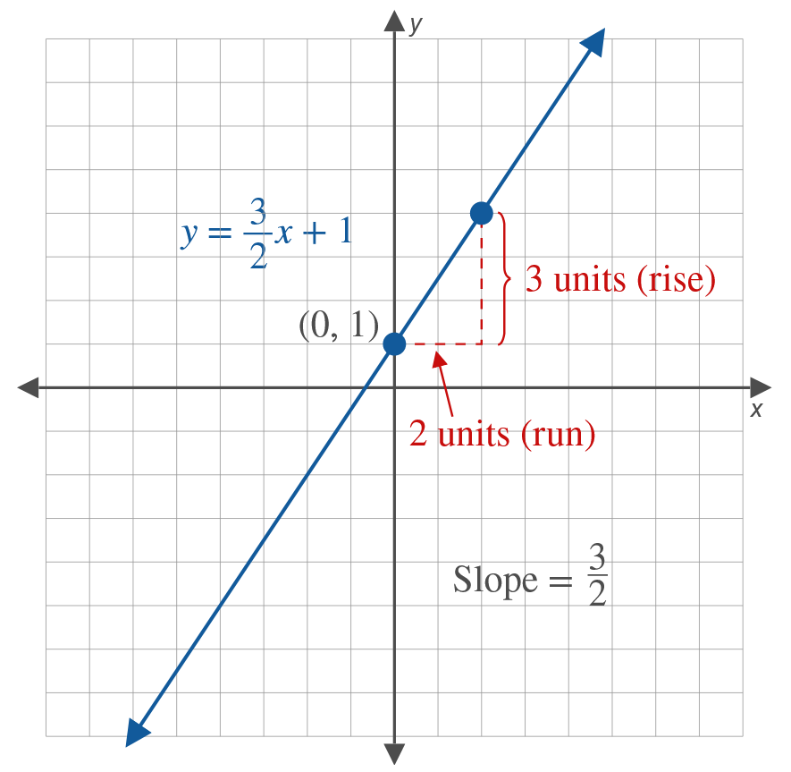

Example 3: Equation of a Line (cont.)
If we start at $\left(0\text{, }1\right)$ and move 2 units to the right (run) and 3 units up (rise), we will arrive at another point on the line. Since two points determine a line, the line through these two points is the graph of the given equation.

Slide 15

Example 4: Equation of a Line
Find the slope-intercept form of the equation $y−5=6\left(x−1\right)$.

Slide 16


Example 4: Equation of a Line (cont.)
Solution
The equation $y−5=6\left(x−1\right)$ is the point-slope form of the line with slope 6 that passes through the point $\left(1\text{, }5\right)$. We can algebraically transform the given equation into slope-intercept form.
​ $y−5$ | ​$=6\left(x−1\right)$
​ $y−5$ | ​$=6x−6$ | Distributive property
$y$ | ​$=6x−1$ | Add 5 to both sides.

