Slide 1
Section 0.7
Quadratic Equations in One Variable

Slide 2
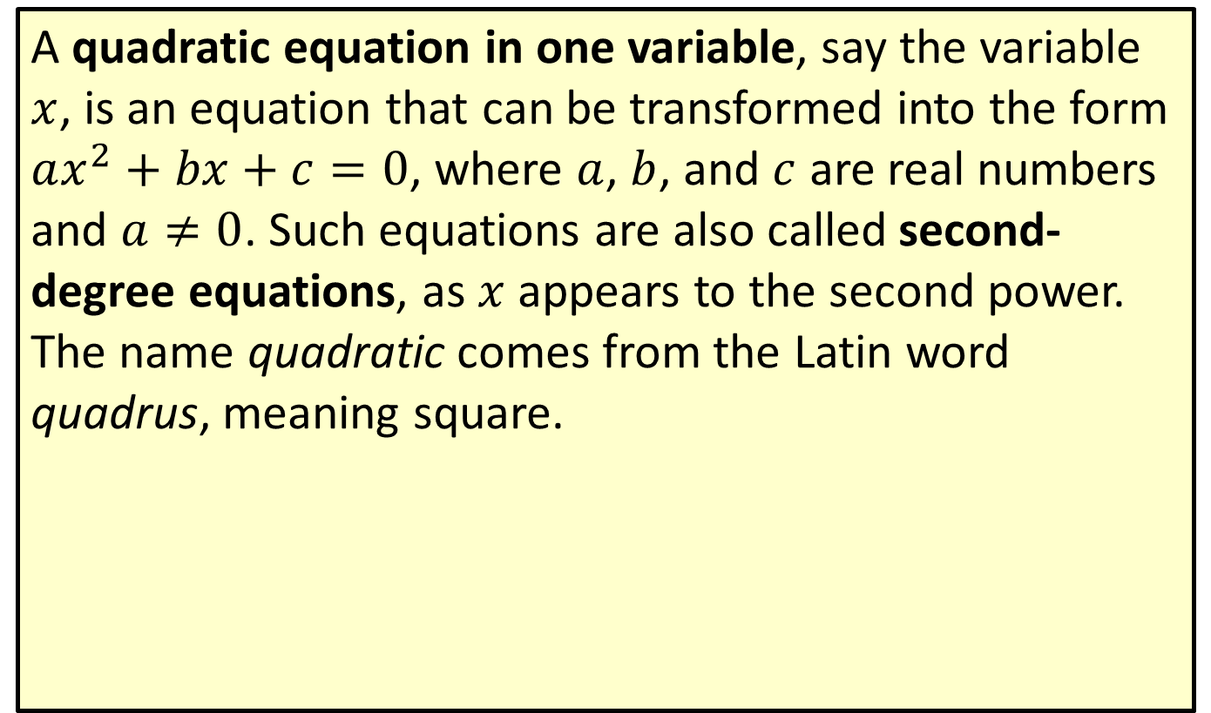
Quadratic Equations
A quadratic equation in one variable, say the variable $x$, is an equation that can be transformed into the form $ax^{2}+bx+c=0$, where $a$, $b$, and $c$ are real numbers and $a≠0$. Such equations are also called second-degree equations, as $x$ appears to the second power. The name quadratic comes from the Latin word quadrus, meaning square.

Slide 3
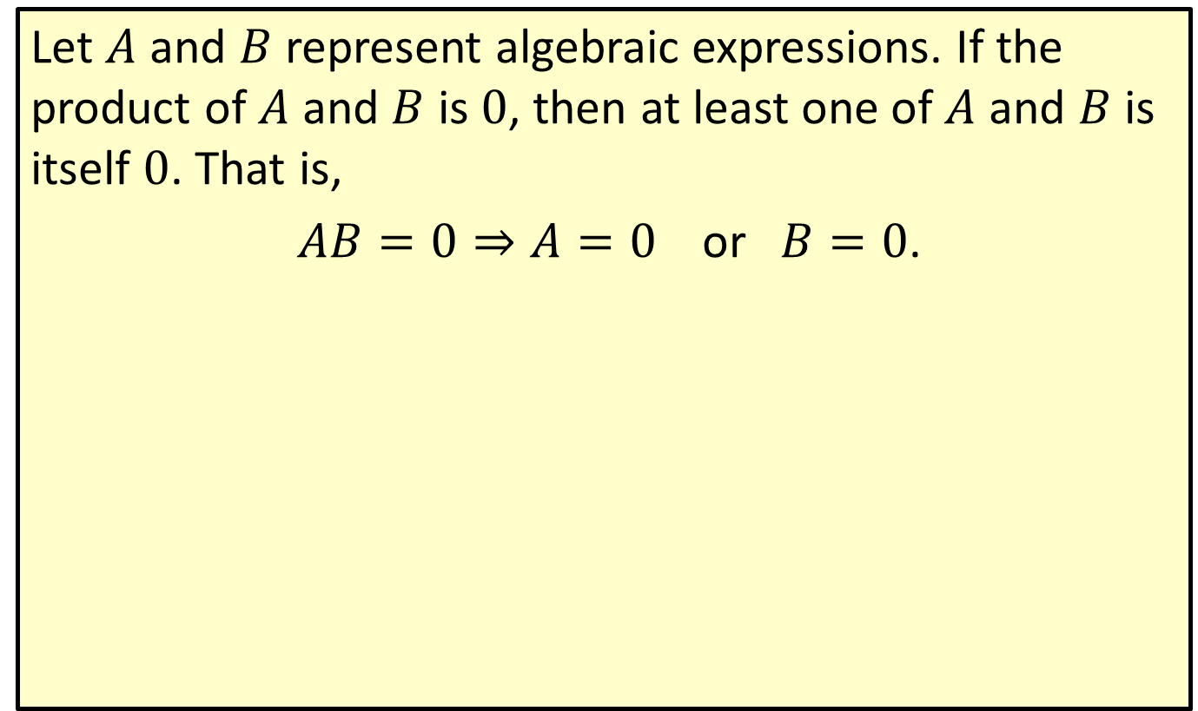
Zero-Factor Property
Let $A$ and $B$ represent algebraic expressions. If the product of $A$ and $B$ is 0, then at least one of $A$ and $B$ is itself 0. That is,
$AB=0⇒A=0 \text{or} B=0$.

Slide 4

Example 1: Solving Quadratic Equations by Factoring
Solve the following quadratic equations by factoring.
​$x^{2}+\frac{11x}{3}=\frac{4}{3}$
​$s^{2}+25=10s$
​$4x^{2}+28x=0$

Slide 5
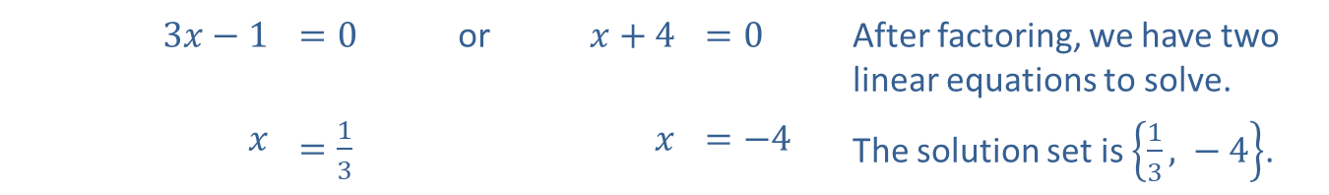
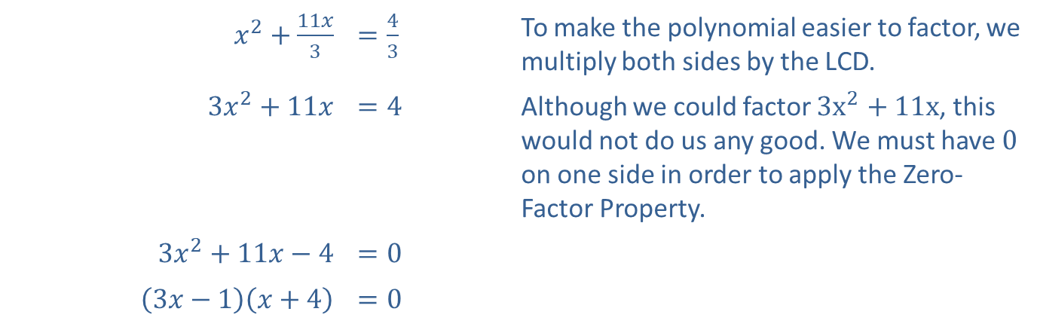
Example 1: Solving Quadratic Equations by Factoring (cont.)
Solution
​
​$x^{2}+\frac{11x}{3}$ | ​$=\frac{4}{3}$ | To make the polynomial easier to factor, we multiply both sides by the LCD.
​$3x^{2}+11x$ | ​$=4$ | Although we could factor $3x^{2}+11x$, this would not do us any good. We must have 0 on one side in order to apply the Zero-Factor Property.
​$3x^{2}+11x−4$ | ​$=0$
​$\left(3x−1\right)\left(x+4\right)$ | ​$=0$
​$3x−1$ | ​$=0$ | or | ​$x+4$ | ​$=0$ | After factoring, we have two linear equations to solve.
$$x$$ | ​$=\frac{1}{3}$ |  | $$x$$ | ​$=−4$ | The solution set is $\left\{\frac{1}{3}\text{, }−4\right\}$.

Slide 6

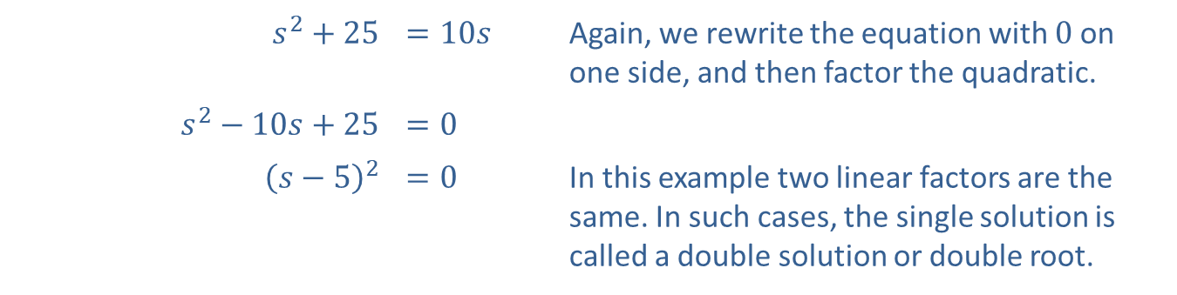
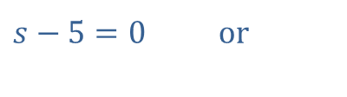
Example 1: Solving Quadratic Equations by Factoring (cont.)
​
​$s^{2}+25$ | ​$=10s$ | Again, we rewrite the equation with 0 on one side, and then factor the quadratic.
​$s^{2}−10s+25$ | ​$=0$
​${\left(s−5\right)}^{2}$ | ​$=0$ | In this example two linear factors are the same. In such cases, the single solution is called a double solution or double root.
$s−5=0$ or
$$s−5=0 \\ s=5$$

Slide 7
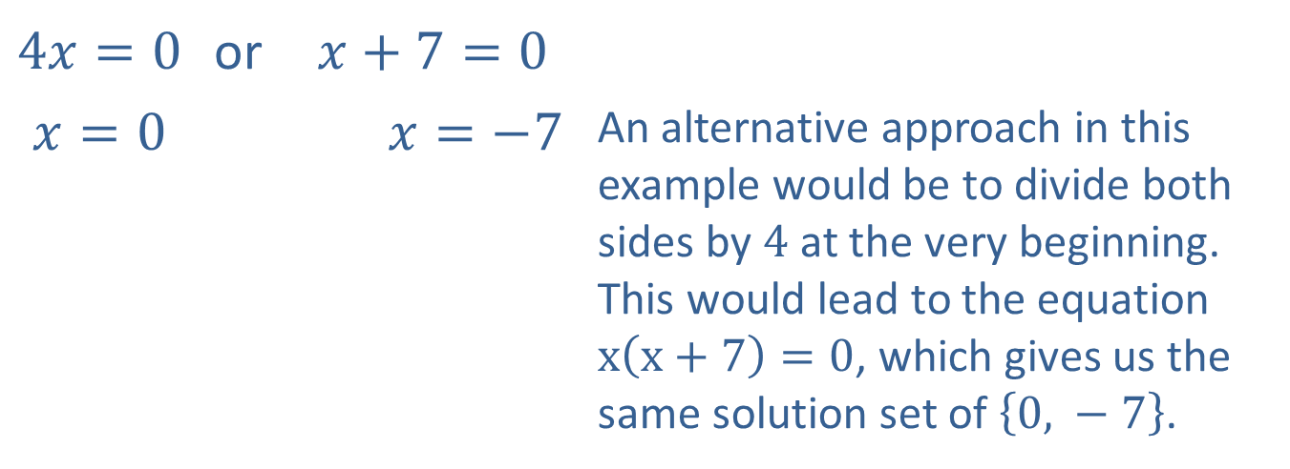

Example 1: Solving Quadratic Equations by Factoring (cont.)
$4x^{2}+28x=0$ $4x\left(x+7\right)=0$
​
​$4x=0$ | or | ​$x+7=0$
​$x=0$ |  | ​7+𝑥=−7 | An alternative approach in this example would be to divide both sides by 4 at the very beginning. This would lead to the equation $x\left(x+7\right)=0$, which gives us the same solution set of $\left\{0\text{, }−7\right\}$.

Slide 8

Example 2: "Perfect Square" Quadratic Equations
Solve the following quadratic equations by taking square roots.
​${\left(2x+5\right)}^{2}=12$
​${\left(x−6\right)}^{2}−7=0$

Slide 9
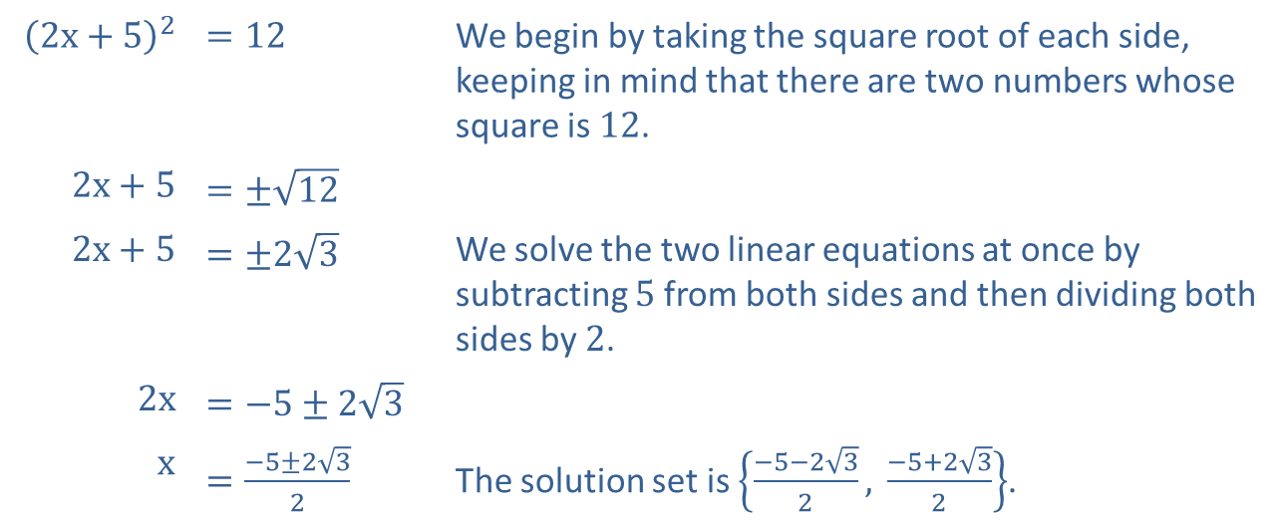
Example 2: "Perfect Square" Quadratic Equations (cont.)
Solution
​
​${\left(2x+5\right)}^{2}$ | ​$=12$ | We begin by taking the square root of each side, keeping in mind that there are two numbers whose square is 12.
​$2x+5$ | ​$=±\sqrt{12}$
​$2x+5$ | ​$=±2\sqrt{3}$ | We solve the two linear equations at once by subtracting 5 from both sides and then dividing both sides by 2.
​$2x$ | ​$=−5±2\sqrt{3}$
$$x$$ | ​$=\frac{−5±2\sqrt{3}}{2}$ | The solution set is $\left\{\frac{−5−2\sqrt{3}}{2}\text{, }\frac{−5+2\sqrt{3}}{2}\right\}$.

Slide 10
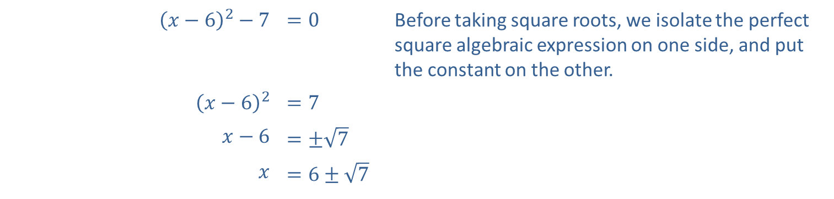
Example 2: "Perfect Square" Quadratic Equations (cont.)
​
​${\left(x−6\right)}^{2}−7$ | ​$=0$ | Before taking square roots, we isolate the perfect square algebraic expression on one side, and put the constant on the other.
​${\left(x−6\right)}^{2}$ | ​$=7$
​$x−6$ | ​$=±\sqrt{7}$
$$x$$ | ​$=6±\sqrt{7}$

Slide 11
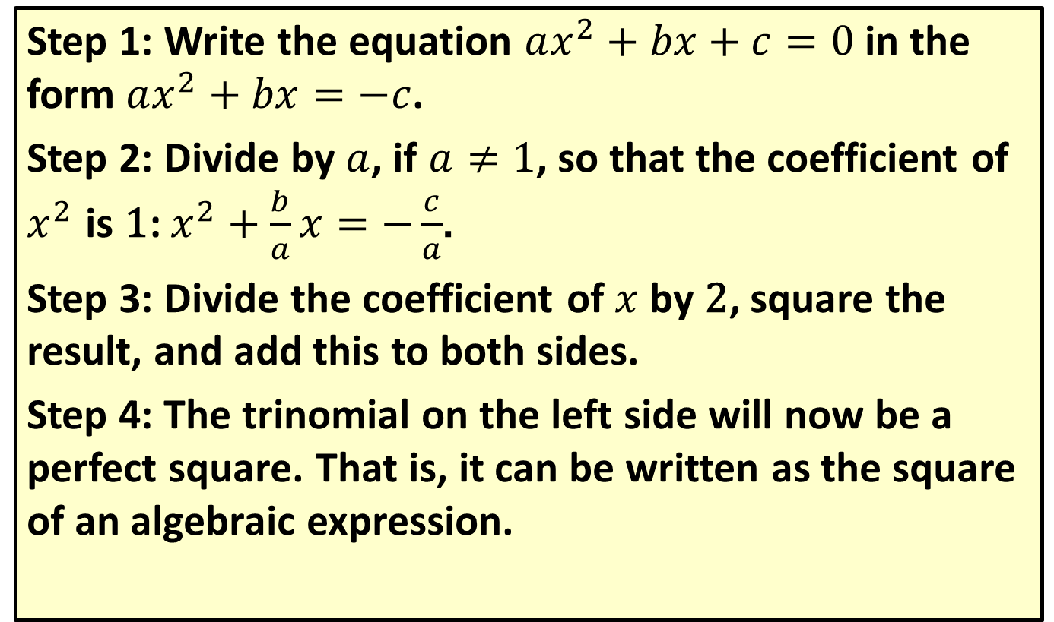
Method of Completing the Square
Step 1: Write the equation $ax^{2}+bx+c=0$ in the form $ax^{2}+bx=−c$.
Step 2: Divide by $a$, if $a≠1$, so that the coefficient of $x^{2}$ is 1: $x^{2}+\frac{b}{a}x=−\frac{c}{a}$.
Step 3: Divide the coefficient of $x$ by 2, square the result, and add this to both sides.
Step 4: The trinomial on the left side will now be a perfect square. That is, it can be written as the square of an algebraic expression.

Slide 12

Example 3: Completing the Square
Solve the following quadratic equations by completing the square.
​$x^{2}−6x−2=0$
​$25x^{2}+5x=6$

Slide 13
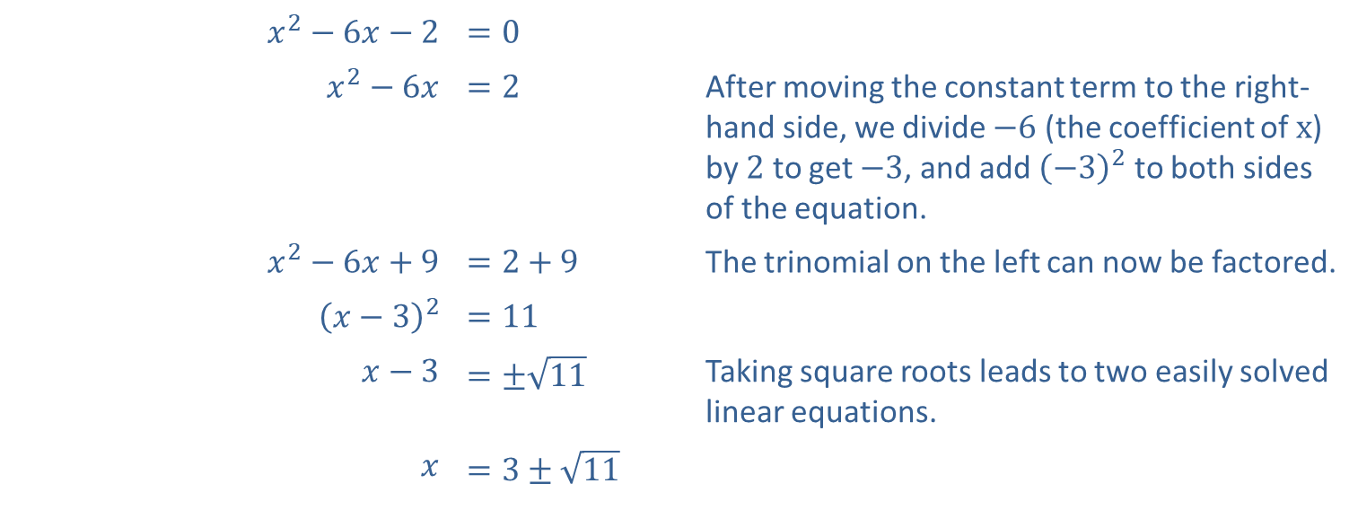
Example 3: Completing the Square (cont.)
Solution
​
​$x^{2}−6x−2$ | ​$=0$
​$x^{2}−6x$ | ​$=2$ | After moving the constant term to the right-hand side, we divide $−6$ (the coefficient of $x$) by 2 to get $−3$, and add ${\left(−3\right)}^{2}$ to both sides of the equation.
​$x^{2}−6x+9$ | ​$=2+9$ | The trinomial on the left can now be factored.
​${\left(x−3\right)}^{2}$ | ​$=11$
​$x−3$ | ​$=±\sqrt{11}$ | Taking square roots leads to two easily solved linear equations.
$$x$$ | ​$=3±\sqrt{11}$

Slide 14
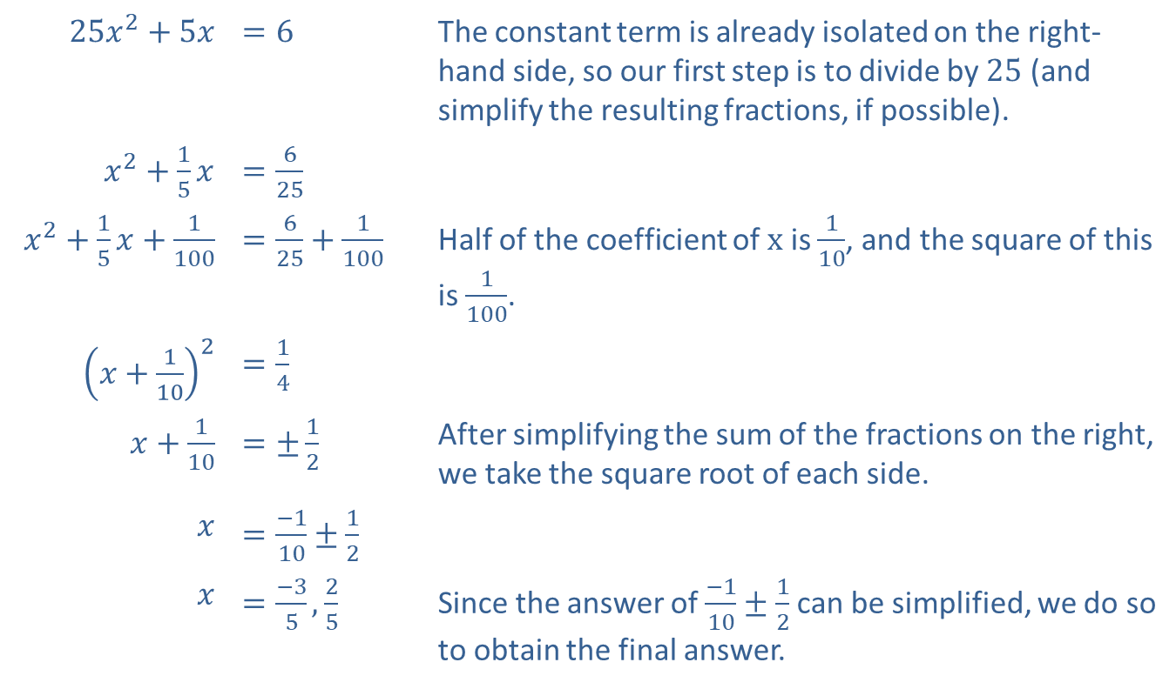
Example 3: Completing the Square (cont.)
​
​$25x^{2}+5x$ | ​$=6$ | The constant term is already isolated on the right-hand side, so our first step is to divide by 25 (and simplify the resulting fractions, if possible).
​$x^{2}+\frac{1}{5}x$ | ​$=\frac{6}{25}$
​$x^{2}+\frac{1}{5}x+\frac{1}{100}$ | ​$=\frac{6}{25}+\frac{1}{100}$ | Half of the coefficient of $x$ is $\frac{1}{10}$, and the square of this is $\frac{1}{100}$.
​${\left(x+\frac{1}{10}\right)}^{2}$ | ​$=\frac{1}{4}$
​$x+\frac{1}{10}$ | ​$=±\frac{1}{2}$ | After simplifying the sum of the fractions on the right, we take the square root of each side.
$$x$$ | ​$=\frac{−1}{10}±\frac{1}{2}$
$$x$$ | ​$=\frac{−3}{5},\frac{2}{5}$ | Since the answer of $\frac{−1}{10}±\frac{1}{2}$ can be simplified, we do so to obtain the final answer.

Slide 15
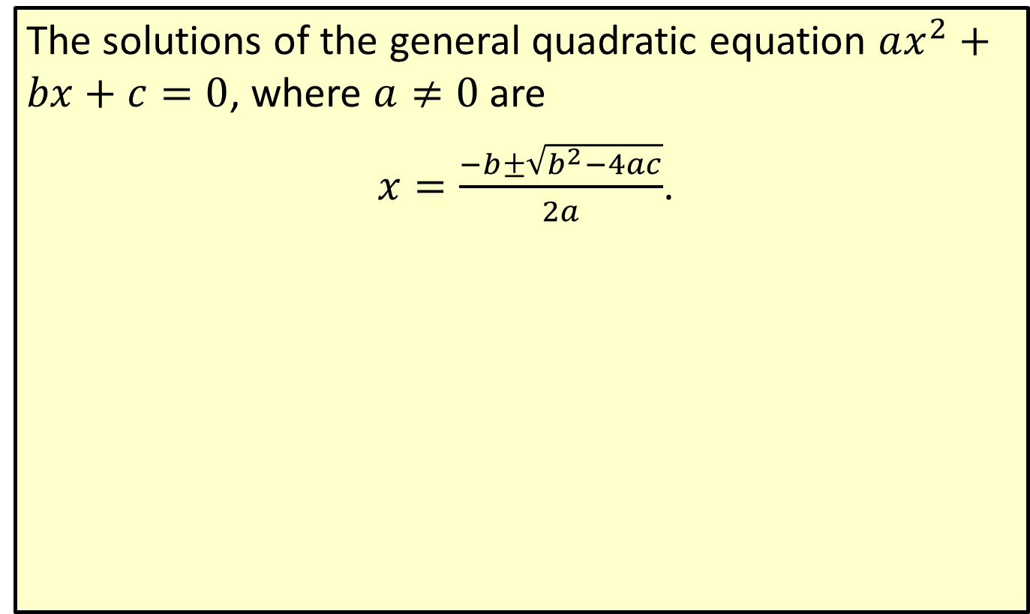
The Quadratic Formula
The solutions of the general quadratic equation $ax^{2}+bx+c=0$, where $a≠0$ are
$x=\frac{−b±\sqrt{b^{2}−4ac}}{2a}$.

Slide 16

Example 4: The Quadratic Formula
Solve the following quadratic equations by using the quadratic formula.
​$6y^{2}−5y=1$
​$t^{2}+8t−12=0$

Slide 17
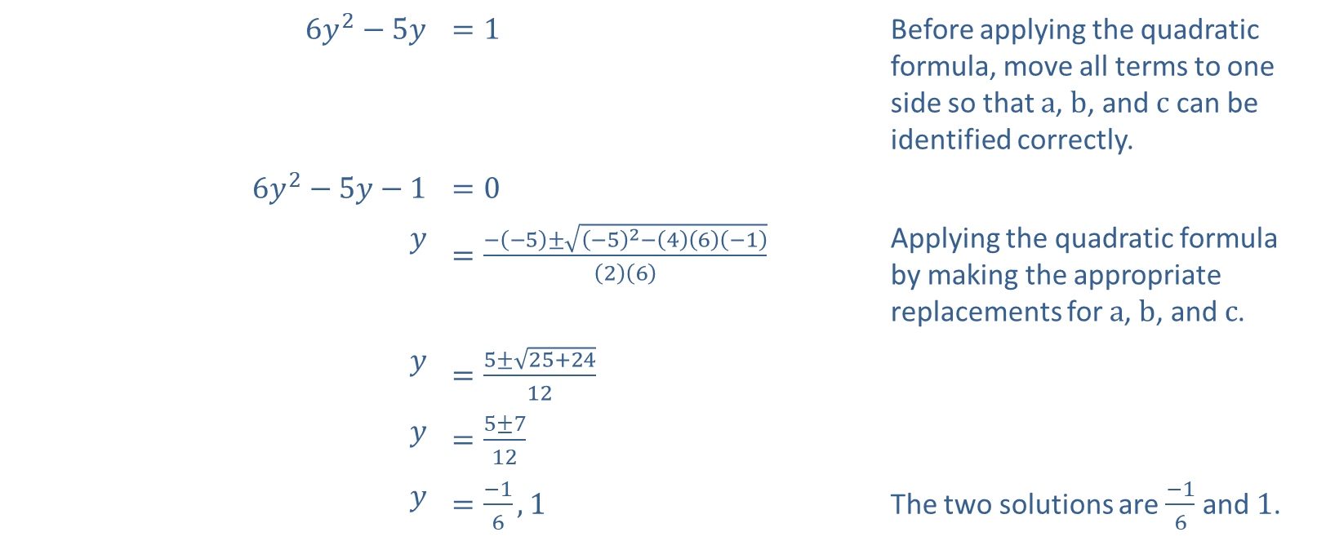
Example 4: The Quadratic Formula (cont.)
Solution
​
​$6y^{2}−5y$ | ​$=1$ | Before applying the quadratic formula, move all terms to one side so that $a$, $b$, and $c$ can be identified correctly.
​$6y^{2}−5y−1$ | ​$=0$
$$y$$ | ​$=\frac{−\left(−5\right)±\sqrt{{\left(−5\right)}^{2}−\left(4\right)\left(6\right)\left(−1\right)}}{\left(2\right)\left(6\right)}$ | Applying the quadratic formula by making the appropriate replacements for $a$, $b$, and $c$.
$$y$$ | ​$=\frac{5±\sqrt{25+24}}{12}$
$$y$$ | ​$=\frac{5±7}{12}$
$$y$$ | ​$=\frac{−1}{6},1$ | The two solutions are $\frac{−1}{6}$ and 1.

Slide 18
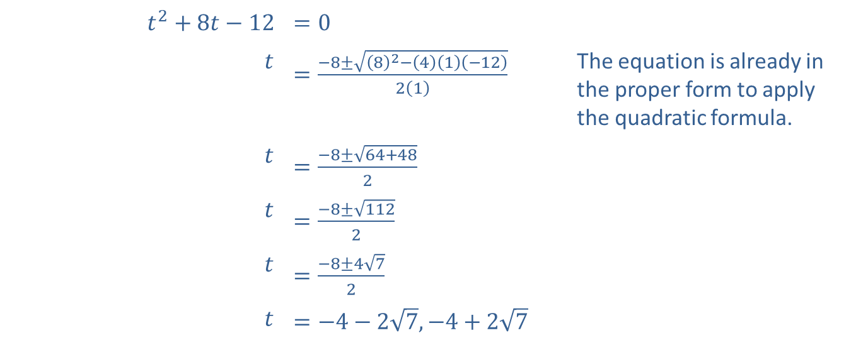
Example 4: The Quadratic Formula (cont.)
​
​$t^{2}+8t−12$ | ​$=0$
$$t$$ | ​$=\frac{−8±\sqrt{{\left(8\right)}^{2}−\left(4\right)\left(1\right)\left(−12\right)}}{2\left(1\right)}$ | The equation is already in the proper form to apply the quadratic formula.
$$t$$ | ​$=\frac{−8±\sqrt{64+48}}{2}$
$$t$$ | ​$=\frac{−8±\sqrt{112}}{2}$
$$t$$ | ​$=\frac{−8±4\sqrt{7}}{2}$
$$t$$ | ​$=−4−2\sqrt{7},−4+2\sqrt{7}$

