Slide 1
Section 0.8
Rational and Radical Equations

Slide 2
Proportion
A proportion is an equation stating that two ratios are equal.

Slide 3
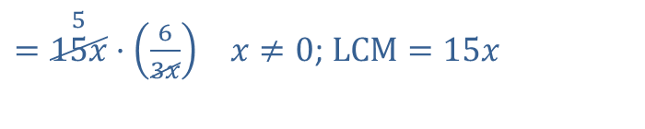


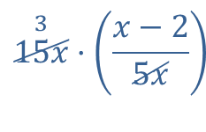
Example 1: Proportions
Solve the following proportions.
​$\frac{x−2}{5x}=\frac{6}{3x}$
​Solution
​
$$\overset{3}{15x}·\left(\frac{x−2}{5x}\right)$$
$=\overset{5}{15x}·\left(\frac{6}{3x}\right)$ $x≠0$; $LCM=15x$
​$3\left(x−2\right)$ | ​$=5\left(6\right)$
​$3x−6$ | ​$=30$
​$3x$ | ​$=36$
$$x$$ | ​$=12$

Slide 4
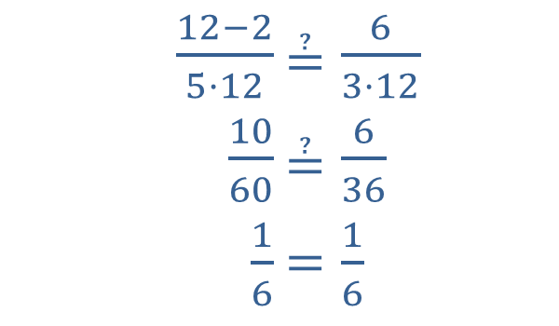

Example 1: Proportions (cont.)
​Check
​
​
Thus, the solution is $x=12$.
​
​$\frac{12−2}{5·12}$ | ​$≟\frac{6}{3·12}$
​$\frac{10}{60}$ | ​$≟\frac{6}{36}$
​$\frac{1}{6}$ | ​$=\frac{1}{6}$

Slide 5
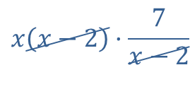


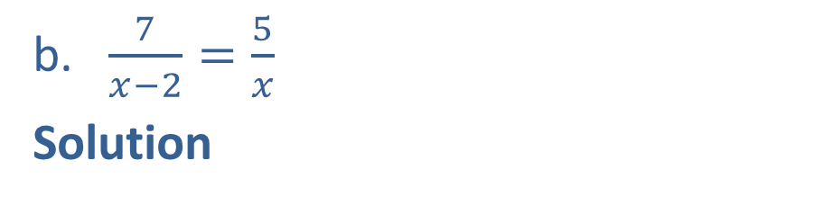
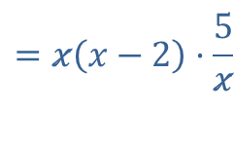
Example 1: Proportions (cont.)
​$\frac{7}{x−2}=\frac{5}{x}$
​Solution
$$x\left(x−2\right)·\frac{7}{x−2}$$
$$=x\left(x−2\right)·\frac{5}{x}$$
$x≠0,2$; $LCM=x\left(x−2\right)$
​$7x$ | ​$=5\left(x−2\right)$
​$7x$ | ​$=5x−10$
​$2x$ | ​$=−10$
$$x$$ | ​$=−5$

Slide 6
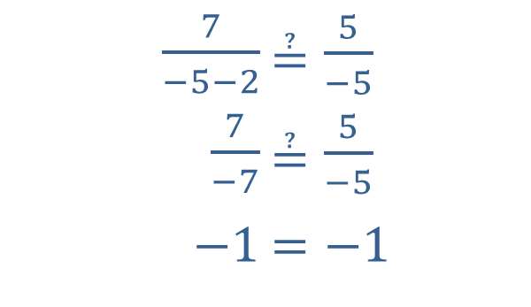

Example 1: Proportions (cont.)
Check
​
Thus, the solution is $x=−5$.
​$\frac{7}{−5−2}$ | ​$≟\frac{5}{−5}$
​$\frac{7}{−7}$ | ​$≟\frac{5}{−5}$
​$−1$ | ​$=−1$

Slide 7
Note:
Proportions can be used to solve many everyday types of word problems. Using the correct ratios of units on both sides of the proportion is critical. One of the following conditions must be true:
​The numerators agree in type and the denominators agree in type.
​The numerators correspond and the denominators correspond.

Slide 8
Solving Equations Containing Rational Expressions
Step 1: Find the LCM of the denominators.
Step 2: Multiply both sides of the equation by this LCM and simplify.
Step 3: Solve the resulting equation. (This equation will have only polynomials on both sides.)
Step 4: Check each solution in the original equation. (Remember that no denominator can be 0 and any solution that gives a 0 denominator is to be discarded.)

Slide 9
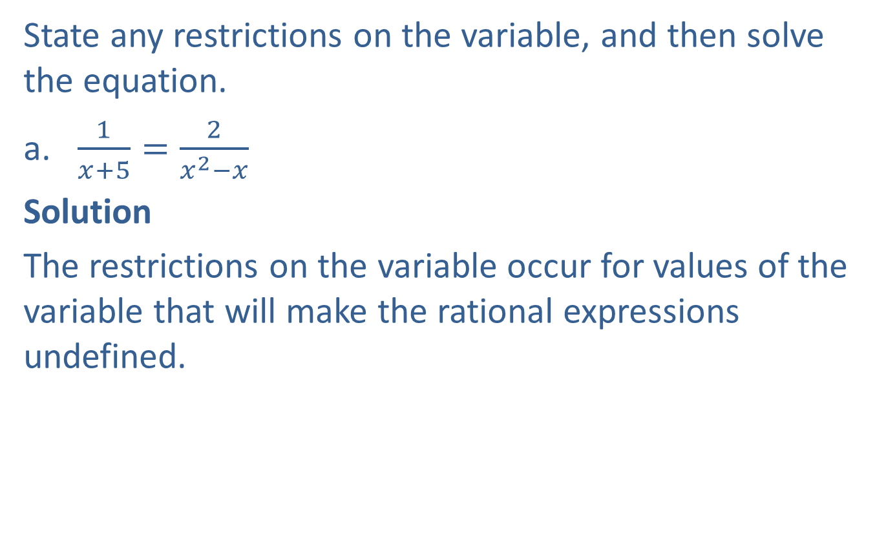
Example 2: Solving Equations Involving Rational Expressions
State any restrictions on the variable, and then solve the equation.
​$\frac{1}{x+5}=\frac{2}{x^{2}−x}$
​Solution
​The restrictions on the variable occur for values of the variable that will make the rational expressions undefined.
​
​

Slide 10
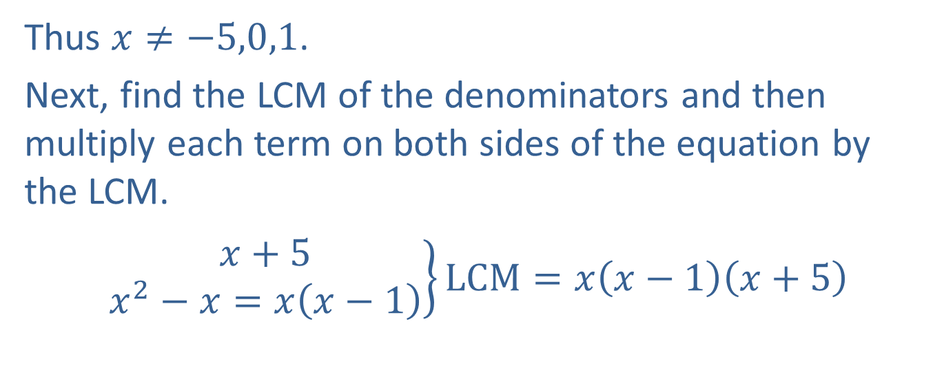
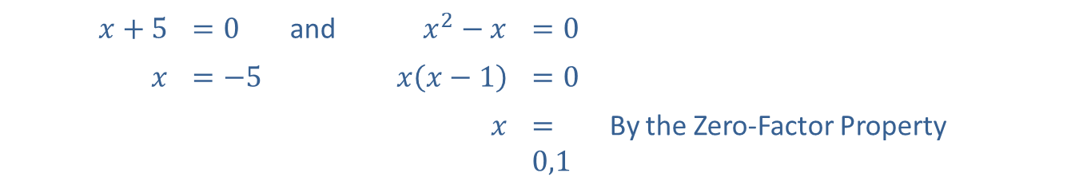
Example 2: Solving Equations Involving Rational Expressions (cont.)
Setting each denominator equal to zero, we have
​$x+5$ | ​$=0$ | and | ​$x^{2}−x$ | ​$=0$
$$x$$ | ​$=−5$ |  | ​$x\left(x−1\right)$ | ​$=0$
 |  |  | $$x$$ | ​$=0,1$ | By the Zero-Factor Property
Thus $x≠−5,0,1$.
​Next, find the LCM of the denominators and then multiply each term on both sides of the equation by the LCM.
​$\left.\begin{aligned}x+5 \\ x^{2}−x=x\left(x−1\right)\end{aligned}\right\}LCM=x\left(x−1\right)\left(x+5\right)$
​

Slide 11

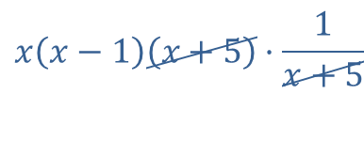

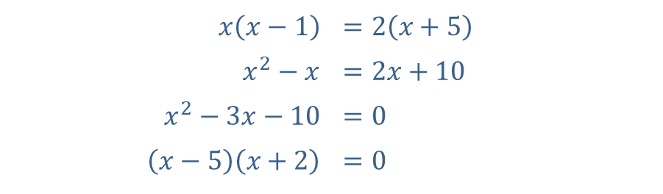

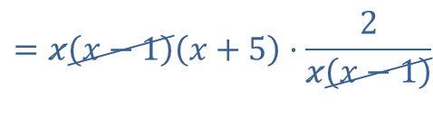
Example 2: Solving Equations Involving Rational Expressions (cont.)
$$x\left(x−1\right)\left(x+5\right)·\frac{1}{x+5}$$
$$=x\left(x−1\right)\left(x+5\right)·\frac{2}{x\left(x−1\right)}$$
$$x≠−5,0,1$$
​$x\left(x−1\right)$ | ​$=2\left(x+5\right)$
​$x^{2}−x$ | ​$=2x+10$
​$x^{2}−3x−10$ | ​$=0$
​$\left(x−5\right)\left(x+2\right)$ | ​$=0$
​$x−5$ | ​$=0$ or
​$x$ | ​$=5$
​$x+2$ | ​$=0$
​$x$ | ​$=−2$
Since 5 and $−2$ are not restrictions, there are two solutions, $x=5$ and $x=−2$.

Slide 12
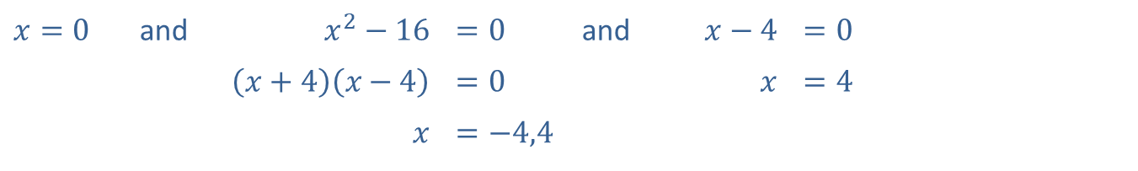
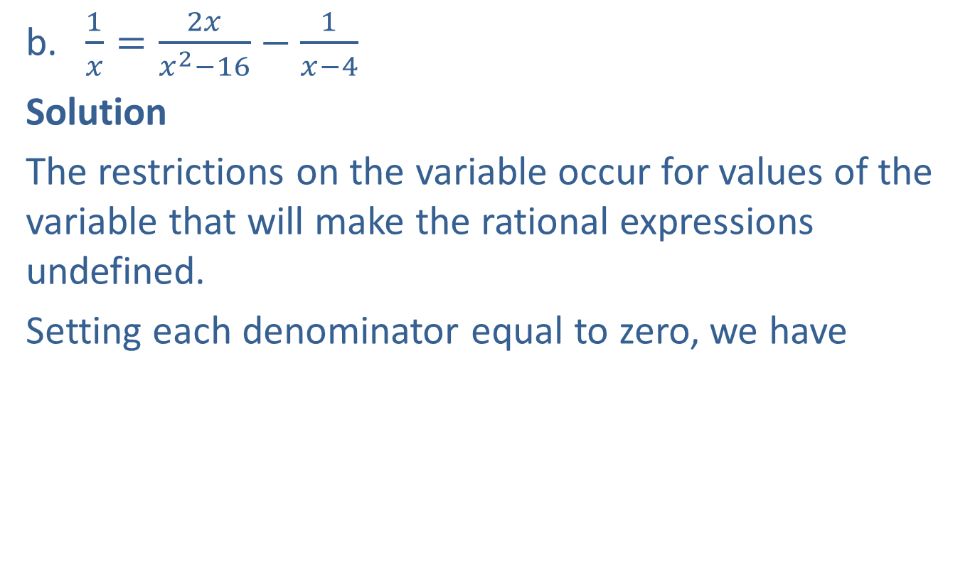
Example 2: Solving Equations Involving Rational Expressions (cont.)
​$\frac{1}{x}=\frac{2x}{x^{2}−16}−\frac{1}{x−4}$
​Solution
​The restrictions on the variable occur for values of the variable that will make the rational expressions undefined.
​Setting each denominator equal to zero, we have
​
​$x=0$ | and | ​$x^{2}−16$ | ​$=0$ | and | ​$x−4$ | ​$=0$
 |  | ​$\left(x+4\right)\left(x−4\right)$ | ​$=0$ |  | $$x$$ | ​$=4$
 |  | $$x$$ | ​$=−4,4$

Slide 13
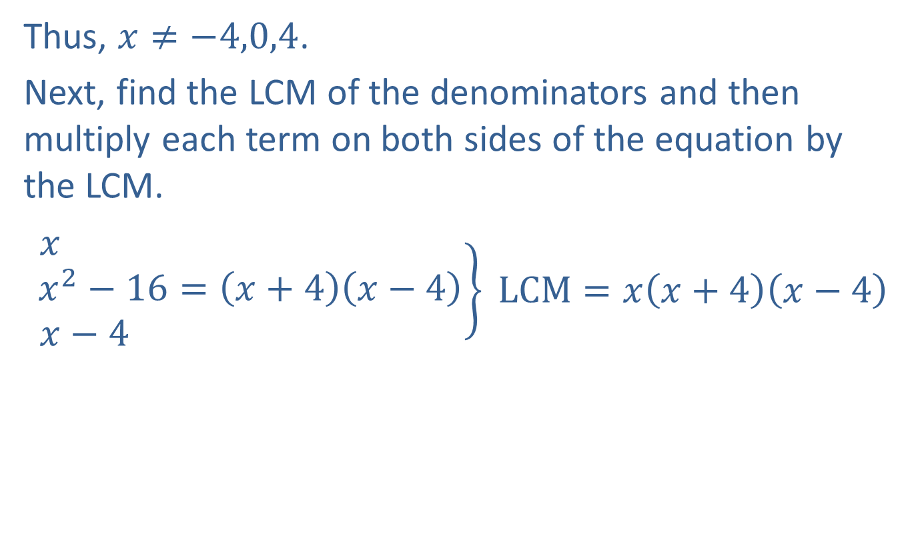
Example 2: Solving Equations Involving Rational Expressions (cont.)
​Thus, $x≠−4,0,4$.
​Next, find the LCM of the denominators and then multiply each term on both sides of the equation by the LCM.
​$\left.\begin{aligned}x \\ x^{2}−16=\left(x+4\right)\left(x−4\right) \\ x−4 \end{aligned}\right\} LCM=x\left(x+4\right)\left(x−4\right)$
​

Slide 14
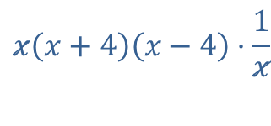
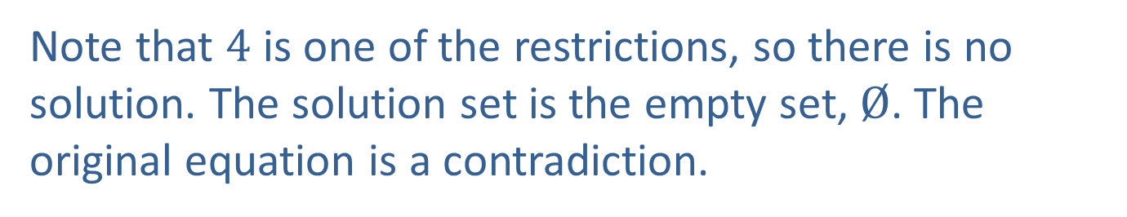
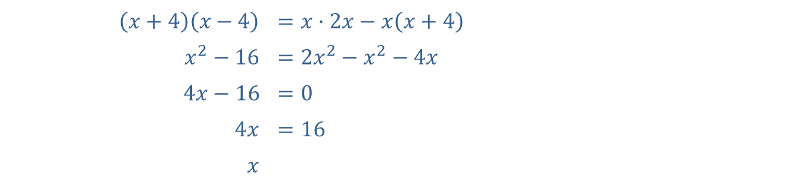

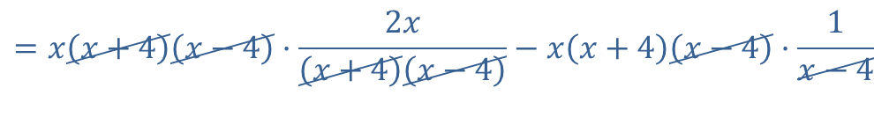
Example 2: Solving Equations Involving Rational Expressions (cont.)
$$x\left(x+4\right)\left(x−4\right)·\frac{1}{x}$$
$$=x\left(x+4\right)\left(x−4\right)·\frac{2x}{\left(x+4\right)\left(x−4\right)}−x\left(x+4\right)\left(x−4\right)·\frac{1}{x−4}$$
$$x≠−4,0,4$$
​$\left(x+4\right)\left(x−4\right)$ | ​$=x·2x−x\left(x+4\right)$
​$x^{2}−16$ | ​$=2x^{2}−x^{2}−4x$
​$4x−16$ | ​$=0$
​$4x$ | ​$=16$
$$x$$ | ​
$$=4$$
Note that 4 is one of the restrictions, so there is no solution. The solution set is the empty set, $Ø$. The original equation is a contradiction.

Slide 15
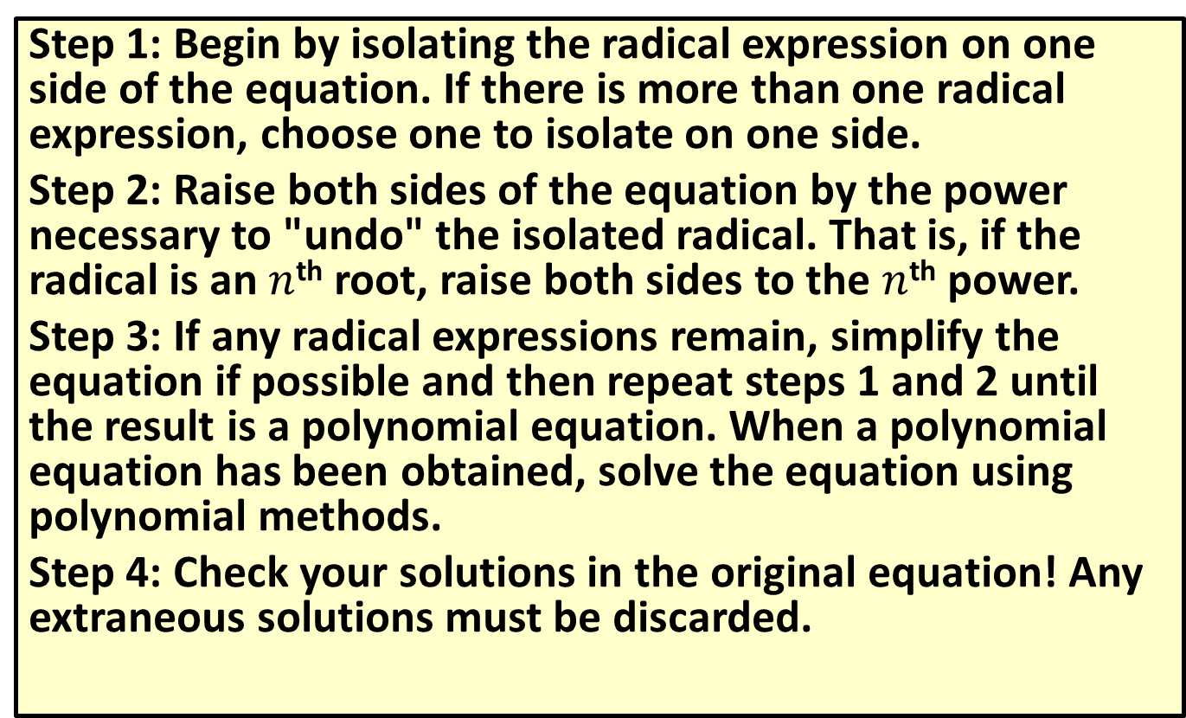
Solving Radical Equations
Step 1: Begin by isolating the radical expression on one side of the equation. If there is more than one radical expression, choose one to isolate on one side.
Step 2: Raise both sides of the equation by the power necessary to "undo" the isolated radical. That is, if the radical is an $n$^{th} root, raise both sides to the $n$^{th} power.
Step 3: If any radical expressions remain, simplify the equation if possible and then repeat steps 1 and 2 until the result is a polynomial equation. When a polynomial equation has been obtained, solve the equation using polynomial methods.
Step 4: Check your solutions in the original equation! Any extraneous solutions must be discarded.

Slide 16

Example 3: Radical Equations
Solve the following radical equations.
​$\sqrt{4−x}−2=x$
​
​

Slide 17
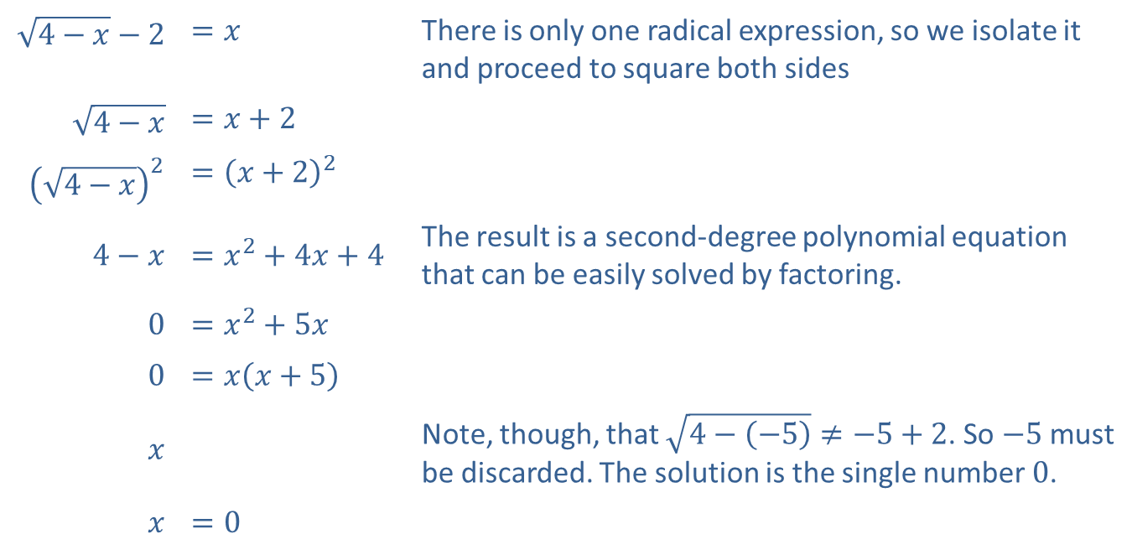
Example 3: Radical Equations (cont.)
Solution
​$\sqrt{4−x}−2$ | ​$=x$ | There is only one radical expression, so we isolate it and proceed to square both sides
​$\sqrt{4−x}$ | ​$=x+2$
​${\left(\sqrt{4−x}\right)}^{2}$ | ​$={\left(x+2\right)}^{2}$
​$4−x$ | ​$=x^{2}+4x+4$ | The result is a second-degree polynomial equation that can be easily solved by factoring.
​0 | ​$=x^{2}+5x$
​0 | ​$=x\left(x+5\right)$
$$x$$ | ​ | Note, though, that $\sqrt{4−\left(−5\right)}≠−5+2$. So $−5$ must be discarded. The solution is the single number 0.
$$x$$ | ​$=0$

Slide 18
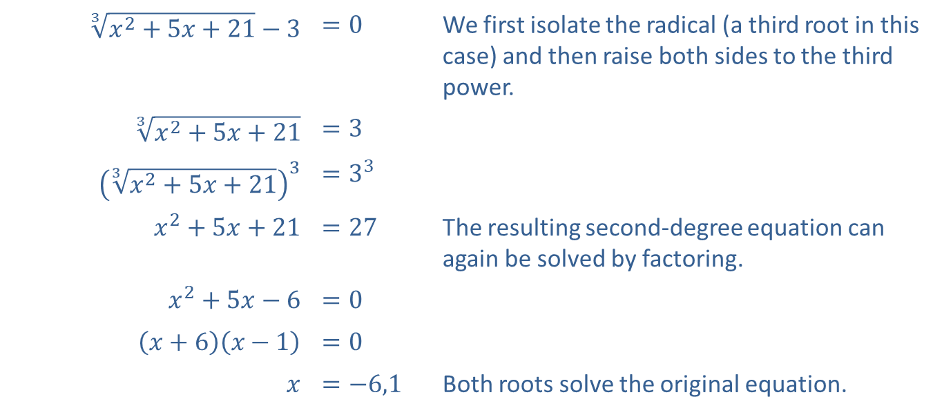

Example 3: Radical Equations (cont.)
​$\sqrt[3]{x^{2}+5x+21}−3=0$
​Solution
​
​$\sqrt[3]{x^{2}+5x+21}−3$ | ​$=0$ | We first isolate the radical (a third root in this case) and then raise both sides to the third power.
​$\sqrt[3]{x^{2}+5x+21}$ | ​$=3$
​${\left(\sqrt[3]{x^{2}+5x+21}\right)}^{3}$ | ​$=3^{3}$
​$x^{2}+5x+21$ | ​$=27$ | The resulting second-degree equation can again be solved by factoring.
​$x^{2}+5x−6$ | ​$=0$
​$\left(x+6\right)\left(x−1\right)$ | ​$=0$
$$x$$ | ​$=−6,1$ | Both roots solve the original equation.

Slide 19

Example 4: Equations with Positive Rational Exponents
Solve the following equations with rational exponents.
​$x^{\frac{3}{4}}−8=0$
​​

Slide 20
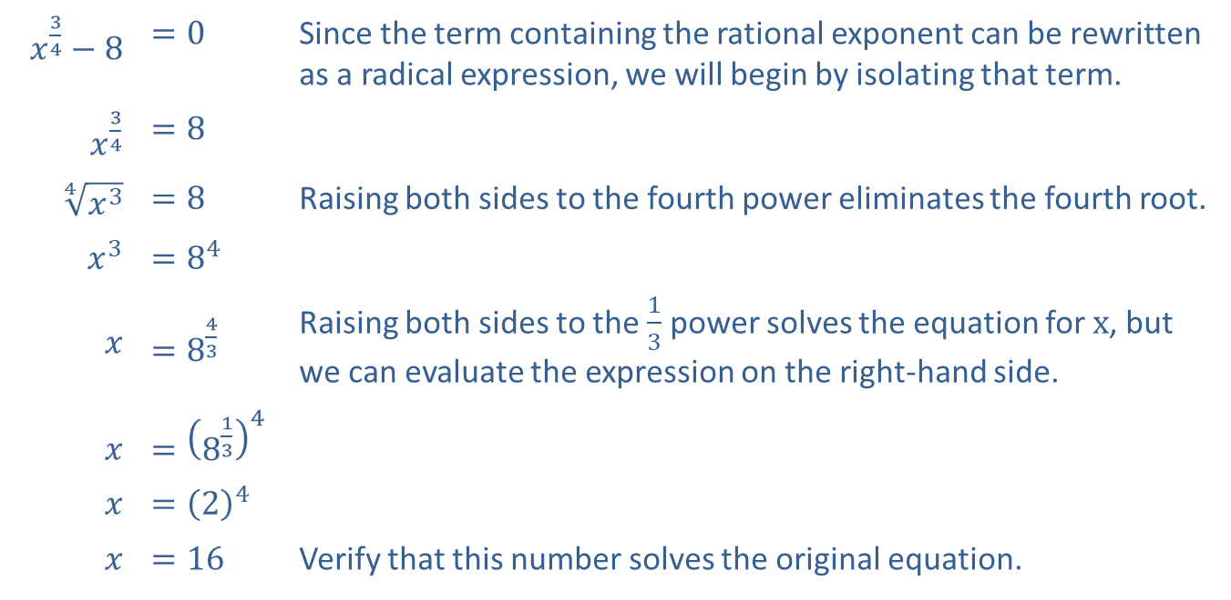
Example 4: Equations with Positive Rational Exponents (cont.)
Solution
​$x^{\frac{3}{4}}−8$ | ​$=0$ | Since the term containing the rational exponent can be rewritten as a radical expression, we will begin by isolating that term.
​$x^{\frac{3}{4}}$ | ​$=8$
​$\sqrt[4]{x^{3}}$ | ​$=8$ | Raising both sides to the fourth power eliminates the fourth root.
​$x^{3}$ | ​$=8^{4}$
$$x$$ | ​$=8^{\frac{4}{3}}$ | Raising both sides to the $\frac{1}{3}$ power solves the equation for $x$, but we can evaluate the expression on the right-hand side.
$$x$$ | ​$={\left(8^{\frac{1}{3}}\right)}^{4}$
$$x$$ | ​$={\left(2\right)}^{4}$
$$x$$ | ​$=16$ | Verify that this number solves the original equation.

Slide 21
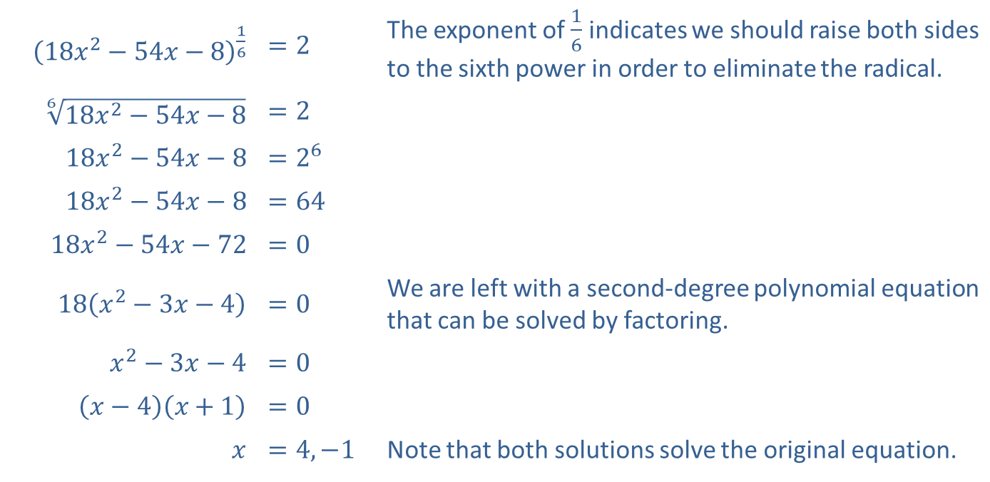

Example 4: Equations with Positive Rational Exponents (cont.)
​${\left(18x^{2}−54x−8\right)}^{\frac{1}{6}}=2$
​Solution
​
​${\left(18x^{2}−54x−8\right)}^{\frac{1}{6}}$ | ​$=2$ | The exponent of $\frac{1}{6}$ indicates we should raise both sides to the sixth power in order to eliminate the radical.
​$\sqrt[6]{18x^{2}−54x−8}$ | ​$=2$
​$18x^{2}−54x−8$ | ​$=2^{6}$
​$18x^{2}−54x−8$ | ​$=64$
​$18x^{2}−54x−72$ | ​$=0$
​$18\left(x^{2}−3x−4\right)$ | ​$=0$ | We are left with a second-degree polynomial equation that can be solved by factoring.
​$x^{2}−3x−4$ | ​$=0$
​$\left(x−4\right)\left(x+1\right)$ | ​$=0$
$$x$$ | ​$=4,−1$ | Note that both solutions solve the original equation.

