Slide 1
Section 1.1
Introduction to Functions

Slide 2
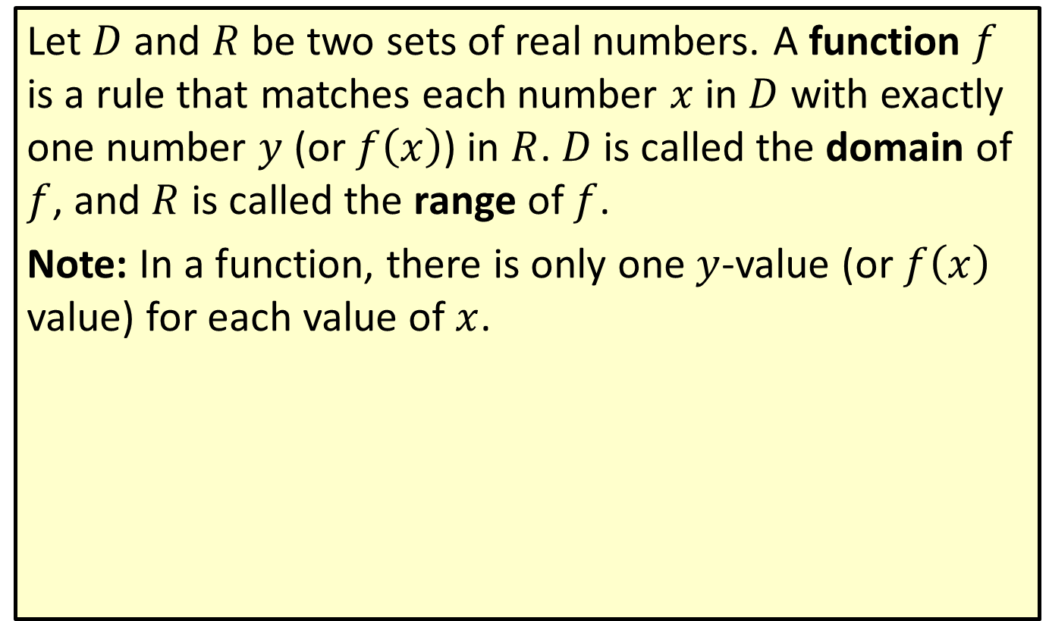
Function, Domain, and Range
Let $D$ and $R$ be two sets of real numbers. A function $f$ is a rule that matches each number $x$ in $D$ with exactly one number $y$ (or $f⁡\left(x\right)$) in $R$. $D$ is called the domain of $f$, and $R$ is called the range of $f$.
Note: In a function, there is only one $y$-value (or $f⁡\left(x\right)$ value) for each value of $x$.

Slide 3

Example 1: Function Evaluation
For the function $f\left(x\right)=x^{2}$, evaluate the following expressions.
​$f⁡\left(3\right)$
​$f⁡\left(5\right)$
​$f⁡\left(−2\right)$
The expression $f⁡\left(3\right)$ is read " f of 3".

Slide 4

Example 1: Function Evaluation (cont.)
Solution
​$f\left(3\right)=3^{2}=9$ Substitute 3 for $x$.
​$f\left(5\right)=5^{2}=25$ Substitute 5 for $x$.
​$f\left(−2\right)={\left(−2\right)}^{2}=4$ Substitute $−2$ for $x$.

Slide 5

Example 2: Function Evaluation
For $f\left(x\right)=x^{3}−2x^{2}+3x+100$, evaluate the following expressions.
​$f⁡\left(2\right)$
​$f⁡\left(a\right)$
​$f⁡\left(a+1\right)$
​$f\left(a\right)+1$

Slide 6
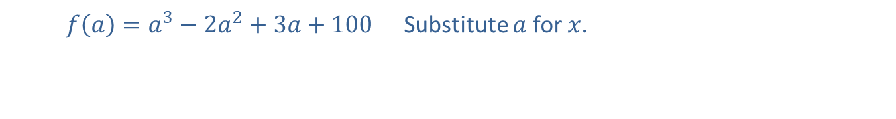
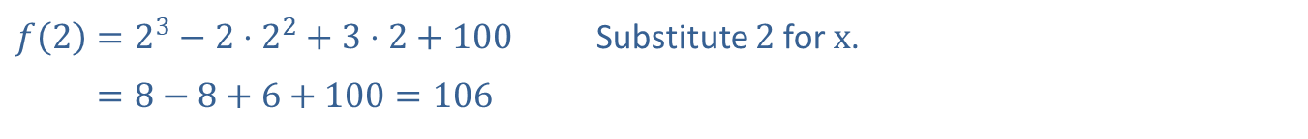
Example 2: Function Evaluation (cont.)
Solution
​
​$f\left(2\right)=2^{3}−2⋅2^{2}+3⋅2+100$ | Substitute 2 for $x$.
​𝑓⁡2=8−8+6+100=106
​$f\left(a\right)=a^{3}−2a^{2}+3a+100$ Substitute $a$ for $x$.

Slide 7
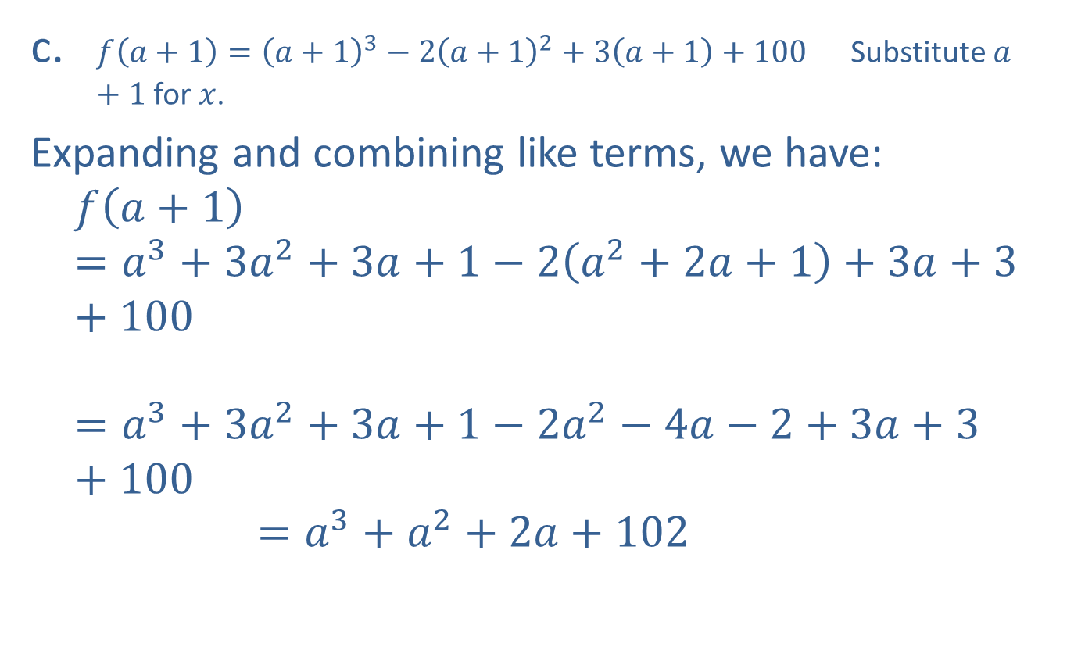
Example 2: Function Evaluation (cont.)
​$f\left(a+1\right)={\left(a+1\right)}^{3}−2{\left(a+1\right)}^{2}+3\left(a+1\right)+100$ Substitute $a+1$ for $x$.
​Expanding and combining like terms, we have:
𝑓𝑎+1=𝑎3+3𝑎2+3𝑎+1−2𝑎2+2𝑎+1+3𝑎+3+100𝑓⁡𝑎+1=𝑎3+3𝑎2+3𝑎+1−2𝑎2−4𝑎−2+3𝑎+3+100𝑓⁡𝑎+1=𝑎3+𝑎2+2𝑎+102

Slide 8
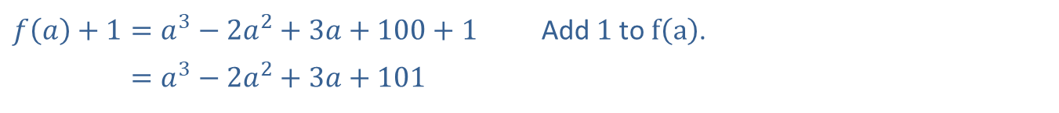
Example 2: Function Evaluation (cont.)
​​
​$f\left(a\right)+1=a^{3}−2a^{2}+3a+100+1$ | Add 1 to $f⁡\left(a\right)$.
​𝑓⁡𝑎+1=𝑎3−2𝑎2+3𝑎+101

Slide 9
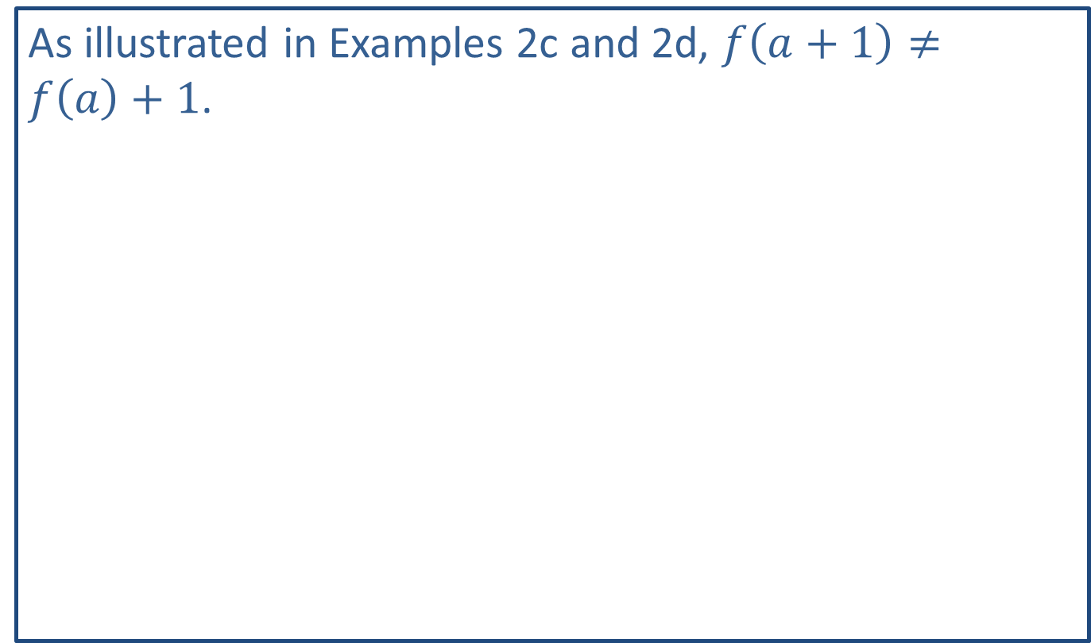
CAUTION!
As illustrated in Examples 2c and 2d, $f\left(a+1\right)≠f⁡\left(a\right)+1$.

Slide 10

Example 3: Function Evaluation
For $F\left(x\right)=x^{2}−8x$, evaluate the following expressions.
​$F\left(5\right)−F\left(2\right)$
​$F⁡\left(x+h\right)$
​$F\left(x+h\right)−F\left(x\right)$

Slide 11


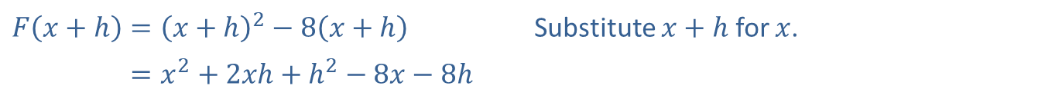
Example 3: Function Evaluation (cont.)
Solution
​We want the difference between the two function values $F⁡\left(5\right)$ and $F⁡\left(2\right)$.
​
​$F⁡\left(5\right)$ | ​$=5^{2}−8⋅5=25−40=−15$ | Substitute 5 for $x$.
​$F⁡\left(2\right)$ | ​$=2^{2}−8⋅2=4−16=−12$ | Substitute 2 for $x$.
​$F\left(5\right)−F\left(2\right)$ | ​$=−15−\left(−12\right)=−15+12=−3$ | Find the difference.
​$F\left(x+h\right)={\left(x+h\right)}^{2}−8\left(x+h\right)$ | Substitute $x+h$ for $x$.
​𝐹⁡𝑥+h=𝑥2+2𝑥h+h2−8𝑥−8h

Slide 12
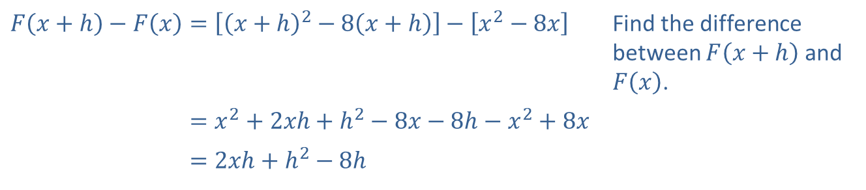
Example 3: Function Evaluation (cont.)
​
​$F\left(x+h\right)−F\left(x\right)=\left[{\left(x+h\right)}^{2}−8\left(x+h\right)\right]−\left[x^{2}−8x\right]$ | Find the difference between $F⁡\left(x+h\right)$ and $F⁡\left(x\right)$.
​𝐹⁡𝑥+h−𝐹⁡𝑥=𝑥2+2𝑥h+h2−8𝑥−8h−𝑥2+8𝑥
​𝐹⁡𝑥+h−𝐹⁡𝑥=2𝑥h+h2−8h

Slide 13
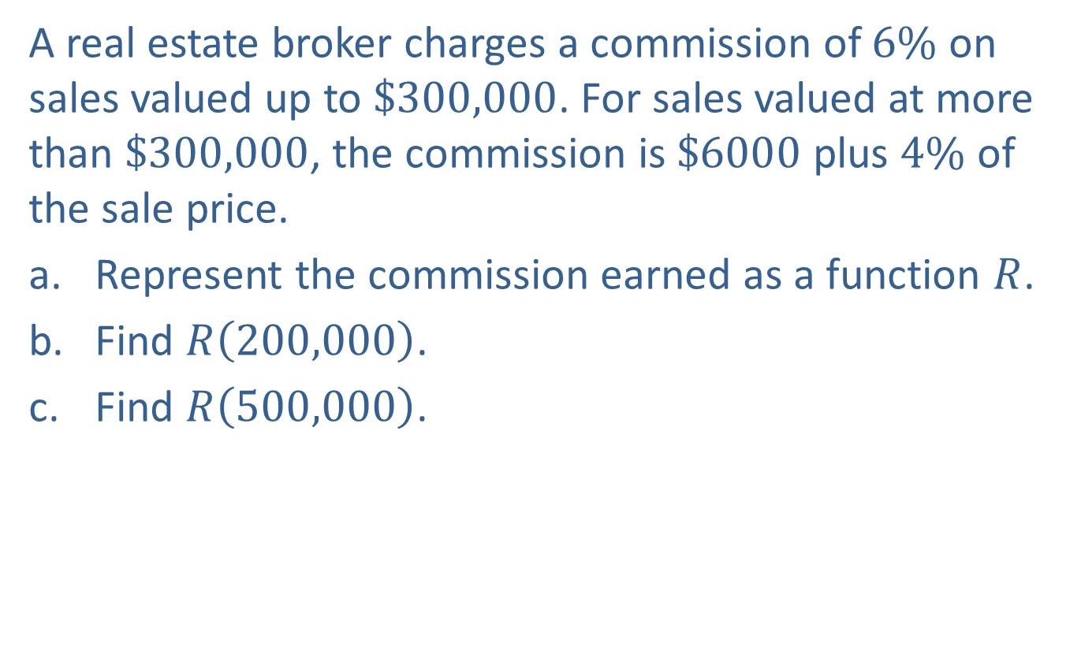
Example 4: Piecewise Function
A real estate broker charges a commission of $6\%$ on sales valued up to $\$300,000$. For sales valued at more than $\$300,000$, the commission is $\$6000$ plus $4\%$ of the sale price.
​Represent the commission earned as a function $R$.
​Find $R⁡\left(200,000\right)$.
​Find $R⁡\left(500,000\right)$.

Slide 14
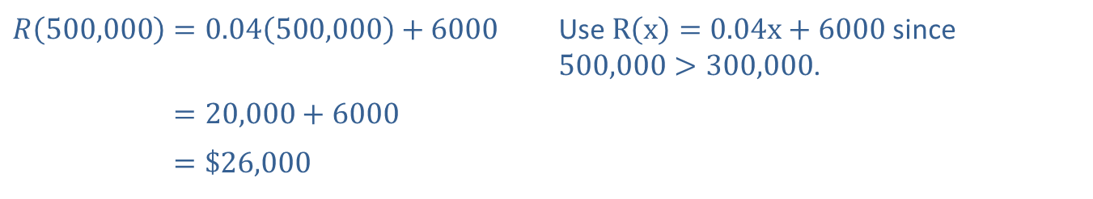
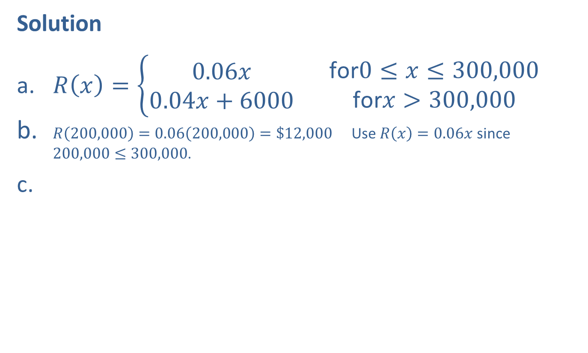
Example 4: Piecewise Function (cont.)
Solution
​$R\left(x\right)=\left\{\begin{aligned}0.06x \\ 0.04x+6000\end{aligned}\right.\begin{matrix} & \text{for}0≤x≤300,000 \\ & \text{for}x>300,000\end{matrix}$
​$R\left(200,000\right)=0.06\left(200,000\right)=\$12,000$ Use $R\left(x\right)=0.06x$ since $200,000≤300,000$.
​
​$R\left(500,000\right)=0.04\left(500,000\right)+6000$ | Use $R\left(x\right)=0.04x+6000$ since $500,000>300,000$.
​𝑅⁡500,000=20,000+6000
​𝑅⁡500,000=$26,000

Slide 15

Example 5: Domain
Find the domain of each of the following functions.
​$f\left(x\right)=\frac{1}{x−2}$
​$h\left(x\right)=\sqrt{x−2}$

Slide 16
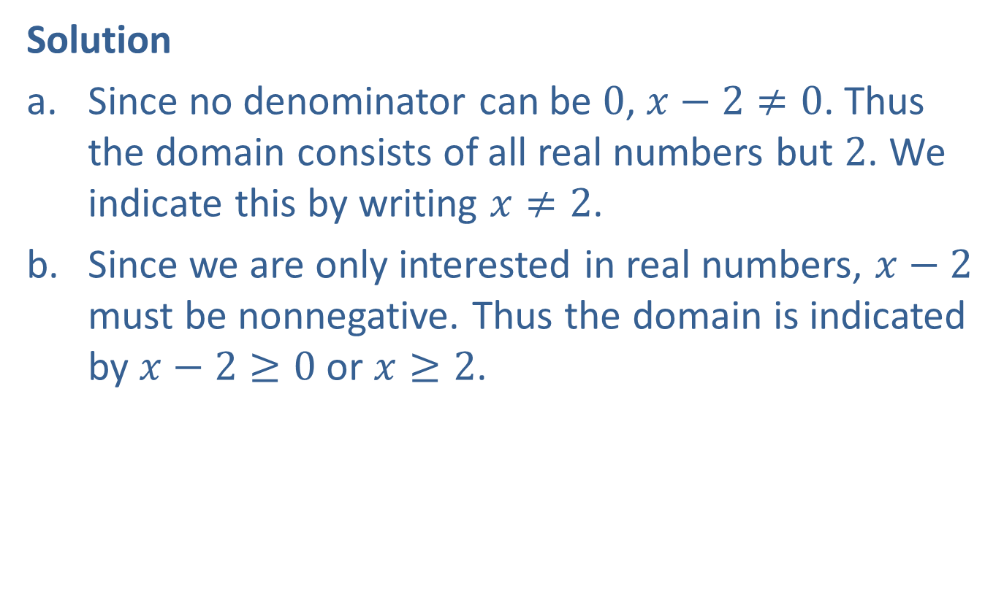
Example 5: Domain (cont.)
Solution
​Since no denominator can be 0, $x−2≠0$. Thus the domain consists of all real numbers but 2. We indicate this by writing $x≠2$.
​Since we are only interested in real numbers, $x−2$ must be nonnegative. Thus the domain is indicated by $x−2≥0$ or $x≥2$.

Slide 17
Vertical Line Test
If any vertical line intersects a graph at more than one point, then the graph does not represent a function.

Slide 18
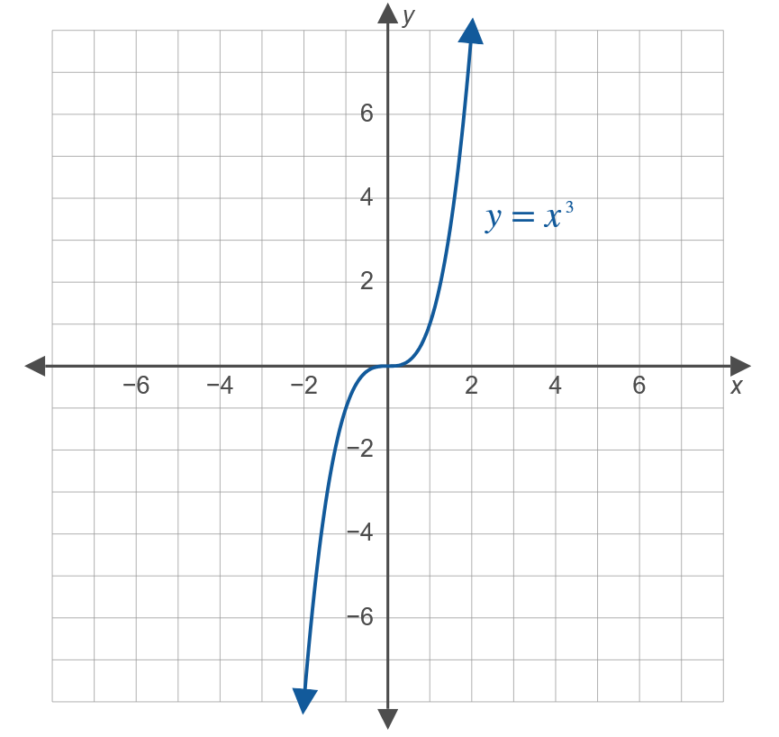
Example 6: Vertical Line Test
Use the vertical line test to determine whether or not each of the following graphs is a function.
​

Slide 19

Example 6: Vertical Line Test (cont.)
​Solution
​The equation $y=x^{3}$ represents a function (which can also be written as $f\left(x\right)=x^{3}$). No vertical line can intersect the graph in more than one point.
​

Slide 20
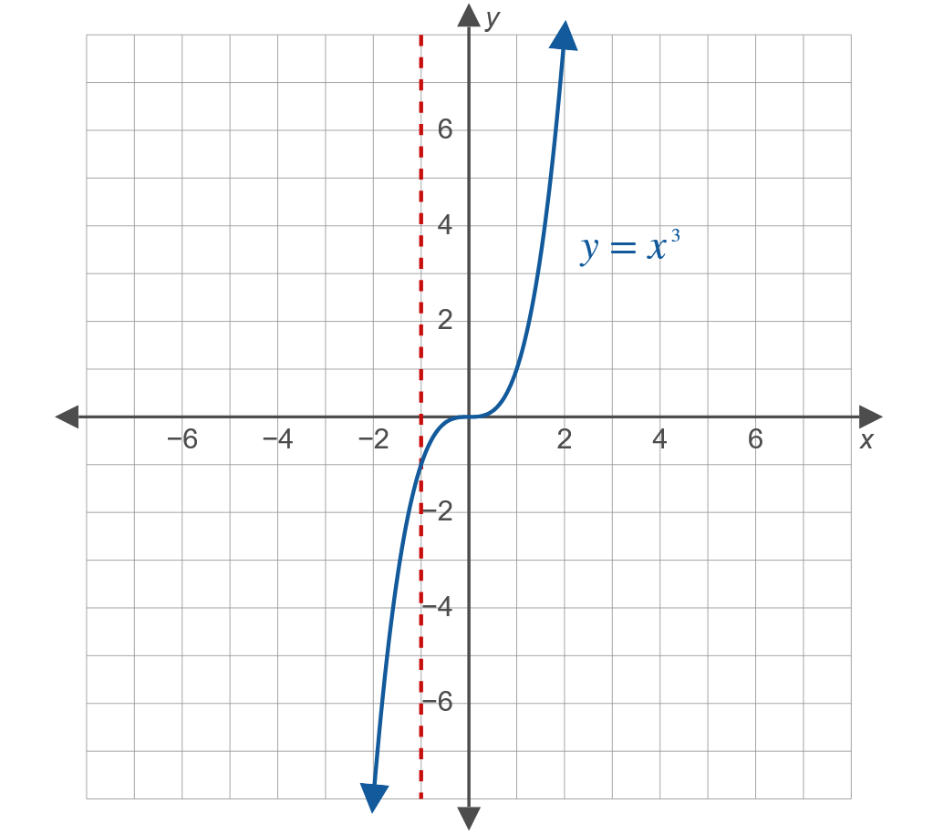
Example 6: Vertical Line Test (cont.)

Slide 21
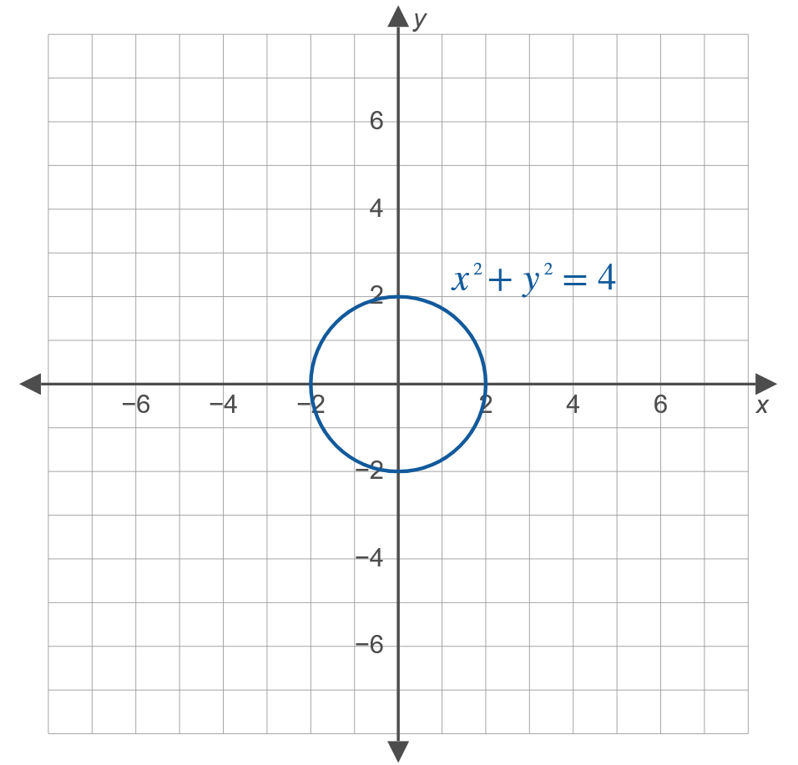
Example 6: Vertical Line Test (cont.)
​

Slide 22

Example 6: Vertical Line Test (cont.)
​Solution
​The graph of $x^{2}+y^{2}=4$ is a circle. The graph shows that the equation does not represent a function. Vertical lines can be drawn that intersect the graph in more than one point.
​

Slide 23
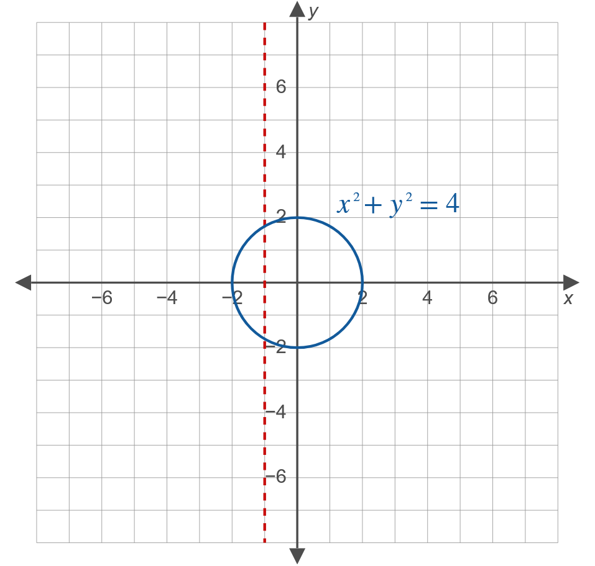
Example 6: Vertical Line Test (cont.)

