Slide 1
Section 1.2
Operations with Functions

Slide 2


Example 1: Recognizing the Parts of a Function
Given $f\left(x\right)=x^{2}+6x+8$, rewrite $f⁡\left(x\right)$ as a sum of two functions, one of which is linear.
Solution
Let $h\left(x\right)=x^{2}$ and $g\left(x\right)=6x+8$. Then $f\left(x\right)=h\left(x\right)+g\left(x\right)$. The function $g⁡\left(x\right)$ is called the "linear part" of $f⁡\left(x\right)$ and $h⁡\left(x\right)$ is called the "quadratic part" of $f⁡\left(x\right)$.

Slide 3
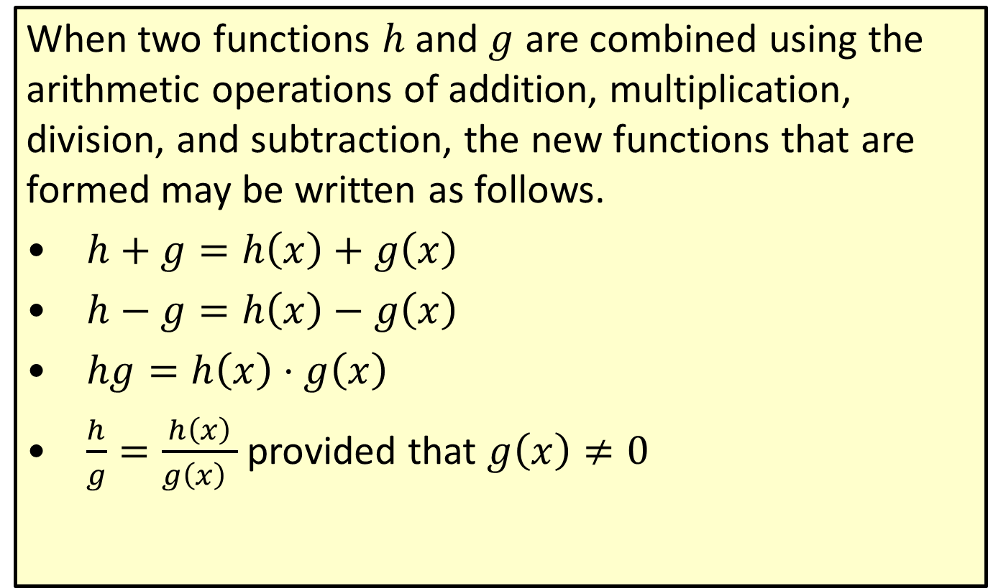
Combining Functions Using Arithmetic Operations
When two functions $h$ and $g$ are combined using the arithmetic operations of addition, multiplication, division, and subtraction, the new functions that are formed may be written as follows.
​$h+g=h\left(x\right)+g\left(x\right)$
​$h−g=h\left(x\right)−g\left(x\right)$
​$hg=h\left(x\right)⋅g\left(x\right)$
​$\frac{h}{g}=\frac{h\left(x\right)}{g{{\left(x\right)}^{ }}}$ provided that $g⁡\left(x\right)≠0$
′

Slide 4
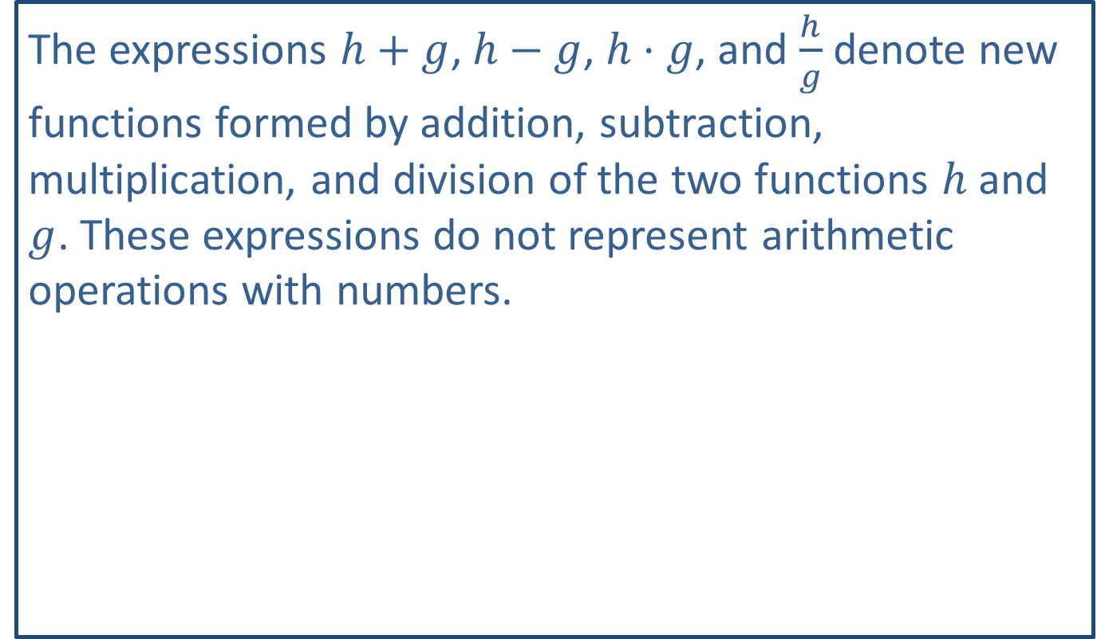
CAUTION
The expressions $h+g$, $h−g$, $h⋅g$, and $\frac{h}{g}$ denote new functions formed by addition, subtraction, multiplication, and division of the two functions $h$ and $g$. These expressions do not represent arithmetic operations with numbers.

Slide 5
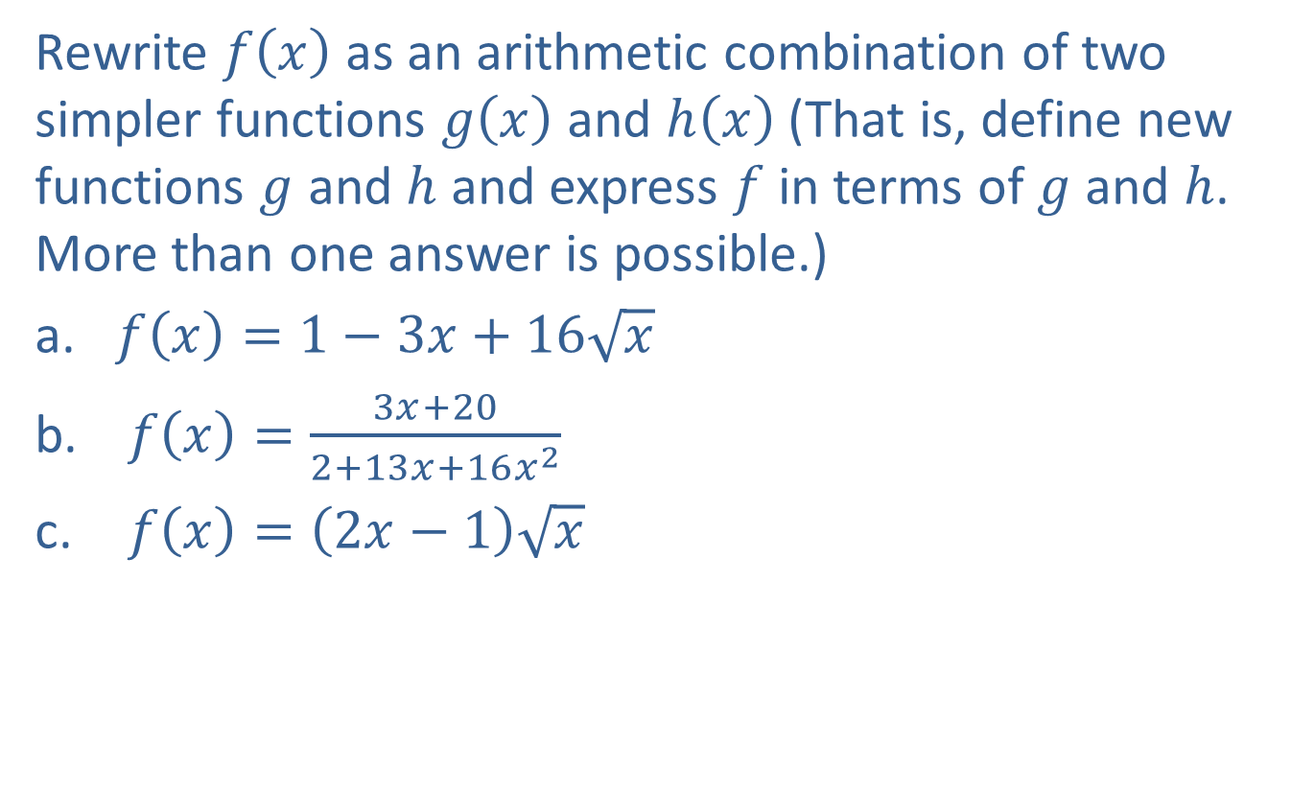
Example 2: Decomposition of a Function
Rewrite $f⁡\left(x\right)$ as an arithmetic combination of two simpler functions $g⁡\left(x\right)$ and $h⁡\left(x\right)$ (That is, define new functions $g$ and $h$ and express $f$ in terms of $g$ and $h$. More than one answer is possible.)
​$f\left(x\right)=1−3x+16\sqrt{x}$
​ $f\left(x\right)=\frac{3x+20}{2+13x+16x^{2}}$
​ $f\left(x\right)=\left(2x−1\right)\sqrt{x}$

Slide 6
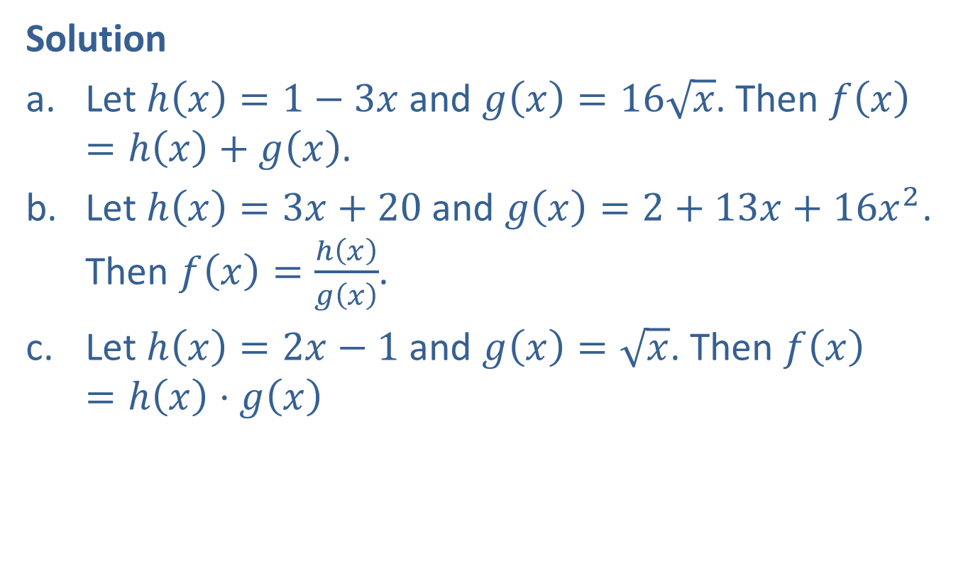
Example 2: Decomposition of a Function (cont.)
Solution
​Let $h\left(x\right)=1−3x$ and $g\left(x\right)=16\sqrt{x}$. Then $f\left(x\right)=h\left(x\right)+g\left(x\right)$.
​Let $h\left(x\right)=3x+20$ and $g\left(x\right)=2+13x+16x^{2}$. Then $f\left(x\right)=\frac{h\left(x\right)}{g\left(x\right)}$.
​Let $h\left(x\right)=2x−1$ and $g\left(x\right)=\sqrt{x}$. Then $f\left(x\right)=h\left(x\right)⋅g\left(x\right)$

Slide 7
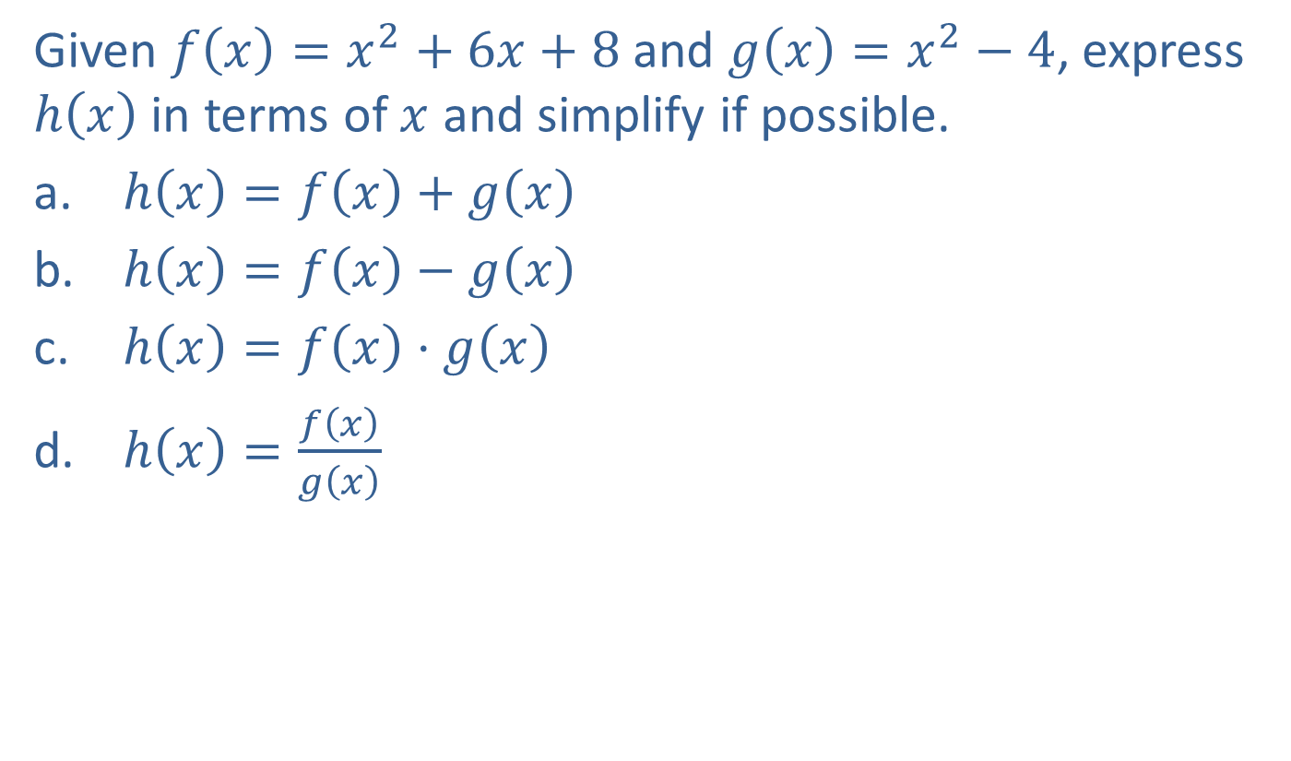
Example 3: Combining Functions Using Arithmetic Operations
Given $f\left(x\right)=x^{2}+6x+8$ and $g\left(x\right)=x^{2}−4$, express $h⁡\left(x\right)$ in terms of $x$ and simplify if possible.
​ $h\left(x\right)=f\left(x\right)+g\left(x\right)$
​ $h\left(x\right)=f\left(x\right)−g\left(x\right)$
​ $h\left(x\right)=f\left(x\right)⋅g\left(x\right)$
​ $h\left(x\right)=\frac{f\left(x\right)}{g\left(x\right)}$

Slide 8
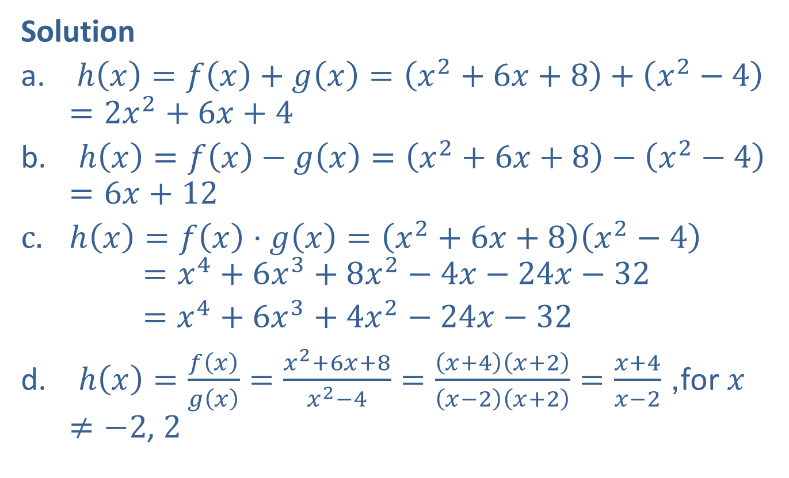
Example 3: Combining Functions Using Arithmetic Operations (cont.)
Solution
​ $h\left(x\right)=f\left(x\right)+g\left(x\right)=\left(x^{2}+6x+8\right)+\left(x^{2}−4\right)=2x^{2}+6x+4$
​ $h\left(x\right)=f\left(x\right)−g\left(x\right)=\left(x^{2}+6x+8\right)−\left(x^{2}−4\right)=6x+12$
$h\left(x\right)=f\left(x\right)⋅g\left(x\right)=\left(x^{2}+6x+8\right)\left(x^{2}−4\right)$
$=x^{4}+6x^{3}+8x^{2}−4x−24x−32$
$=x^{4}+6x^{3}+4x^{2}−24x−32$
​ $h\left(x\right)=\frac{f\left(x\right)}{g\left(x\right)}=\frac{x^{2}+6x+8}{x^{2}−4}=\frac{\left(x+4\right)\left(x+2\right)}{\left(x−2\right)\left(x+2\right)}=\frac{x+4}{x−2}$, for $x≠−2$, 2

Slide 9
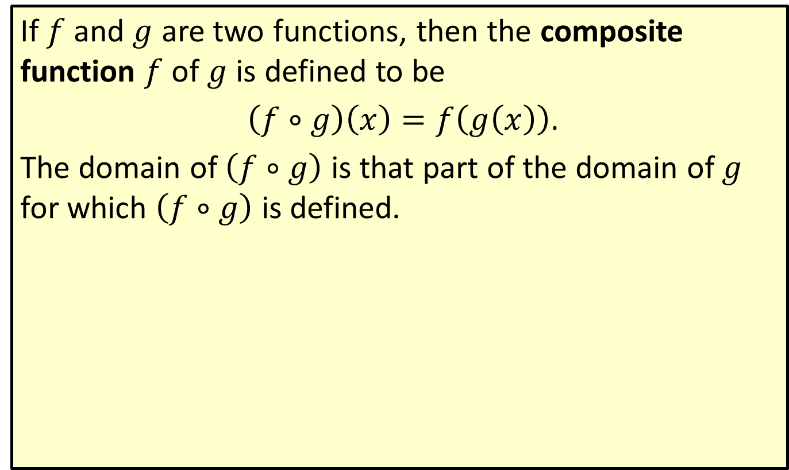
Composite Functions
If $f$ and $g$ are two functions, then the composite function $f$ of $g$ is defined to be
$\left(f∘g\right)\left(x\right)=f\left(g\left(x\right)\right)$.
The domain of $\left(f∘g\right)$ is that part of the domain of $g$ for which $\left(f∘g\right)$ is defined.

Slide 10

Example 4: Composite Functions
For the functions $f\left(x\right)=\sqrt{x−1}$ and $g\left(x\right)=x^{2}+2$, form the following composite functions.
​$f⁡\left(g\left(x\right)\right)$
​$g⁡\left(f\left(x\right)\right)$

Slide 11
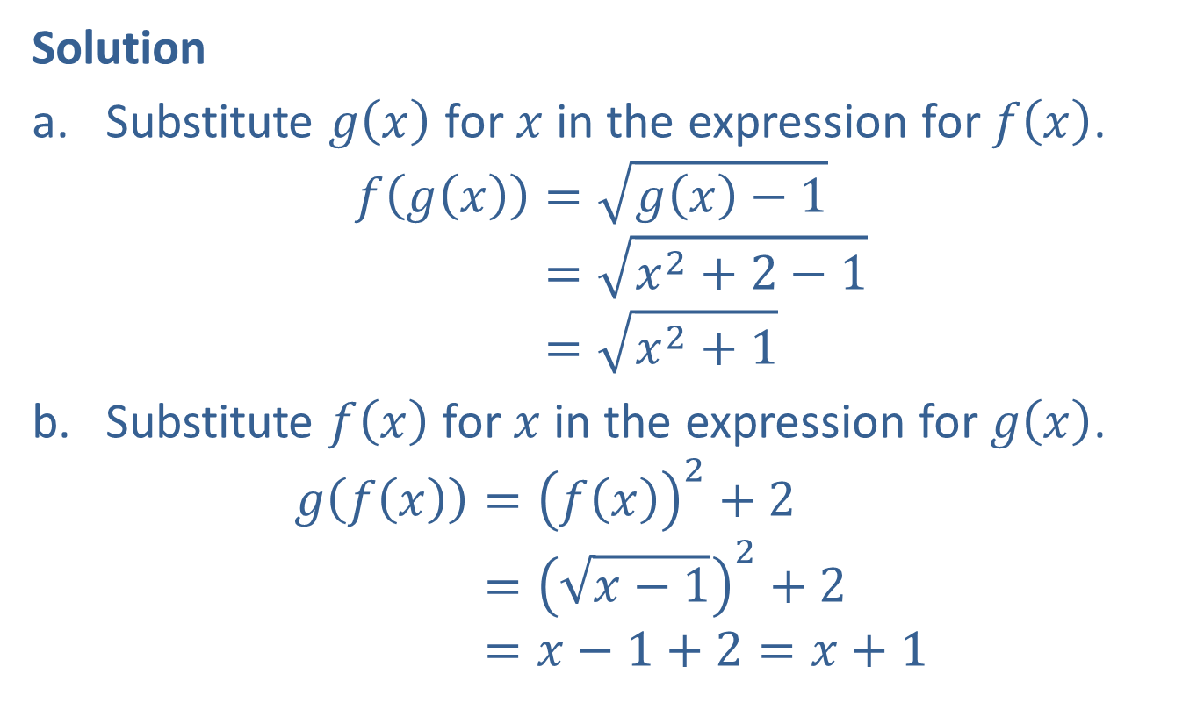
Example 4: Composite Functions (cont.)
Solution
​Substitute $g⁡\left(x\right)$ for $x$ in the expression for $f⁡\left(x\right)$.
𝑓⁡𝑔𝑥=𝑔⁡𝑥−1𝑓⁡𝑔𝑥=𝑥2+2−1𝑓⁡𝑔𝑥=𝑥2+1
​Substitute $f⁡\left(x\right)$ for $x$ in the expression for $g⁡\left(x\right)$.
𝑔⁡𝑓𝑥=𝑓⁡𝑥2+2𝑔⁡𝑓𝑥=𝑥−12+2𝑔⁡𝑓𝑥=𝑥−1+2=𝑥+1

Slide 12
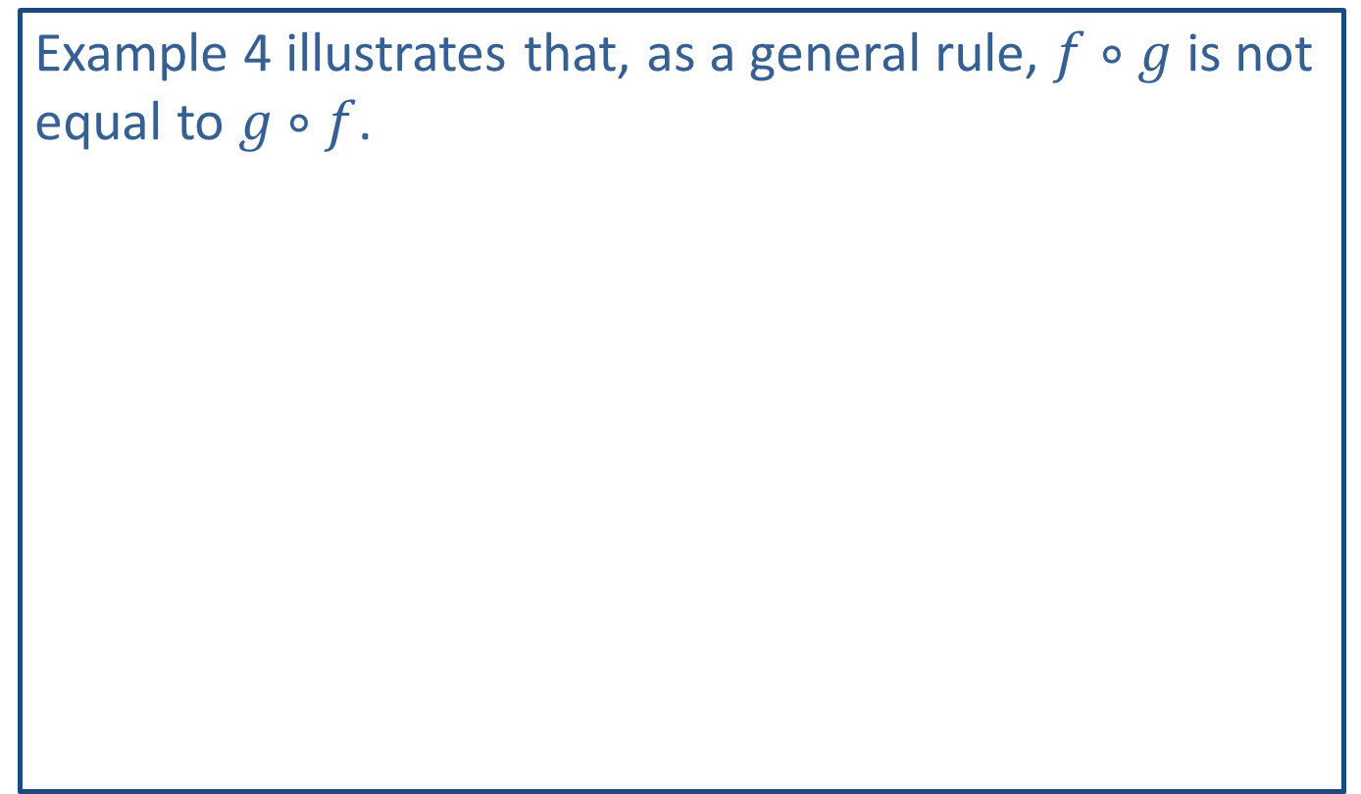
CAUTION!
Example 4 illustrates that, as a general rule, $f∘g$ is not equal to $g∘f$.

Slide 13

Example 5: Composite Functions
For the functions $F\left(x\right)=2x^{2}+x$ and $H\left(x\right)=3x$, find the following composite functions.
​$F⁡\left(H\left(x\right)\right)$
​$H⁡\left(F\left(x\right)\right)$

Slide 14

Example 5: Composite Functions (cont.)
Solution
$F\left(H\left(x\right)\right)=2⋅{\left(H⁡\left(x\right)\right)}^{2}+H⁡\left(x\right)$
𝐹⁡𝐻𝑥=23𝑥2+3𝑥
𝐹⁡𝐻𝑥=18𝑥2+3𝑥
$H\left(F\left(x\right)\right)=3⋅F\left(x\right)$
𝐻⁡𝐹𝑥=32𝑥2+𝑥
𝐻⁡𝐹𝑥=6𝑥2+3𝑥

Slide 15
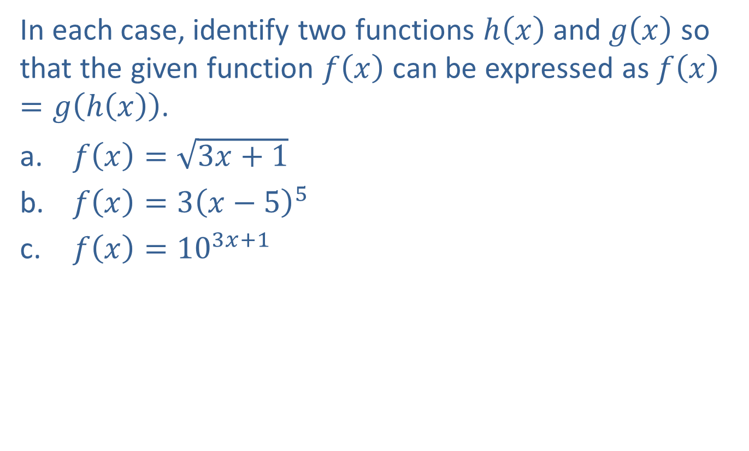
Example 6: Composite Functions
In each case, identify two functions $h⁡\left(x\right)$ and $g⁡\left(x\right)$ so that the given function $f⁡\left(x\right)$ can be expressed as $f\left(x\right)=g\left(h\left(x\right)\right)$.
​ $f\left(x\right)=\sqrt{3x+1}$
​ $f\left(x\right)=3{\left(x−5\right)}^{5}$
​ $f\left(x\right)={10}^{3x+1}$

Slide 16
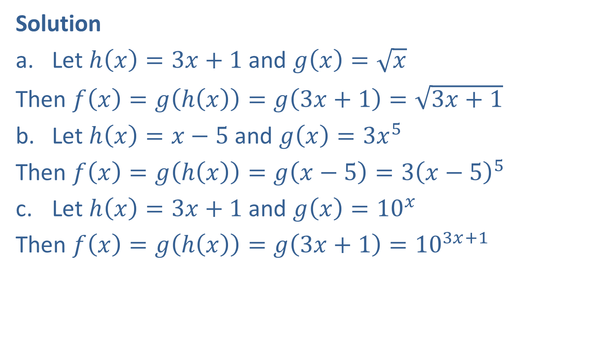
Example 6: Composite Functions (cont.)
Solution
​Let $h\left(x\right)=3x+1$ and $g\left(x\right)=\sqrt{x}$
​Then $f\left(x\right)=g\left(h\left(x\right)\right)=g\left(3x+1\right)=\sqrt{3x+1}$
​Let $h\left(x\right)=x−5$ and $g\left(x\right)=3x^{5}$
​Then $f\left(x\right)=g\left(h\left(x\right)\right)=g\left(x−5\right)=3{\left(x−5\right)}^{5}$
​Let $h\left(x\right)=3x+1$ and $g\left(x\right)={10}^{x}$
​Then $f\left(x\right)=g\left(h\left(x\right)\right)=g\left(3x+1\right)={10}^{3x+1}$

Slide 17
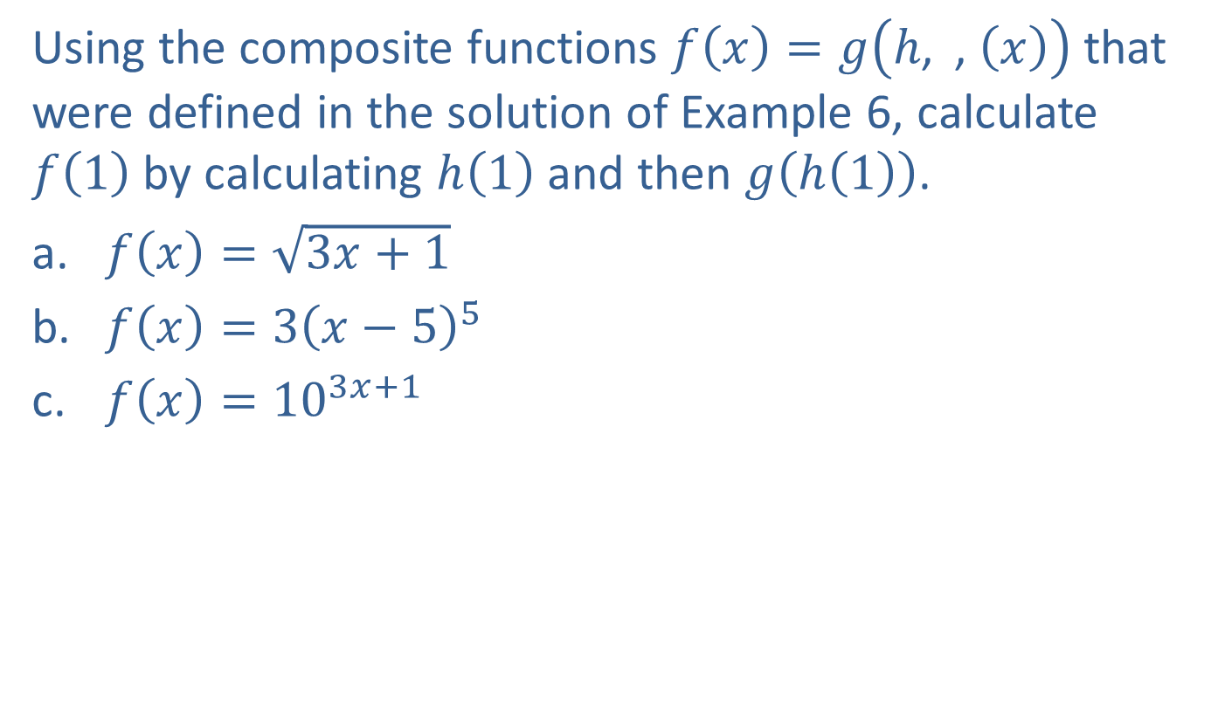
Example 7: Evaluating a Function
Using the composite functions $f\left(x\right)=g\left(h\text{, }⁡\text{, }\left(x\right)\right)$ that were defined in the solution of Example 6, calculate $f⁡\left(1\right)$ by calculating $h⁡\left(1\right)$ and then $g⁡\left(h\left(1\right)\right)$.
​$f\left(x\right)=\sqrt{3x+1}$
​$f\left(x\right)=3{\left(x−5\right)}^{5}$
​$f\left(x\right)={10}^{3x+1}$

Slide 18
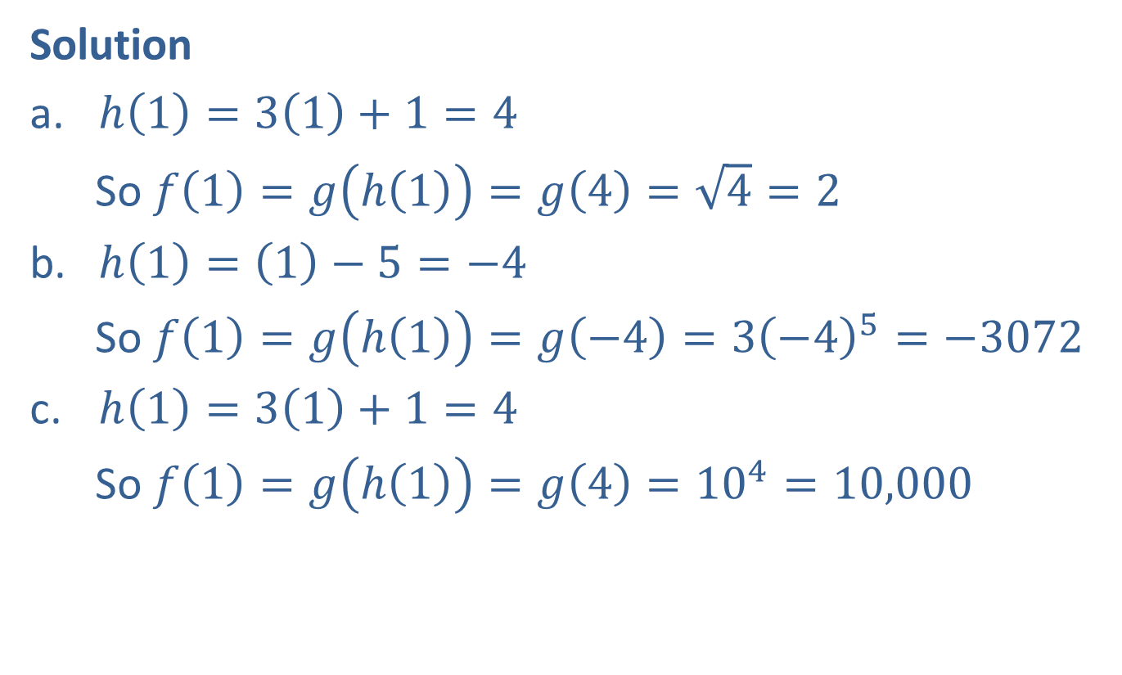
Example 7: Evaluating a Function (cont.)
Solution
​$h\left(1\right)=3\left(1\right)+1=4$
​ So $f\left(1\right)=g\left(h⁡\left(1\right)\right)=g\left(4\right)=\sqrt{4}=2$
​$h\left(1\right)=\left(1\right)−5=−4$
​So $f\left(1\right)=g\left(h⁡\left(1\right)\right)=g\left(−4\right)=3{\left(−4\right)}^{5}=−3072$
​$h\left(1\right)=3\left(1\right)+1=4$
​So $f\left(1\right)=g\left(h⁡\left(1\right)\right)=g\left(4\right)={10}^{4}=10,000$

Slide 19
NOTE
The difference quotient will appear repeatedly in later sections, and we emphasize that difference quotients are slopes.

Slide 20
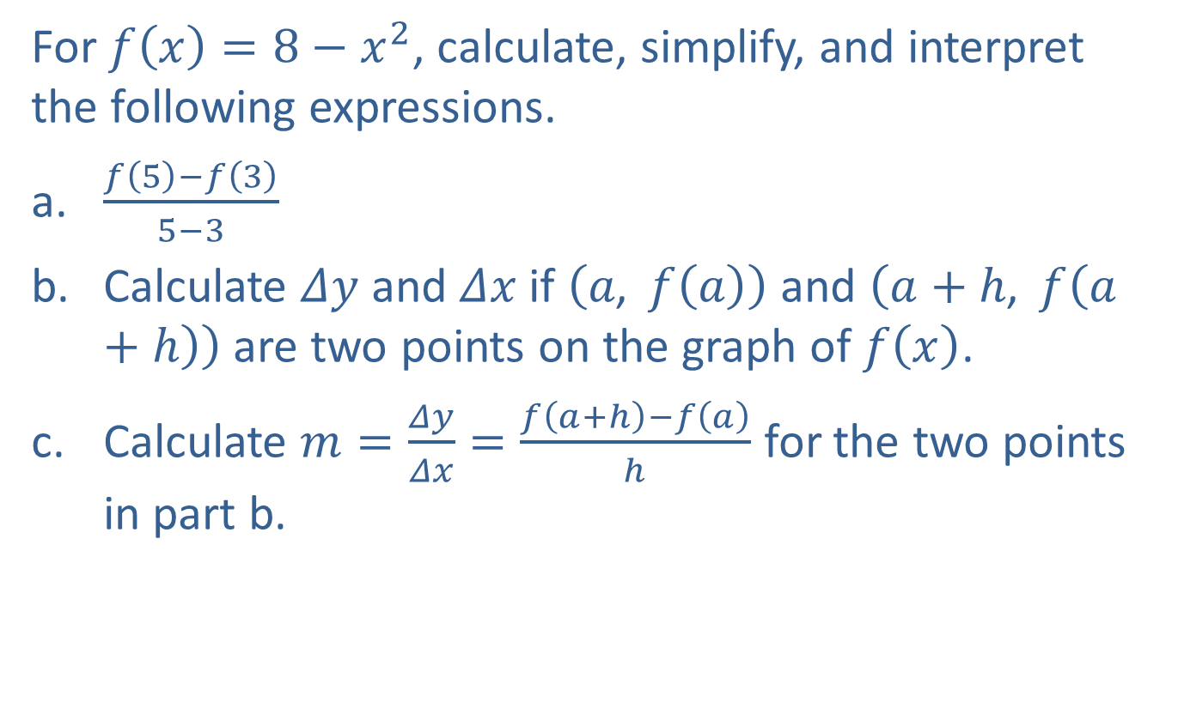
Example 8 :The Difference Quotient
For $f\left(x\right)=8−x^{2}$, calculate, simplify, and interpret the following expressions.
​$\frac{f\left(5\right)−f\left(3\right)}{5−3}$
​Calculate $Δy$ and $Δx$ if $\left(a\text{, }f\left(a\right)\right)$ and $\left(a+h\text{, }f\left(a+h\right)\right)$ are two points on the graph of $f⁡\left(x\right)$.
​Calculate $m=\frac{Δy}{Δx}=\frac{f\left(a+h\right)−f\left(a\right)}{h}$ for the two points in part b.

Slide 21
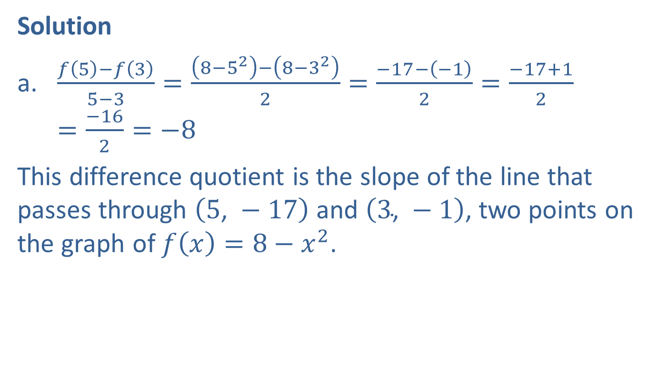
Example 8 :The Difference Quotient (cont.)
Solution
​$\frac{f\left(5\right)−f\left(3\right)}{5−3}=\frac{\left(8−5^{2}\right)−\left(8−3^{2}\right)}{2}=\frac{−17−\left(−1\right)}{2}=\frac{−17+1}{2}=\frac{−16}{2}=−8$
​This difference quotient is the slope of the line that passes through $\left(5\text{, }−17\right)$ and $\left(3\text{, }−1\right)$, two points on the graph of $f\left(x\right)=8−x^{2}$.

Slide 22
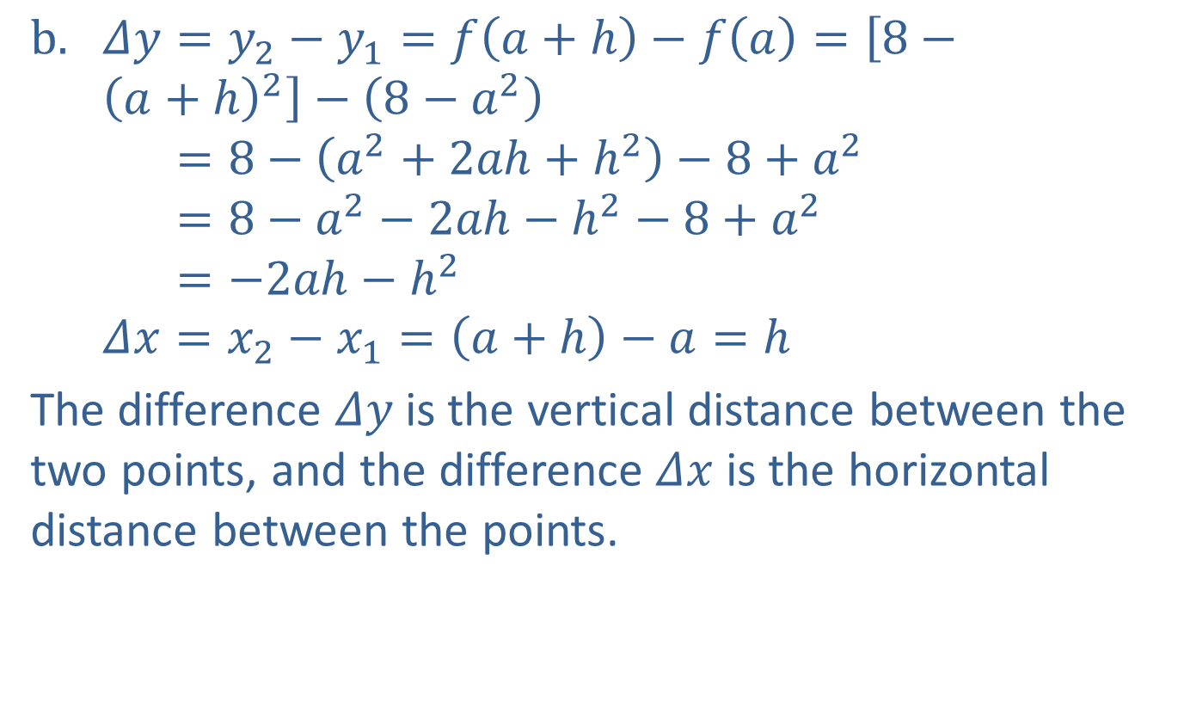
Example 8 :The Difference Quotient (cont.)
$Δy=y_{2}−y_{1}=f\left(a+h\right)−f\left(a\right)=\left[8−{\left(a+h\right)}^{2}\right]−\left(8−a^{2}\right)$
𝛥𝑦=8−𝑎2+2𝑎h+h2−8+𝑎2
𝛥𝑦=8−𝑎2−2𝑎h−h2−8+𝑎2
𝛥𝑦=−2𝑎h−h2
$Δx=x_{2}−x_{1}=\left(a+h\right)−a=h$
​The difference $Δy$ is the vertical distance between the two points, and the difference $Δx$ is the horizontal distance between the points.

Slide 23
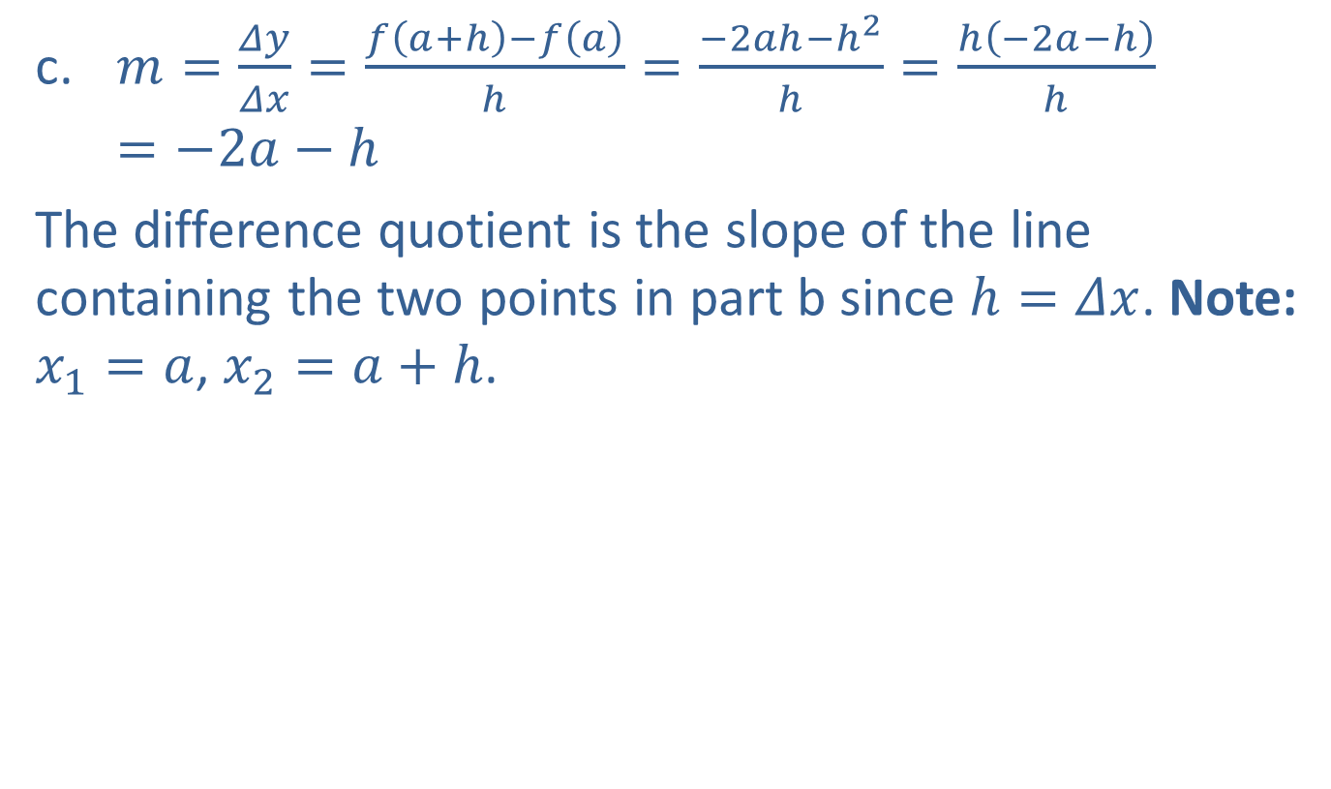
Example 8 :The Difference Quotient (cont.)
​$m=\frac{Δy}{Δx}=\frac{f\left(a+h\right)−f\left(a\right)}{h}=\frac{−2ah−h^{2}}{h}=\frac{h\left(−2a−h\right)}{h}=−2a−h$
​The difference quotient is the slope of the line containing the two points in part b since $h=Δx$. Note: $x_{1}=a$, $x_{2}=a+h$.

