Slide 1
Section 1.3
Functions and Models

Slide 2
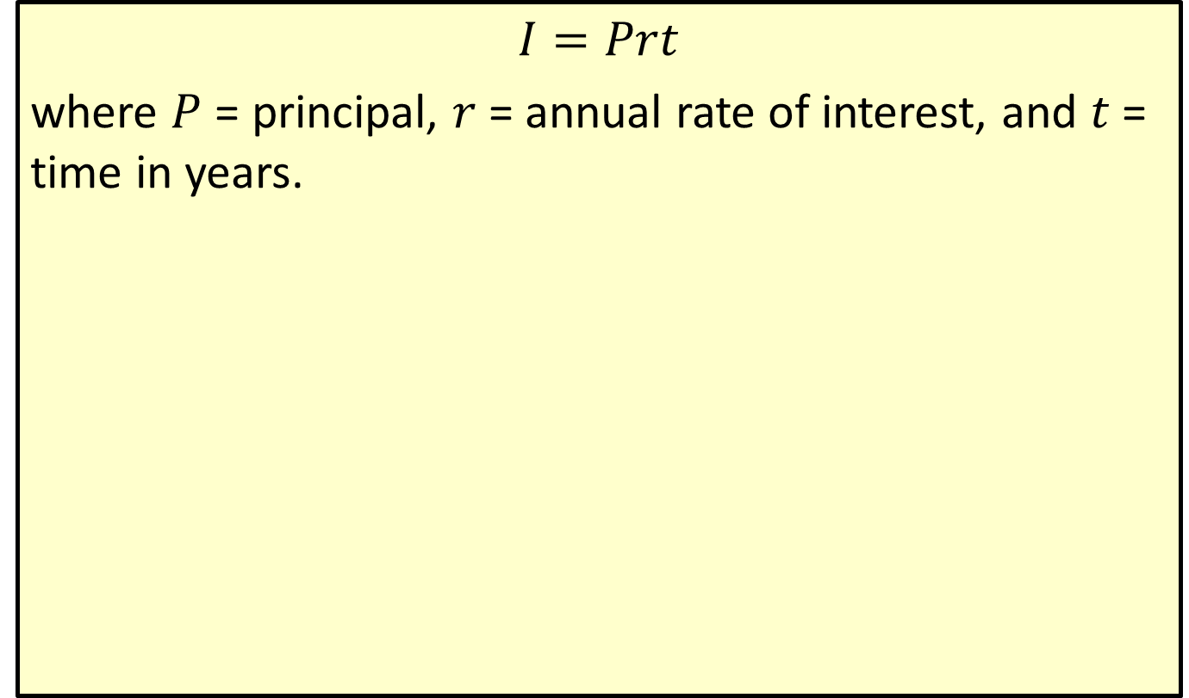
Simple Interest
$$I=Prt$$
where $P$ = principal, $r$ = annual rate of interest, and $t$ = time in years.

Slide 3
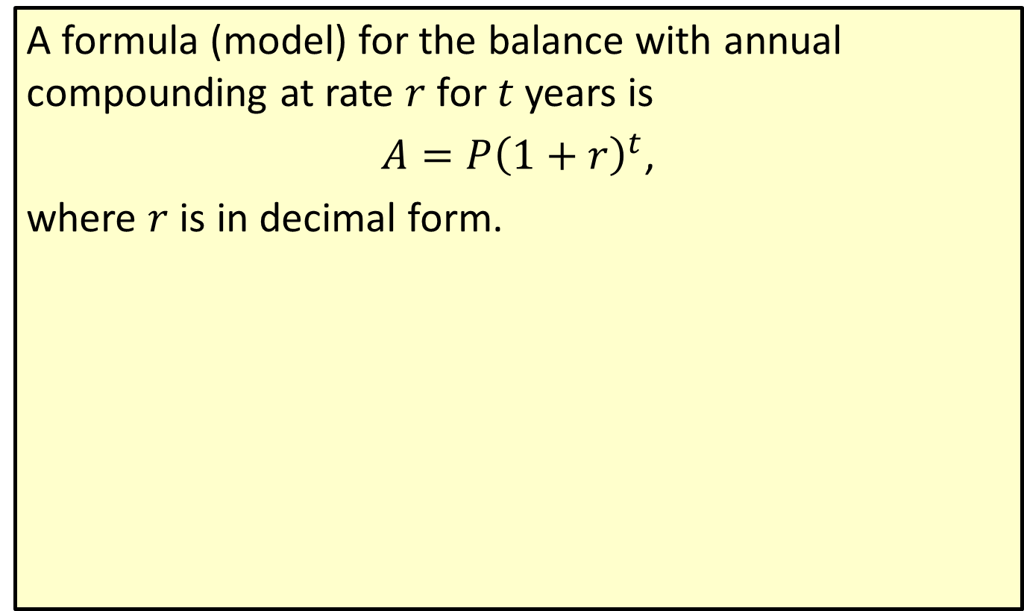
Compound Interest
A formula (model) for the balance with annual compounding at rate $r$ for $t$ years is
$A=P{\left(1+r\right)}^{t}$,
where $r$ is in decimal form.

Slide 4
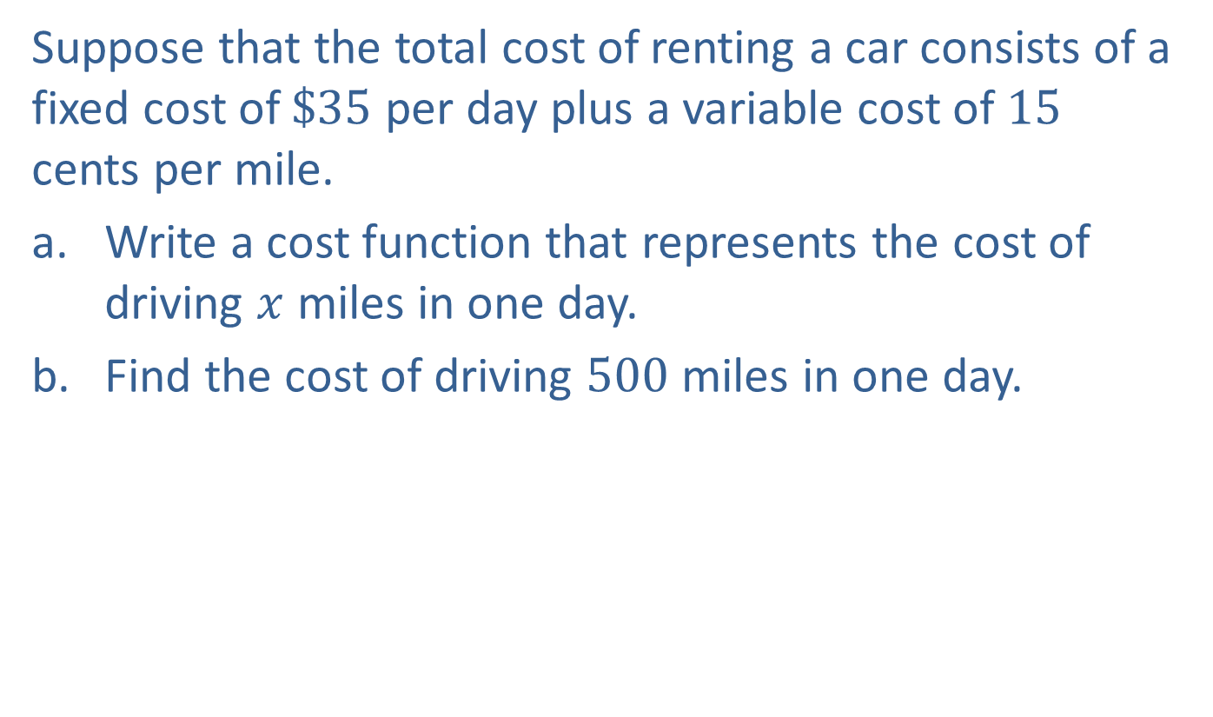
Example 1: Car Rental
Suppose that the total cost of renting a car consists of a fixed cost of $\$35$ per day plus a variable cost of 15 cents per mile.
​Write a cost function that represents the cost of driving $x$ miles in one day.
​Find the cost of driving 500 miles in one day.

Slide 5
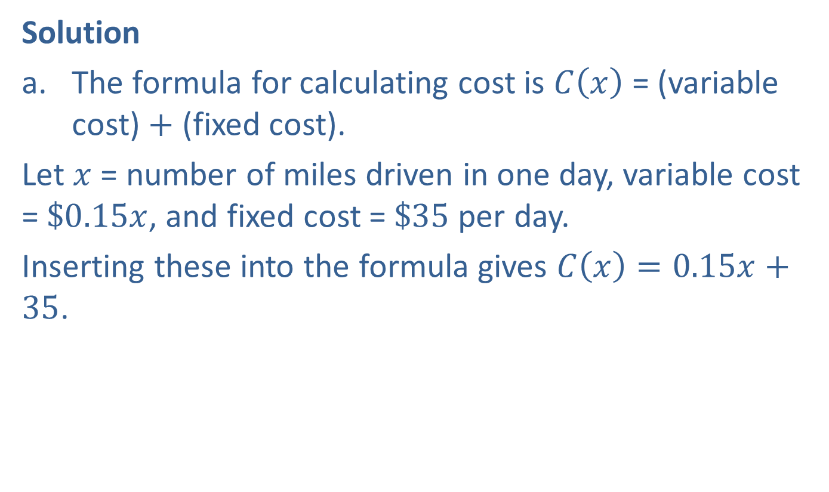
Example 1: Car Rental (cont.)
Solution
​The formula for calculating cost is $C⁡\left(x\right)$ = (variable cost) + (fixed cost).
​Let $x$ = number of miles driven in one day, variable cost = $\$0.15x$, and fixed cost = $\$35$ per day.
​Inserting these into the formula gives $C\left(x\right)=0.15x+35$.

Slide 6
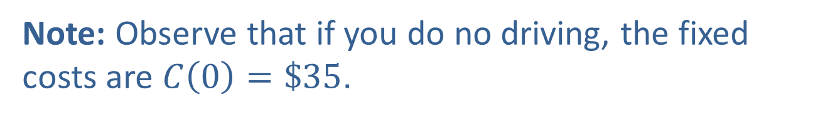
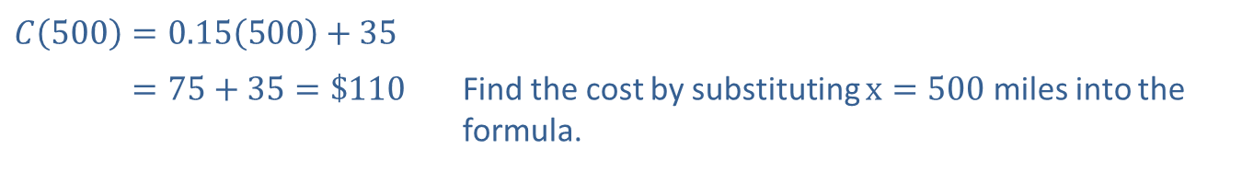
Example 1: Car Rental (cont.)
​$C\left(500\right)=0.15\left(500\right)+35$
​𝐶500=75+35=$110 | Find the cost by substituting $x=500$ miles into the formula.
Note: Observe that if you do no driving, the fixed costs are $C\left(0\right)=\$35$.

Slide 7

Example 2: Revenue
A manufacturer determines that the revenue generated by selling $x$ units of a product is a linear function of $x$. If the revenue from 20 units is $\$380$ and the revenue from 15 units is $\$285$, find the revenue function.

Slide 8
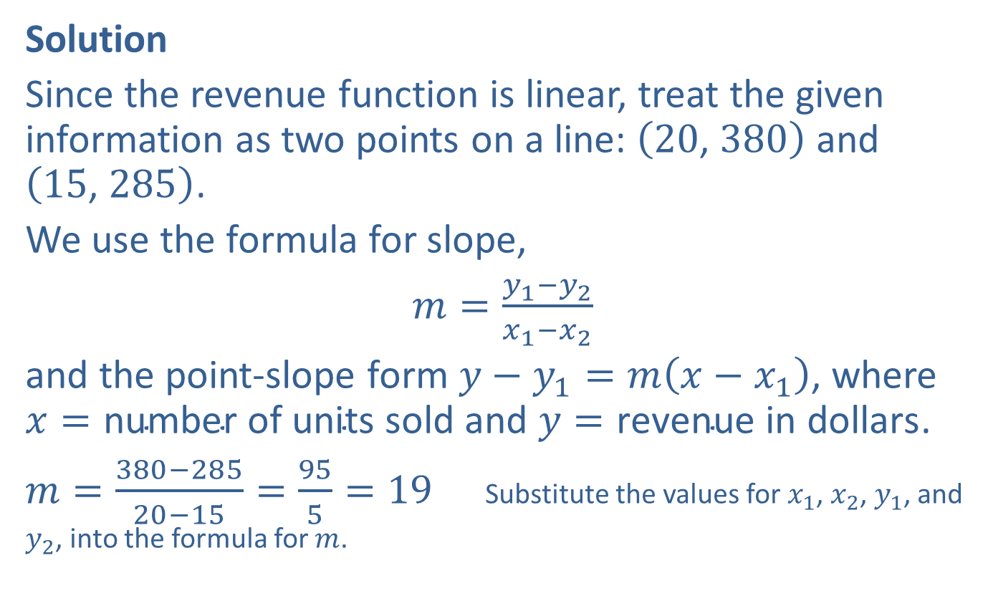
Example 2: Revenue (cont.)
Solution
Since the revenue function is linear, treat the given information as two points on a line: $\left(20\text{, }380\right)$ and $\left(15\text{, }285\right)$.
We use the formula for slope,
$m=\frac{y_{1}−y_{2}}{x_{1}−x_{2}}$
and the point-slope form $y−y_{1}=m\left(x−x_{1}\right)$, where $x=\text{number} \text{of} \text{units} \text{sold}$ and $y=\text{revenue} \text{in} \text{dollars}$.
$m=\frac{380−285}{20−15}=\frac{95}{5}=19$ Substitute the values for $x_{1}$, $x_{2}$, $y_{1}$, and $y_{2}$, into the formula for $m$.

Slide 9
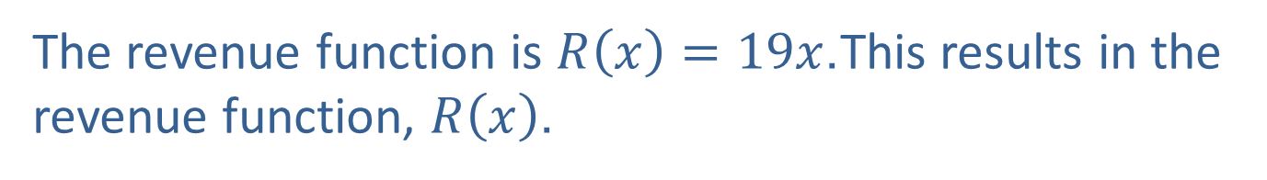
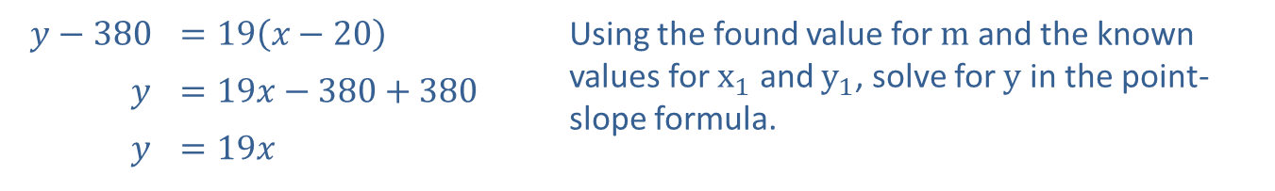
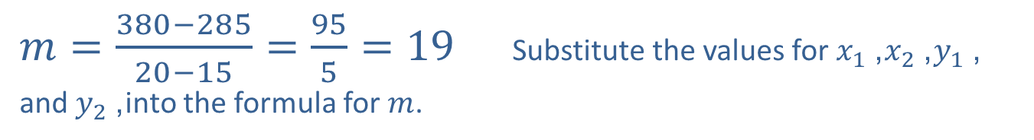
Example 2: Revenue (cont.)
$m=\frac{380−285}{20−15}=\frac{95}{5}=19$ Substitute the values for $x_{1}$, $x_{2}$, $y_{1}$, and $y_{2}$, into the formula for $m$.
​$y−380$ | ​$=19\left(x−20\right)$ | Using the found value for $m$ and the known values for $x_{1}$ and $y_{1}$, solve for $y$ in the point-slope formula.
$$y$$ | ​$=19x−380+380$
$$y$$ | ​$=19x$
The revenue function is $R\left(x\right)=19x$.This results in the revenue function, $R⁡\left(x\right)$.

Slide 10

Example 3: Break-Even Point
The Green-Belt Company determines that the cost of manufacturing men's belts is $\$2$ each plus $\$300$ per day in fixed costs. The company sells the belts for $\$3$ each. What is the break-even point?

Slide 11

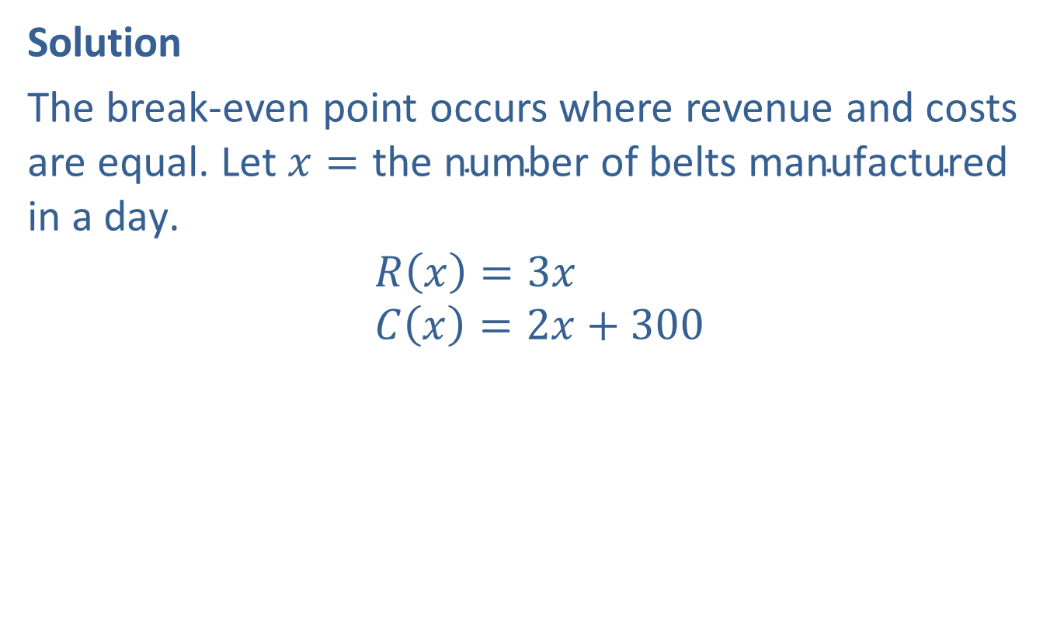
Example 3: Break-Even Point (cont.)
Solution
The break-even point occurs where revenue and costs are equal. Let $x=\text{the} \text{number} \text{of} \text{belts} \text{manufactured} \text{in} \text{a} \text{day}\text{.}$
$$R⁡\left(x\right)=3x \\ C⁡\left(x\right)=2x+300$$
​
​$R⁡\left(x\right)$ | ​$=C⁡\left(x\right)\text{,}$
​$3x$ | ​$=2x+300$
​$x$ | ​$=300\text{.}$

Slide 12
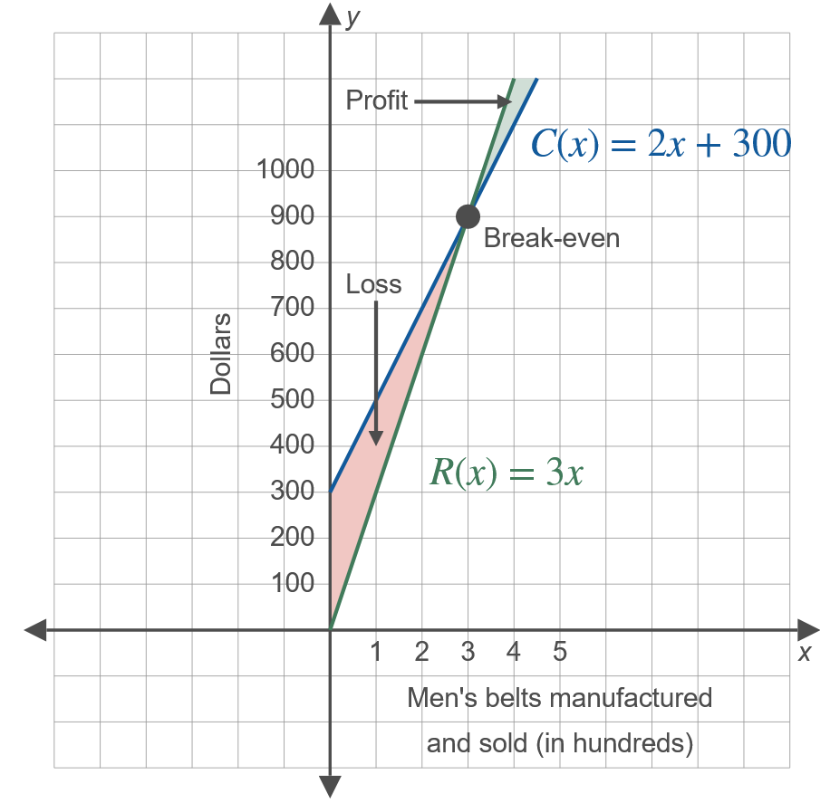
Example 3: Break-Even Point (cont.)

Slide 13
Example 3: Break-Even Point (cont.)
So 300 belts must be made and sold each day for the company to break even. The company must sell more than 300 belts each day to make a profit.

Slide 14
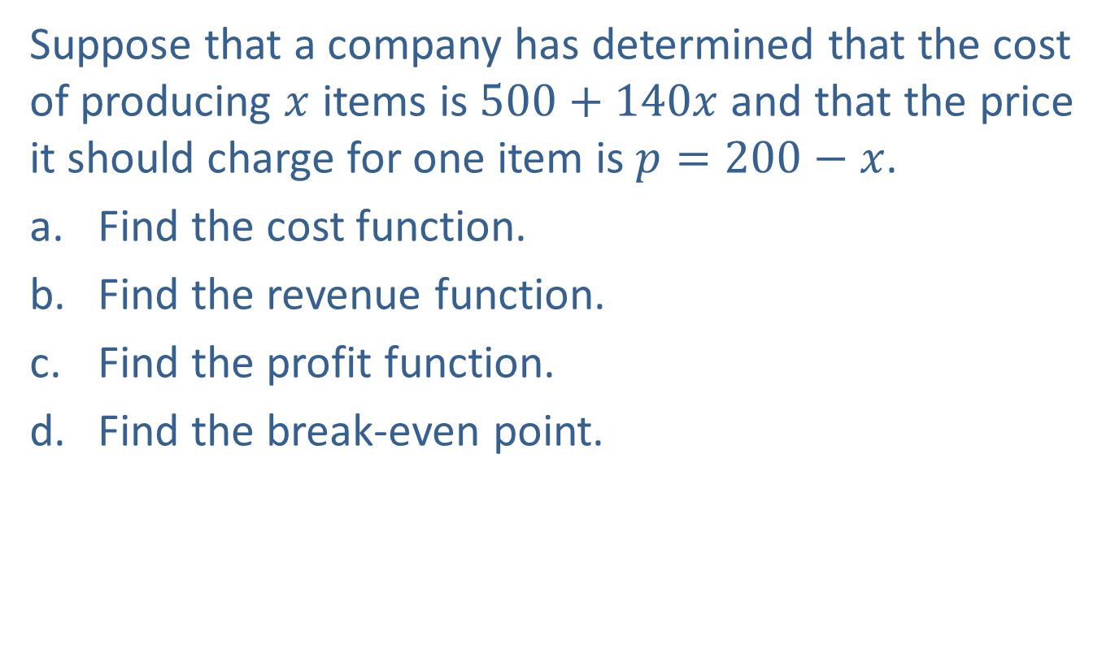
Example 4: Modeling in Production
Suppose that a company has determined that the cost of producing $x$ items is $500+140x$ and that the price it should charge for one item is $p=200−x$.
​Find the cost function.
​Find the revenue function.
​Find the profit function.
​Find the break-even point.

Slide 15
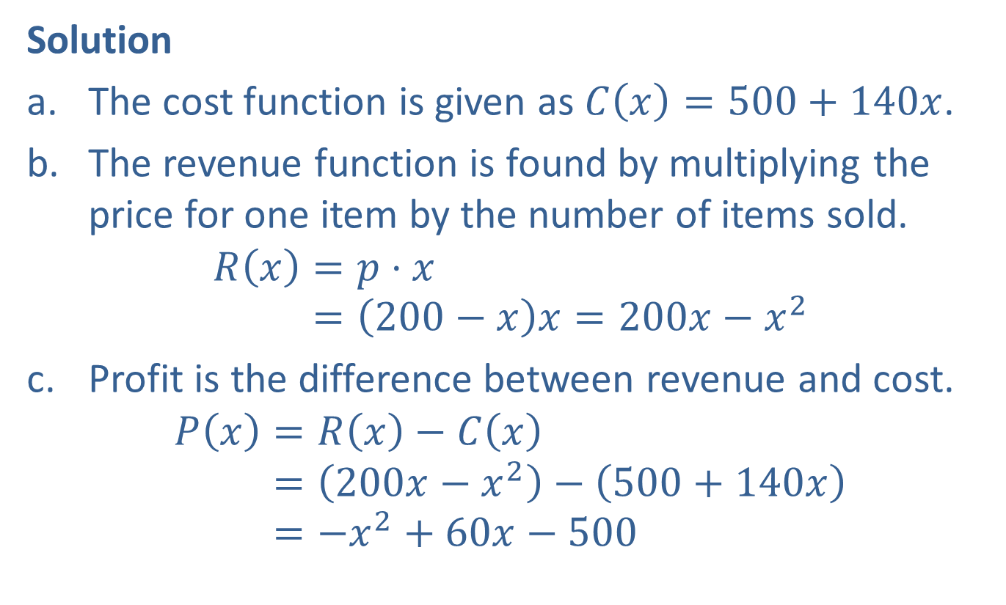
Example 4: Modeling in Production (cont.)
Solution
​The cost function is given as $C\left(x\right)=500+140x$.
​The revenue function is found by multiplying the price for one item by the number of items sold.
𝑅𝑥=𝑝⋅𝑥𝑅⁡𝑥=200−𝑥𝑥=200𝑥−𝑥2
​Profit is the difference between revenue and cost.
𝑃𝑥=𝑅𝑥−𝐶𝑥𝑃⁡𝑥=200𝑥−𝑥2−500+140𝑥𝑃⁡𝑥=−𝑥2+60𝑥−500

Slide 16
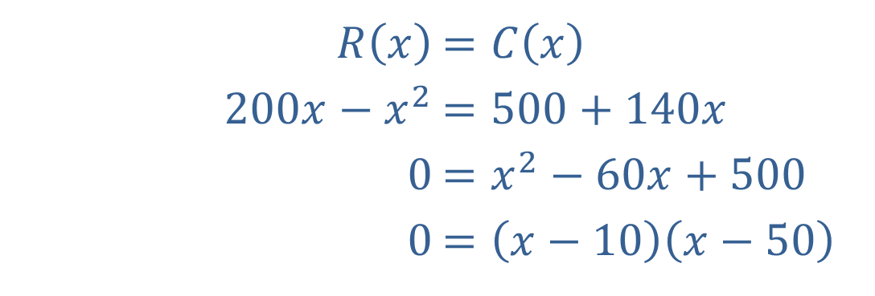

Example 4: Modeling in Production (cont.)
​To find the break-even point, set the revenue equal to the cost and solve for $x$.
​
​ $x=10$ or $x=50$
​There are two break-even points.
​$R⁡\left(x\right)$ | ​$=C\left(x\right)$
​$200x−x^{2}$ | ​$=500+140x$
​$0$ | ​$=x^{2}−60x+500$
​$0$ | ​$=\left(x−10\right)\left(x−50\right)$

Slide 17
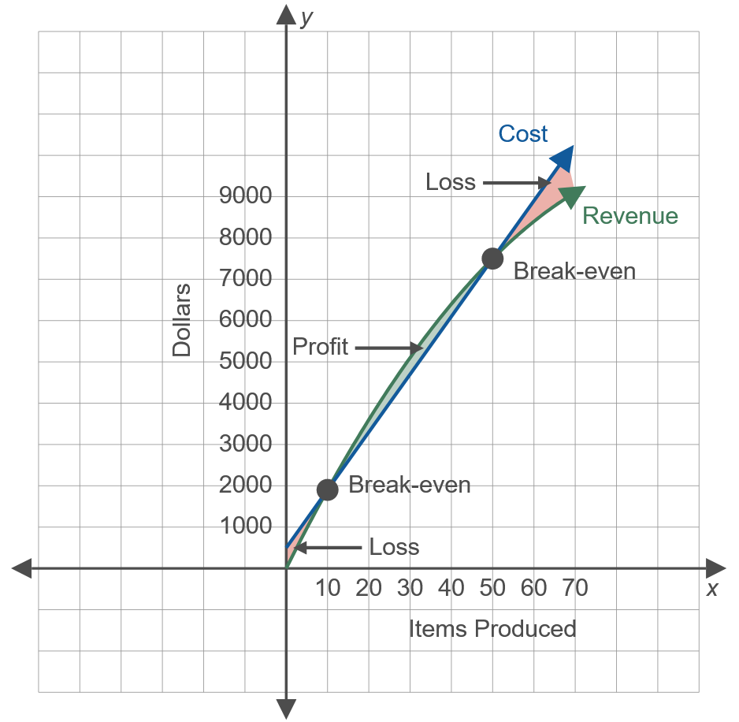
Example 4: Modeling in Production (cont.)
This model shows that a profit occurs if the company produces between 10 and 50 items. Techniques for maximizing profit are discussed in calculus.

Slide 18

Example 5: Equilibrium Point
Suppose that the supply function for a particular product is $p=S\left(x\right)=x^{2}+x+3$ and the demand function $p=D\left(x\right)={\left(x−5\right)}^{2}$ where $x$ represents thousands of units and $p$ represents thousands of dollars. Find the equilibrium point $\left(x_{E}\text{, }p_{E}\right)$.

Slide 19


Example 5: Equilibrium Point (cont.)
Solution
We solve for $x_{E}$ by setting $S\left(x\right)=D\left(x\right)$. Then we substitute this value for $x$ into either $S⁡\left(x\right)$ or $D⁡\left(x\right)$ to find $p_{E}$.
​
​$S⁡\left(x_{E}\right)$ | ​$=D\left(x_{E}\right)$
​${x_{E}}^{2}+x_{E}+3$ | ​$={\left(x_{E}−5\right)}^{2}$
​${x_{E}}^{2}+x_{E}+3$ | ​$={x_{E}}^{2}−10x_{E}+25$
​$11x_{E}$ | ​$=22$
​$x_{E}$ | ​$=2$
​$p_{E}$ | ​$=S\left(x_{E}\right)=S\left(2\right)$
​ | ​$=2^{2}+2+3=9$

Slide 20
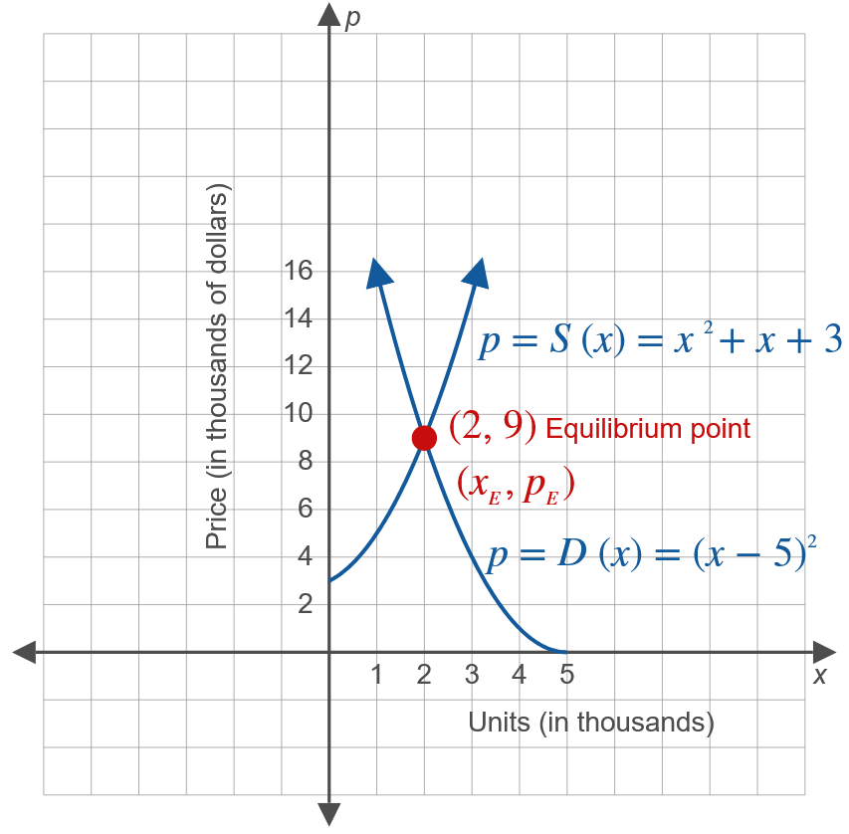
Example 5: Equilibrium Point (cont.)

Slide 21

Example 5: Equilibrium Point (cont.)
The equilibrium point occurs where $x=2000$ units and $p=\$9000$.

Slide 22
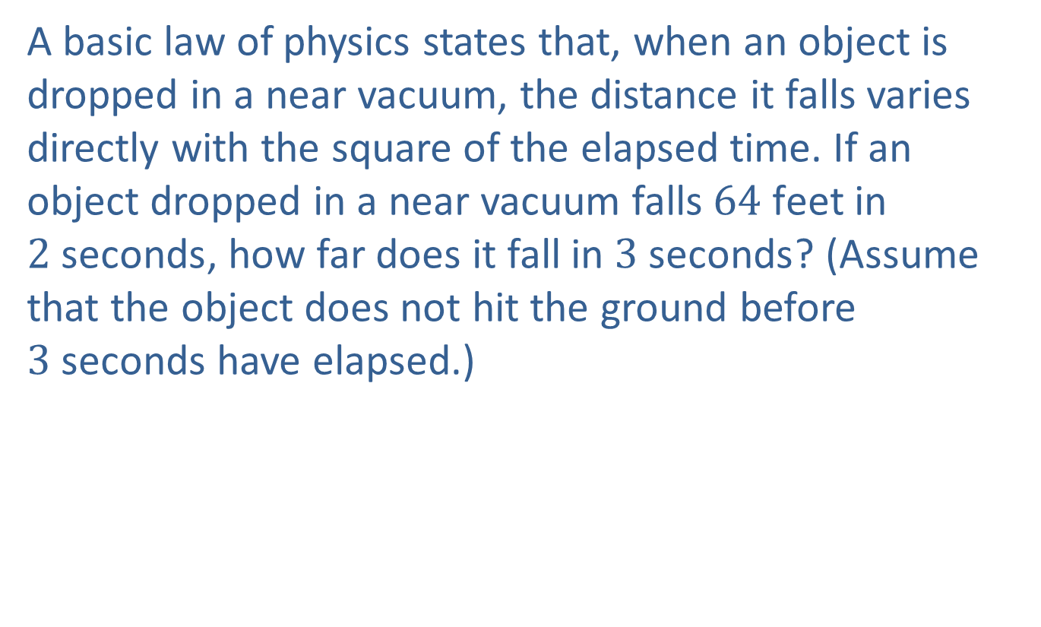
Example 6: Physics
A basic law of physics states that, when an object is dropped in a near vacuum, the distance it falls varies directly with the square of the elapsed time. If an object dropped in a near vacuum falls $64 \text{feet}$ in $2 \text{seconds}$, how far does it fall in $3 \text{seconds}$? (Assume that the object does not hit the ground before $3 \text{seconds}$ have elapsed.)

Slide 23
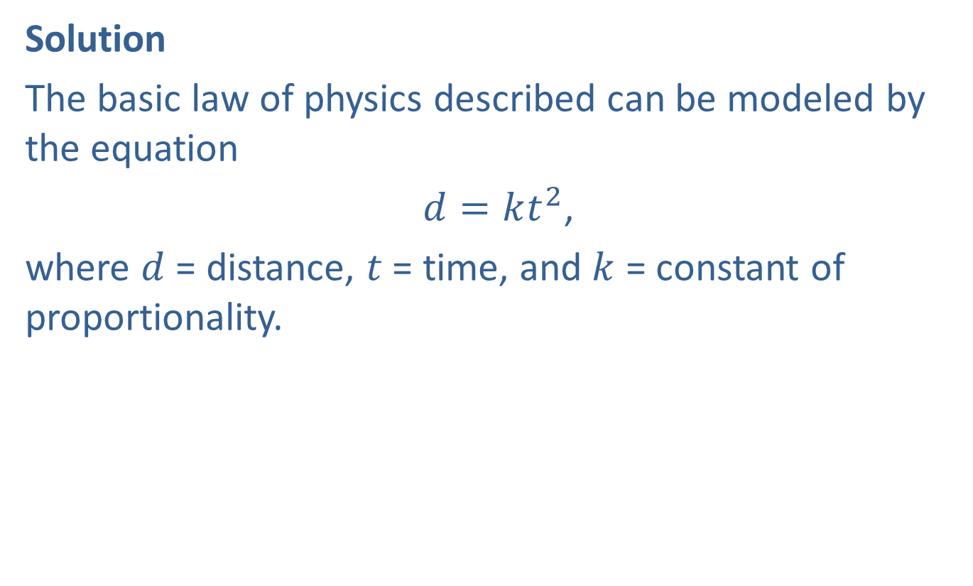
Example 6: Physics (cont.)
Solution
The basic law of physics described can be modeled by the equation
$d=kt^{2}$,
where $d$ = distance, $t$ = time, and $k$ = constant of proportionality.

Slide 24
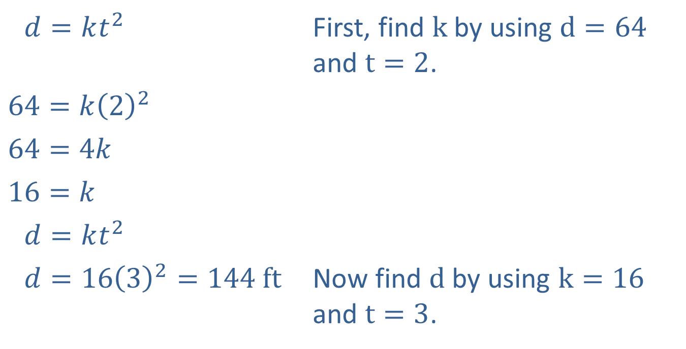
Example 6: Physics (cont.)
​1𝑑=𝑘𝑡2 | First, find $k$ by using $d=64$ and $t=2$.
​$64=k{\left(2\right)}^{2}$
​$64=4k$
​$16=k$
​1𝑑=𝑘𝑡2
​1𝑑=1632=144 ft | Now find $d$ by using $k=16$ and $t=3$.
The object will fall $144 \text{feet}$ in $3 \text{seconds}$.

Slide 25
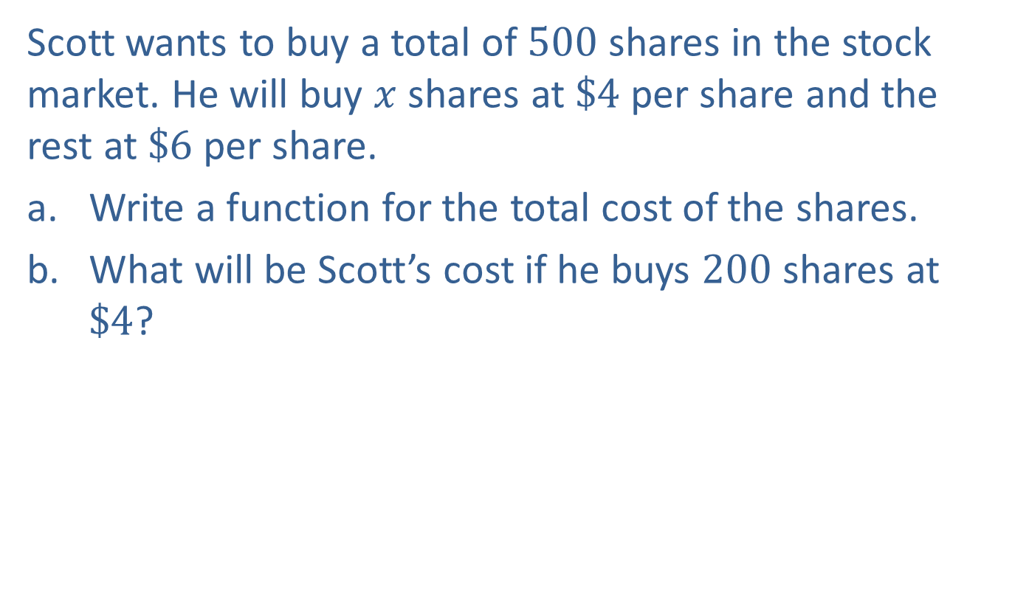
Example 7: Stock Market
Scott wants to buy a total of 500 shares in the stock market. He will buy $x$ shares at $\$4$ per share and the rest at $\$6$ per share.
​Write a function for the total cost of the shares.
​What will be Scott’s cost if he buys 200 shares at $\$4$?

Slide 26
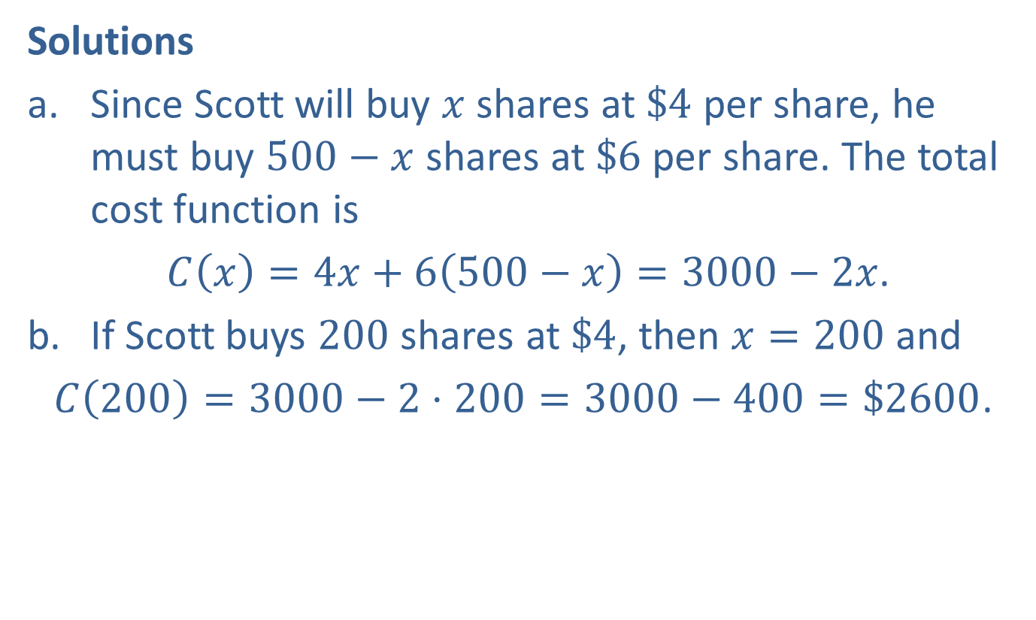
Example 7: Stock Market (cont.)
Solutions
​Since Scott will buy $x$ shares at $\$4$ per share, he must buy $500−x$ shares at $\$6$ per share. The total cost function is
​ $C\left(x\right)=4x+6\left(500−x\right)=3000−2x$.
​If Scott buys 200 shares at $\$4$, then $x=200$ and
​$C\left(200\right)=3000−2⋅200=3000−400=\$2600$.

Slide 27
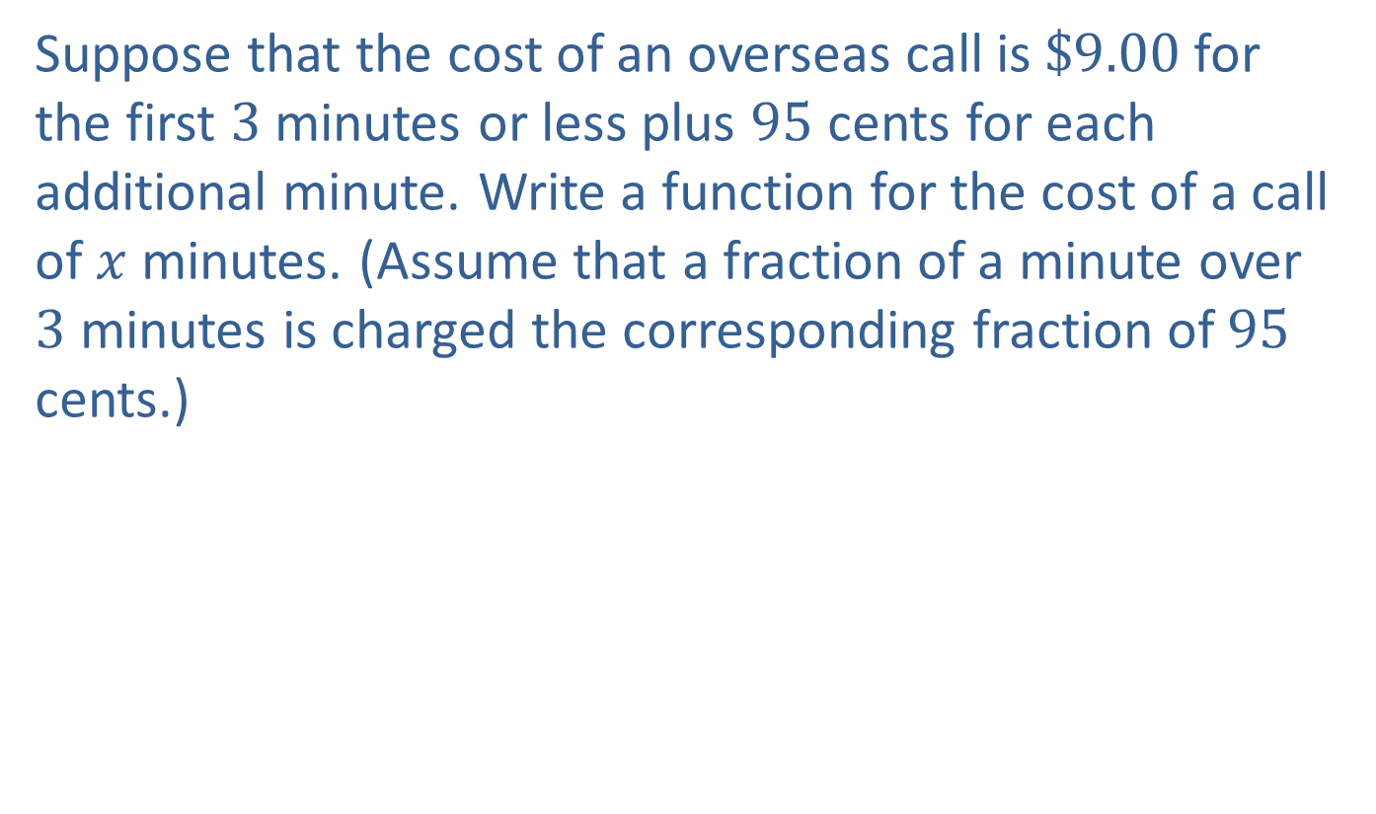
Example 8: Phone Call Charges
Suppose that the cost of an overseas call is $\$9.00$ for the first 3 minutes or less plus 95 cents for each additional minute. Write a function for the cost of a call of $x$ minutes. (Assume that a fraction of a minute over 3 minutes is charged the corresponding fraction of 95 cents.)

Slide 28
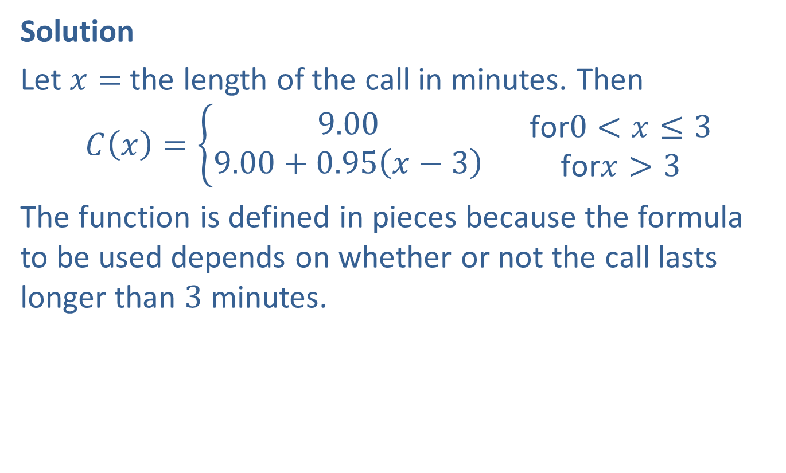
Example 8: Phone Call Charges (cont.)
Solution
Let $x=$ the length of the call in minutes. Then
$$C\left(x\right)=\left\{\begin{aligned}9.00 \\ 9.00+0.95\left(x−3\right)\end{aligned}\right.\begin{matrix} & \text{for}0<x≤3 \\ & \text{for}x>3\end{matrix}$$
The function is defined in pieces because the formula to be used depends on whether or not the call lasts longer than 3 minutes.

Slide 29

Example 9: Perimeter
A rectangular lot is fenced on three sides. An adjacent building forms the fourth side (see diagram). If the total length of the fencing is $48 \text{feet}$, write a function that represents the area of the rectangle. Determine a good viewing rectangle and graph the function.

Slide 30

Example 9: Perimeter (cont.)
Solution
Let $x=$ width of the rectangle. Since the total length of the fence is $48\text{feet}$ and two sides are each of length $x$, then the length of the third side must be $48−2x$.

Slide 31
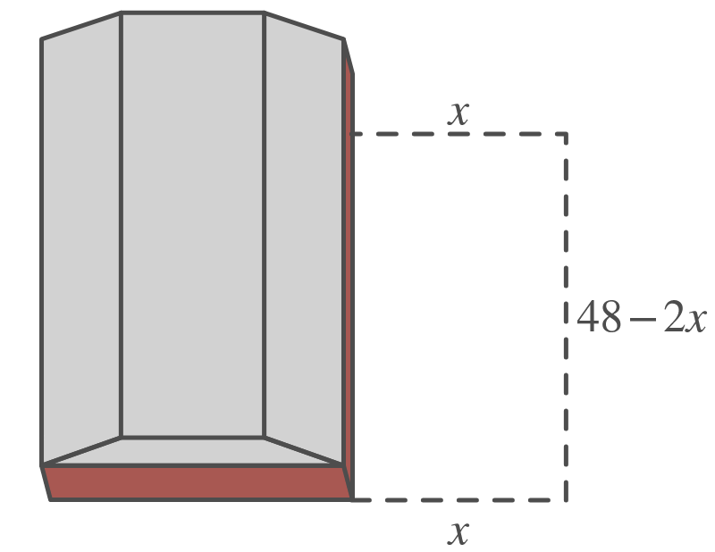
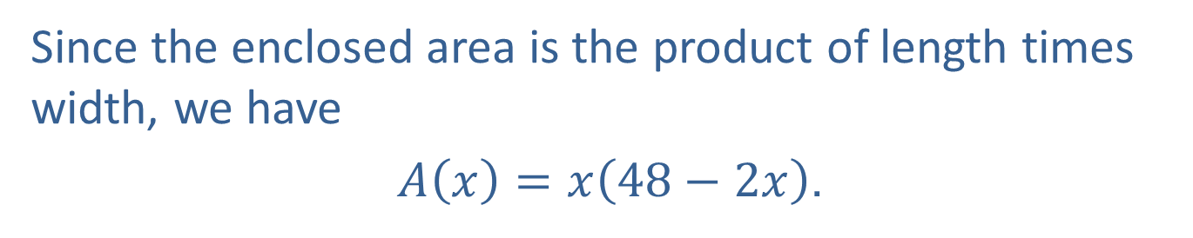
Example 9: Perimeter (cont.)
Since the enclosed area is the product of length times width, we have
$A\left(x\right)=x\left(48−2x\right)$.

Slide 32
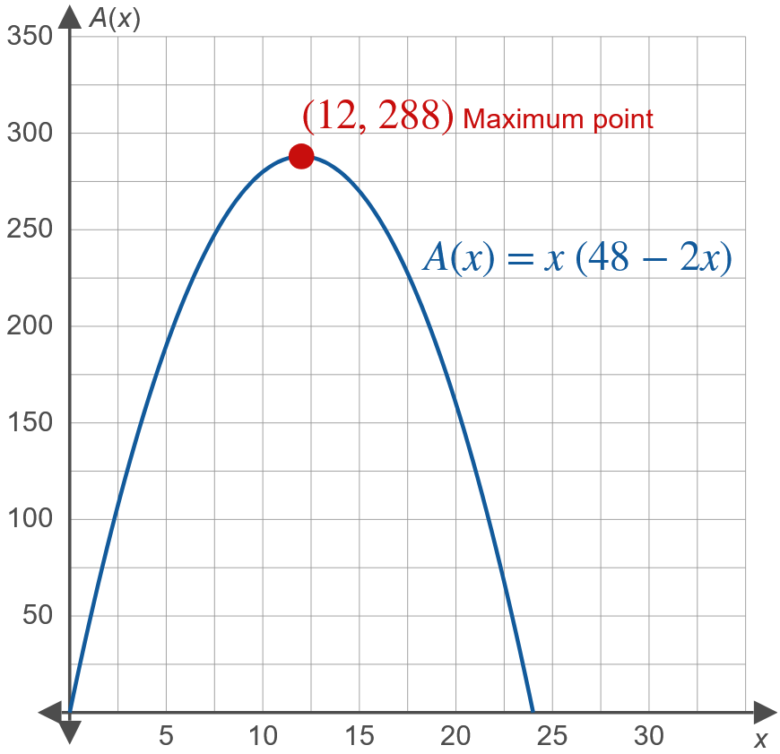
Example 9: Perimeter (cont.)

Slide 33

Example 9: Perimeter (cont.)
The significance of the highest point (at $x=12$) is that when the width is 12, the maximum area is enclosed ($288 ^{ft}$). Any other dimensions for the fence reduce total enclosed area.

