Slide 1
Section 1.4
Functions and Their Graphs: A Calculator Section

Slide 2

Example 1: Selecting Window Dimensions with a Calculator
Using a calculator as an aid, draw on a sheet of paper a sketch of $y=\frac{4x+1}{3^{x}}$. Determine a window of appropriate dimensions.

Slide 3
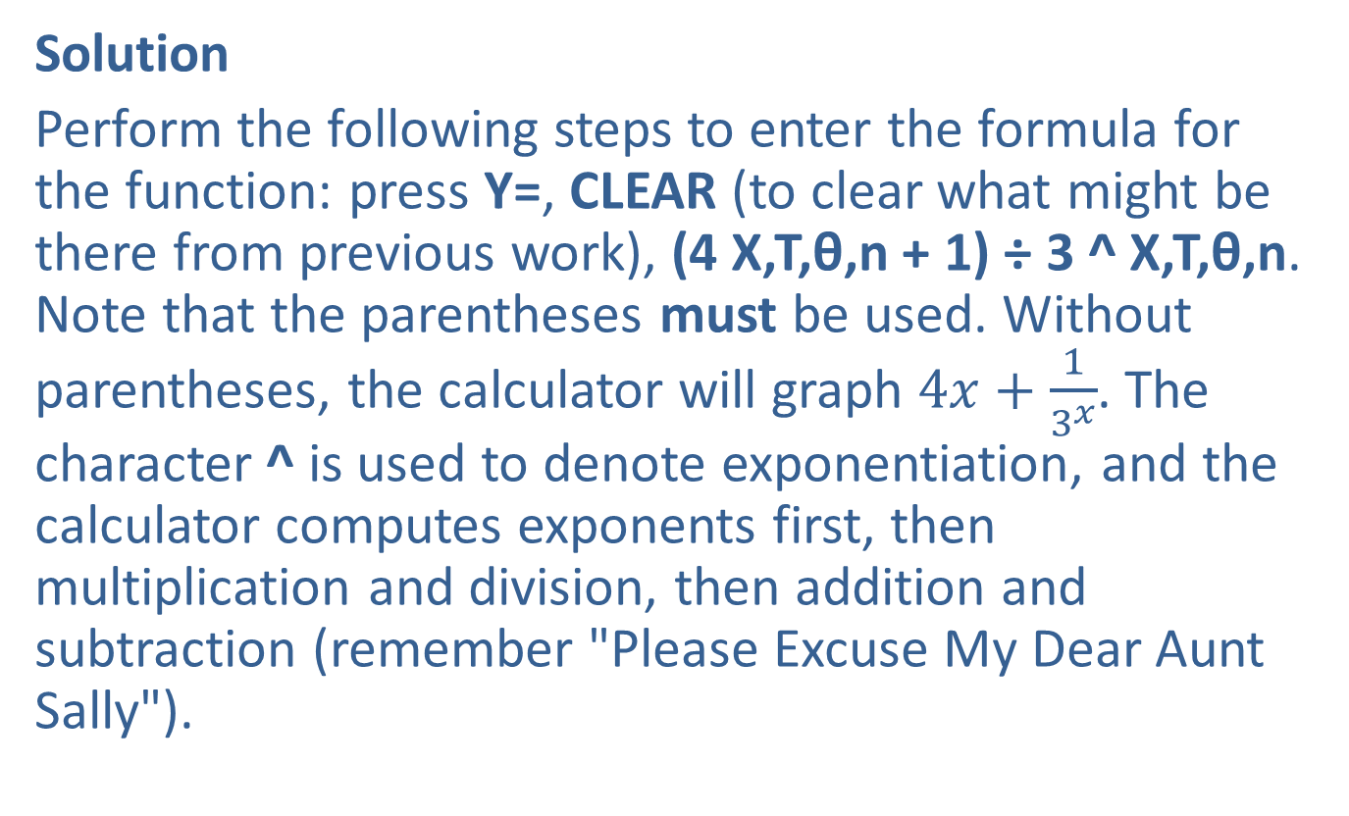
Example 1: Selecting Window Dimensions with a Calculator (cont.)
Solution
Perform the following steps to enter the formula for the function: press Y=, CLEAR (to clear what might be there from previous work), (4 X,T,θ,n + 1) ÷ 3 ^ X,T,θ,n. Note that the parentheses must be used. Without parentheses, the calculator will graph $4x+\frac{1}{3^{x}}$. The character ^ is used to denote exponentiation, and the calculator computes exponents first, then multiplication and division, then addition and subtraction (remember "Please Excuse My Dear Aunt Sally").

Slide 4
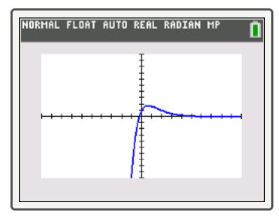
Example 1: Selecting Window Dimensions with a Calculator (cont.)
Now we select a window. The standard window, with Xmin=−10, Xmax =10, Xscl=1, Ymin=−10, Ymax=10, and Yscl=1 is rather poor. Most of the screen is just empty space (See Figure 6).
FIGURE 6: First Graph

Slide 5
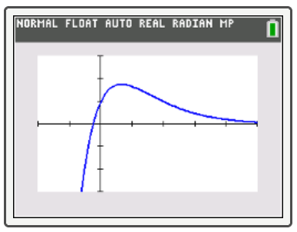
Example 1: Selecting Window Dimensions with a Calculator (cont.)
FIGURE 7: Second Graph
Press WINDOW and enter Xmin=−2, Xmax=5, Xscl=1, Ymin=−3, Ymax=3, and Yscl=1. Press GRAPH. The second graph drawn is now very revealing, and we do not need to change the window settings any further (see Figure 7).

Slide 6

Example 2: Selecting Window Dimensions without a Calculator
Determine a sensible window for $y=\frac{6x^{3}+2x+20}{x^{2}+1}$ without graphing. Then check by drawing the graph with a graphing calculator.

Slide 7
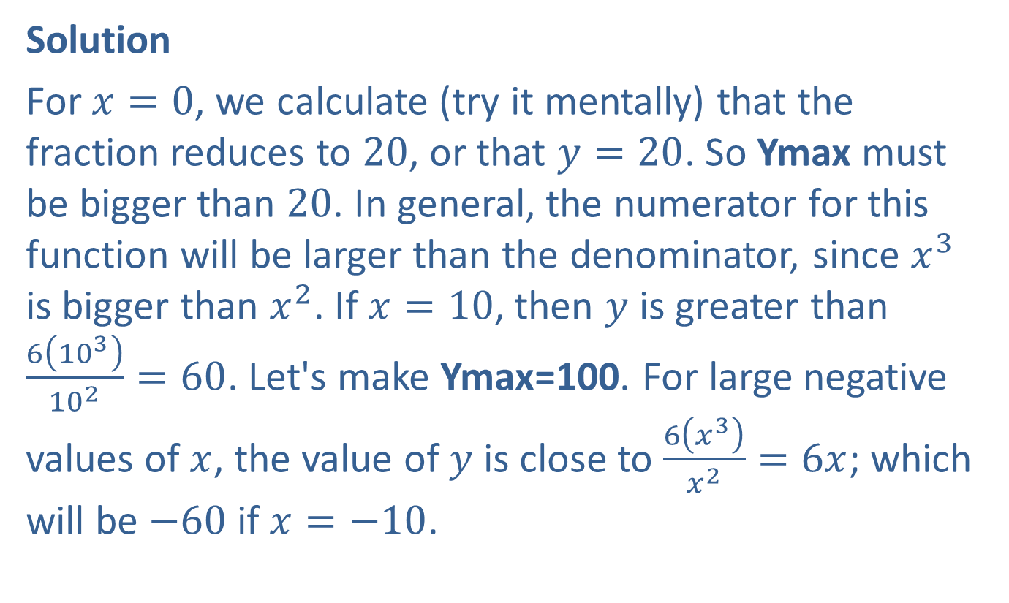
Example 2: Selecting Window Dimensions without a Calculator (cont.)
Solution
For $x=0$, we calculate (try it mentally) that the fraction reduces to 20, or that $y=20$. So Ymax must be bigger than 20. In general, the numerator for this function will be larger than the denominator, since $x^{3}$ is bigger than $x^{2}$. If $x=10$, then $y$ is greater than $\frac{6\left({10}^{3}\right)}{{10}^{2}}=60$. Let's make Ymax=100. For large negative values of $x$, the value of $y$ is close to $\frac{6\left(x^{3}\right)}{x^{2}}=6x$; which will be $−60$ if $x=−10$.

Slide 8
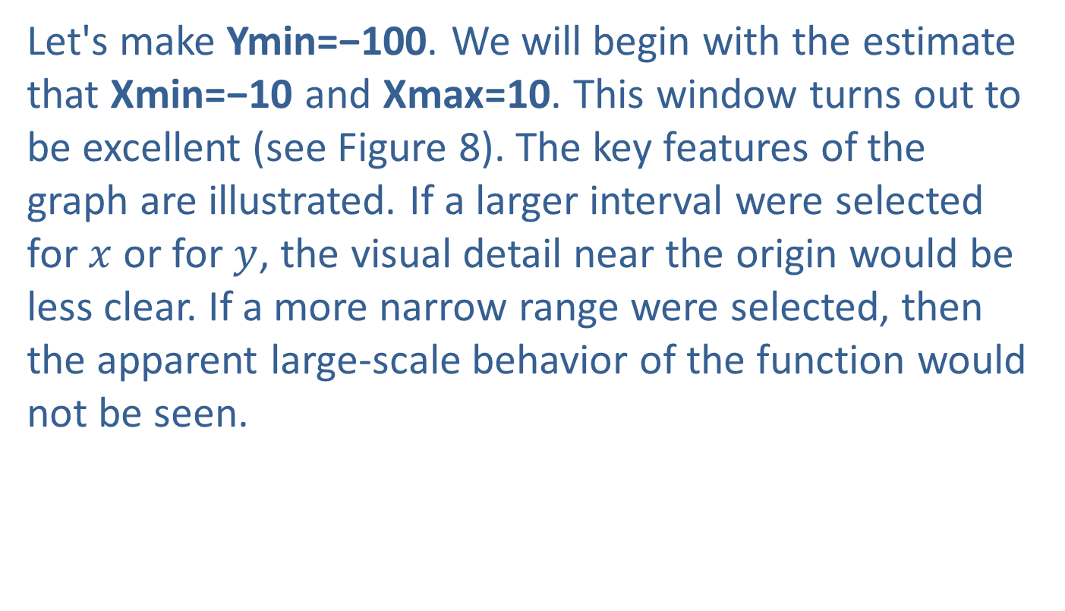
Example 2: Selecting Window Dimensions without a Calculator (cont.)
Let's make Ymin=−100. We will begin with the estimate that Xmin=−10 and Xmax=10. This window turns out to be excellent (see Figure 8). The key features of the graph are illustrated. If a larger interval were selected for $x$ or for $y$, the visual detail near the origin would be less clear. If a more narrow range were selected, then the apparent large-scale behavior of the function would not be seen.

Slide 9
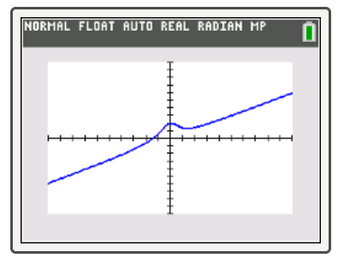
Example 2: Selecting Window Dimensions without a Calculator (cont.)
FIGURE 8

Slide 10
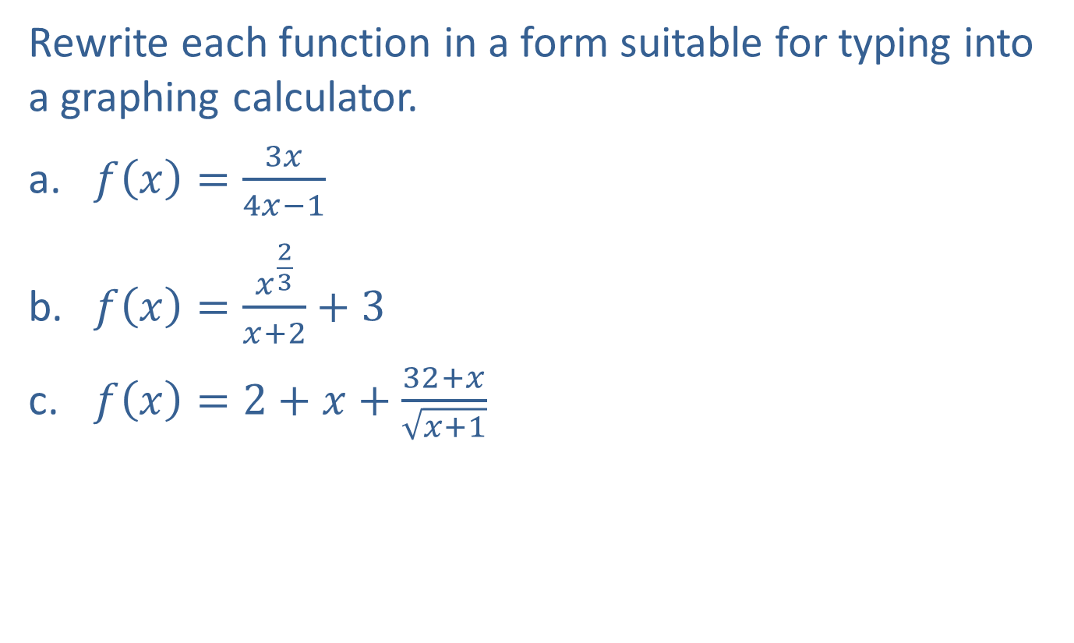
Example 3: Rewriting Functions for Calculator Use
Rewrite each function in a form suitable for typing into a graphing calculator.
​$f\left(x\right)=\frac{3x}{4x−1}$
​$f\left(x\right)=\frac{x^{\frac{2}{3}}}{x+2}+3$
​$f\left(x\right)=2+x+\frac{32+x}{\sqrt{x+1}}$

Slide 11
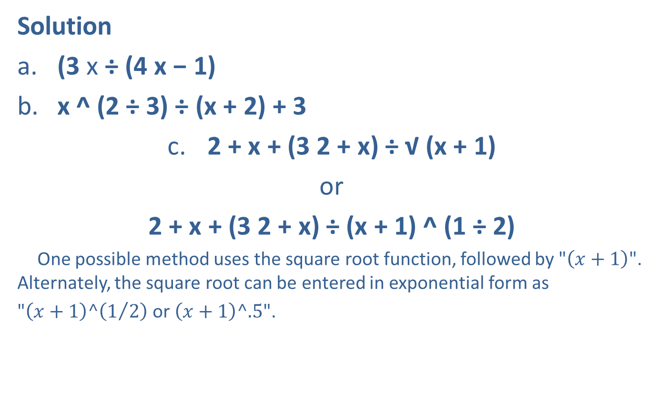
Example 3: Rewriting Functions for Calculator Use (cont.)
Solution
​(3 x ÷ (4 x − 1)
​x ^ (2 ÷ 3) ÷ (x + 2) + 3
​2 + x + (3 2 + x) ÷ √ (x + 1)
​or
​2 + x + (3 2 + x) ÷ (x + 1) ^ (1 ÷ 2)
​ One possible method uses the square root function, followed by "$\left(x+1\right)$". Alternately, the square root can be entered in exponential form as
"$\left(x+1\right)^\left(1/2\right)$ or $\left(x+1\right)^.5$".

Slide 12

Example 4: Finding the Zero of a Function Using a Calculator
Solve $x^{3}−2x+3=0$.

Slide 13
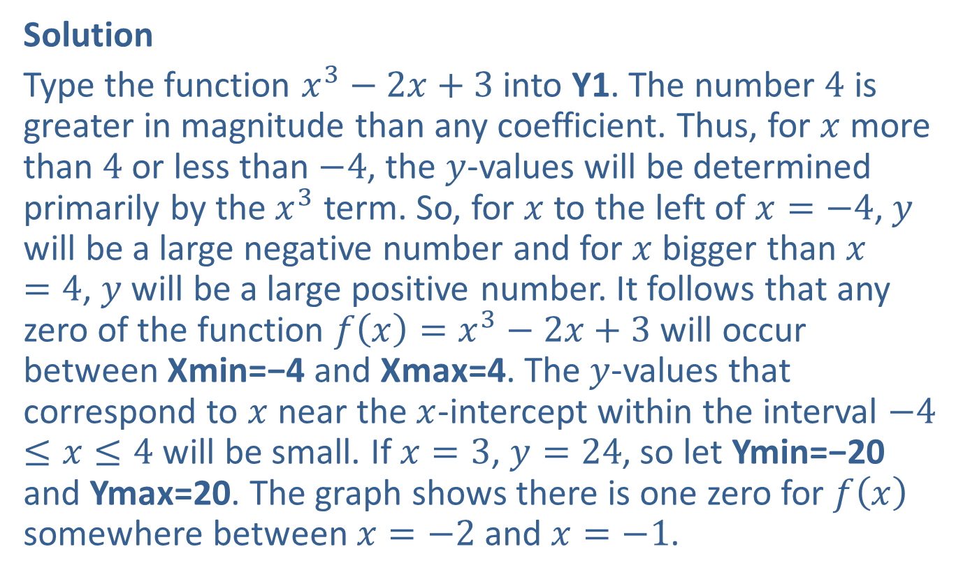
Example 4: Finding the Zero of a Function Using a Calculator (cont.)
Solution
Type the function $x^{3}−2x+3$ into Y1. The number 4 is greater in magnitude than any coefficient. Thus, for $x$ more than 4 or less than $−4$, the $y$-values will be determined primarily by the $x^{3}$ term. So, for $x$ to the left of $x=−4$, $y$ will be a large negative number and for $x$ bigger than $x=4$, $y$ will be a large positive number. It follows that any zero of the function $f\left(x\right)=x^{3}−2x+3$ will occur between Xmin=−4 and Xmax=4. The $y$-values that correspond to $x$ near the $x$-intercept within the interval $−4≤x≤4$ will be small. If $x=3$, $y=24$, so let Ymin=−20 and Ymax=20. The graph shows there is one zero for $f\left(x\right)$ somewhere between $x=−2$ and $x=−1$.

Slide 14
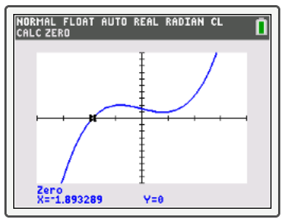

Example 4: Finding the Zero of a Function Using a Calculator (cont.)
Press 2nd TRACE 2 and, at the left bound prompt, press (-) 2 and ENTER. Then, for the right bound, press (-) 1 and ENTER. As a guess, select (-) 1. 5 and ENTER. The answer is $f\left(−1.893289\right)=0$ (see Figure 11).
FIGURE 11

