Slide 1
Section 10.1
Sequences and Series

Slide 2
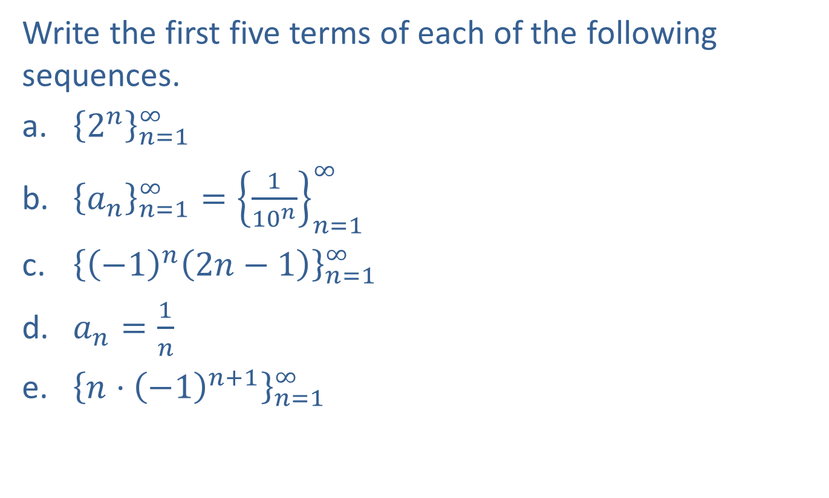
Example 1: Terms of a Sequence
Write the first five terms of each of the following sequences.
​${\left\{2^{n}\right\}}_{n=1}^{∞}$
​${\left\{a_{n}\right\}}_{n=1}^{∞}={\left\{\frac{1}{{10}^{n}}\right\}}_{n=1}^{∞}$
​${\left\{{\left(−1\right)}^{n}\left(2n−1\right)\right\}}_{n=1}^{∞}$
​$a_{n}=\frac{1}{n}$
​${\left\{n⋅{\left(−1\right)}^{n+1}\right\}}_{n=1}^{∞}$

Slide 3
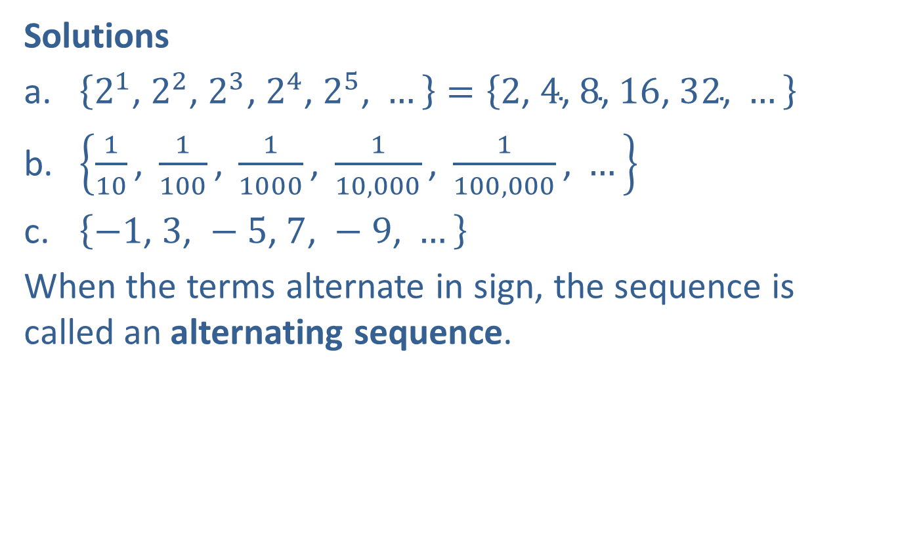
Example 1: Terms of a Sequence (cont.)
Solutions
​$\left\{2^{1}\text{, }2^{2}\text{, }2^{3}\text{, }2^{4}\text{, }2^{5}\text{, }…\right\}=\left\{2\text{, }4\text{, }8\text{, }16\text{, }32\text{, }…\right\}$
​$\left\{\frac{1}{10}\text{, }\frac{1}{100}\text{, }\frac{1}{1000}\text{, }\frac{1}{10,000}\text{, }\frac{1}{100,000}\text{, }…\right\}$
​$\left\{−1\text{, }3\text{, }−5\text{, }7\text{, }−9\text{, }…\right\}$
​When the terms alternate in sign, the sequence is called an alternating sequence.

Slide 4

Example 1: Terms of a Sequence (cont.)
$\left\{1\text{, }\frac{1}{2}\text{, }\frac{1}{3}\text{, }\frac{1}{4}\text{, }\frac{1}{5}\text{, }…\right\}$
​When the domain is not specified, it is assumed that $n=1$ for the first term of the sequence.
​$\left\{1\text{, }−2\text{, }3\text{, }−4\text{, }5\text{, }…\right\}$

Slide 5
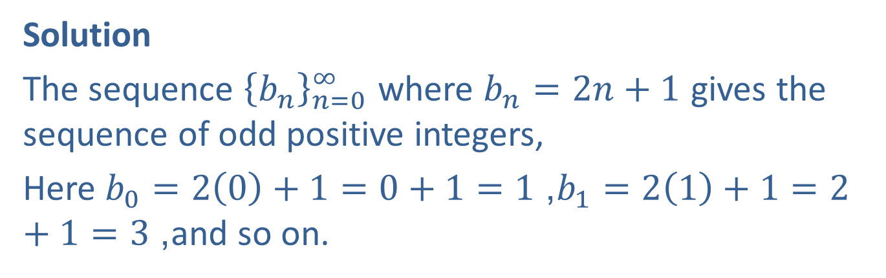

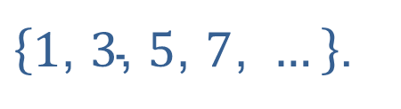
Example 2: Finding a Formula for a Sequence
Determine a formula for $b$_{n} the sequence ${\left\{b_{n}\right\}}_{n=0}^{∞}=\left\{1\text{, }3\text{, }5\text{, }7\text{, }…\right\}$.
Solution
The sequence ${\left\{b_{n}\right\}}_{n=0}^{∞}$ where $b_{n}=2n+1$ gives the sequence of odd positive integers,
Here $b_{0}=2\left(0\right)+1=0+1=1$, $b_{1}=2\left(1\right)+1=2+1=3$, and so on.
$\left\{1\text{, }3\text{, }5\text{, }7\text{, }…\right\}$.

Slide 6
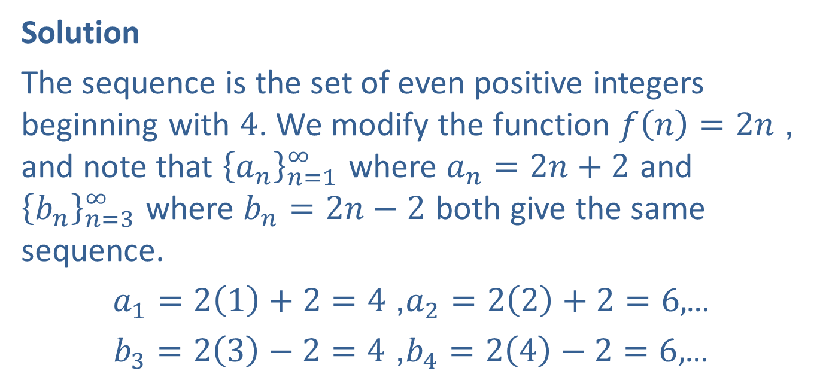

Example 3: Expressing a Sequence Using Different Formulas
Express the sequence $\left\{4\text{, }6\text{, }8\text{, }10\text{, }…\right\}$ as ${\left\{a_{n}\right\}}_{n=1}^{∞}$ and as ${\left\{b_{n}\right\}}_{n=3}^{∞}$.
Solution
The sequence is the set of even positive integers beginning with 4. We modify the function $f\left(n\right)=2n$, and note that ${\left\{a_{n}\right\}}_{n=1}^{∞}$ where $a_{n}=2n+2$ and ${\left\{b_{n}\right\}}_{n=3}^{∞}$ where $b_{n}=2n−2$ both give the same sequence.
$a_{1}=2\left(1\right)+2=4$, $a_{2}=2\left(2\right)+2=6,$ …
$b_{3}=2\left(3\right)−2=4$, $b_{4}=2\left(4\right)−2=6,$ …

Slide 7
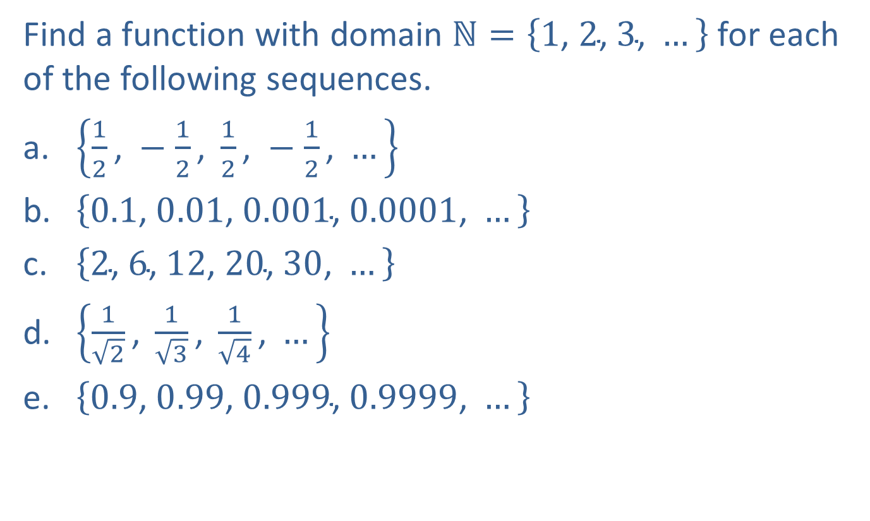
Example 4: Finding a Function for a Sequence
Find a function with domain $ℕ=\left\{1\text{, }2\text{, }3\text{, }…\right\}$ for each of the following sequences.
​$\left\{\frac{1}{2}\text{, }−\frac{1}{2}\text{, }\frac{1}{2}\text{, }−\frac{1}{2}\text{, }…\right\}$
​$\left\{0.1\text{, }0.01\text{, }0.001\text{, }0.0001\text{, }…\right\}$
​$\left\{2\text{, }6\text{, }12\text{, }20\text{, }30\text{, }…\right\}$
​$\left\{\frac{1}{\sqrt{2}}\text{, }\frac{1}{\sqrt{3}}\text{, }\frac{1}{\sqrt{4}}\text{, }…\right\}$
​$\left\{0.9\text{, }0.99\text{, }0.999\text{, }0.9999\text{, }…\right\}$

Slide 8
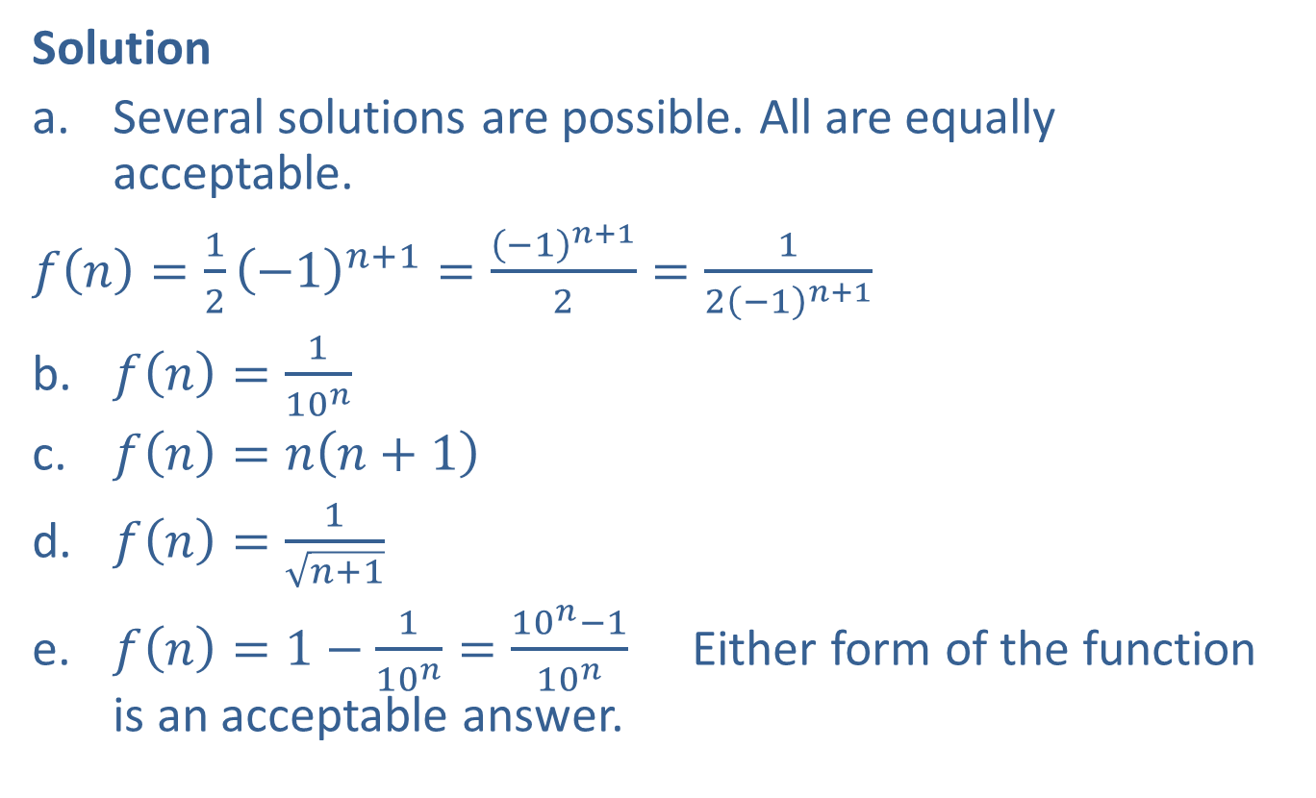
Example 4: Finding a Function for a Sequence (cont.)
Solution
​Several solutions are possible. All are equally acceptable.
​$f\left(n\right)=\frac{1}{2}{\left(−1\right)}^{n+1}=\frac{{\left(−1\right)}^{n+1}}{2}=\frac{1}{2{\left(−1\right)}^{n+1}}$
​$f\left(n\right)=\frac{1}{{10}^{n}}$
​$f\left(n\right)=n\left(n+1\right)$
​$f\left(n\right)=\frac{1}{\sqrt{n+1}}$
​$f\left(n\right)=1−\frac{1}{{10}^{n}}=\frac{{10}^{n}−1}{{10}^{n}}$ Either form of the function is an acceptable answer.

Slide 9
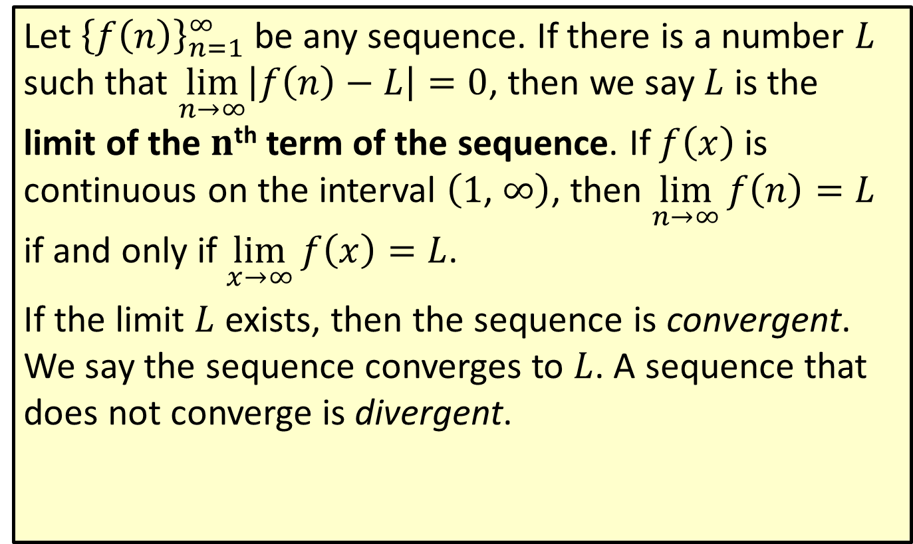
Limit of a Sequence
Let ${\left\{f\left(n\right)\right\}}_{n=1}^{∞}$ be any sequence. If there is a number $L$ such that $\lim_{n→∞}\left|f\left(n\right)−L\right|=0$, then we say $L$ is the limit of the $n$^{th} term of the sequence. If $f⁡\left(x\right)$ is continuous on the interval $\left(1\text{, }∞\right)$, then $\lim_{n→∞}f\left(n\right)=L$ if and only if $\lim_{x→∞}f\left(x\right)=L$.
If the limit $L$ exists, then the sequence is convergent. We say the sequence converges to $L$. A sequence that does not converge is divergent.

Slide 10
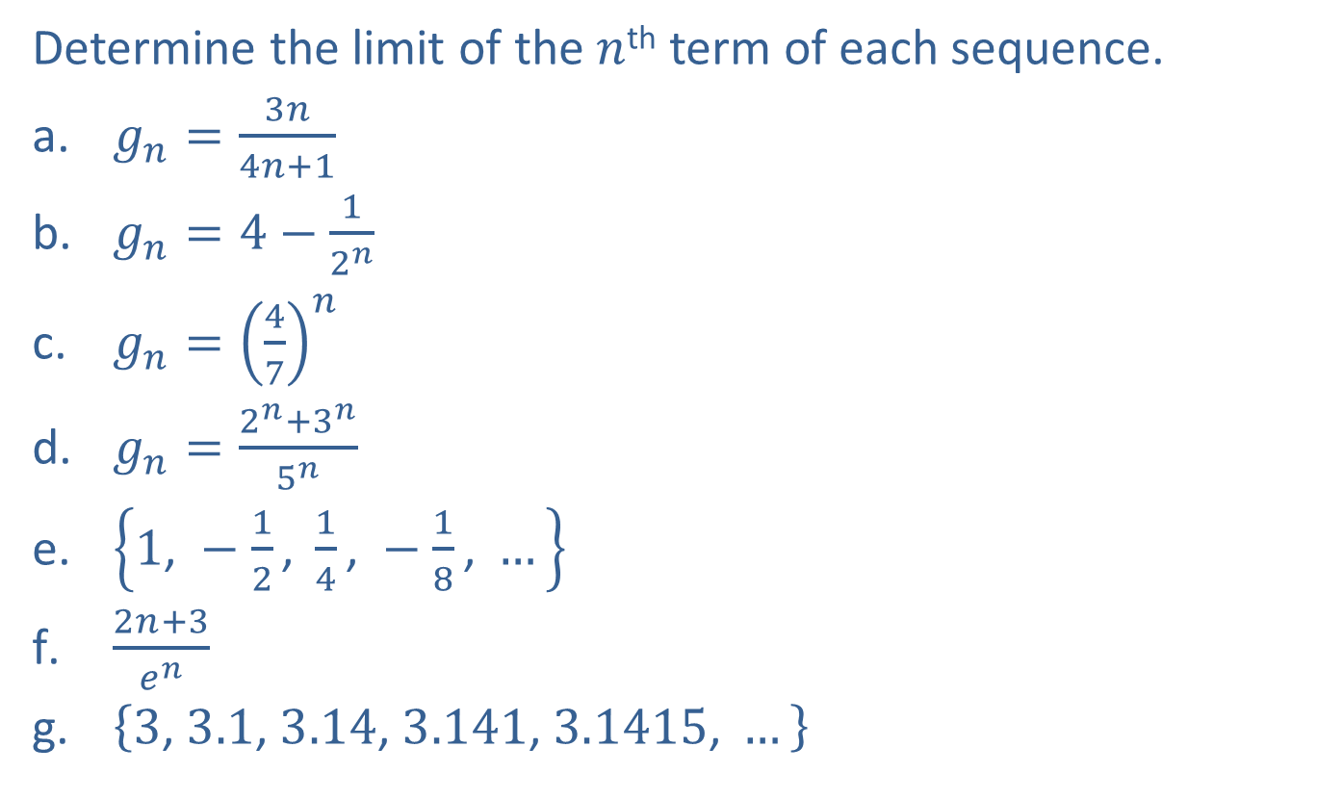
Example 5: Limit of a Sequence
Determine the limit of the $n$^{th} term of each sequence.
​$g_{n}=\frac{3n}{4n+1}$
​$g_{n}=4−\frac{1}{2^{n}}$
​$g_{n}={\left(\frac{4}{7}\right)}^{n}$
​$g_{n}=\frac{2^{n}+3^{n}}{5^{n}}$
​$\left\{1\text{, }−\frac{1}{2}\text{, }\frac{1}{4}\text{, }−\frac{1}{8}\text{, }…\right\}$
​$\frac{2n+3}{e^{n}}$
​$\left\{3\text{, }3.1\text{, }3.14\text{, }3.141\text{, }3.1415\text{, }…\right\}$

Slide 11
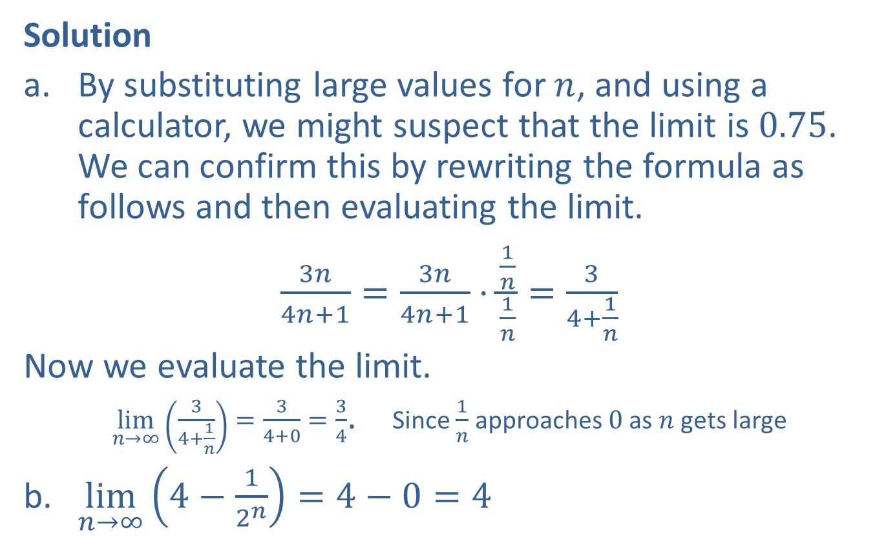
Example 5: Limit of a Sequence (cont.)
Solution
​By substituting large values for $n$, and using a calculator, we might suspect that the limit is 0.75. We can confirm this by rewriting the formula as follows and then evaluating the limit.
​$\frac{3n}{4n+1}=\frac{3n}{4n+1}⋅\frac{\frac{1}{n}}{\frac{1}{n}}=\frac{3}{4+\frac{1}{n}}$
​Now we evaluate the limit.
​$\lim_{n→∞}\left(\frac{3}{4+\frac{1}{n}}\right)=\frac{3}{4+0}=\frac{3}{4}$. Since $\frac{1}{n}$ approaches 0 as $n$ gets large
​$\lim_{n→∞}\left(4−\frac{1}{2^{n}}\right)=4−0=4$

Slide 12
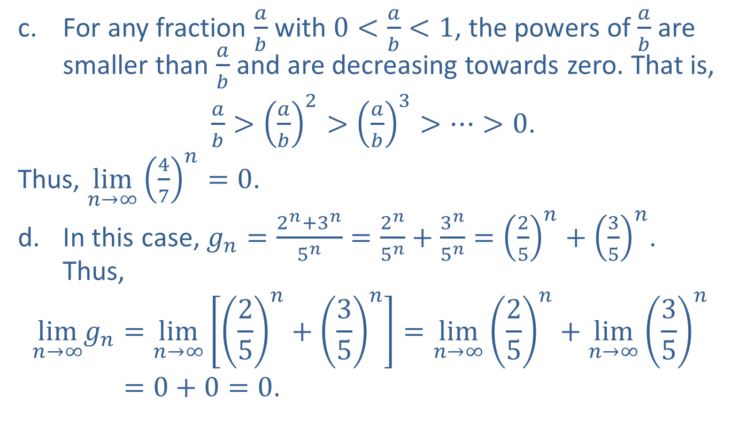
Example 5: Limit of a Sequence (cont.)
​For any fraction $\frac{a}{b}$ with $0<\frac{a}{b}<1$, the powers of $\frac{a}{b}$ are smaller than $\frac{a}{b}$ and are decreasing towards zero. That is,
​ $\frac{a}{b}>{\left(\frac{a}{b}\right)}^{2}>{\left(\frac{a}{b}\right)}^{3}>⋯>0$.
​Thus, $\lim_{n→∞}{\left(\frac{4}{7}\right)}^{n}=0$.
​In this case, $g_{n}=\frac{2^{n}+3^{n}}{5^{n}}=\frac{2^{n}}{5^{n}}+\frac{3^{n}}{5^{n}}={\left(\frac{2}{5}\right)}^{n}+{\left(\frac{3}{5}\right)}^{n}$. Thus,
lim𝑛→∞𝑔𝑛=lim𝑛→∞25𝑛+35𝑛=lim𝑛→∞25𝑛+lim𝑛→∞35𝑛lim𝑛→∞𝑔𝑛=0+0=0.

Slide 13
Example 5: Limit of a Sequence (cont.)
​Although the terms alternate, they get smaller and smaller in absolute value and thus the terms approach 0. This explains the necessity of the absolute value sign in the definition of the limit of a sequence.

Slide 14
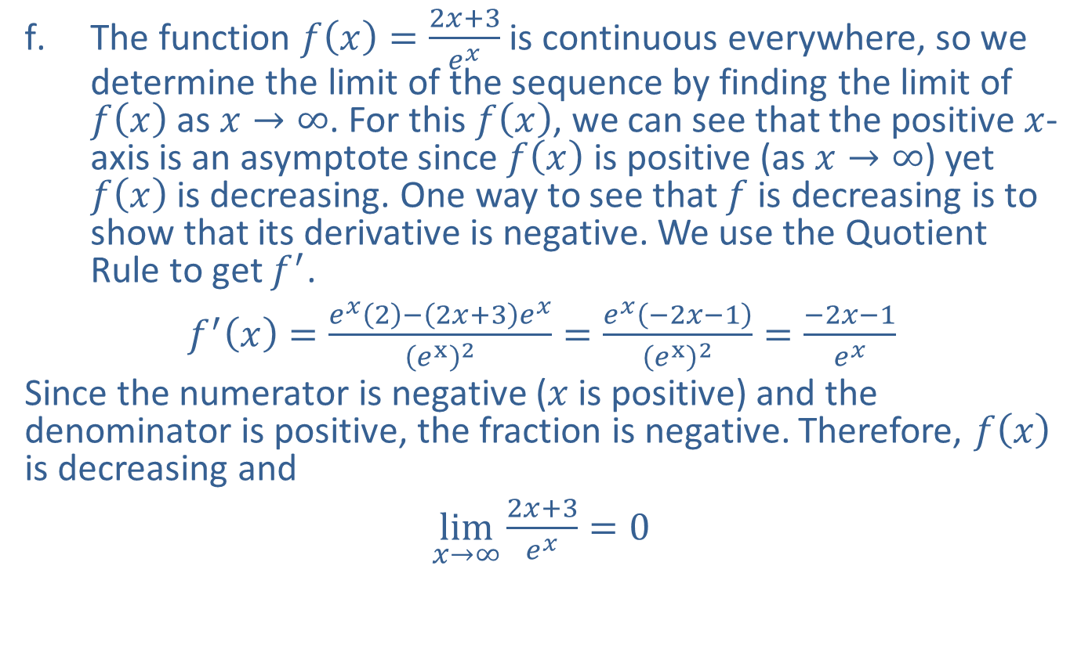
Example 5: Limit of a Sequence (cont.)
​The function $f\left(x\right)=\frac{2x+3}{e^{x}}$ is continuous everywhere, so we determine the limit of the sequence by finding the limit of $f⁡\left(x\right)$ as $x→∞$. For this $f⁡\left(x\right)$, we can see that the positive $x$-axis is an asymptote since $f⁡\left(x\right)$ is positive (as $x→∞$) yet $f⁡\left(x\right)$ is decreasing. One way to see that $f$ is decreasing is to show that its derivative is negative. We use the Quotient Rule to get $f^{′}$.
​$f^{′}\left(x\right)=\frac{e^{x}\left(2\right)−\left(2x+3\right)e^{x}}{{\left(e^{x}\right)}^{2}}=\frac{e^{x}\left(−2x−1\right)}{{\left(e^{x}\right)}^{2}}=\frac{−2x−1}{e^{x}}$
​Since the numerator is negative ($x$ is positive) and the denominator is positive, the fraction is negative. Therefore, $f⁡\left(x\right)$ is decreasing and
​$\lim_{x→∞}\frac{2x+3}{e^{x}}=0$
​

Slide 15
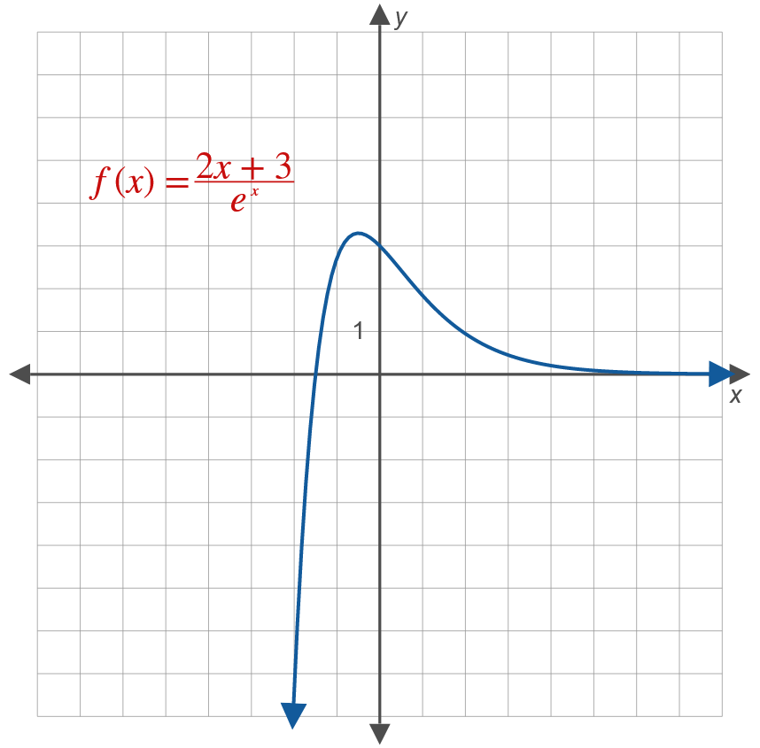
Example 5: Limit of a Sequence (cont.)

Slide 16
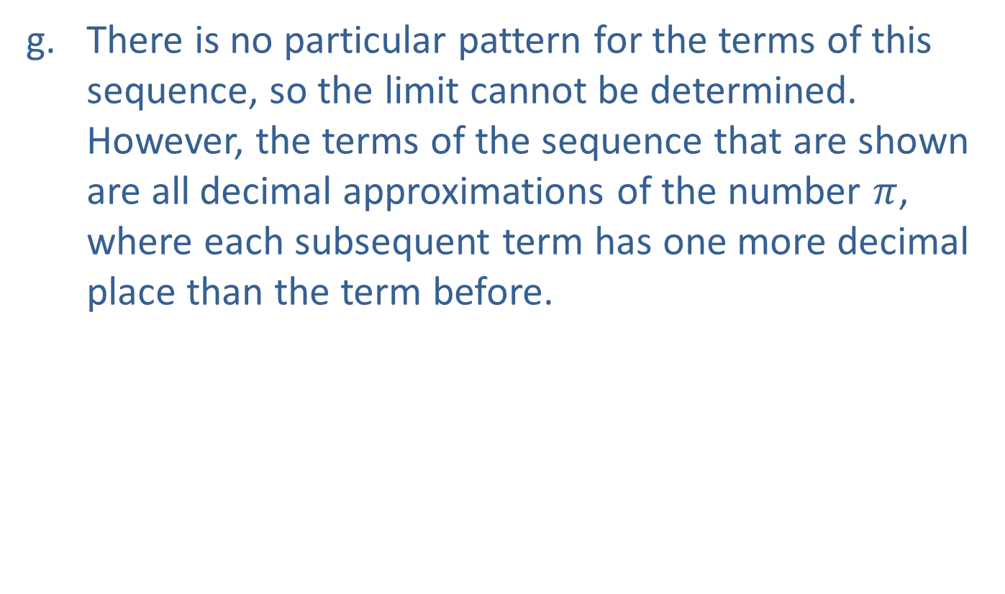
Example 5: Limit of a Sequence (cont.)
​There is no particular pattern for the terms of this sequence, so the limit cannot be determined. However, the terms of the sequence that are shown are all decimal approximations of the number $π$, where each subsequent term has one more decimal place than the term before.

Slide 17
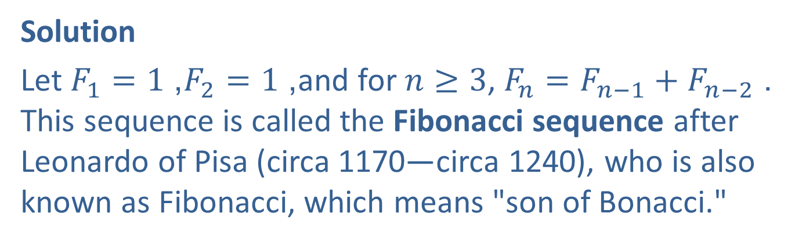

Example 6: Fibonacci Sequence
Express $\left\{1\text{, }1\text{, }2\text{, }3\text{, }5\text{, }8\text{, }13\text{, }21\text{, }…\right\}$ as a recursive sequence.
Solution
Let $F_{1}=1$, $F_{2}=1$, and for $n≥3$, $F_{n}=F_{n−1}+F_{n−2}$. This sequence is called the Fibonacci sequence after Leonardo of Pisa (circa 1170—circa 1240), who is also known as Fibonacci, which means "son of Bonacci."

Slide 18
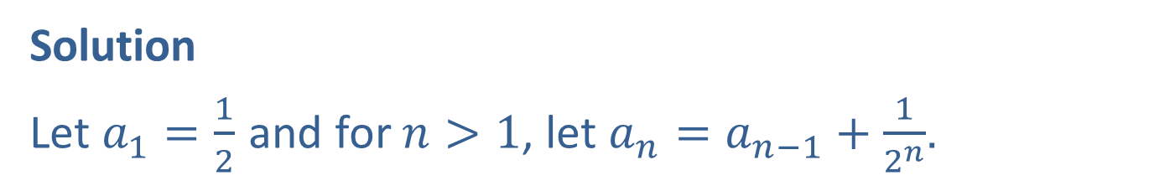

Example 7: Define a Recursive Sequence
Find a recursive definition for the sequence $a_{1}=\frac{1}{2}$, $a_{2}=\frac{1}{2}+\frac{1}{2^{2}}$, $a_{3}=\frac{1}{2}+\frac{1}{2^{2}}+\frac{1}{2^{3}}$, $…$
Solution
Let $a_{1}=\frac{1}{2}$ and for $n>1$, let $a_{n}=a_{n−1}+\frac{1}{2^{n}}$.

Slide 19
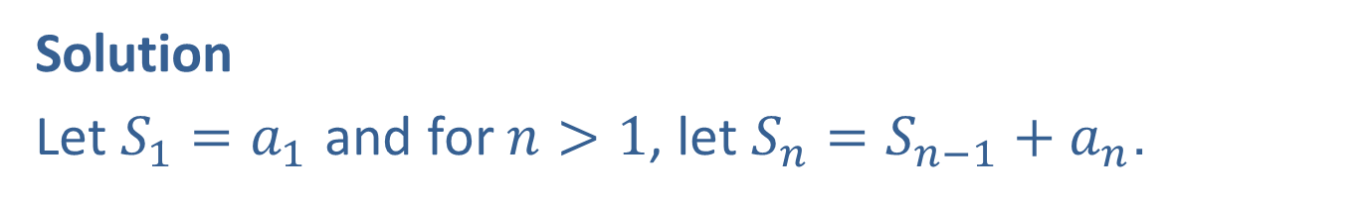

Example 8: Sequence of Partial Sums
Given the series $\sum_{n=1}^{∞}{a_{n}}a_{n}=a_{1}+a_{2}+a_{3}+⋯$, define the sequence of partial sums recursively.
Solution
Let $S_{1}=a_{1}$ and for $n>1$, let $S_{n}=S_{n−1}+a_{n}$.

Slide 20

Example 9: Terms of a Sequence of Partial Sums
Write out the first five partial sums of the following series from the Merton College Problem that was described in the Chapter 10 introduction.
$$\frac{1}{2}+\frac{2}{4}+\frac{3}{8}+\frac{4}{16}+⋯+\frac{n}{2^{n}}+⋯$$

Slide 21
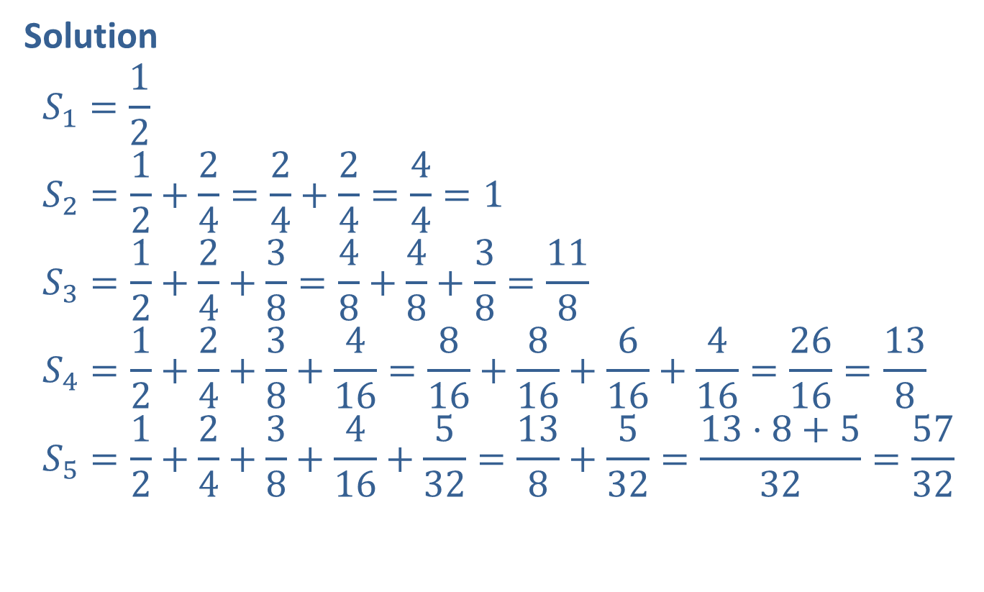
Example 9: Terms of a Sequence of Partial Sums (cont.)
Solution
$$S_{1}=\frac{1}{2} \\ S_{2}=\frac{1}{2}+\frac{2}{4}=\frac{2}{4}+\frac{2}{4}=\frac{4}{4}=1 \\ S_{3}=\frac{1}{2}+\frac{2}{4}+\frac{3}{8}=\frac{4}{8}+\frac{4}{8}+\frac{3}{8}=\frac{11}{8} \\ S_{4}=\frac{1}{2}+\frac{2}{4}+\frac{3}{8}+\frac{4}{16}=\frac{8}{16}+\frac{8}{16}+\frac{6}{16}+\frac{4}{16}=\frac{26}{16}=\frac{13}{8} \\ S_{5}=\frac{1}{2}+\frac{2}{4}+\frac{3}{8}+\frac{4}{16}+\frac{5}{32}=\frac{13}{8}+\frac{5}{32}=\frac{13⋅8+5}{32}=\frac{57}{32}$$

Slide 22
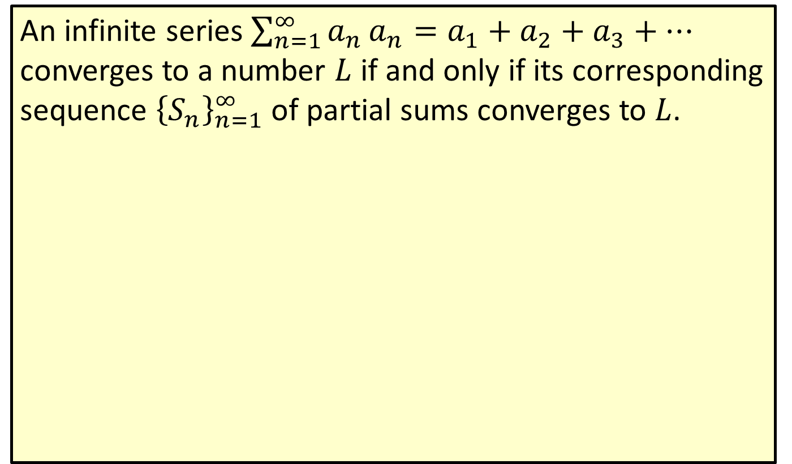
Convergence Principle for Infinite Series
An infinite series $\sum_{n=1}^{∞}{a_{n}}a_{n}=a_{1}+a_{2}+a_{3}+⋯$ converges to a number $L$ if and only if its corresponding sequence ${\left\{S_{n}\right\}}_{n=1}^{∞}$ of partial sums converges to $L$.

Slide 23

Example 10: Converging Series
Determine the number to which the series from the Merton College Problem, $\frac{1}{2}+\frac{2}{4}+\frac{3}{8}+\frac{4}{16}+⋯+\frac{n}{2^{n}}+⋯$, converges.

Slide 24
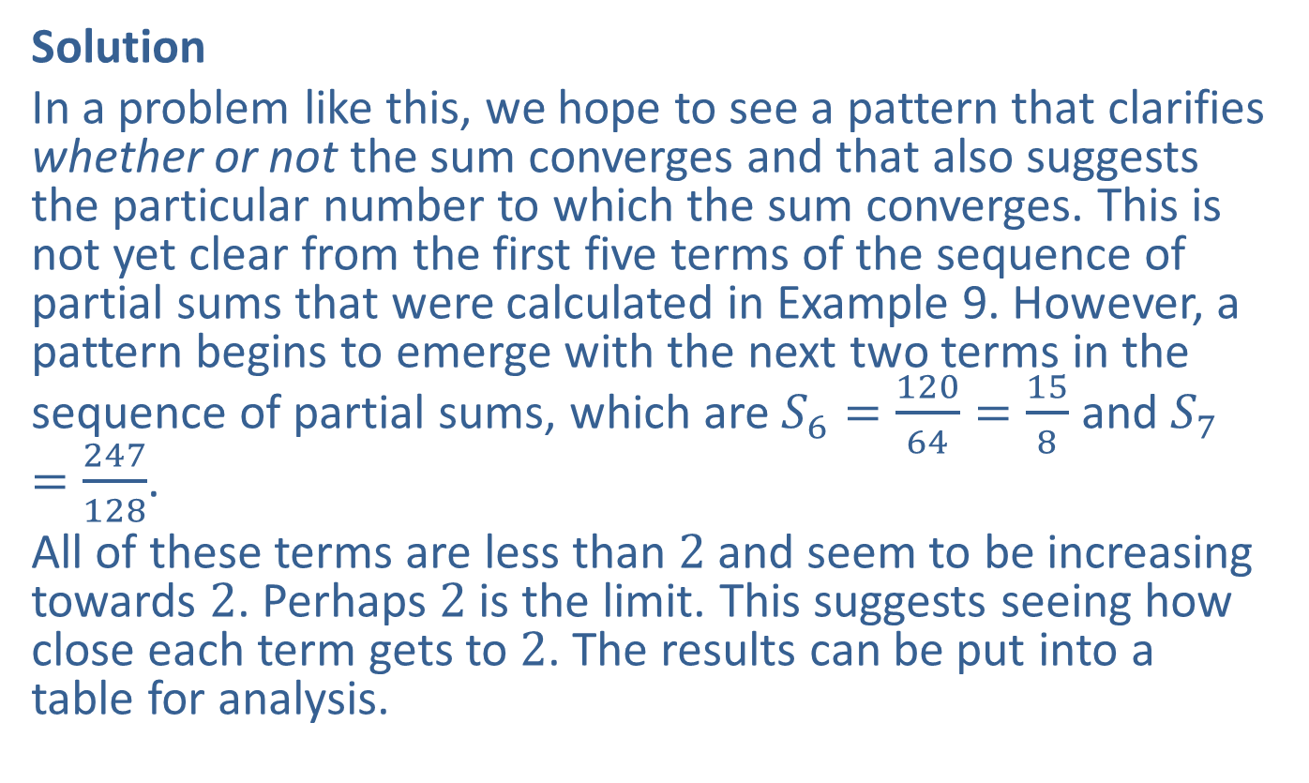
Example 10: Converging Series (cont.)
Solution
In a problem like this, we hope to see a pattern that clarifies whether or not the sum converges and that also suggests the particular number to which the sum converges. This is not yet clear from the first five terms of the sequence of partial sums that were calculated in Example 9. However, a pattern begins to emerge with the next two terms in the sequence of partial sums, which are $S_{6}=\frac{120}{64}=\frac{15}{8}$ and $S_{7}=\frac{247}{128}$.
All of these terms are less than 2 and seem to be increasing towards 2. Perhaps 2 is the limit. This suggests seeing how close each term gets to 2. The results can be put into a table for analysis.

Slide 25
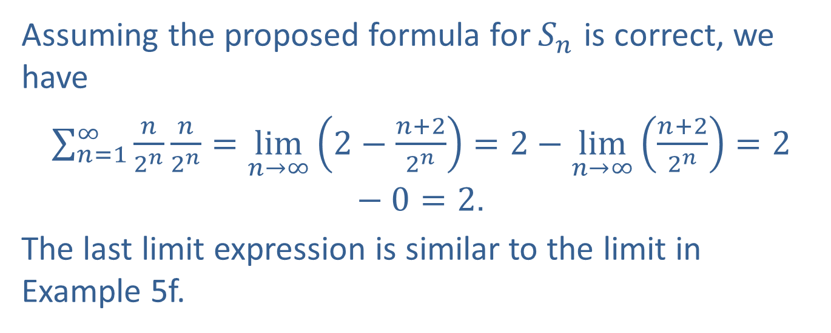
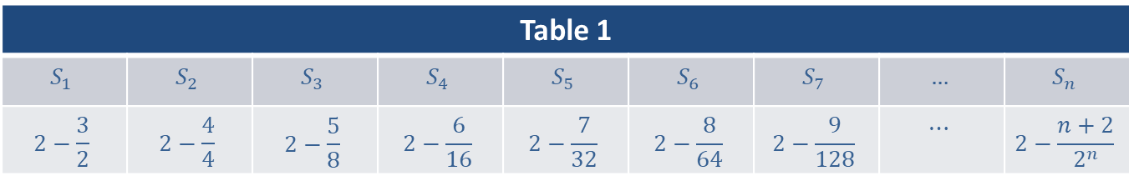
Example 10: Converging Series (cont.)
Table 1
$$S_{1}$$ | $$S_{2}$$ | $$S_{3}$$ | $$S_{4}$$ | $$S_{5}$$ | $$S_{6}$$ | $$S_{7}$$ | $$…$$ | $$S_{n}$$
$$2−\frac{3}{2}$$ | $$2−\frac{4}{4}$$ | $$2−\frac{5}{8}$$ | $$2−\frac{6}{16}$$ | $$2−\frac{7}{32}$$ | $$2−\frac{8}{64}$$ | $$2−\frac{9}{128}$$ | $$⋯$$ | $$2−\frac{n+2}{2^{n}}$$
Assuming the proposed formula for $S_{n}$ is correct, we have
$\sum_{n=1}^{∞}{\frac{n}{2^{n}}}\frac{n}{2^{n}}=\lim_{n→∞}\left(2−\frac{n+2}{2^{n}}\right)=2−\lim_{n→∞}\left(\frac{n+2}{2^{n}}\right)=2−0=2$.
The last limit expression is similar to the limit in Example 5f.

Slide 26
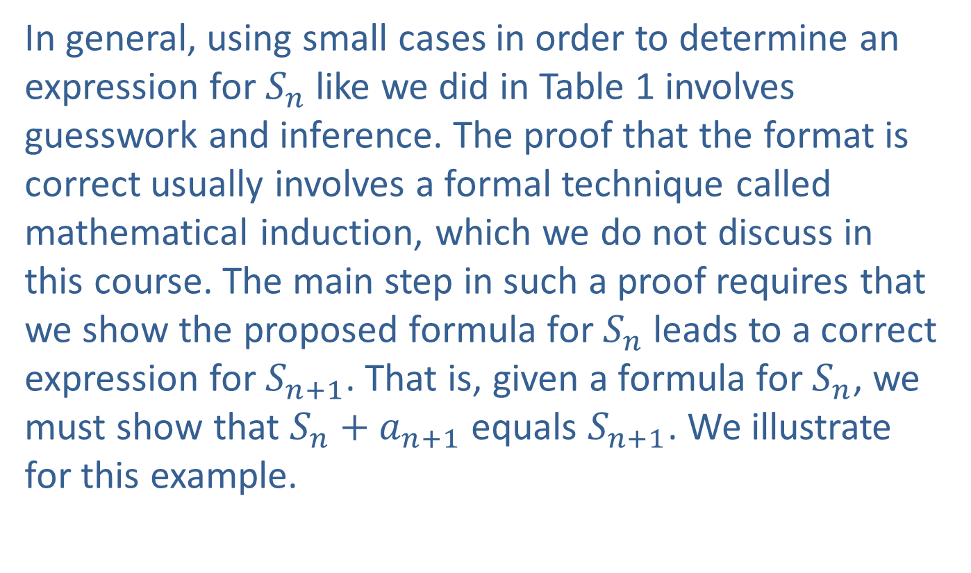
Example 10: Converging Series (cont.)
In general, using small cases in order to determine an expression for $S_{n}$ like we did in Table 1 involves guesswork and inference. The proof that the format is correct usually involves a formal technique called mathematical induction, which we do not discuss in this course. The main step in such a proof requires that we show the proposed formula for $S_{n}$ leads to a correct expression for $S_{n+1}$. That is, given a formula for $S_{n}$, we must show that $S_{n}+a_{n+1}$ equals $S_{n+1}$. We illustrate for this example.

Slide 27
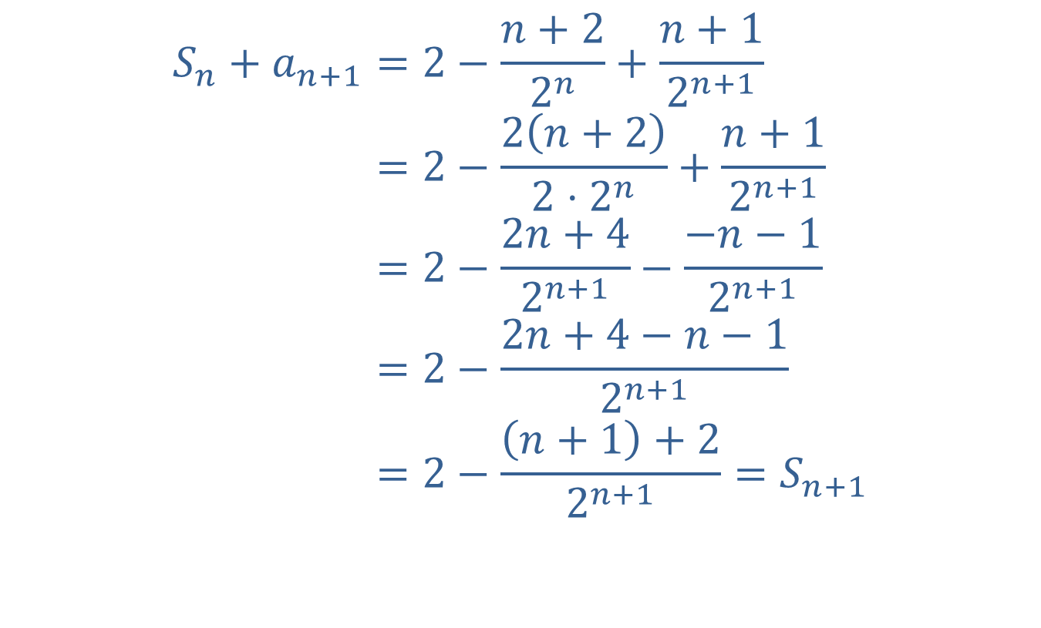
Example 10: Converging Series (cont.)
𝑆𝑛+𝑎𝑛+1=2−𝑛+22𝑛+𝑛+12𝑛+1𝑆𝑛+𝑎𝑛+1=2−2𝑛+22⋅2𝑛+𝑛+12𝑛+1𝑆𝑛+𝑎𝑛+1=2−2𝑛+42𝑛+1−−𝑛−12𝑛+1𝑆𝑛+𝑎𝑛+1=2−2𝑛+4−𝑛−12𝑛+1𝑆𝑛+𝑎𝑛+1=2−𝑛+1+22𝑛+1=𝑆𝑛+1

Slide 28
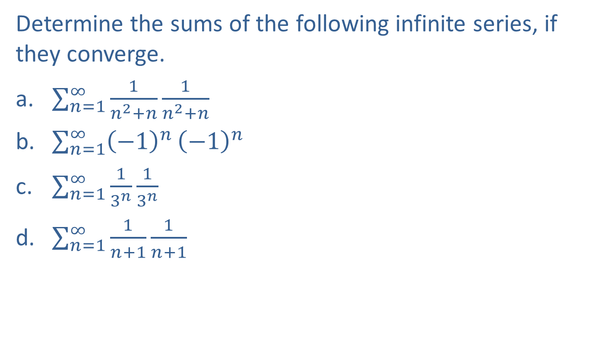
Example 11: Calculating the Sum of an Infinite Series
Determine the sums of the following infinite series, if they converge.
​$\sum_{n=1}^{∞}{\frac{1}{n^{2}+n}}\frac{1}{n^{2}+n}$
​$\sum_{n=1}^{∞}{{\left(−1\right)}^{n}}{\left(−1\right)}^{n}$
​$\sum_{n=1}^{∞}{\frac{1}{3^{n}}}\frac{1}{3^{n}}$
​$\sum_{n=1}^{∞}{\frac{1}{n+1}}\frac{1}{n+1}$

Slide 29
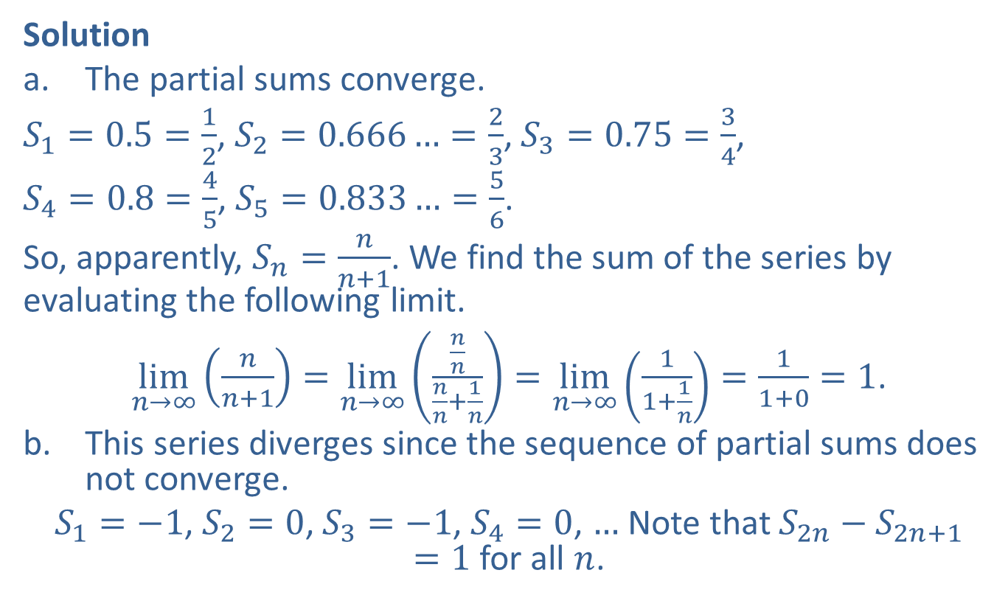
Example 11: Calculating the Sum of an Infinite Series (cont.)
Solution
​The partial sums converge.
​$S_{1}=0.5=\frac{1}{2}$, $S_{2}=0.666…=\frac{2}{3}$, $S_{3}=0.75=\frac{3}{4}$,
​$S_{4}=0.8=\frac{4}{5}$, $S_{5}=0.833…=\frac{5}{6}$.
​So, apparently, $S_{n}=\frac{n}{n+1}$. We find the sum of the series by evaluating the following limit.
​$\lim_{n→∞}\left(\frac{n}{n+1}\right)=\lim_{n→∞}\left(\frac{\frac{n}{n}}{\frac{n}{n}+\frac{1}{n}}\right)=\lim_{n→∞}\left(\frac{1}{1+\frac{1}{n}}\right)=\frac{1}{1+0}=1$.
​This series diverges since the sequence of partial sums does not converge.
​$S_{1}=−1$, $S_{2}=0$, $S_{3}=−1$, $S_{4}=0$, $…$ Note that $S_{2n}−S_{2n+1}=1$ for all $n$.

Slide 30
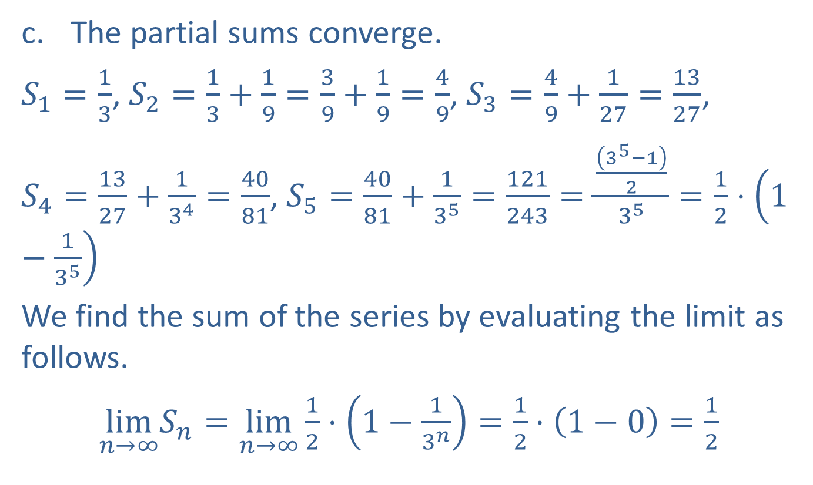
Example 11: Calculating the Sum of an Infinite Series (cont.)
​The partial sums converge.
​$S_{1}=\frac{1}{3}$, $S_{2}=\frac{1}{3}+\frac{1}{9}=\frac{3}{9}+\frac{1}{9}=\frac{4}{9}$, $S_{3}=\frac{4}{9}+\frac{1}{27}=\frac{13}{27}$,
​$S_{4}=\frac{13}{27}+\frac{1}{3^{4}}=\frac{40}{81}$, $S_{5}=\frac{40}{81}+\frac{1}{3^{5}}=\frac{121}{243}=\frac{\frac{\left(3^{5}−1\right)}{2}}{3^{5}}=\frac{1}{2}⋅\left(1−\frac{1}{3^{5}}\right)$
​We find the sum of the series by evaluating the limit as follows.
​$\lim_{n→∞}S_{n}=\lim_{n→∞}\frac{1}{2}⋅\left(1−\frac{1}{3^{n}}\right)=\frac{1}{2}⋅\left(1−0\right)=\frac{1}{2}$

Slide 31
Example 11: Calculating the Sum of an Infinite Series (cont.)
​This series diverges. This is an important infinite series. It seems like it would converge since the terms of the sequence of partial sums are not too large and the terms of the given series are getting closer together. Nevertheless, the partial sums increase without bound ("go to infinity"). We can see this by partitioning the terms of the series in a new way, as follows.
​

Slide 32
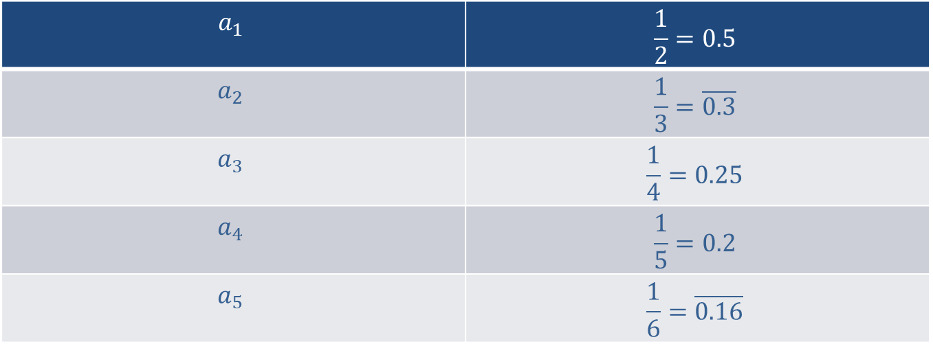
Example 11: Calculating the Sum of an Infinite Series (cont.)
$$a_{1}$$ | $$\frac{1}{2}=0.5$$
$$a_{2}$$ | $$\frac{1}{3}=\overline{0.3}$$
$$a_{3}$$ | $$\frac{1}{4}=0.25$$
$$a_{4}$$ | $$\frac{1}{5}=0.2$$
$$a_{5}$$ | $$\frac{1}{6}=\overline{0.16}$$

Slide 33
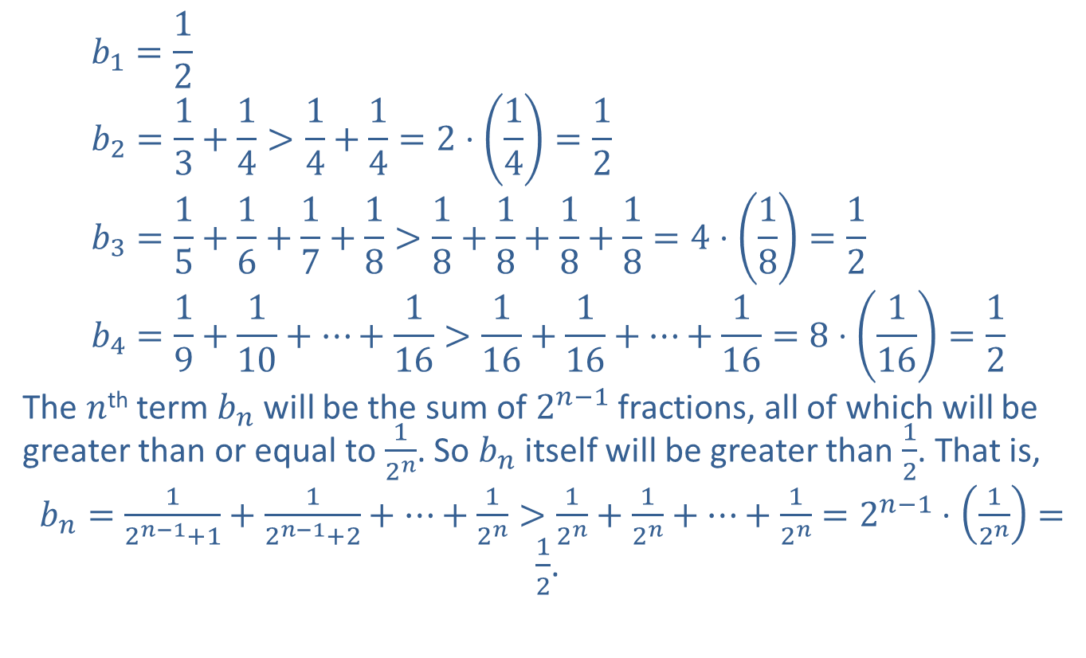
Example 11: Calculating the Sum of an Infinite Series (cont.)
$$b_{1}=\frac{1}{2} \\ b_{2}=\frac{1}{3}+\frac{1}{4}>\frac{1}{4}+\frac{1}{4}=2⋅\left(\frac{1}{4}\right)=\frac{1}{2} \\ b_{3}=\frac{1}{5}+\frac{1}{6}+\frac{1}{7}+\frac{1}{8}>\frac{1}{8}+\frac{1}{8}+\frac{1}{8}+\frac{1}{8}=4⋅\left(\frac{1}{8}\right)=\frac{1}{2} \\ b_{4}=\frac{1}{9}+\frac{1}{10}+⋯+\frac{1}{16}>\frac{1}{16}+\frac{1}{16}+⋯+\frac{1}{16}=8⋅\left(\frac{1}{16}\right)=\frac{1}{2}$$
​The $n$^{th} term $b_{n}$ will be the sum of $2^{n−1}$ fractions, all of which will be greater than or equal to $\frac{1}{2^{n}}$. So $b_{n}$ itself will be greater than $\frac{1}{2}$. That is,
​ $b_{n}=\frac{1}{2^{n−1}+1}+\frac{1}{2^{n−1}+2}+⋯+\frac{1}{2^{n}}>\frac{1}{2^{n}}+\frac{1}{2^{n}}+⋯+\frac{1}{2^{n}}=2^{n−1}⋅\left(\frac{1}{2^{n}}\right)=\frac{1}{2}$.
​

Slide 34
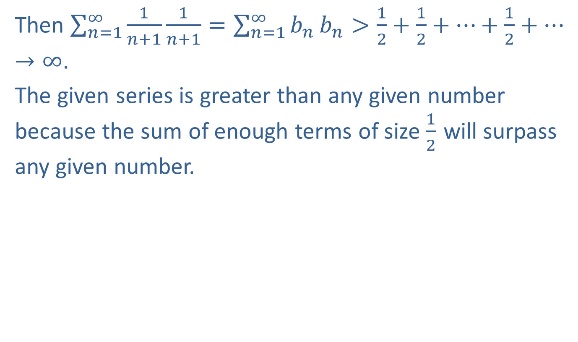
Example 11: Calculating the Sum of an Infinite Series (cont.)
Then $\sum_{n=1}^{∞}{\frac{1}{n+1}}\frac{1}{n+1}=\sum_{n=1}^{∞}{b_{n}}b_{n}>\frac{1}{2}+\frac{1}{2}+⋯+\frac{1}{2}+⋯→∞$.
​The given series is greater than any given number because the sum of enough terms of size $\frac{1}{2}$ will surpass any given number.

Slide 35

Example 12: Limits
Show that $\lim_{x→∞}\left(\ln{x}\right)$ does not exist.

Slide 36
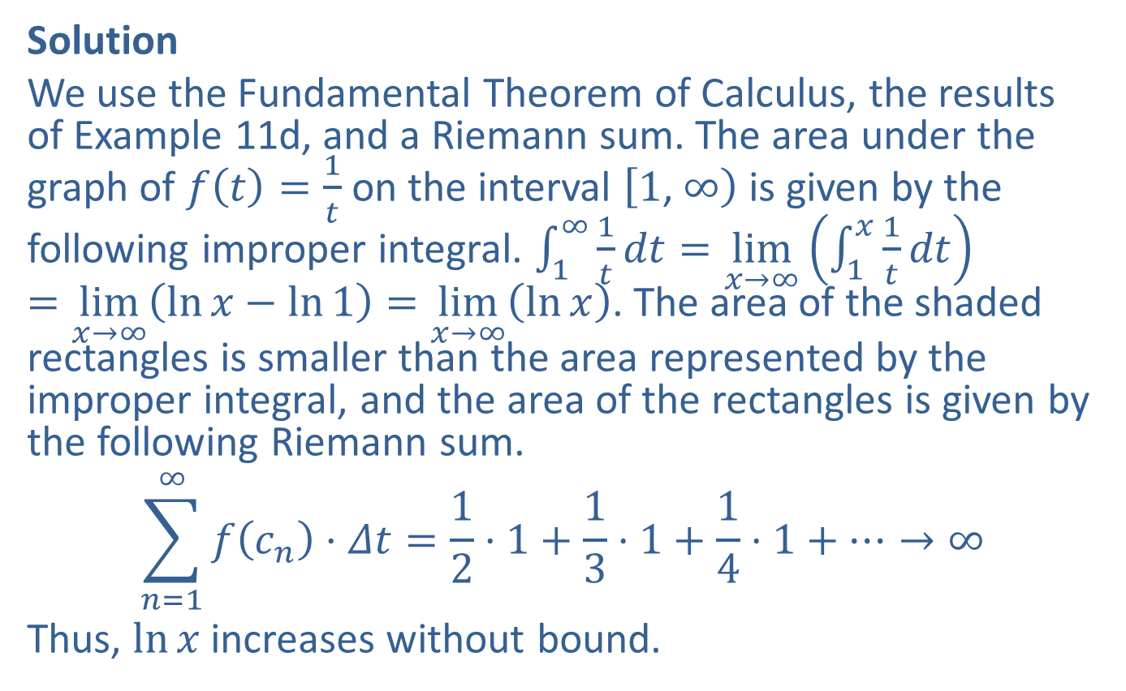
Example 12: Limits (cont.)
Solution
We use the Fundamental Theorem of Calculus, the results of Example 11d, and a Riemann sum. The area under the graph of $f\left(t\right)=\frac{1}{t}$ on the interval $\left[1\text{, }∞\right)$ is given by the following improper integral. $\int_{1}^{∞}{\frac{1}{t}dt}=\lim_{x→∞}\left(\int_{1}^{x}{\frac{1}{t}dt}\right)=\lim_{x→∞}\left(\ln{x}−\ln{1}\right)=\lim_{x→∞}\left(\ln{x}\right)$. The area of the shaded rectangles is smaller than the area represented by the improper integral, and the area of the rectangles is given by the following Riemann sum.
$$\sum_{n=1}^{∞}{f\left(c_{n}\right)⋅Δt}=\frac{1}{2}⋅1+\frac{1}{3}⋅1+\frac{1}{4}⋅1+⋯→∞$$
Thus, $ln⁡x$ increases without bound.

Slide 37
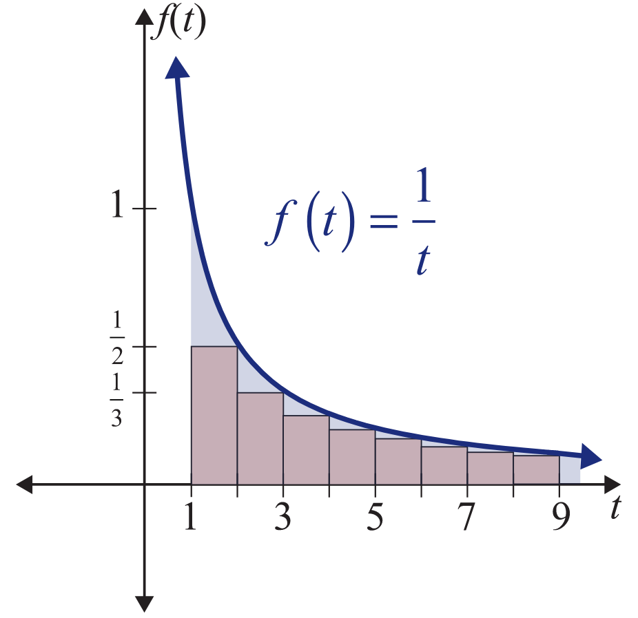
Example 12: Limits (cont.)

Slide 38
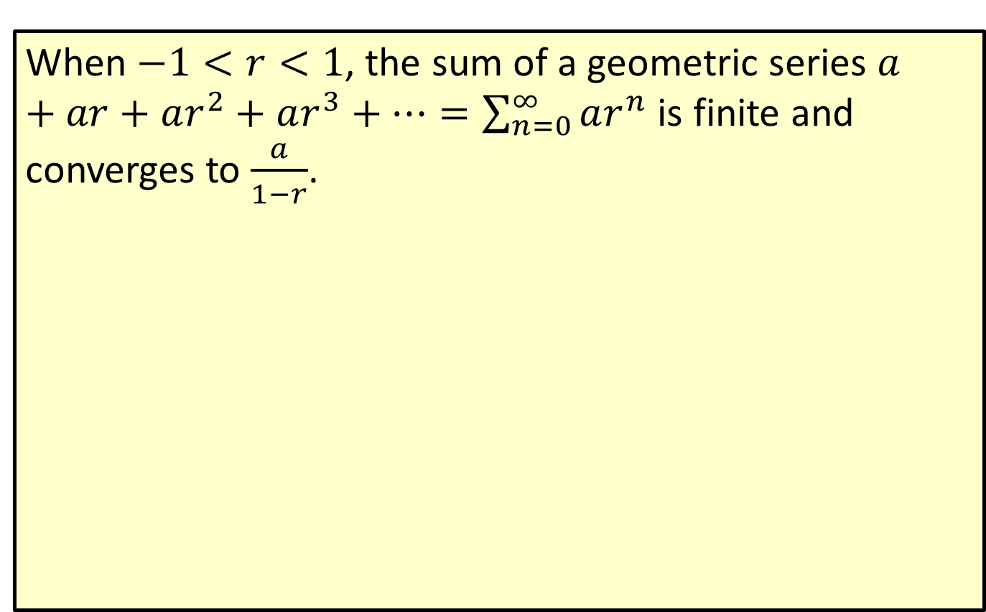
Convergence of a Geometric Series
When $−1<r<1$, the sum of a geometric series $a+ar+ar^{2}+ar^{3}+⋯=\sum_{n=0}^{∞}{ar^{n}}$ is finite and converges to $\frac{a}{1−r}$.

Slide 39

Example 13: Sums of Geometric Series
Determine the sums of the following geometric series, if they converge.
​$\sum_{n=0}^{∞}{\frac{3}{2^{n}}}\frac{3}{2^{n}}$
​$2−1+\frac{1}{2}−\frac{1}{4}+\frac{1}{8}−\frac{1}{16}+⋯$
​$\frac{1}{4}+\frac{1}{4^{2}}+\frac{1}{4^{3}}+⋯$

Slide 40
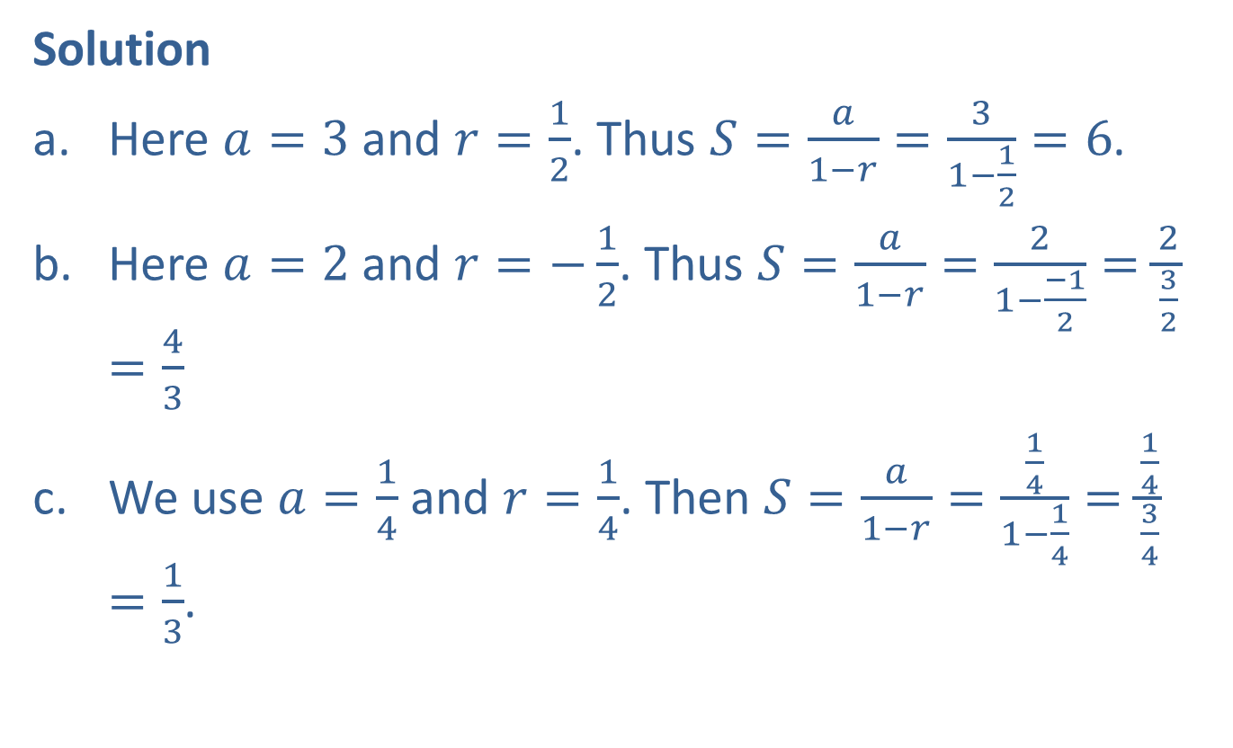
Example 13: Sums of Geometric Series (cont.)
Solution
​Here $a=3$ and $r=\frac{1}{2}$. Thus $S=\frac{a}{1−r}=\frac{3}{1−\frac{1}{2}}=6$.
​Here $a=2$ and $r=−\frac{1}{2}$. Thus $S=\frac{a}{1−r}=\frac{2}{1−\frac{−1}{2}}=\frac{2}{\frac{3}{2}}=\frac{4}{3}$
​We use $a=\frac{1}{4}$ and $r=\frac{1}{4}$. Then $S=\frac{a}{1−r}=\frac{\frac{1}{4}}{1−\frac{1}{4}}=\frac{\frac{1}{4}}{\frac{3}{4}}=\frac{1}{3}$.
​​

Slide 41
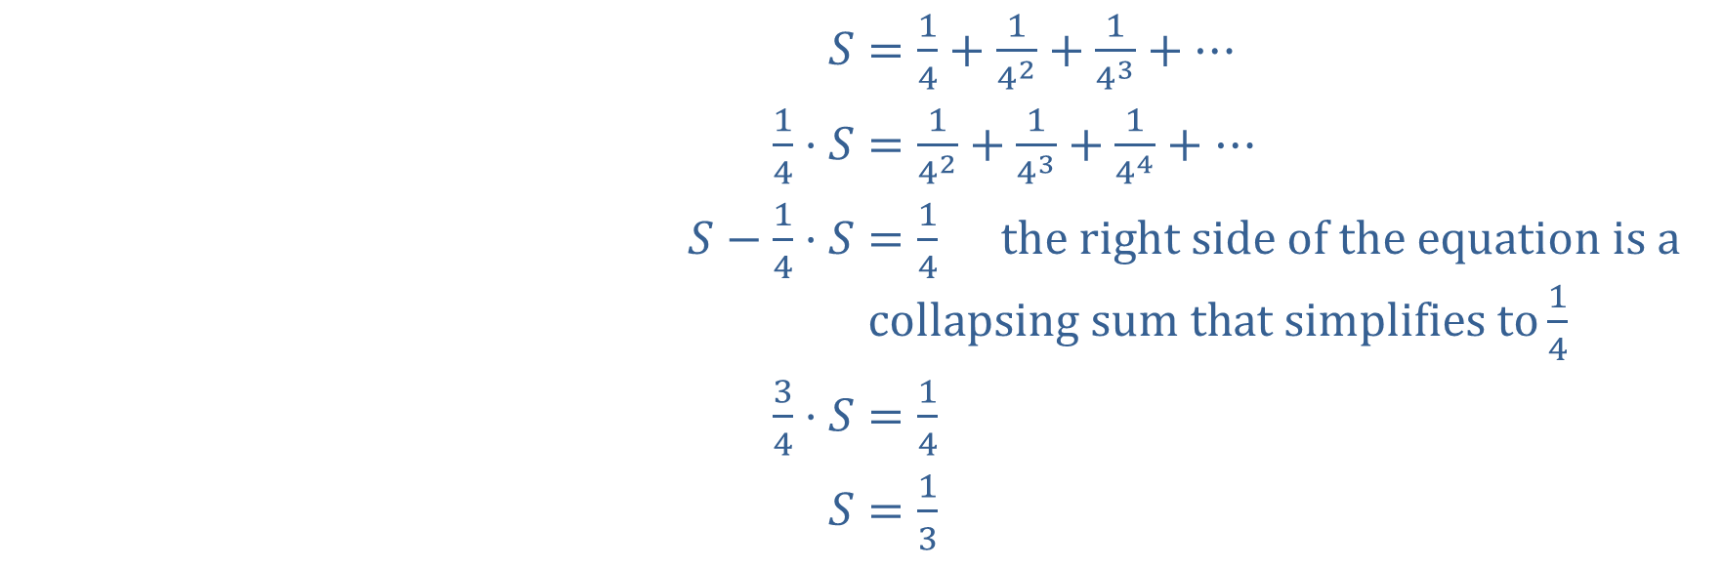

Example 13: Sums of Geometric Series (cont.)
Another way to find the sum is to multiply by $\frac{1}{4}$ to get a second equation and then subtract as follows.
​$S$ | ​$=\frac{1}{4}+\frac{1}{4^{2}}+\frac{1}{4^{3}}+⋯$
​$\frac{1}{4}⋅S$ | ​$=\frac{1}{4^{2}}+\frac{1}{4^{3}}+\frac{1}{4^{4}}+⋯$
​$S−\frac{1}{4}⋅S$ | ​$=\frac{1}{4} \text{the} \text{right} \text{side} \text{of} \text{the} \text{equation} \text{is} \text{a} \text{collapsing} \text{sum} \text{that} \text{simplifies} \text{to}\frac{1}{4}$
​$\frac{3}{4}⋅S$ | ​$=\frac{1}{4}$
​$S$ | ​$=\frac{1}{3}$

Slide 42
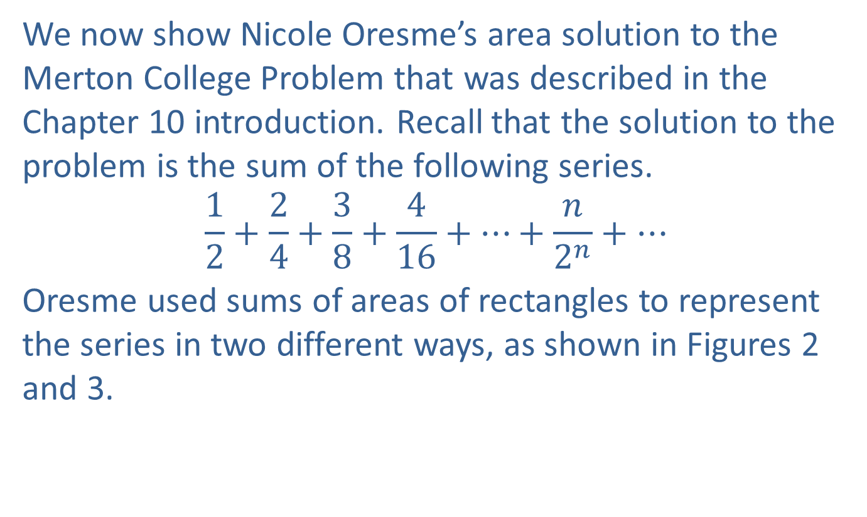
Example 14: Merton College Puzzle
We now show Nicole Oresme’s area solution to the Merton College Problem that was described in the Chapter 10 introduction. Recall that the solution to the problem is the sum of the following series.
$$\frac{1}{2}+\frac{2}{4}+\frac{3}{8}+\frac{4}{16}+⋯+\frac{n}{2^{n}}+⋯$$
Oresme used sums of areas of rectangles to represent the series in two different ways, as shown in Figures 2 and 3.

Slide 43
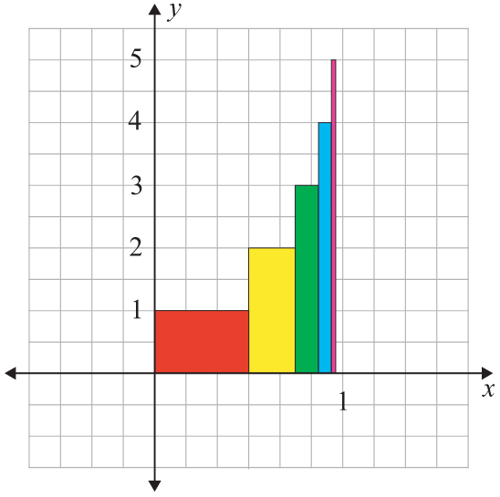
Example 14: Merton College Puzzle (cont.)
Figure 2

Slide 44
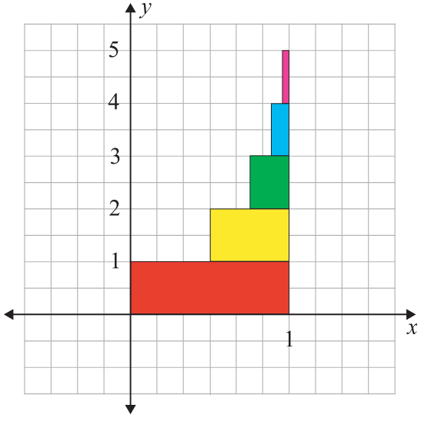
Example 14: Merton College Puzzle (cont.)
Figure 3

Slide 45
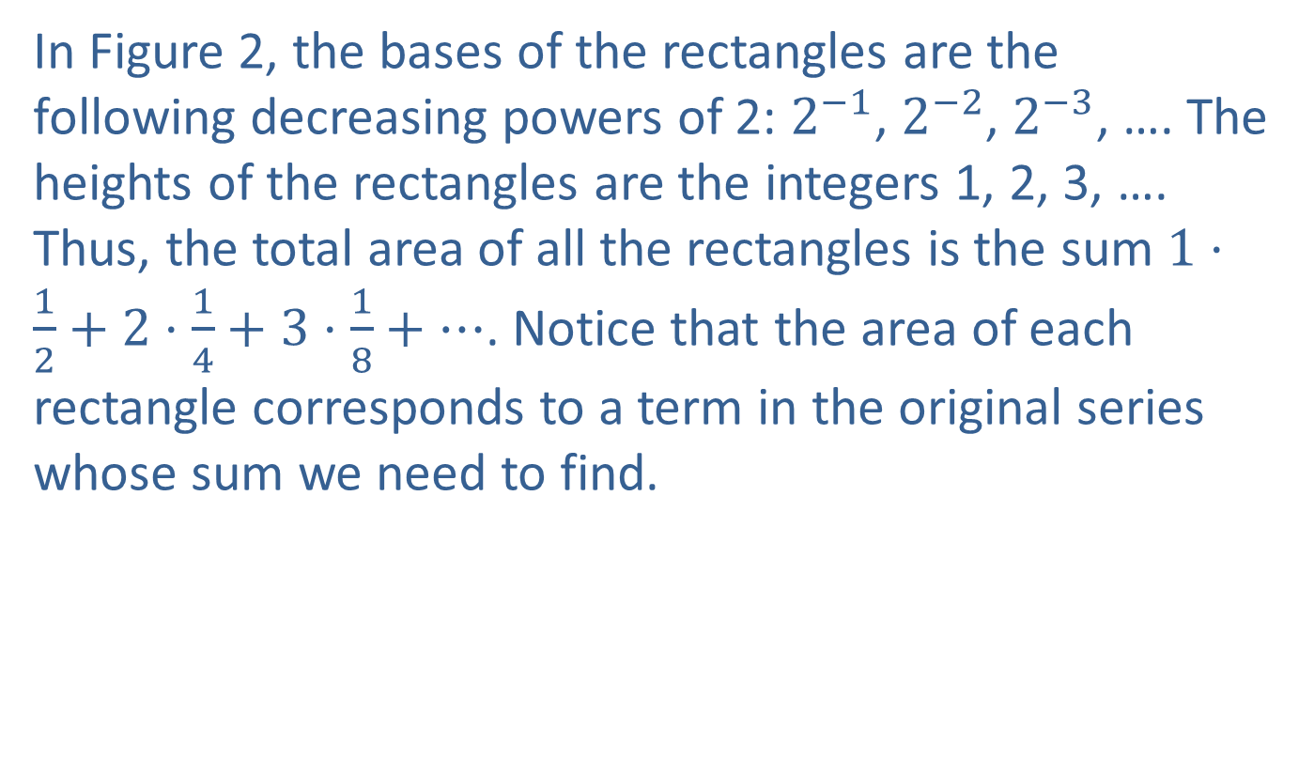
Example 14: Merton College Puzzle (cont.)
In Figure 2, the bases of the rectangles are the following decreasing powers of 2: $2^{−1}$, $2^{−2}$, $2^{−3}$, …. The heights of the rectangles are the integers 1, 2, 3, …. Thus, the total area of all the rectangles is the sum $1⋅\frac{1}{2}+2⋅\frac{1}{4}+3⋅\frac{1}{8}+…$. Notice that the area of each rectangle corresponds to a term in the original series whose sum we need to find.

Slide 46

Example 14: Merton College Puzzle (cont.)
In Figure 3, the same total area is decomposed into rectangles of height 1 with bases that are the following decreasing powers of 2: $2^{−1}$, $2^{−2}$, $2^{−3}$, …. Thus, the total area of all these rectangles is the sum $!+\frac{1}{2}+\frac{1}{4}+\frac{1}{8}+…$. We recognize this sum as a geometric series with $a=1$ and $r=\frac{1}{2}$. Therefore, the total area is $\frac{a}{1−r}=\frac{1}{1−\frac{1}{2}}=\frac{1}{\frac{1}{2}}=2$.

