Slide 1
Section 10.2
Taylor Polynomials

Slide 2
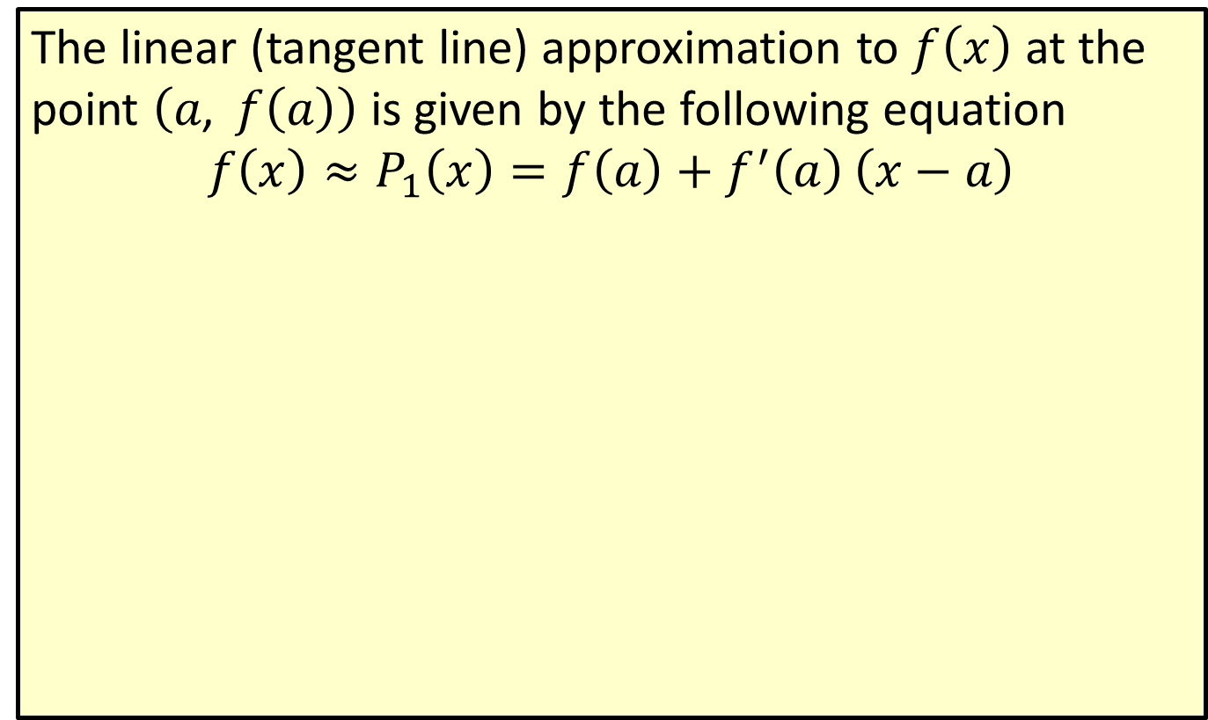
Linear Approximation
The linear (tangent line) approximation to $f⁡\left(x\right)$ at the point $\left(a\text{, }f\left(a\right)\right)$ is given by the following equation
$$f\left(x\right)≈P_{1}\left(x\right)=f\left(a\right)+f^{′}\left(a\right)\left(x−a\right)$$

Slide 3
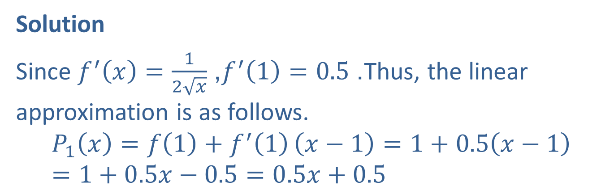

Example 1: Linear Approximation
Find the linear approximation $P_{1}⁡\left(x\right)$ to $y=\sqrt{x}$ at the point $\left(1\text{, }1\right)$.
Solution
Since $f^{′}\left(x\right)=\frac{1}{2\sqrt{x}}$, $f^{′}\left(1\right)=0.5$. Thus, the linear approximation is as follows.
$$P_{1}\left(x\right)=f\left(1\right)+f^{′}\left(1\right)\left(x−1\right)=1+0.5\left(x−1\right)=1+0.5x−0.5=0.5x+0.5$$

Slide 4
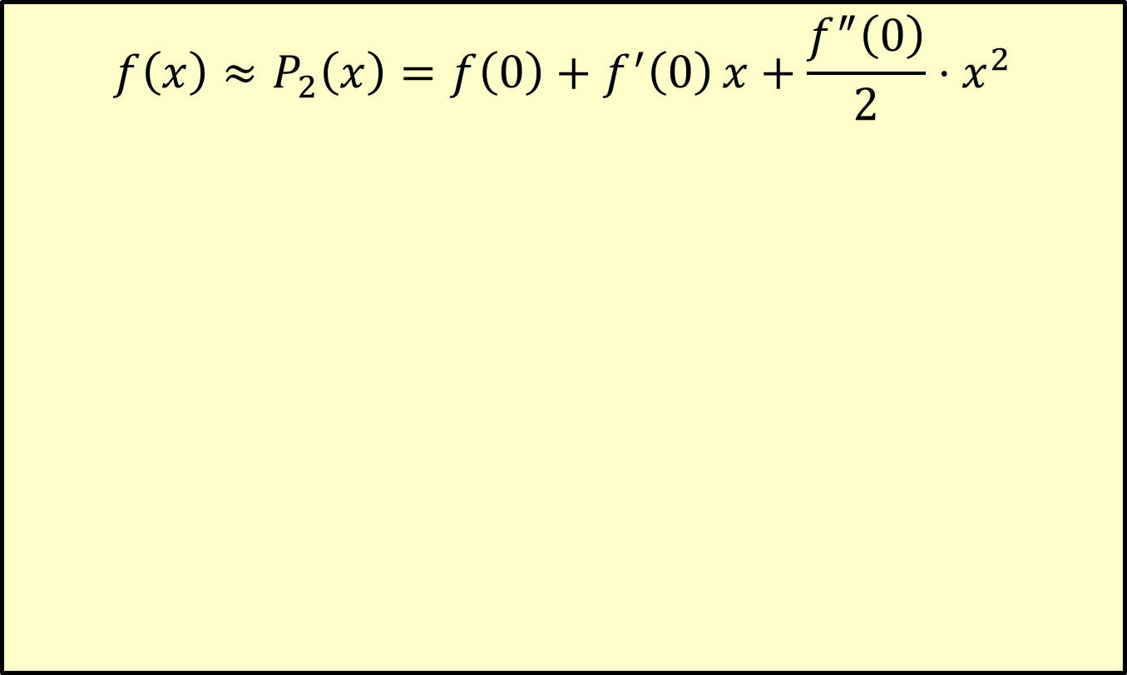

The Taylor Polynomial of Degree 2 Approximating $f$ ($x$) near $x$ = 0
$$f\left(x\right)≈P_{2}\left(x\right)=f\left(0\right)+f^{′}\left(0\right)x+\frac{f^{″}\left(0\right)}{2}⋅x^{2}$$

Slide 5
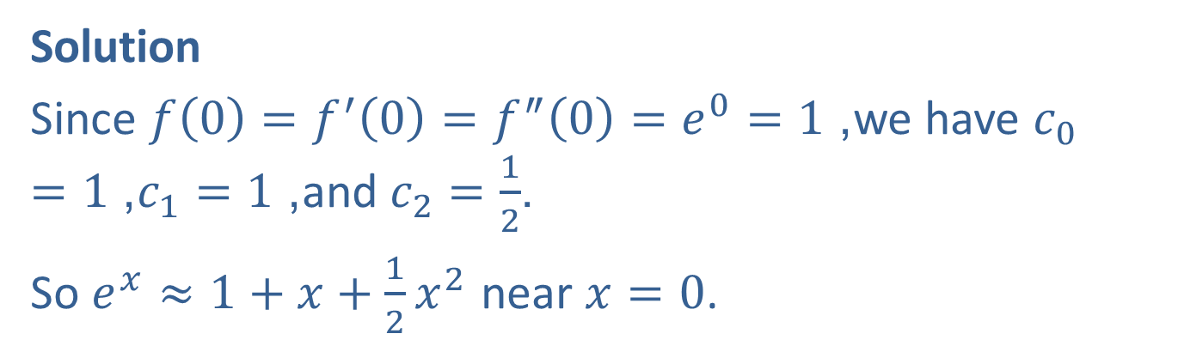

Example 2: Taylor Polynomial of Degree 2
Determine the Taylor polynomial of degree 2 approximating $y=e^{x}$ near $x=0$.
Solution
Since $f\left(0\right)=f^{′}\left(0\right)=f^{″}\left(0\right)=e^{0}=1$, we have $c_{0}=1$, $c_{1}=1$, and $c_{2}=\frac{1}{2}$.
So $e^{x}≈1+x+\frac{1}{2}x^{2}$ near $x=0$.

Slide 6
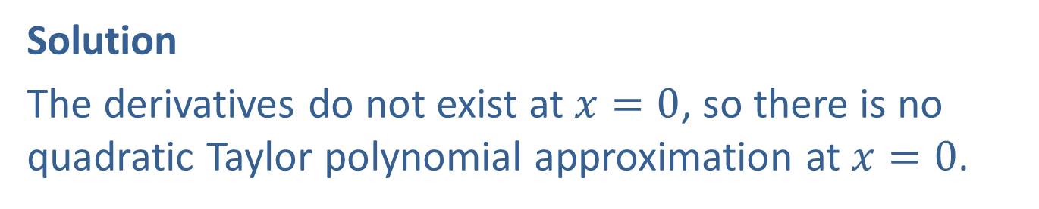

Example 3: Taylor Polynomial of Degree 2
Determine the Taylor polynomial of degree 2 approximating $y=\sqrt{x}$ near the point $\left(0\text{, }0\right)$.
Solution
The derivatives do not exist at $x=0$, so there is no quadratic Taylor polynomial approximation at $x=0$.

Slide 7
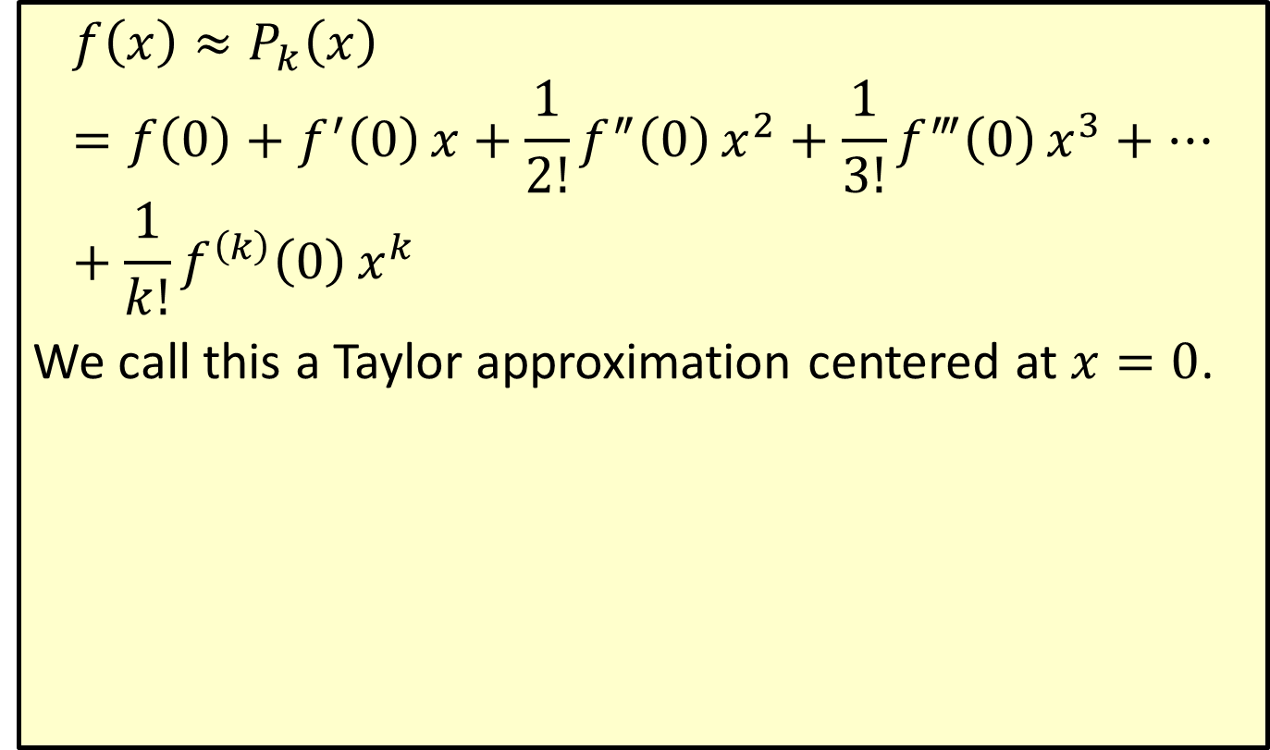

The Taylor Polynomial of Degree $k$ Approximating $f$ ($x$) near $x$ = 0
$$f\left(x\right)≈P_{k}\left(x\right)=f\left(0\right)+f^{′}\left(0\right)x+\frac{1}{2!}f^{″}\left(0\right)x^{2}+\frac{1}{3!}f^{‴}\left(0\right)x^{3}+⋯+\frac{1}{k!}f^{\left(k\right)}\left(0\right)x^{k}$$
We call this a Taylor approximation centered at $x=0$.

Slide 8

Example 4: Taylor Polynomial of Degree 7
Construct the Taylor polynomial of degree 7 for $y=\sin{x}$ near $x=0$.

Slide 9
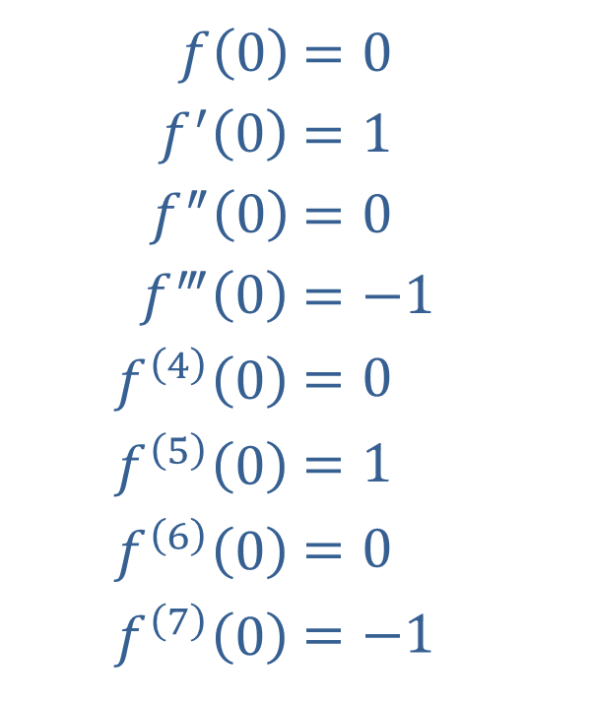
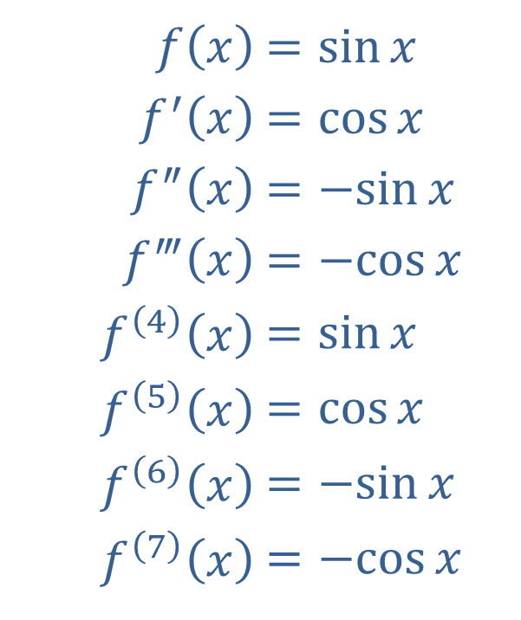
Example 4: Taylor Polynomial of Degree 7 (cont.)
Solution
​
​$f⁡\left(x\right)$ | ​$=\sin{x}$
​$f^{′}⁡\left(x\right)$ | ​$=\cos{x}$
​$f^{″}⁡\left(x\right)$ | ​$=−sin⁡x$
​$f^{‴}⁡\left(x\right)$ | ​$=−cos⁡x$
​$f^{\left(4\right)}⁡\left(x\right)$ | ​$=\sin{x}$
​$f^{\left(5\right)}⁡\left(x\right)$ | ​$=\cos{x}$
​$f^{\left(6\right)}⁡\left(x\right)$ | ​$=−sin⁡x$
​$f^{\left(7\right)}⁡\left(x\right)$ | ​$=−cos⁡x$
​$f⁡\left(0\right)$ | ​$=0$
​$f^{′}⁡\left(0\right)$ | ​$=1$
​$f^{″}⁡\left(0\right)$ | ​$=0$
​$f^{‴}⁡\left(0\right)$ | ​$=−1$
​$f^{\left(4\right)}⁡\left(0\right)$ | ​$=0$
​$f^{\left(5\right)}⁡\left(0\right)$ | ​$=1$
​$f^{\left(6\right)}⁡\left(0\right)$ | ​$=0$
​$f^{\left(7\right)}⁡\left(0\right)$ | ​$=−1$

Slide 10

Example 4: Taylor Polynomial of Degree 7 (cont.)
Substituting these values into the formula for a Taylor polynomial of degree 7, we get the following Taylor approximation centered at $x=0$.
$$\sin{x}≈P_{7}\left(x\right)=x−\frac{1}{3!}x^{3}+\frac{1}{5!}x^{5}−\frac{1}{7!}x^{7}$$

Slide 11
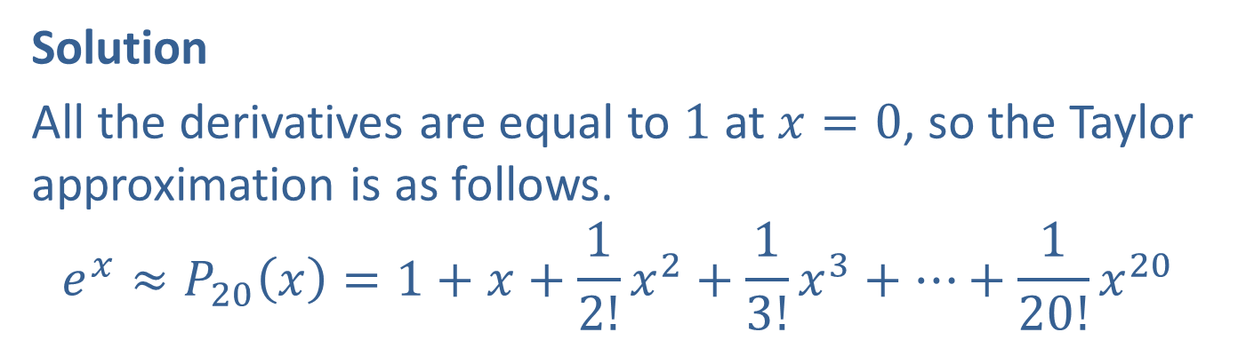

Example 5: Taylor Polynomial of Degree 20
Construct the Taylor polynomial of degree 20 for $y=e^{x}$ near $x=0$.
Solution
All the derivatives are equal to 1 at $x=0$, so the Taylor approximation is as follows.
$$e^{x}≈P_{20}\left(x\right)=1+x+\frac{1}{2!}x^{2}+\frac{1}{3!}x^{3}+⋯+\frac{1}{20!}x^{20}$$

Slide 12



Example 6: Taylor Polynomial of Degree $k$
Construct the Taylor polynomial of degree $k$ for $y=e^{3x}$ near $x=0$.
Solution
The first derivative is $f^{′}\left(x\right)=3e^{3x}$ and in general, $f^{\left(k\right)}\left(x\right)=3^{k}e^{3x}$.
Evaluating at $x=0$, we have $f^{\left(k\right)}\left(0\right)=3^{k}e^{3⋅0}=3^{k}⋅1=3^{k}$.
Thus, the general Taylor polynomial is the following.
$e^{3x}≈1+3x+\frac{3^{2}x^{2}}{2!}+\frac{3^{3}x^{3}}{3!}+\frac{3^{4}x^{4}}{4!}+⋯+\frac{3^{k}x^{k}}{k!}$.

Slide 13
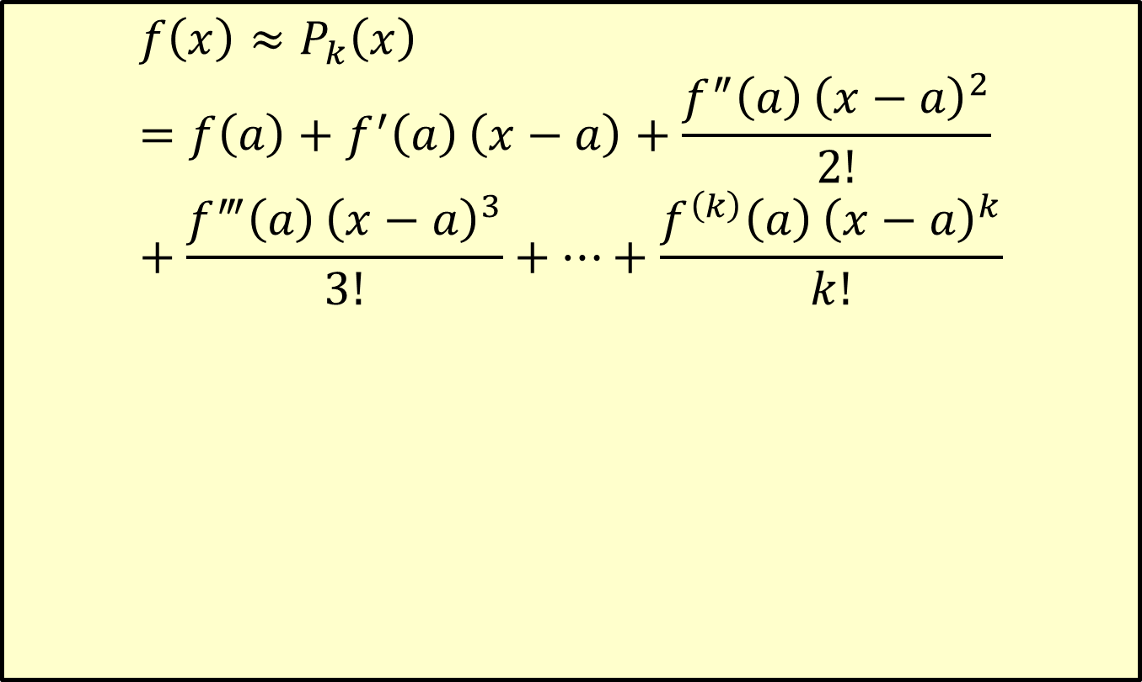

The General Taylor Polynomial of Degree $k$ Centered at $x$ = $a$
$$f\left(x\right)≈P_{k}\left(x\right)=f\left(a\right)+f^{′}\left(a\right)\left(x−a\right)+\frac{f^{″}\left(a\right){\left(x−a\right)}^{2}}{2!}+\frac{f^{‴}\left(a\right){\left(x−a\right)}^{3}}{3!}+⋯+\frac{f^{\left(k\right)}\left(a\right){\left(x−a\right)}^{k}}{k!}$$

Slide 14

Example 7: Taylor Polynomial for the Natural Log Function
Construct the Taylor polynomial of degree $k$ for $y=\ln{x}$ centered at $x=1$.

Slide 15
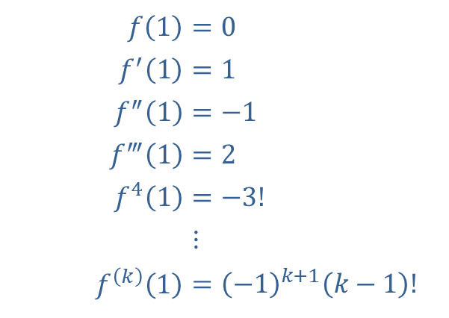
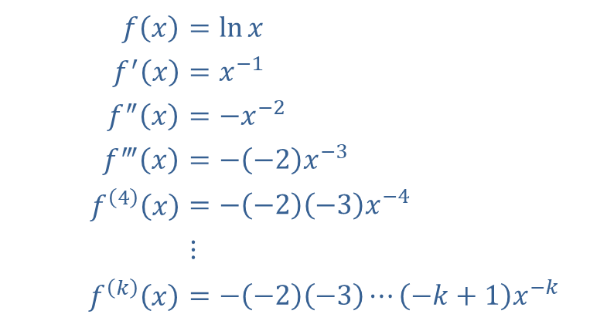
Example 7: Taylor Polynomial for the Natural Log Function (cont.)
Solution
​
​$f⁡\left(x\right)$ | ​$=\ln{x}$
​$f^{′}⁡\left(x\right)$ | ​$=x^{−1}$
​$f^{″}⁡\left(x\right)$ | ​$=−x^{−2}$
​$f^{‴}⁡\left(x\right)$ | ​$=−\left(−2\right)x^{−3}$
​$f^{\left(4\right)}⁡\left(x\right)$ | ​$=−\left(−2\right)\left(−3\right)x^{−4}$
​ | ​$⋮$
​$f^{\left(k\right)}⁡\left(x\right)$ | ​$=−\left(−2\right)\left(−3\right)⋯\left(−k+1\right)x^{−k}$
​$f⁡\left(1\right)$ | ​$=0$
​$f^{′}⁡\left(1\right)$ | ​$=1$
​$f^{″}⁡\left(1\right)$ | ​$=−1$
​$f^{‴}⁡\left(1\right)$ | ​$=2$
​$f^{4}⁡\left(1\right)$ | ​$=−3!$
​ | ​$⋮$
​$f^{\left(k\right)}⁡\left(1\right)$ | ​$={\left(−1\right)}^{k+1}\left(k−1\right)!$

Slide 16
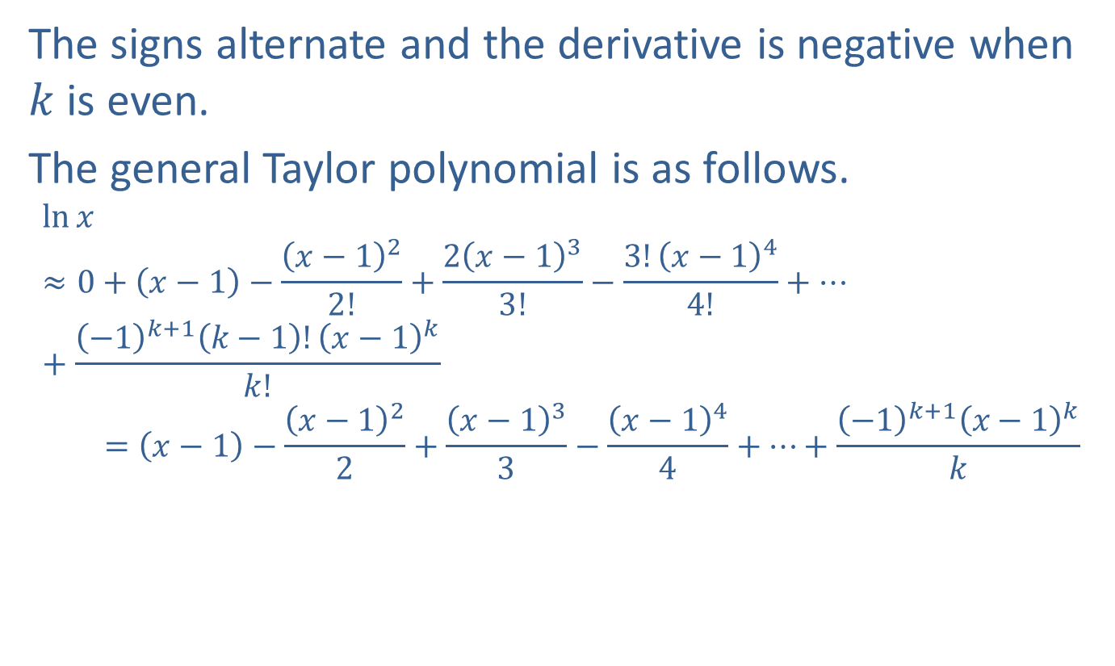
Example 7: Taylor Polynomial for the Natural Log Function (cont.)
The signs alternate and the derivative is negative when $k$ is even.
The general Taylor polynomial is as follows.
ln𝑥≈0+𝑥−1−𝑥−122!+2𝑥−133!−3!𝑥−144!+⋯+−1𝑘+1𝑘−1!𝑥−1𝑘𝑘!ln⁡𝑥=𝑥−1−𝑥−122+𝑥−133−𝑥−144+⋯+−1𝑘+1𝑥−1𝑘𝑘

Slide 17
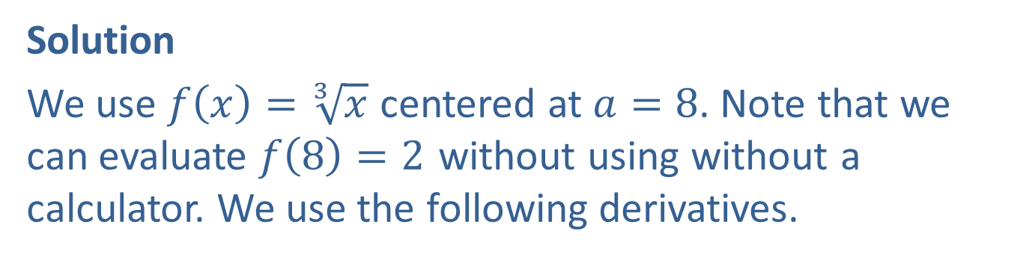

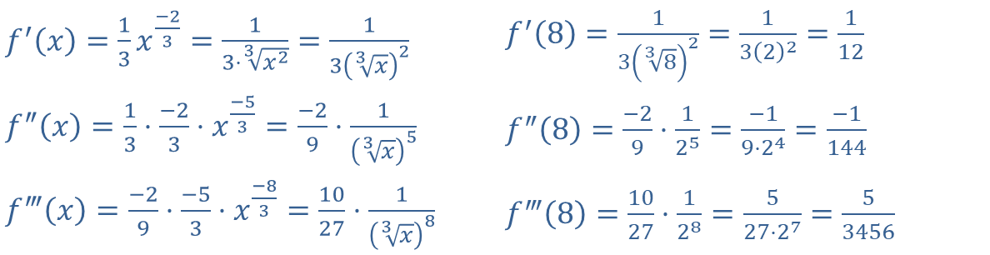
Example 8: Rational Approximation
Obtain a rational number approximation to $\sqrt[3]{8.5}$ using a Taylor polynomial of degree 3.
Solution
We use $f\left(x\right)=\sqrt[3]{x}$ centered at $a=8$. Note that we can evaluate $f\left(8\right)=2$ without using without a calculator. We use the following derivatives.
​$f^{′}\left(x\right)=\frac{1}{3}x^{\frac{−2}{3}}=\frac{1}{3⋅\sqrt[3]{x^{2}}}=\frac{1}{3{\left(\sqrt[3]{x}\right)}^{2}}$ | ​$f^{′}\left(8\right)=\frac{1}{3{\left(\sqrt[3]{8}\right)}^{2}}=\frac{1}{3{\left(2\right)}^{2}}=\frac{1}{12}$
​$f^{″}\left(x\right)=\frac{1}{3}⋅\frac{−2}{3}⋅x^{\frac{−5}{3}}=\frac{−2}{9}⋅\frac{1}{{\left(\sqrt[3]{x}\right)}^{5}}$ | ​$f^{″}\left(8\right)=\frac{−2}{9}⋅\frac{1}{2^{5}}=\frac{−1}{9⋅2^{4}}=\frac{−1}{144}$
​$f^{‴}\left(x\right)=\frac{−2}{9}⋅\frac{−5}{3}⋅x^{\frac{−8}{3}}=\frac{10}{27}⋅\frac{1}{{\left(\sqrt[3]{x}\right)}^{8}}$ | ​$f^{‴}\left(8\right)=\frac{10}{27}⋅\frac{1}{2^{8}}=\frac{5}{27⋅2^{7}}=\frac{5}{3456}$

Slide 18
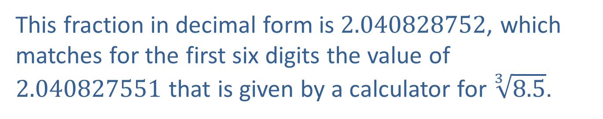
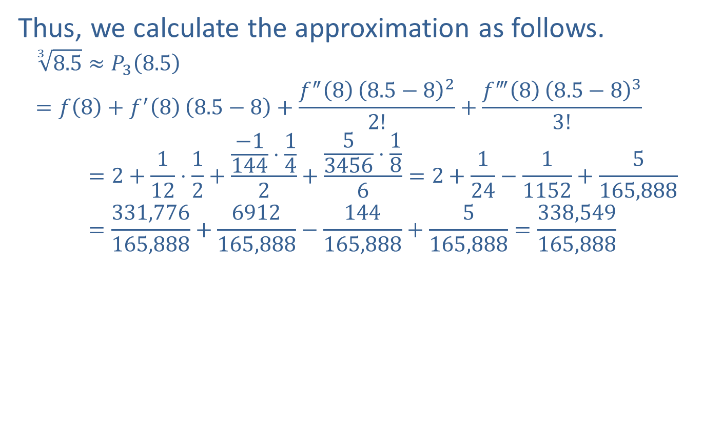
Example 8: Rational Approximation (cont.)
Thus, we calculate the approximation as follows.
38.5≈𝑃38.5=𝑓8+𝑓′88.5−8+𝑓″88.5−822!+𝑓‴88.5−833!38.5=2+112⋅12+−1144⋅142+53456⋅186=2+124−11152+5165,88838.5=331,776165,888+6912165,888−144165,888+5165,888=338,549165,888
This fraction in decimal form is 2.040828752, which matches for the first six digits the value of 2.040827551 that is given by a calculator for $\sqrt[3]{8.5}$.

