Slide 1
Section 10.3
Taylor Series, Power Series, and Their Applications

Slide 2

Example 1: Binomial Coefficient
How many two-element subsets are there in a set of six elements?
Solution
$${}_{6}^{ }{C_{2}}=\frac{6\left(6−1\right)}{1⋅2}=15$$

Slide 3
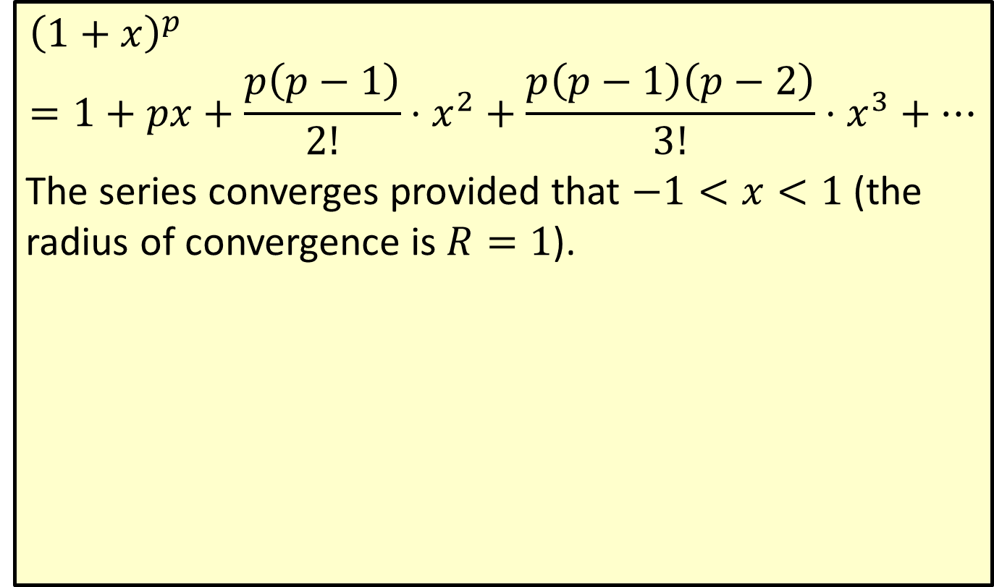
The Binomial Series
$${\left(1+x\right)}^{p}=1+px+\frac{p\left(p−1\right)}{2!}⋅x^{2}+\frac{p\left(p−1\right)\left(p−2\right)}{3!}⋅x^{3}+…$$
The series converges provided that $−1<x<1$ (the radius of convergence is $R=1$).

Slide 4
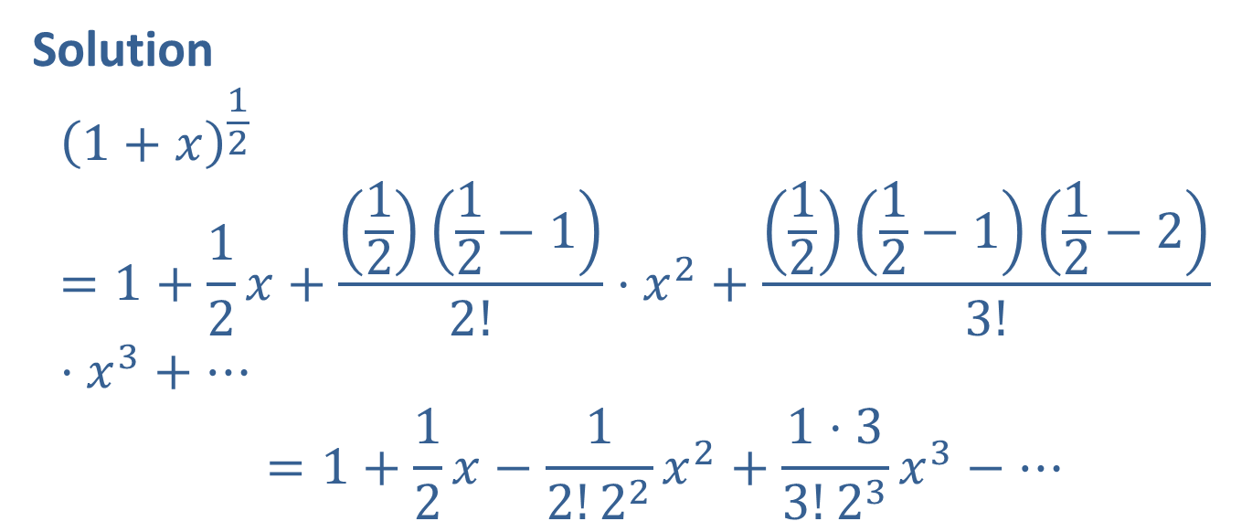

Example 2: Binomial Series
Use the binomial series with $p=\frac{1}{2}$ to write $f\left(x\right)=\sqrt{1+x}$ as a series.
Solution
1+𝑥12=1+12𝑥+1212−12!⋅𝑥2+1212−112−23!⋅𝑥3+⋯1+𝑥12=1+12𝑥−12!22𝑥2+1⋅33!23𝑥3−⋯

Slide 5

Example 3: Taylor Series
Find a Taylor series for $y=\frac{1}{1+x}$ centered at $x=0$.

Slide 6
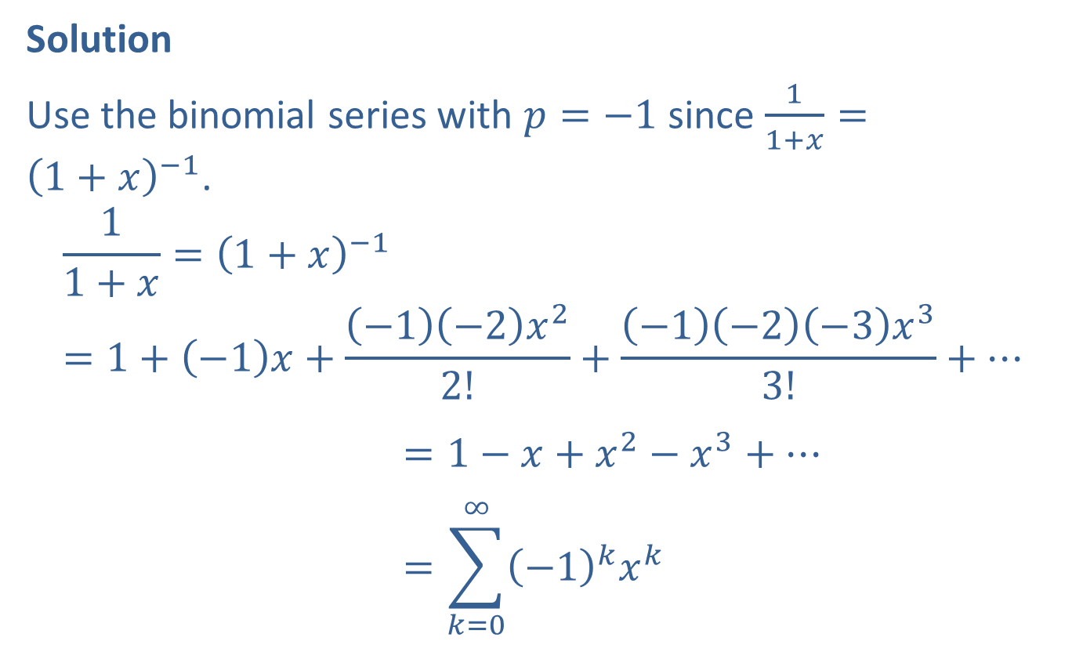
Example 3: Taylor Series (cont.)
Solution
Use the binomial series with $p=−1$ since $\frac{1}{1+x}={\left(1+x\right)}^{−1}$.
11+𝑥=1+𝑥−1=1+−1𝑥+−1−2𝑥22!+−1−2−3𝑥33!+⋯11+𝑥=1+𝑥−1=1−𝑥+𝑥2−𝑥3+⋯11+𝑥=1+𝑥−1=𝑘=0∞−1𝑘𝑥𝑘

Slide 7
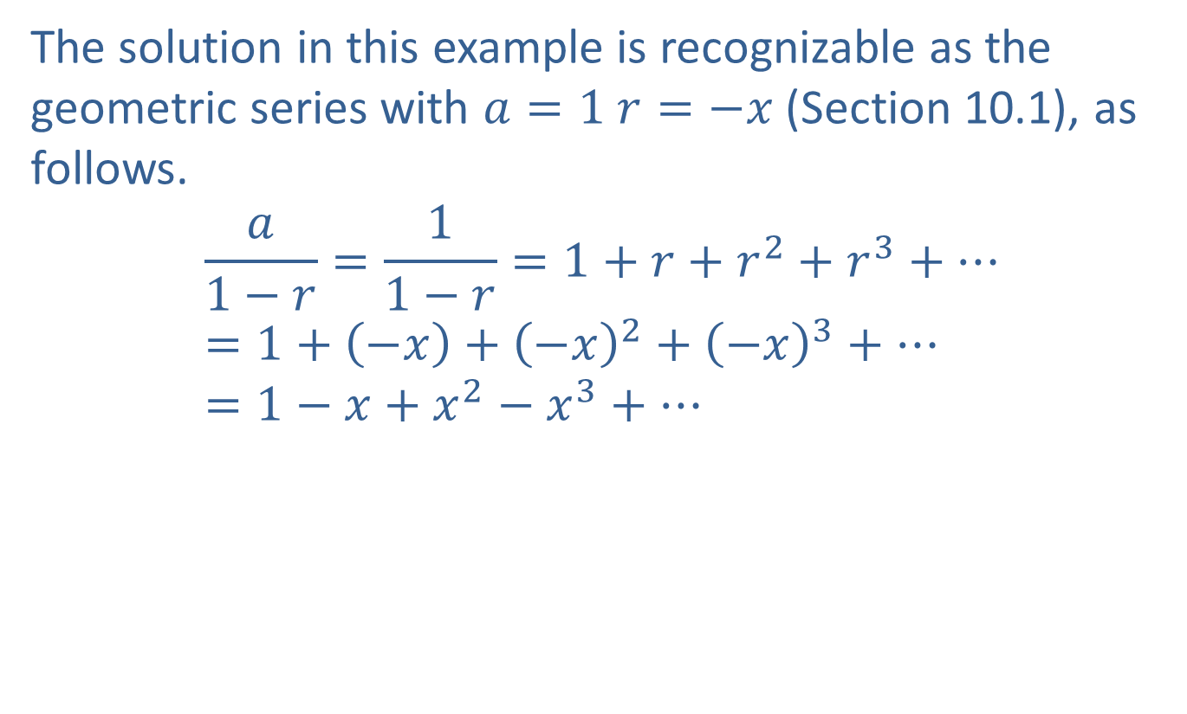
Example 3: Taylor Series (cont.)
The solution in this example is recognizable as the geometric series with $a=1$ $r=−x$ (Section 10.1), as follows.
$$\frac{a}{1−r}=\frac{1}{1−r}=1+r+r^{2}+r^{3}+⋯=1+\left(−x\right)+{\left(−x\right)}^{2}+{\left(−x\right)}^{3}+⋯=1−x+x^{2}−x^{3}+⋯$$

Slide 8

Example 4: Taylor Series
Obtain a Taylor series centered at $x=0$ for $y=\frac{1}{1−x^{2}}$.

Slide 9
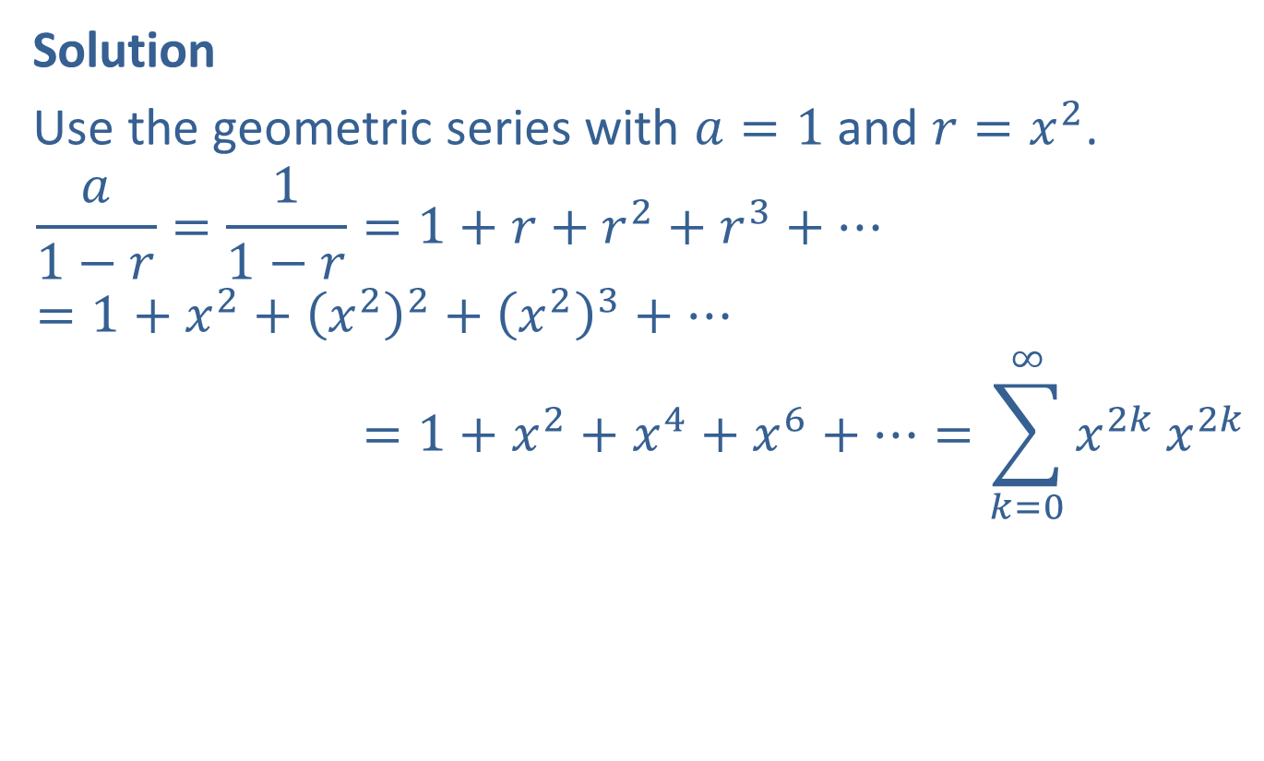
Example 4: Taylor Series (cont.)
Solution
Use the geometric series with $a=1$ and $r=x^{2}$.
𝑎1−𝑟=11−𝑟=1+𝑟+𝑟2+𝑟3+⋯=1+𝑥2+𝑥22+𝑥23+⋯𝑎1−𝑟=11−𝑟=1+𝑥2+𝑥4+𝑥6+⋯=𝑘=0∞𝑥2𝑘𝑥2𝑘

Slide 10
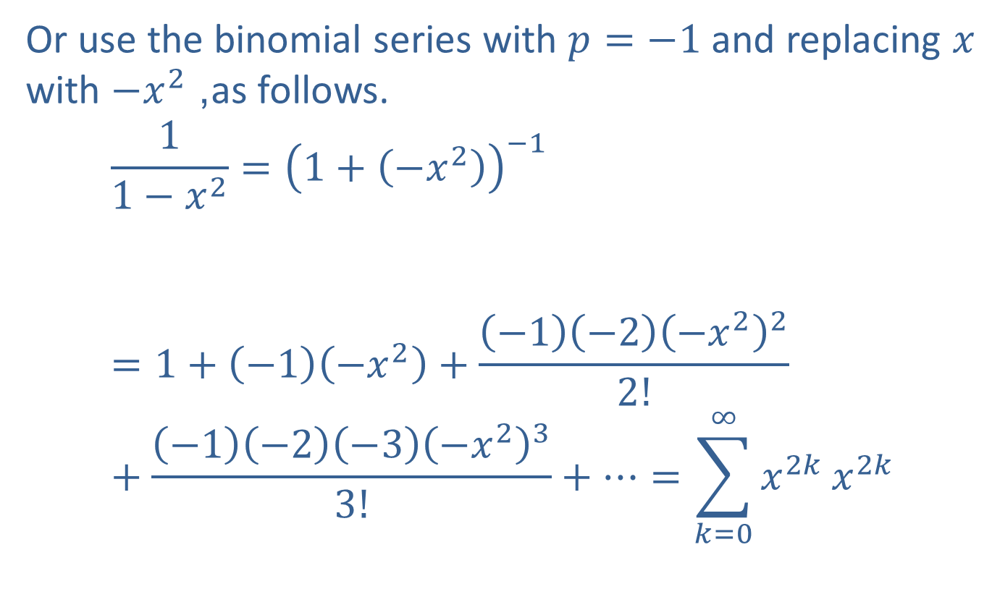
Example 4: Taylor Series (cont.)
Or use the binomial series with $p=−1$ and replacing $x$ with $−x^{2}$, as follows.
11−𝑥2=1+−𝑥2−111−𝑥2=1+−1−𝑥2+−1−2−𝑥222!+−1−2−3−𝑥233!+⋯=𝑘=0∞𝑥2𝑘𝑥2𝑘

Slide 11


Example 5: Taylor Series
Find a Taylor series centered at $x=0$ for $y=e^{kx}$, where $k$ is some constant.
Solution
Differentiating, we find $f^{′}\left(x\right)=ke^{kx}$ and in general $f^{\left(n\right)}\left(x\right)=k^{n}e^{kx}$. Thus, $f\left(0\right)=1$, $f^{′}\left(0\right)=k$, and in general $f^{\left(n\right)}\left(0\right)=k^{n}$. Now we substitute into the formula for a Taylor series.
$$e^{kx}=1+kx+\frac{k^{2}x^{2}}{2!}+\frac{k^{3}x^{3}}{3!}+⋯=\sum_{n=0}^{∞}{\frac{{\left(kx\right)}^{n}}{n!}}$$

Slide 12
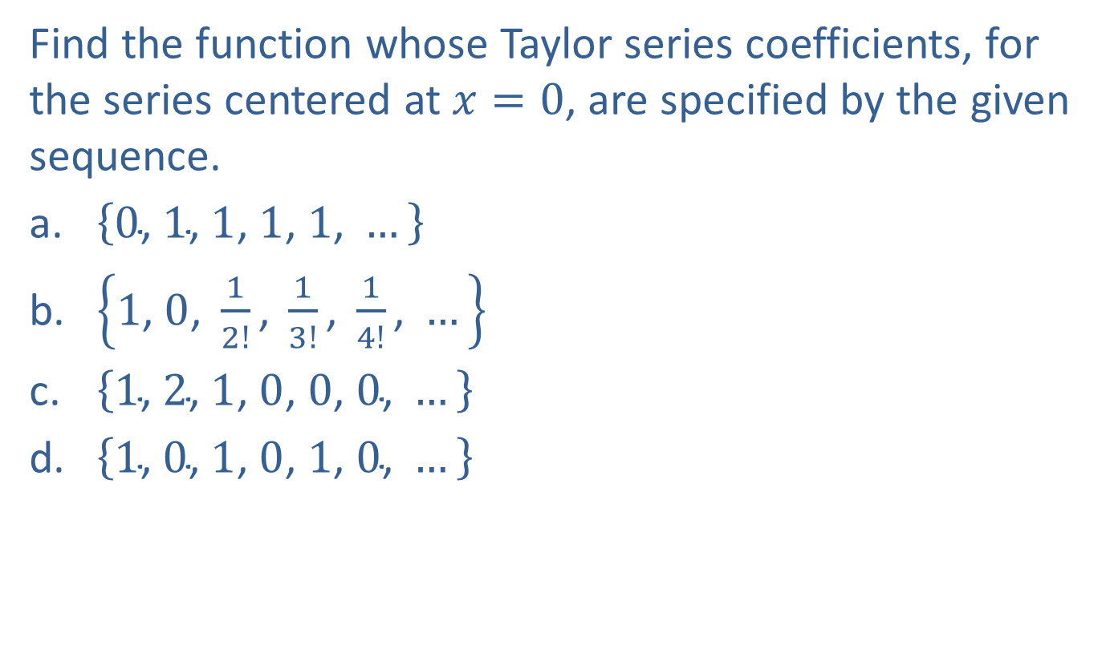
Example 6: Taylor Series
Find the function whose Taylor series coefficients, for the series centered at $x=0$, are specified by the given sequence.
​$\left\{0\text{, }1\text{, }1\text{, }1\text{, }1\text{, }…\right\}$
​$\left\{1\text{, }0\text{, }\frac{1}{2!}\text{, }\frac{1}{3!}\text{, }\frac{1}{4!}\text{, }…\right\}$
​$\left\{1\text{, }2\text{, }1\text{, }0\text{, }0\text{, }0\text{, }…\right\}$
​$\left\{1\text{, }0\text{, }1\text{, }0\text{, }1\text{, }0\text{, }…\right\}$

Slide 13
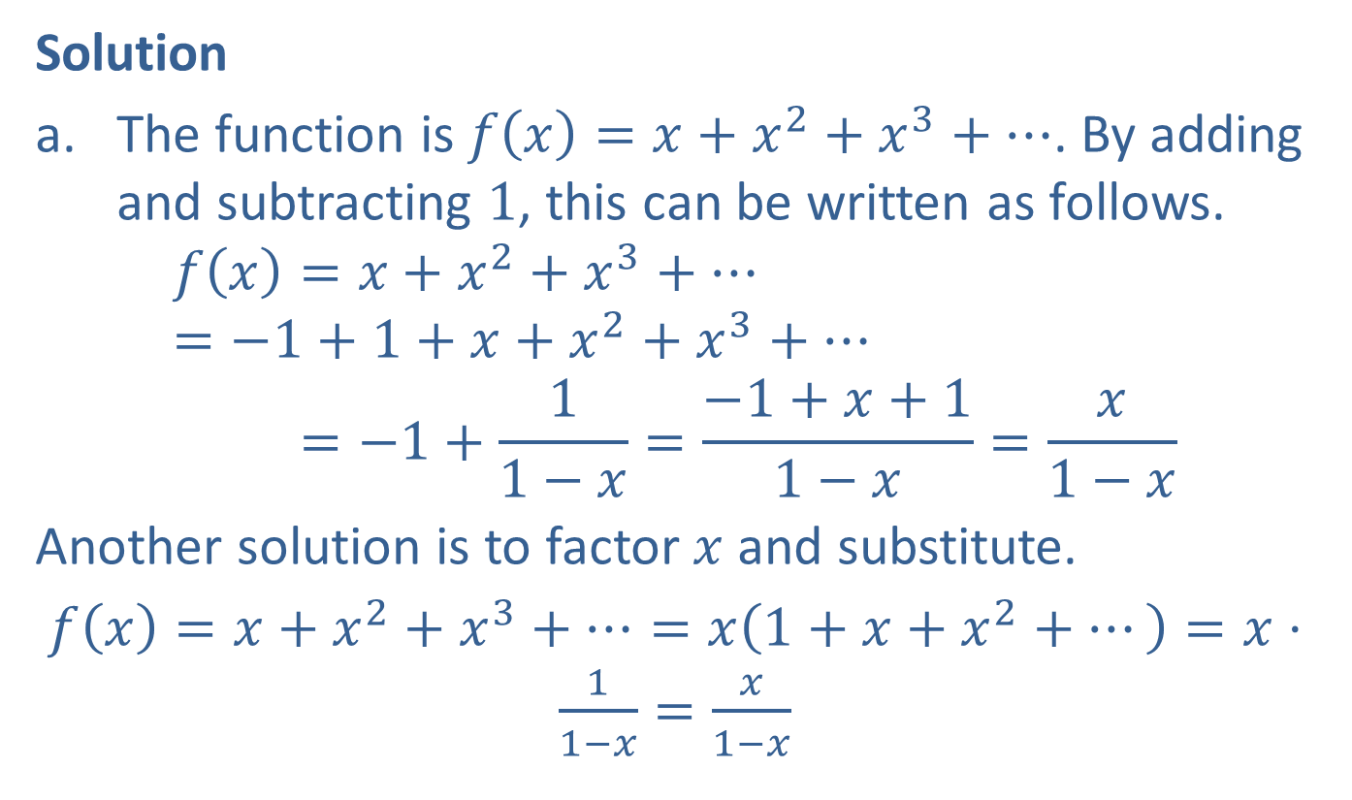
Example 6: Taylor Series (cont.)
Solution
​The function is $f\left(x\right)=x+x^{2}+x^{3}+⋯$. By adding and subtracting 1, this can be written as follows.
𝑓𝑥=𝑥+𝑥2+𝑥3+⋯=−1+1+𝑥+𝑥2+𝑥3+⋯𝑓⁡𝑥=−1+11−𝑥=−1+𝑥+11−𝑥=𝑥1−𝑥
​Another solution is to factor $x$ and substitute.
​$f\left(x\right)=x+x^{2}+x^{3}+⋯=x\left(1+x+x^{2}+⋯\right)=x⋅\frac{1}{1−x}=\frac{x}{1−x}$

Slide 14
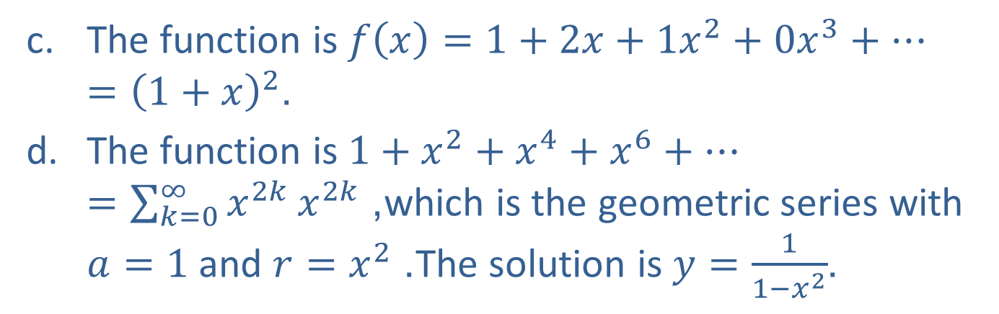

Example 6: Taylor Series (cont.)
The coefficients are almost the ones for $e^{x}$, except for the coefficient of $x$. This suggests the solution: $f\left(x\right)=e^{x}−x$.
​The function is $f\left(x\right)=1+2x+1x^{2}+0x^{3}+⋯={\left(1+x\right)}^{2}$.
​The function is $1+x^{2}+x^{4}+x^{6}+⋯=\sum_{k=0}^{∞}{x^{2k}}x^{2k}$, which is the geometric series with $a=1$ and $r=x^{2}$. The solution is $y=\frac{1}{1−x^{2}}$.

Slide 15
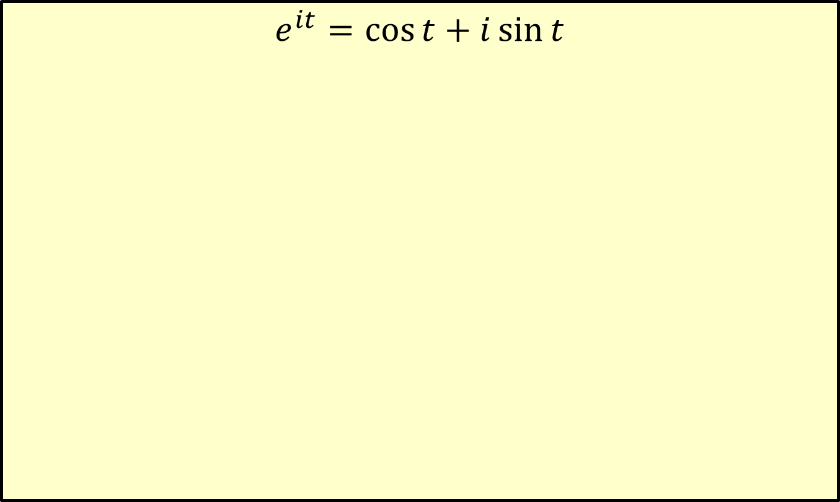
Euler’s Formula
$$e^{it}=\cos{t}+i\sin{t}$$

Slide 16
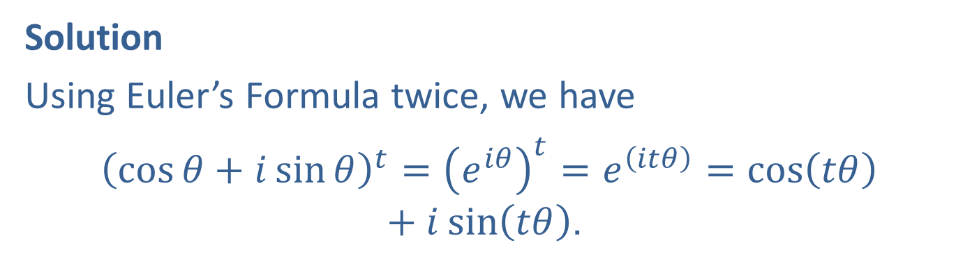

Example 7: Application of Euler’s Formula
Prove the identity: for any real number $t$, ${\left(\cos{θ}+i\sin{θ}\right)}^{t}=\cos\left(tθ\right)+i\sin\left(tθ\right)$.
Solution
Using Euler’s Formula twice, we have
${\left(\cos{θ}+i\sin{θ}\right)}^{t}={\left(e^{iθ}\right)}^{t}=e^{\left(itθ\right)}=\cos\left(tθ\right)+i\sin\left(tθ\right)$.

Slide 17
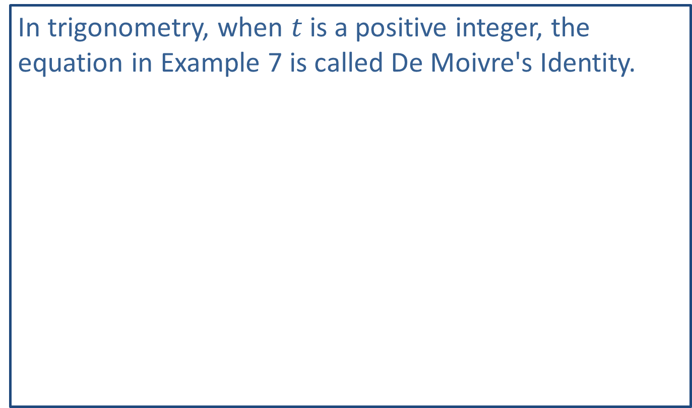
Note
In trigonometry, when $t$ is a positive integer, the equation in Example 7 is called De Moivre's Identity.

Slide 18

Example 8: Solving an Equation
Find all five complex number solutions of the equation: $x^{5}=1$.

Slide 19
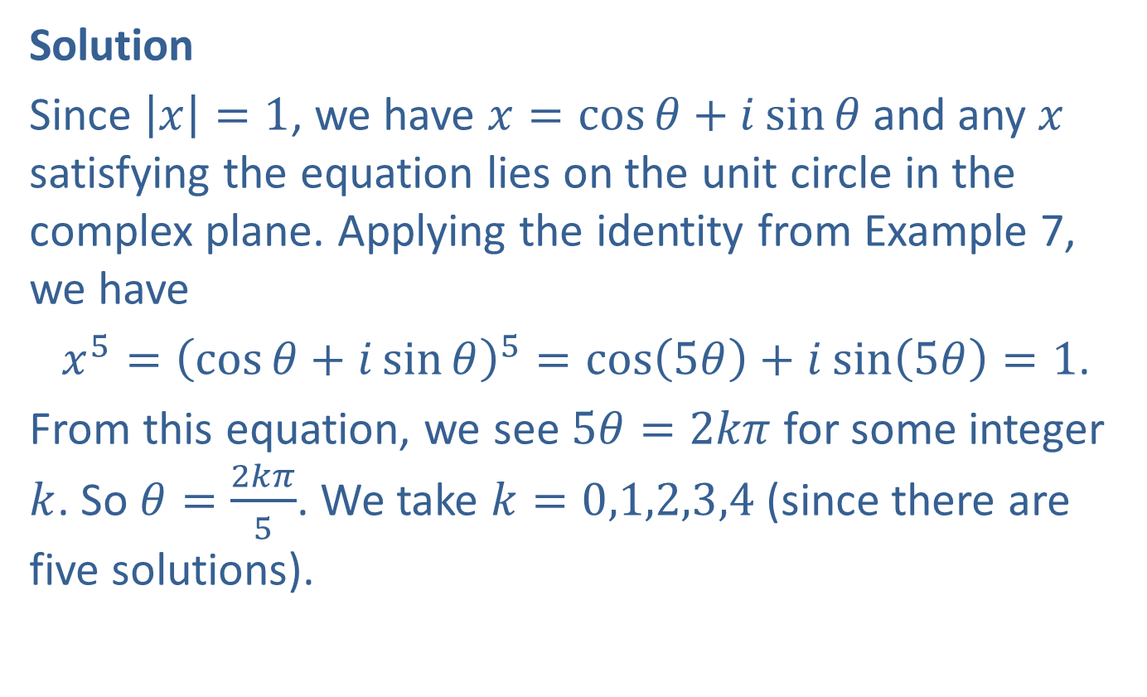
Example 8: Solving an Equation (cont.)
Solution
Since $\left|x\right|=1$, we have $x=\cos{θ}+i\sin{θ}$ and any $x$ satisfying the equation lies on the unit circle in the complex plane. Applying the identity from Example 7, we have
$x^{5}={\left(\cos{θ}+i\sin{θ}\right)}^{5}=\cos\left(5θ\right)+i sin⁡\left(5θ\right)=1$.
From this equation, we see $5θ=2kπ$ for some integer $k$. So $θ=\frac{2kπ}{5}$. We take $k=0,1,2,3,4$ (since there are five solutions).
​

Slide 20
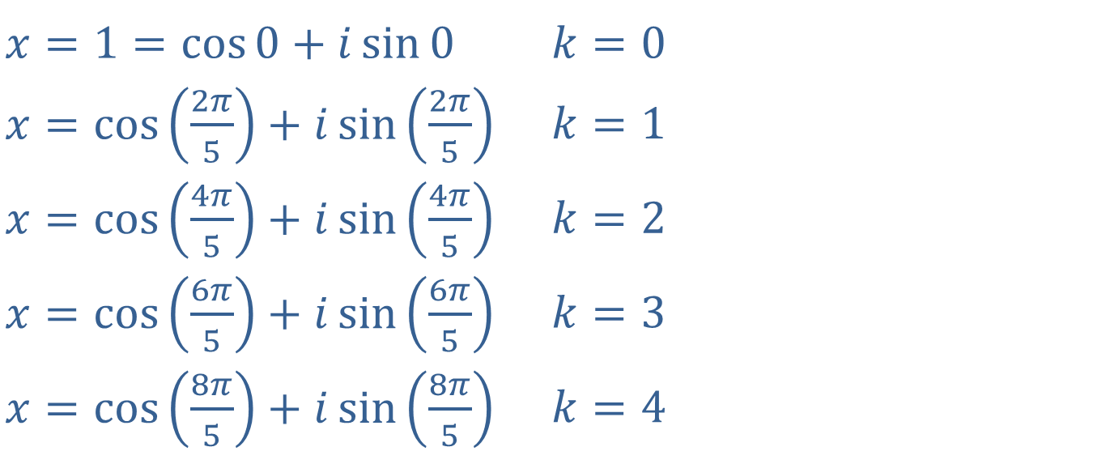
Example 8: Solving an Equation (cont.)
​$x=1=\cos{0}+i\sin{0}$ | ​$k=0$
​$x=\cos\left(\frac{2π}{5}\right)+i\sin\left(\frac{2π}{5}\right)$ | ​$k=1$
​$x=\cos\left(\frac{4π}{5}\right)+i\sin\left(\frac{4π}{5}\right)$ | ​$k=2$
​$x=\cos\left(\frac{6π}{5}\right)+i\sin\left(\frac{6π}{5}\right)$ | ​$k=3$
​$x=\cos\left(\frac{8π}{5}\right)+i\sin\left(\frac{8π}{5}\right)$ | ​$k=4$

Slide 21
Note
Geometric series, Taylor series, and binomial series are all types of power series.

Slide 22

Example 9: Polynomial of Degree 5
Find $y=f\left(x\right)$ a polynomial of degree 5 that approximately satisfies the following conditions $f^{′}\left(x\right)=2y$ and $f\left(0\right)=1$.

Slide 23
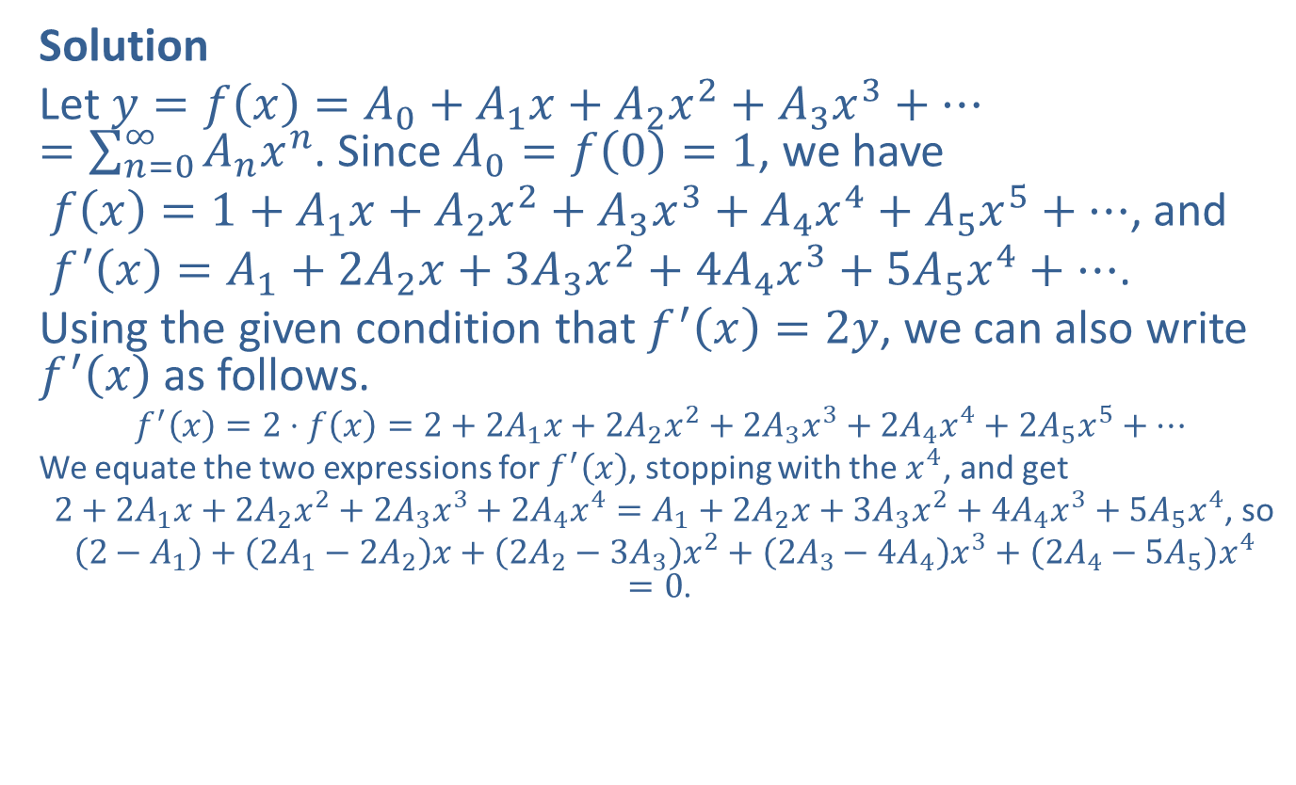
Example 9: Polynomial of Degree 5 (cont.)
Solution
Let $y=f\left(x\right)=A_{0}+A_{1}x+A_{2}x^{2}+A_{3}x^{3}+⋯=\sum_{n=0}^{∞}{A_{n}x^{n}}$. Since $A_{0}=f\left(0\right)=1$, we have
$f\left(x\right)=1+A_{1}x+A_{2}x^{2}+A_{3}x^{3}+A_{4}x^{4}+A_{5}x^{5}+⋯$, and
$f^{′}\left(x\right)=A_{1}+2A_{2}x+3A_{3}x^{2}+4A_{4}x^{3}+5A_{5}x^{4}+⋯$.
Using the given condition that $f^{′}\left(x\right)=2y$, we can also write $f^{′}\left(x\right)$ as follows.
$$f^{′}\left(x\right)=2⋅f⁡\left(x\right)=2+2A_{1}x+2A_{2}x^{2}+2A_{3}x^{3}+2A_{4}x^{4}+2A_{5}x^{5}+⋯$$
We equate the two expressions for $f^{′}⁡\left(x\right)$, stopping with the $x^{4}$, and get
$2+2A_{1}x+2A_{2}x^{2}+2A_{3}x^{3}+2A_{4}x^{4}=A_{1}+2A_{2}x+3A_{3}x^{2}+4A_{4}x^{3}+5A_{5}x^{4}$, so
$\left(2−A_{1}\right)+\left(2A_{1}−2A_{2}\right)x+\left(2A_{2}−3A_{3}\right)x^{2}+\left(2A_{3}−4A_{4}\right)x^{3}+\left(2A_{4}−5A_{5}\right)x^{4}=0$.
​

Slide 24
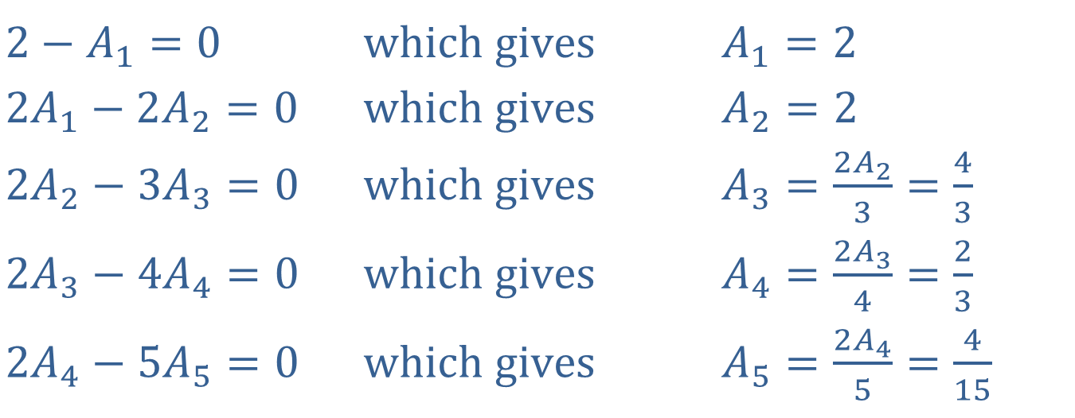

Example 9: Polynomial of Degree 5 (cont.)
This equation is valid for all $x$ in some interval centered at $x=0$. This means that the coefficient of each power of $x$ is zero.
​$2−A_{1}=0$ | ​$\text{which} \text{gives}$ | ​$A_{1}=2$
​$2A_{1}−2A_{2}=0$ | ​$\text{which} \text{gives}$ | ​$A_{2}=2$
​$2A_{2}−3A_{3}=0$ | ​$\text{which} \text{gives}$ | ​$A_{3}=\frac{2A_{2}}{3}=\frac{4}{3}$
​$2A_{3}−4A_{4}=0$ | ​$\text{which} \text{gives}$ | ​$A_{4}=\frac{2A_{3}}{4}=\frac{2}{3}$
​$2A_{4}−5A_{5}=0$ | ​$\text{which} \text{gives}$ | ​$A_{5}=\frac{2A_{4}}{5}=\frac{4}{15}$

Slide 25

Example 9: Polynomial of Degree 5 (cont.)
Therefore, $f\left(x\right)≈P_{5}\left(x\right)=1+2x+2x^{2}+\frac{4}{3}x^{3}+\frac{2}{3}x^{4}+\frac{4}{15}x^{5}$.
We may verify that this polynomial approximation for $f⁡\left(x\right)$ satisfies the given conditions: $P_{5}\left(0\right)=1$ and
${P_{5}}^{′}\left(x\right)=2+4x+4x^{2}+\frac{8}{3}x^{3}+\frac{4}{3}x^{4}=2\left(1+2x+2x^{2}+\frac{4}{3}x^{3}+\frac{2}{3}x^{4}\right)=2⋅P_{4}\left(x\right)$.
The conditions in the problem lead to the so-called recursion equation
$$2A_{k}−\left(k+1\right)A_{k+1}=0$$
for all $k≥0$. Since $A_{0}=1$ is given, all the coefficients can be found using the recursion equation.

Slide 26

Example 10: Power Series
Determine a power series centered at $x=0$ for the function $y=f\left(x\right)$ that satisfies $\frac{dy}{dx}=2xy$ subject to the condition that $f\left(0\right)=1$.

Slide 27
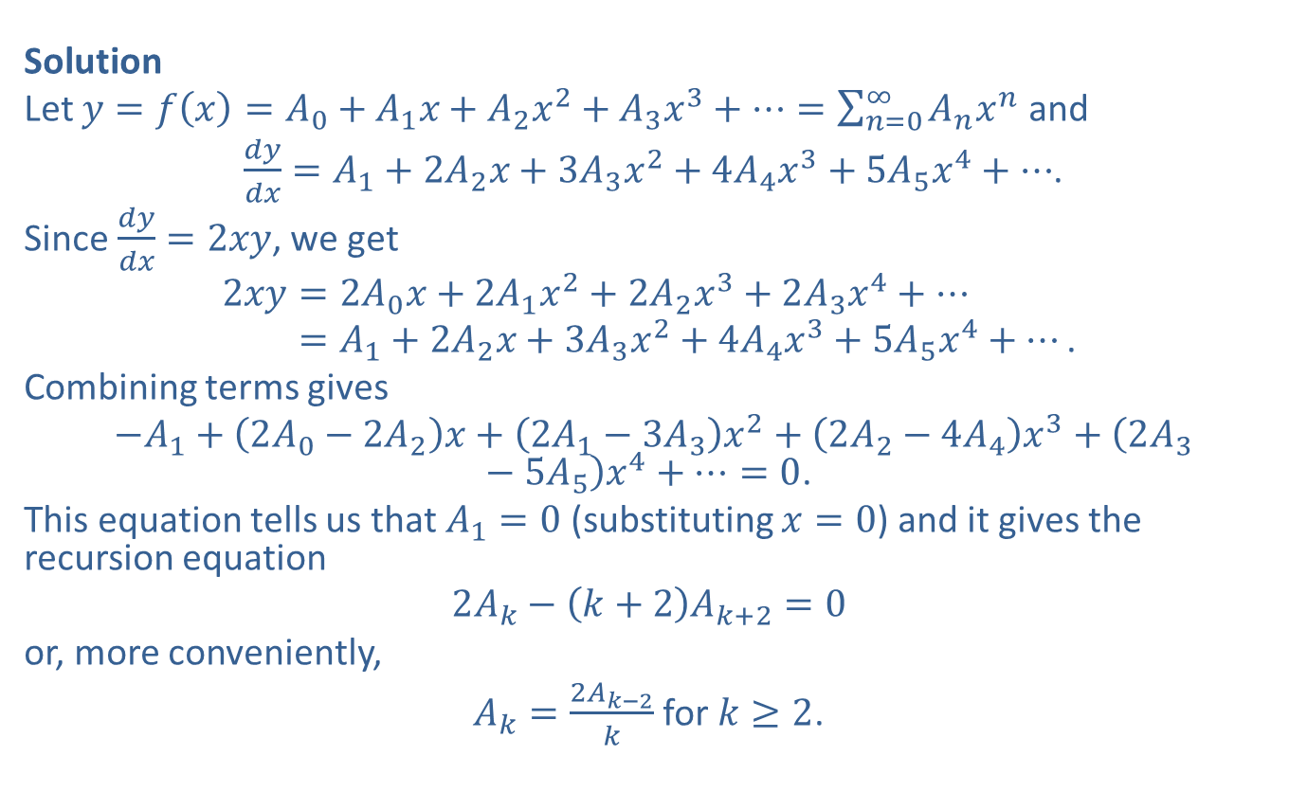
Example 10: Power Series (cont.)
Solution
Let $y=f\left(x\right)=A_{0}+A_{1}x+A_{2}x^{2}+A_{3}x^{3}+⋯=\sum_{n=0}^{∞}{A_{n}x^{n}}$ and
$\frac{dy}{dx}=A_{1}+2A_{2}x+3A_{3}x^{2}+4A_{4}x^{3}+5A_{5}x^{4}+⋯$.
Since $\frac{dy}{dx}=2xy$, we get
2𝑥𝑦=2𝐴0𝑥+2𝐴1𝑥2+2𝐴2𝑥3+2𝐴3𝑥4+⋯2𝑥𝑦=𝐴1+2𝐴2𝑥+3𝐴3𝑥2+4𝐴4𝑥3+5𝐴5𝑥4+⋯.
Combining terms gives
$−A_{1}+\left(2A_{0}−2A_{2}\right)x+\left(2A_{1}−3A_{3}\right)x^{2}+\left(2A_{2}−4A_{4}\right)x^{3}+\left(2A_{3}−5A_{5}\right)x^{4}+⋯=0$.
This equation tells us that $A_{1}=0$ (substituting $x=0$) and it gives the recursion equation
$$2A_{k}−\left(k+2\right)A_{k+2}=0$$
or, more conveniently,
$A_{k}=\frac{2A_{k−2}}{k}$ for $k≥2$.

Slide 28
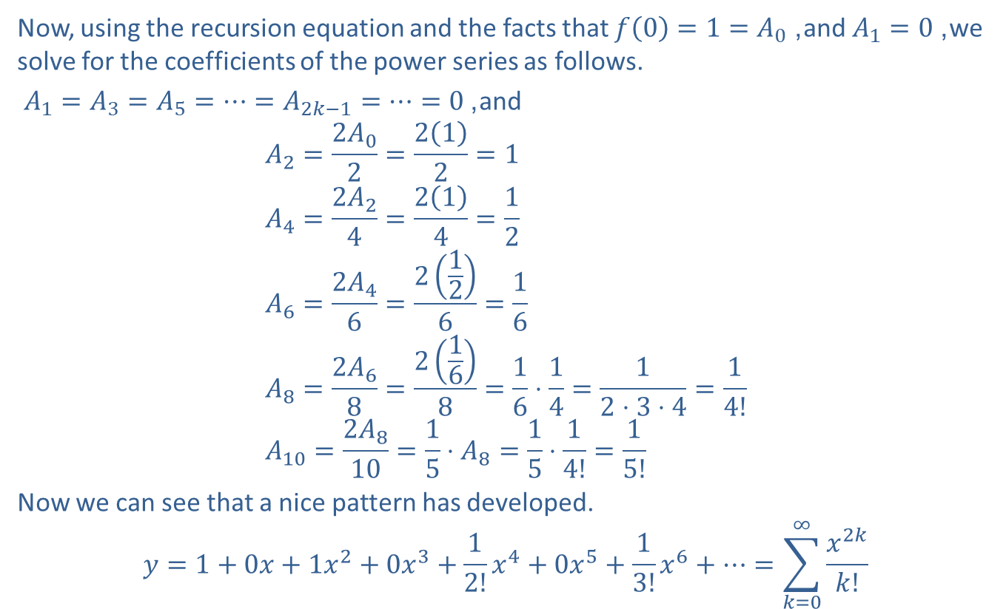
Example 10: Power Series (cont.)
Now, using the recursion equation and the facts that $f\left(0\right)=1=A_{0}$, and $A_{1}=0$, we solve for the coefficients of the power series as follows.
$A_{1}=A_{3}=A_{5}=⋯=A_{2k−1}=⋯=0$, and
$$A_{2}=\frac{2A_{0}}{2}=\frac{2\left(1\right)}{2}=1 \\ A_{4}=\frac{2A_{2}}{4}=\frac{2\left(1\right)}{4}=\frac{1}{2} \\ A_{6}=\frac{2A_{4}}{6}=\frac{2\left(\frac{1}{2}\right)}{6}=\frac{1}{6} \\ A_{8}=\frac{2A_{6}}{8}=\frac{2\left(\frac{1}{6}\right)}{8}=\frac{1}{6}⋅\frac{1}{4}=\frac{1}{2⋅3⋅4}=\frac{1}{4!} \\ A_{10}=\frac{2A_{8}}{10}=\frac{1}{5}⋅A_{8}=\frac{1}{5}⋅\frac{1}{4!}=\frac{1}{5!}$$
Now we can see that a nice pattern has developed.
$$y=1+0x+1x^{2}+0x^{3}+\frac{1}{2!}x^{4}+0x^{5}+\frac{1}{3!}x^{6}+⋯=\sum_{k=0}^{∞}{\frac{x^{2k}}{k!}}$$

Slide 29
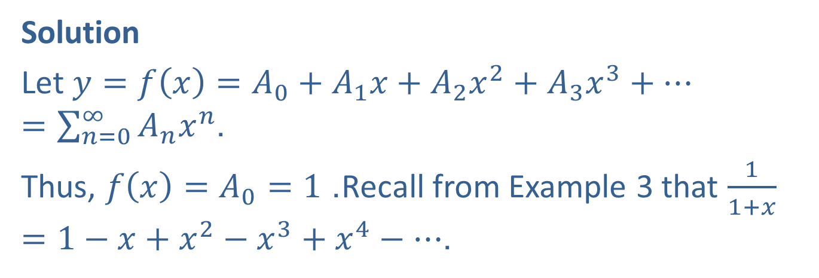

Example 11: Polynomial of Degree 6
Find a polynomial of degree 6 that approximates the function satisfying $y^{′}=y+\frac{1}{1+x}$ and contains the point $\left(0\text{, }1\right)$. In other words, $f\left(0\right)=1$.
Solution
Let $y=f\left(x\right)=A_{0}+A_{1}x+A_{2}x^{2}+A_{3}x^{3}+⋯=\sum_{n=0}^{∞}{A_{n}x^{n}}$.
Thus, $f\left(x\right)=A_{0}=1$. Recall from Example 3 that $\frac{1}{1+x}=1−x+x^{2}−x^{3}+x^{4}−⋯$.

Slide 30
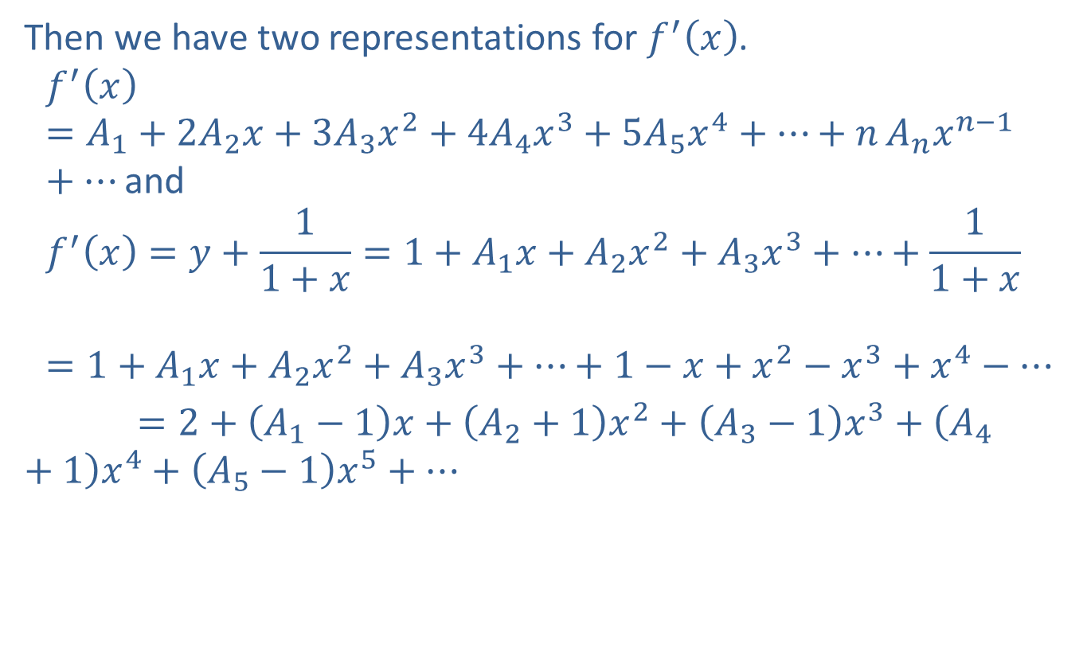
Example 11: Polynomial of Degree 6 (cont.)
Then we have two representations for $f^{′}⁡\left(x\right)$.
𝑓′𝑥=𝐴1+2𝐴2𝑥+3𝐴3𝑥2+4𝐴4𝑥3+5𝐴5𝑥4+⋯+𝑛⁡𝐴𝑛𝑥𝑛−1+⋯and𝑓′𝑥=𝑦+11+𝑥=1+𝐴1𝑥+𝐴2𝑥2+𝐴3𝑥3+⋯+11+𝑥𝑓′𝑥=1+𝐴1𝑥+𝐴2𝑥2+𝐴3𝑥3+…+1−𝑥+𝑥2−𝑥3+𝑥4−⋯
$=2+\left(A_{1}−1\right)x+\left(A_{2}+1\right)x^{2}+\left(A_{3}−1\right)x^{3}+\left(A_{4}+1\right)x^{4}+\left(A_{5}−1\right)x^{5}+⋯$
​

Slide 31
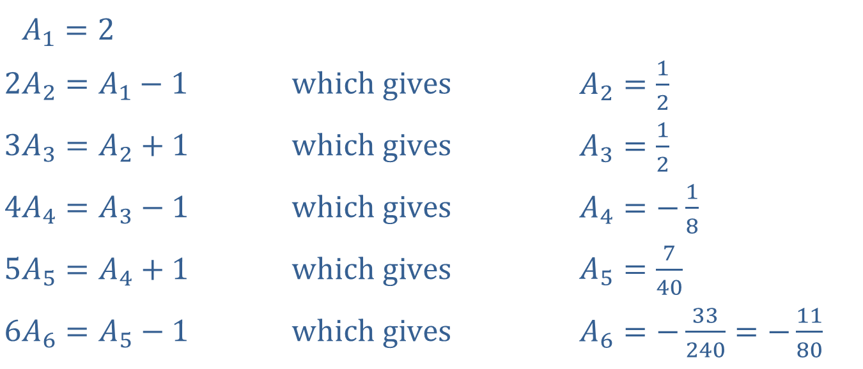
Example 11: Polynomial of Degree 6 (cont.)
When we equate the corresponding coefficients in the two representations, we Find the following coefficients of the power series.
​2𝐴1=2 | ​ | ​
​$2A_{2}=A_{1}−1$ | ​$\text{which} \text{gives}$ | ​$A_{2}=\frac{1}{2}$
​$3A_{3}=A_{2}+1$ | ​$\text{which} \text{gives}$ | ​$A_{3}=\frac{1}{2}$
​$4A_{4}=A_{3}−1$ | ​$\text{which} \text{gives}$ | ​$A_{4}=−\frac{1}{8}$
​$5A_{5}=A_{4}+1$ | ​$\text{which} \text{gives}$ | ​$A_{5}=\frac{7}{40}$
​$6A_{6}=A_{5}−1$ | ​$\text{which} \text{gives}$ | ​$A_{6}=−\frac{33}{240}=−\frac{11}{80}$

Slide 32

Example 11: Polynomial of Degree 6 (cont.)
The recursion equation is given by $kA_{k}=A_{k−1}+{\left(−1\right)}^{k−1}$ for $k≥1$.
We conclude $y≈P_{6}\left(x\right)=1+2x+\frac{1}{2}x^{2}+\frac{1}{2}x^{3}−\frac{1}{8}x^{4}+\frac{7}{40}x^{5}−\frac{11}{80}x^{6}$.

Slide 33


Example 12: Power Series
Solve $y^{″}=−y$ subject to the conditions $y\left(0\right)=1$ and $y^{′}\left(0\right)=0$.
Solution
As before, let $y=\sum_{n=0}^{∞}{A_{n}x^{n}}$.
Then $y^{′}=A_{1}+2A_{2}x+3A_{3}x^{2}+⋯=\sum_{n=1}^{∞}{nA_{n}x^{n−1}}$
and $y^{″}=2A_{2}+2⋅3A_{3}x+3⋅4A_{4}x^{2}+4⋅5A_{5}x^{3}+⋯=\sum_{n=2}^{∞}{\left(n−1\right)nA_{n}x^{n−2}}$.
Since $y\left(0\right)=1$, we know $A_{0}=1$. Since $y^{′}\left(0\right)=0$, we have $A_{0}=1$.

Slide 34
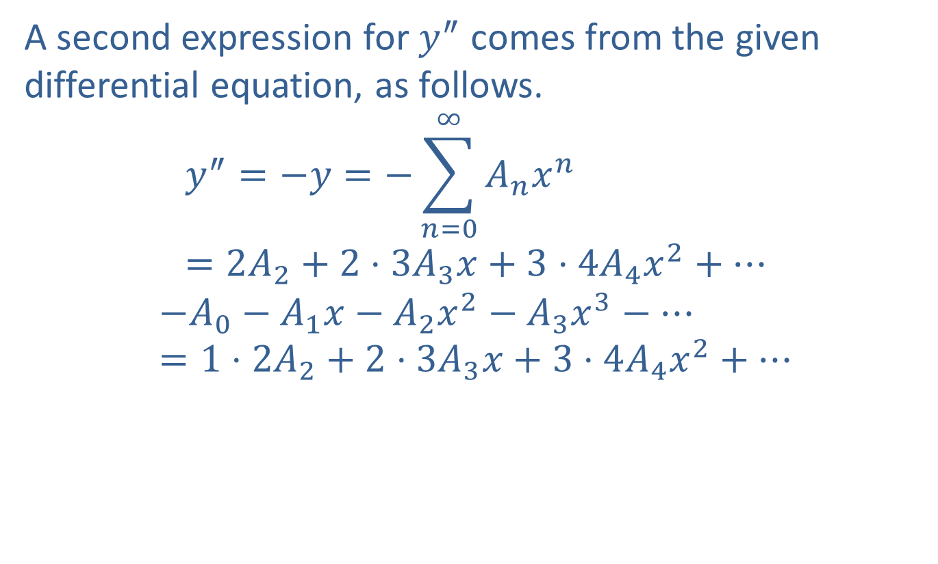
Example 12: Power Series (cont.)
A second expression for $y^{″}$ comes from the given differential equation, as follows.
$$y^{″}=−y=−\sum_{n=0}^{∞}{A_{n}x^{n}}=2A_{2}+2⋅3A_{3}x+3⋅4A_{4}x^{2}+⋯$$
$$−A_{0}−A_{1}x−A_{2}x^{2}−A_{3}x^{3}−⋯=1⋅2A_{2}+2⋅3A_{3}x+3⋅4A_{4}x^{2}+⋯$$

Slide 35
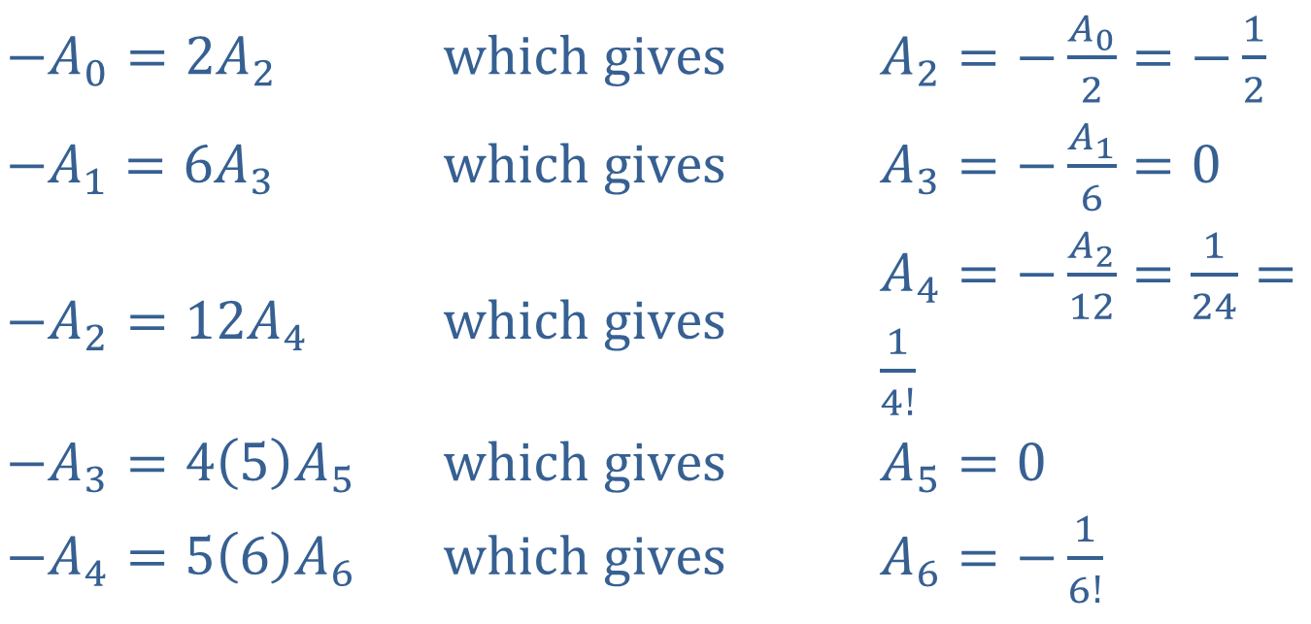
Example 12: Power Series (cont.)
And as usual we equate the corresponding coefficients to get
​
​$−A_{0}=2A_{2}$ | ​$\text{which} \text{gives}$ | ​$A_{2}=−\frac{A_{0}}{2}=−\frac{1}{2}$
​$−A_{1}=6A_{3}$ | ​$\text{which} \text{gives}$ | ​$A_{3}=−\frac{A_{1}}{6}=0$
​$−A_{2}=12A_{4}$ | ​$\text{which} \text{gives}$ | ​$A_{4}=−\frac{A_{2}}{12}=\frac{1}{24}=\frac{1}{4!}$
​$−A_{3}=4\left(5\right)A_{5}$ | ​$\text{which} \text{gives}$ | ​$A_{5}=0$
​$−A_{4}=5\left(6\right)A_{6}$ | ​$\text{which} \text{gives}$ | ​$A_{6}=−\frac{1}{6!}$
and so on.

Slide 36

Example 12: Power Series (cont.)
We get $y=1+0x−\frac{1}{2!}x^{2}+0x^{3}+\frac{1}{4!}x^{4}+0x^{5}−\frac{1}{6!}x^{6}+⋯=\sum_{n=0}^{∞}{{\left(−1\right)}^{n}\frac{x^{2n}}{\left(2n\right)!}}$.
This is recognizable as the Taylor series for $y=\cos{x}$ centered at $x=0$.

