Slide 1
Section 2.1
One-Sided Limits

Slide 2
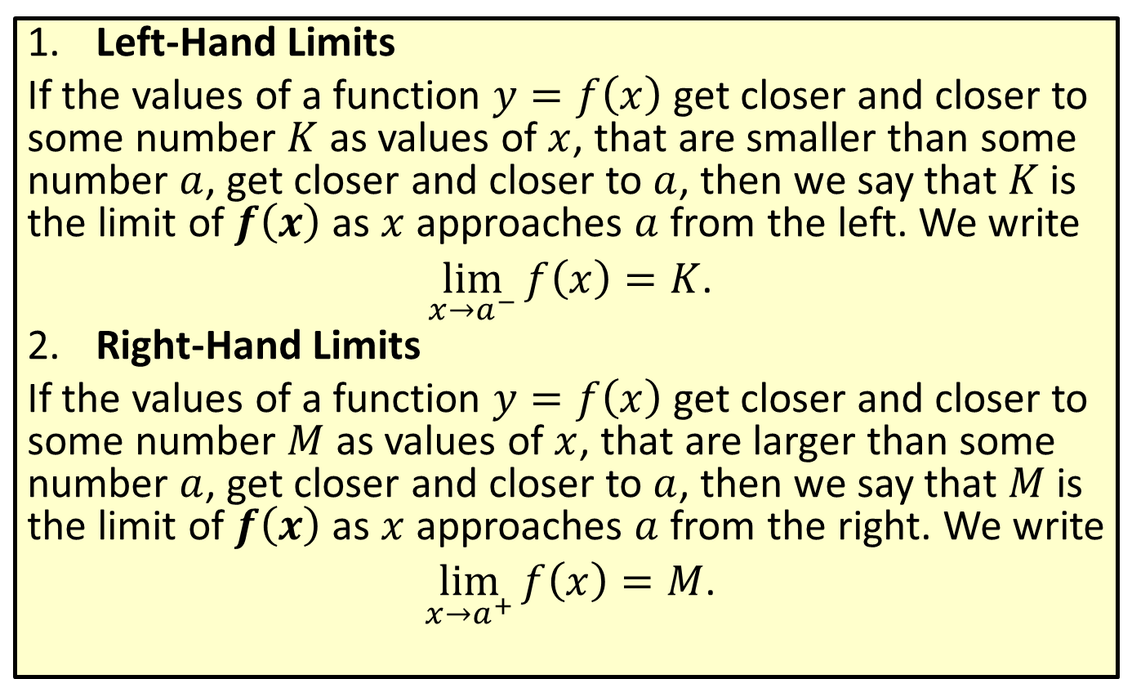
One-Sided Limits Defined Informally
​Left-Hand Limits
​If the values of a function $y=f\left(x\right)$ get closer and closer to some number $K$ as values of $x$, that are smaller than some number $a$, get closer and closer to $a$, then we say that $K$ is the limit of $f⁡\left(x\right)$ as $x$ approaches $a$ from the left. We write
​ $\lim_{x→a^{−}}f\left(x\right)=K$.
​Right-Hand Limits
​If the values of a function $y=f\left(x\right)$ get closer and closer to some number $M$ as values of $x$, that are larger than some number $a$, get closer and closer to $a$, then we say that $M$ is the limit of $f⁡\left(x\right)$ as $x$ approaches $a$ from the right. We write
​ $\lim_{x→a^{+}}f\left(x\right)=M$.

Slide 3

Example 1: Finding One-Sided Limits
The graph of the function $f\left(x\right)=\{\begin{matrix}x^{2} & \text{if}0≤x≤2 \\ 2 & \text{if}2<x<4 \\ x & \text{if}4≤x≤6\end{matrix}$ is shown. Find the following one-sided limits by inspecting the graph.

Slide 4
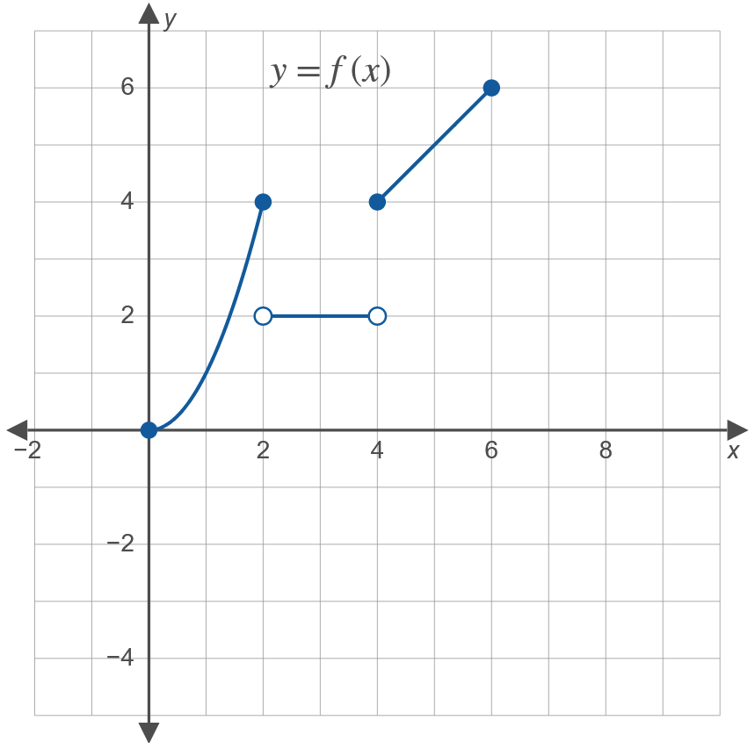
Example 1: Finding One-Sided Limits (cont.)

Slide 5
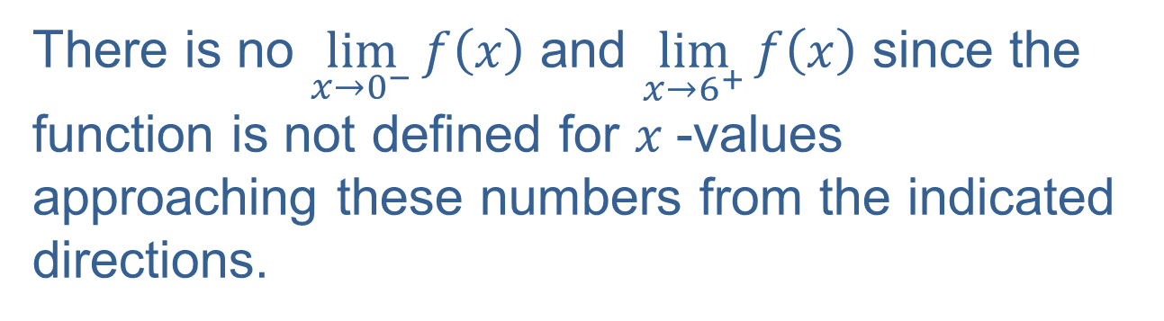
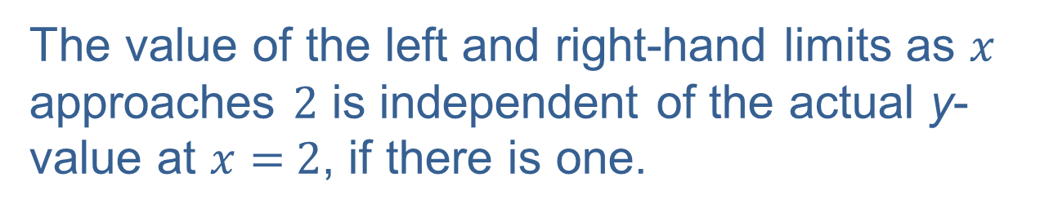
Example 1: Finding One-Sided Limits (cont.)
Remarks concerning the graph:
The value of the left and right-hand limits as $x$ approaches $2$ is independent of the actual y-value at $x=$ $2$, if there is one.
There is no $\lim_{x→0^{−}}f\left(x\right)$ and $\lim_{x→6^{+}}f\left(x\right)$ since the function is not defined for $x$-values approaching these numbers from the indicated directions.

Slide 6





Example 1: Finding One-Sided Limits (cont.)
​$\lim_{x→2^{−}}f\left(x\right)$
​Solution
​$\lim_{x→2^{−}}f\left(x\right)=4$
​$\lim_{x→2^{+}}f\left(x\right)$
​Solution
​$\lim_{x→2^{+}}f\left(x\right)=2$
​$\lim_{x→4^{−}}f\left(x\right)$
​Solution
​$\lim_{x→4^{−}}f\left(x\right)=2$
$\lim_{x→4^{+}}f\left(x\right)$
​Solution
​$\lim_{x→4^{+}}f\left(x\right)=4$
$\lim_{x→0^{+}}f\left(x\right)$
​Solution
​$\lim_{x→0^{+}}f\left(x\right)=0$

Slide 7
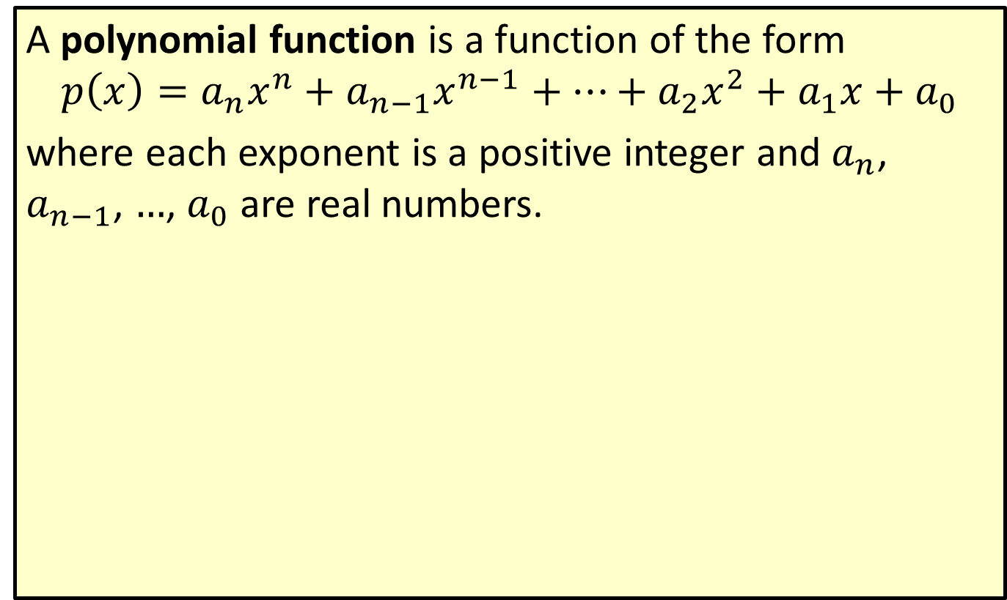
Polynomial Function
A polynomial function is a function of the form
$$p\left(x\right)=a_{n}x^{n}+a_{n−1}x^{n−1}+⋯+a_{2}x^{2}+a_{1}x+a_{0}$$
where each exponent is a positive integer and $a_{n}$, $a_{n−1}$, $…$, $a_{0}$ are real numbers.

Slide 8
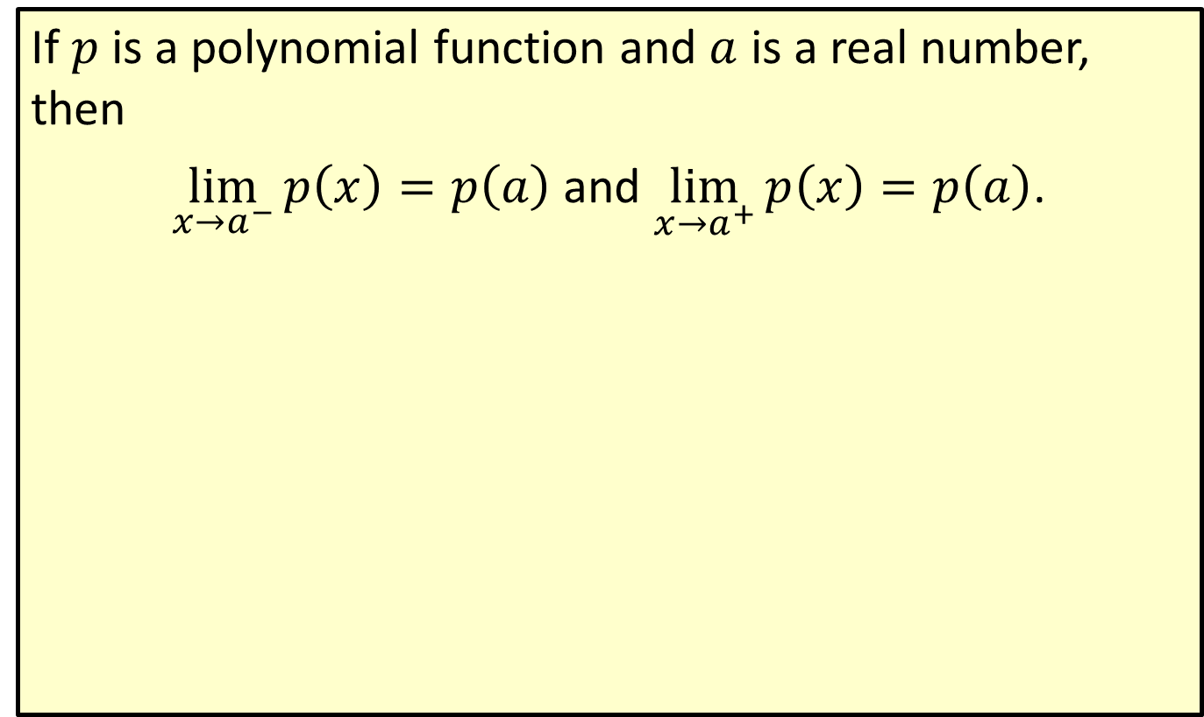
One-Sided Limits of Polynomial Functions
If $p$ is a polynomial function and $a$ is a real number, then
$\lim_{x→a^{−}}p\left(x\right)=p\left(a\right)$ and $\lim_{x→a^{+}}p\left(x\right)=p\left(a\right)$.

Slide 9

Example 2: Finding One-Sided Limits
Find the values of each of the following one-sided limits.
​$\lim_{x→3^{−}}\left(x^{2}+3x−7\right)$
​$\lim_{x→2^{+}}\left(x^{3}−5x\right)$
​$\lim_{x→0^{−}}\left(4x^{2}−8x+3\right)$

Slide 10
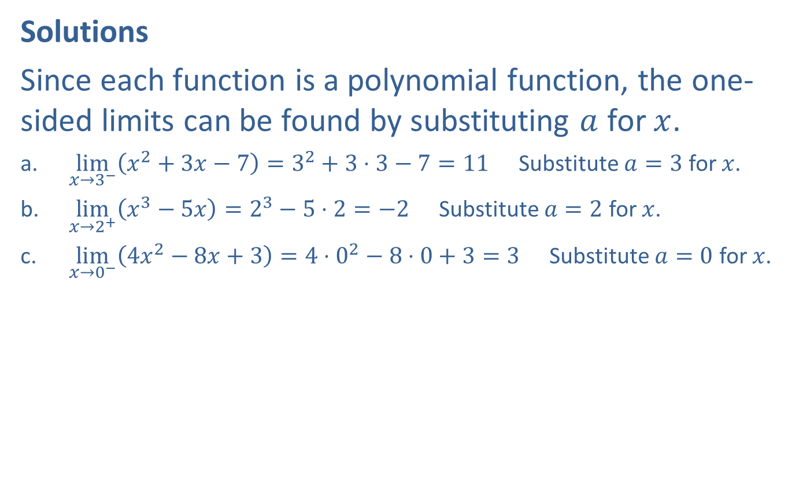
Example 2: Finding One-Sided Limits (cont.)
Solutions
Since each function is a polynomial function, the one-sided limits can be found by substituting $a$ for $x$.
​$\lim_{x→3^{−}}\left(x^{2}+3x−7\right)=3^{2}+3⋅3−7=11$ Substitute $a=3$ for $x$.
​$\lim_{x→2^{+}}\left(x^{3}−5x\right)=2^{3}−5⋅2=−2$ Substitute $a=2$ for $x$.
​$\lim_{x→0^{−}}\left(4x^{2}−8x+3\right)=4⋅0^{2}−8⋅0+3=3$ Substitute $a=0$ for $x$.

Slide 11
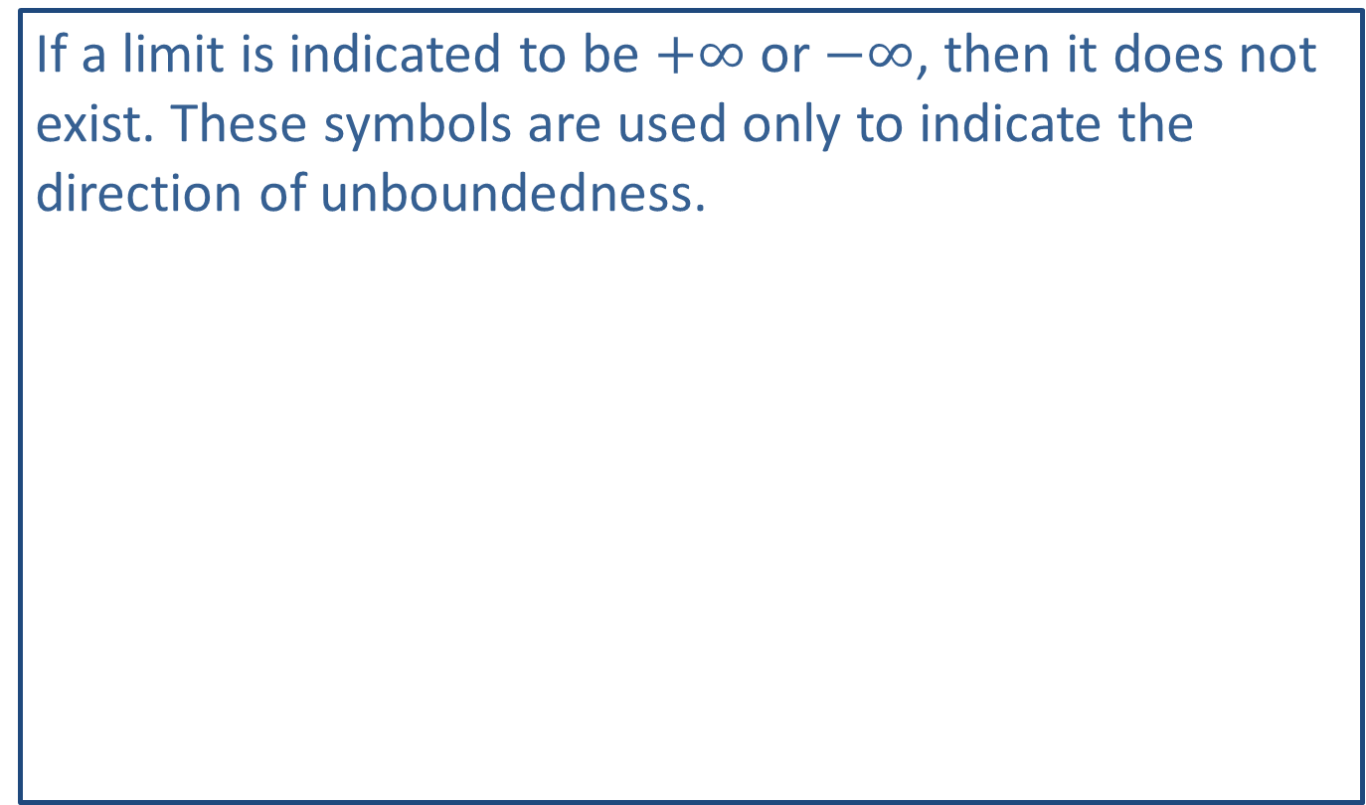
Note:
If a limit is indicated to be $+∞$ or $−∞$, then it does not exist. These symbols are used only to indicate the direction of unboundedness.

Slide 12
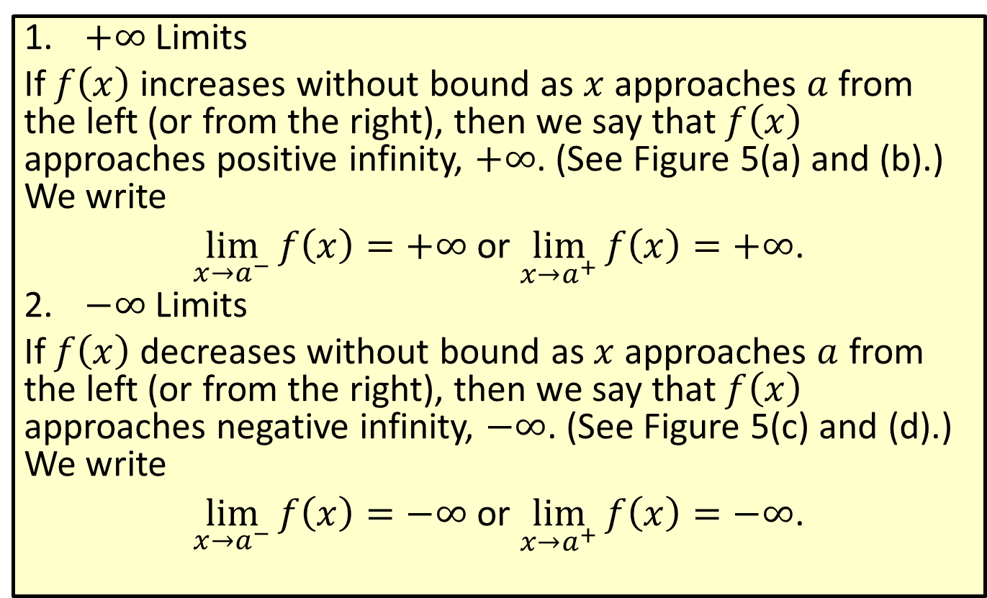
Infinite One-Sided Limits (Unbounded One-Sided Limits)
​$+∞$ Limits
​If $f⁡\left(x\right)$ increases without bound as $x$ approaches $a$ from the left (or from the right), then we say that $f⁡\left(x\right)$ approaches positive infinity, $+∞$. (See Figure 5(a) and (b).) We write
​$\lim_{x→a^{−}}f\left(x\right)=+∞$ or $\lim_{x→a^{+}}f\left(x\right)=+∞$.
​$−∞$ Limits
​If $f⁡\left(x\right)$ decreases without bound as $x$ approaches $a$ from the left (or from the right), then we say that $f⁡\left(x\right)$ approaches negative infinity, $−∞$. (See Figure 5(c) and (d).) We write
​$\lim_{x→a^{−}}f\left(x\right)=−∞$ or $\lim_{x→a^{+}}f\left(x\right)=−∞$.

Slide 13
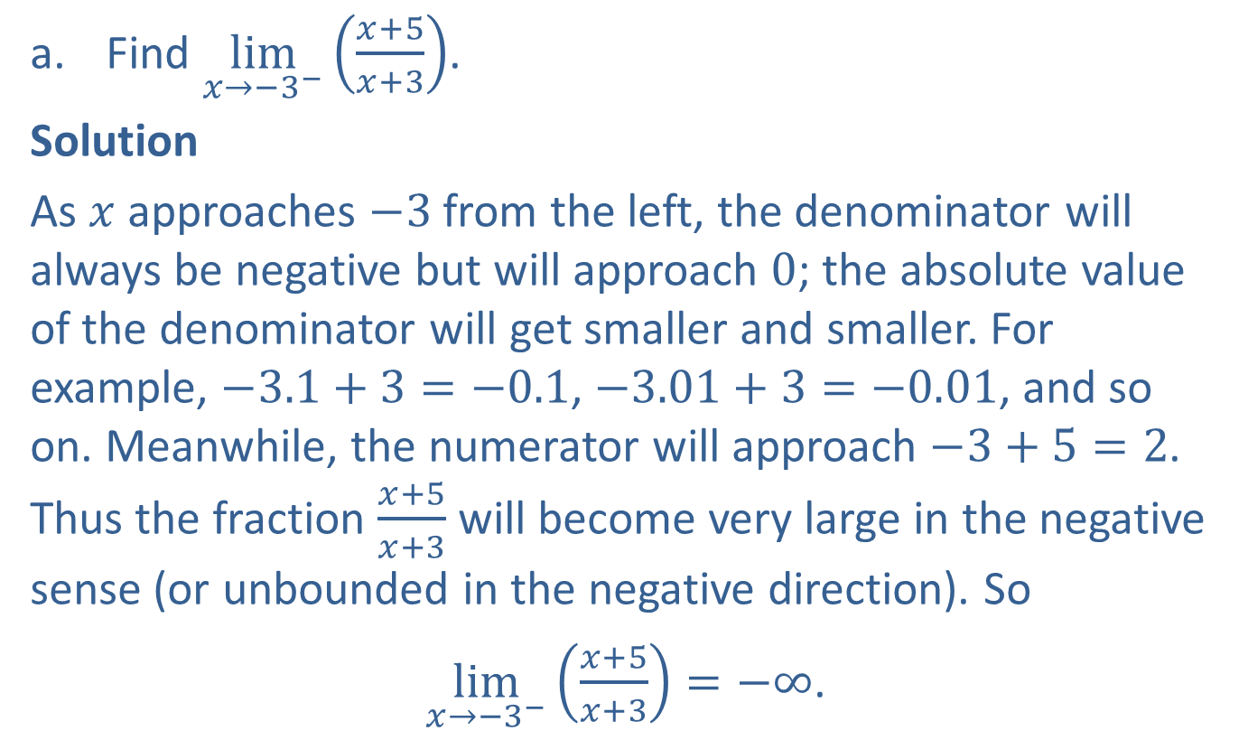
Example 3: Finding Infinite One-Sided Limits
​Find $\lim_{x→{−3}^{−}}\left(\frac{x+5}{x+3}\right)$.
​Solution
​As $x$ approaches $−3$ from the left, the denominator will always be negative but will approach 0; the absolute value of the denominator will get smaller and smaller. For example, $−3.1+3=−0.1$, $−3.01+3=−0.01$, and so on. Meanwhile, the numerator will approach $−3+5=2$. Thus the fraction $\frac{x+5}{x+3}$ will become very large in the negative sense (or unbounded in the negative direction). So
$\lim_{x→{−3}^{−}}\left(\frac{x+5}{x+3}\right)=−∞$.

Slide 14
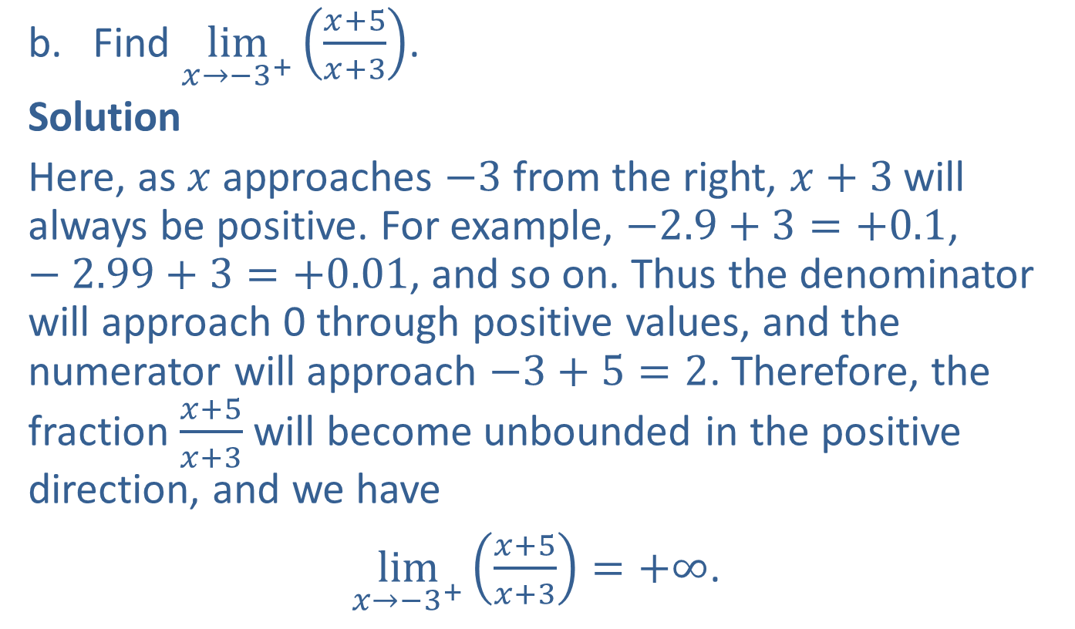
Example 3: Finding Infinite One-Sided Limits (cont.)
​Find $\lim_{x→{−3}^{+}}\left(\frac{x+5}{x+3}\right)$.
​Solution
​Here, as $x$ approaches $−3$ from the right, $x+3$ will always be positive. For example, $−2.9+3=+0.1$, $−2.99+3=+0.01$, and so on. Thus the denominator will approach 0 through positive values, and the numerator will approach $−3+5=2$. Therefore, the fraction $\frac{x+5}{x+3}$ will become unbounded in the positive direction, and we have
$\lim_{x→{−3}^{+}}\left(\frac{x+5}{x+3}\right)=+∞$.

Slide 15
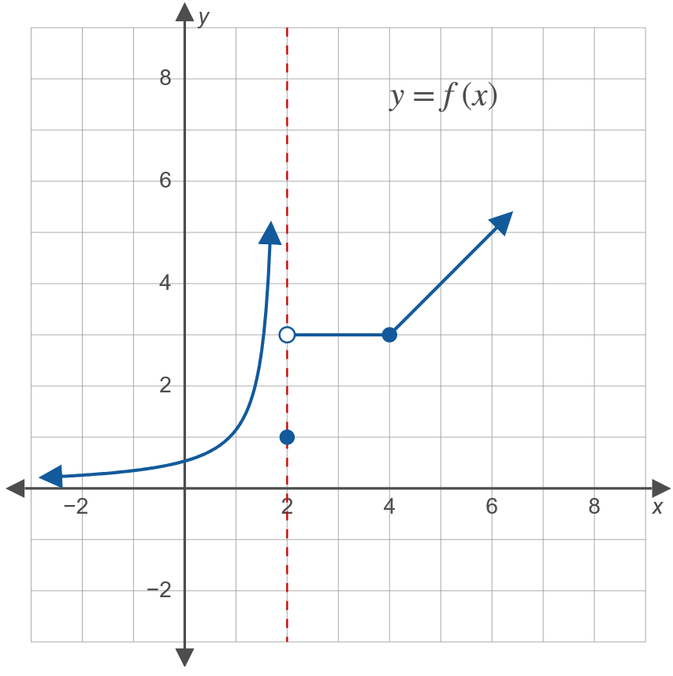

Example 4: Finding One-Sided Limits Using a Graph
Study the graph shown for $y=f\left(x\right)$ and find the following one-sided limits.

Slide 16


Example 4: Finding One-Sided Limits Using a Graph (cont.)
​$\lim_{x→2^{−}}f\left(x\right)$
​Solution
​$\lim_{x→2^{−}}f\left(x\right)=+∞$
$\lim_{x→2^{+}}f\left(x\right)$
​Solution
​$\lim_{x→2^{+}}f\left(x\right)=3$
Note: $f\left(2\right)=1$ according to the graph, but this fact does not affect either the left- or right-hand limits in parts a. and b.

Slide 17


Example 4: Finding One-Sided Limits Using a Graph (cont.)
​$\lim_{x→4^{−}}f\left(x\right)$
​Solution
​$\lim_{x→4^{−}}f\left(x\right)=3$
​$\lim_{x→4^{+}}f\left(x\right)$
​Solution
​$\lim_{x→4^{+}}f\left(x\right)=3$

