Slide 1
Section 2.2
Limits

Slide 2
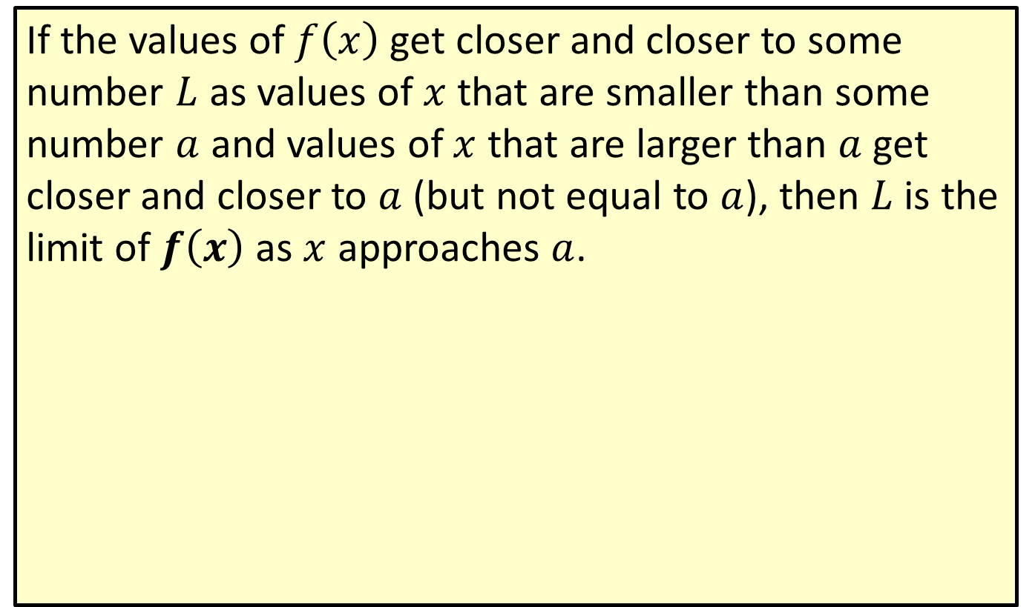
Limit Defined Informally
If the values of $f⁡\left(x\right)$ get closer and closer to some number $L$ as values of $x$ that are smaller than some number $a$ and values of $x$ that are larger than $a$ get closer and closer to $a$ (but not equal to $a$), then $L$ is the limit of $f⁡\left(x\right)$ as $x$ approaches $a$.

Slide 3
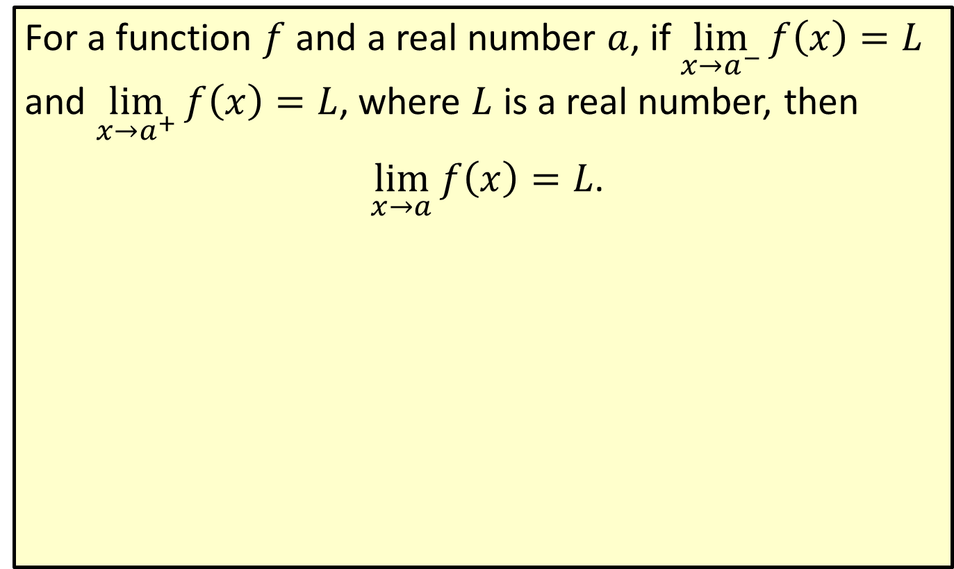
Limit Defined Symbolically
For a function $f$ and a real number $a$, if $\lim_{x→a^{−}}f\left(x\right)=L$ and $\lim_{x→a^{+}}f\left(x\right)=L$, where $L$ is a real number, then
$\lim_{x→a}f\left(x\right)=L$.

Slide 4
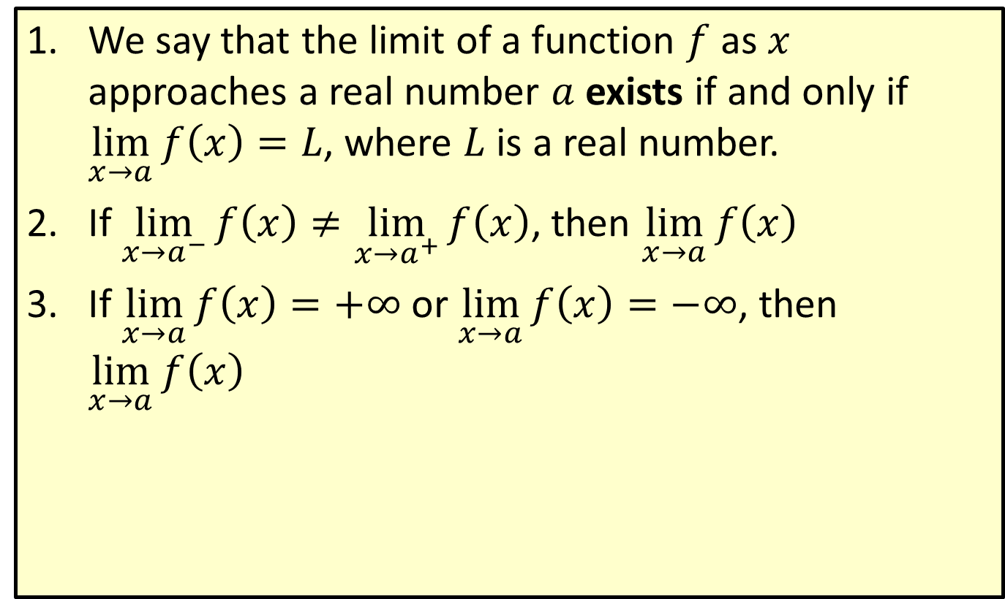
Existence of a Limit
​We say that the limit of a function $f$ as $x$ approaches a real number $a$ exists if and only if $\lim_{x→a}f\left(x\right)=L$, where $L$ is a real number.
​If $\lim_{x→a^{−}}f\left(x\right)≠\lim_{x→a^{+}}f\left(x\right)$, then $\lim_{x→a}f\left(x\right)$
​If $\lim_{x→a}f\left(x\right)=+∞$ or $\lim_{x→a}f\left(x\right)=−∞$, then $\lim_{x→a}f\left(x\right)$

Slide 5
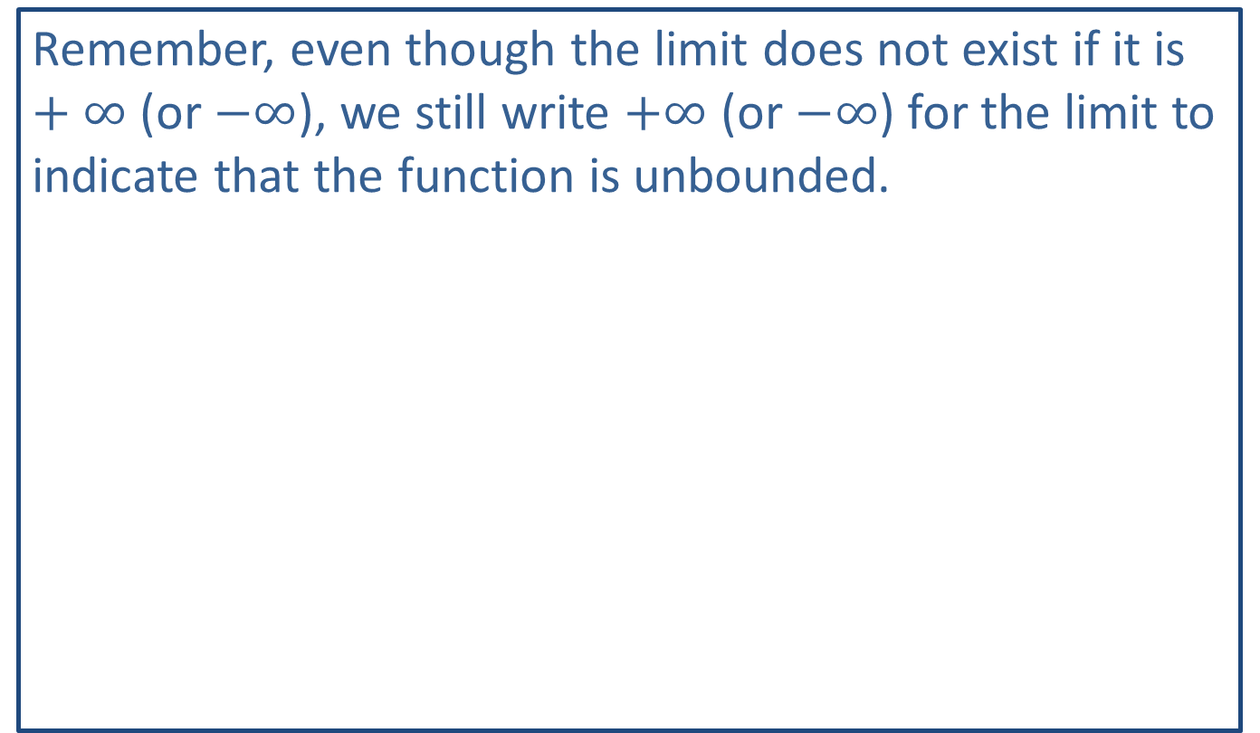
Note:
Remember, even though the limit does not exist if it is $+∞$ (or $−∞$), we still write $+∞$ (or $−∞$) for the limit to indicate that the function is unbounded.

Slide 6

Example 1: Finding a Limit Using a Graph
Use the graph of $y=f\left(x\right)$ in the figure to find
​ $\lim_{x→3}f\left(x\right)$, and
​ $\lim_{x→0}f\left(x\right)$.

Slide 7
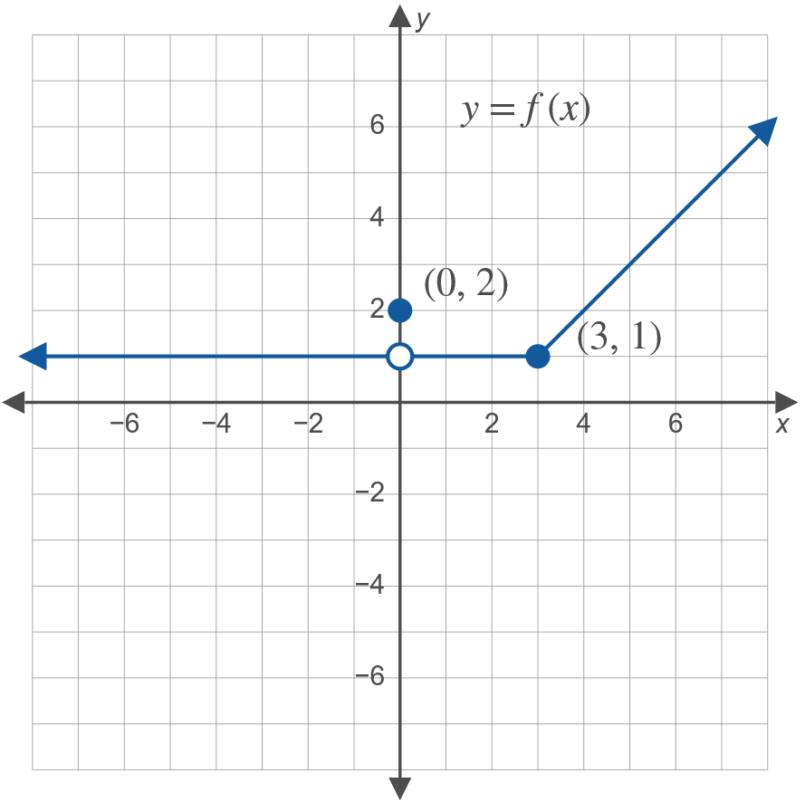
Example 1: Finding a Limit Using a Graph (cont.)

Slide 8
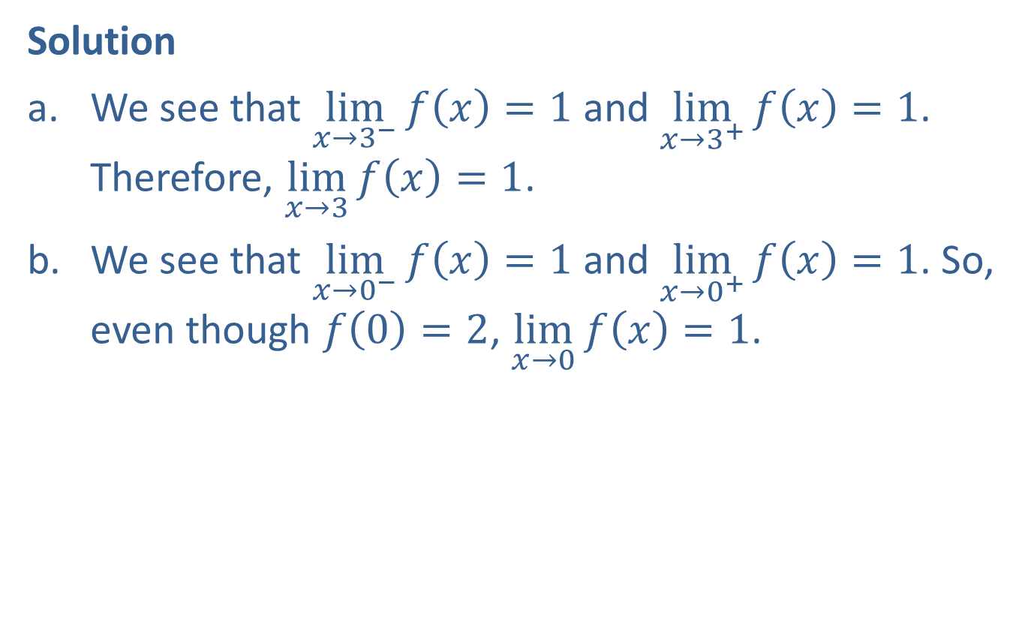
Example 1: Finding a Limit Using a Graph (cont.)
Solution
​We see that $\lim_{x→3^{−}}f\left(x\right)=1$ and $\lim_{x→3^{+}}f\left(x\right)=1$. Therefore, $\lim_{x→3}f\left(x\right)=1$.
​We see that $\lim_{x→0^{−}}f\left(x\right)=1$ and $\lim_{x→0^{+}}f\left(x\right)=1$. So, even though $f\left(0\right)=2$, $\lim_{x→0}f\left(x\right)=1$.

Slide 9

Example 2: Finding a Limit Using a Graph
Use the graph of $y=g\left(x\right)$ in the figure to find
​ $\lim_{x→−2}g\left(x\right)$, and
​ $\lim_{x→2}g\left(x\right)$, if the limits exist.

Slide 10
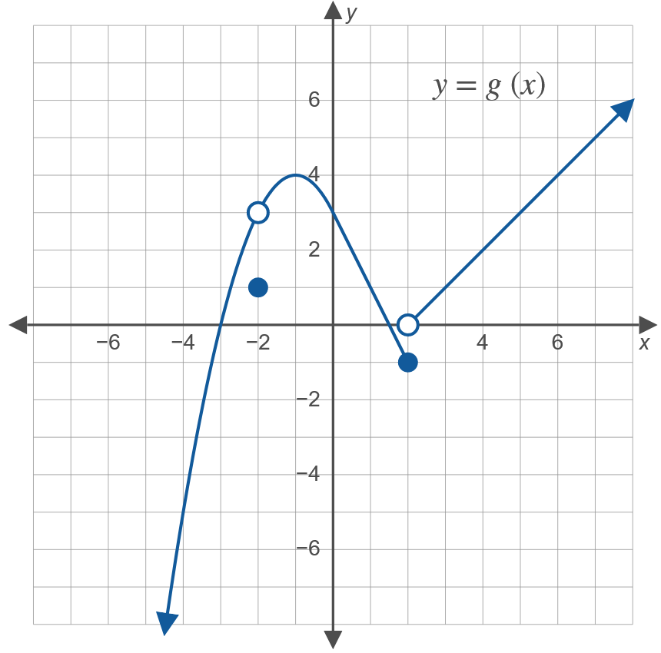
Example 2: Finding a Limit Using a Graph (cont.)

Slide 11

Example 2: Finding a Limit Using a Graph (cont.)
Solution
​$\lim_{x→−2}g\left(x\right)=3$
​$\lim_{x→2^{−}}g\left(x\right)=−1$ and $\lim_{x→2^{+}}g\left(x\right)=0$.
​Since $−1≠0$, $\lim_{x→2}g\left(x\right)$ does not exist.

Slide 12
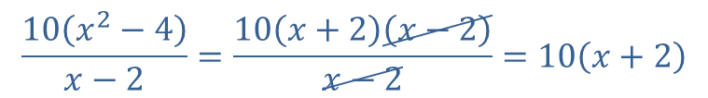

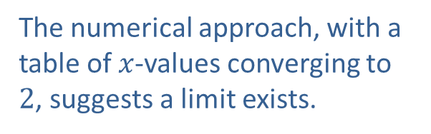
Example 3: Finding Limits Algebraically
​Determine $\lim_{x→2}\left(\frac{10\left(x^{2}−4\right)}{x−2}\right)$ by using an algebraically equivalent expression.
​Solution
​We first factor the numerator and simplify the fraction:
$$\frac{10\left(x^{2}−4\right)}{x−2}=\frac{10\left(x+2\right)\left(x−2\right)}{x−2}=10\left(x+2\right)$$
The numerical approach, with a table of $x$-values converging to 2, suggests a limit exists.

Slide 13
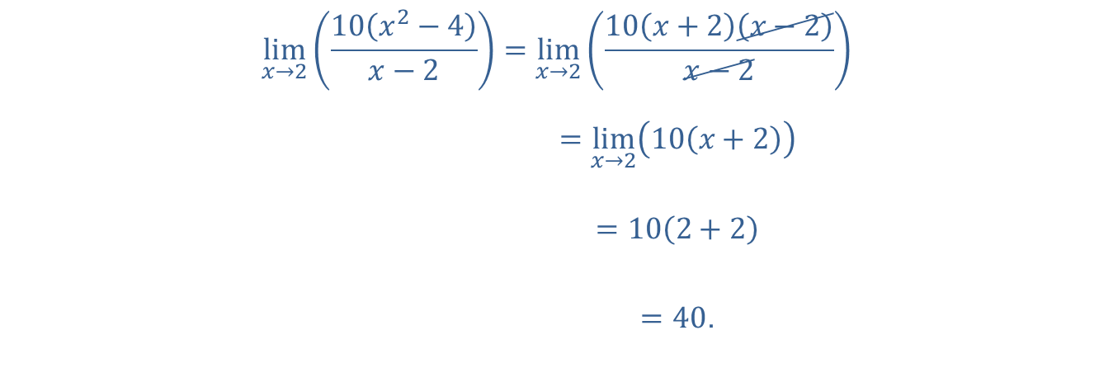

Example 3: Finding Limits Algebraically (cont.)
Since $\frac{10\left(x^{2}−4\right)}{x−2}=10\left(x+2\right)$ for any $x≠2$, we may replace the given expression with the simplified one. Thus
lim𝑥→210𝑥2−4𝑥−2=lim𝑥→210𝑥+2𝑥−2𝑥−2lim𝑥→210𝑥2−4𝑥−2=lim𝑥→210𝑥+2lim𝑥→210𝑥2−4𝑥−2=102+2lim𝑥→210𝑥2−4𝑥−2=40.

Slide 14
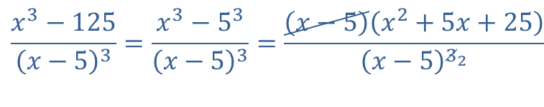

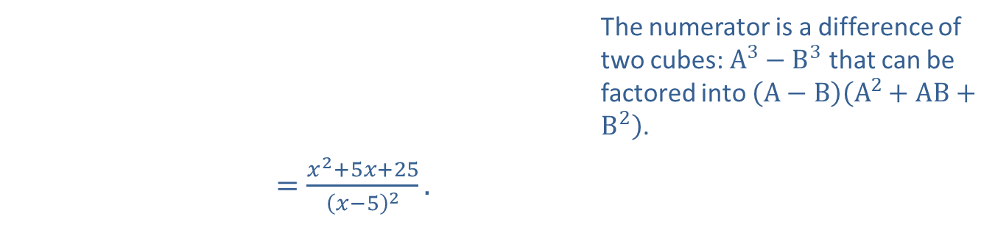
Example 3: Finding Limits Algebraically (cont.)
​Determine $\lim_{x→5}\left(\frac{x^{3}−125}{{\left(x−5\right)}^{3}}\right)$ algebraically.
​Solution
​We factor the numerator:
​ | The numerator is a difference of two cubes: $A^{3}−B^{3}$ that can be factored into $\left(A−B\right)\left(A^{2}+AB+B^{2}\right)$.
$=\frac{x^{2}+5x+25}{{\left(x−5\right)}^{2}}\text{.}$
$$\frac{x^{3}−125}{{\left(x−5\right)}^{3}}=\frac{x^{3}−5^{3}}{{\left(x−5\right)}^{3}}=\frac{\left(x−5\right)\left(x^{2}+5x+25\right)}{{\left(x−5\right)}^{3_{2}}}$$

Slide 15

Example 3: Finding Limits Algebraically (cont.)
Then the given limit, if it exists, is equivalent to $\lim_{x→5}\left(\frac{x^{2}+5x+25}{{\left(x−5\right)}^{2}}\right)$. However, the numerator does not have a limit of zero, but the limit of the denominator is zero. Thus the limit fails to exist.

Slide 16
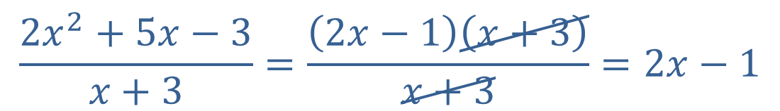
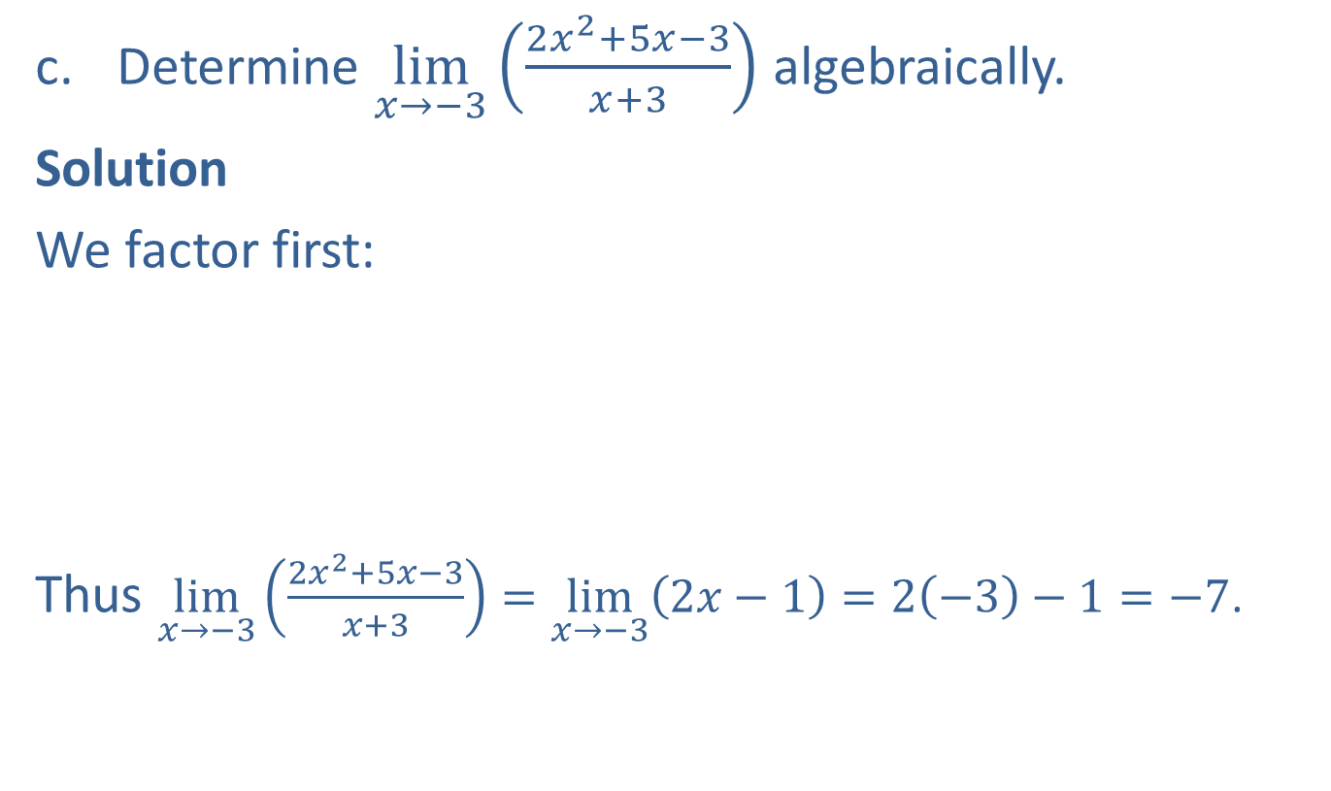
Example 3: Finding Limits Algebraically (cont.)
​Determine $\lim_{x→−3}\left(\frac{2x^{2}+5x−3}{x+3}\right)$ algebraically.
​Solution
​We factor first:
Thus $\lim_{x→−3}\left(\frac{2x^{2}+5x−3}{x+3}\right)=\lim_{x→−3}\left(2x−1\right)=2\left(−3\right)−1=−7$.
$$\frac{2x^{2}+5x−3}{x+3}=\frac{\left(2x−1\right)\left(x+3\right)}{x+3}=2x−1$$

Slide 17
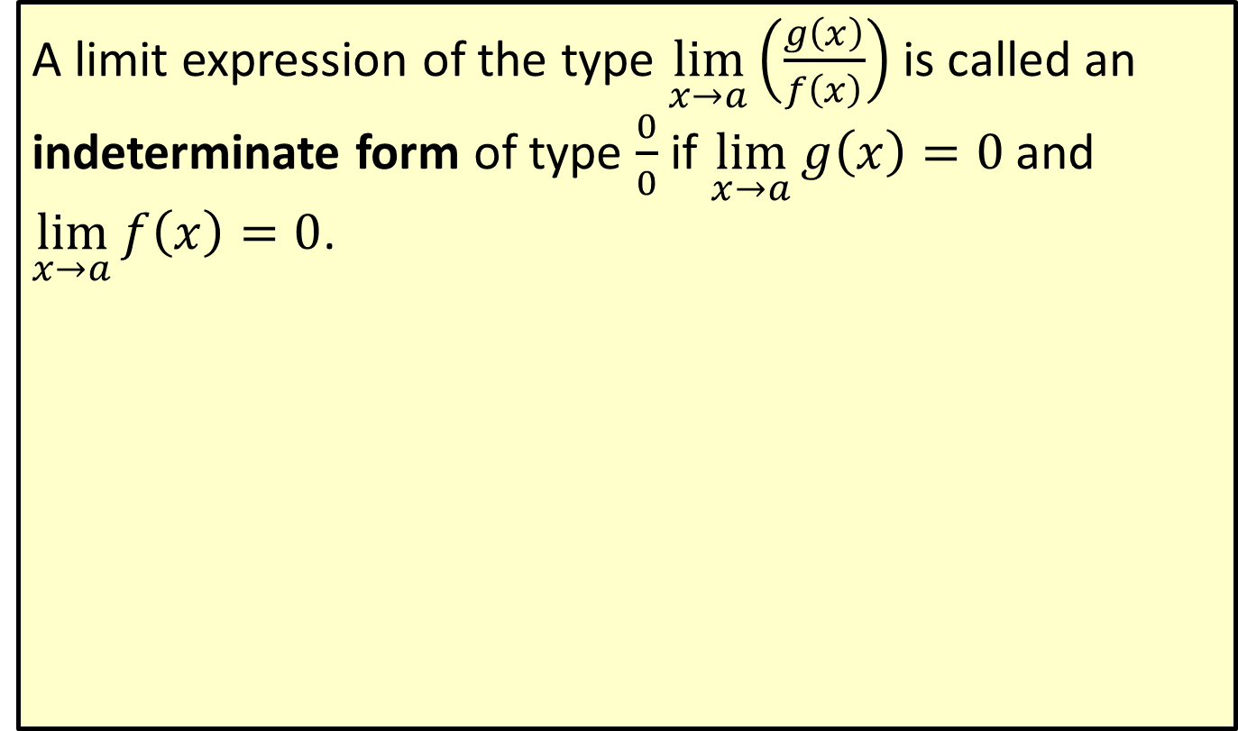
Indeterminate Form
A limit expression of the type $\lim_{x→a}\left(\frac{g\left(x\right)}{f\left(x\right)}\right)$ is called an indeterminate form of type $\frac{0}{0}$ if $\lim_{x→a}g\left(x\right)=0$ and $\lim_{x→a}f\left(x\right)=0$.

