Slide 1
Section 2.3
More about Limits

Slide 2
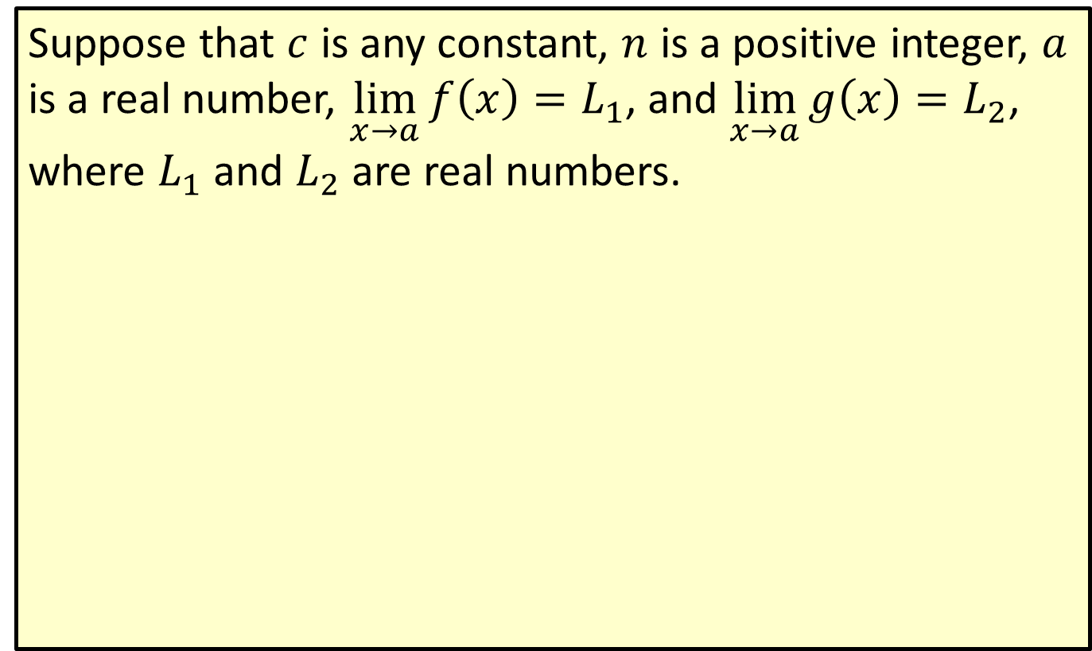

Limits as $x$ → $a$
Suppose that $c$ is any constant, $n$ is a positive integer, $a$ is a real number, $\lim_{x→a}f\left(x\right)=L_{1}$, and $\lim_{x→a}g\left(x\right)=L_{2}$, where $L_{1}$ and $L_{2}$ are real numbers.

Slide 3
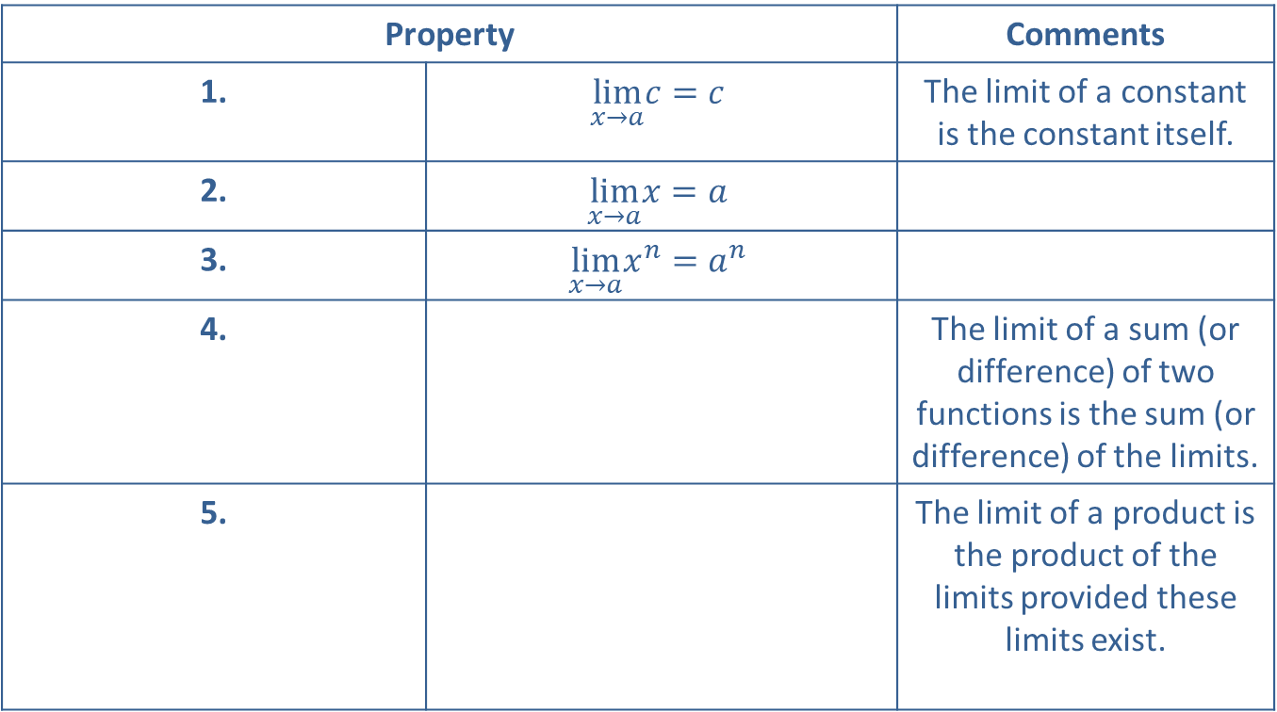
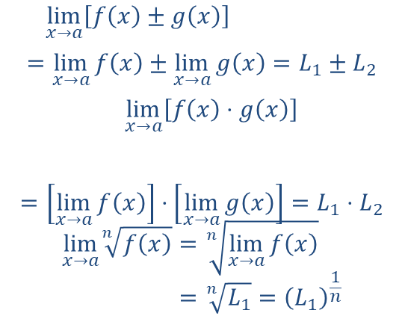

=lim𝑥→𝑎𝑓𝑥±𝑔𝑥=lim𝑥→𝑎𝑓𝑥±lim𝑥→𝑎𝑔𝑥=𝐿1±𝐿2
=lim𝑥→𝑎𝑓𝑥⋅𝑔𝑥
$$=\left[\lim_{x→a}f\left(x\right)\right]⋅\left[\lim_{x→a}g\left(x\right)\right]=L_{1}⋅L_{2}$$
lim𝑥→𝑎𝑛𝑓𝑥=𝑛lim𝑥→𝑎𝑓𝑥lim𝑥→𝑎𝑛𝑓𝑥=𝑛𝐿1=𝐿11𝑛
Limits as $x$ → $a$ (cont.)
Property |  | Comments
1. | $$\lim_{x→a}c=c$$ | The limit of a constant is the constant itself.
2. | $$\lim_{x→a}x=a$$
3. | $$\lim_{x→a}x^{n}=a^{n}$$
4. | ​ | The limit of a sum (or difference) of two functions is the sum (or difference) of the limits.
5. | ​ | The limit of a product is the product of the limits provided these limits exist.

Slide 4

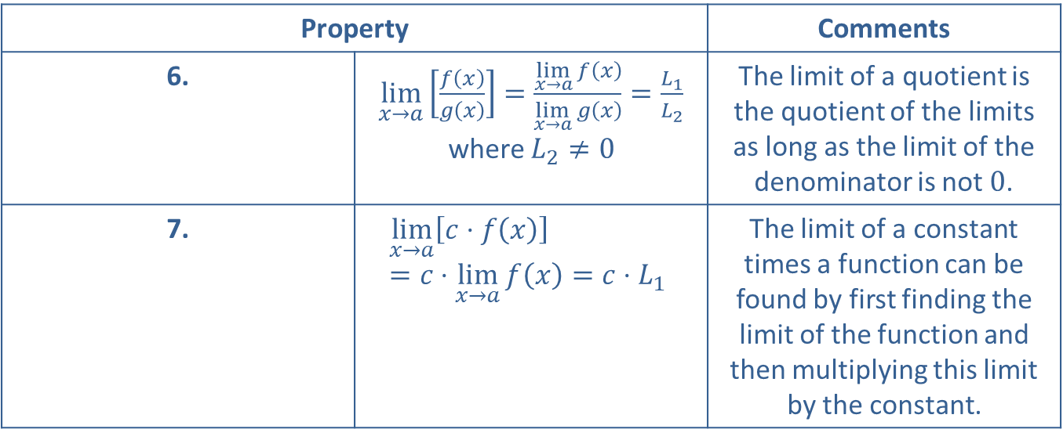
Limits as $x$ → $a$ (cont.)
Property |  | Comments
6. | $\lim_{x→a}\left[\frac{f\left(x\right)}{g\left(x\right)}\right]=\frac{\lim_{x→a}f\left(x\right)}{\lim_{x→a}g\left(x\right)}=\frac{L_{1}}{L_{2}}$ where $L_{2}≠0$ | The limit of a quotient is the quotient of the limits as long as the limit of the denominator is not 0.
7. | $$\lim_{x→a}\left[c⋅f\left(x\right)\right]=c⋅\lim_{x→a}f\left(x\right)=c⋅L_{1}$$ | The limit of a constant times a function can be found by first finding the limit of the function and then multiplying this limit by the constant.

Slide 5
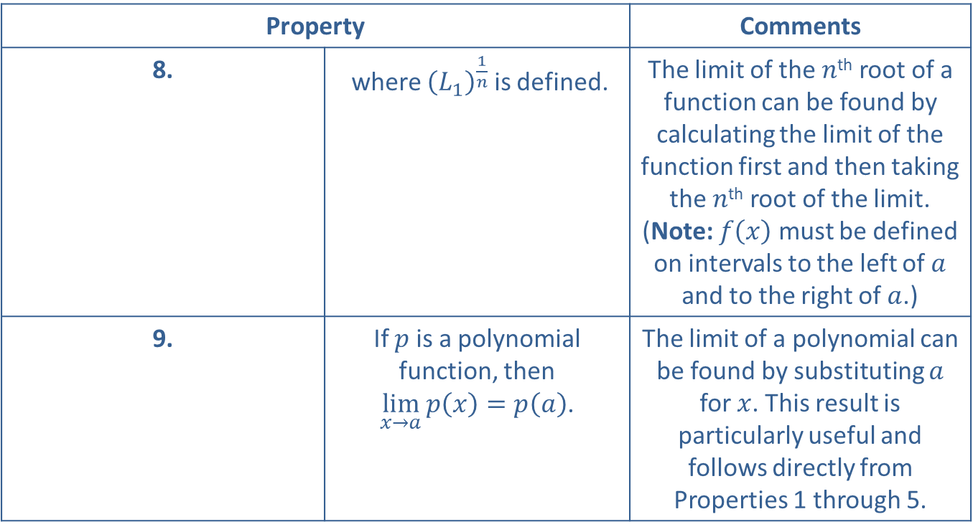
Limits as $x$ → $a$ (cont.)
Property |  | Comments
8. | ​ where ${\left(L_{1}\right)}^{\frac{1}{n}}$ is defined. | The limit of the $n$^{th} root of a function can be found by calculating the limit of the function first and then taking the $n$^{th} root of the limit. (Note: $f⁡\left(x\right)$ must be defined on intervals to the left of $a$ and to the right of $a$.)
9. | If $p$ is a polynomial function, then $\lim_{x→a}p\left(x\right)=p\left(a\right)$. | The limit of a polynomial can be found by substituting $a$ for $x$. This result is particularly useful and follows directly from Properties 1 through 5.

Slide 6

Example 1: Properties of Limits
Use the properties of limits to find each of the following limits.
​$\lim_{x→4}10$
​Solution
​$\lim_{x→4}10=10$
​$\lim_{x→3}\left(x^{2}+5x+7\right)$
​
​

Slide 7
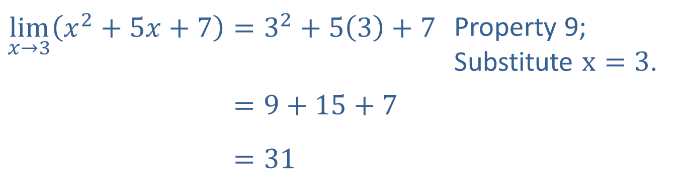
Example 1: Properties of Limits (cont.)
Solution
​$\lim_{x→3}\left(x^{2}+5x+7\right)=3^{2}+5\left(3\right)+7$ | Property 9; Substitute $x=3$.
​lim𝑥→3𝑥2+5𝑥+7=9+15+7
​lim𝑥→3𝑥2+5𝑥+7=31

Slide 8
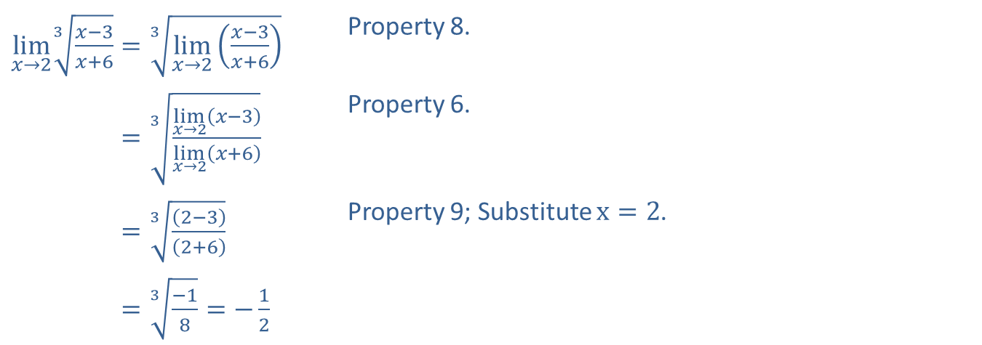

Example 1: Properties of Limits (cont.)
​$\lim_{x→2}\sqrt[3]{\frac{x−3}{x+6}}$
​Solution
​
​$\lim_{x→2}\sqrt[3]{\frac{x−3}{x+6}}=\sqrt[3]{\lim_{x→2}\left(\frac{x−3}{x+6}\right)}$ | Property 8.
​lim𝑥→23𝑥−3𝑥+6=3lim𝑥→2𝑥−3lim𝑥→2𝑥+6 | Property 6.
​lim𝑥→23𝑥−3𝑥+6=32−32+6 | Property 9; Substitute $x=2$.
​lim𝑥→23𝑥−3𝑥+6=3−18=−12

Slide 9
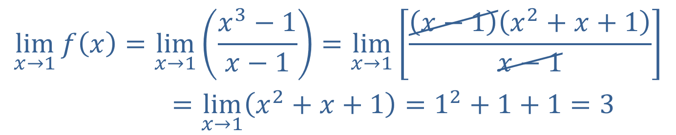

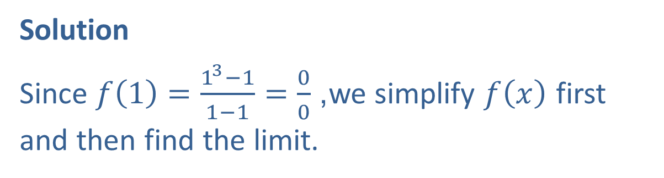
Example 2: Indeterminate Form
If $f\left(x\right)=\frac{x^{3}−1}{x−1}$, find $\lim_{x→1}f\left(x\right)$.
Solution
Since $f\left(1\right)=\frac{1^{3}−1}{1−1}=\frac{0}{0}$, we simplify $f⁡\left(x\right)$ first and then find the limit.
lim𝑥→1𝑓𝑥=lim𝑥→1𝑥3−1𝑥−1=lim𝑥→1𝑥−1𝑥2+𝑥+1𝑥−1lim𝑥→1𝑓𝑥=lim𝑥→1𝑥2+𝑥+1=12+1+1=3

Slide 10

Example 3: Undefined Limit
For $f\left(x\right)=\frac{1}{x−5}$, find $\lim_{x→5}f\left(x\right)$.

Slide 11
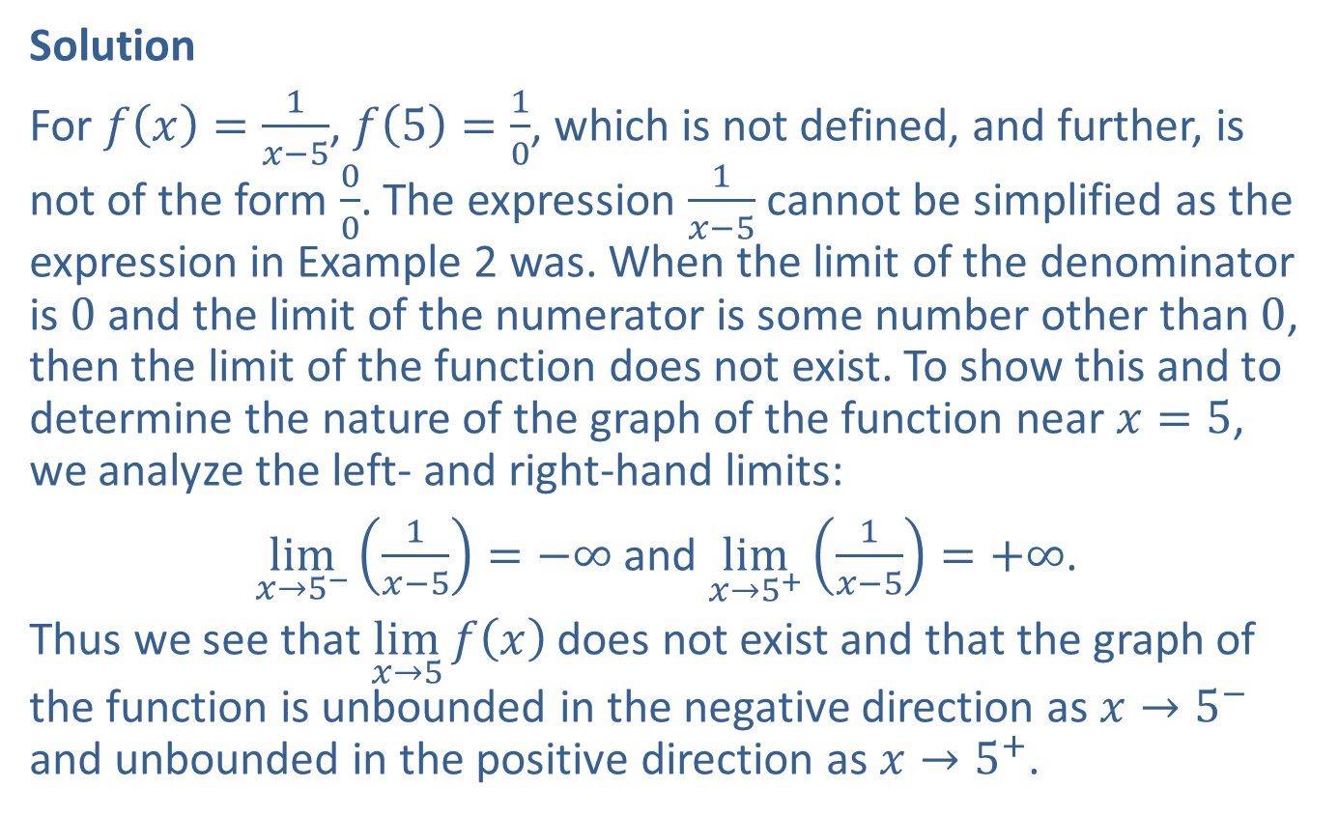
Example 3: Undefined Limit (cont.)
Solution
For $f\left(x\right)=\frac{1}{x−5}$, $f\left(5\right)=\frac{1}{0}$, which is not defined, and further, is not of the form $\frac{0}{0}$. The expression $\frac{1}{x−5}$ cannot be simplified as the expression in Example 2 was. When the limit of the denominator is 0 and the limit of the numerator is some number other than 0, then the limit of the function does not exist. To show this and to determine the nature of the graph of the function near $x=5$, we analyze the left- and right-hand limits:
$\lim_{x→5^{−}}\left(\frac{1}{x−5}\right)=−∞$ and $\lim_{x→5^{+}}\left(\frac{1}{x−5}\right)=+∞$.
Thus we see that $\lim_{x→5}f\left(x\right)$ does not exist and that the graph of the function is unbounded in the negative direction as $x→5^{−}$ and unbounded in the positive direction as $x→5^{+}$.

Slide 12

Example 4: Piecewise Function
The function $f⁡\left(x\right)$ is defined piecewise as follows.
$$f\left(x\right)=\{\begin{matrix}2x & \text{if}x≤3 \\ x+3 & \text{if}x>3\end{matrix}$$
Find $\lim_{x→3}f\left(x\right)$ if it exists.

Slide 13
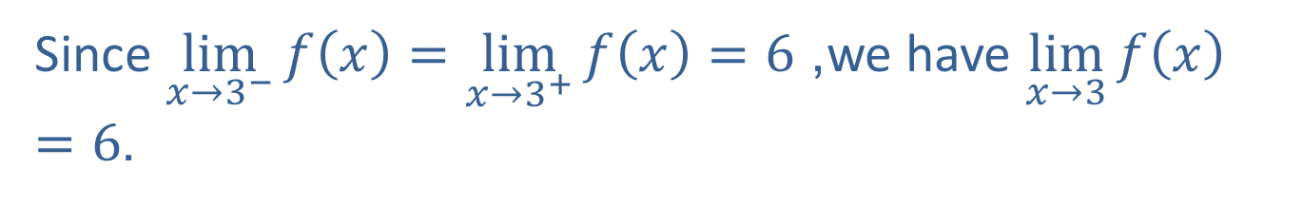
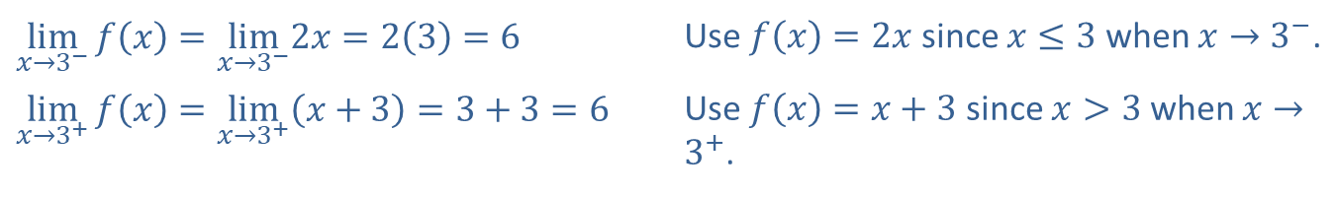
Example 4: Piecewise Function (cont.)
Solution
​$\lim_{x→3^{−}}f\left(x\right)=\lim_{x→3^{−}}2x=2\left(3\right)=6$ | Use $f\left(x\right)=2x$ since $x≤3$ when $x→3^{−}$.
​$\lim_{x→3^{+}}f\left(x\right)=\lim_{x→3^{+}}\left(x+3\right)=3+3=6$ | Use $f\left(x\right)=x+3$ since $x>3$ when $x→3^{+}$.
Since $\lim_{x→3^{−}}f\left(x\right)=\lim_{x→3^{+}}f\left(x\right)=6$, we have $\lim_{x→3}f\left(x\right)=6$.

Slide 14
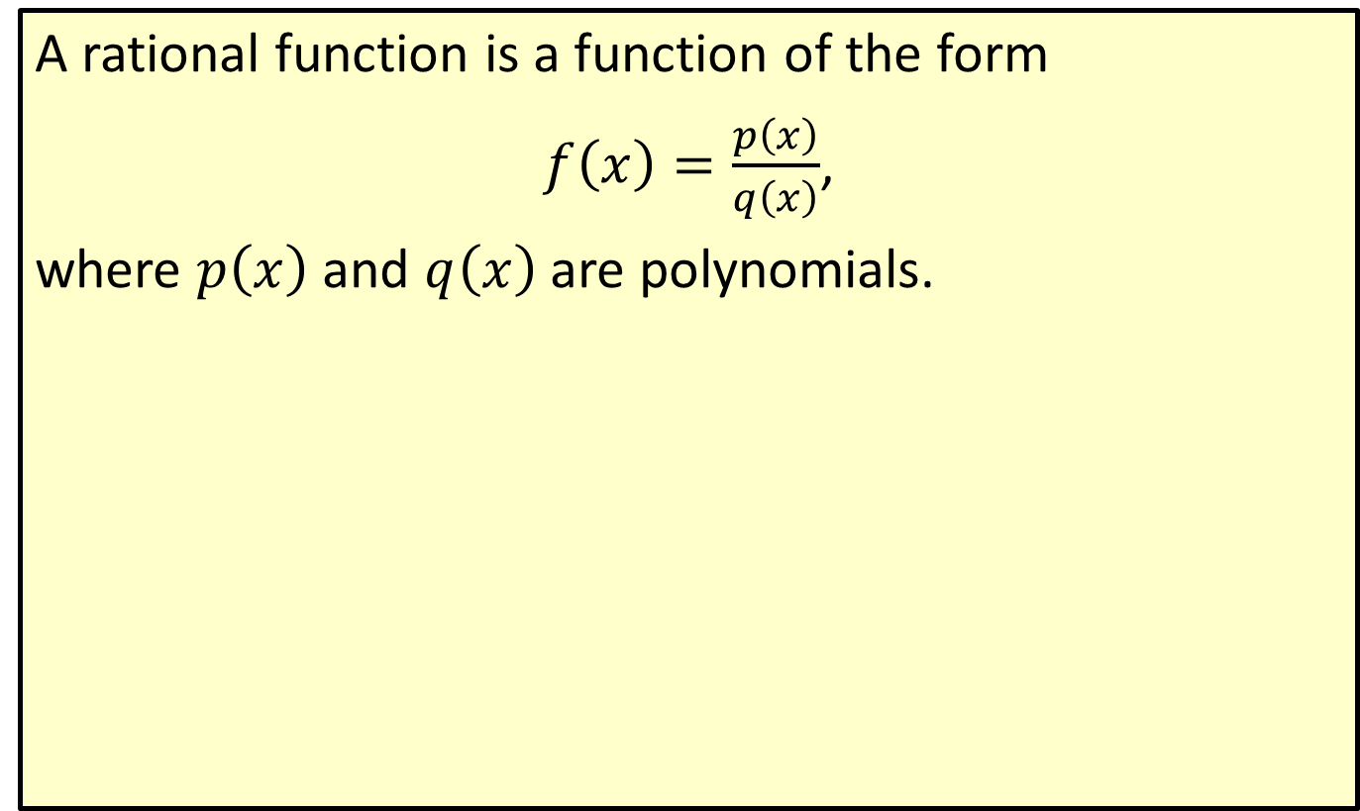
Rational Function
A rational function is a function of the form
$f\left(x\right)=\frac{p\left(x\right)}{q\left(x\right)}$,
where $p⁡\left(x\right)$ and $q⁡\left(x\right)$ are polynomials.

Slide 15

Example 5: Properties of Limits
Find $\lim_{x→+∞}\left(\frac{3x+5}{2x−1}\right)$, if it exists.

Slide 16
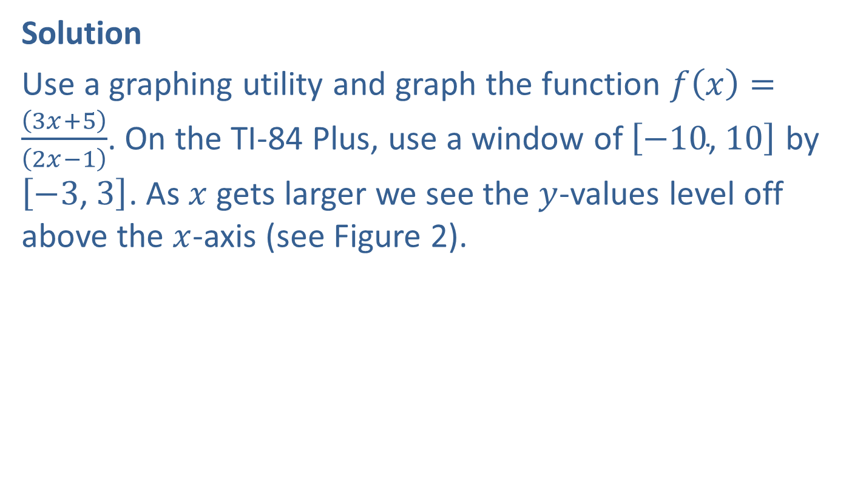
Example 5: Properties of Limits (cont.)
Solution
Use a graphing utility and graph the function $f\left(x\right)=\frac{\left(3x+5\right)}{\left(2x−1\right)}$. On the TI-84 Plus, use a window of $\left[−10\text{, }10\right]$ by $\left[−3\text{, }3\right]$. As $x$ gets larger we see the $y$-values level off above the $x$-axis (see Figure 2).

Slide 17
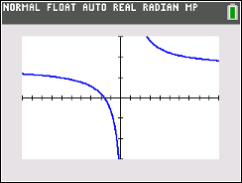
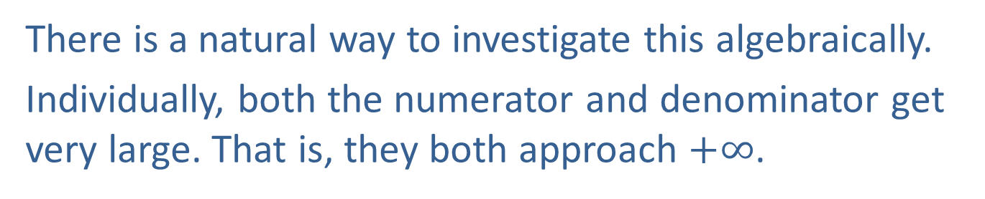
Example 5: Properties of Limits (cont.)
Figure 2
There is a natural way to investigate this algebraically.
Individually, both the numerator and denominator get very large. That is, they both approach $+∞$.
$\lim_{x→+∞}\left(3x+5\right)=+∞$ and $\lim_{x→+∞}\left(2x−1\right)=+∞$.

Slide 18
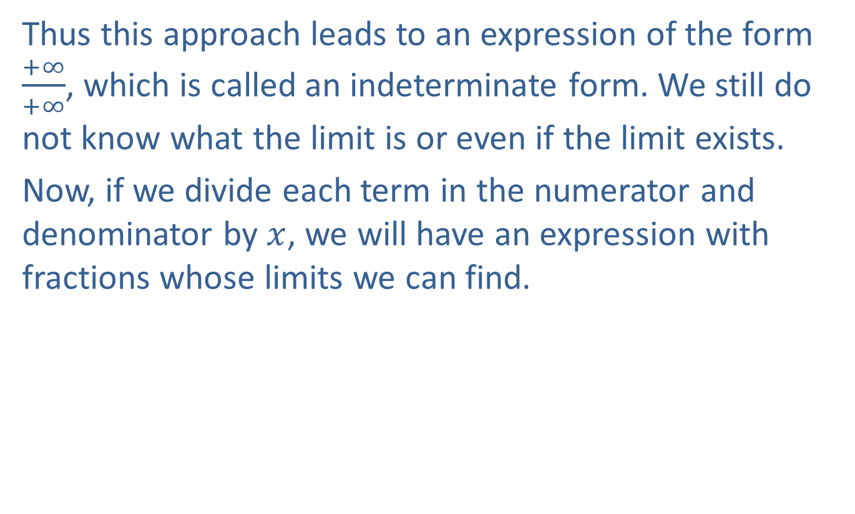
Example 5: Properties of Limits (cont.)
Thus this approach leads to an expression of the form $\frac{+∞}{+∞}$, which is called an indeterminate form. We still do not know what the limit is or even if the limit exists.
Now, if we divide each term in the numerator and denominator by $x$, we will have an expression with fractions whose limits we can find.

Slide 19
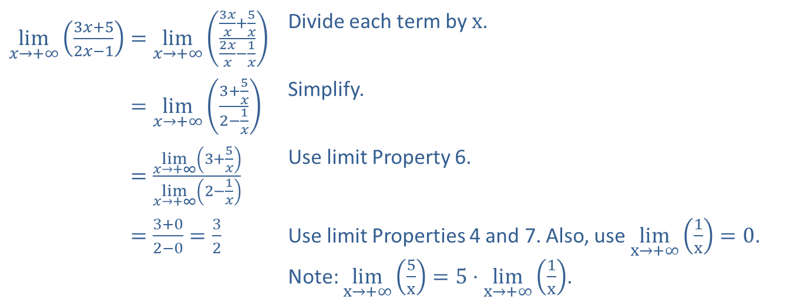
Example 5: Properties of Limits (cont.)
​$\lim_{x→+∞}\left(\frac{3x+5}{2x−1}\right)=\lim_{x→+∞}\left(\frac{\frac{3x}{x}+\frac{5}{x}}{\frac{2x}{x}−\frac{1}{x}}\right)$ | Divide each term by $x$.
​lim𝑥→+∞3𝑥+52𝑥−1=lim𝑥→+∞3+5𝑥2−1𝑥 | Simplify.
​lim𝑥→+∞3𝑥+52𝑥−1=lim𝑥→+∞3+5𝑥lim𝑥→+∞2−1𝑥 | Use limit Property 6.
​lim𝑥→+∞3𝑥+52𝑥−1=3+02−0=32 | Use limit Properties 4 and 7. Also, use $\lim_{x→+∞}\left(\frac{1}{x}\right)=0$. Note: $\lim_{x→+∞}\left(\frac{5}{x}\right)=5⋅\lim_{x→+∞}\left(\frac{1}{x}\right)$.

Slide 20
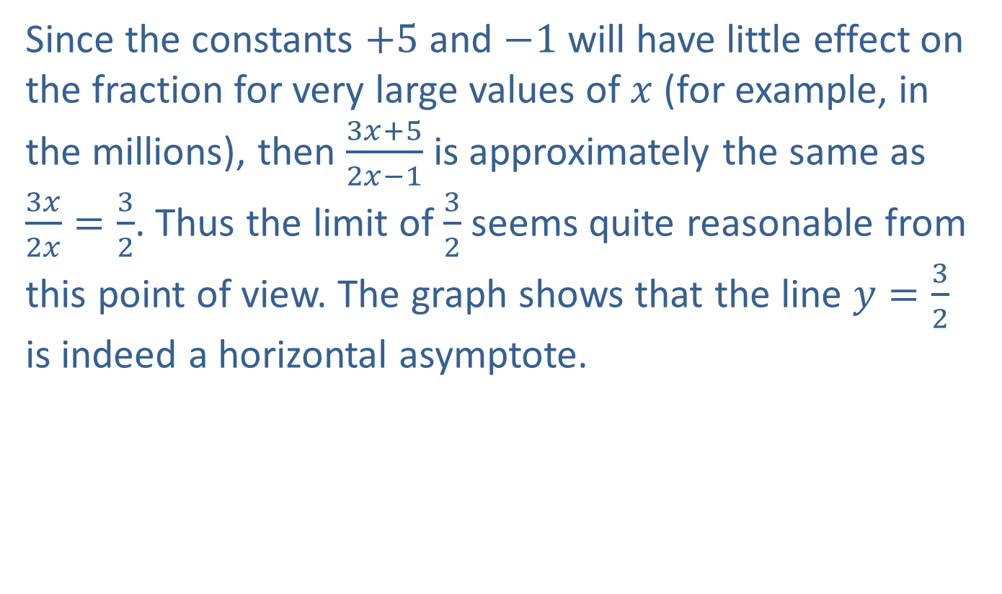
Example 5: Properties of Limits (cont.)
Since the constants $+5$ and $−1$ will have little effect on the fraction for very large values of $x$ (for example, in the millions), then $\frac{3x+5}{2x−1}$ is approximately the same as $\frac{3x}{2x}=\frac{3}{2}$. Thus the limit of $\frac{3}{2}$ seems quite reasonable from this point of view. The graph shows that the line $y=\frac{3}{2}$ is indeed a horizontal asymptote.

Slide 21
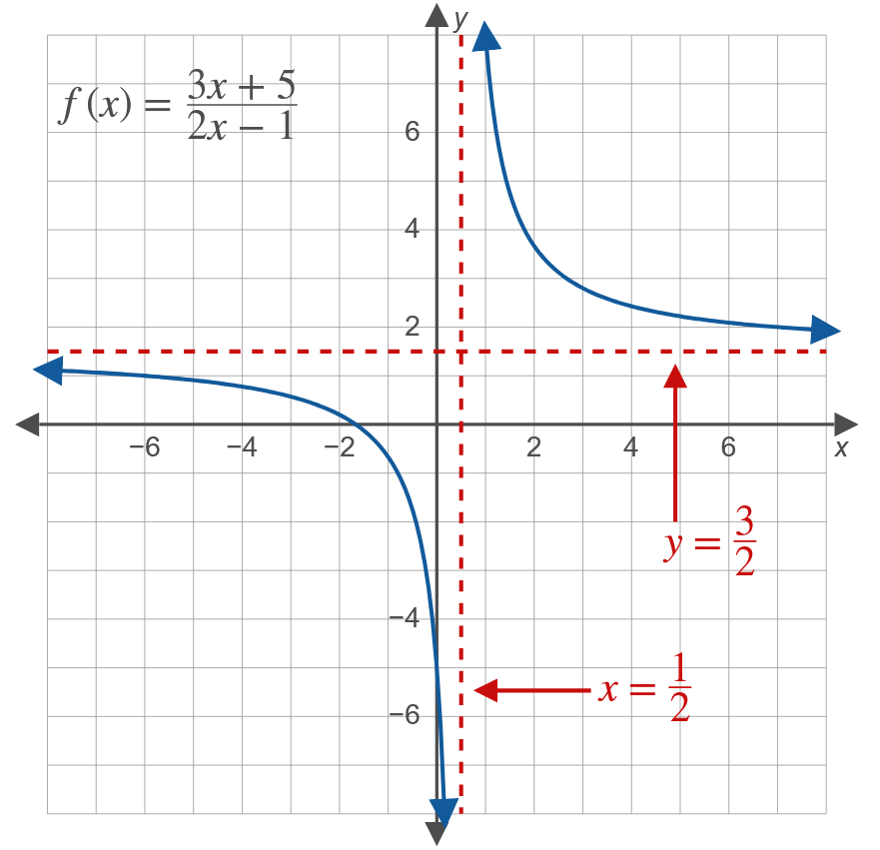
Example 5: Properties of Limits (cont.)

Slide 22
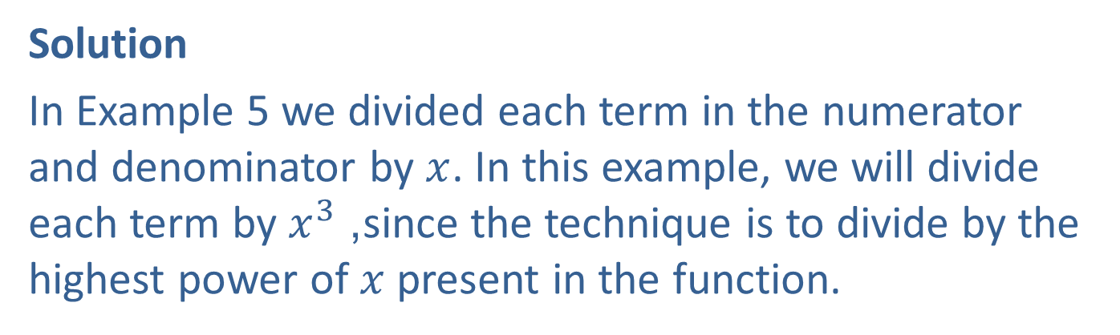

Example 6: Properties of Limits
Find $\lim_{x→+∞}\left(\frac{2x+3}{x^{3}−8}\right)$, if it exists.
Solution
In Example 5 we divided each term in the numerator and denominator by $x$. In this example, we will divide each term by $x^{3}$, since the technique is to divide by the highest power of $x$ present in the function.

Slide 23
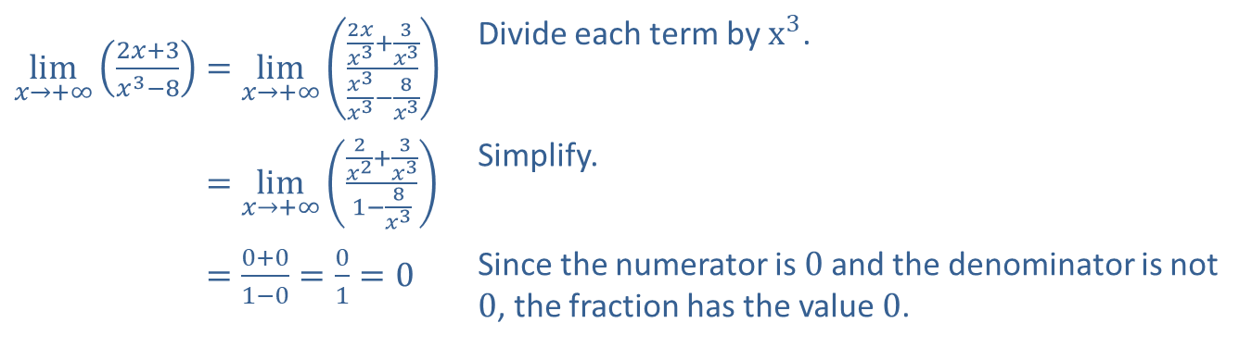
Example 6: Properties of Limits (cont.)
​$\lim_{x→+∞}\left(\frac{2x+3}{x^{3}−8}\right)=\lim_{x→+∞}\left(\frac{\frac{2x}{x^{3}}+\frac{3}{x^{3}}}{\frac{x^{3}}{x^{3}}−\frac{8}{x^{3}}}\right)$ | Divide each term by $x^{3}$.
​lim𝑥→+∞2𝑥+3𝑥3−8=lim𝑥→+∞2𝑥2+3𝑥31−8𝑥3 | Simplify.
​lim𝑥→+∞2𝑥+3𝑥3−8=0+01−0=01=0 | Since the numerator is 0 and the denominator is not 0, the fraction has the value 0.

Slide 24
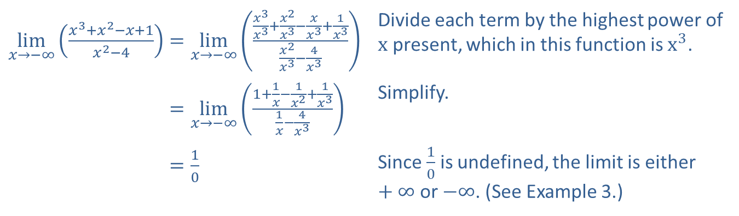

Example 7: Properties of Limits
Find $\lim_{x→−∞}\left(\frac{x^{3}+x^{2}−x+1}{x^{2}−4}\right)$, if it exists.
Solution
​$\lim_{x→−∞}\left(\frac{x^{3}+x^{2}−x+1}{x^{2}−4}\right)=\lim_{x→−∞}\left(\frac{\frac{x^{3}}{x^{3}}+\frac{x^{2}}{x^{3}}−\frac{x}{x^{3}}+\frac{1}{x^{3}}}{\frac{x^{2}}{x^{3}}−\frac{4}{x^{3}}}\right)$ | Divide each term by the highest power of $x$ present, which in this function is $x^{3}$.
​lim𝑥→−∞𝑥3+𝑥2−𝑥+1𝑥2−4=lim𝑥→−∞1+1𝑥−1𝑥2+1𝑥31𝑥−4𝑥3 | Simplify.
​lim𝑥→−∞𝑥3+𝑥2−𝑥+1𝑥2−4=10 | Since $\frac{1}{0}$ is undefined, the limit is either $+∞$ or $−∞$. (See Example 3.)

Slide 25
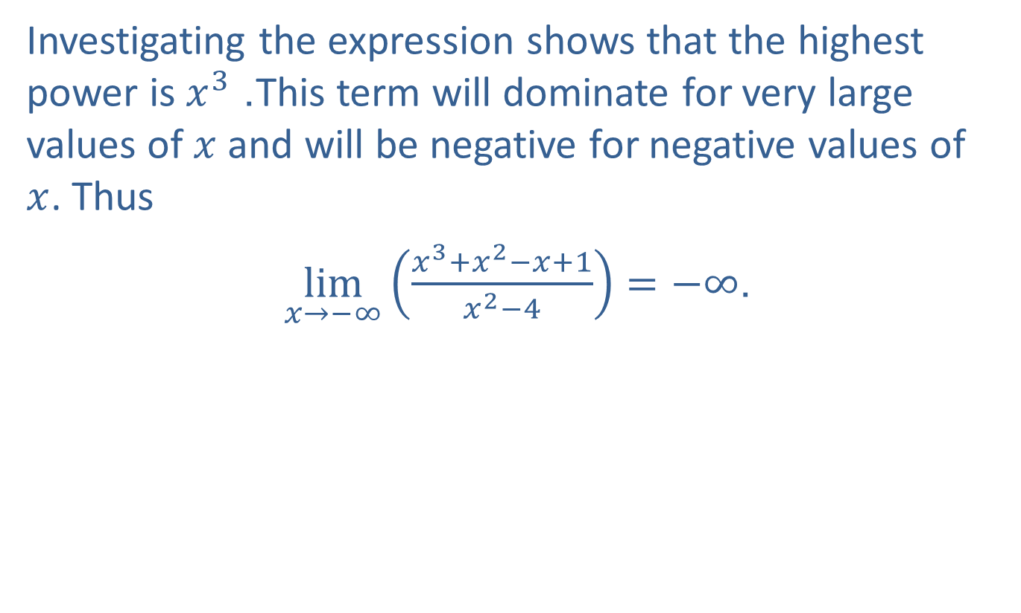
Example 7: Properties of Limits (cont.)
Investigating the expression shows that the highest power is $x^{3}$. This term will dominate for very large values of $x$ and will be negative for negative values of $x$. Thus
$\lim_{x→−∞}\left(\frac{x^{3}+x^{2}−x+1}{x^{2}−4}\right)=−∞$.

Slide 26
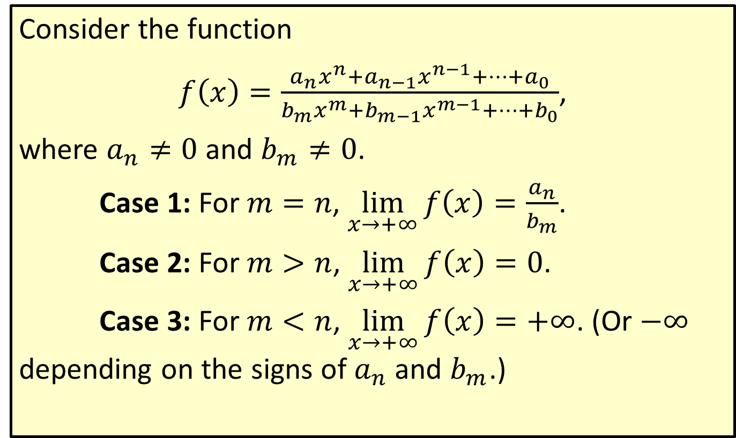
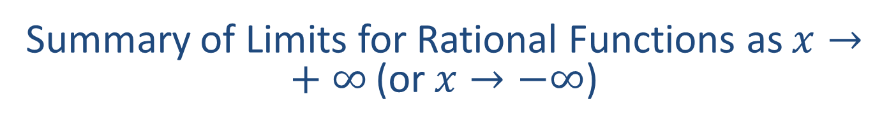
Summary of Limits for Rational Functions as $x→+∞$ (or $x→−∞$)
Consider the function
$f\left(x\right)=\frac{a_{n}x^{n}+a_{n−1}x^{n−1}+⋯+a_{0}}{b_{m}x^{m}+b_{m−1}x^{m−1}+⋯+b_{0}}$,
where $a_{n}≠0$ and $b_{m}≠0$.
Case 1: For $m=n$, $\lim_{x→+∞}f\left(x\right)=\frac{a_{n}}{b_{m}}$.
Case 2: For $m>n$, $\lim_{x→+∞}f\left(x\right)=0$.
Case 3: For $m<n$, $\lim_{x→+∞}f\left(x\right)=+∞$. (Or $−∞$ depending on the signs of $a_{n}$ and $b_{m}$.)

