Slide 1
Section 2.4
Continuity

Slide 2
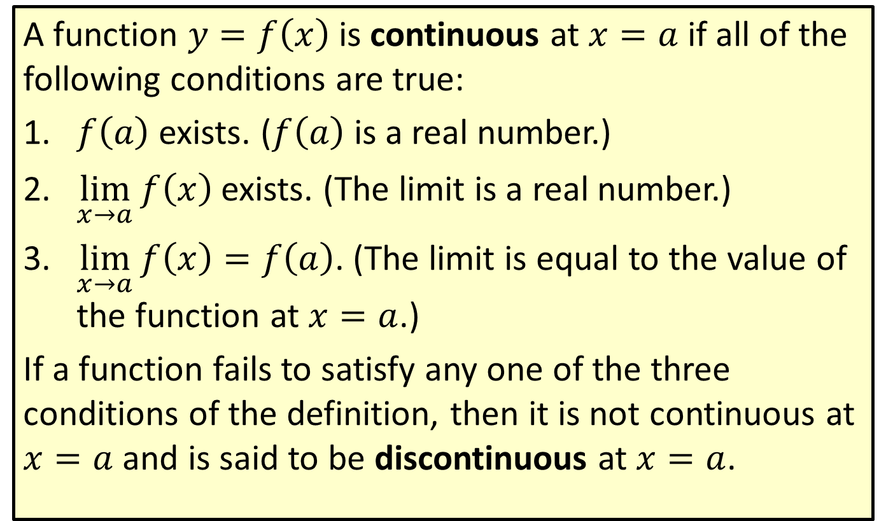
Continuity
A function $y=f\left(x\right)$ is continuous at $x=a$ if all of the following conditions are true:
​$f⁡\left(a\right)$ exists. ($f⁡\left(a\right)$ is a real number.)
​$\lim_{x→a}f\left(x\right)$ exists. (The limit is a real number.)
​$\lim_{x→a}f\left(x\right)=f\left(a\right)$. (The limit is equal to the value of the function at $x=a$.)
If a function fails to satisfy any one of the three conditions of the definition, then it is not continuous at $x=a$ and is said to be discontinuous at $x=a$.

Slide 3

Example 1: Continuity
Use the definition of continuity to determine whether the function $f\left(x\right)=\frac{x^{2}−x−6}{x−3}$ is continuous at
​$x=2$, and
​$x=3$.

Slide 4
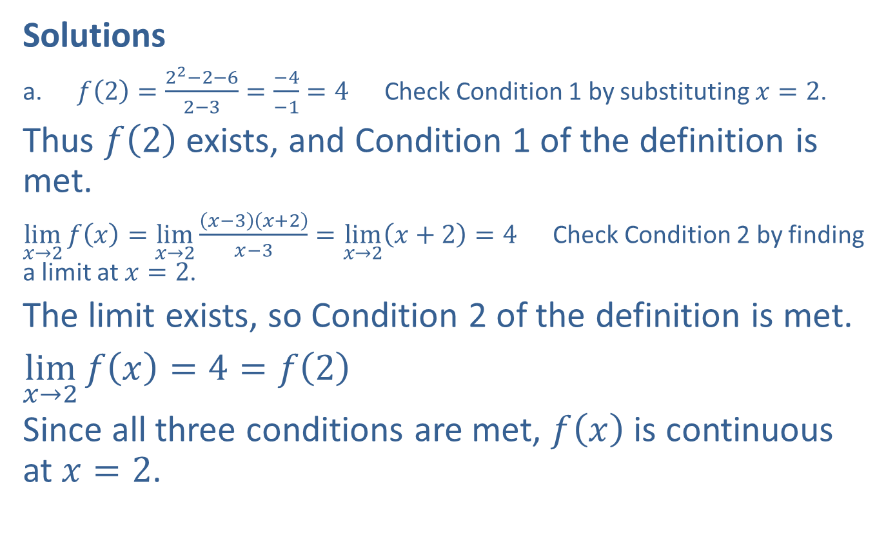
Example 1: Continuity (cont.)
Solutions
​$f\left(2\right)=\frac{2^{2}−2−6}{2−3}=\frac{−4}{−1}=4$ Check Condition 1 by substituting $x=2$.
​Thus $f⁡\left(2\right)$ exists, and Condition 1 of the definition is met.
​$\lim_{x→2}f\left(x\right)=\lim_{x→2}\frac{\left(x−3\right)\left(x+2\right)}{x−3}=\lim_{x→2}\left(x+2\right)=4$ Check Condition 2 by finding a limit at $x=2$.
​The limit exists, so Condition 2 of the definition is met.
​$\lim_{x→2}f\left(x\right)=4=f\left(2\right)$
​Since all three conditions are met, $f⁡\left(x\right)$ is continuous at $x=2$.

Slide 5
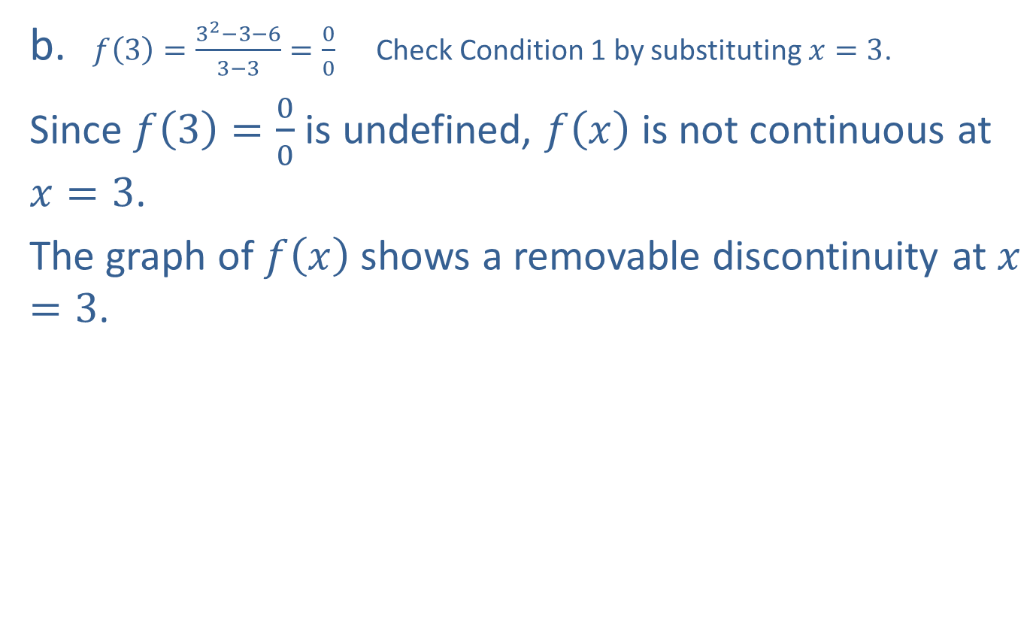
Example 1: Continuity (cont.)
​$f\left(3\right)=\frac{3^{2}−3−6}{3−3}=\frac{0}{0}$ Check Condition 1 by substituting $x=3$.
​Since $f\left(3\right)=\frac{0}{0}$ is undefined, $f⁡\left(x\right)$ is not continuous at $x=3$.
​The graph of $f⁡\left(x\right)$ shows a removable discontinuity at $x=3$.
​

Slide 6
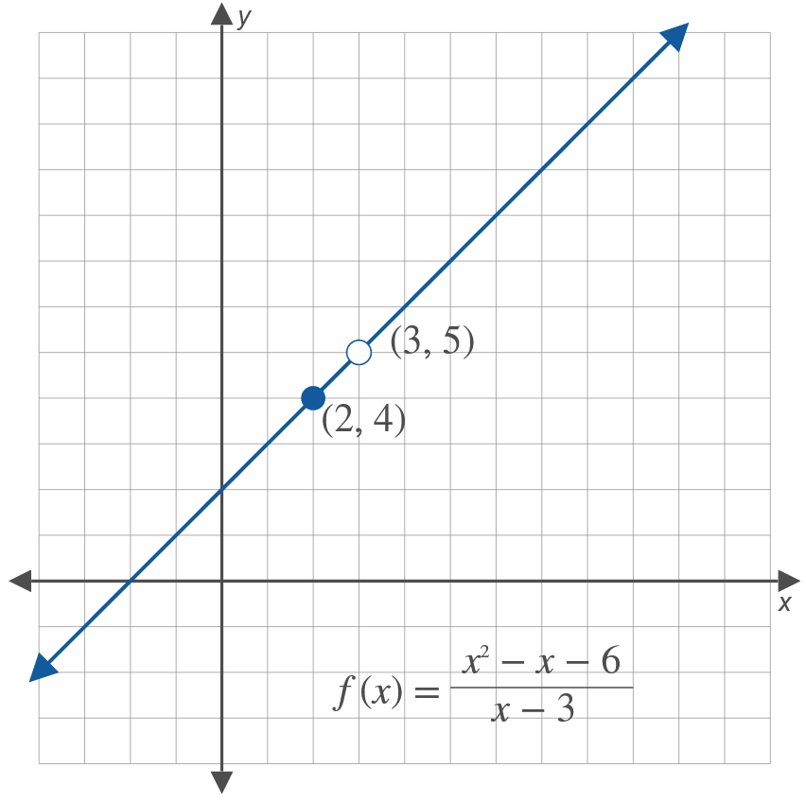
Example 1: Continuity (cont.)

Slide 7
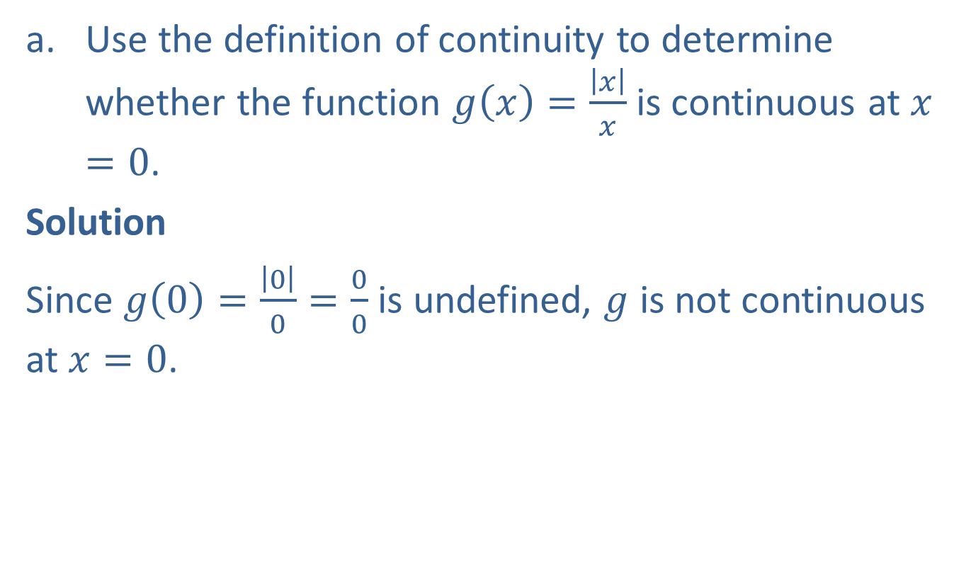
Example 2: Graphing a Discontinuous Function
​Use the definition of continuity to determine whether the function $g\left(x\right)=\frac{\left|x\right|}{x}$ is continuous at $x=0$.
​Solution
​Since $g\left(0\right)=\frac{\left|0\right|}{0}=\frac{0}{0}$ is undefined, $g$ is not continuous at $x=0$.

Slide 8
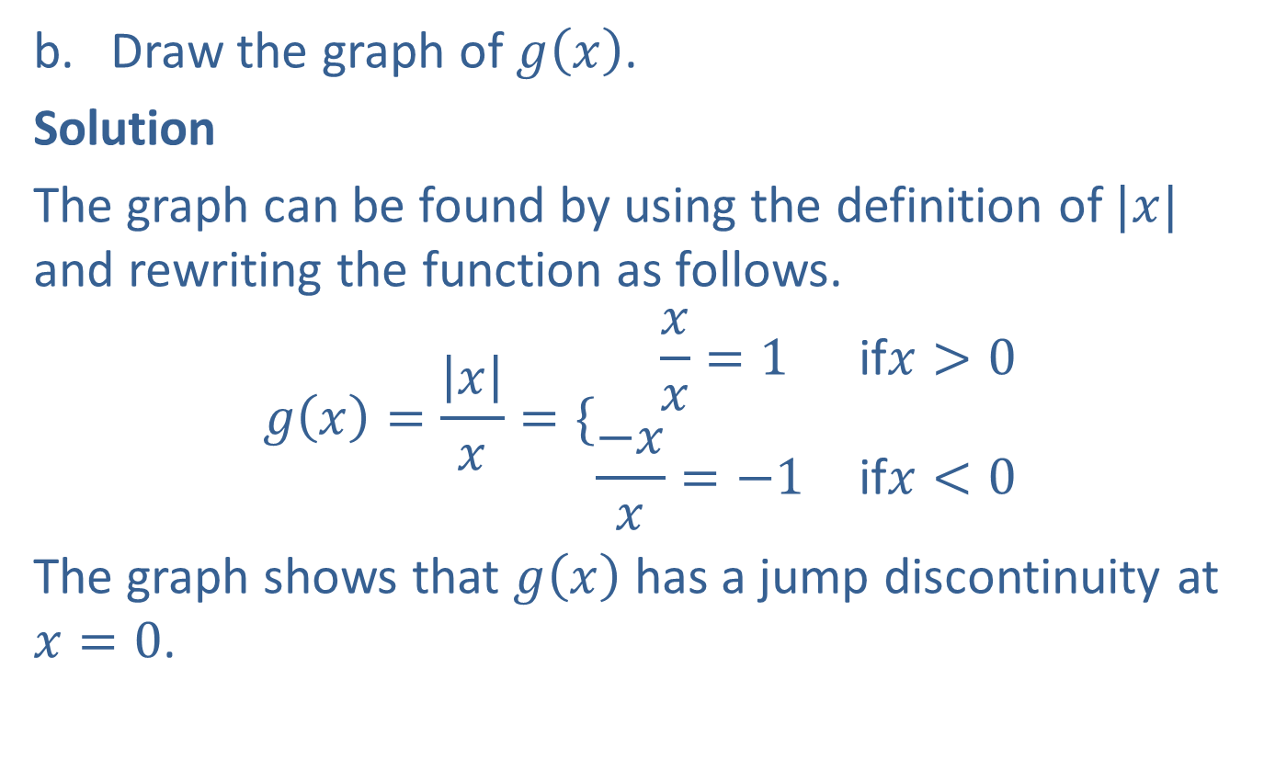
Example 2: Graphing a Discontinuous Function (cont.)
​Draw the graph of $g⁡\left(x\right)$.
​Solution
​The graph can be found by using the definition of $|x|$ and rewriting the function as follows.
𝑔𝑥=𝑥𝑥={−𝑥𝑥=1if𝑥>0−𝑥𝑥=−1if𝑥<0
The graph shows that $g⁡\left(x\right)$ has a jump discontinuity at $x=0$.

Slide 9
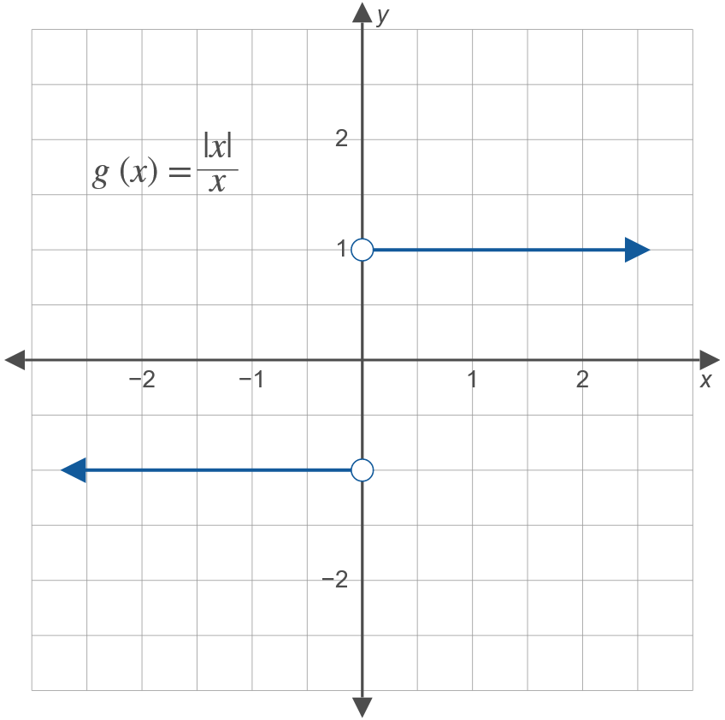
Example 2: Graphing a Discontinuous Function (cont.)

Slide 10
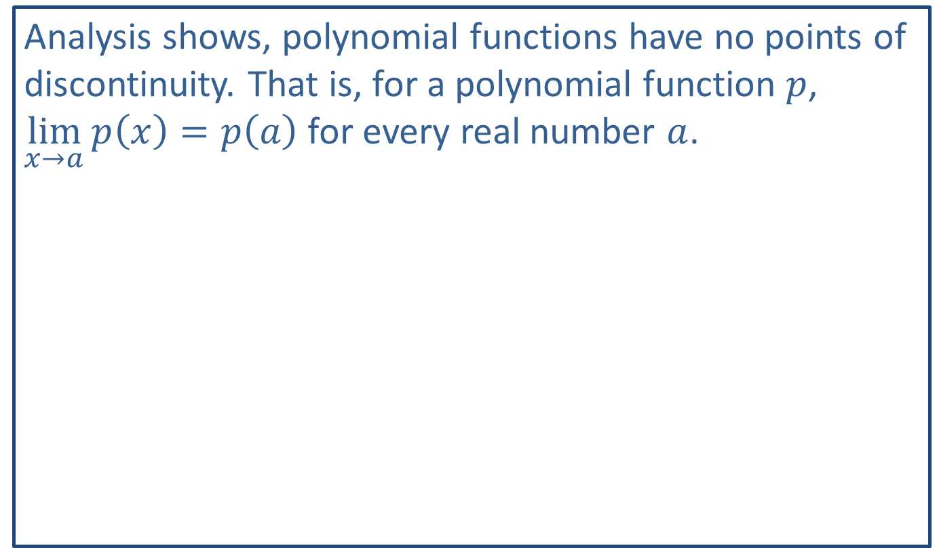
Note:
Analysis shows, polynomial functions have no points of discontinuity. That is, for a polynomial function $p$, $\lim_{x→a}p\left(x\right)=p\left(a\right)$ for every real number $a$.

Slide 11
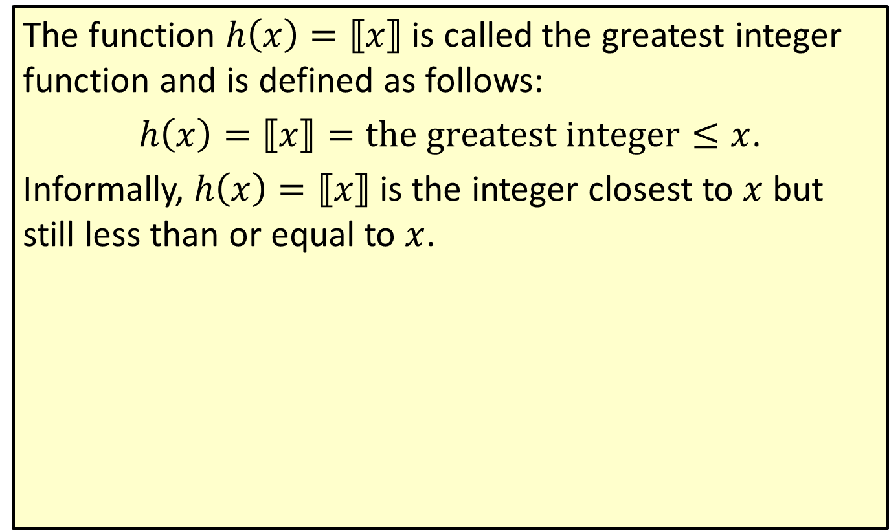
Greatest Integer Function
The function $h\left(x\right)=⟦x⟧$ is called the greatest integer function and is defined as follows:
$h\left(x\right)=⟦x⟧=the greatest integer≤x$.
Informally, $h\left(x\right)=⟦x⟧$ is the integer closest to $x$ but still less than or equal to $x$.

Slide 12

Example 3: Making a Function Continuous
Find a value for $k$ so that the function
$$f\left(x\right)=\{\begin{matrix}x^{2} & \text{if}x<2 \\ −3x+k & \text{if}x≥2\end{matrix}$$
will be continuous at $x=2$.

Slide 13
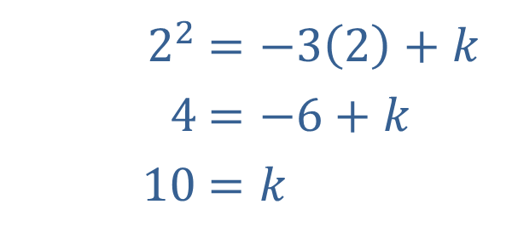
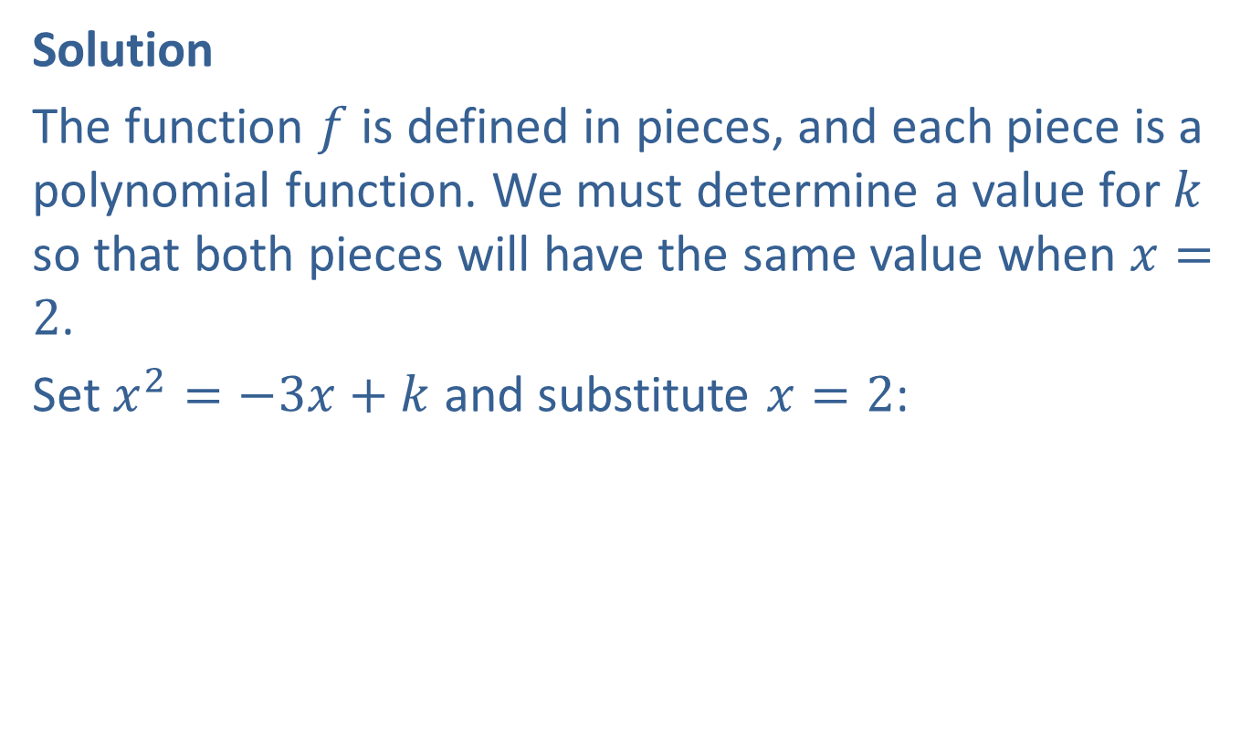
Example 3: Making a Function Continuous (cont.)
Solution
The function $f$ is defined in pieces, and each piece is a polynomial function. We must determine a value for $k$ so that both pieces will have the same value when $x=2$.
Set $x^{2}=−3x+k$ and substitute $x=2$:
​
​$2^{2}$ | ​$=−3\left(2\right)+k$
​$4$ | ​$=−6+k$
​$10$ | ​$=k$

Slide 14
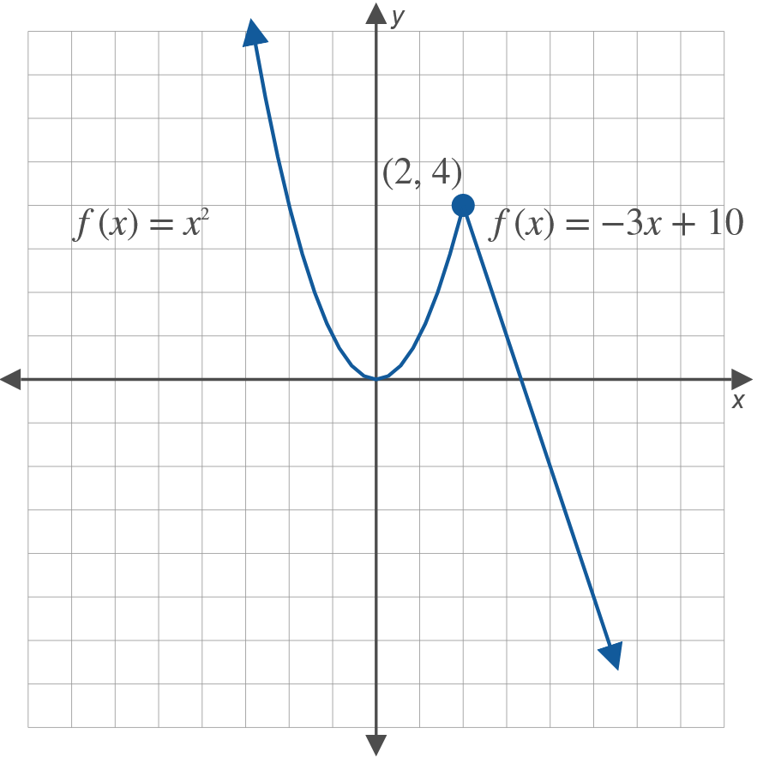

Example 3: Making a Function Continuous (cont.)
Thus, the function $f$ is continuous at $x=2$ if $k=10$.
Graphically, we see that the two pieces "fit" together at the point $\left(2\text{, }4\right)$.

