Slide 1
Section 2.5
Average Rate of Change

Slide 2
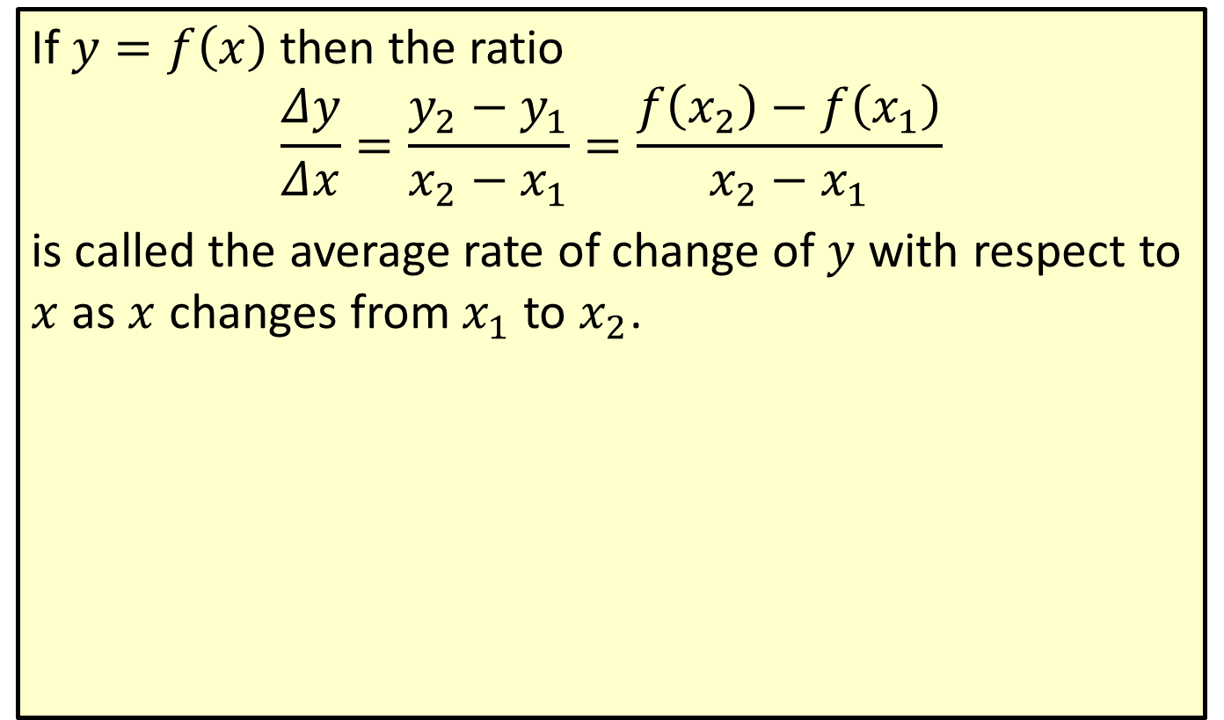
Average Rate of Change
If $y=f\left(x\right)$ then the ratio
$$\frac{Δy}{Δx}=\frac{y_{2}−y_{1}}{x_{2}−x_{1}}=\frac{f\left(x_{2}\right)−f\left(x_{1}\right)}{x_{2}−x_{1}}$$
is called the average rate of change of $y$ with respect to $x$ as $x$ changes from $x_{1}$ to $x_{2}$.

Slide 3

Example 1: Finding the Average Rate of Change
For the function $y=2x+1$, find the average rate of change of $y$ with respect to $x$, $\frac{Δy}{Δx}$, as $x$ changes from 0 to 3.

Slide 4
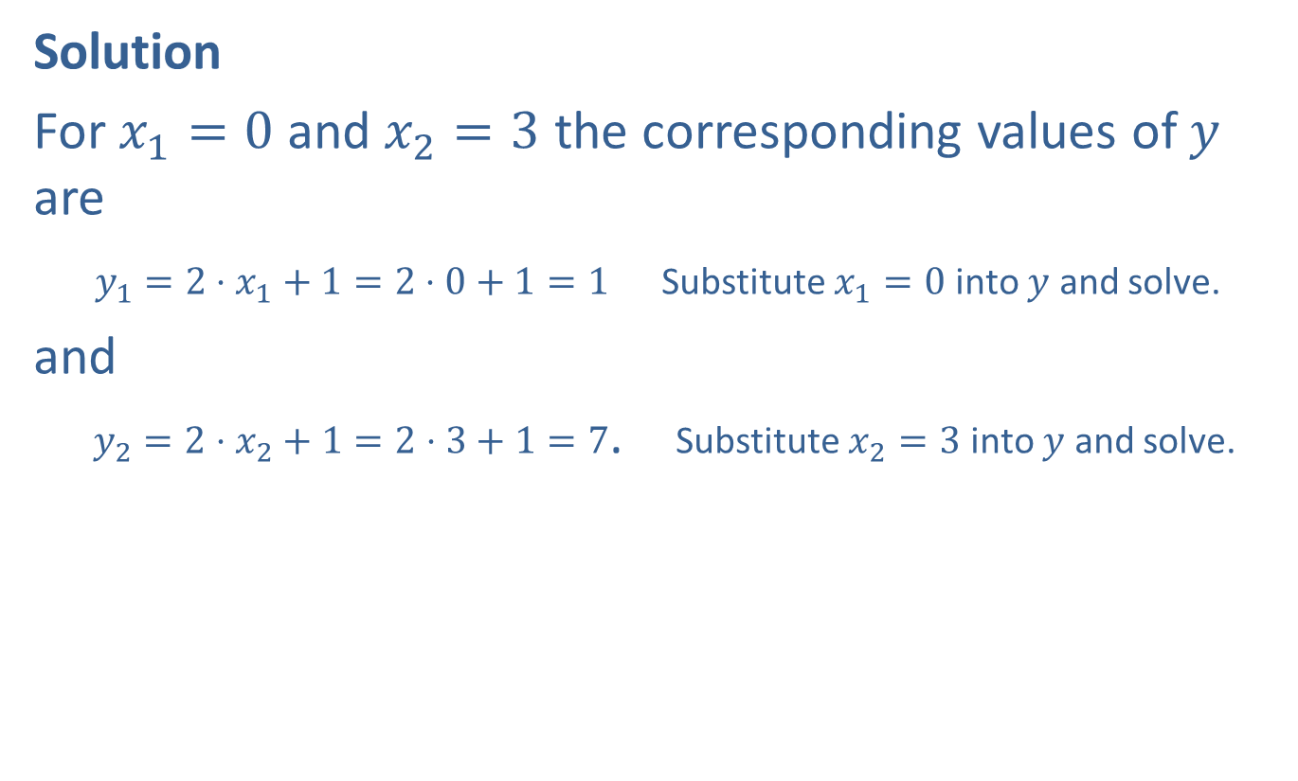
Example 1: Finding the Average Rate of Change (cont.)
Solution
For $x_{1}=0$ and $x_{2}=3$ the corresponding values of $y$ are
$y_{1}=2⋅x_{1}+1=2⋅0+1=1$ Substitute $x_{1}=0$ into $y$ and solve.
and
$y_{2}=2⋅x_{2}+1=2⋅3+1=7$. Substitute $x_{2}=3$ into $y$ and solve.

Slide 5
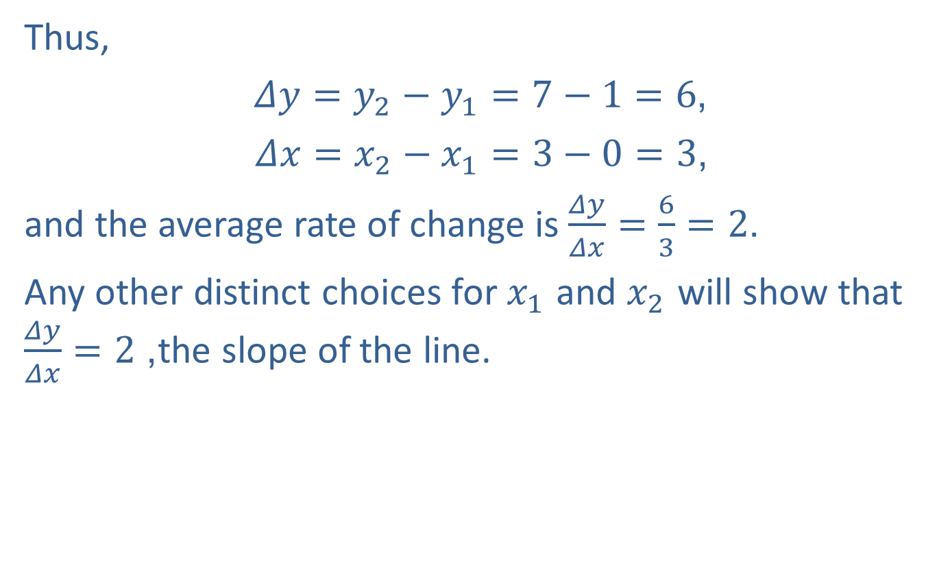
Example 1: Finding the Average Rate of Change (cont.)
Thus,
$Δy=y_{2}−y_{1}=7−1=6$,
$Δx=x_{2}−x_{1}=3−0=3$,
and the average rate of change is $\frac{Δy}{Δx}=\frac{6}{3}=2$.
Any other distinct choices for $x_{1}$ and $x_{2}$ will show that $\frac{Δy}{Δx}=2$, the slope of the line.

Slide 6
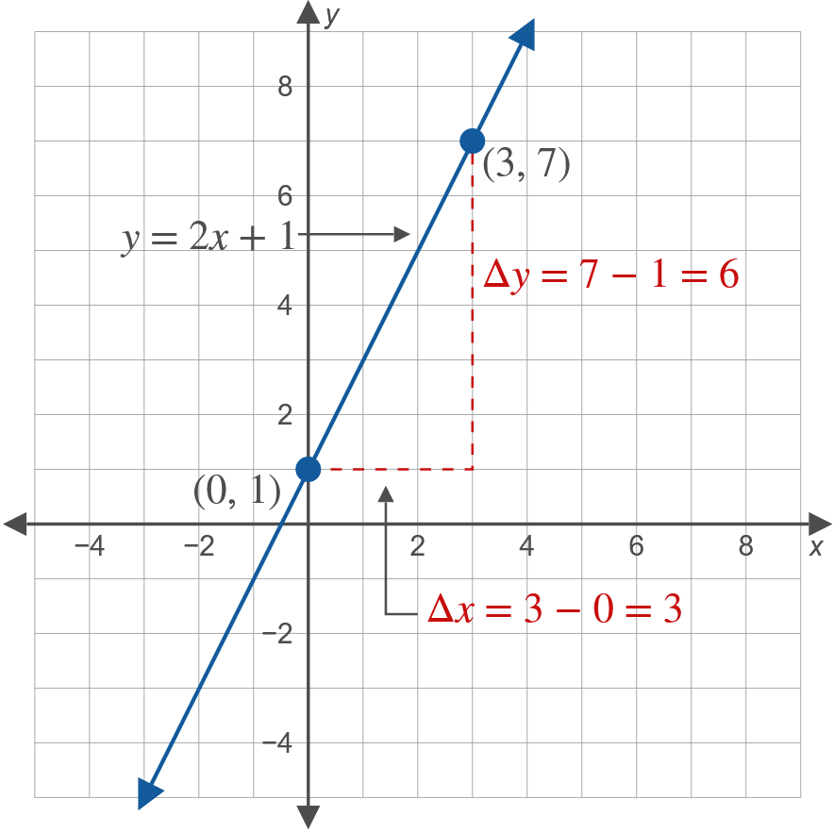
Example 1: Finding the Average Rate of Change (cont.)

Slide 7

Example 2: Average Rate of Change
Let $f\left(x\right)=\frac{2}{x}$. Find and simplify the expression that represents the average rate of change of $f$ between $x$ and $x+h$.

Slide 8
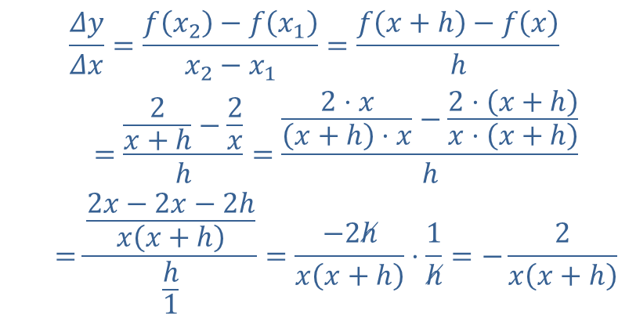

Example 2: Average Rate of Change (cont.)
Solution
Here $x_{1}=x$ and $x_{2}=x+h$. Therefore, $Δx=x_{2}−x_{1}=x+h−x=h$.
So the average rate of change is calculated as follows.
𝛥𝑦𝛥𝑥=𝑓𝑥2−𝑓𝑥1𝑥2−𝑥1=𝑓𝑥+h−𝑓𝑥h𝛥𝑦𝛥𝑥=2𝑥+h−2𝑥h=2⋅𝑥𝑥+h⋅𝑥−2⋅𝑥+h𝑥⋅𝑥+hh𝛥𝑦𝛥𝑥=2𝑥−2𝑥−2h𝑥𝑥+hh1=−2h𝑥𝑥+h⋅1h=−2𝑥𝑥+h

Slide 9
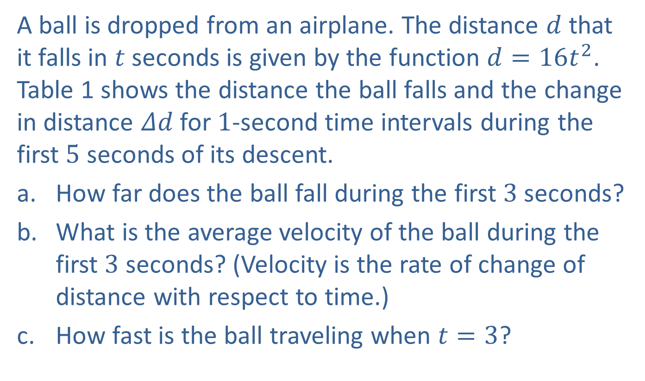
Example 3: A Falling Object
A ball is dropped from an airplane. The distance $d$ that it falls in $t$ seconds is given by the function $d=16t^{2}$. Table 1 shows the distance the ball falls and the change in distance $Δd$ for 1-second time intervals during the first 5 seconds of its descent.
​How far does the ball fall during the first 3 seconds?
​What is the average velocity of the ball during the first 3 seconds? (Velocity is the rate of change of distance with respect to time.)
​How fast is the ball traveling when $t=3$?

Slide 10
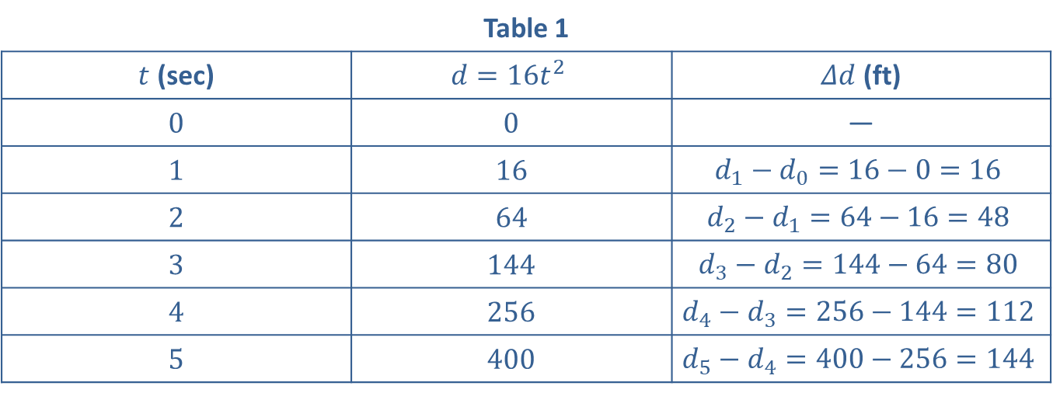
Example 3: A Falling Object (cont.)
Table 1
$t$ (sec) | $$d=16t^{2}$$ | $Δd$ (ft)
0 | 0 | —
1 | 16 | $$d_{1}−d_{0}=16−0=16$$
2 | 64 | $$d_{2}−d_{1}=64−16=48$$
3 | 144 | $$d_{3}−d_{2}=144−64=80$$
4 | 256 | $$d_{4}−d_{3}=256−144=112$$
5 | 400 | $$d_{5}−d_{4}=400−256=144$$

Slide 11
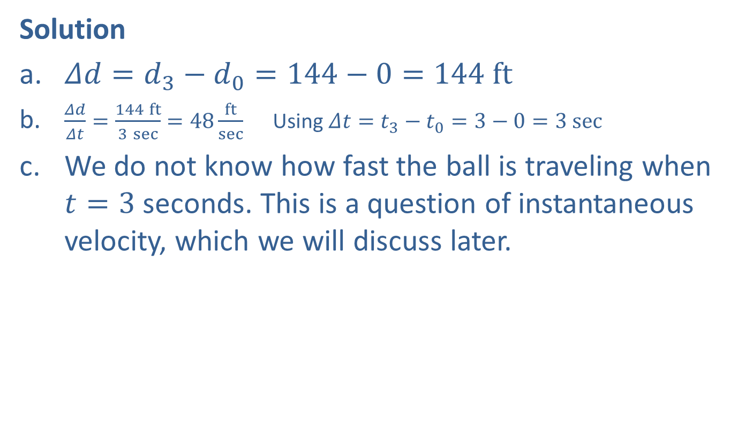
Example 3: A Falling Object (cont.)
Solution
​$Δd=d_{3}−d_{0}=144−0=144 ft$
​$\frac{Δd}{Δt}=\frac{144 ft}{3 sec}=48\frac{ft}{sec}$ Using $Δt=t_{3}−t_{0}=3−0=3 sec$
​We do not know how fast the ball is traveling when $t=3$ seconds. This is a question of instantaneous velocity, which we will discuss later.

