Slide 1
Section 2.6
Instantaneous Rate of Change

Slide 2
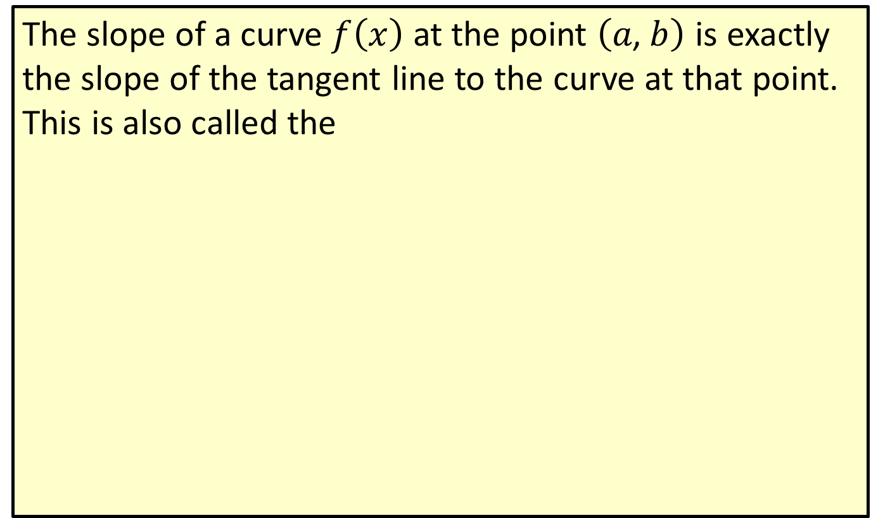
Slope at a Point on a Curve
The slope of a curve $f⁡\left(x\right)$ at the point $\left(a\text{, }b\right)$ is exactly the slope of the tangent line to the curve at that point. This is also called the

Slide 3
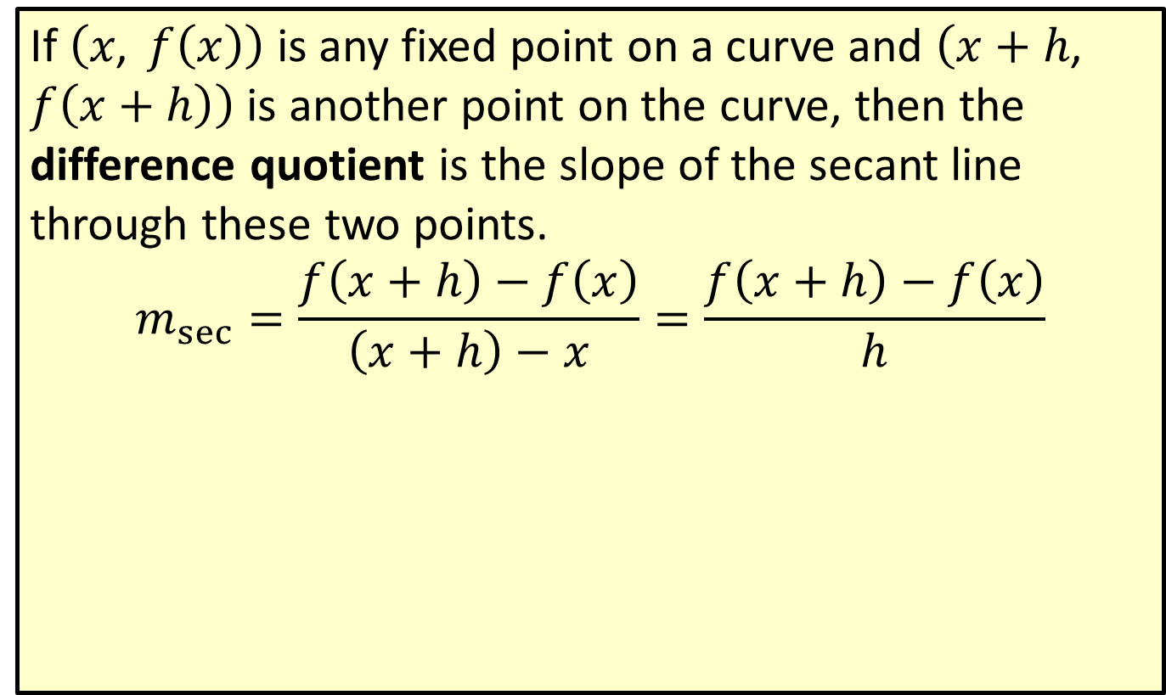
Difference Quotient
If $\left(x\text{, }f\left(x\right)\right)$ is any fixed point on a curve and $\left(x+h\text{, }f\left(x+h\right)\right)$ is another point on the curve, then the difference quotient is the slope of the secant line through these two points.
$$m_{sec}=\frac{f\left(x+h\right)−f\left(x\right)}{\left(x+h\right)−x}=\frac{f\left(x+h\right)−f\left(x\right)}{h}$$

Slide 4
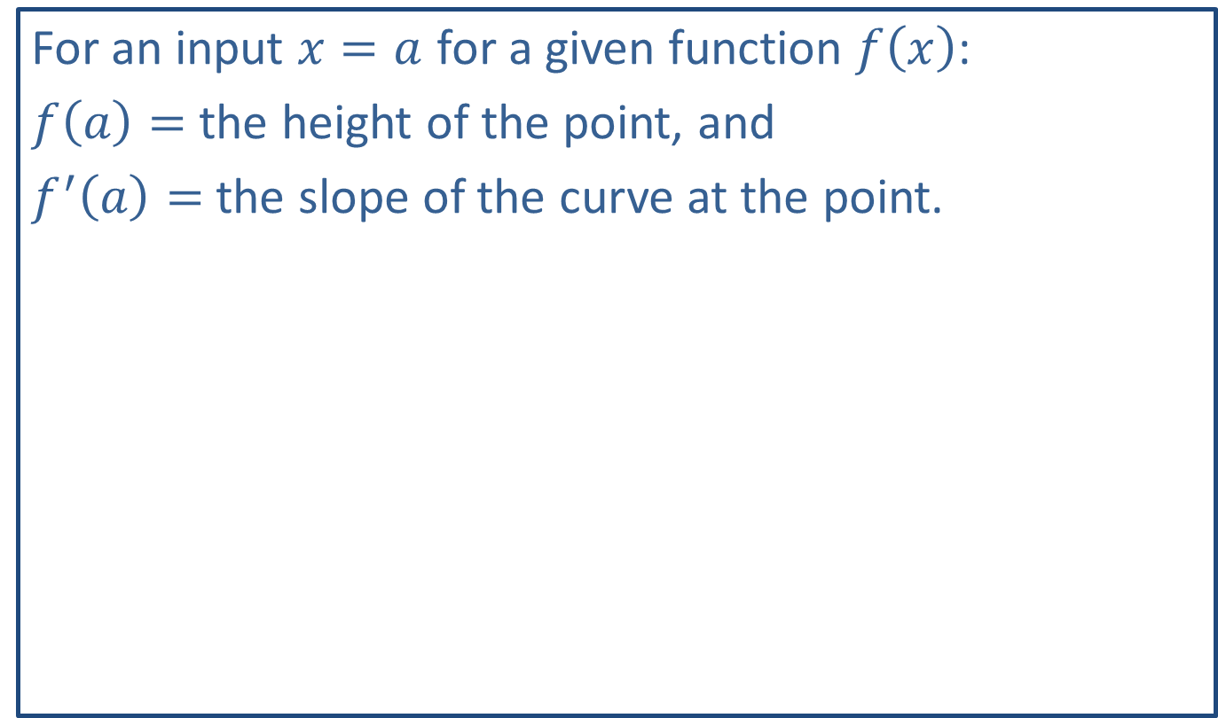
Note:
For an input $x=a$ for a given function $f⁡\left(x\right)$:
$f\left(a\right)=$ the height of the point, and
$f^{′}⁡\left(a\right)=$ the slope of the curve at the point.

Slide 5
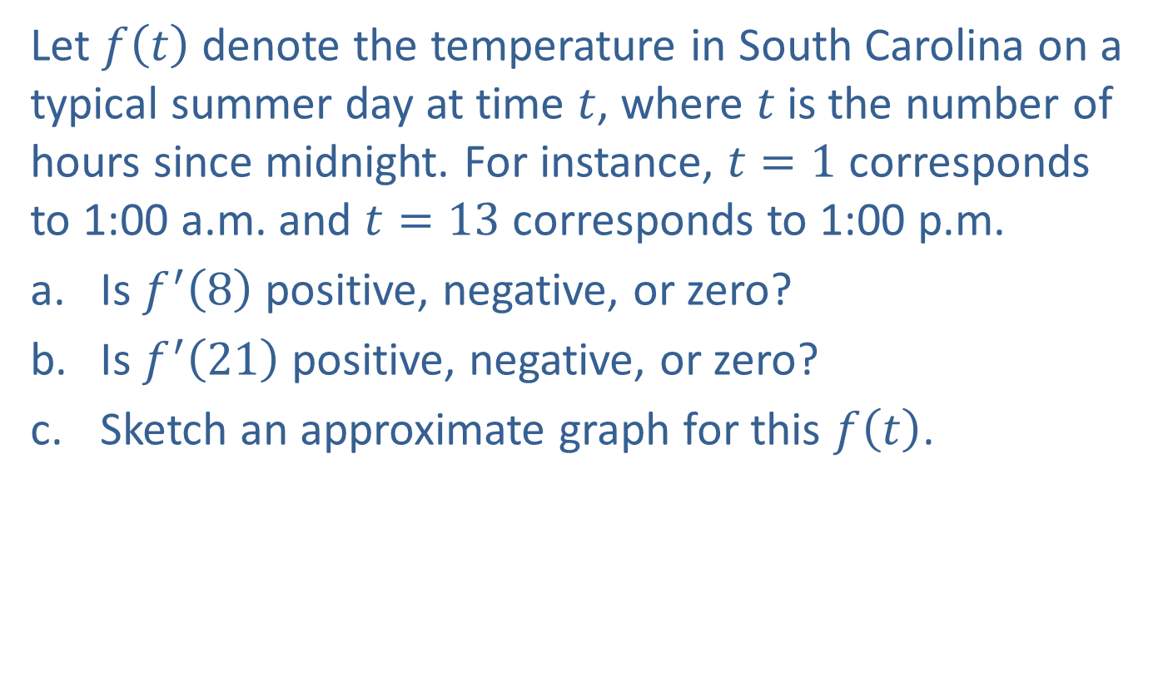
Example 1: Temperature
Let $f⁡\left(t\right)$ denote the temperature in South Carolina on a typical summer day at time $t$, where $t$ is the number of hours since midnight. For instance, $t=1$ corresponds to 1:00 a.m. and $t=13$ corresponds to 1:00 p.m.
​Is $f^{′}⁡\left(8\right)$ positive, negative, or zero?
​Is $f^{′}⁡\left(21\right)$ positive, negative, or zero?
​Sketch an approximate graph for this $f⁡\left(t\right)$.

Slide 6
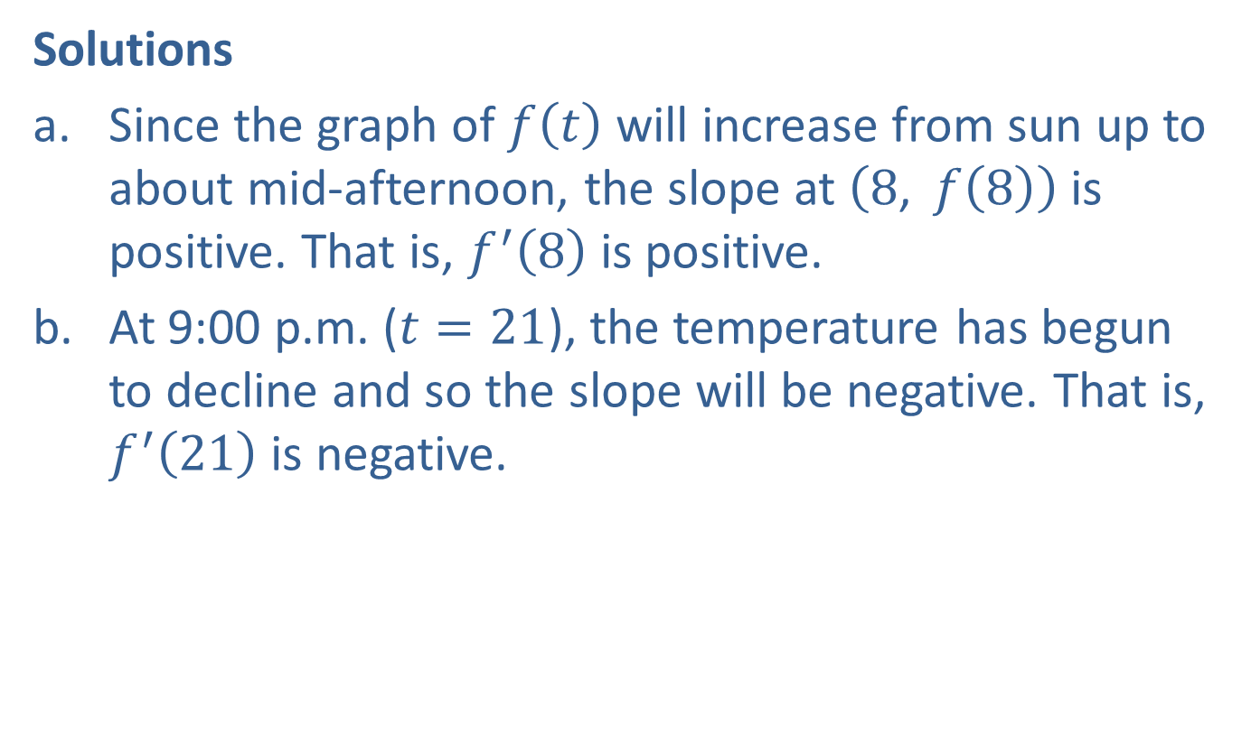
Example 1: Temperature (cont.)
Solutions
​Since the graph of $f⁡\left(t\right)$ will increase from sun up to about mid-afternoon, the slope at $\left(8\text{, }f\left(8\right)\right)$ is positive. That is, $f^{′}⁡\left(8\right)$ is positive.
​At 9:00 p.m. ($t=21$), the temperature has begun to decline and so the slope will be negative. That is, $f^{′}⁡\left(21\right)$ is negative.

Slide 7
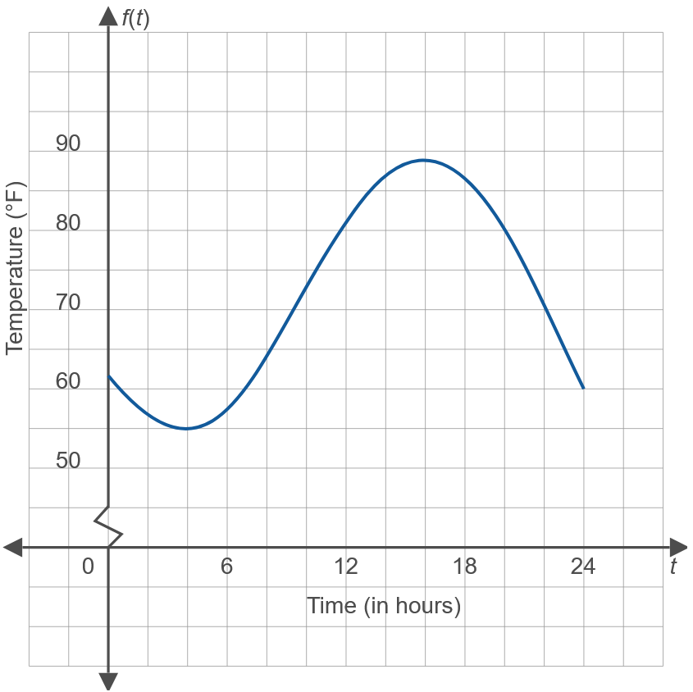
Example 1: Temperature (cont.)
​

Slide 8
Example 1: Temperature (cont.)
​The graph needs to increase from about 6:00 a.m. to 4:00 p.m. and then decline, as described in parts a. and b. Drawing such a graph will also support the answers found in parts a. and b.

Slide 9

Example 2: Manufacturing
Let $C⁡\left(x\right)$ denote the total cost of manufacturing $x$ units of a certain style of metal office bookcase.
​Given $C\left(300\right)=31,000$ and $C^{′}\left(300\right)=90$, sketch a tangent line to $C⁡\left(x\right)$ at the point $\left(300\text{, }31,000\right)$.
​Estimate the cost of manufacturing 303 bookcases.

Slide 10
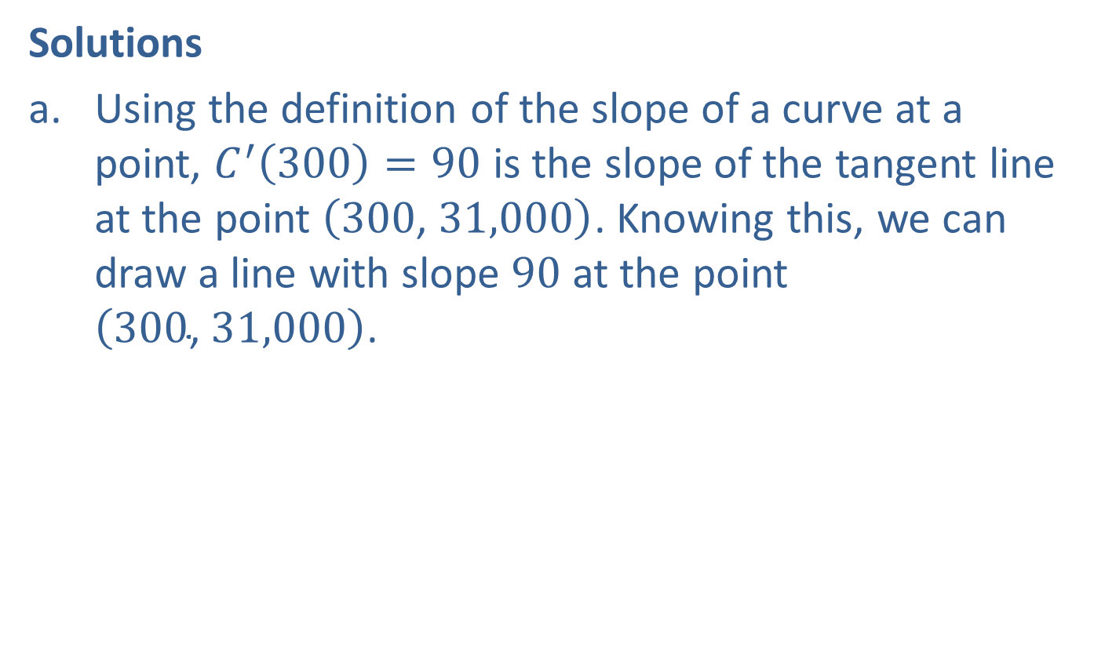
Example 2: Manufacturing (cont.)
Solutions
​Using the definition of the slope of a curve at a point, $C^{′}\left(300\right)=90$ is the slope of the tangent line at the point $\left(300\text{, }31,000\right)$. Knowing this, we can draw a line with slope 90 at the point $\left(300\text{, }31,000\right)$.
​

Slide 11
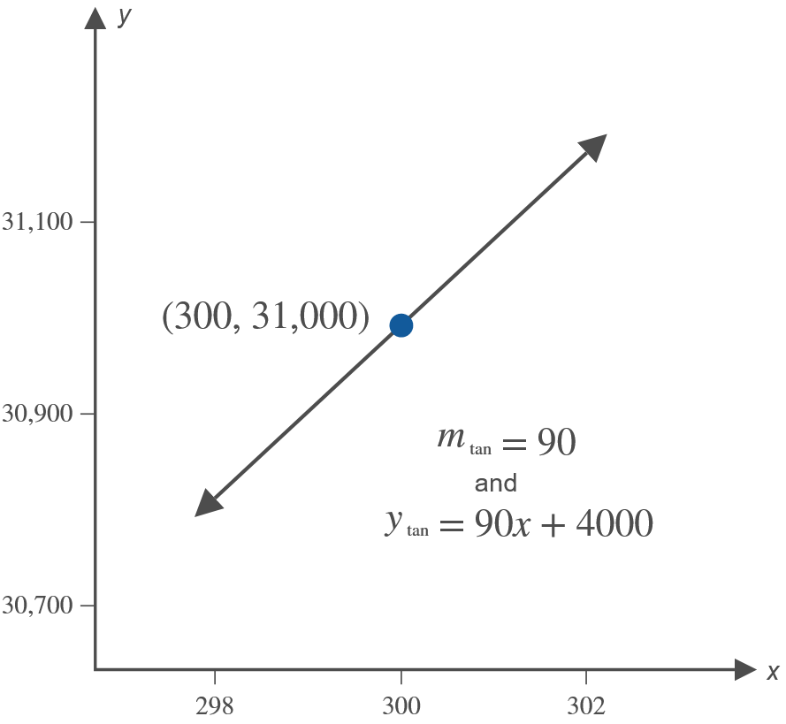
Example 2: Manufacturing (cont.)

Slide 12
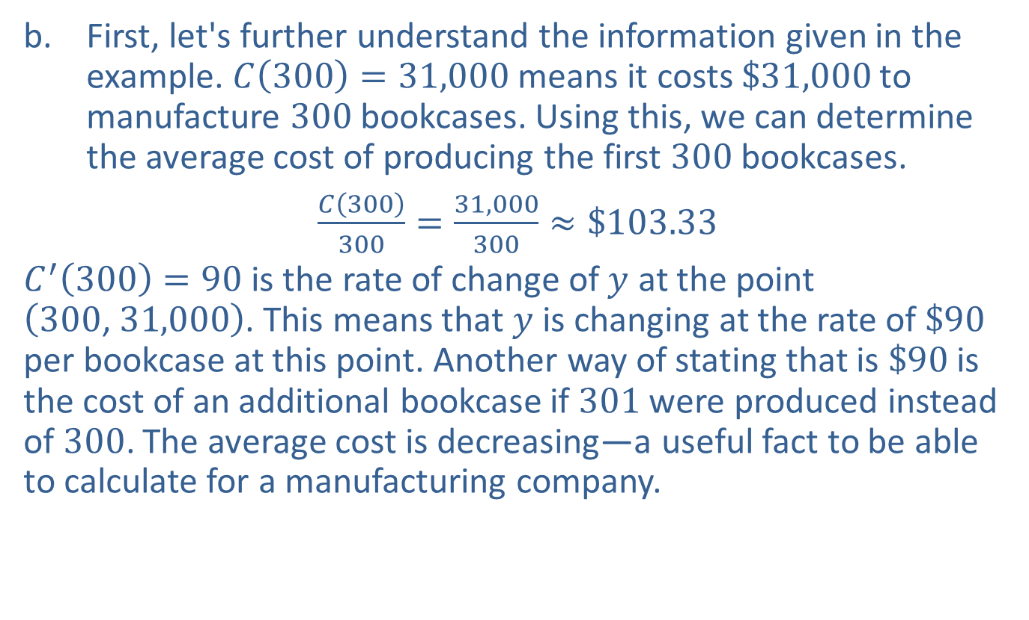
Example 2: Manufacturing (cont.)
​First, let's further understand the information given in the example. $C\left(300\right)=31,000$ means it costs $\$31,000$ to manufacture 300 bookcases. Using this, we can determine the average cost of producing the first 300 bookcases.
​$\frac{C\left(300\right)}{300}=\frac{31,000}{300}≈\$103.33$
​$C^{′}\left(300\right)=90$ is the rate of change of $y$ at the point $\left(300\text{, }31,000\right)$. This means that $y$ is changing at the rate of $\$90$ per bookcase at this point. Another way of stating that is $\$90$ is the cost of an additional bookcase if 301 were produced instead of 300. The average cost is decreasing—a useful fact to be able to calculate for a manufacturing company.
​

Slide 13

Example 2: Manufacturing (cont.)
​Using these meanings, the cost of producing 3 more bookcases, compared to the cost of producing 300, is about $90⋅3=270$ dollars more. So it will cost $\$31,000+\$270=\$31,270$ to manufacture 303 bookcases.

Slide 14
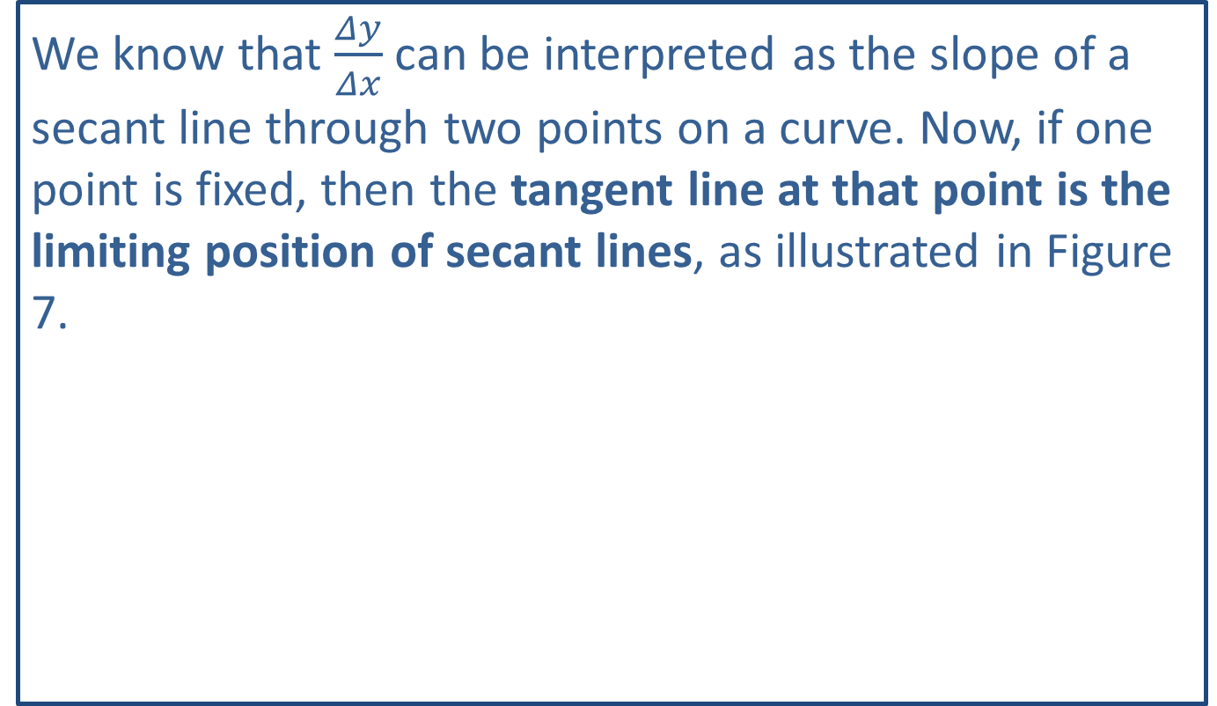
Note:
We know that $\frac{Δy}{Δx}$ can be interpreted as the slope of a secant line through two points on a curve. Now, if one point is fixed, then the tangent line at that point is the limiting position of secant lines, as illustrated in Figure 7.

Slide 15
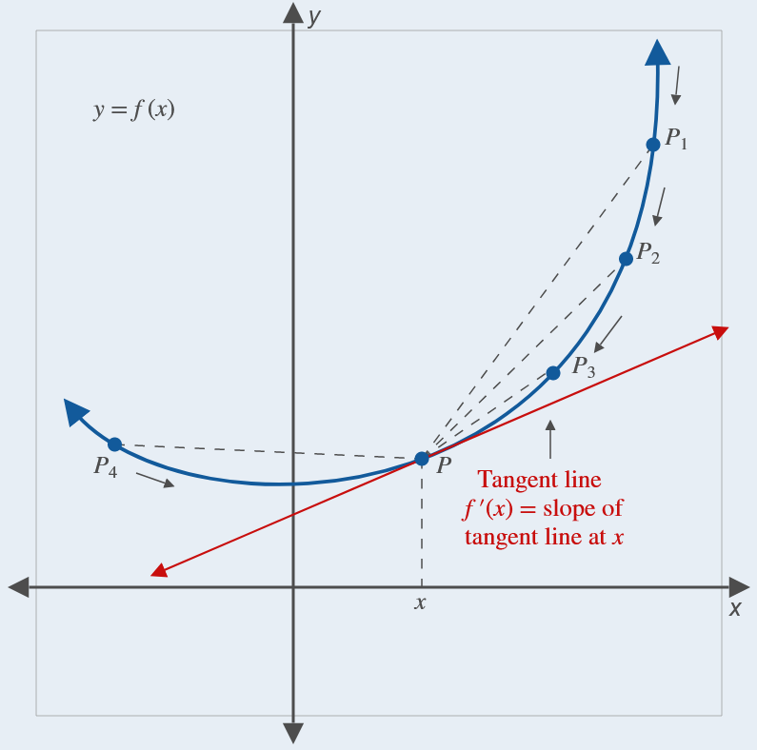
Note: (cont.)
Figure 7

Slide 16
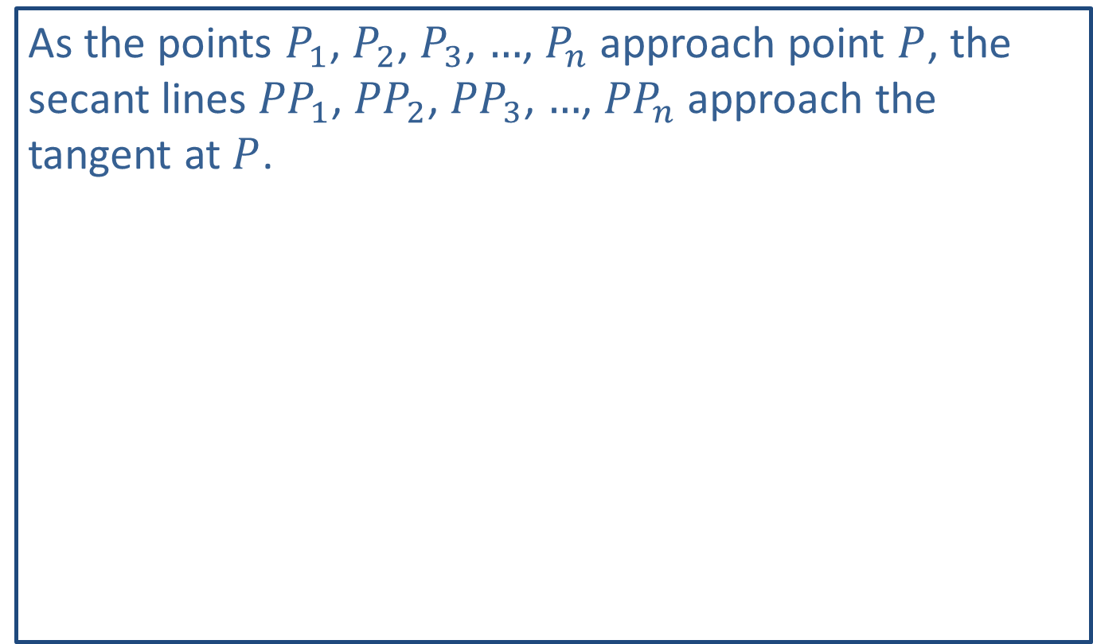
Note: (cont.)
As the points $P_{1}$, $P_{2}$, $P_{3}$, $…$, $P_{n}$ approach point $P$, the secant lines ${PP}_{1}$, ${PP}_{2}$, ${PP}_{3}$, $…$, ${PP}_{n}$ approach the tangent at $P$.

Slide 17

Example 3: Average Rate of Change
Consider the function $f\left(x\right)=\frac{1}{3}x^{3}$. Find the average rate of change of $f$ as $x$ changes from $x_{1}=0$ to $x_{2}=3$.

Slide 18
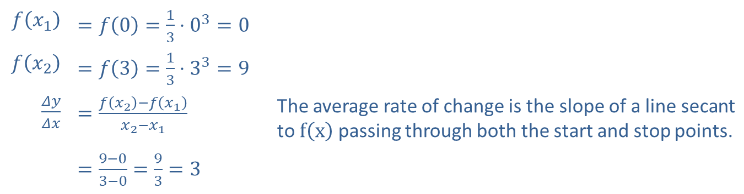
Example 3: Average Rate of Change (cont.)
Solution
​$f⁡\left(x_{1}\right)$ | ​$=f\left(0\right)=\frac{1}{3}⋅0^{3}=0$
​$f⁡\left(x_{2}\right)$ | ​$=f\left(3\right)=\frac{1}{3}⋅3^{3}=9$
​$\frac{Δy}{Δx}$ | ​$=\frac{f\left(x_{2}\right)−f\left(x_{1}\right)}{x_{2}−x_{1}}$ | The average rate of change is the slope of a line secant to $f⁡\left(x\right)$ passing through both the start and stop points.
 | ​$=\frac{9−0}{3−0}=\frac{9}{3}=3$

Slide 19
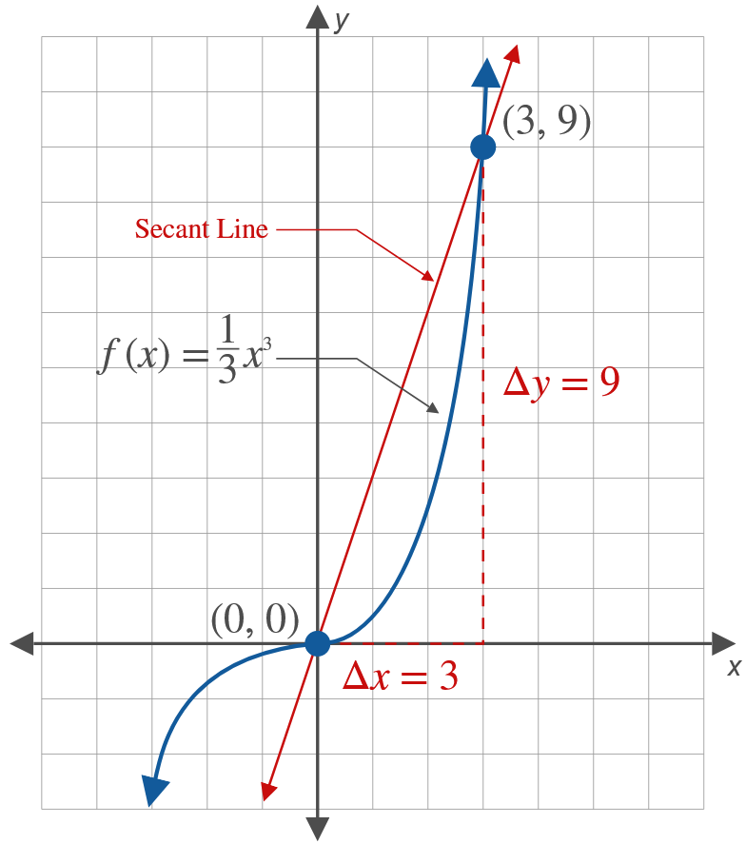
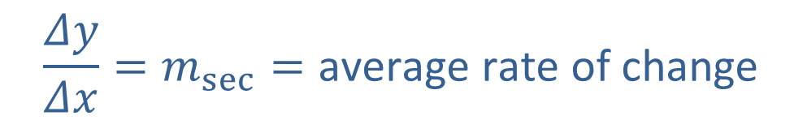
Example 3: Average Rate of Change (cont.)
$$\frac{Δy}{Δx}=m_{sec}=\text{average} \text{rate} \text{of} \text{change}$$

Slide 20

Example 4: Instantaneous Velocity
An arrow is shot into the air and its height in feet after $t$ seconds is given by the function $f\left(t\right)=−16t^{2}+80t$. The graph of the curve $y=f\left(t\right)$ is the parabola shown.

Slide 21
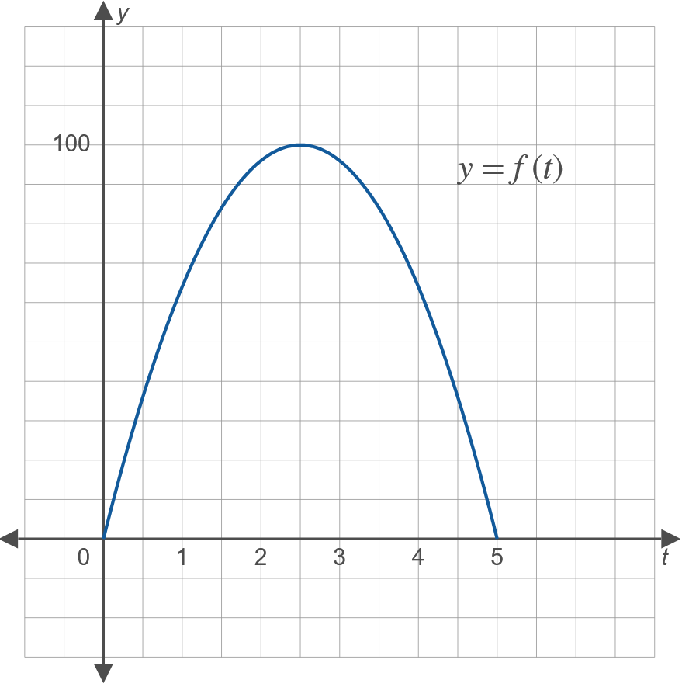
Example 4: Instantaneous Velocity (cont.)

Slide 22
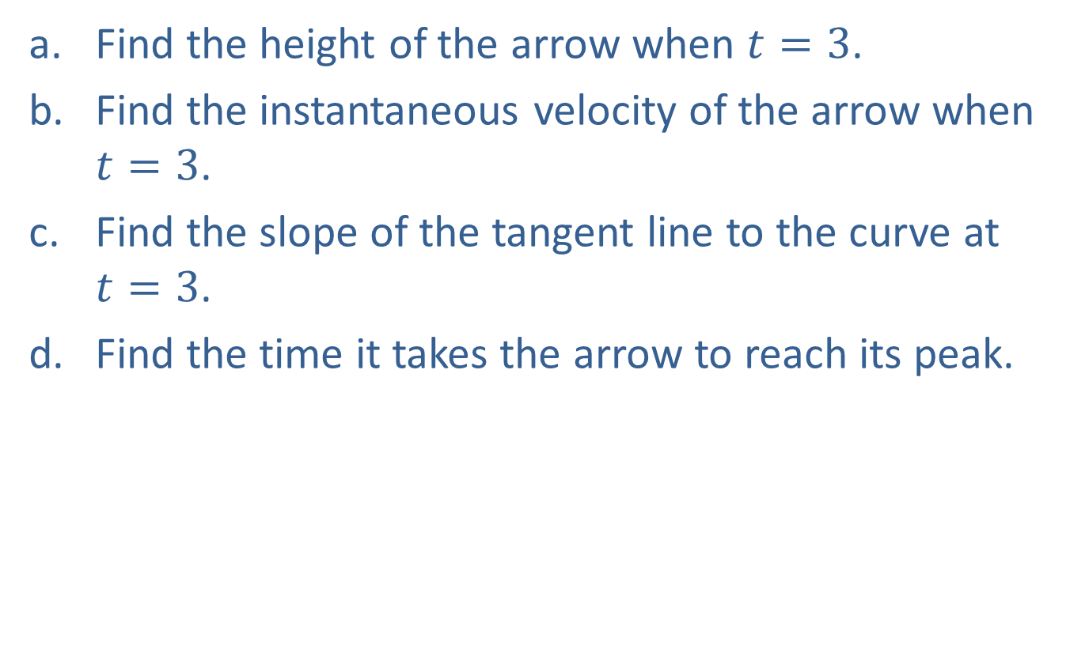
Example 4: Instantaneous Velocity (cont.)
​Find the height of the arrow when $t=3$.
​Find the instantaneous velocity of the arrow when $t=3$.
​Find the slope of the tangent line to the curve at $t=3$.
​Find the time it takes the arrow to reach its peak.

Slide 23
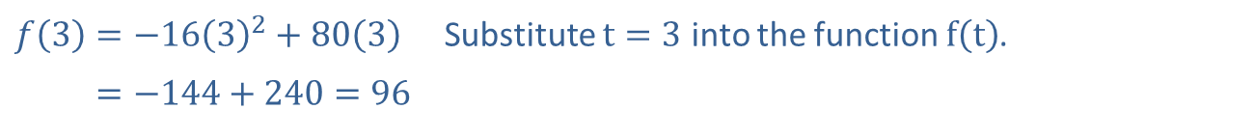

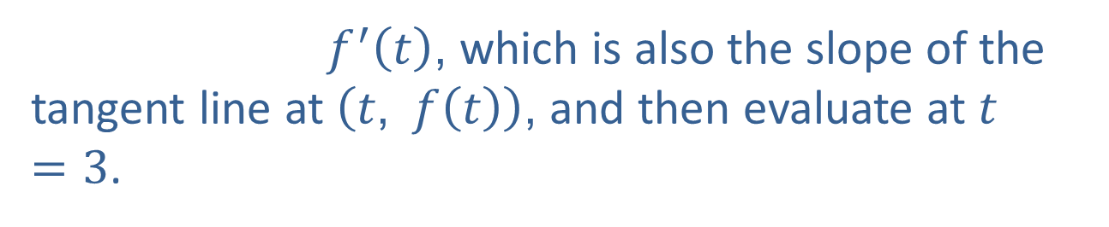
Example 4: Instantaneous Velocity (cont.)
Solution
​To find the instantaneous velocity when $t=3$, find the derivative
​$f\left(3\right)=−16{\left(3\right)}^{2}+80\left(3\right)$ | Substitute $t=3$ into the function $f⁡\left(t\right)$.
​𝑓⁡3=−144+240=96
So, when $t=3$, the height is 96 feet.
$f^{′}⁡\left(t\right)$, which is also the slope of the tangent line at $\left(t\text{, }f\left(t\right)\right)$, and then evaluate at $t=3$.

Slide 24

Example 4: Instantaneous Velocity (cont.)
​Step 1: Form the difference quotient.
$$\frac{f⁡\left(t+h\right)−f⁡\left(t\right)}{h}=\frac{\left[−16{\left(t+h\right)}^{2}+80\left(t+h\right)\right]−\left[−16t^{2}+80t\right]}{h}$$

Slide 25
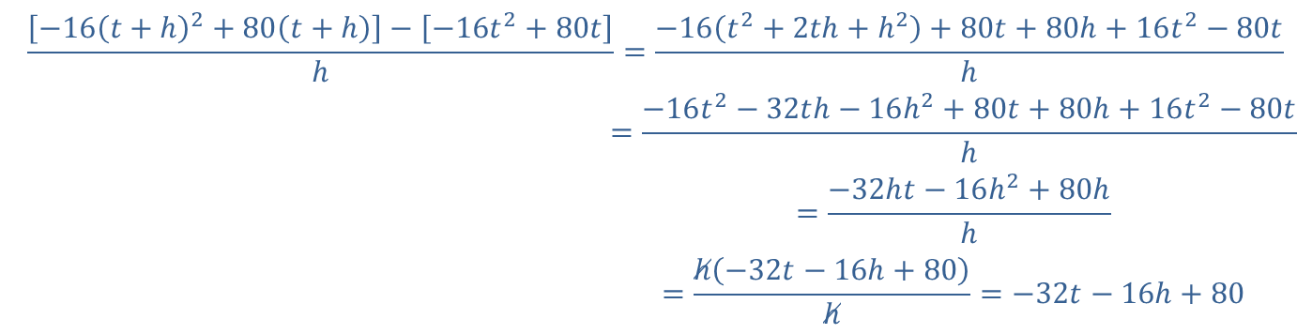
Example 4: Instantaneous Velocity (cont.)
Step 2: Simplify the difference quotient.
−16𝑡+h2+80𝑡+h−−16𝑡2+80𝑡h=−16𝑡2+2𝑡h+h2+80𝑡+80h+16𝑡2−80𝑡h−16𝑡+h2+80𝑡+h−−16𝑡2+80𝑡h=−16𝑡2−32𝑡h−16h2+80𝑡+80h+16𝑡2−80𝑡h−16𝑡+h2+80𝑡+h−−16𝑡2+80𝑡h=−32h𝑡−16h2+80hh−16𝑡+h2+80𝑡+h−−16𝑡2+80𝑡h=h−32𝑡−16h+80h=−32𝑡−16h+80

Slide 26
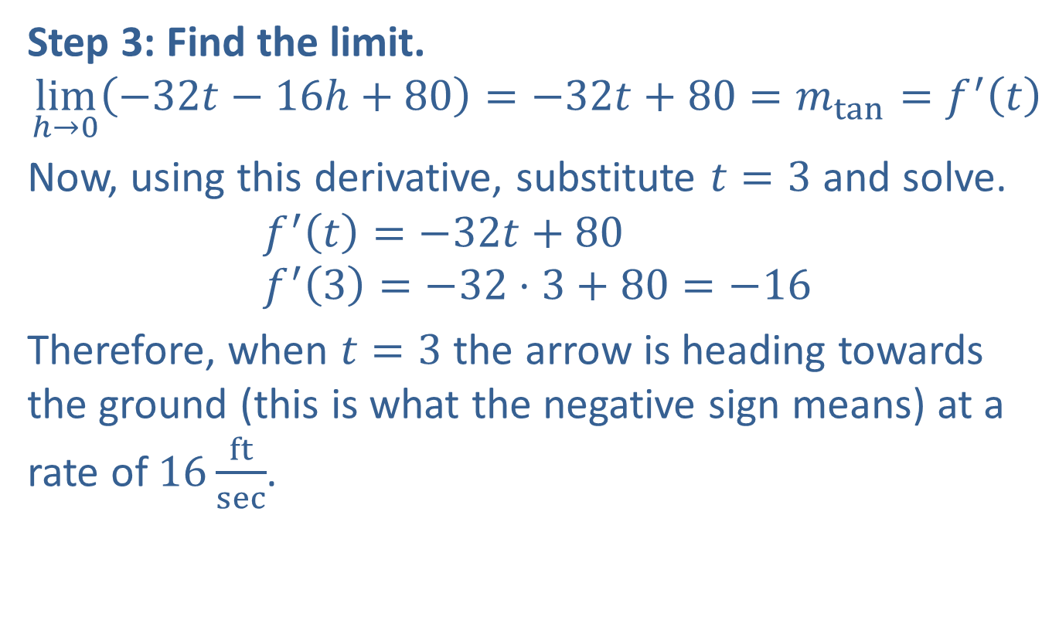
Example 4: Instantaneous Velocity (cont.)
Step 3: Find the limit.
$$\lim_{h→0}\left(−32t−16h+80\right)=−32t+80=m_{tan}=f^{′}\left(t\right)$$
​Now, using this derivative, substitute $t=3$ and solve.
$$f^{′}\left(t\right)=−32t+80 \\ f^{′}\left(3\right)=−32⋅3+80=−16$$
​Therefore, when $t=3$ the arrow is heading towards the ground (this is what the negative sign means) at a rate of $16\frac{ft}{sec}$.

Slide 27
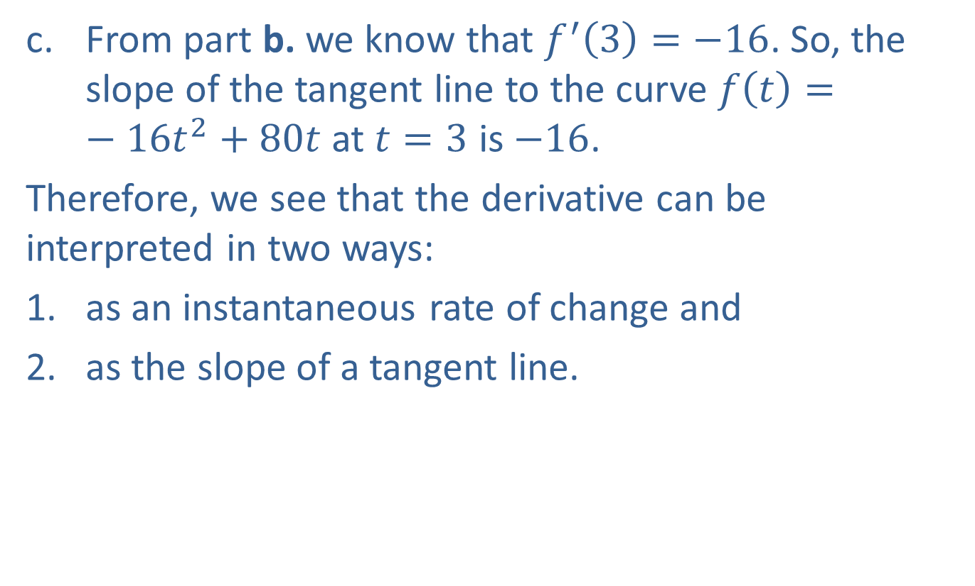
Example 4: Instantaneous Velocity (cont.)
​From part b. we know that $f^{′}\left(3\right)=−16$. So, the slope of the tangent line to the curve $f\left(t\right)=−16t^{2}+80t$ at $t=3$ is $−16$.
​Therefore, we see that the derivative can be interpreted in two ways:
​as an instantaneous rate of change and
​as the slope of a tangent line.
​

Slide 28
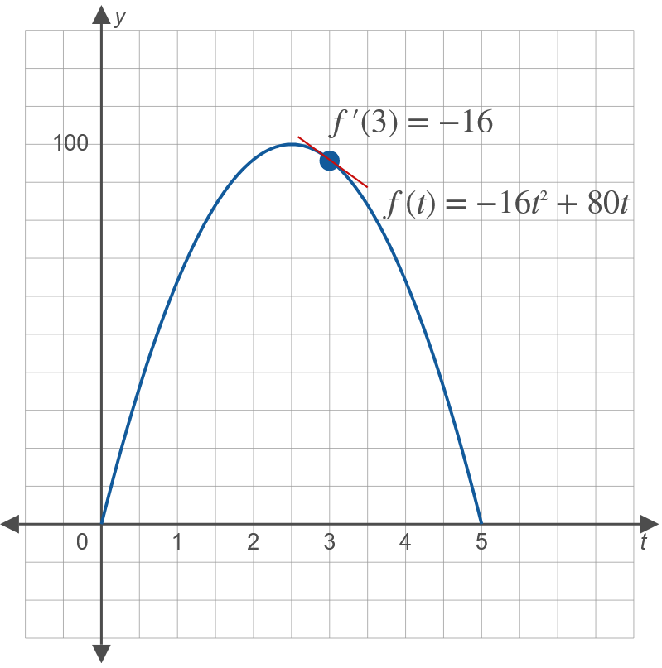
Example 4: Instantaneous Velocity (cont.)

Slide 29
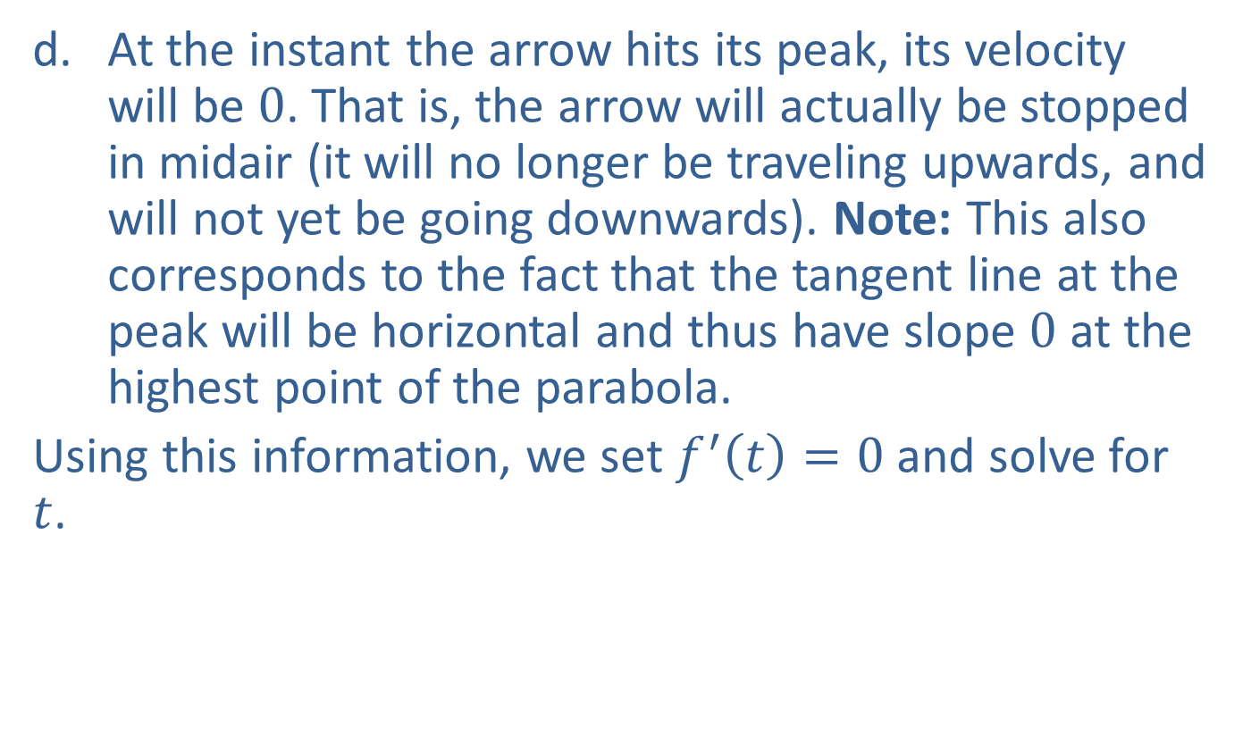
Example 4: Instantaneous Velocity (cont.)
​At the instant the arrow hits its peak, its velocity will be 0. That is, the arrow will actually be stopped in midair (it will no longer be traveling upwards, and will not yet be going downwards). Note: This also corresponds to the fact that the tangent line at the peak will be horizontal and thus have slope 0 at the highest point of the parabola.
​Using this information, we set $f^{′}\left(t\right)=0$ and solve for $t$.
​
​

Slide 30
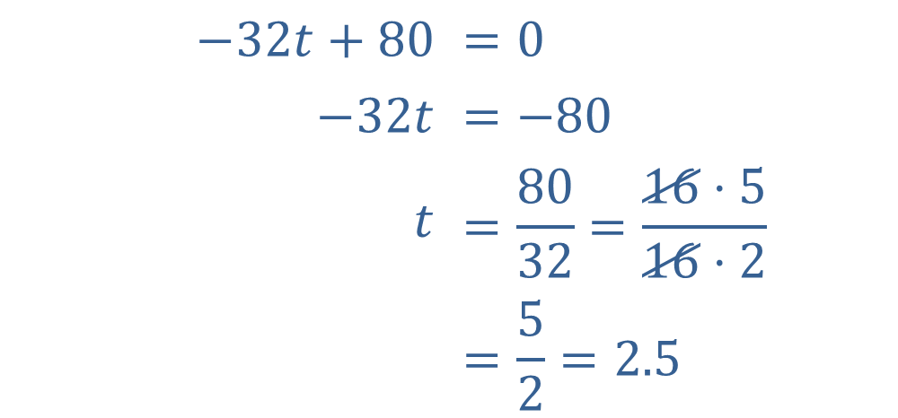

Example 4: Instantaneous Velocity (cont.)
The arrow hits its peak in $2.5 sec$.
$$−32t+80$$ | $$=0$$
$$−32t$$ | $$=−80$$
$$t$$ | $$=\frac{80}{32}=\frac{16⋅5}{16⋅2}$$
 | $$=\frac{5}{2}=2.5$$

Slide 31
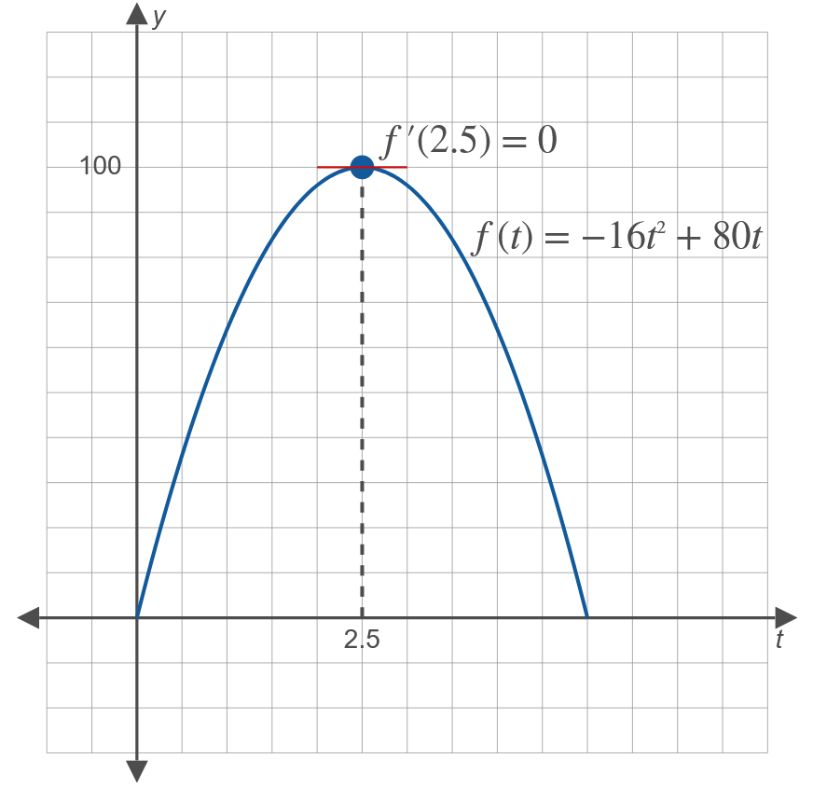
Example 4: Instantaneous Velocity (cont.)

Slide 32
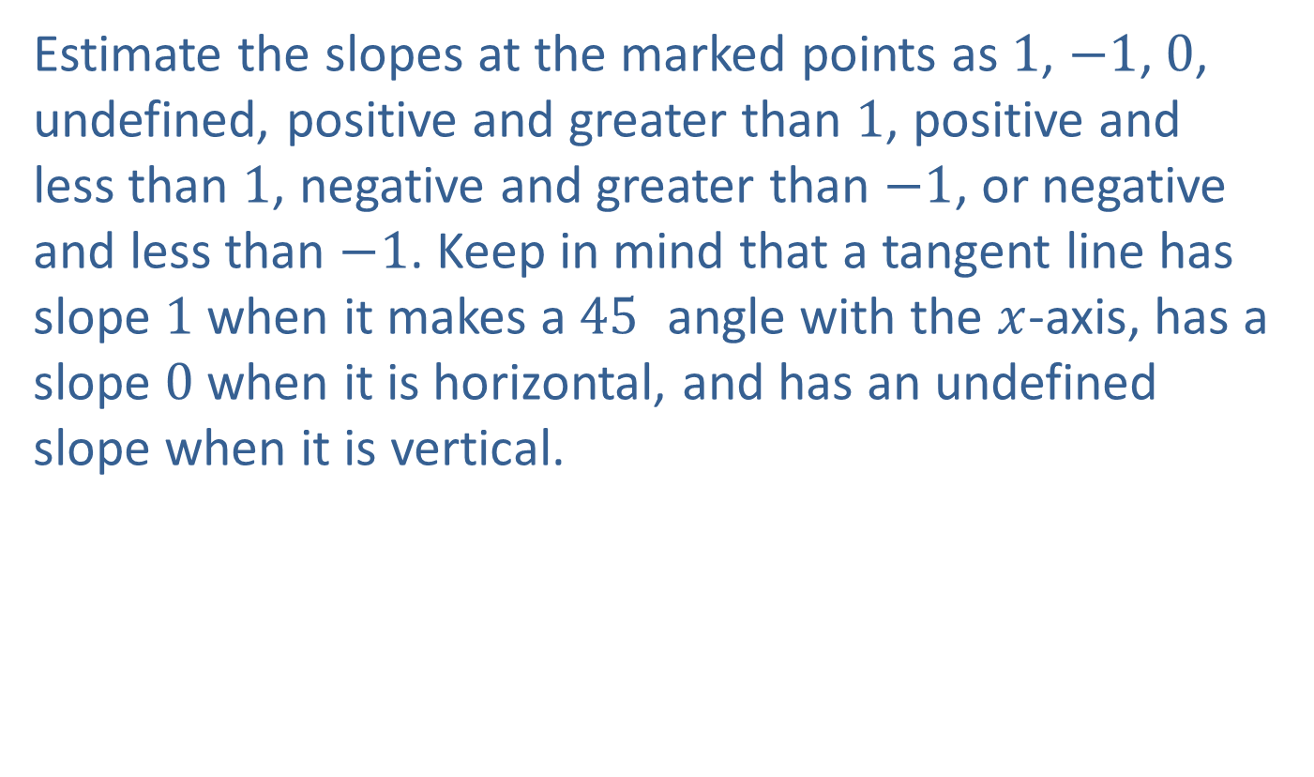
Example 5: Interpreting a Graph
Estimate the slopes at the marked points as 1, $−1$, 0, undefined, positive and greater than 1, positive and less than 1, negative and greater than $−1$, or negative and less than $−1$. Keep in mind that a tangent line has slope 1 when it makes a ${45}^{ }$ angle with the $x$-axis, has a slope 0 when it is horizontal, and has an undefined slope when it is vertical.

Slide 33
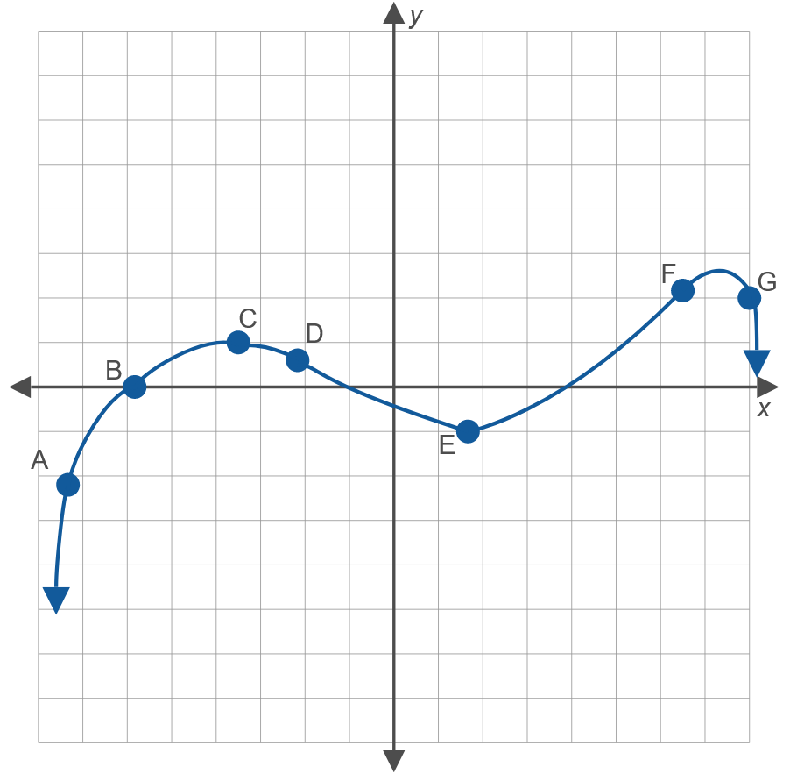
Example 5: Interpreting a Graph (cont.)

Slide 34
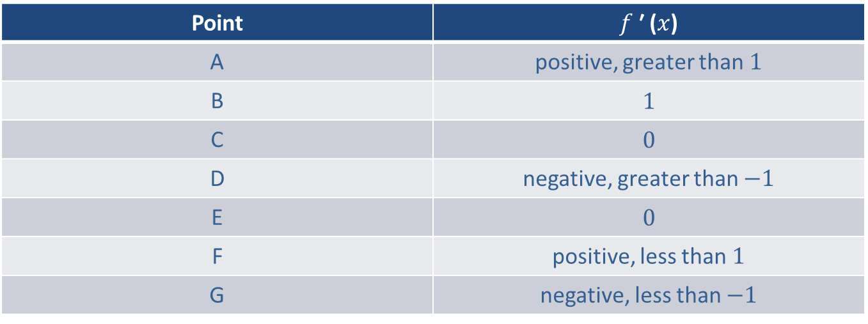
Example 5: Interpreting a Graph (cont.)
Solution
Point | $f$ ′ ($x$)
A | positive, greater than 1
B | 1
C | 0
D | negative, greater than $−1$
E | 0
F | positive, less than 1
G | negative, less than $−1$

Slide 35
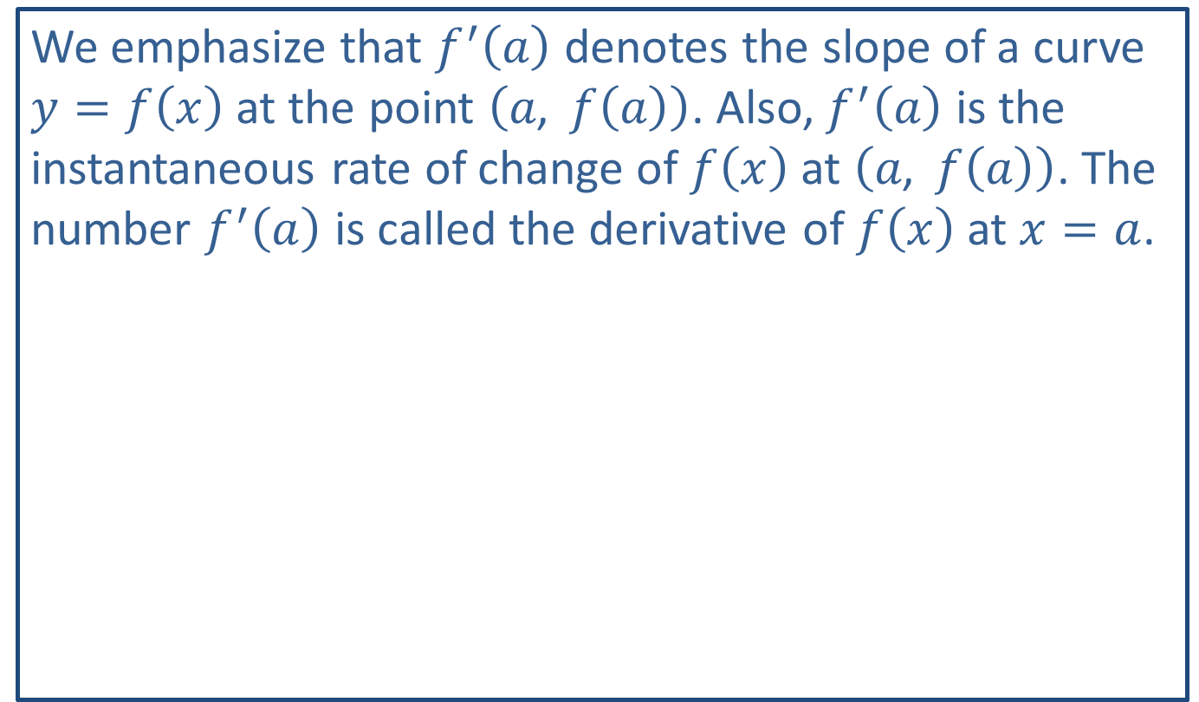
Note:
We emphasize that $f^{′}⁡\left(a\right)$ denotes the slope of a curve $y=f\left(x\right)$ at the point $\left(a\text{, }f\left(a\right)\right)$. Also, $f^{′}⁡\left(a\right)$ is the instantaneous rate of change of $f⁡\left(x\right)$ at $\left(a\text{, }f\left(a\right)\right)$. The number $f^{′}⁡\left(a\right)$ is called the derivative of $f⁡\left(x\right)$ at $x=a$.

Slide 36
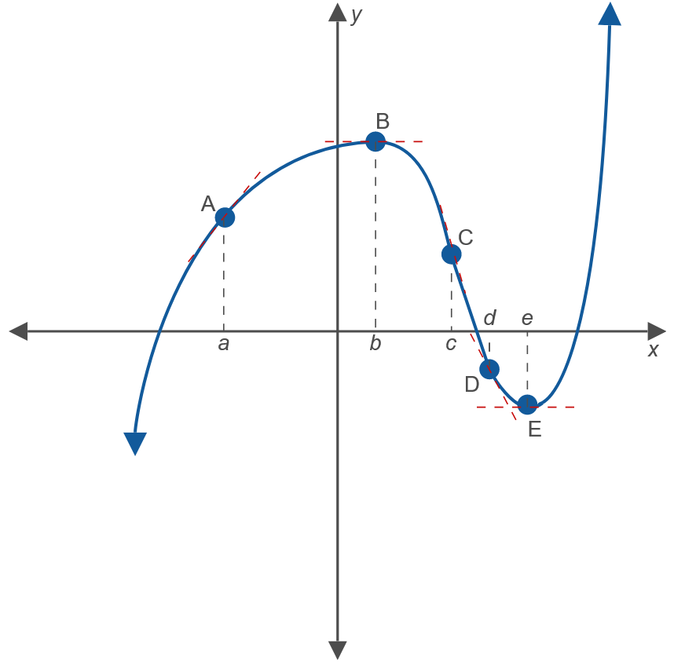

Example 6: Describing and Graphing Rates of Change
​Describe $f^{′}⁡\left(x\right)$ at the points marked on the graph.
​

Slide 37
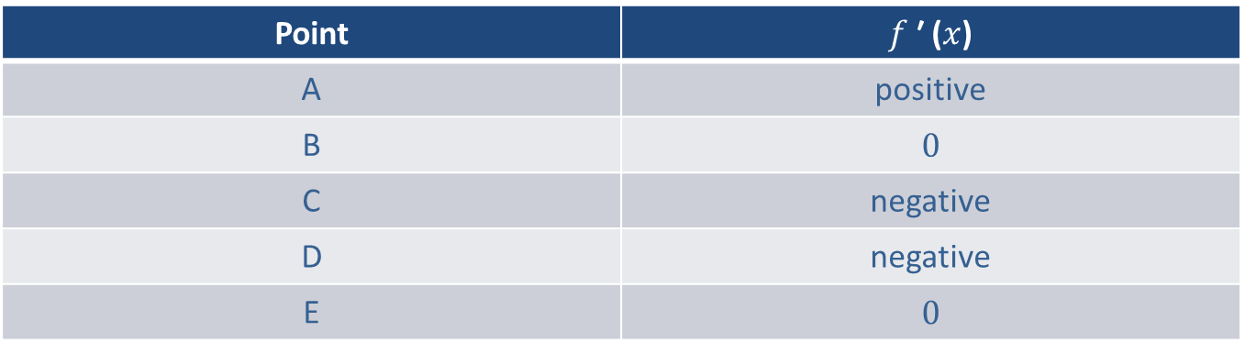
Example 6: Describing and Graphing Rates of Change (cont.)
​Solution
​
Point | $f$ ′ ($x$)
A | positive
B | 0
C | negative
D | negative
E | 0

Slide 38
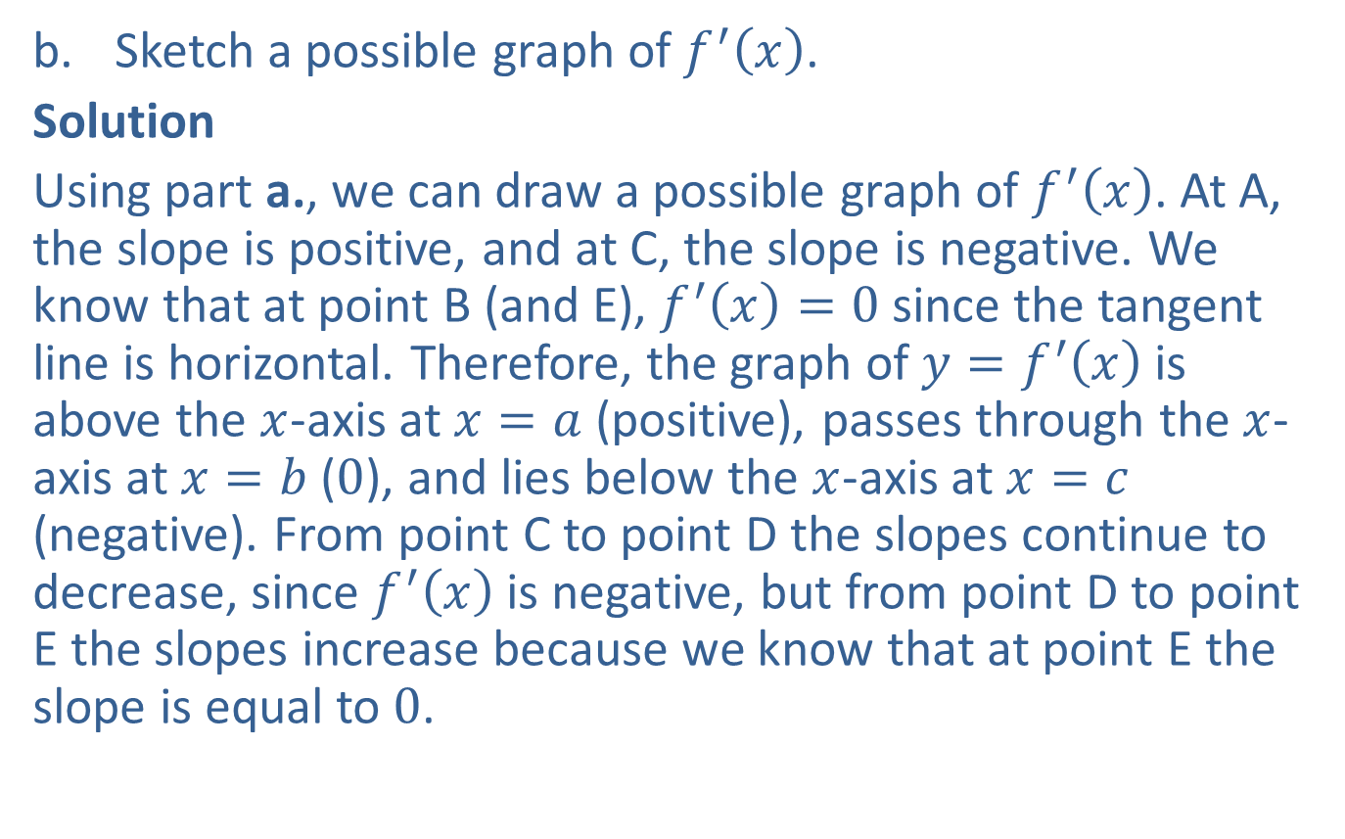
Example 6: Describing and Graphing Rates of Change (cont.)
​Sketch a possible graph of $f^{′}⁡\left(x\right)$.
​Solution
​Using part a., we can draw a possible graph of $f^{′}⁡\left(x\right)$. At A, the slope is positive, and at C, the slope is negative. We know that at point B (and E), $f^{′}\left(x\right)=0$ since the tangent line is horizontal. Therefore, the graph of $y=f^{′}\left(x\right)$ is above the $x$-axis at $x=a$ (positive), passes through the $x$-axis at $x=b$ (0), and lies below the $x$-axis at $x=c$ (negative). From point C to point D the slopes continue to decrease, since $f^{′}⁡\left(x\right)$ is negative, but from point D to point E the slopes increase because we know that at point E the slope is equal to 0.
​

Slide 39
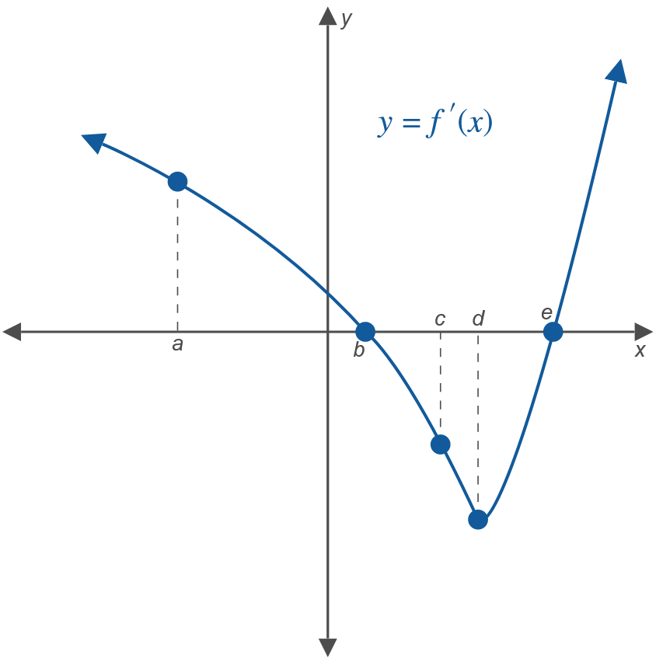
Example 6: Describing and Graphing Rates of Change (cont.)

