Slide 1
Section 2.7
Definition of the Derivative and the Power Rule

Slide 2
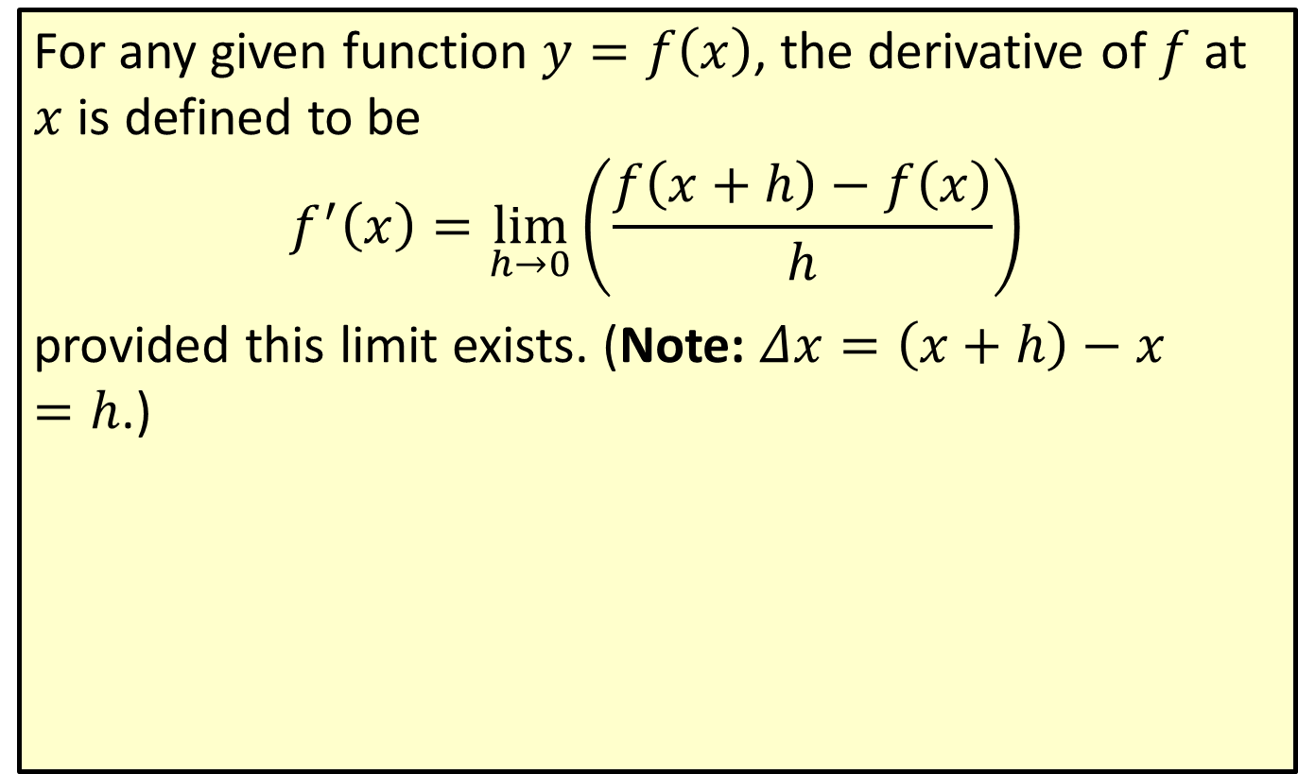
Derivative
For any given function $y=f\left(x\right)$, the derivative of $f$ at $x$ is defined to be
$$f^{′}\left(x\right)=\lim_{h→0}\left(\frac{f\left(x+h\right)−f\left(x\right)}{h}\right)$$
provided this limit exists. (Note: $Δx=\left(x+h\right)−x=h$.)

Slide 3
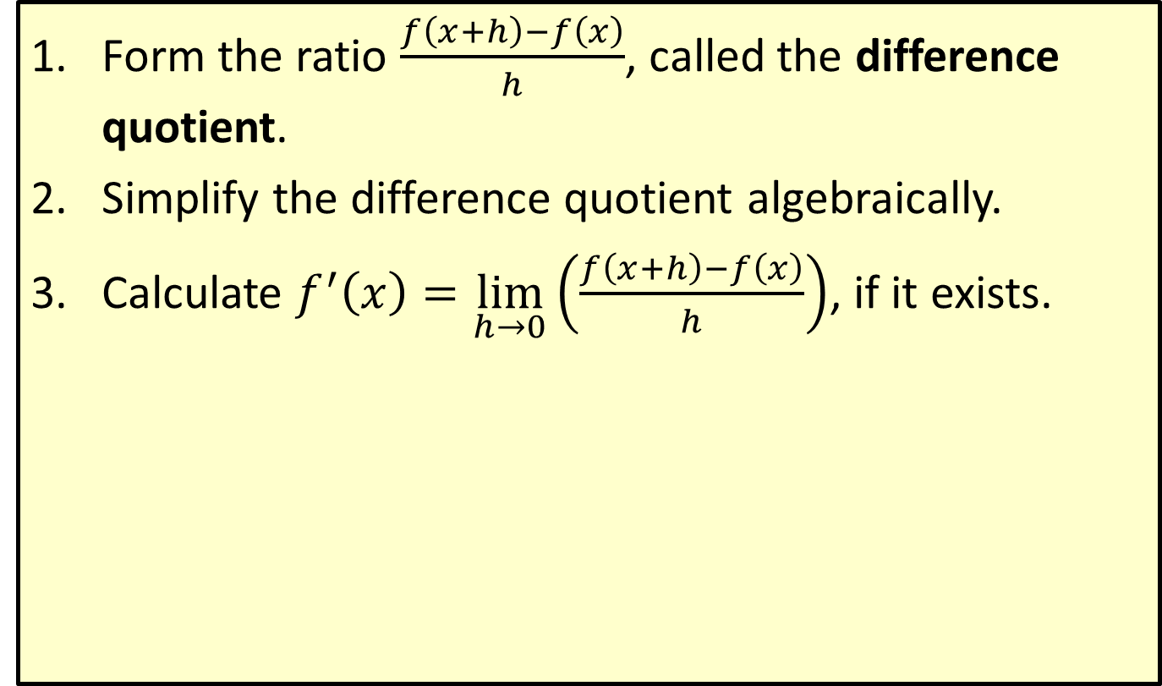
The Three-Step Method for Finding a Derivative
​Form the ratio $\frac{f\left(x+h\right)−f\left(x\right)}{h}$, called the difference quotient.
​Simplify the difference quotient algebraically.
​Calculate $f^{′}\left(x\right)=\lim_{h→0}\left(\frac{f\left(x+h\right)−f\left(x\right)}{h}\right)$, if it exists.

Slide 4

Example 1: Finding a Derivative
Use the Three-Step Method to find $f^{′}⁡\left(x\right)$ for $f\left(x\right)=x^{3}−5x$.

Slide 5
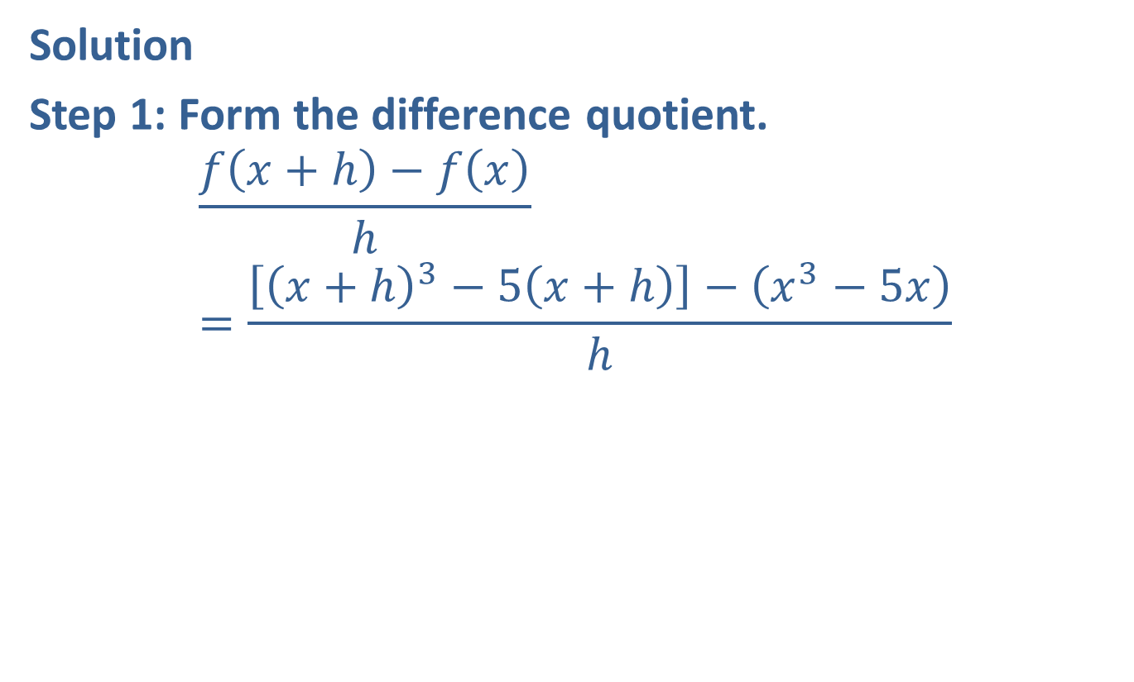
Example 1: Finding a Derivative (cont.)
Solution
Step 1: Form the difference quotient.
$$\frac{f\left(x+h\right)−f\left(x\right)}{h}=\frac{\left[{\left(x+h\right)}^{3}−5\left(x+h\right)\right]−\left(x^{3}−5x\right)}{h}$$

Slide 6
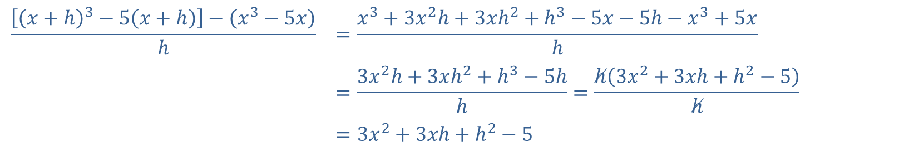
Example 1: Finding a Derivative (cont.)
Step 2: Simplify the difference quotient.
$$\frac{\left[{\left(x+h\right)}^{3}−5\left(x+h\right)\right]−\left(x^{3}−5x\right)}{h}$$ | $$=\frac{x^{3}+3x^{2}h+3xh^{2}+h^{3}−5x−5h−x^{3}+5x}{h}$$
 | $$=\frac{3x^{2}h+3xh^{2}+h^{3}−5h}{h}=\frac{h\left(3x^{2}+3xh+h^{2}−5\right)}{h}$$
 | $$=3x^{2}+3xh+h^{2}−5$$

Slide 7
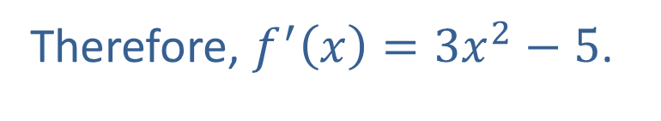
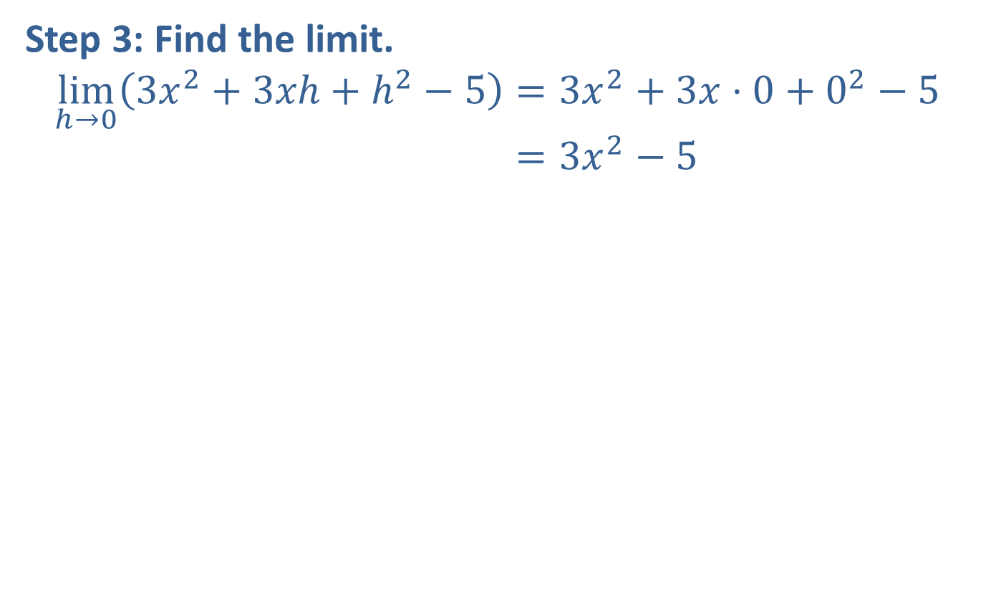
Example 1: Finding a Derivative (cont.)
Step 3: Find the limit.
limh→03𝑥2+3𝑥h+h2−5=3𝑥2+3𝑥⋅0+02−5limh→03𝑥2+3𝑥h+h2−5=3𝑥2−5
Therefore, $f^{′}⁡\left(x\right)=3x^{2}−5$.

Slide 8
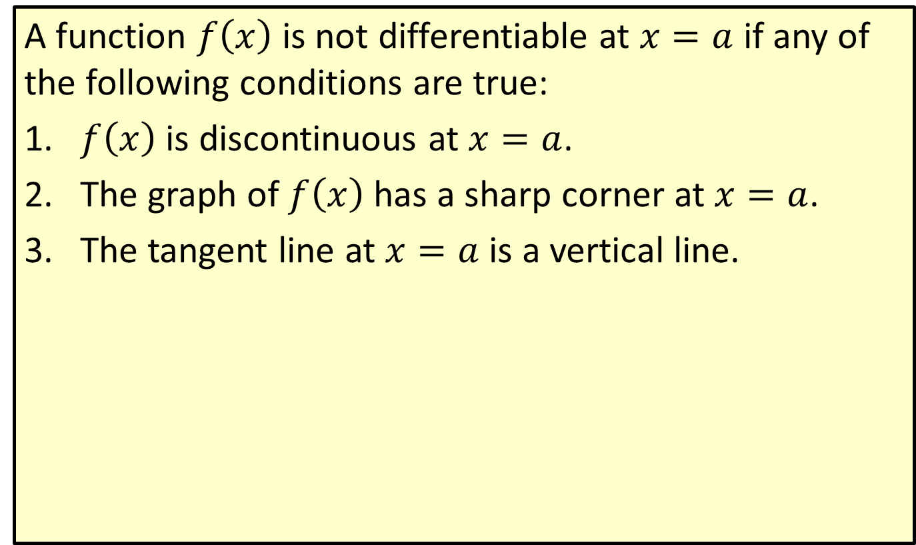
Conditions of a Nondifferentiable Function
A function $f⁡\left(x\right)$ is not differentiable at $x=a$ if any of the following conditions are true:
​$f⁡\left(x\right)$ is discontinuous at $x=a$.
​The graph of $f⁡\left(x\right)$ has a sharp corner at $x=a$.
​The tangent line at $x=a$ is a vertical line.

Slide 9

Example 2: Nondifferentiable Functions
​The function $f\left(x\right)=\frac{1}{x}$ is not defined at $x=0$. Thus, there cannot be a tangent line at $x=0$ and the limit does not exist.
​

Slide 10
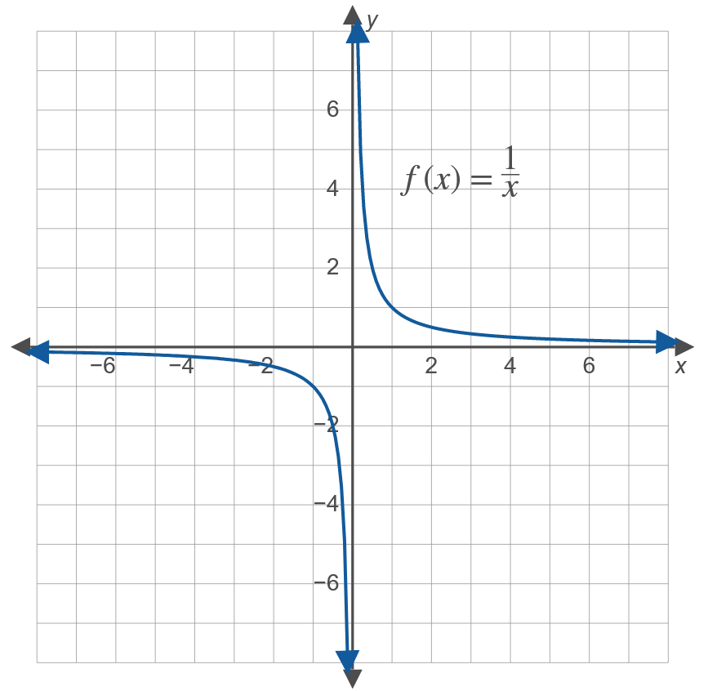
Example 2: Nondifferentiable Functions (cont.)

Slide 11
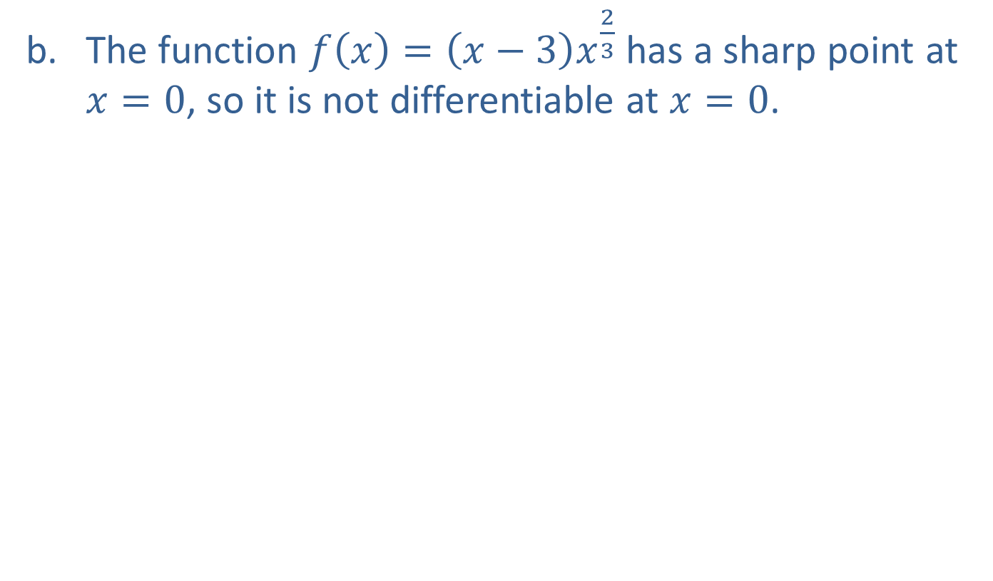
Example 2: Nondifferentiable Functions (cont.)
​The function $f\left(x\right)=\left(x−3\right)x^{\frac{2}{3}}$ has a sharp point at $x=0$, so it is not differentiable at $x=0$.
​

Slide 12
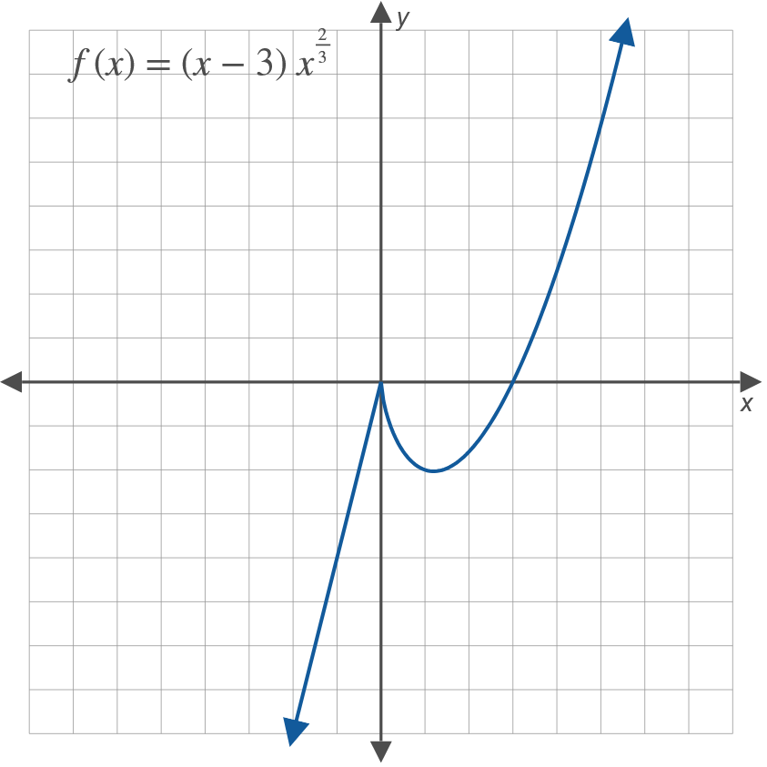

Example 2: Nondifferentiable Functions (cont.)
​ Note: The limit of a set of secant lines from the right of $x=0$ will have negative slope, but from the left, the limit will have positive slope.

Slide 13
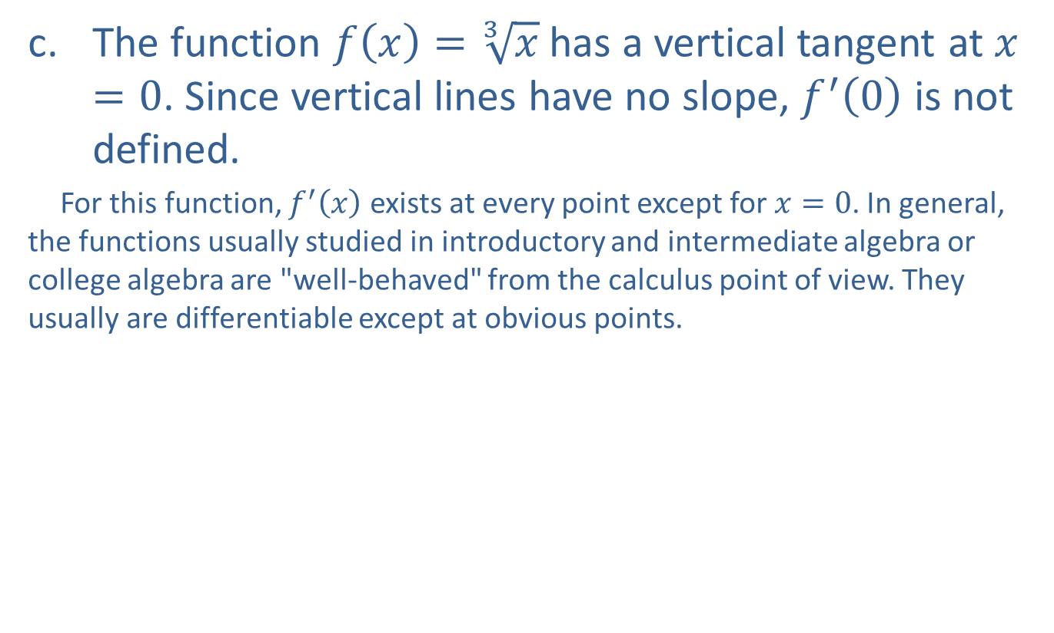
Example 2: Nondifferentiable Functions (cont.)
​The function $f\left(x\right)=\sqrt[3]{x}$ has a vertical tangent at $x=0$. Since vertical lines have no slope, $f^{′}⁡\left(0\right)$ is not defined.
​ For this function, $f^{′}⁡\left(x\right)$ exists at every point except for $x=0$. In general, the functions usually studied in introductory and intermediate algebra or college algebra are "well-behaved" from the calculus point of view. They usually are differentiable except at obvious points.
​

Slide 14
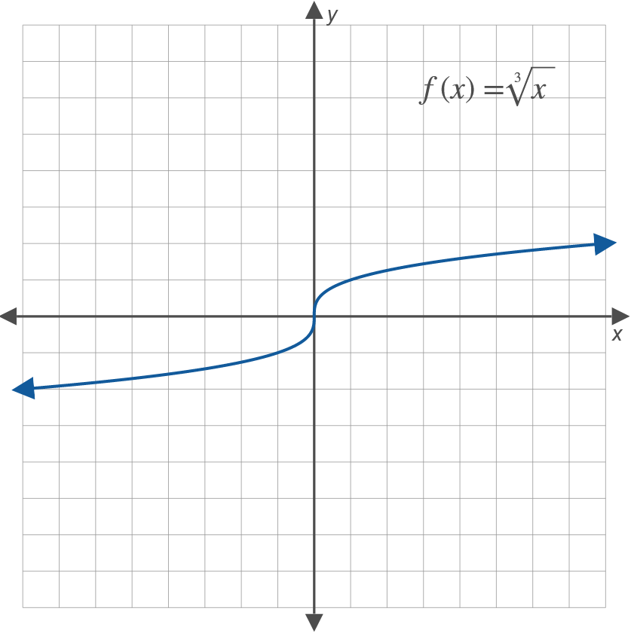
Example 2: Nondifferentiable Functions (cont.)

Slide 15
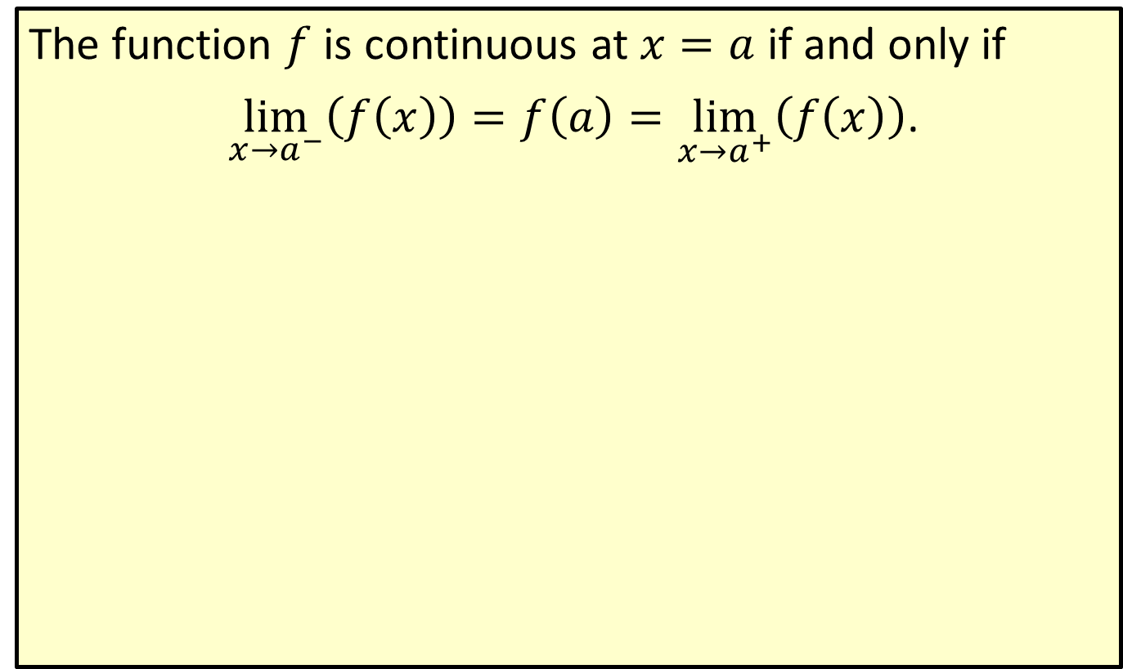

Continuity at $x=a$
The function $f$ is continuous at $x=a$ if and only if
$\lim_{x→a^{−}}\left(f\left(x\right)\right)=f\left(a\right)=\lim_{x→a^{+}}\left(f\left(x\right)\right)$.

Slide 16
Note:
Informally, continuous functions can be drawn without lifting one's pencil from the paper. Every differentiable function is continuous, but not every continuous function is differentiable (see Example 2b). Put another way, differentiability is a more restrictive condition—it requires that a function be continuous, smooth, and without vertical tangents.

Slide 17
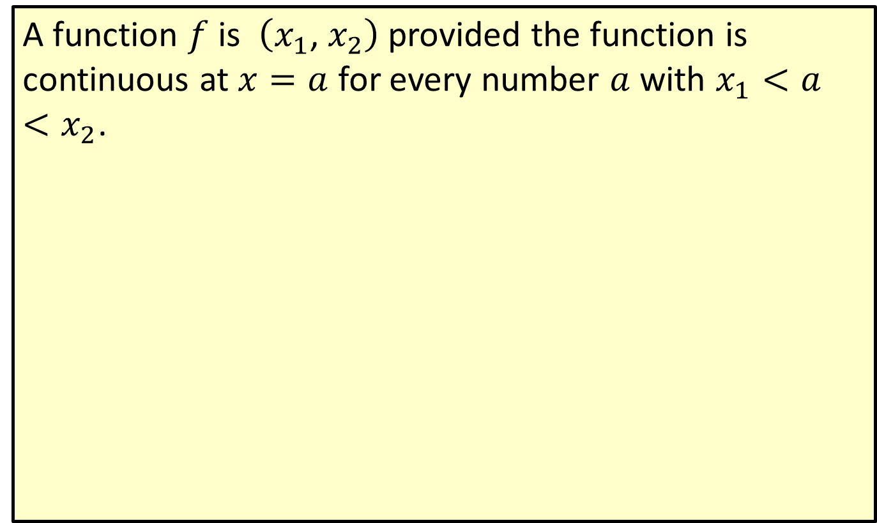
Continuous Function on an Interval
A function $f$ is $\left(x_{1}\text{, }x_{2}\right)$ provided the function is continuous at $x=a$ for every number $a$ with $x_{1}<a<x_{2}$.

Slide 18

Example 3: Using the Definition of Derivative
Use the definition of derivative to find $f^{′}⁡\left(x\right)$ for $f\left(x\right)=x^{2}$.

Slide 19
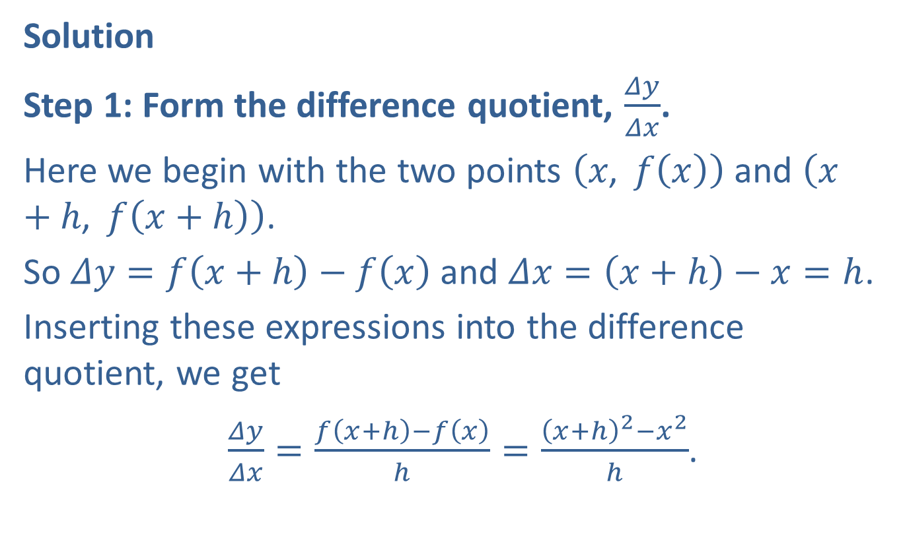
Example 3: Using the Definition of Derivative (cont.)
Solution
Step 1: Form the difference quotient, $\frac{Δy}{Δx}$.
Here we begin with the two points $\left(x\text{, }f\left(x\right)\right)$ and $\left(x+h\text{, }f\left(x+h\right)\right)$.
So $Δy=f\left(x+h\right)−f\left(x\right)$ and $Δx=\left(x+h\right)−x=h$.
Inserting these expressions into the difference quotient, we get
$\frac{Δy}{Δx}=\frac{f\left(x+h\right)−f\left(x\right)}{h}=\frac{{\left(x+h\right)}^{2}−x^{2}}{h}$.

Slide 20
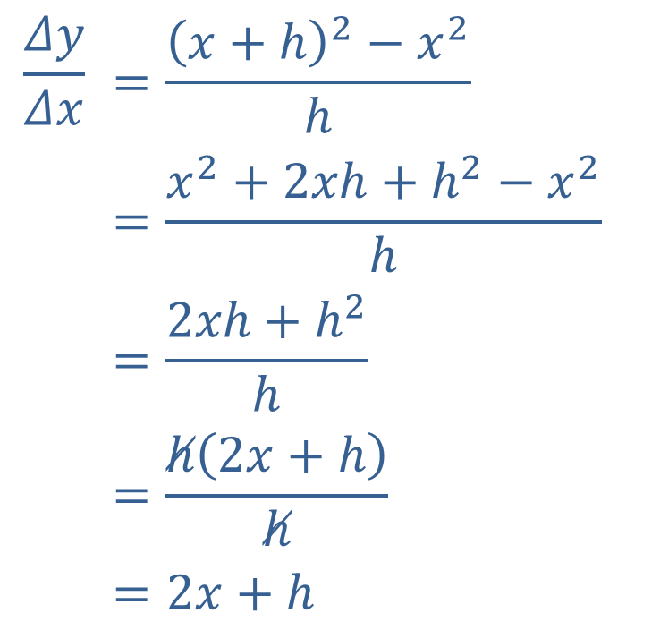
Example 3: Using the Definition of Derivative (cont.)
Step 2: Simplify the difference quotient.
$$\frac{Δy}{Δx}$$ | $$=\frac{{\left(x+h\right)}^{2}−x^{2}}{h}$$
 | $$=\frac{x^{2}+2xh+h^{2}−x^{2}}{h}$$
 | $$=\frac{2xh+h^{2}}{h}$$
 | $$=\frac{h\left(2x+h\right)}{h}$$
 | $$=2x+h$$

Slide 21
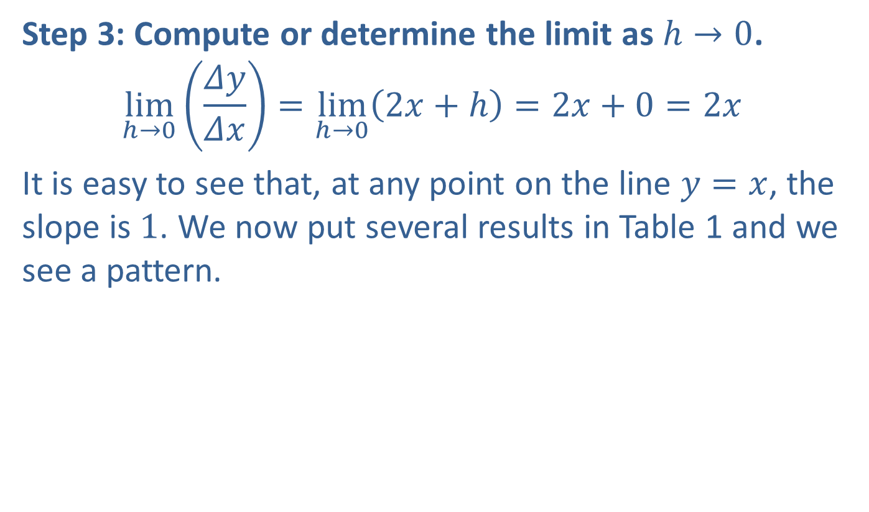
Example 3: Using the Definition of Derivative (cont.)
Step 3: Compute or determine the limit as $h→0$.
$$\lim_{h→0}\left(\frac{Δy}{Δx}\right)=\lim_{h→0}\left(2x+h\right)=2x+0=2x$$
It is easy to see that, at any point on the line $y=x$, the slope is 1. We now put several results in Table 1 and we see a pattern.

Slide 22
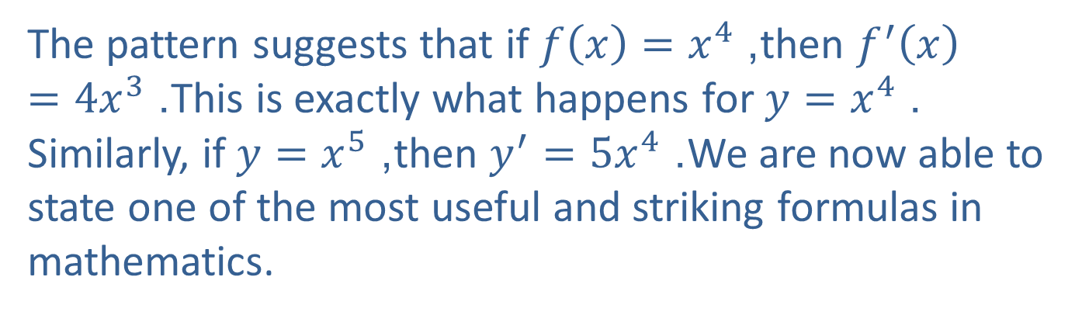

Example 3: Using the Definition of Derivative (cont.)
Table 1
$$y$$ | $$y^{′}$$
$$x$$ | 1
$$x^{2}$$ | $$2x$$
$$x^{3}$$ | $$3x^{2}$$
The pattern suggests that if $f\left(x\right)=x^{4}$, then $f^{′}\left(x\right)=4x^{3}$. This is exactly what happens for $y=x^{4}$. Similarly, if $y=x^{5}$, then $y^{′}=5x^{4}$. We are now able to state one of the most useful and striking formulas in mathematics.

Slide 23
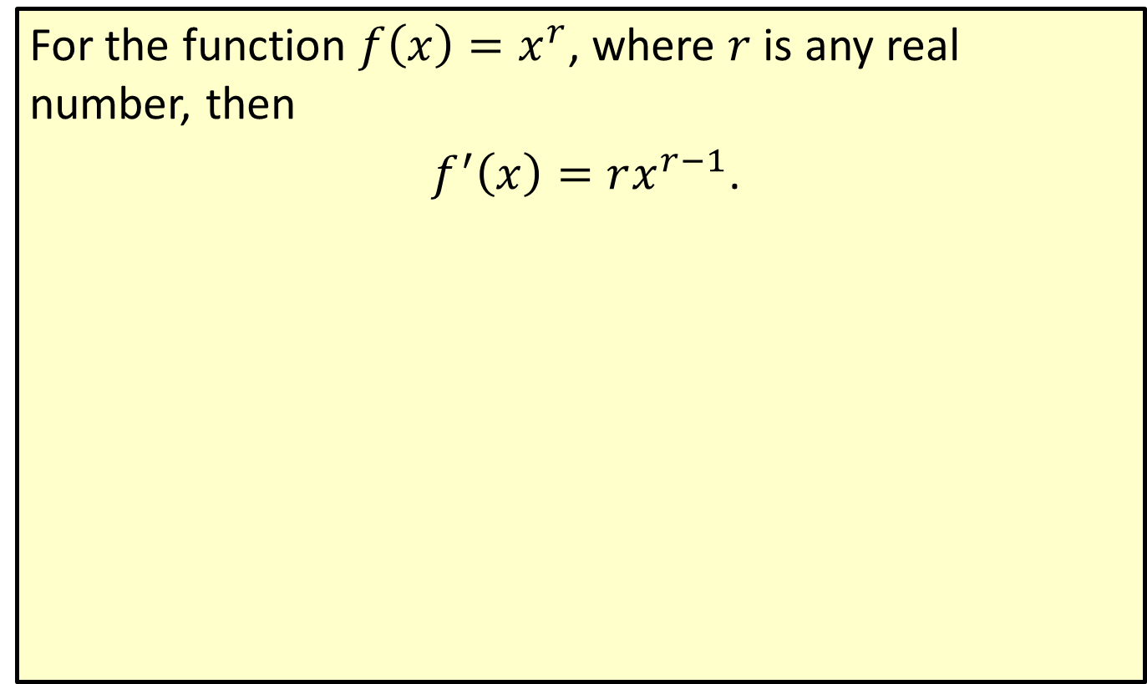
The Power Rule
For the function $f\left(x\right)=x^{r}$, where $r$ is any real number, then
$f^{′}\left(x\right)=rx^{r−1}$.

Slide 24
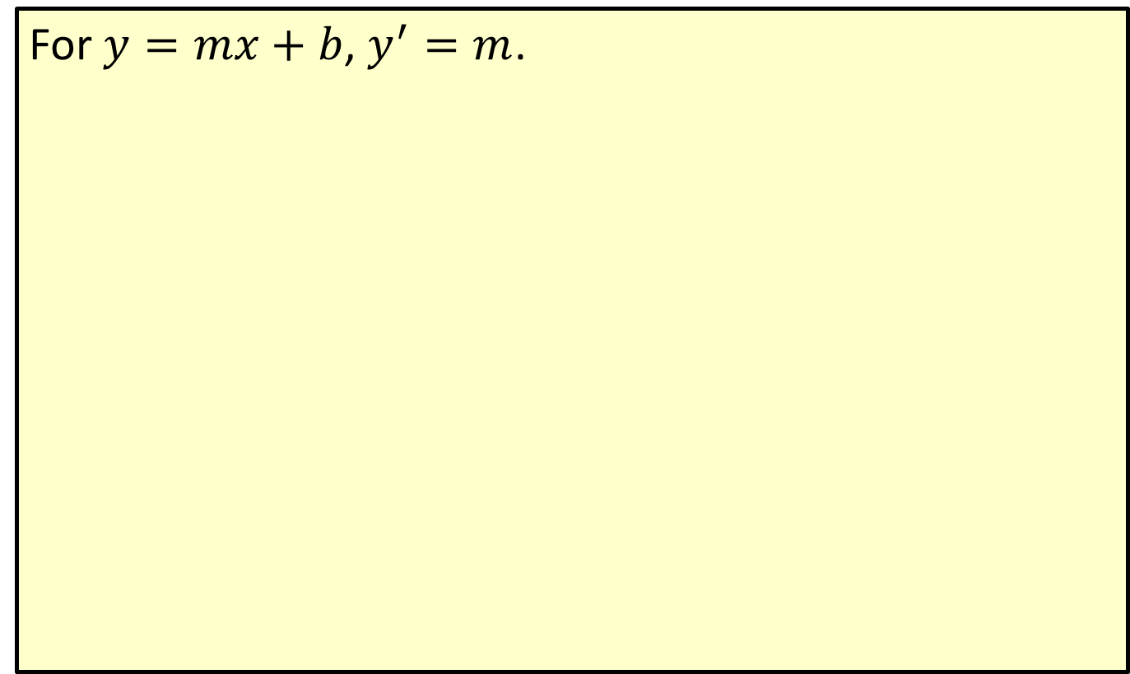
Basic Rule of the Derivative of a Linear Function
For $y=mx+b$, $y^{′}=m$.

Slide 25
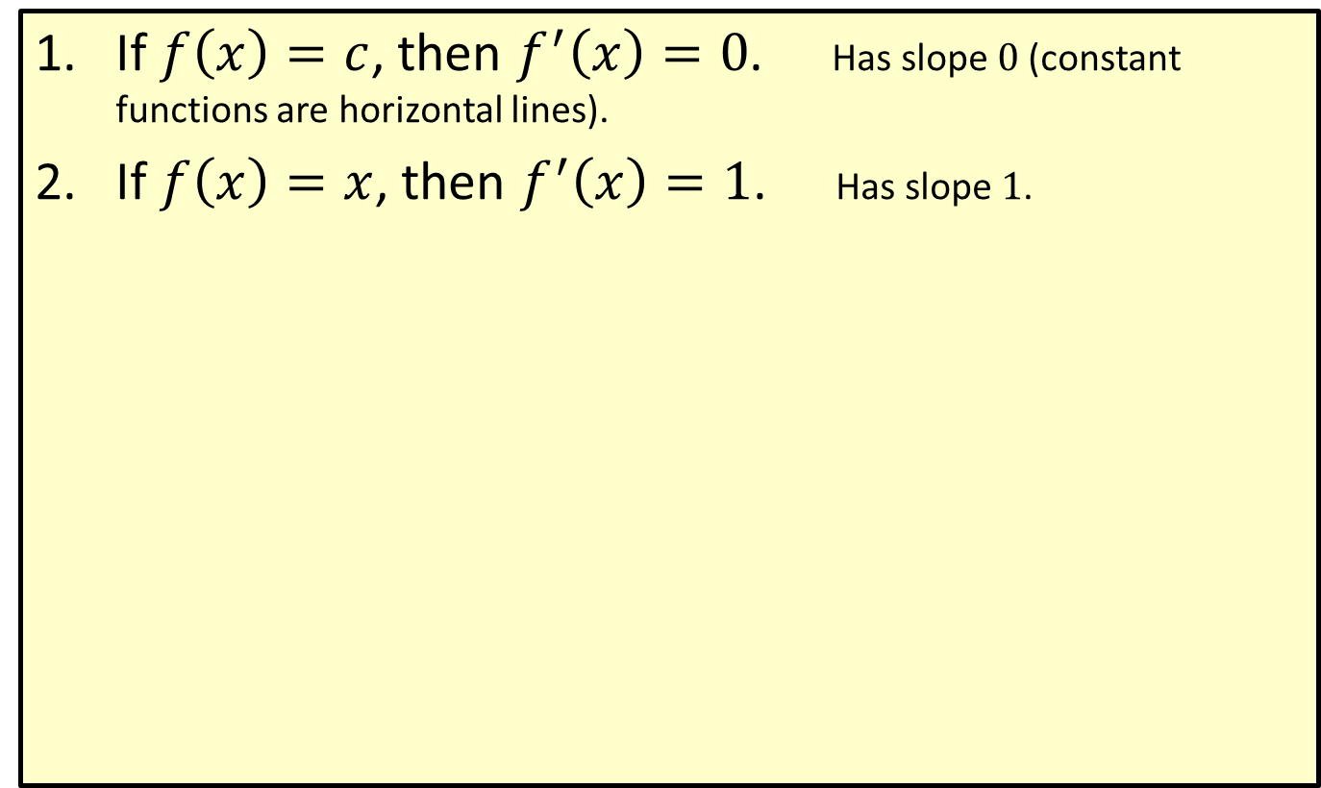
Two Special Cases of the Basic Rule
​If $f\left(x\right)=c$, then $f^{′}\left(x\right)=0$. Has slope 0 (constant functions are horizontal lines).
​If $f\left(x\right)=x$, then $f^{′}\left(x\right)=1$. Has slope 1.

Slide 26
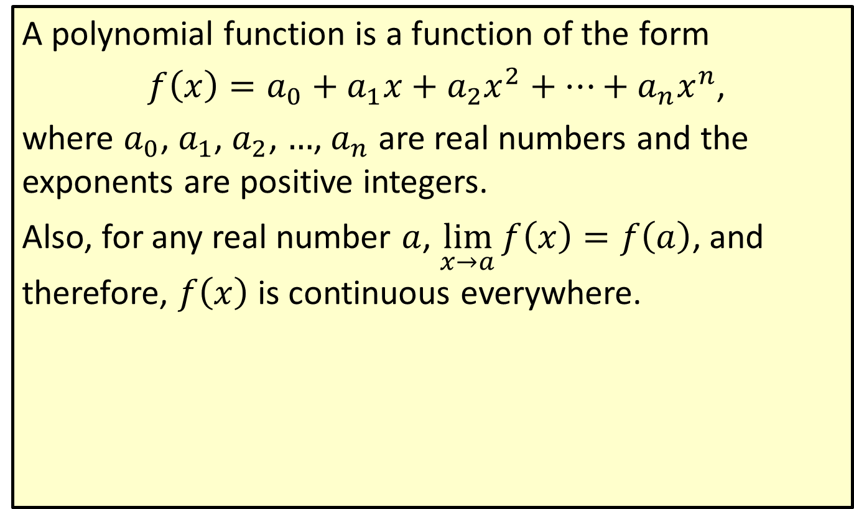
Polynomial Functions
A polynomial function is a function of the form
$f\left(x\right)=a_{0}+a_{1}x+a_{2}x^{2}+⋯+a_{n}x^{n}$,
where $a_{0}$, $a_{1}$, $a_{2}$, …, $a_{n}$ are real numbers and the exponents are positive integers.
Also, for any real number $a$, $\lim_{x→a}f\left(x\right)=f\left(a\right)$, and therefore, $f⁡\left(x\right)$ is continuous everywhere.

Slide 27
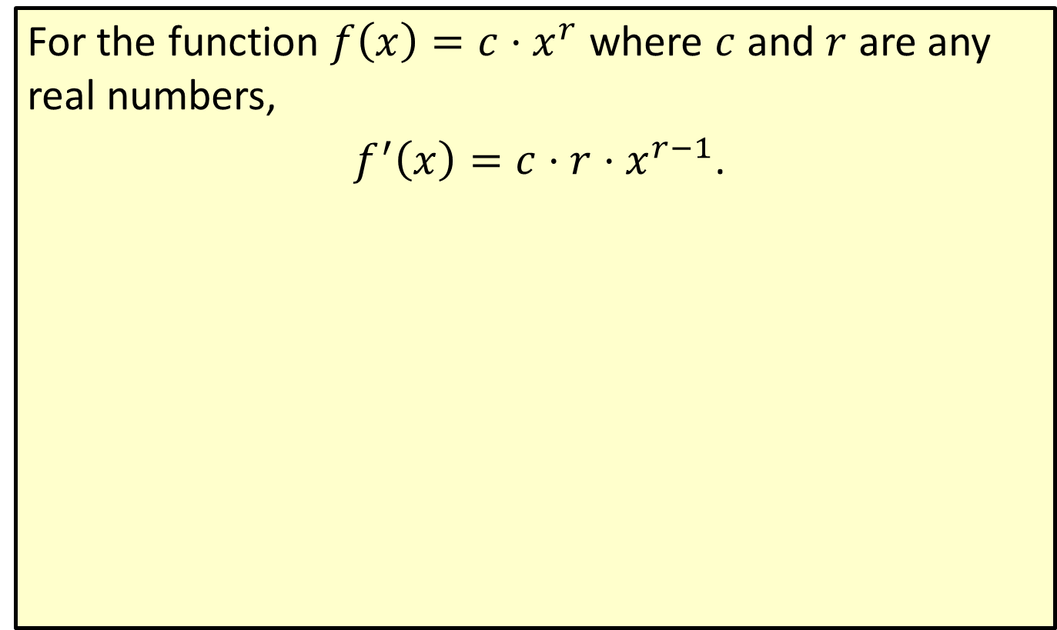
Power Rule (General Case)
For the function $f\left(x\right)=c⋅x^{r}$ where $c$ and $r$ are any real numbers,
$f^{′}\left(x\right)=c⋅r⋅x^{r−1}$.

Slide 28
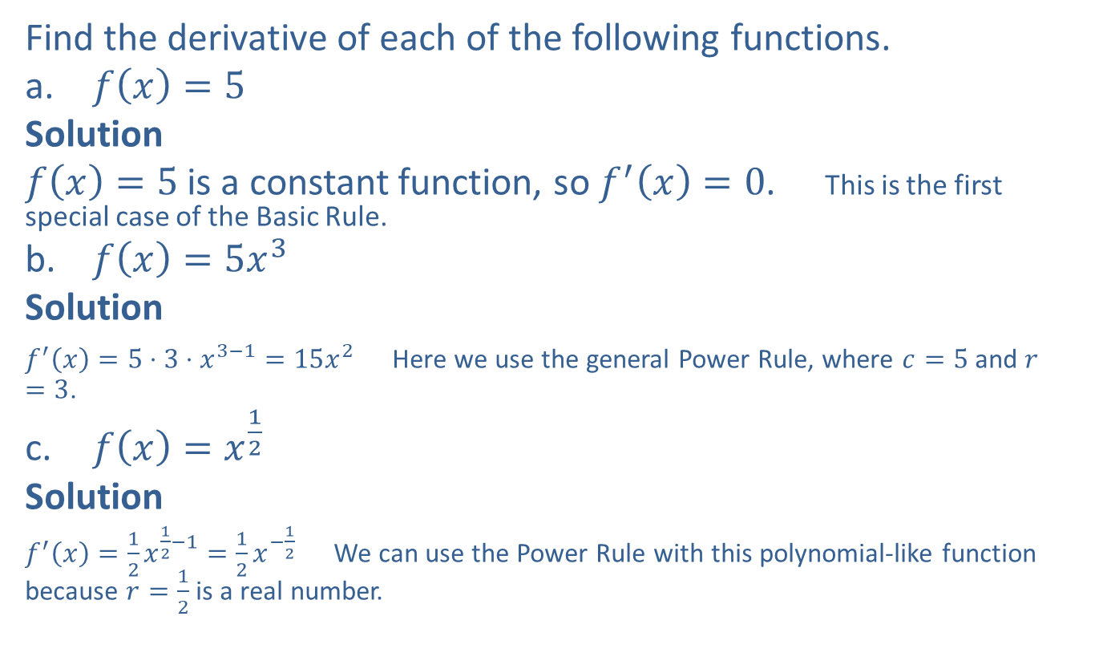
Example 4: Finding the Derivatives of Functions
Find the derivative of each of the following functions.
​$f\left(x\right)=5$
​Solution
​$f\left(x\right)=5$ is a constant function, so $f^{′}\left(x\right)=0$. This is the first special case of the Basic Rule.
​$f\left(x\right)=5x^{3}$
​Solution
​$f^{′}\left(x\right)=5⋅3⋅x^{3−1}=15x^{2}$ Here we use the general Power Rule, where $c=5$ and $r=3$.
​$f\left(x\right)=x^{\frac{1}{2}}$
​Solution
​$f^{′}\left(x\right)=\frac{1}{2}x^{\frac{1}{2}−1}=\frac{1}{2}x^{−\frac{1}{2}}$ We can use the Power Rule with this polynomial-like function because $r=\frac{1}{2}$ is a real number.

Slide 29
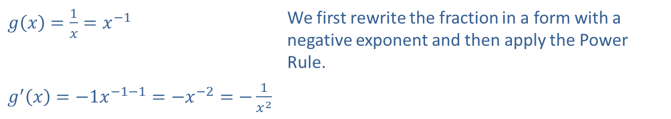

Example 5: Rewriting a Fraction to Find the Derivative
Find the derivative of $g⁡\left(x\right)$ given that $g\left(x\right)=\frac{1}{x}$.
Solution
​$g\left(x\right)=\frac{1}{x}=x^{−1}$ | We first rewrite the fraction in a form with a negative exponent and then apply the Power Rule.
​$g^{′}\left(x\right)=−1x^{−1−1}=−x^{−2}=−\frac{1}{x^{2}}$

Slide 30

Example 6: Using Derivative Notation
Find $D_{x}\left(h\left(x\right)\right)$ where $h\left(x\right)=\frac{18}{x^{\frac{2}{3}}}$.

Slide 31
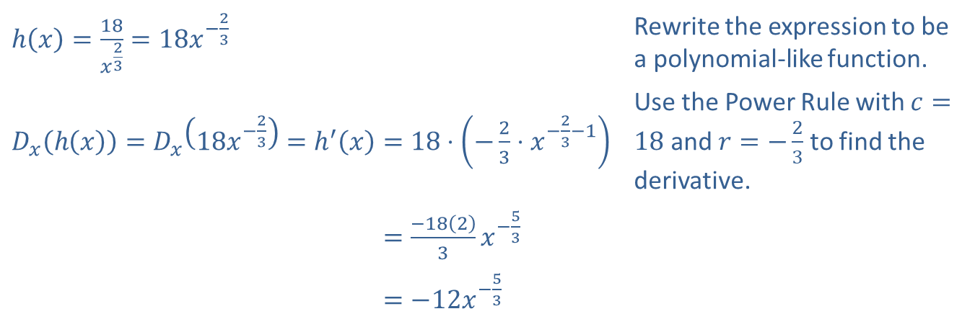
Example 6: Using Derivative Notation (cont.)
Solution
​$h\left(x\right)=\frac{18}{x^{\frac{2}{3}}}=18x^{−\frac{2}{3}}$ | Rewrite the expression to be a polynomial-like function.
​$D_{x}\left(h\left(x\right)\right)=D_{x}\left(18x^{−\frac{2}{3}}\right)=h^{′}\left(x\right)=18⋅\left(−\frac{2}{3}⋅x^{−\frac{2}{3}−1}\right)$ | Use the Power Rule with $c=18$ and $r=−\frac{2}{3}$ to find the derivative.
​𝐷𝑥h𝑥=𝐷𝑥18𝑥−23=h′𝑥=−1823𝑥−53
​𝐷𝑥h𝑥=𝐷𝑥18𝑥−23=h′𝑥=−12𝑥−53

