Slide 1
Section 2.8
Techniques for Finding Derivatives

Slide 2
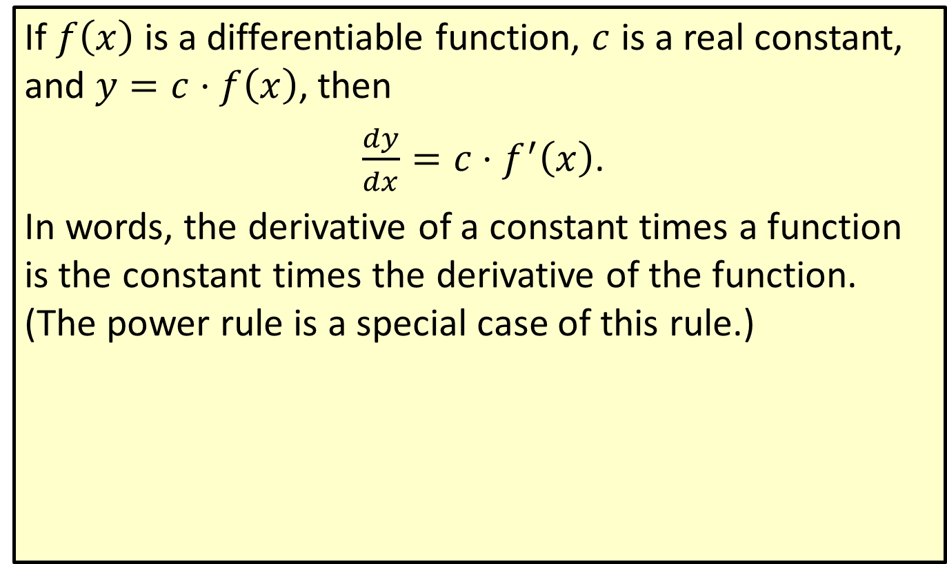
Constant Times a Function Rule
If $f⁡\left(x\right)$ is a differentiable function, $c$ is a real constant, and $y=c⋅f\left(x\right)$, then
$\frac{dy}{dx}=c⋅f^{′}\left(x\right)$.
In words, the derivative of a constant times a function is the constant times the derivative of the function. (The power rule is a special case of this rule.)

Slide 3
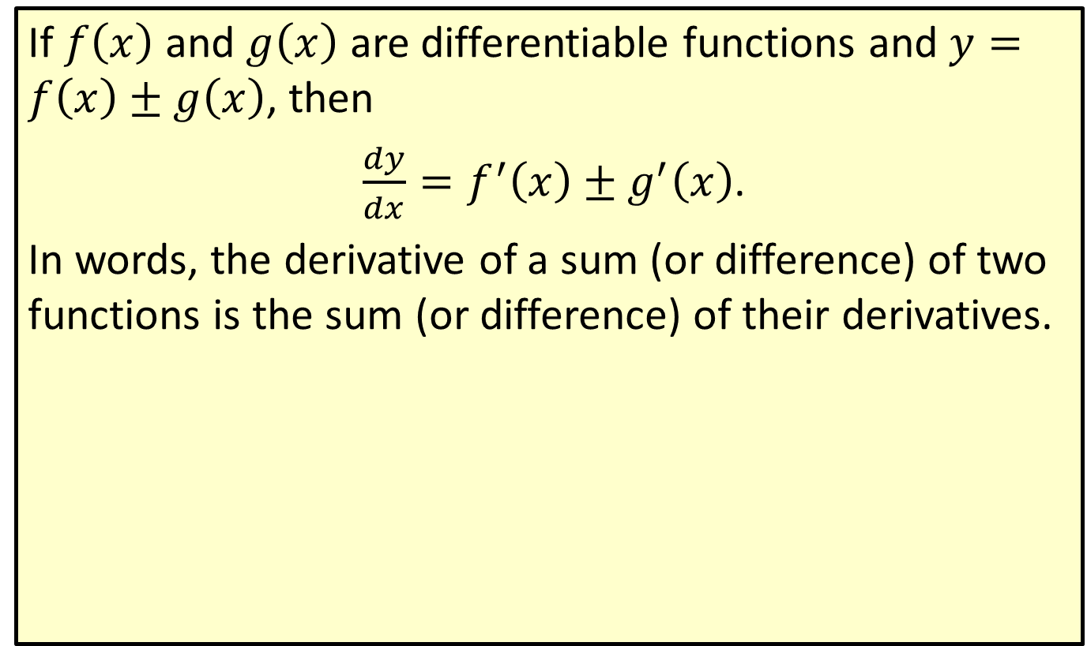
The Sum and Difference Rule
If $f⁡\left(x\right)$ and $g⁡\left(x\right)$ are differentiable functions and $y=f\left(x\right)±g\left(x\right)$, then
$\frac{dy}{dx}=f^{′}\left(x\right)±g^{′}\left(x\right)$.
In words, the derivative of a sum (or difference) of two functions is the sum (or difference) of their derivatives.

Slide 4

Example 1: Using the Rules
Find the derivative of each of the following functions.
​$y=5x^{2}$
​Solution
​

Slide 5
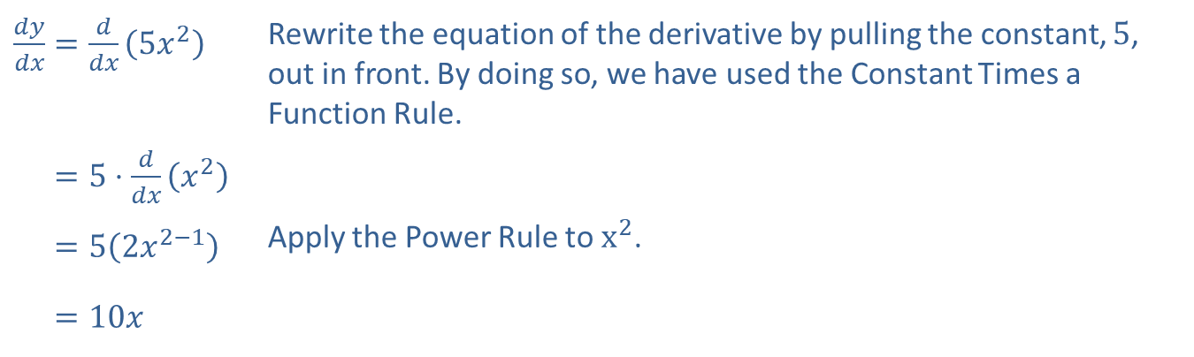
Example 1: Using the Rules (cont.)
​$\frac{dy}{dx}=\frac{d}{dx}\left(5x^{2}\right)$ | Rewrite the equation of the derivative by pulling the constant, 5, out in front. By doing so, we have used the Constant Times a Function Rule.
​𝑑𝑦𝑑𝑥=5⋅𝑑𝑑𝑥𝑥2
​𝑑𝑦𝑑𝑥=52𝑥2−1 | Apply the Power Rule to $x^{2}$.
​𝑑𝑦𝑑𝑥=10𝑥

Slide 6
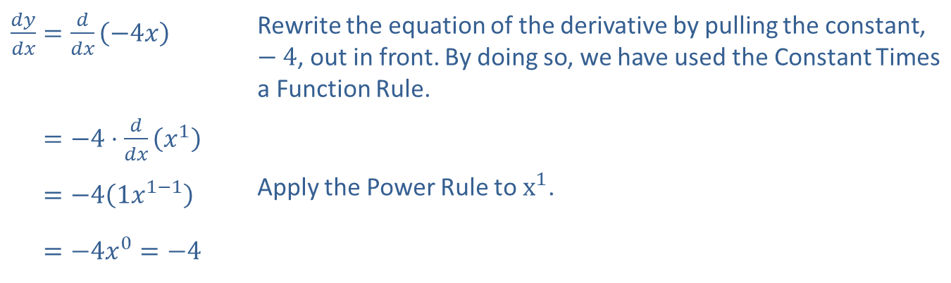

Example 1: Using the Rules (cont.)
​$y=−4x$
​Solution
​
​$\frac{dy}{dx}=\frac{d}{dx}\left(−4x\right)$ | Rewrite the equation of the derivative by pulling the constant, $−4$, out in front. By doing so, we have used the Constant Times a Function Rule.
​𝑑𝑦𝑑𝑥=−4⋅𝑑𝑑𝑥𝑥1
​𝑑𝑦𝑑𝑥=−41𝑥1−1 | Apply the Power Rule to $x^{1}$.
​𝑑𝑦𝑑𝑥=−4𝑥0=−4

Slide 7
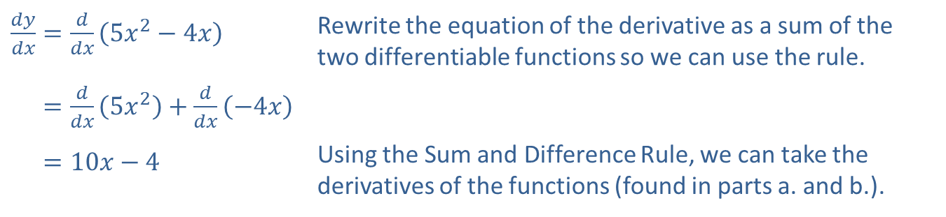

Example 1: Using the Rules (cont.)
​$y=5x^{2}−4x$
​Solution
​Notice that this function is actually the sum of the functions in parts a. and b. Therefore, to find the derivative of this function we will add the results from parts a. and b.
​$\frac{dy}{dx}=\frac{d}{dx}\left(5x^{2}−4x\right)$ | Rewrite the equation of the derivative as a sum of the two differentiable functions so we can use the rule.
​𝑑𝑦𝑑𝑥=𝑑𝑑𝑥5𝑥2+𝑑𝑑𝑥−4𝑥
​𝑑𝑦𝑑𝑥=10𝑥−4 | Using the Sum and Difference Rule, we can take the derivatives of the functions (found in parts a. and b.).

Slide 8
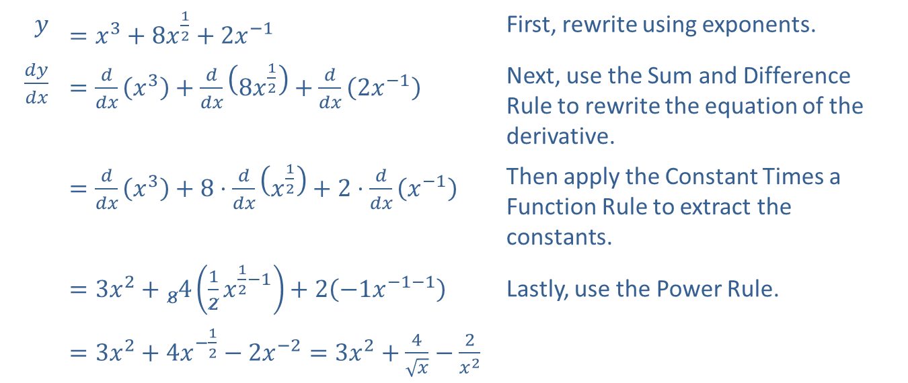

Example 1: Using the Rules (cont.)
​$y=x^{3}+8\sqrt{x}+\frac{2}{x}$
​Solution
​
$$y$$ | ​$=x^{3}+8x^{\frac{1}{2}}+2x^{−1}$ | First, rewrite using exponents.
​$\frac{dy}{dx}$ | ​$=\frac{d}{dx}\left(x^{3}\right)+\frac{d}{dx}\left(8x^{\frac{1}{2}}\right)+\frac{d}{dx}\left(2x^{−1}\right)$ | Next, use the Sum and Difference Rule to rewrite the equation of the derivative.
 | ​$=\frac{d}{dx}\left(x^{3}\right)+8⋅\frac{d}{dx}\left(x^{\frac{1}{2}}\right)+2⋅\frac{d}{dx}\left(x^{−1}\right)$ | Then apply the Constant Times a Function Rule to extract the constants.
 | ​$=3x^{2}+{}_{8}^{ }4\left(\frac{1}{2}x^{\frac{1}{2}−1}\right)+2\left(−1x^{−1−1}\right)$ | Lastly, use the Power Rule.
 | ​$=3x^{2}+4x^{−\frac{1}{2}}−2x^{−2}=3x^{2}+\frac{4}{\sqrt{x}}−\frac{2}{x^{2}}$

Slide 9
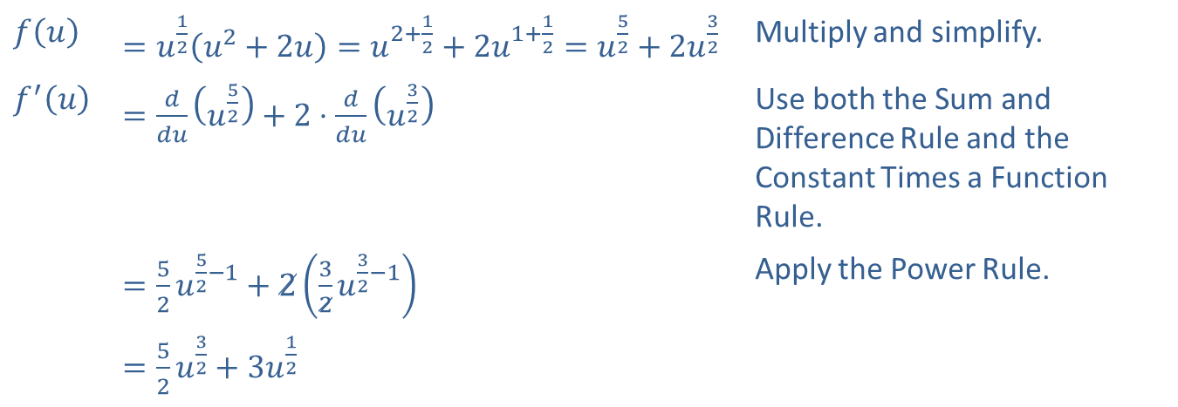

Example 2: Algebraic Manipulations
​Find $f^{′}⁡\left(u\right)$ if $f\left(u\right)=u^{\frac{1}{2}}\left(u^{2}+2u\right)$.
​Solution
​
​$f⁡\left(u\right)$ | ​$=u^{\frac{1}{2}}\left(u^{2}+2u\right)=u^{2+\frac{1}{2}}+2u^{1+\frac{1}{2}}=u^{\frac{5}{2}}+2u^{\frac{3}{2}}$ | Multiply and simplify.
​$f^{′}\left(u\right)$ | ​$=\frac{d}{du}\left(u^{\frac{5}{2}}\right)+2⋅\frac{d}{du}\left(u^{\frac{3}{2}}\right)$ | Use both the Sum and Difference Rule and the Constant Times a Function Rule.
 | ​$=\frac{5}{2}u^{\frac{5}{2}−1}+2\left(\frac{3}{2}u^{\frac{3}{2}−1}\right)$ | Apply the Power Rule.
 | ​$=\frac{5}{2}u^{\frac{3}{2}}+3u^{\frac{1}{2}}$

Slide 10
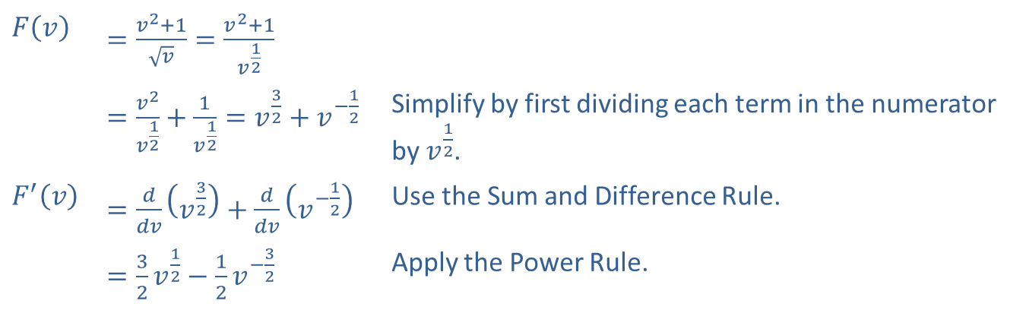

Example 2: Algebraic Manipulations (cont.)
​If $F\left(v\right)=\frac{v^{2}+1}{\sqrt{v}}$, find $F^{′}⁡\left(v\right)$.
​Solution
​
​$F\left(v\right)$ | ​$=\frac{v^{2}+1}{\sqrt{v}}=\frac{v^{2}+1}{v^{\frac{1}{2}}}$
 | ​$=\frac{v^{2}}{v^{\frac{1}{2}}}+\frac{1}{v^{\frac{1}{2}}}=v^{\frac{3}{2}}+v^{−\frac{1}{2}}$ | Simplify by first dividing each term in the numerator by $v^{\frac{1}{2}}$.
​$F^{′}⁡\left(v\right)$ | ​$=\frac{d}{dv}\left(v^{\frac{3}{2}}\right)+\frac{d}{dv}\left(v^{−\frac{1}{2}}\right)$ | Use the Sum and Difference Rule.
 | ​$=\frac{3}{2}v^{\frac{1}{2}}−\frac{1}{2}v^{−\frac{3}{2}}$ | Apply the Power Rule.

Slide 11

Example 2: Algebraic Manipulations (cont.)
​Or, we can factor and write the answer in fraction form with a single denominator.
$$F^{′}\left(v\right)=\frac{1}{2}v^{−\frac{3}{2}}\left(3v^{2}−1\right)=\frac{3v^{2}−1}{2v^{\frac{3}{2}}}$$

Slide 12
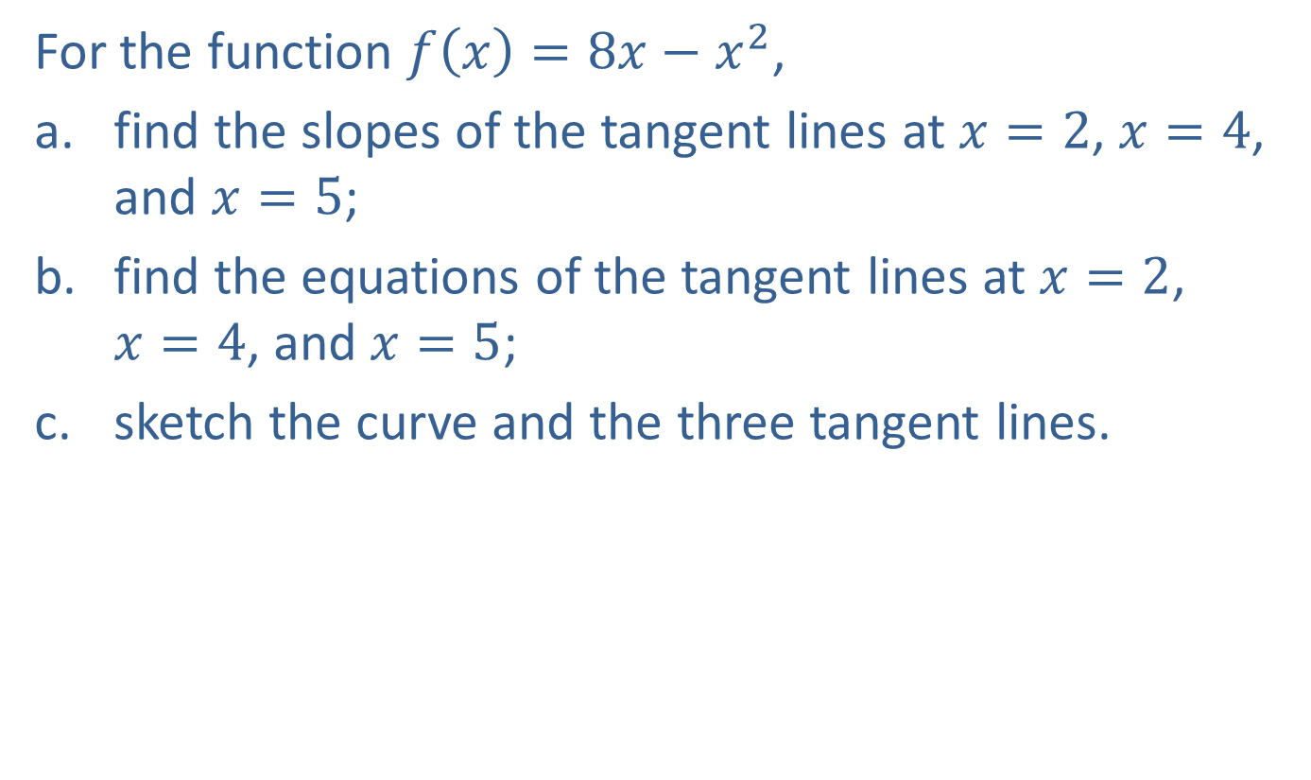
Example 3: Tangent Lines
For the function $f\left(x\right)=8x−x^{2}$,
​find the slopes of the tangent lines at $x=2$, $x=4$, and $x=5$;
​find the equations of the tangent lines at $x=2$, $x=4$, and $x=5$;
​sketch the curve and the three tangent lines.

Slide 13
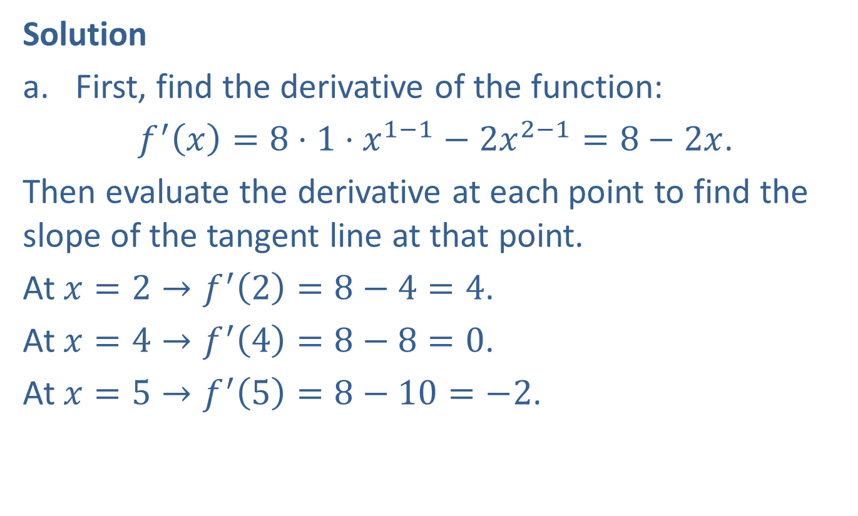
Example 3: Tangent Lines (cont.)
Solution
​First, find the derivative of the function:
$f^{′}\left(x\right)=8⋅1⋅x^{1−1}−2x^{2−1}=8−2x$.
Then evaluate the derivative at each point to find the slope of the tangent line at that point.
At $x=2→f^{′}\left(2\right)=8−4=4$.
At $x=4→f^{′}\left(4\right)=8−8=0$.
At $x=5→f^{′}\left(5\right)=8−10=−2$.

Slide 14

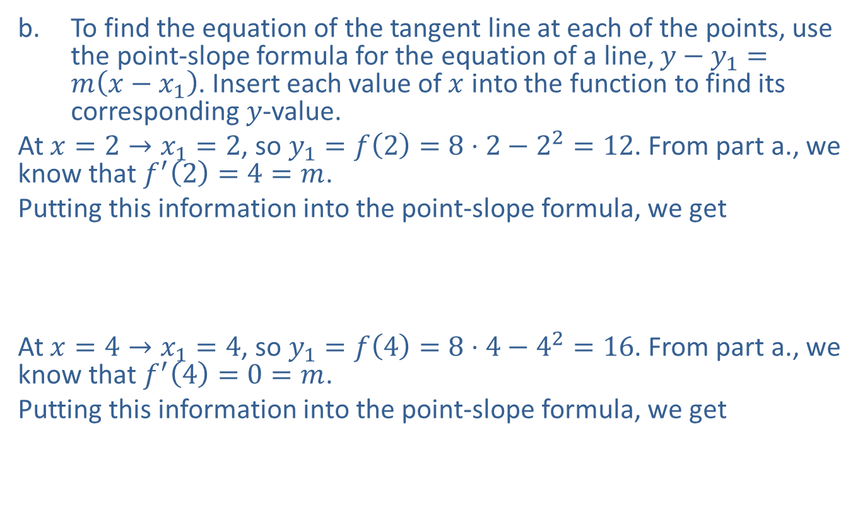

Example 3: Tangent Lines (cont.)
​To find the equation of the tangent line at each of the points, use the point-slope formula for the equation of a line, $y−y_{1}=m\left(x−x_{1}\right)$. Insert each value of $x$ into the function to find its corresponding $y$-value.
At $x=2→x_{1}=2$, so $y_{1}=f\left(2\right)=8⋅2−2^{2}=12$. From part a., we know that $f^{′}\left(2\right)=4=m$.
Putting this information into the point-slope formula, we get
​
At $x=4→x_{1}=4$, so $y_{1}=f\left(4\right)=8⋅4−4^{2}=16$. From part a., we know that $f^{′}\left(4\right)=0=m$.
Putting this information into the point-slope formula, we get
​
​
​$y−12$ | ​$=4\left(x−2\right)$
​$y$ | ​$=4x+4\text{.}$
​$y−16$ | ​$=0\left(x−4\right)$
​$y$ | ​$=16\text{.}$

Slide 15


Example 3: Tangent Lines (cont.)
At $x=5→x_{1}=5$ so $y_{1}=f\left(5\right)=8⋅5−5^{2}=15$. From part a., we know that $f^{′}\left(5\right)=−2=m$.
Putting this information into the point-slope formula, we get
​
​$y−15$ | ​$=−2\left(x−5\right)$
​$y$ | ​$=−2x+25\text{.}$

Slide 16

Example 3: Tangent Lines (cont.)
​The graph is a parabola that opens downward. The vertex of the parabola occurs at $\left(4\text{, }16\right)$, where the tangent line has slope 0.
​

Slide 17
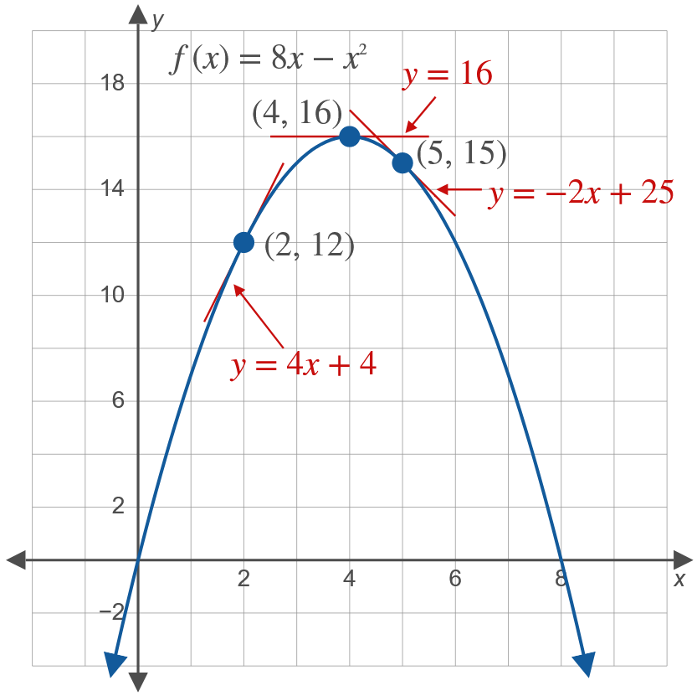
Example 3: Tangent Lines (cont.)

Slide 18
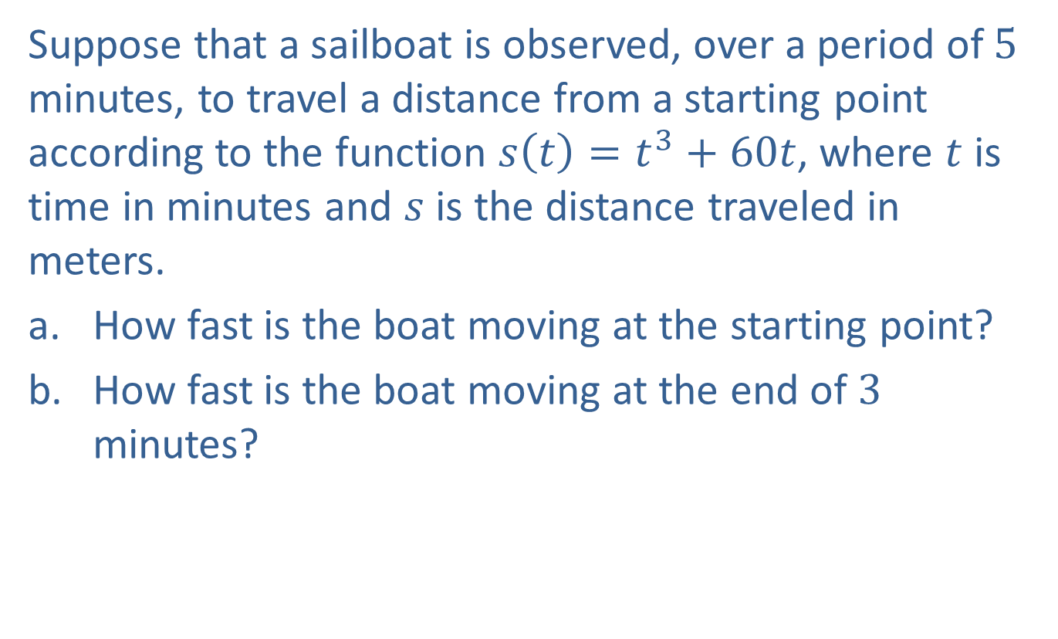
Example 4: Velocity
Suppose that a sailboat is observed, over a period of 5 minutes, to travel a distance from a starting point according to the function $s\left(t\right)=t^{3}+60t$, where $t$ is time in minutes and $s$ is the distance traveled in meters.
​How fast is the boat moving at the starting point?
​How fast is the boat moving at the end of 3 minutes?

Slide 19
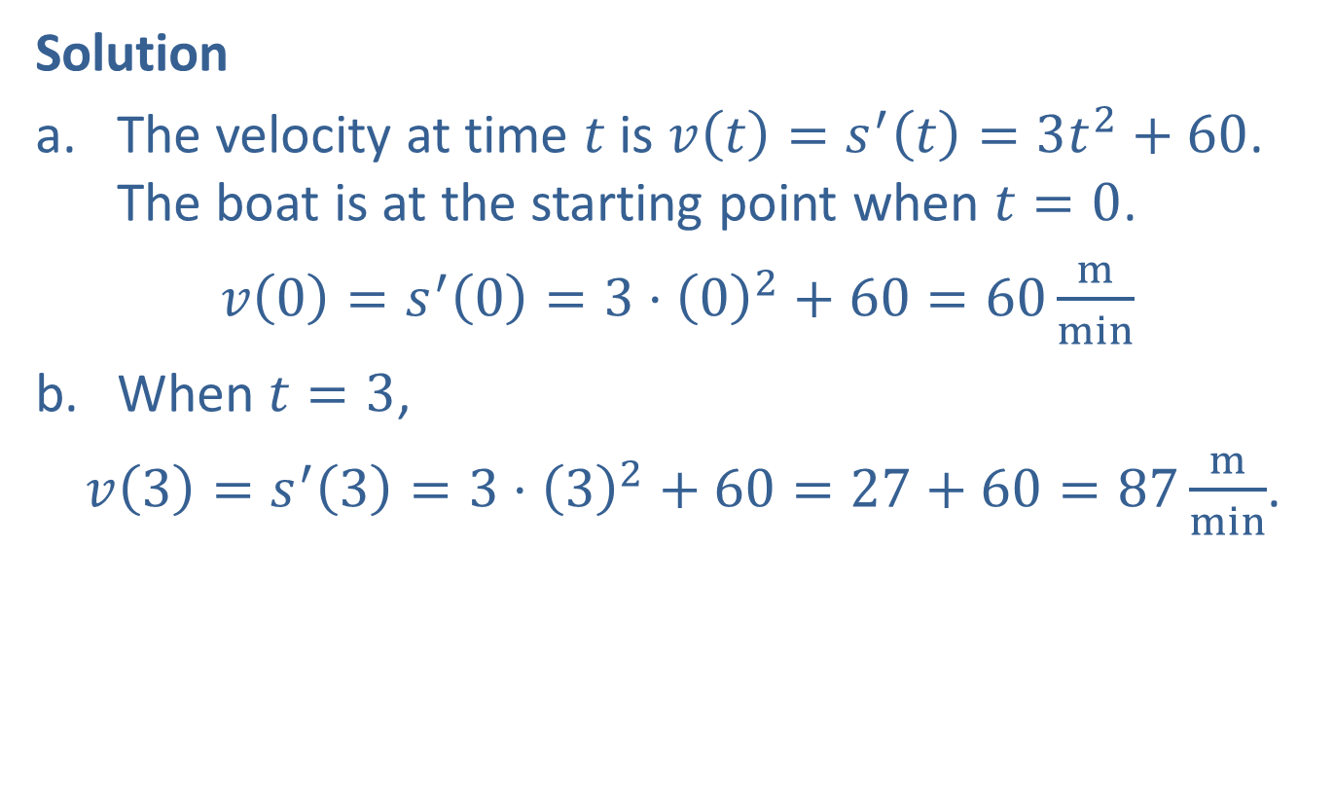
Example 4: Velocity (cont.)
Solution
​The velocity at time $t$ is $v\left(t\right)=s^{′}\left(t\right)=3t^{2}+60$. The boat is at the starting point when $t=0$.
​$v\left(0\right)=s^{′}\left(0\right)=3⋅{\left(0\right)}^{2}+60=60\frac{m}{min}$
​When $t=3$,
​ $v\left(3\right)=s^{′}\left(3\right)=3⋅{\left(3\right)}^{2}+60=27+60=87\frac{m}{min}$.

Slide 20
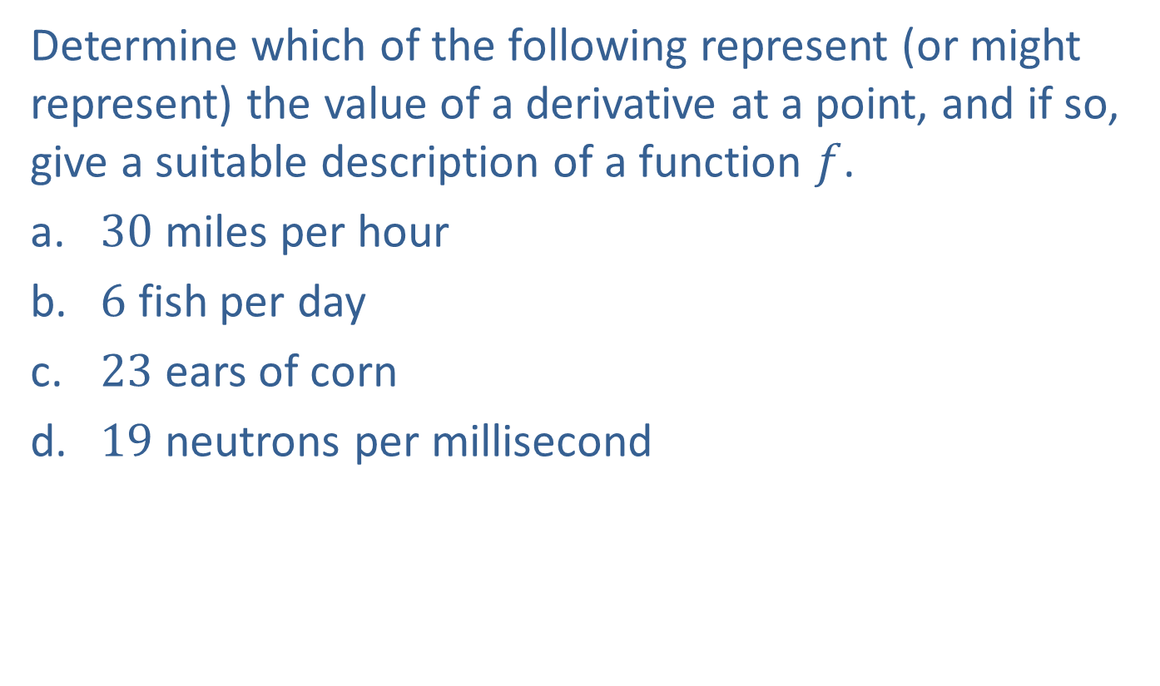
Example 5: Identifying Derivatives in Real Life
Determine which of the following represent (or might represent) the value of a derivative at a point, and if so, give a suitable description of a function $f$.
​30 miles per hour
​6 fish per day
​23 ears of corn
​19 neutrons per millisecond

Slide 21
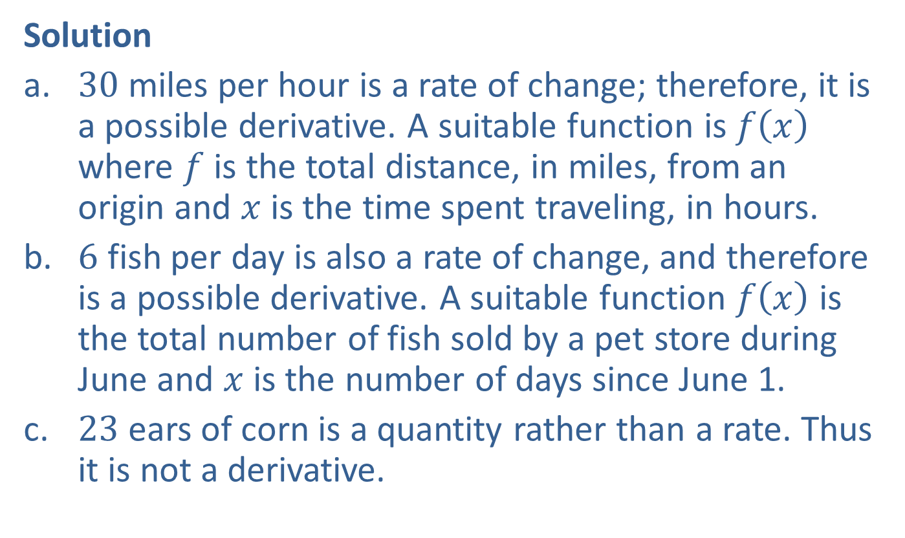
Example 5: Identifying Derivatives in Real Life (cont.)
Solution
​30 miles per hour is a rate of change; therefore, it is a possible derivative. A suitable function is $f⁡\left(x\right)$ where $f$ is the total distance, in miles, from an origin and $x$ is the time spent traveling, in hours.
​6 fish per day is also a rate of change, and therefore is a possible derivative. A suitable function $f⁡\left(x\right)$ is the total number of fish sold by a pet store during June and $x$ is the number of days since June 1.
​23 ears of corn is a quantity rather than a rate. Thus it is not a derivative.

Slide 22
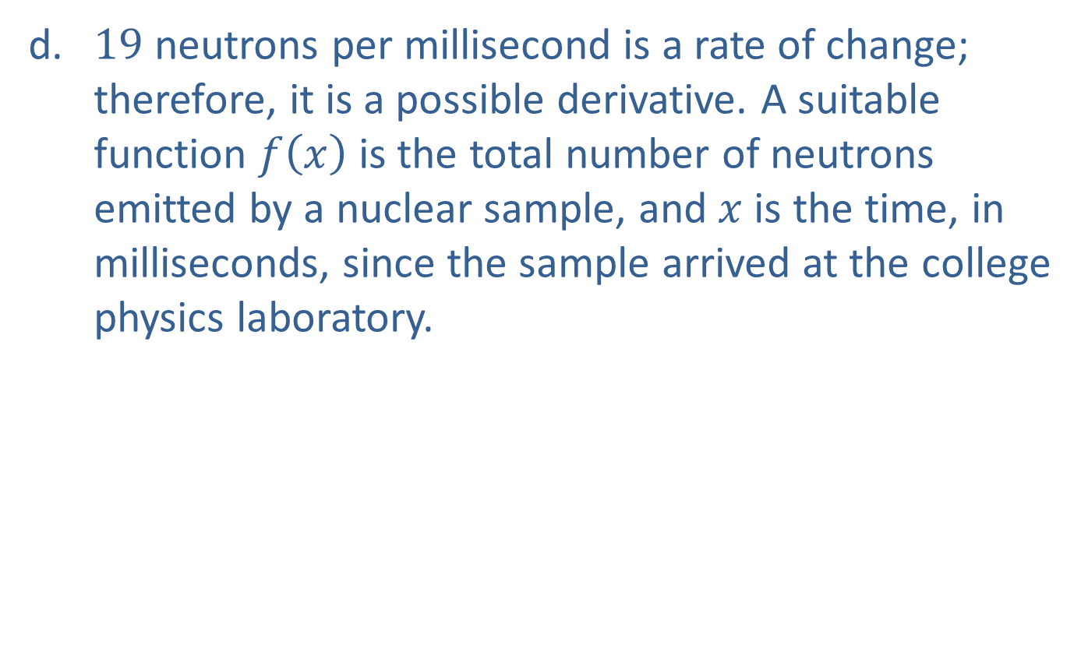
Example 5: Identifying Derivatives in Real Life (cont.)
​19 neutrons per millisecond is a rate of change; therefore, it is a possible derivative. A suitable function $f⁡\left(x\right)$ is the total number of neutrons emitted by a nuclear sample, and $x$ is the time, in milliseconds, since the sample arrived at the college physics laboratory.

