Slide 1
Section 3.1
The Product and Quotient Rules

Slide 2
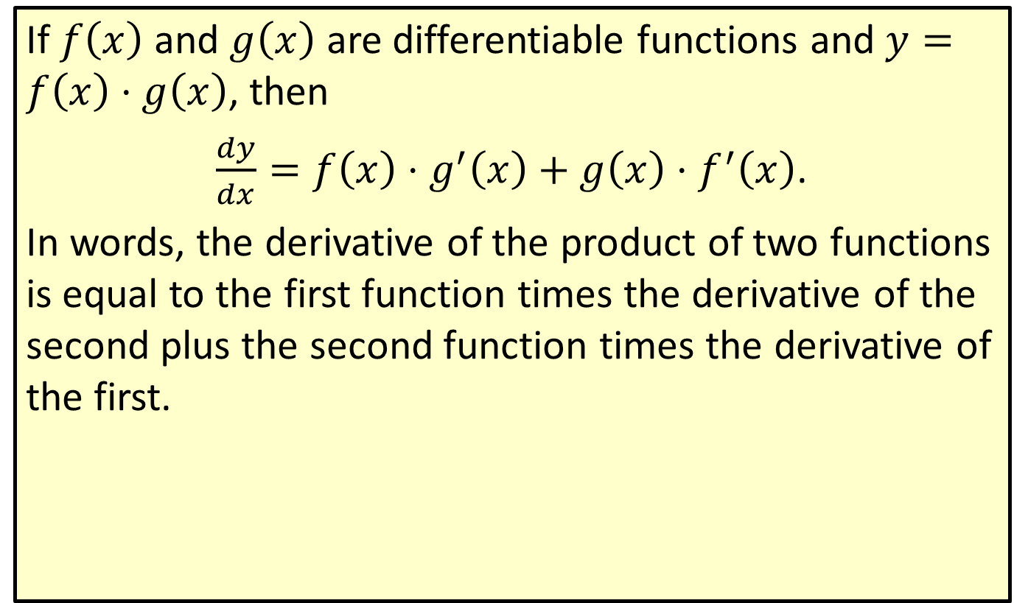
Product Rule
If $f⁡\left(x\right)$ and $g⁡\left(x\right)$ are differentiable functions and $y=f\left(x\right)⋅g\left(x\right)$, then
$\frac{dy}{dx}=f\left(x\right)⋅g^{′}\left(x\right)+g\left(x\right)⋅f^{′}\left(x\right)$.
In words, the derivative of the product of two functions is equal to the first function times the derivative of the second plus the second function times the derivative of the first.

Slide 3
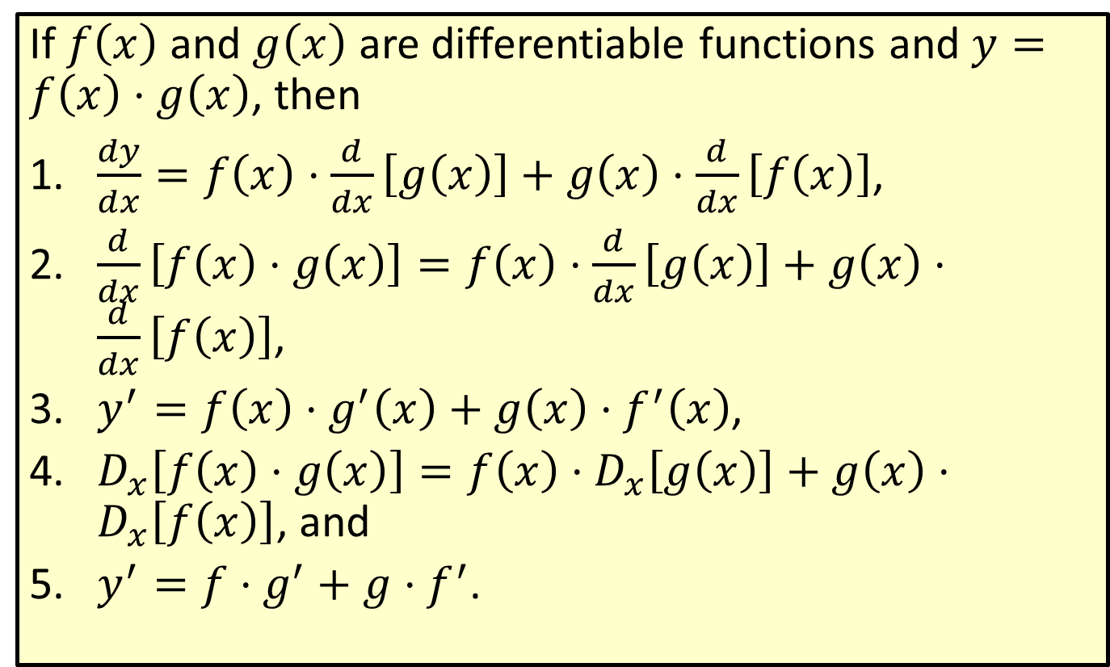
Other Forms of the Product Rule
If $f⁡\left(x\right)$ and $g⁡\left(x\right)$ are differentiable functions and $y=f\left(x\right)⋅g\left(x\right)$, then
​$\frac{dy}{dx}=f\left(x\right)⋅\frac{d}{dx}\left[g\left(x\right)\right]+g\left(x\right)⋅\frac{d}{dx}\left[f\left(x\right)\right]$,
​$\frac{d}{dx}\left[f\left(x\right)⋅g\left(x\right)\right]=f\left(x\right)⋅\frac{d}{dx}\left[g\left(x\right)\right]+g\left(x\right)⋅\frac{d}{dx}\left[f\left(x\right)\right]$,
​$y^{′}=f\left(x\right)⋅g^{′}\left(x\right)+g\left(x\right)⋅f^{′}\left(x\right)$,
​$D_{x}\left[f\left(x\right)⋅g\left(x\right)\right]=f\left(x\right)⋅D_{x}\left[g\left(x\right)\right]+g\left(x\right)⋅D_{x}\left[f\left(x\right)\right]$, and
​$y^{′}=f⋅g^{′}+g⋅f^{′}$.

Slide 4

Example 1: Using the Product Rule
Use the Product Rule to find $\frac{dy}{dx}$ given $y=\left(x^{2}+3x−1\right)\left(x^{3}−8x\right)$.

Slide 5
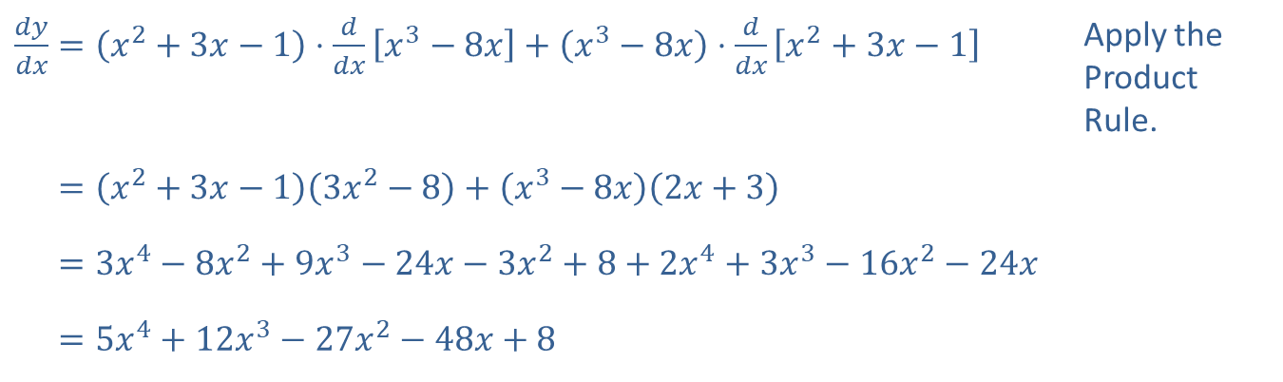
Example 1: Using the Product Rule (cont.)
Solution
​$\frac{dy}{dx}=\left(x^{2}+3x−1\right)⋅\frac{d}{dx}\left[x^{3}−8x\right]+\left(x^{3}−8x\right)⋅\frac{d}{dx}\left[x^{2}+3x−1\right]$ | Apply the Product Rule.
​𝑑𝑦𝑑𝑥=𝑥2+3𝑥−13𝑥2−8+𝑥3−8𝑥2𝑥+3
​𝑑𝑦𝑑𝑥=3𝑥4−8𝑥2+9𝑥3−24𝑥−3𝑥2+8+2𝑥4+3𝑥3−16𝑥2−24𝑥
​𝑑𝑦𝑑𝑥=5𝑥4+12𝑥3−27𝑥2−48𝑥+8

Slide 6
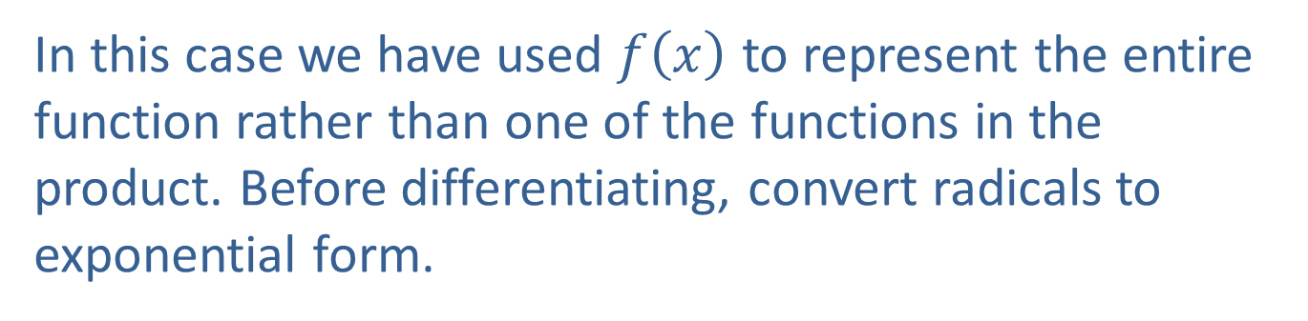

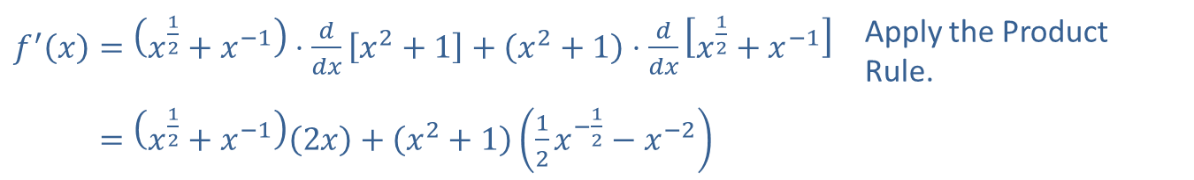
Example 2: Using the Product Rule
Use the Product Rule to find the derivative of the function $f\left(x\right)=\left(\sqrt{x}+x^{−1}\right)\left(x^{2}+1\right)$.
Solution
In this case we have used $f⁡\left(x\right)$ to represent the entire function rather than one of the functions in the product. Before differentiating, convert radicals to exponential form.
​$f^{′}\left(x\right)=\left(x^{\frac{1}{2}}+x^{−1}\right)⋅\frac{d}{dx}\left[x^{2}+1\right]+\left(x^{2}+1\right)⋅\frac{d}{dx}\left[x^{\frac{1}{2}}+x^{−1}\right]$ | Apply the Product Rule.
​𝑓′⁡𝑥=𝑥12+𝑥−12𝑥+𝑥2+112𝑥−12−𝑥−2

Slide 7
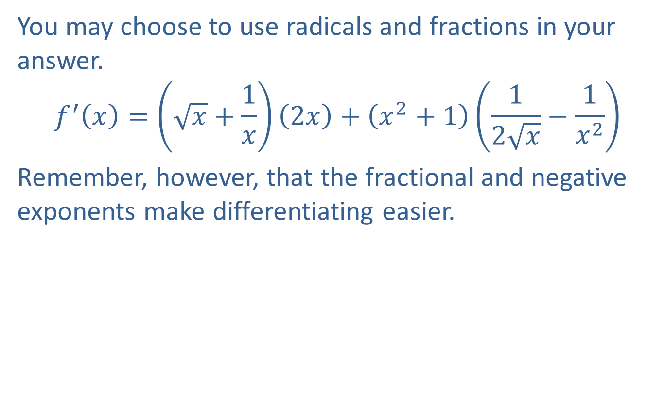
Example 2: Using the Product Rule (cont.)
You may choose to use radicals and fractions in your answer.
$$f^{′}\left(x\right)=\left(\sqrt{x}+\frac{1}{x}\right)\left(2x\right)+\left(x^{2}+1\right)\left(\frac{1}{2\sqrt{x}}−\frac{1}{x^{2}}\right)$$
Remember, however, that the fractional and negative exponents make differentiating easier.

Slide 8
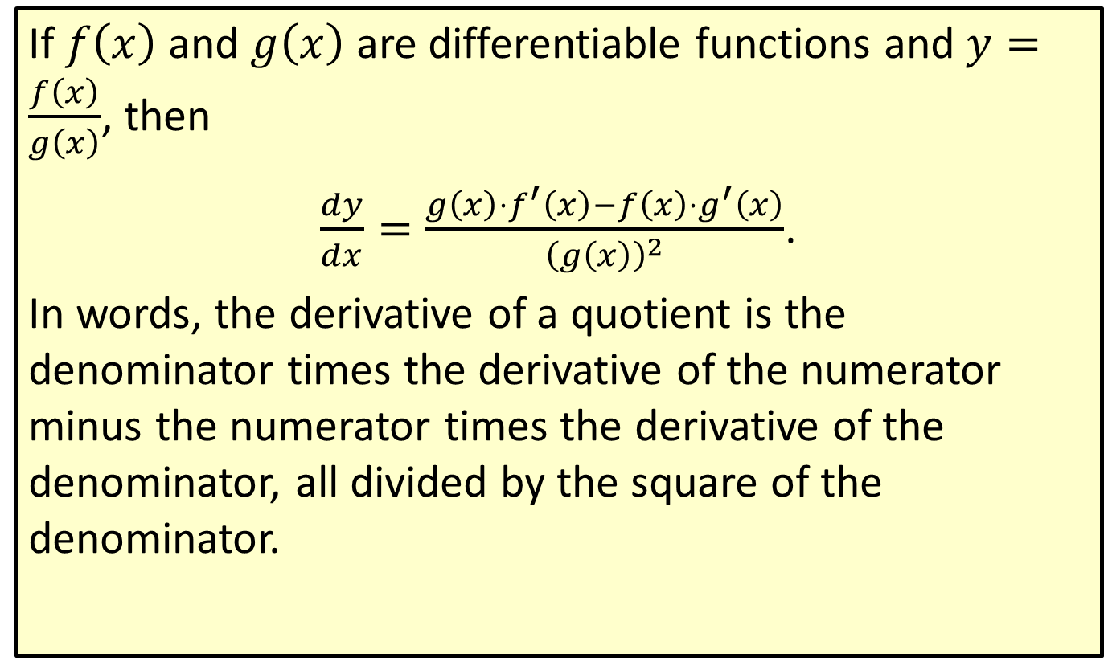
Quotient Rule
If $f⁡\left(x\right)$ and $g⁡\left(x\right)$ are differentiable functions and $y=\frac{f\left(x\right)}{g\left(x\right)}$, then
$\frac{dy}{dx}=\frac{g\left(x\right)⋅f^{′}\left(x\right)−f\left(x\right)⋅g^{′}\left(x\right)}{{\left(g\left(x\right)\right)}^{2}}$.
In words, the derivative of a quotient is the denominator times the derivative of the numerator minus the numerator times the derivative of the denominator, all divided by the square of the denominator.

Slide 9

Example 3: Using the Quotient Rule
Use the Quotient Rule to find the derivative of the function $y=\frac{x^{2}}{5x+1}$.

Slide 10
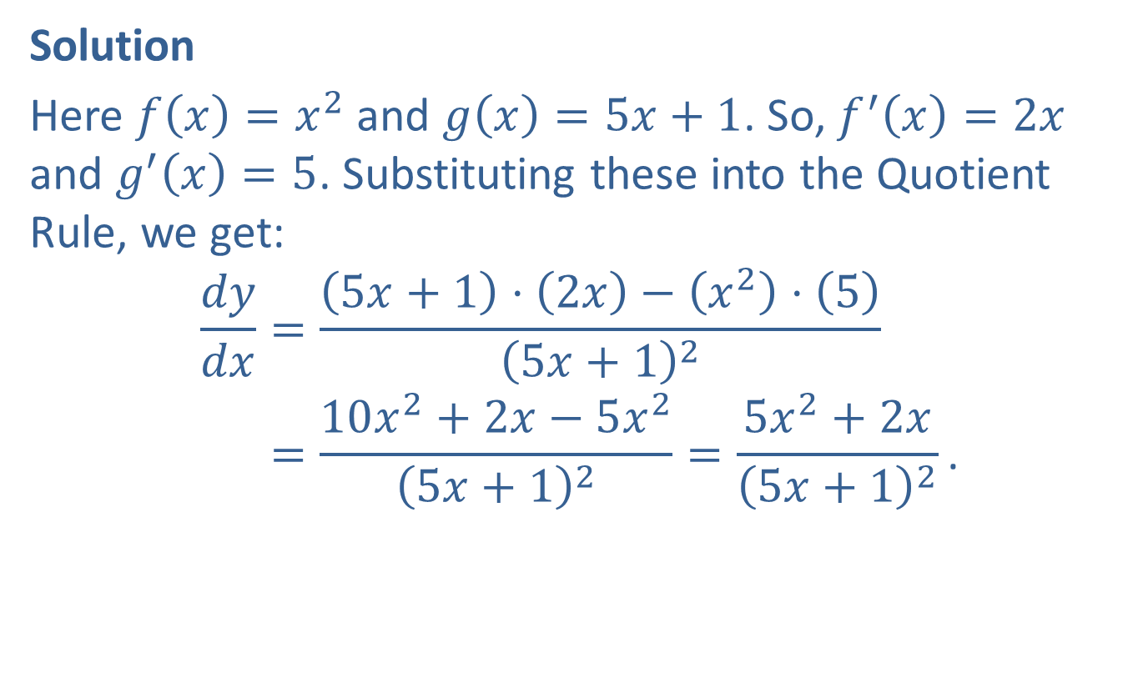
Example 3: Using the Quotient Rule (cont.)
Solution
Here $f\left(x\right)=x^{2}$ and $g\left(x\right)=5x+1$. So, $f^{′}\left(x\right)=2x$ and $g^{′}\left(x\right)=5$. Substituting these into the Quotient Rule, we get:
𝑑𝑦𝑑𝑥=5𝑥+1⋅2𝑥−𝑥2⋅55𝑥+12𝑑𝑦𝑑𝑥=10𝑥2+2𝑥−5𝑥25𝑥+12=5𝑥2+2𝑥5𝑥+12.

Slide 11
CAUTION!
Because of the minus sign in the Quotient Rule, the order of terms in the numerator is critical.

Slide 12
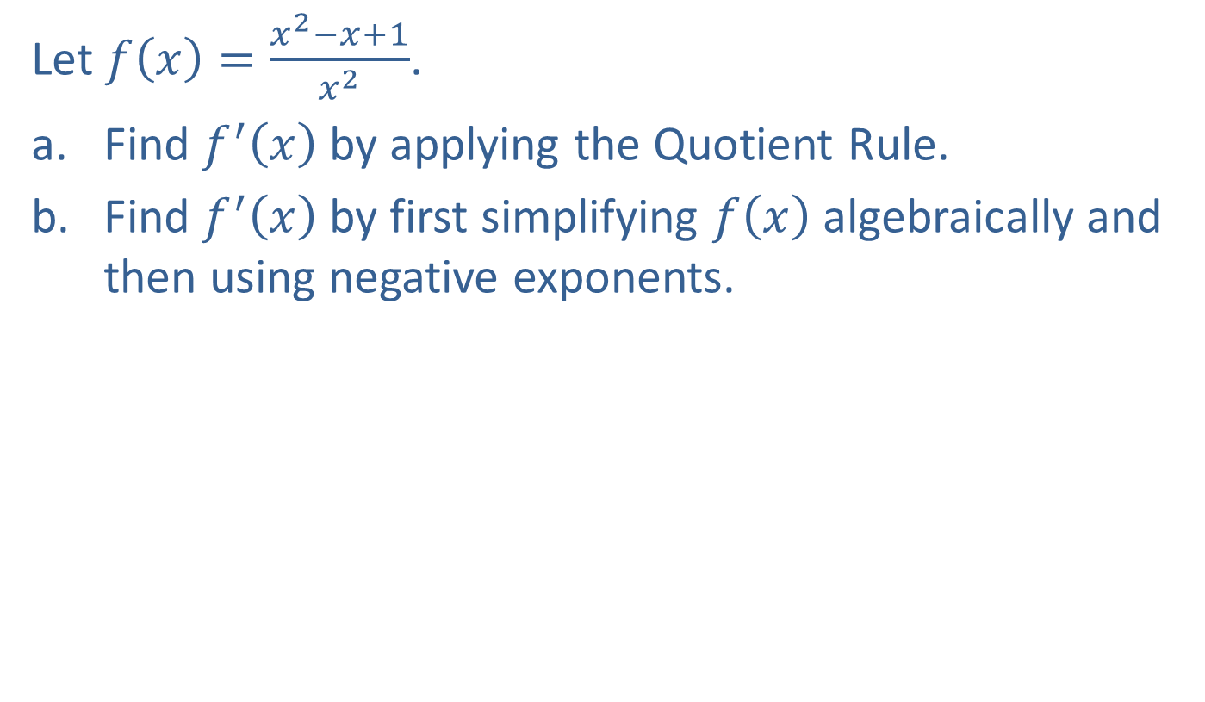
Example 4: Using the Quotient Rule
Let $f\left(x\right)=\frac{x^{2}−x+1}{x^{2}}$.
​Find $f^{′}⁡\left(x\right)$ by applying the Quotient Rule.
​Find $f^{′}⁡\left(x\right)$ by first simplifying $f⁡\left(x\right)$ algebraically and then using negative exponents.

Slide 13

Example 4: Using the Quotient Rule (cont.)
Solution
​Here $f⁡\left(x\right)$ represents the entire quotient. In this case, we can think of the statement of the Quotient Rule in terms of numerator and denominator rather than in terms of $f⁡\left(x\right)$ and $g⁡\left(x\right)$.
​

Slide 14
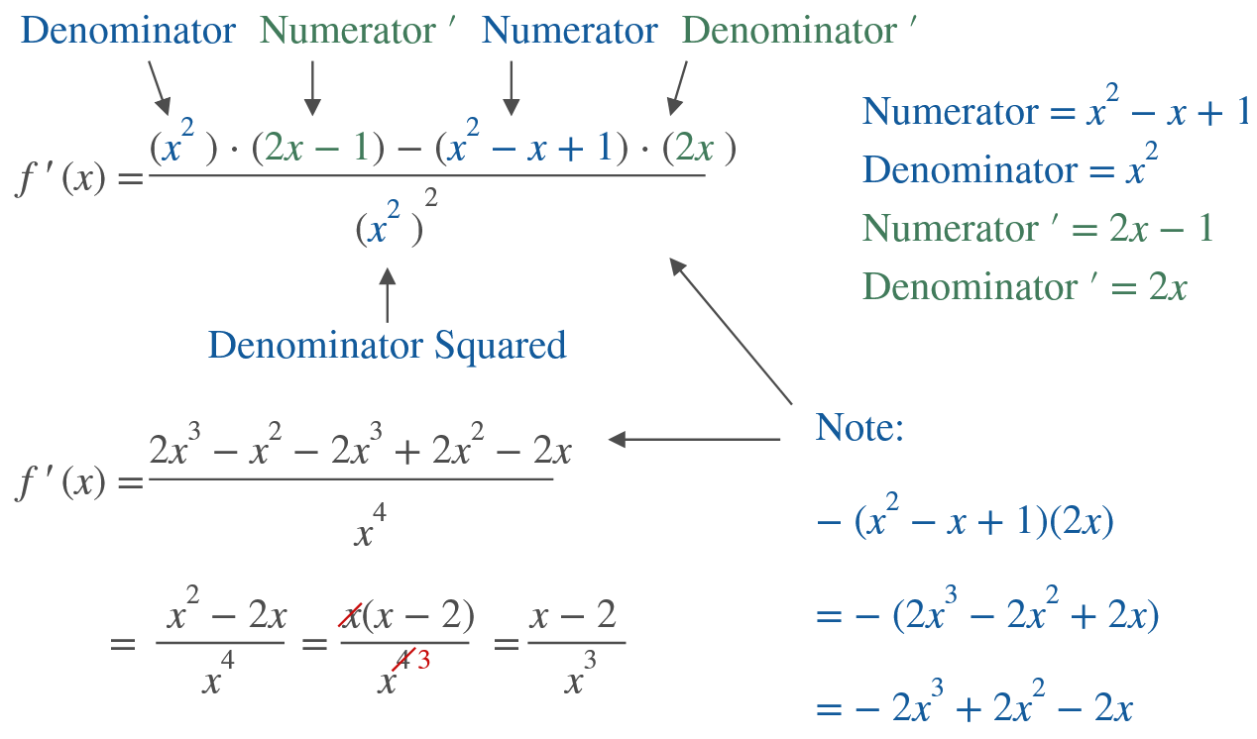
Example 4: Using the Quotient Rule (cont.)

Slide 15
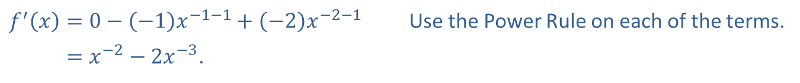
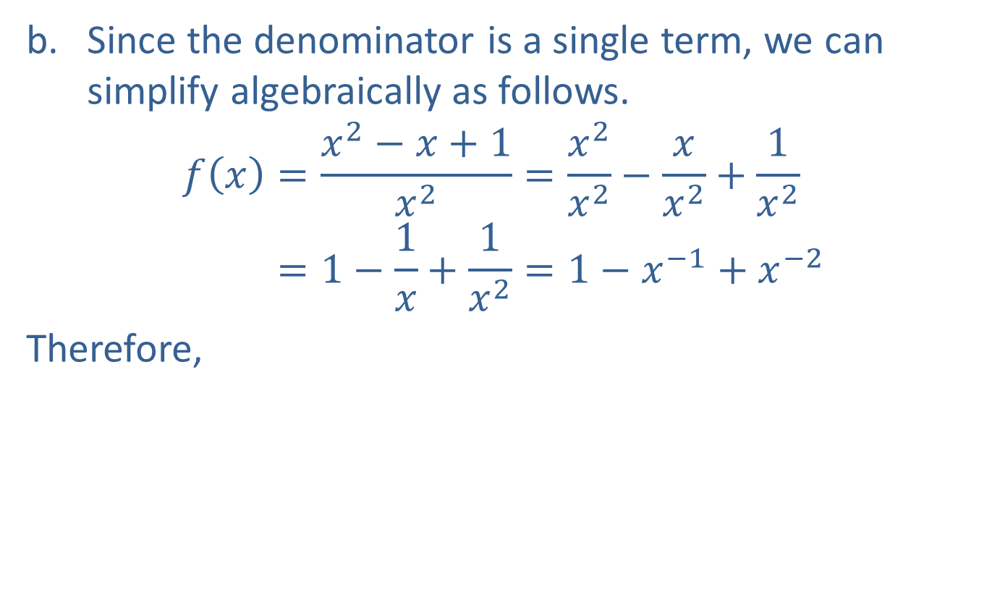
Example 4: Using the Quotient Rule (cont.)
​Since the denominator is a single term, we can simplify algebraically as follows.
𝑓𝑥=𝑥2−𝑥+1𝑥2=𝑥2𝑥2−𝑥𝑥2+1𝑥2𝑓⁡𝑥=1−1𝑥+1𝑥2=1−𝑥−1+𝑥−2
​Therefore,
​
​$f^{′}\left(x\right)=0−\left(−1\right)x^{−1−1}+\left(−2\right)x^{−2−1}$ | Use the Power Rule on each of the terms.
​𝑓′⁡𝑥=𝑥−2−2𝑥−3.

Slide 16

Example 4: Using the Quotient Rule (cont.)
Note that the answers in parts a. and b. are different forms of the same answer.
$$x^{−2}−2x^{−3}=\frac{1}{x^{2}}−\frac{2}{x^{3}}=\frac{x−2}{x^{3}}$$

Slide 17

Example 5: Growth of Bacteria
Several years of study have shown that $t$ hours after a bacterium is introduced to a particular culture, the number of bacteria is given by $N\left(t\right)=\frac{t^{2}+t}{\sqrt{t}+1}$. Find the rate of growth of the bacteria after 4 hours.

Slide 18
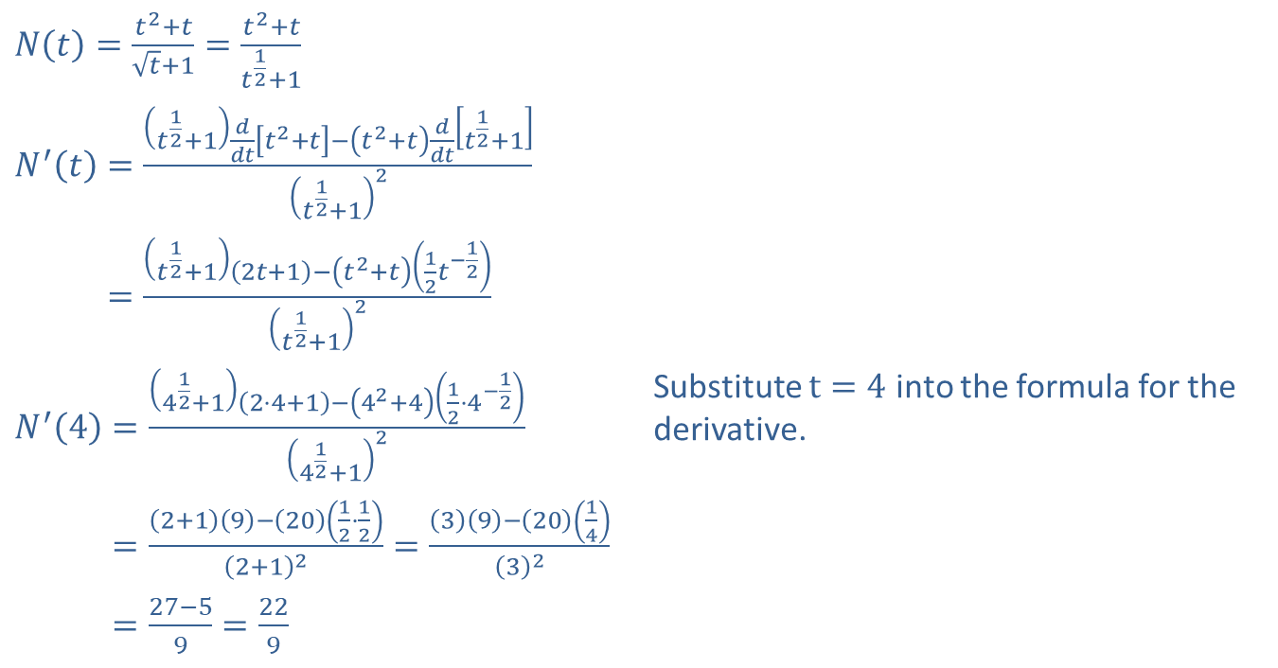
Example 5: Growth of Bacteria (cont.)
Solution
​$N\left(t\right)=\frac{t^{2}+t}{\sqrt{t}+1}=\frac{t^{2}+t}{t^{\frac{1}{2}}+1}$
​$N^{′}\left(t\right)=\frac{\left(t^{\frac{1}{2}}+1\right)\frac{d}{dt}\left[t^{2}+t\right]−\left(t^{2}+t\right)\frac{d}{dt}\left[t^{\frac{1}{2}}+1\right]}{{\left(t^{\frac{1}{2}}+1\right)}^{2}}$
​𝑁′⁡𝑡=𝑡12+12𝑡+1−𝑡2+𝑡12𝑡−12𝑡12+12
​$N^{′}\left(4\right)=\frac{\left(4^{\frac{1}{2}}+1\right)\left(2⋅4+1\right)−\left(4^{2}+4\right)\left(\frac{1}{2}⋅4^{−\frac{1}{2}}\right)}{{\left(4^{\frac{1}{2}}+1\right)}^{2}}$ | Substitute $t=4$ into the formula for the derivative.
​𝑁′⁡4=2+19−2012⋅122+12=39−201432
​𝑁′⁡4=27−59=229

Slide 19
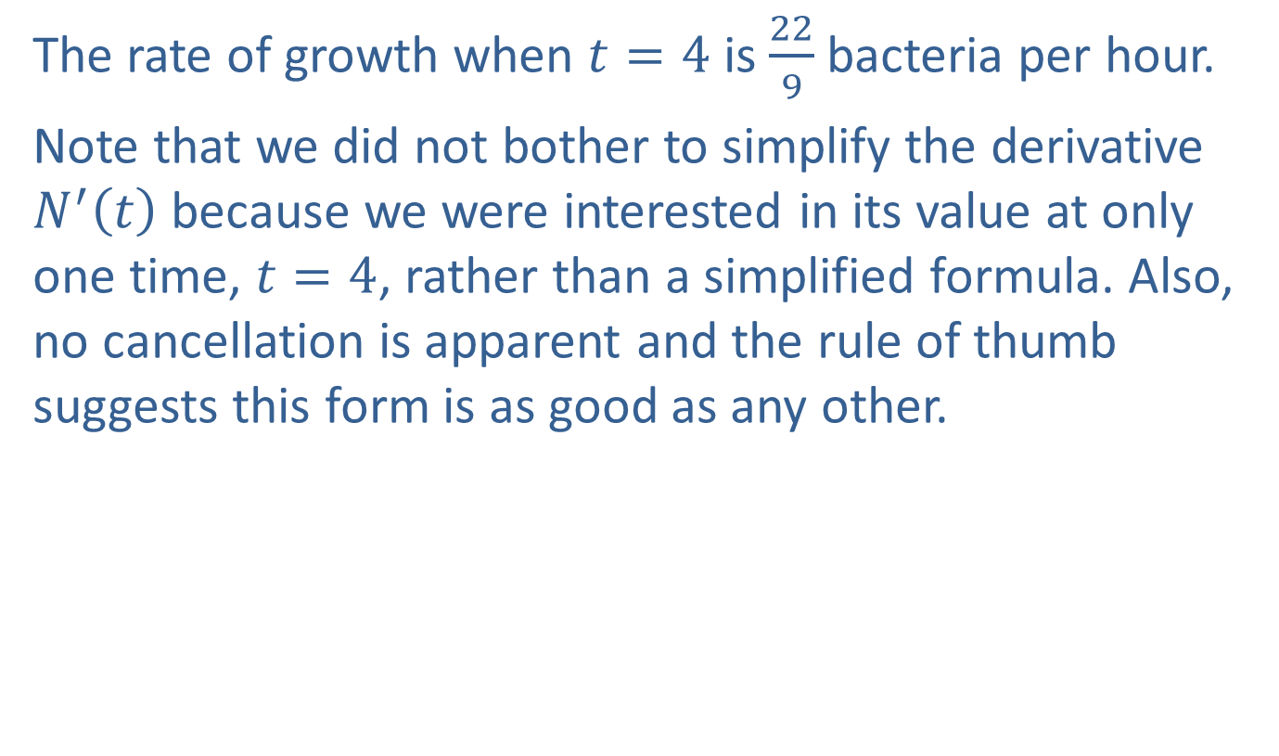
Example 5: Growth of Bacteria (cont.)
The rate of growth when $t=4$ is $\frac{22}{9}$ bacteria per hour.
Note that we did not bother to simplify the derivative $N^{′}⁡\left(t\right)$ because we were interested in its value at only one time, $t=4$, rather than a simplified formula. Also, no cancellation is apparent and the rule of thumb suggests this form is as good as any other.

Slide 20
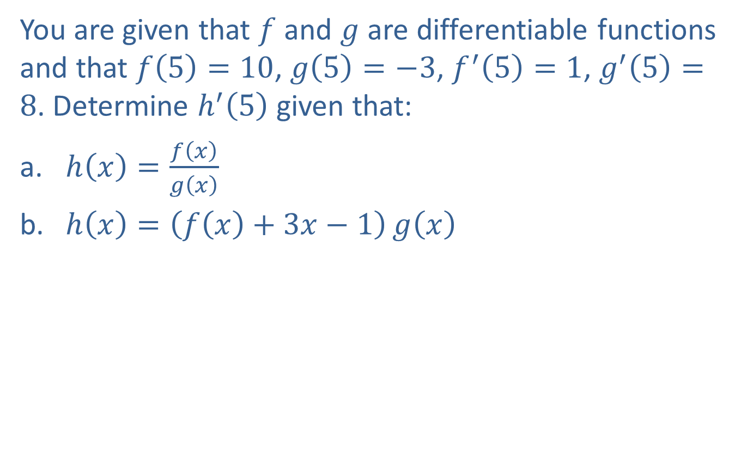
Example 6: Elementary Operations on Functions
You are given that $f$ and $g$ are differentiable functions and that $f\left(5\right)=10$, $g\left(5\right)=−3$, $f^{′}\left(5\right)=1$, $g^{′}\left(5\right)=8$. Determine $h^{′}⁡\left(5\right)$ given that:
​$h\left(x\right)=\frac{f\left(x\right)}{g\left(x\right)}$
​$h\left(x\right)=\left(f\left(x\right)+3x−1\right)g\left(x\right)$

Slide 21
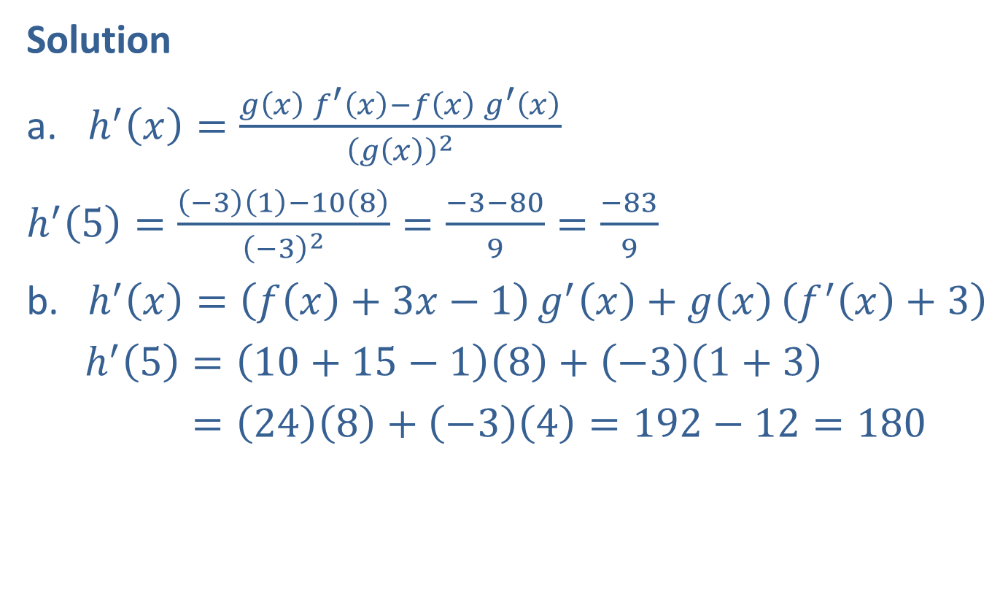
Example 6: Elementary Operations on Functions (cont.)
Solution
​$h^{′}\left(x\right)=\frac{g\left(x\right)f^{′}\left(x\right)−f\left(x\right)g^{′}\left(x\right)}{{\left(g\left(x\right)\right)}^{2}}$
​$h^{′}\left(5\right)=\frac{\left(−3\right)\left(1\right)−10\left(8\right)}{{\left(−3\right)}^{2}}=\frac{−3−80}{9}=\frac{−83}{9}$
​$h^{′}\left(x\right)=\left(f\left(x\right)+3x−1\right)g^{′}\left(x\right)+g\left(x\right)\left(f^{′}\left(x\right)+3\right)$
​ $h^{′}\left(5\right)=\left(10+15−1\right)\left(8\right)+\left(−3\right)\left(1+3\right)$
​ h′⁡5=248+−34=192−12=180

Slide 22
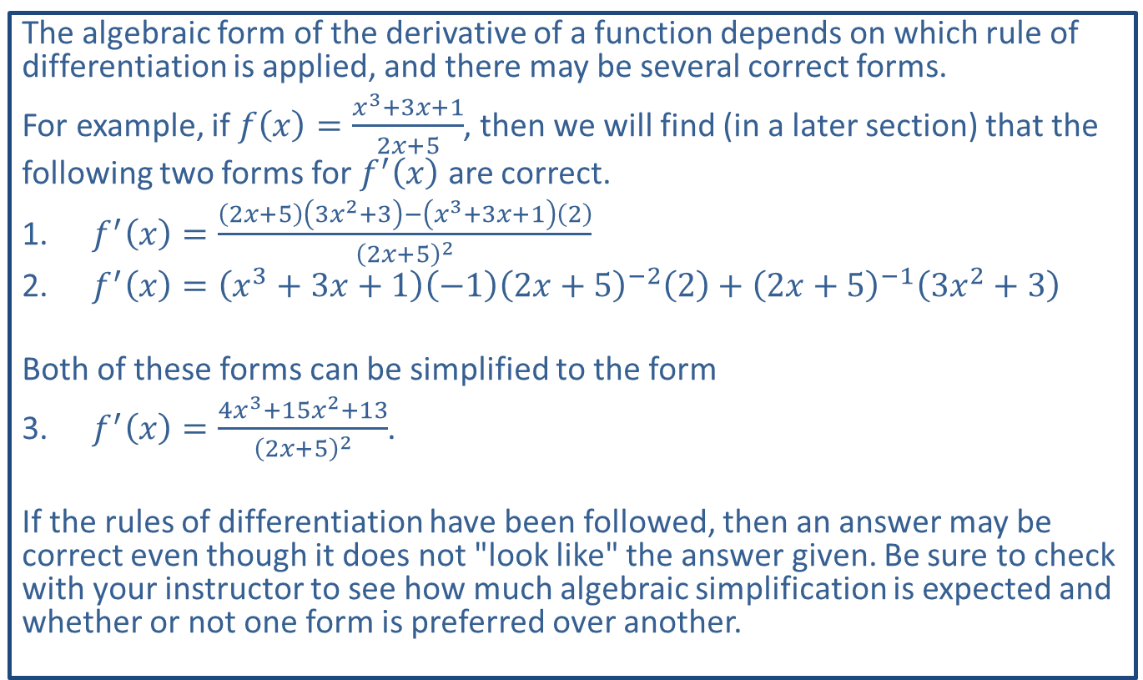
CAUTION!
The algebraic form of the derivative of a function depends on which rule of differentiation is applied, and there may be several correct forms.
For example, if $f\left(x\right)=\frac{x^{3}+3x+1}{2x+5}$, then we will find (in a later section) that the
following two forms for $f^{′}⁡\left(x\right)$ are correct.
​$f^{′}\left(x\right)=\frac{\left(2x+5\right)\left(3x^{2}+3\right)−\left(x^{3}+3x+1\right)\left(2\right)}{{\left(2x+5\right)}^{2}}$
​$f^{′}\left(x\right)=\left(x^{3}+3x+1\right)\left(−1\right){\left(2x+5\right)}^{−2}\left(2\right)+{\left(2x+5\right)}^{−1}\left(3x^{2}+3\right)$
Both of these forms can be simplified to the form
​$f^{′}\left(x\right)=\frac{4x^{3}+15x^{2}+13}{{\left(2x+5\right)}^{2}}$.
If the rules of differentiation have been followed, then an answer may be correct even though it does not "look like" the answer given. Be sure to check with your instructor to see how much algebraic simplification is expected and whether or not one form is preferred over another.

