Slide 1
Section 3.2
The Chain Rule and the General Power Rule

Slide 2
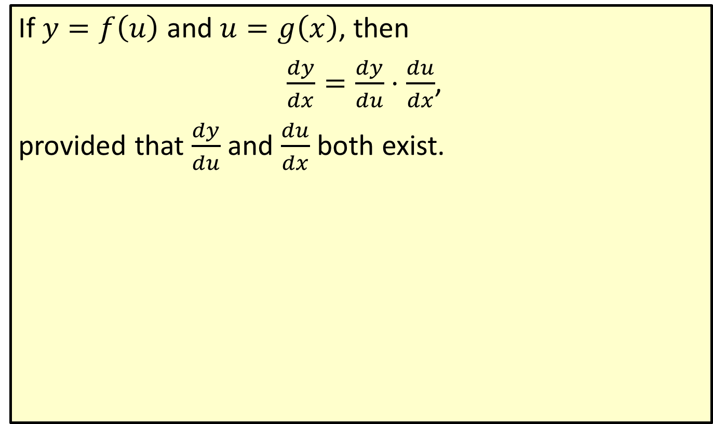
The Chain Rule
If $y=f\left(u\right)$ and $u=g\left(x\right)$, then
$\frac{dy}{dx}=\frac{dy}{du}⋅\frac{du}{dx}$,
provided that $\frac{dy}{du}$ and $\frac{du}{dx}$ both exist.

Slide 3

Example 1: Using the Chain Rule
Suppose that $y=u+\sqrt{u}$ and $u=x^{3}+17$. Use the Chain Rule to find $\frac{dy}{dx}$. Then evaluate $\frac{dy}{dx}$ at $x=2$. This evaluation is denoted more briefly by ${\frac{dy}{dx}|}_{x=2}$.

Slide 4
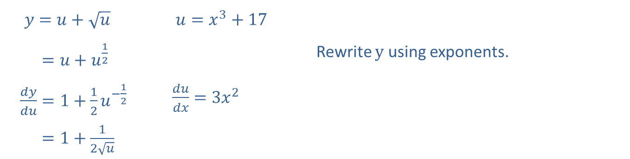
Example 1: Using the Chain Rule (cont.)
Solution
​𝑑𝑦𝑑𝑢𝑦=𝑢+𝑢 | ​𝑑𝑢𝑑𝑥𝑢=𝑥3+17
​𝑑𝑦𝑑𝑢𝑦=𝑢+𝑢12 |  | Rewrite $y$ using exponents.
​𝑦𝑑𝑦𝑑𝑢=1+12𝑢−12 | ​𝑢𝑑𝑢𝑑𝑥=3𝑥2
​𝑑𝑦𝑑𝑢𝑦=1+12𝑢

Slide 5
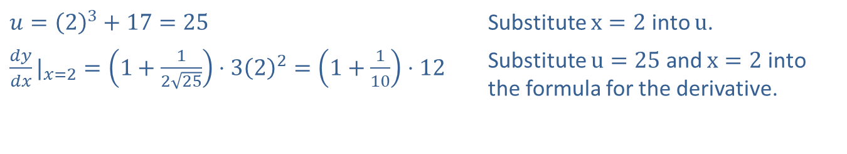
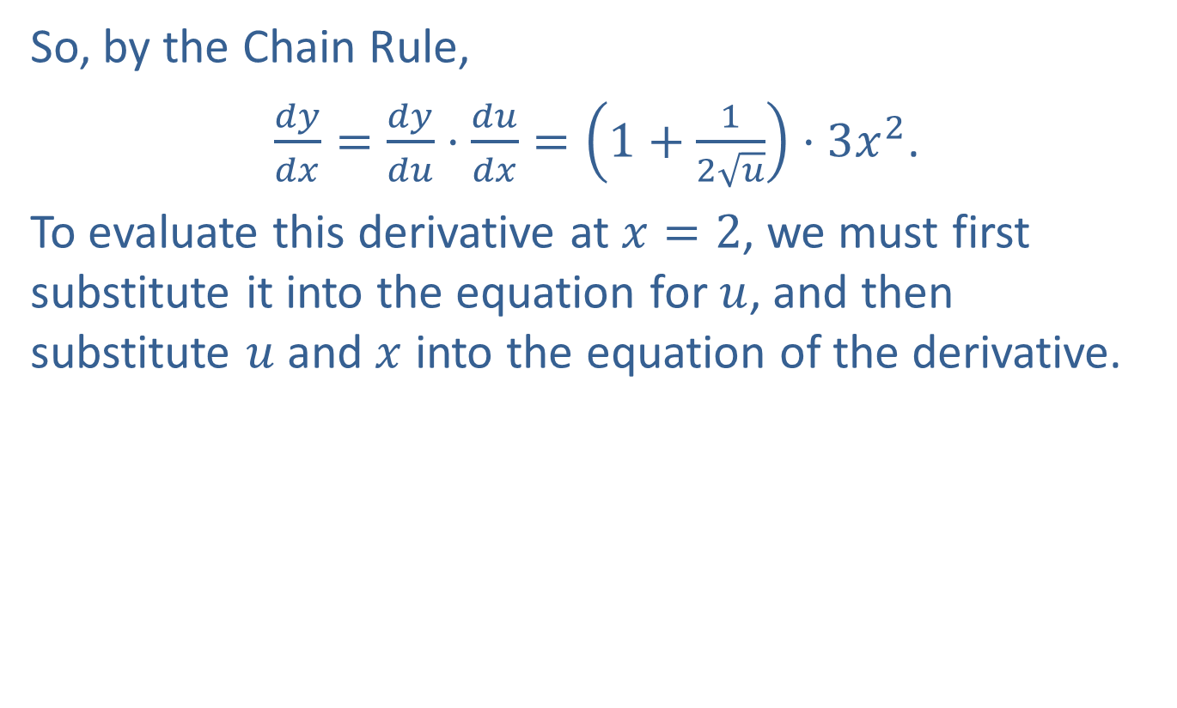
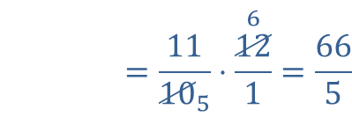
Example 1: Using the Chain Rule (cont.)
So, by the Chain Rule,
$\frac{dy}{dx}=\frac{dy}{du}⋅\frac{du}{dx}=\left(1+\frac{1}{2\sqrt{u}}\right)⋅3x^{2}$.
To evaluate this derivative at $x=2$, we must first substitute it into the equation for $u$, and then substitute $u$ and $x$ into the equation of the derivative.
​$u={\left(2\right)}^{3}+17=25$ | Substitute $x=2$ into $u$.
​${\frac{dy}{dx}|}_{x=2}=\left(1+\frac{1}{2\sqrt{25}}\right)⋅3{\left(2\right)}^{2}=\left(1+\frac{1}{10}\right)⋅12$ | Substitute $u=25$ and $x=2$ into the formula for the derivative.
​
𝑑𝑦𝑑𝑥|𝑥=2=11105⋅1261=665

Slide 6
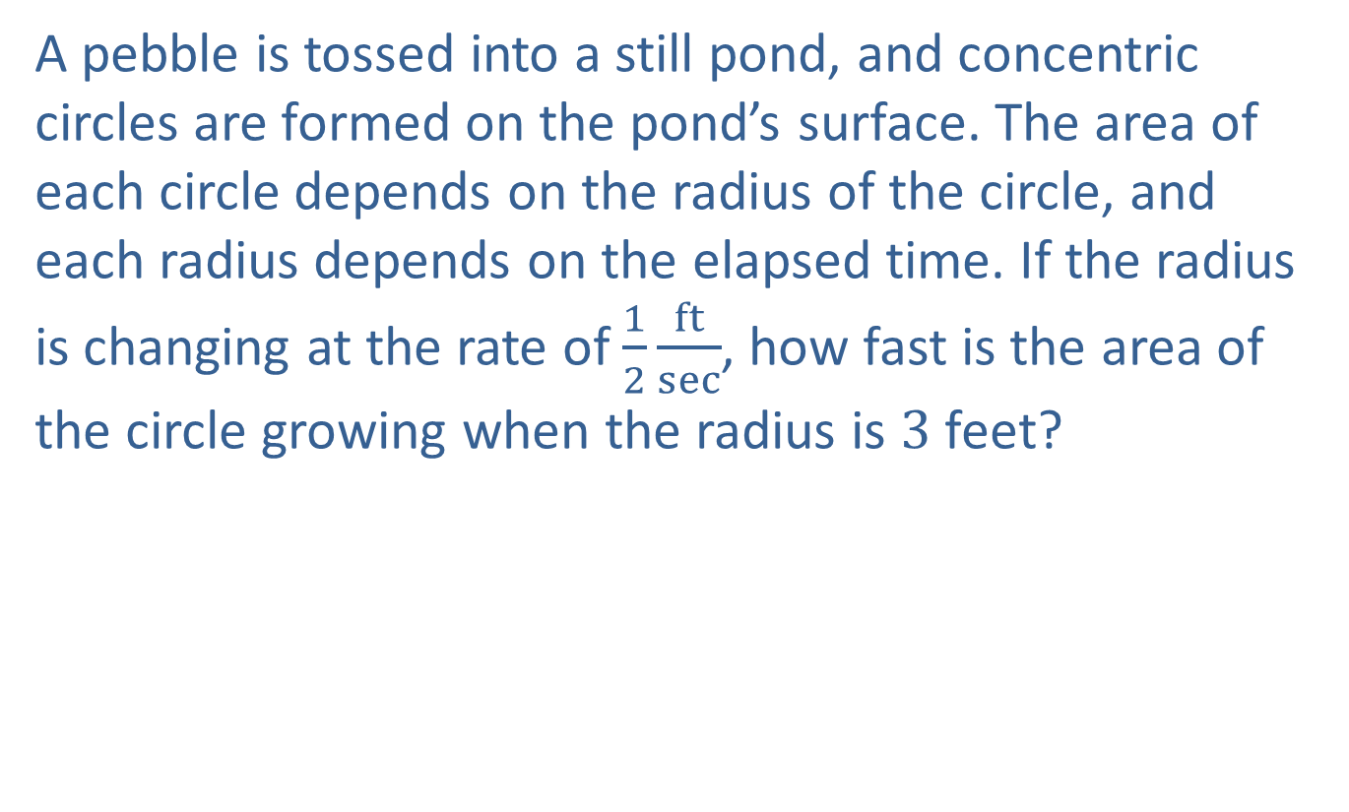
Example 2: Ripples on a Pond
A pebble is tossed into a still pond, and concentric circles are formed on the pond’s surface. The area of each circle depends on the radius of the circle, and each radius depends on the elapsed time. If the radius is changing at the rate of $\frac{1}{2}\frac{ft}{sec}$, how fast is the area of the circle growing when the radius is 3 feet?

Slide 7
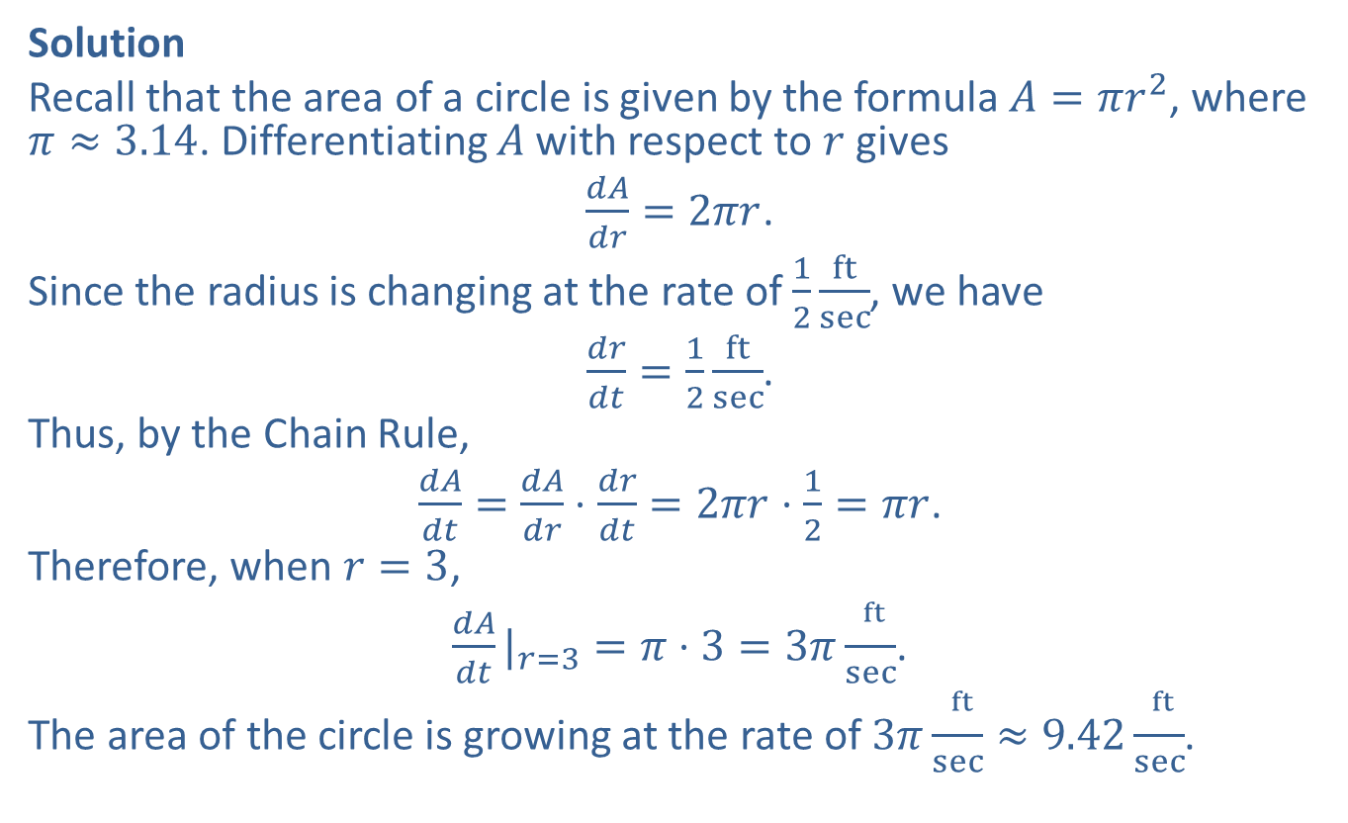
Example 2: Ripples on a Pond (cont.)
Solution
Recall that the area of a circle is given by the formula $A=πr^{2}$, where $π≈3.14$. Differentiating $A$ with respect to $r$ gives
$\frac{dA}{dr}=2πr$.
Since the radius is changing at the rate of $\frac{1}{2}\frac{ft}{sec}$, we have
$\frac{dr}{dt}=\frac{1}{2}\frac{ft}{sec}$.
Thus, by the Chain Rule,
$\frac{dA}{dt}=\frac{dA}{dr}⋅\frac{dr}{dt}=2πr⋅\frac{1}{2}=πr$.
Therefore, when $r=3$,
${\frac{dA}{dt}|}_{r=3}=π⋅3=3π\frac{ ^{ft}}{sec}$.
The area of the circle is growing at the rate of $3π\frac{ ^{ft}}{sec}≈9.42\frac{ ^{ft}}{sec}$.

Slide 8
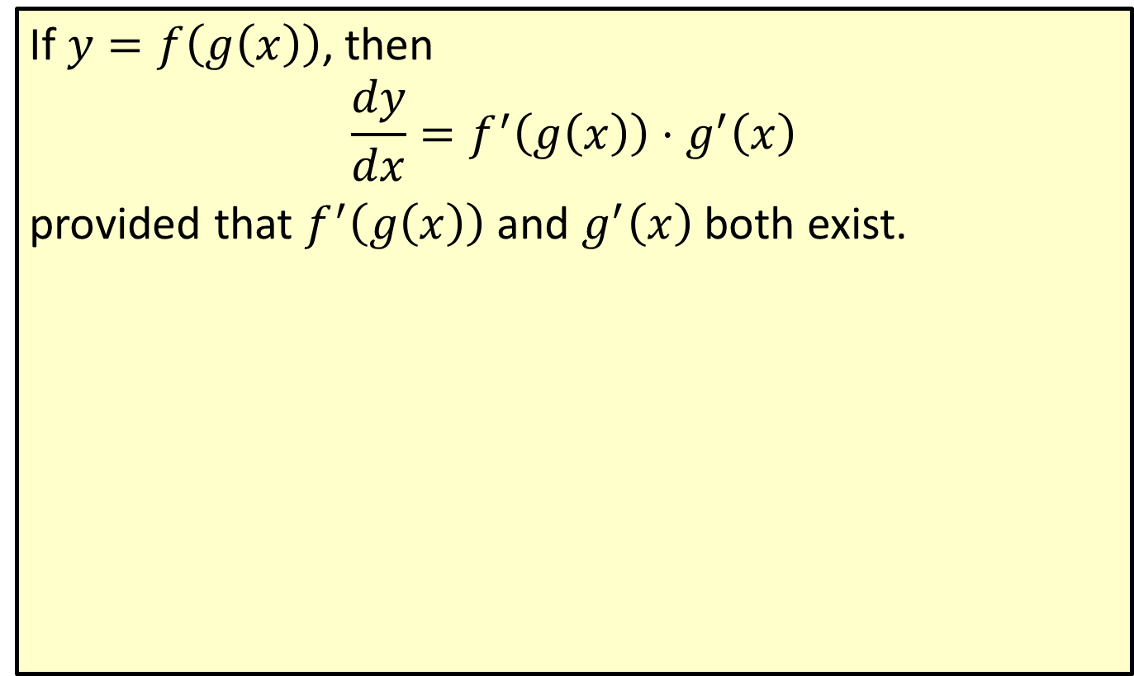
The Chain Rule (Second Form)
If $y=f\left(g\left(x\right)\right)$, then
$$\frac{dy}{dx}=f^{′}\left(g\left(x\right)\right)⋅g^{′}\left(x\right)$$
provided that $f^{′}⁡\left(g\left(x\right)\right)$ and $g^{′}⁡\left(x\right)$ both exist.

Slide 9

Example 3: Second Form of the Chain Rule
Use the second form of the Chain Rule to find $\frac{dy}{dx}$ if $y={\left(x^{2}+3x−7\right)}^{\frac{5}{2}}$.

Slide 10
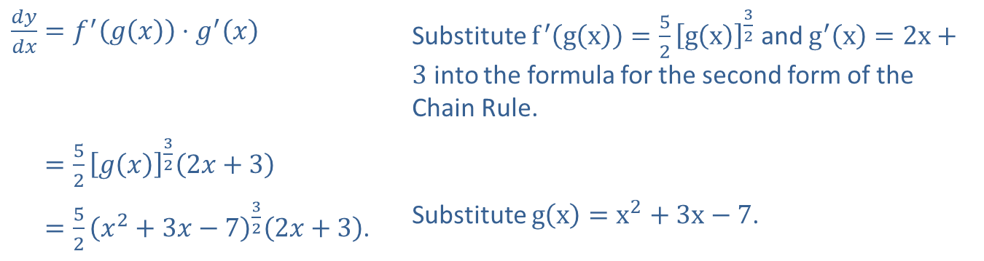

Example 3: Second Form of the Chain Rule (cont.)
Solution
Let $g\left(x\right)=x^{2}+3x−7$. Then we can write
$y=f\left(g\left(x\right)\right)={\left[g\left(x\right)\right]}^{\frac{5}{2}}$.
Using the second form of the Chain Rule, we get
​$\frac{dy}{dx}=f^{′}⁡\left(g\left(x\right)\right)⋅g^{′}⁡\left(x\right)$ | Substitute $f^{′}\left(g\left(x\right)\right)=\frac{5}{2}{\left[g\left(x\right)\right]}^{\frac{3}{2}}$ and $g^{′}\left(x\right)=2x+3$ into the formula for the second form of the Chain Rule.
​𝑑𝑦𝑑𝑥=52𝑔𝑥322𝑥+3
​𝑑𝑦𝑑𝑥=52𝑥2+3𝑥−7322𝑥+3. | Substitute $g\left(x\right)=x^{2}+3x−7$.

Slide 11
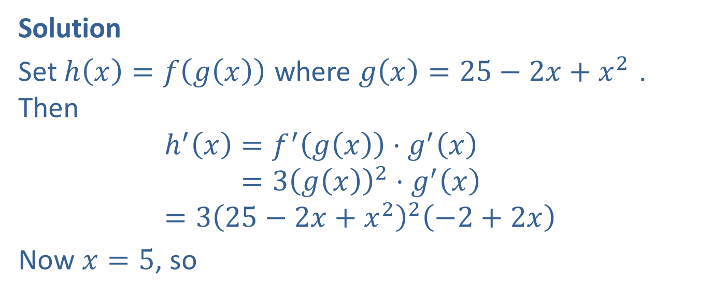

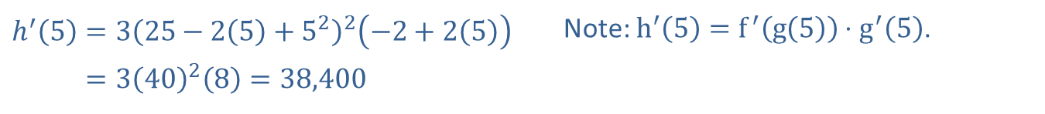
Example 4: Second Form of the Chain Rule
Determine $h^{′}⁡\left(5\right)$ if $h\left(x\right)={\left(25−2x+x^{2}\right)}^{3}$.
Solution
Set $h\left(x\right)=f\left(g\left(x\right)\right)$ where $g\left(x\right)=25−2x+x^{2}$. Then
h′𝑥=𝑓′𝑔𝑥⋅𝑔′𝑥h′⁡𝑥=3𝑔𝑥2⋅𝑔′𝑥=325−2𝑥+𝑥22−2+2𝑥
Now $x=5$, so
​$h^{′}\left(5\right)=3{\left(25−2\left(5\right)+5^{2}\right)}^{2}\left(−2+2\left(5\right)\right)$ | Note: $h^{′}⁡\left(5\right)=f^{′}⁡\left(g\left(5\right)\right)⋅g^{′}⁡\left(5\right)$.
​h′⁡5=34028=38,400

Slide 12
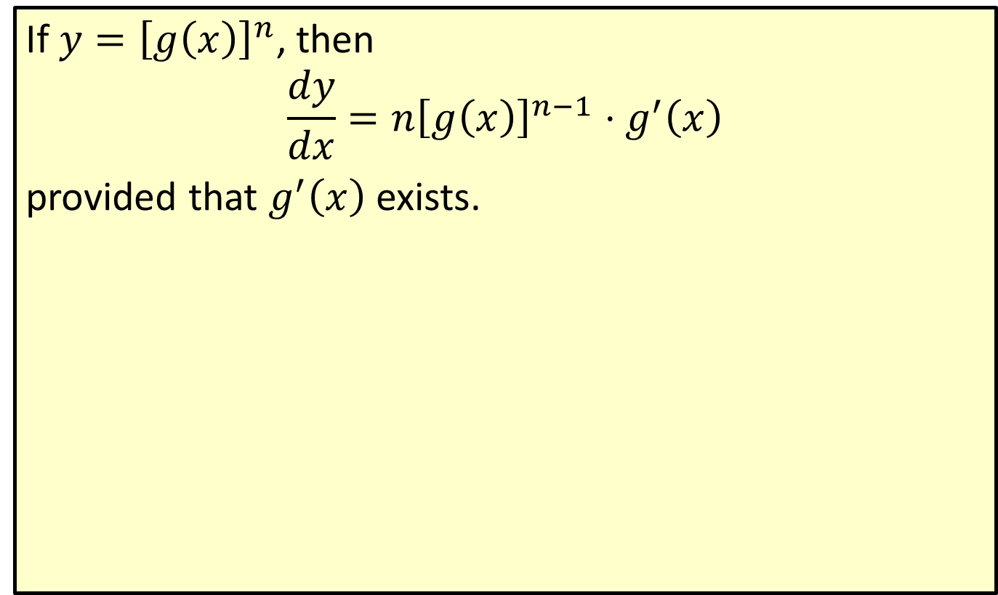
The General Power Rule
If $y={\left[g\left(x\right)\right]}^{n}$, then
$$\frac{dy}{dx}=n{\left[g\left(x\right)\right]}^{n−1}⋅g^{′}\left(x\right)$$
provided that $g^{′}⁡\left(x\right)$ exists.

Slide 13
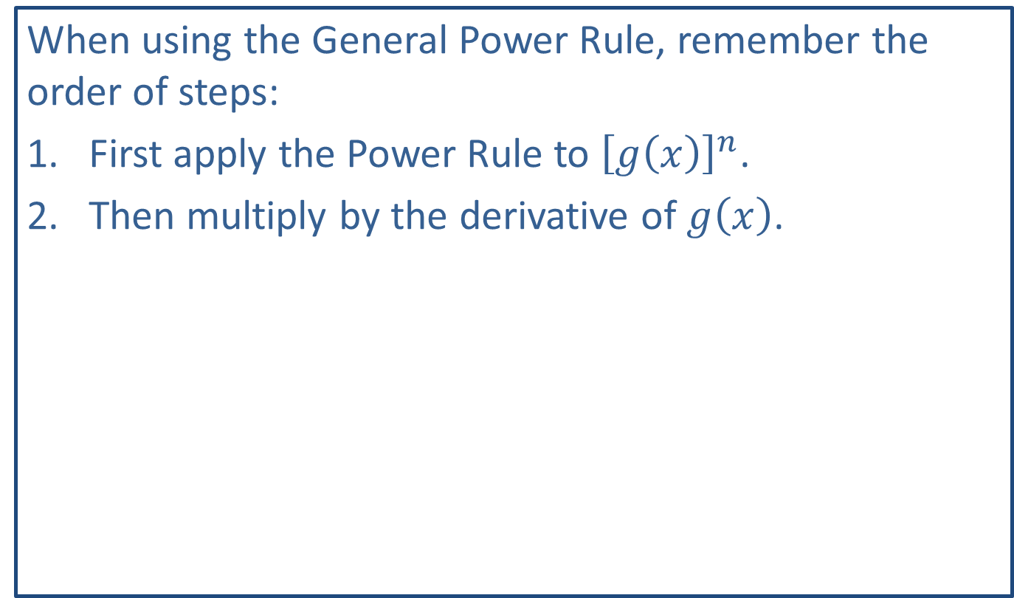
Note:
When using the General Power Rule, remember the order of steps:
​First apply the Power Rule to ${\left[g\left(x\right)\right]}^{n}$.
​Then multiply by the derivative of $g⁡\left(x\right)$.

Slide 14
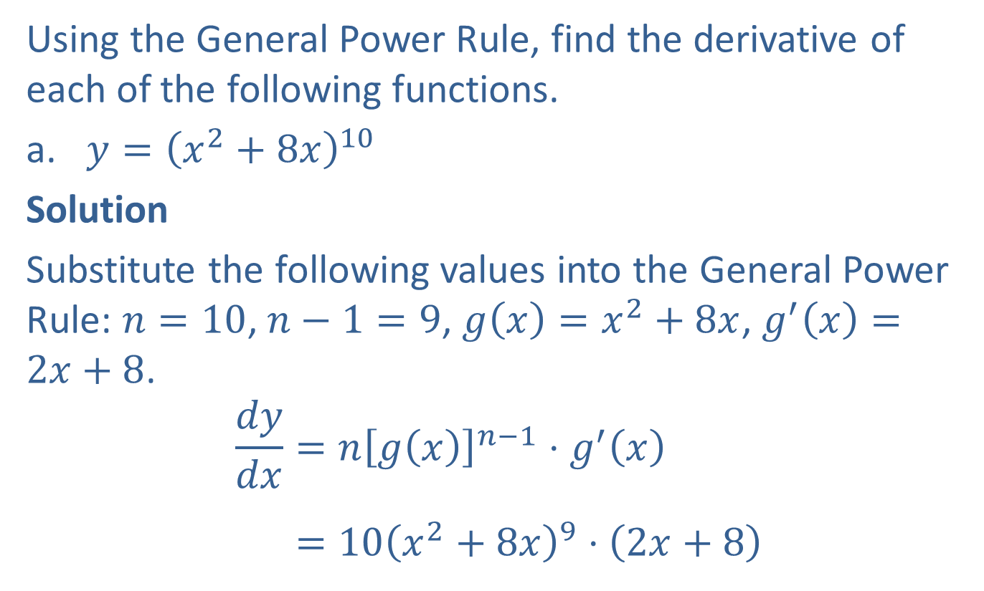
Example 5: The General Power Rule
Using the General Power Rule, find the derivative of each of the following functions.
​$y={\left(x^{2}+8x\right)}^{10}$
​Solution
​Substitute the following values into the General Power Rule: $n=10$, $n−1=9$, $g\left(x\right)=x^{2}+8x$, $g^{′}\left(x\right)=2x+8$.
𝑑𝑦𝑑𝑥=𝑛𝑔⁡𝑥𝑛−1⋅𝑔′⁡𝑥𝑑𝑦𝑑𝑥=10𝑥2+8𝑥9⋅2𝑥+8

Slide 15
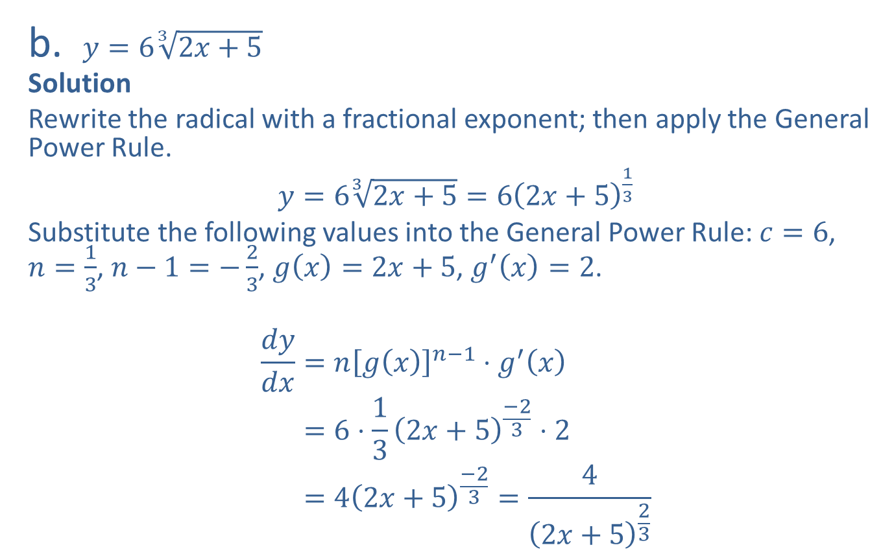
Example 5: The General Power Rule (cont.)
​$y=6\sqrt[3]{2x+5}$
​Solution
​Rewrite the radical with a fractional exponent; then apply the General Power Rule.
​$y=6\sqrt[3]{2x+5}=6{\left(2x+5\right)}^{\frac{1}{3}}$
​Substitute the following values into the General Power Rule: $c=6$, $n=\frac{1}{3}$, $n−1=−\frac{2}{3}$, $g⁡\left(x\right)=2x+5$, $g^{′}⁡\left(x\right)=2$.
𝑑𝑦𝑑𝑥=𝑛𝑔⁡𝑥𝑛−1⋅𝑔′𝑥𝑑𝑦𝑑𝑥=6⋅132𝑥+5−23⋅2𝑑𝑦𝑑𝑥=42𝑥+5−23=42𝑥+523

Slide 16

Example 6: The General Power Rule
Use the General Power Rule to find $f^{′}⁡\left(u\right)$ if $f\left(u\right)=\frac{1}{\sqrt{7−u}}$.

Slide 17
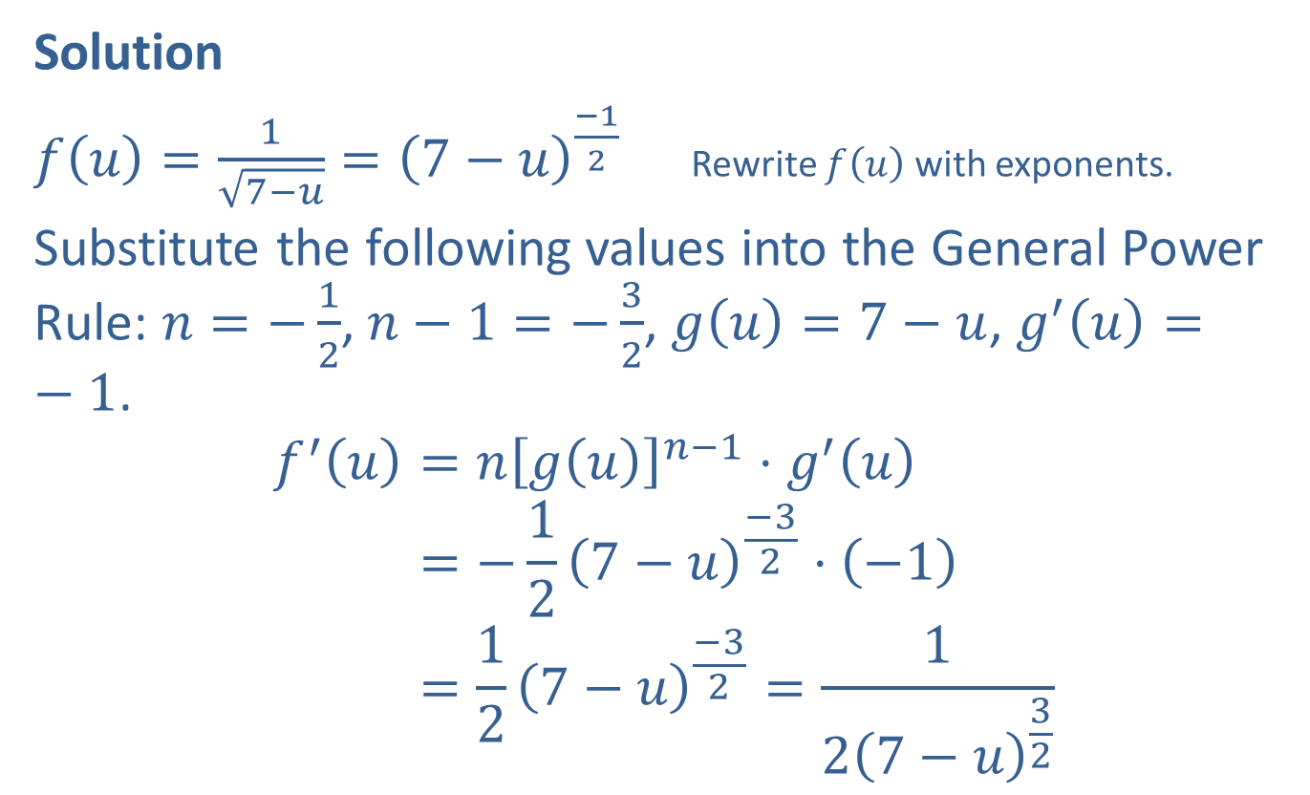
Example 6: The General Power Rule (cont.)
Solution
$f\left(u\right)=\frac{1}{\sqrt{7−u}}={\left(7−u\right)}^{\frac{−1}{2}}$ Rewrite $f⁡\left(u\right)$ with exponents.
Substitute the following values into the General Power Rule: $n=−\frac{1}{2}$, $n−1=−\frac{3}{2}$, $g\left(u\right)=7−u$, $g^{′}\left(u\right)=−1$.
𝑓′𝑢=𝑛𝑔⁡𝑢𝑛−1⋅𝑔′⁡𝑢𝑓′⁡𝑢=−127−𝑢−32⋅−1𝑓′⁡𝑢=127−𝑢−32=127−𝑢32

Slide 18

Example 7: Using Multiple Rules
Find $\frac{dy}{dx}$ if $y=\left(x^{2}+1\right)\sqrt{2x−3}$.

Slide 19
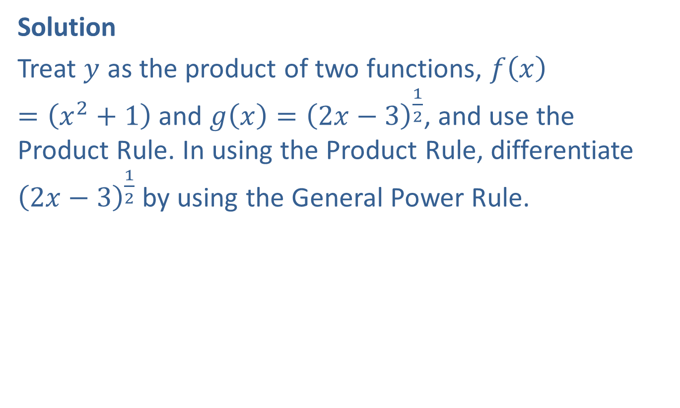
Example 7: Using Multiple Rules (cont.)
Solution
Treat $y$ as the product of two functions, $f\left(x\right)=\left(x^{2}+1\right)$ and $g\left(x\right)={\left(2x−3\right)}^{\frac{1}{2}}$, and use the Product Rule. In using the Product Rule, differentiate ${\left(2x−3\right)}^{\frac{1}{2}}$ by using the General Power Rule.

Slide 20

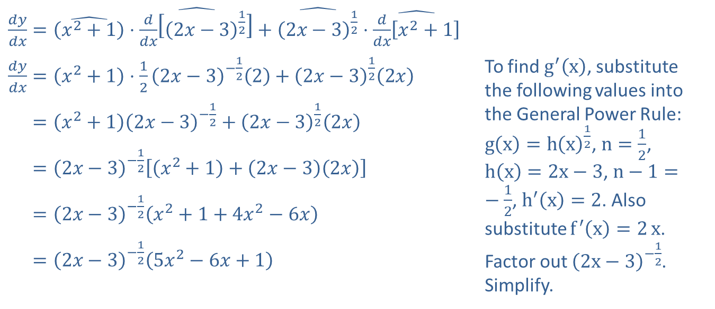
Example 7: Using Multiple Rules (cont.)
$$g^{′}⁡\left(x\right)$$
$$g\left(x\right)$$
$$f\left(x\right)$$
$$f^{′}⁡\left(x\right)$$
​$\frac{dy}{dx}=\hat{\left(x^{2}+1\right)}⋅\hat{\frac{d}{dx}\left[{\left(2x−3\right)}^{\frac{1}{2}}\right]}+\hat{{\left(2x−3\right)}^{\frac{1}{2}}}⋅\hat{\frac{d}{dx}\left[x^{2}+1\right]}$
​$\frac{dy}{dx}=\left(x^{2}+1\right)⋅\frac{1}{2}{\left(2x−3\right)}^{−\frac{1}{2}}\left(2\right)+{\left(2x−3\right)}^{\frac{1}{2}}\left(2x\right)$ | To find $g^{′}⁡\left(x\right)$, substitute the following values into the General Power Rule: $g\left(x\right)=h{{\left(x\right)}^{\frac{1}{2}}}$, $n=\frac{1}{2}$, $h\left(x\right)=2x−3$, $n−1=−\frac{1}{2}$, $h^{′}\left(x\right)=2$. Also substitute $f^{′}\left(x\right)=2{x}$. Factor out ${\left(2x−3\right)}^{−\frac{1}{2}}$. Simplify.
​𝑑𝑦𝑑𝑥=𝑥2+12𝑥−3−12+2𝑥−3122𝑥
​𝑑𝑦𝑑𝑥=2𝑥−3−12𝑥2+1+2𝑥−32𝑥
​𝑑𝑦𝑑𝑥=2𝑥−3−12𝑥2+1+4𝑥2−6𝑥
​𝑑𝑦𝑑𝑥=2𝑥−3−125𝑥2−6𝑥+1
Using radical notation, we have
$\frac{dy}{dx}=\frac{5x^{2}−6x+1}{\sqrt{2x−3}}$.

Slide 21

Example 7: Using Multiple Rules (cont.)
Using radical notation, we have
$\frac{dy}{dx}=\frac{5x^{2}−6x+1}{\sqrt{2x−3}}$.

Slide 22

Example 8: Using Multiple Rules
Find $D_{x}⁡\left[\sqrt[3]{\frac{2x−7}{3x+4}}\right]$.

Slide 23
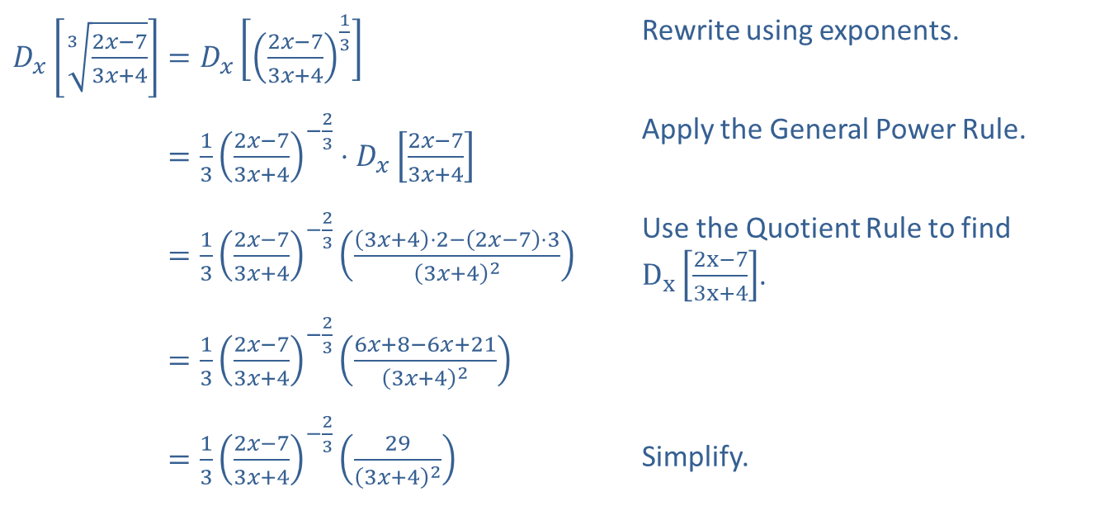
Example 8: Using Multiple Rules (cont.)
Solution
Apply the General Power Rule and the Quotient Rule.
​$D_{x}⁡\left[\sqrt[3]{\frac{2x−7}{3x+4}}\right]=D_{x}\left[{\left(\frac{2x−7}{3x+4}\right)}^{\frac{1}{3}}\right]$ | Rewrite using exponents.
​𝐷𝑥⁡32𝑥−73𝑥+4=132𝑥−73𝑥+4−23⋅𝐷𝑥2𝑥−73𝑥+4 | Apply the General Power Rule.
​𝐷𝑥⁡32𝑥−73𝑥+4=132𝑥−73𝑥+4−233𝑥+4⋅2−2𝑥−7⋅33𝑥+42 | Use the Quotient Rule to find $D_{x}⁡\left[\frac{2x−7}{3x+4}\right]$.
​𝐷𝑥⁡32𝑥−73𝑥+4=132𝑥−73𝑥+4−236𝑥+8−6𝑥+213𝑥+42
​𝐷𝑥⁡32𝑥−73𝑥+4=132𝑥−73𝑥+4−23293𝑥+42 | Simplify.

Slide 24
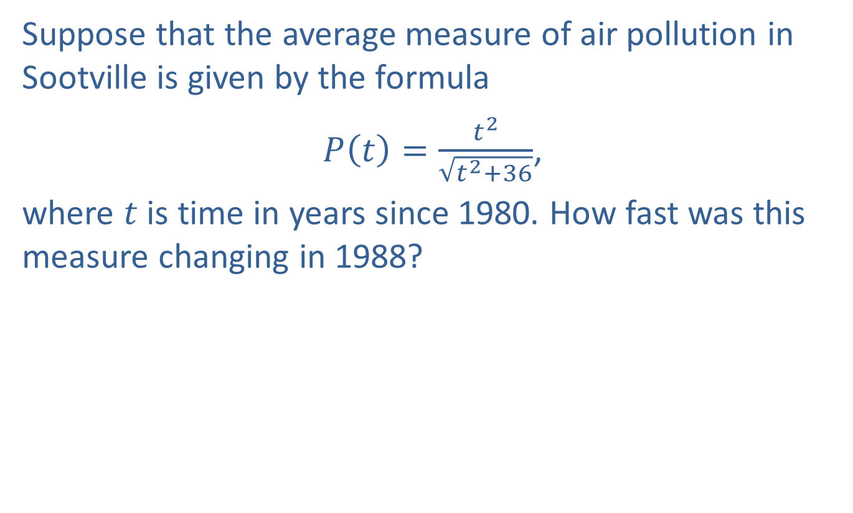
Example 9: Air Pollution
Suppose that the average measure of air pollution in Sootville is given by the formula
$P\left(t\right)=\frac{t^{2}}{\sqrt{t^{2}+36}}$,
where $t$ is time in years since 1980. How fast was this measure changing in 1988?

Slide 25
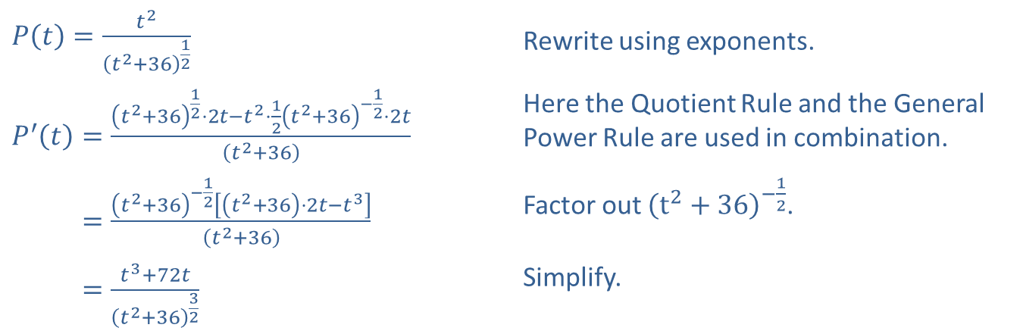

Example 9: Air Pollution (cont.)
Solution
Find the derivative of $P⁡\left(t\right)$ by using the Quotient Rule and the General Power Rule.
​$P\left(t\right)=\frac{t^{2}}{{\left(t^{2}+36\right)}^{\frac{1}{2}}}$ | Rewrite using exponents.
​$P^{′}\left(t\right)=\frac{{\left(t^{2}+36\right)}^{\frac{1}{2}}⋅2t−t^{2}⋅\frac{1}{2}{\left(t^{2}+36\right)}^{−\frac{1}{2}}⋅2t}{\left(t^{2}+36\right)}$ | Here the Quotient Rule and the General Power Rule are used in combination.
​𝑃′⁡𝑡=𝑡2+36−12𝑡2+36⋅2𝑡−𝑡3𝑡2+36 | Factor out ${\left(t^{2}+36\right)}^{−\frac{1}{2}}$.
​𝑃′⁡𝑡=𝑡3+72𝑡𝑡2+3632 | Simplify.

Slide 26
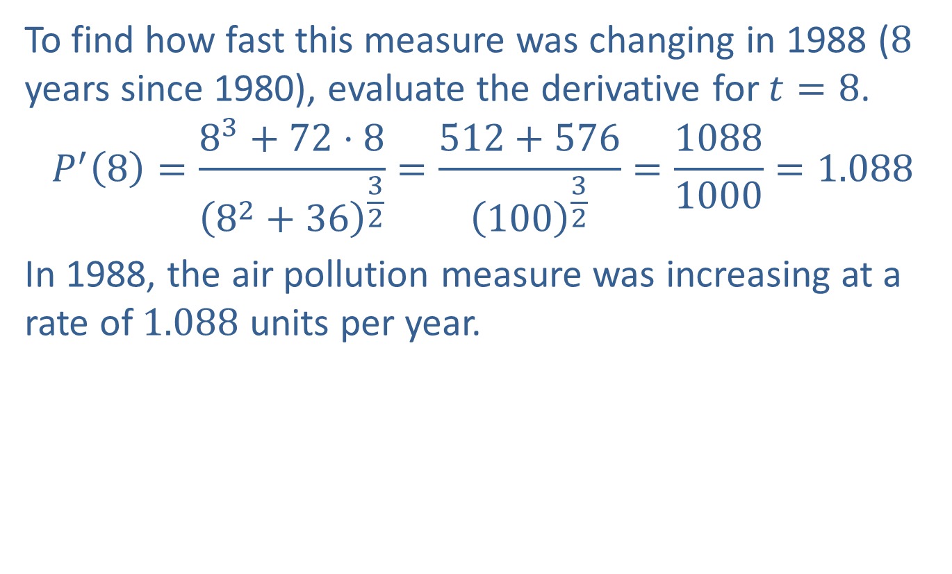
Example 9: Air Pollution (cont.)
To find how fast this measure was changing in 1988 (8 years since 1980), evaluate the derivative for $t=8$.
$$P^{′}\left(8\right)=\frac{8^{3}+72⋅8}{{\left(8^{2}+36\right)}^{\frac{3}{2}}}=\frac{512+576}{{\left(100\right)}^{\frac{3}{2}}}=\frac{1088}{1000}=1.088$$
In 1988, the air pollution measure was increasing at a rate of 1.088 units per year.

