Slide 1
Section 3.3
Implicit Differentiation and Related Rates

Slide 2
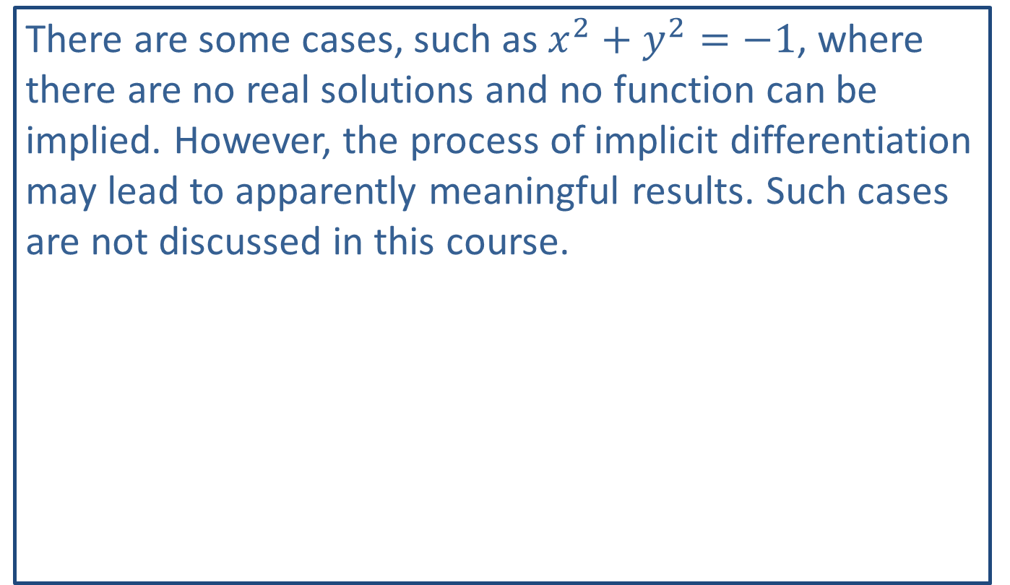
Note:
There are some cases, such as $x^{2}+y^{2}=−1$, where there are no real solutions and no function can be implied. However, the process of implicit differentiation may lead to apparently meaningful results. Such cases are not discussed in this course.

Slide 3
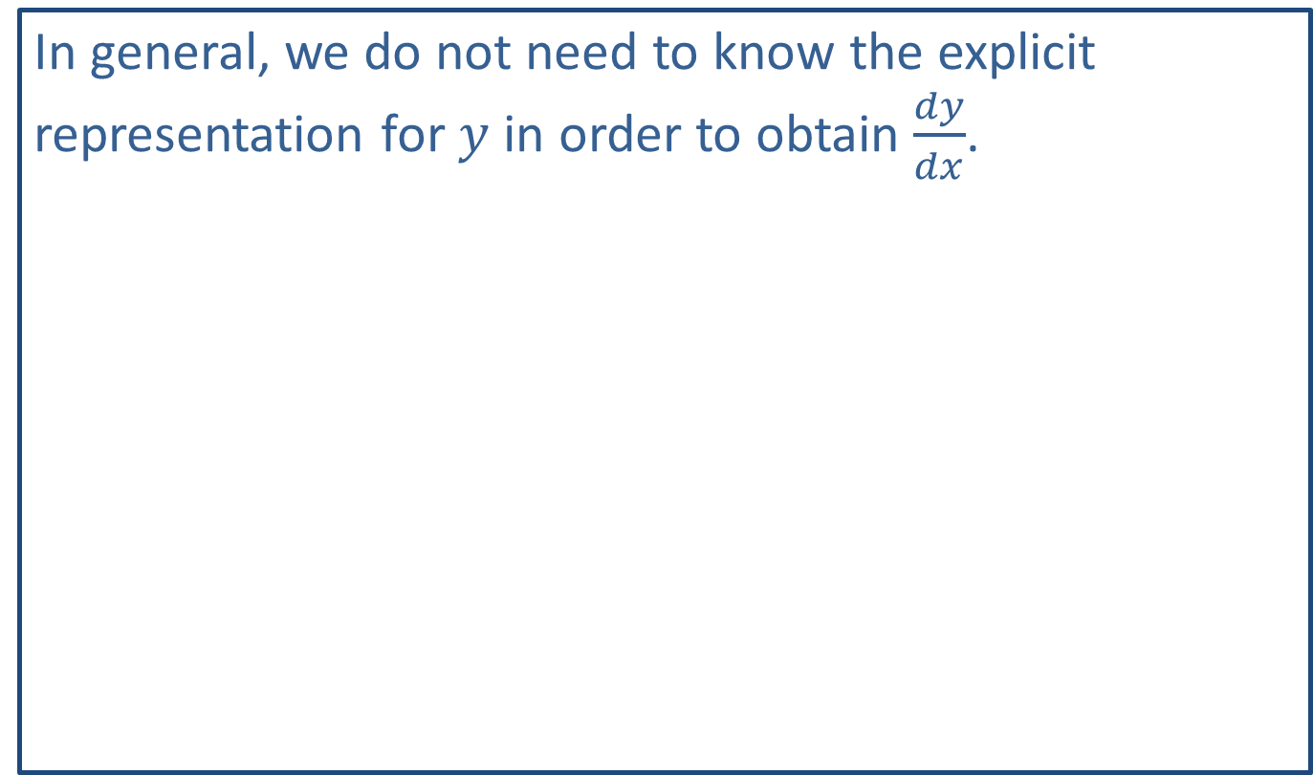
Note:
In general, we do not need to know the explicit representation for $y$ in order to obtain $\frac{dy}{dx}$.

Slide 4

Example 1: Derivative at a Point
Given the equation $x^{2}+y^{2}=25$, find $\frac{dy}{dx}$ and then evaluate the derivative at $\left(4\text{, }3\right)$ and $\left(0\text{, }5\right)$.

Slide 5
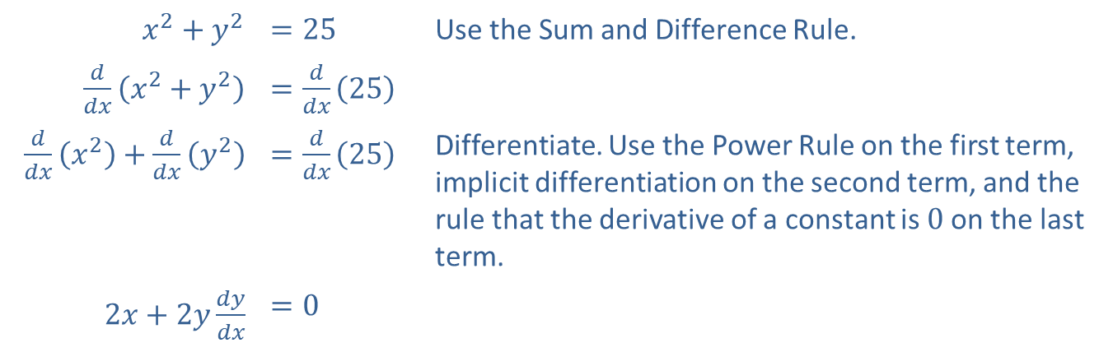
Example 1: Derivative at a Point (cont.)
Solution
​$x^{2}+y^{2}$ | ​$=25$ | Use the Sum and Difference Rule.
​$\frac{d}{dx}\left(x^{2}+y^{2}\right)$ | ​$=\frac{d}{dx}\left(25\right)$
​$\frac{d}{dx}\left(x^{2}\right)+\frac{d}{dx}\left(y^{2}\right)$ | ​$=\frac{d}{dx}\left(25\right)$ | Differentiate. Use the Power Rule on the first term, implicit differentiation on the second term, and the rule that the derivative of a constant is 0 on the last term.
​$2x+2y\frac{dy}{dx}$ | ​$=0$

Slide 6

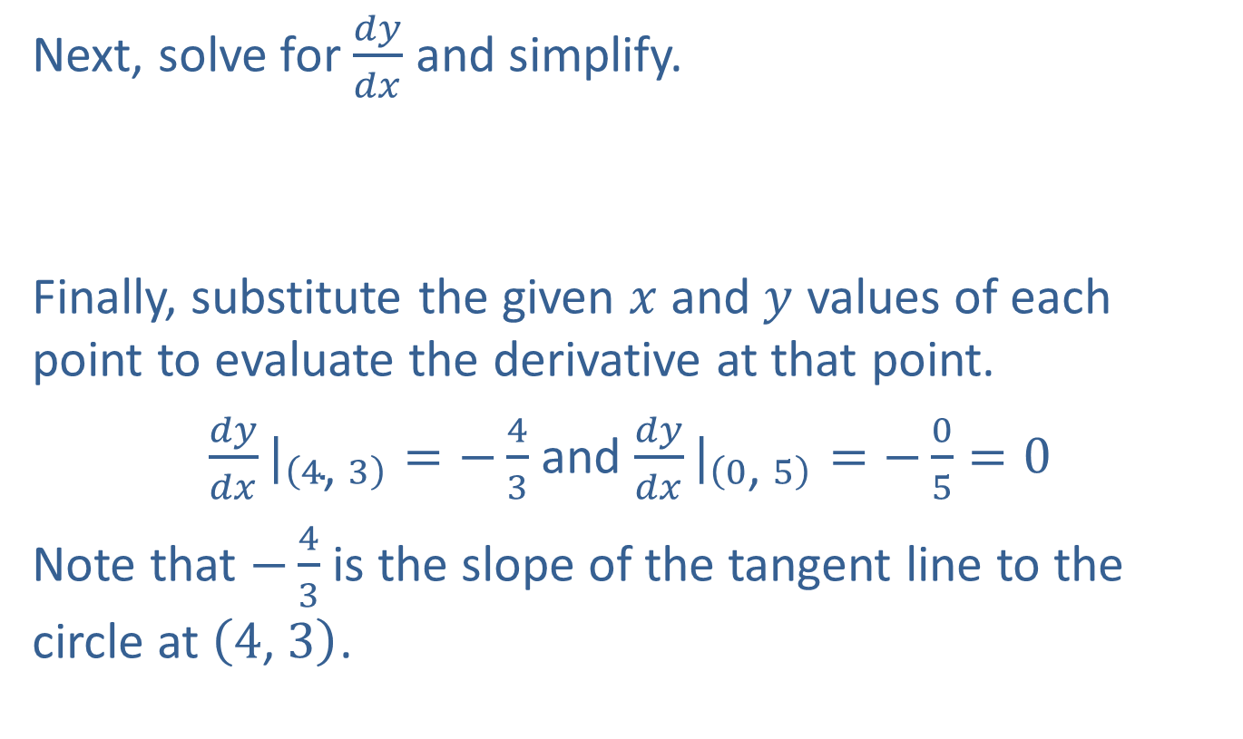
Example 1: Derivative at a Point (cont.)
Next, solve for $\frac{dy}{dx}$ and simplify.
​
Finally, substitute the given $x$ and $y$ values of each point to evaluate the derivative at that point.
${\frac{dy}{dx}|}_{\left(4\text{, }3\right)}=−\frac{4}{3}$ and ${\frac{dy}{dx}|}_{\left(0\text{, }5\right)}=−\frac{0}{5}=0$
Note that $−\frac{4}{3}$ is the slope of the tangent line to the circle at $\left(4\text{, }3\right)$.
​$2y\frac{dy}{dx}$ | ​$=−2x$
​$\frac{dy}{dx}$ | ​$=−\frac{x}{y}$

Slide 7
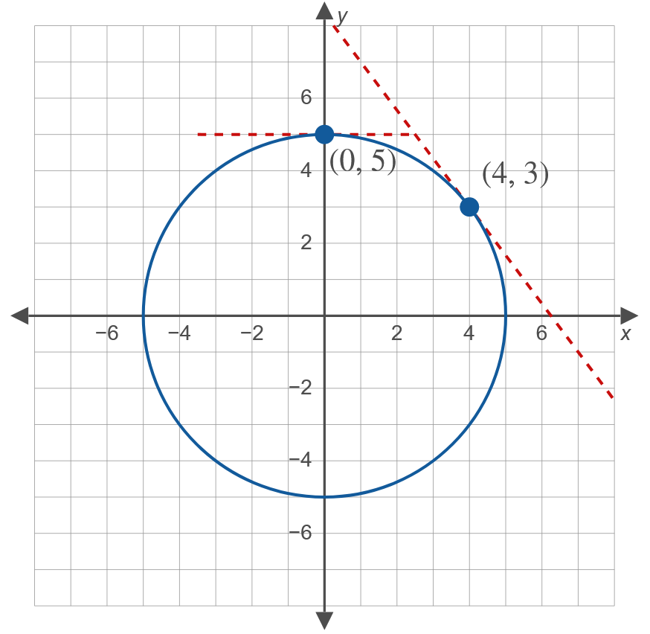
Example 1: Derivative at a Point (cont.)

Slide 8

Example 2: Implicit Differentiation
If $xy+x^{2}y^{3}−1=0$, find $\frac{dy}{dx}$.

Slide 9

Example 2: Implicit Differentiation (cont.)
Solution
Note that both $xy$ and $x^{2}y^{3}$ are products and that the Product Rule must be used.

Slide 10
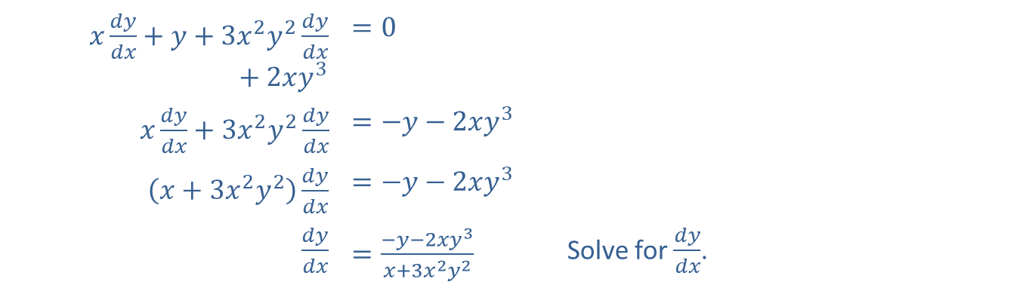
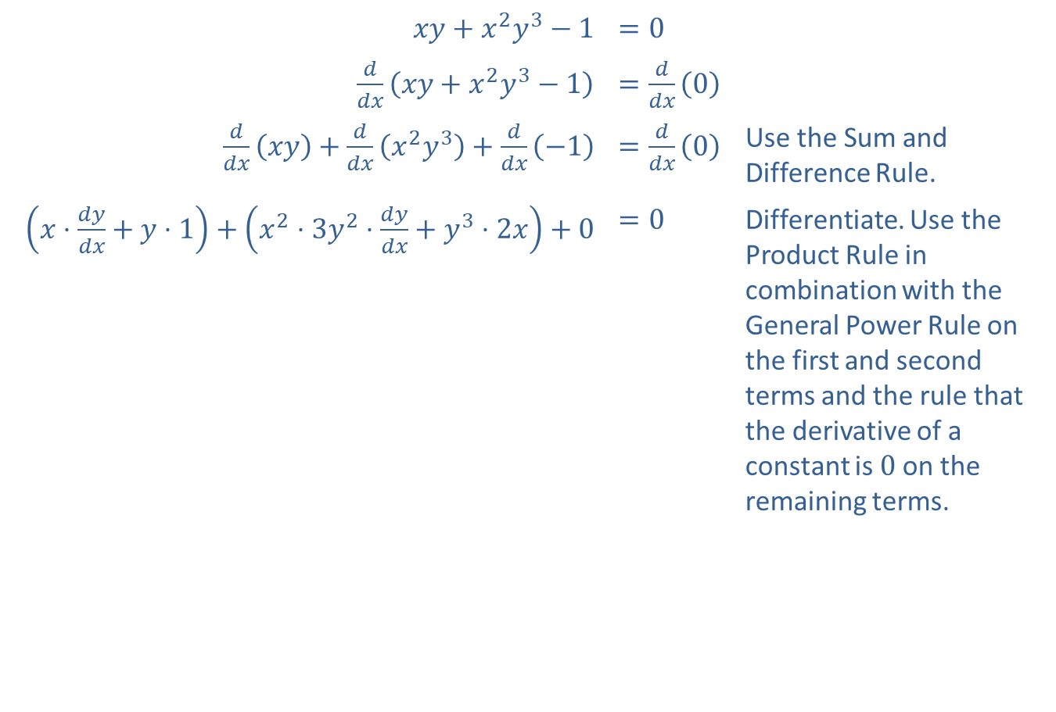
Example 2: Implicit Differentiation (cont.)
​$xy+x^{2}y^{3}−1$ | ​$=0$
​$\frac{d}{dx}\left(xy+x^{2}y^{3}−1\right)$ | ​$=\frac{d}{dx}\left(0\right)$
​$\frac{d}{dx}\left(xy\right)+\frac{d}{dx}\left(x^{2}y^{3}\right)+\frac{d}{dx}\left(−1\right)$ | ​$=\frac{d}{dx}\left(0\right)$ | Use the Sum and Difference Rule.
​$\left(x⋅\frac{dy}{dx}+y⋅1\right)+\left(x^{2}⋅3y^{2}⋅\frac{dy}{dx}+y^{3}⋅2x\right)+0$ | ​$=0$ | Differentiate. Use the Product Rule in combination with the General Power Rule on the first and second terms and the rule that the derivative of a constant is 0 on the remaining terms.
​$x\frac{dy}{dx}+y+3x^{2}y^{2}\frac{dy}{dx}+2xy^{3}$ | ​$=0$
​$x\frac{dy}{dx}+3x^{2}y^{2}\frac{dy}{dx}$ | ​$=−y−2xy^{3}$
​$\left(x+3x^{2}y^{2}\right)\frac{dy}{dx}$ | ​$=−y−2xy^{3}$
​$\frac{dy}{dx}$ | ​$=\frac{−y−2xy^{3}}{x+3x^{2}y^{2}}$ | Solve for $\frac{dy}{dx}$.

Slide 11

Example 3: Implicit Differentiation
Find $\frac{dy}{dx}$ if $\sqrt{x}−\sqrt{y}=16$.

Slide 12
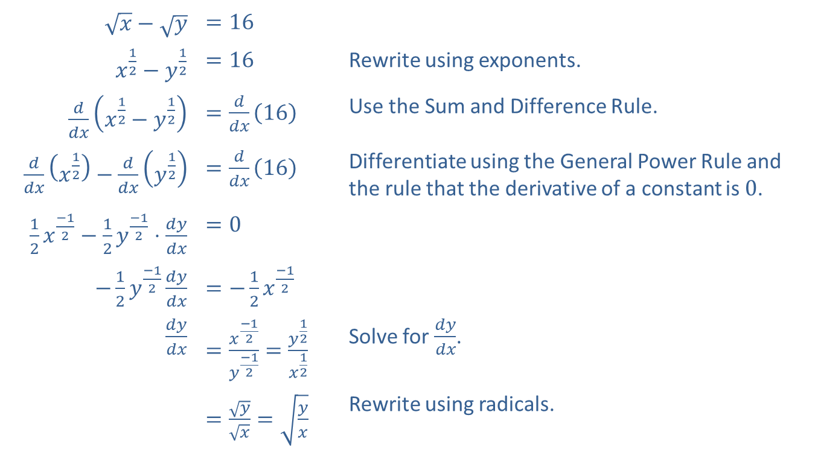
Example 3: Implicit Differentiation (cont.)
Solution
​$\sqrt{x}−\sqrt{y}$ | ​$=16$
​$x^{\frac{1}{2}}−y^{\frac{1}{2}}$ | ​$=16$ | Rewrite using exponents.
​$\frac{d}{dx}\left(x^{\frac{1}{2}}−y^{\frac{1}{2}}\right)$ | ​$=\frac{d}{dx}\left(16\right)$ | Use the Sum and Difference Rule.
​$\frac{d}{dx}\left(x^{\frac{1}{2}}\right)−\frac{d}{dx}\left(y^{\frac{1}{2}}\right)$ | ​$=\frac{d}{dx}\left(16\right)$ | Differentiate using the General Power Rule and the rule that the derivative of a constant is 0.
​$\frac{1}{2}x^{\frac{−1}{2}}−\frac{1}{2}y^{\frac{−1}{2}}⋅\frac{dy}{dx}$ | ​$=0$
​$−\frac{1}{2}y^{\frac{−1}{2}}\frac{dy}{dx}$ | ​$=−\frac{1}{2}x^{\frac{−1}{2}}$
​$\frac{dy}{dx}$ | ​$=\frac{x^{\frac{−1}{2}}}{y^{\frac{−1}{2}}}=\frac{y^{\frac{1}{2}}}{x^{\frac{1}{2}}}$ | Solve for $\frac{dy}{dx}$.
 | ​$=\frac{\sqrt{y}}{\sqrt{x}}=\sqrt{\frac{y}{x}}$ | Rewrite using radicals.

Slide 13
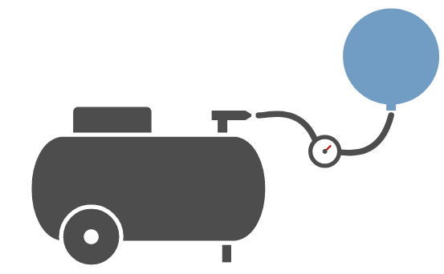

Example 4: Balloon Inflation
Suppose that a spherical balloon is inflated by a continuous flow of air from an air compressor at a rate of $2{ ^{in.}}/{sec}$. How fast is the radius of the balloon growing when the radius is $3 in.$?

Slide 14
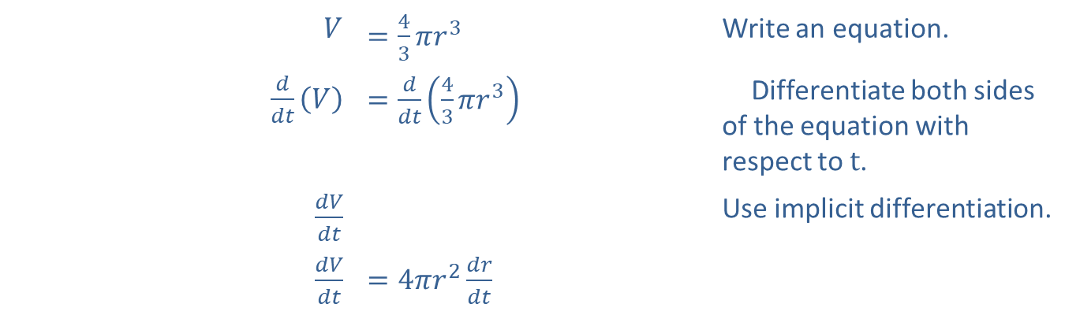


Example 4: Balloon Inflation (cont.)
Solution
We know that $\frac{dV}{dt}=2{ ^{in.}}/{sec}$, and we want to find $\frac{dr}{dt}$.
The formula for the volume of a sphere is $V=\frac{4}{3}πr^{3}$.
$$V$$ | ​$=\frac{4}{3}πr^{3}$ | Write an equation.
​$\frac{d}{dt}\left(V\right)$ | ​$=\frac{d}{dt}\left(\frac{4}{3}πr^{3}\right)$ | Differentiate both sides of the equation with respect to $t$.
​$\frac{dV}{dt}$ | ​ | Use implicit differentiation.
​$\frac{dV}{dt}$ | ​$=4πr^{2}\frac{dr}{dt}$
$$=\frac{4}{3}π⋅3r^{2}⋅\frac{dr}{dt}$$

Slide 15




Example 4: Balloon Inflation (cont.)
Now substitute $\frac{dV}{dt}=2$ and $r=3$.
​2 | ​$=4π{\left(3\right)}^{2}\frac{dr}{dt}$ | Solve for $\frac{dr}{dt}$.
​ | ​$=\frac{dr}{dt}$
$$\frac{{}_{2}^{1} }{{}_{36}^{18} π}$$
Therefore,
$\frac{dr}{dt}=\frac{1}{18π} in./sec≈0.018 in./sec$.

Slide 16
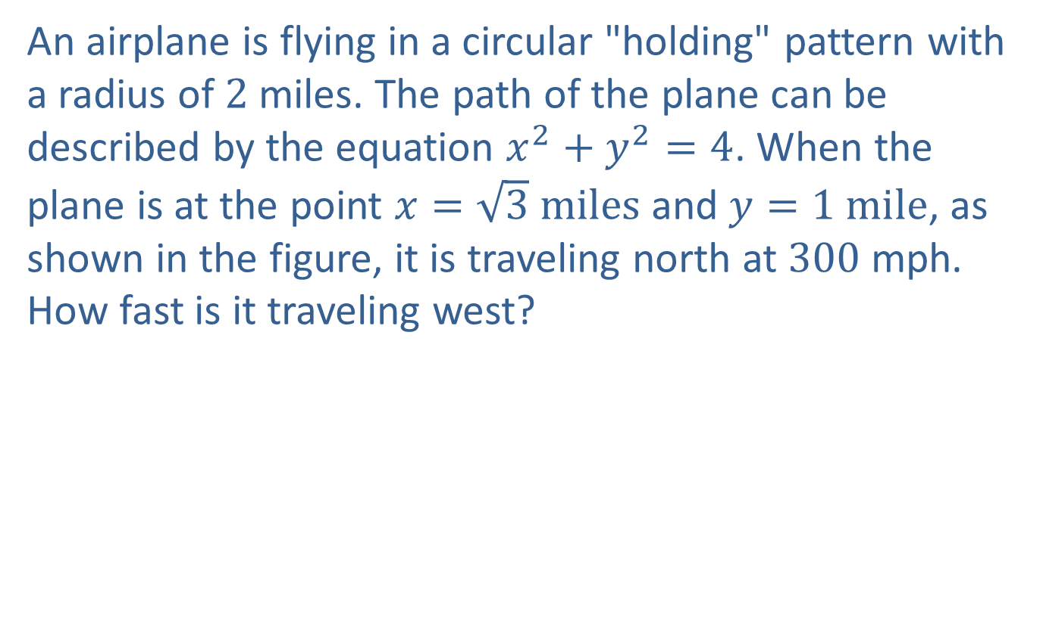
Example 5: Airplane Holding Pattern
An airplane is flying in a circular "holding" pattern with a radius of 2 miles. The path of the plane can be described by the equation $x^{2}+y^{2}=4$. When the plane is at the point $x=\sqrt{3} miles$ and $y=1 mile$, as shown in the figure, it is traveling north at 300 mph. How fast is it traveling west?

Slide 17
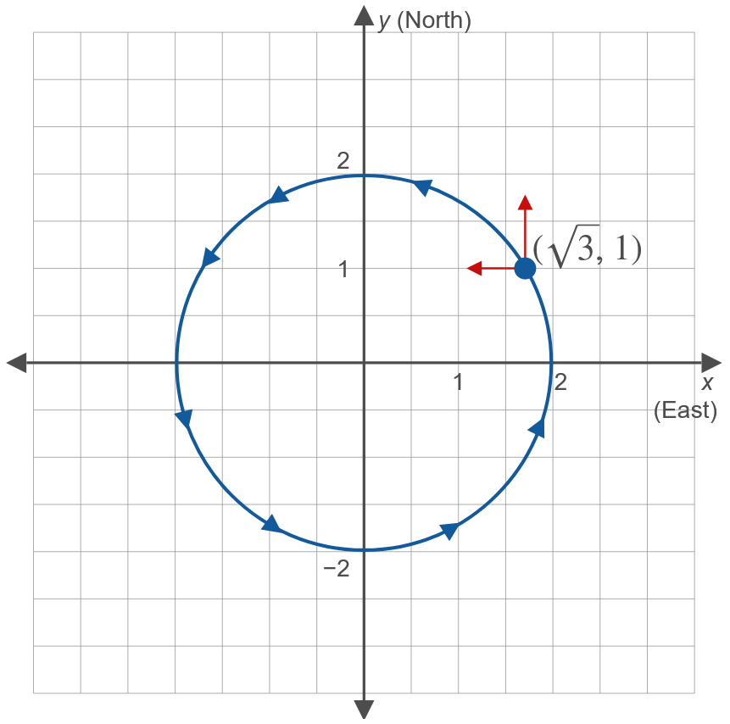
Example 5: Airplane Holding Pattern (cont.)

Slide 18
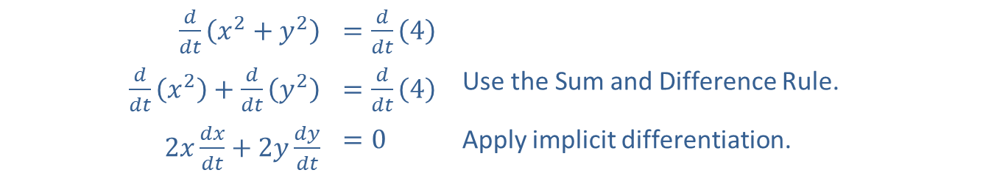

Example 5: Airplane Holding Pattern (cont.)
Solution
First, differentiate both sides of the equation $x^{2}+y^{2}=4$ with respect to $t$.
​$\frac{d}{dt}\left(x^{2}+y^{2}\right)$ | ​$=\frac{d}{dt}\left(4\right)$
​$\frac{d}{dt}\left(x^{2}\right)+\frac{d}{dt}\left(y^{2}\right)$ | ​$=\frac{d}{dt}\left(4\right)$ | Use the Sum and Difference Rule.
​$2x\frac{dx}{dt}+2y\frac{dy}{dt}$ | ​$=0$ | Apply implicit differentiation.

Slide 19
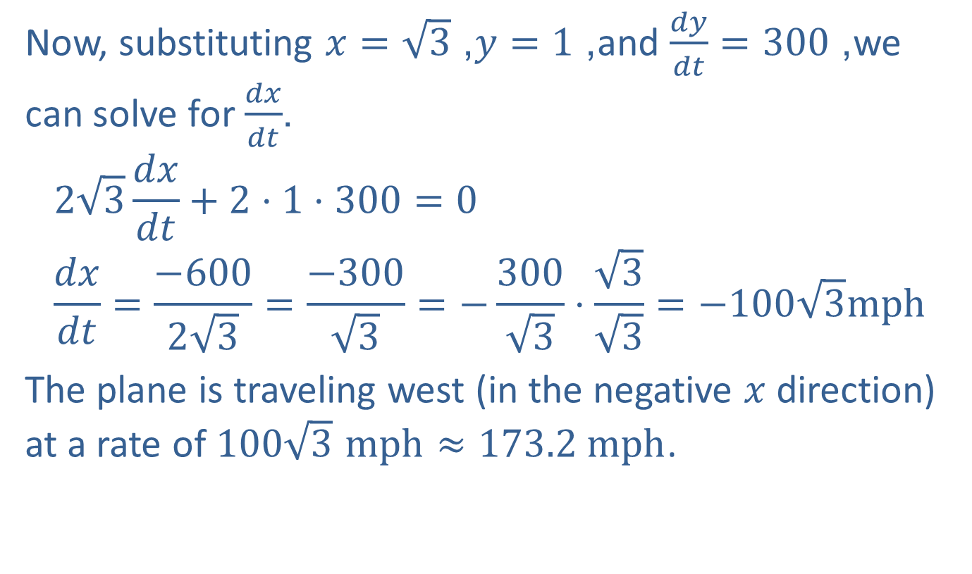
Example 5: Airplane Holding Pattern (cont.)
Now, substituting $x=\sqrt{3}$, $y=1$, and $\frac{dy}{dt}=300$, we can solve for $\frac{dx}{dt}$.
$$2\sqrt{3}\frac{dx}{dt}+2⋅1⋅300=0 \\ \frac{dx}{dt}=\frac{−600}{2\sqrt{3}}=\frac{−300}{\sqrt{3}}=−\frac{300}{\sqrt{3}}⋅\frac{\sqrt{3}}{\sqrt{3}}=−100\sqrt{3}mph$$
The plane is traveling west (in the negative $x$ direction) at a rate of $100\sqrt{3} mph≈173.2 mph$.

Slide 20
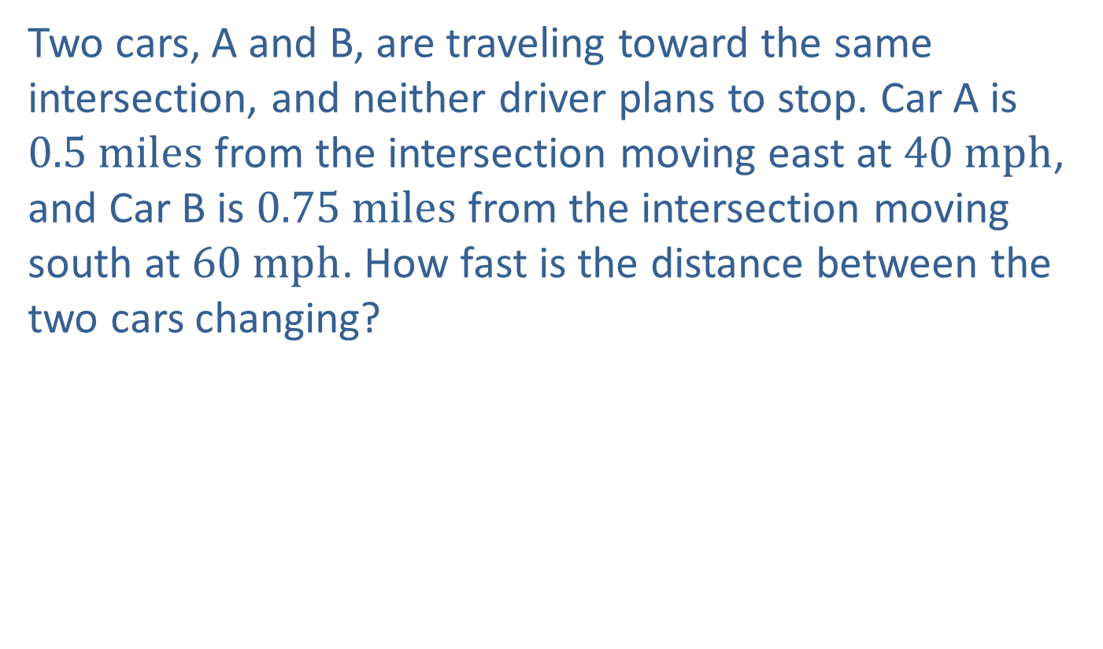
Example 6: Moving Cars
Two cars, A and B, are traveling toward the same intersection, and neither driver plans to stop. Car A is $0.5 miles$ from the intersection moving east at $40 mph$, and Car B is $0.75 miles$ from the intersection moving south at $60 mph$. How fast is the distance between the two cars changing?

Slide 21
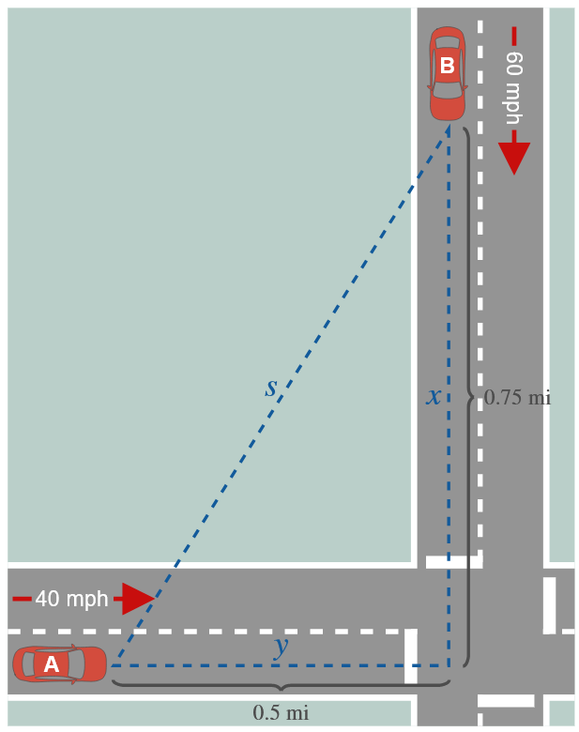
Example 6: Moving Cars (cont.)

Slide 22
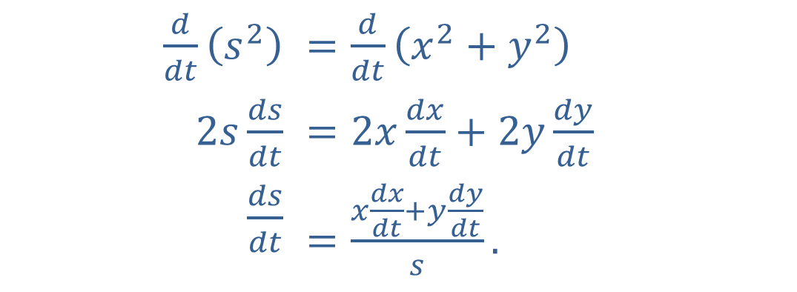

Example 6: Moving Cars (cont.)
Solution
From the figure, $s^{2}=x^{2}+y^{2}$.
Differentiating with respect to $t$, we obtain
​$\frac{d}{dt}\left(s^{2}\right)$ | ​$=\frac{d}{dt}\left(x^{2}+y^{2}\right)$
​$2s\frac{ds}{dt}$ | ​$=2x\frac{dx}{dt}+2y\frac{dy}{dt}$
​$\frac{ds}{dt}$ | ​$=\frac{x\frac{dx}{dt}+y\frac{dy}{dt}}{s}\text{.}$

Slide 23
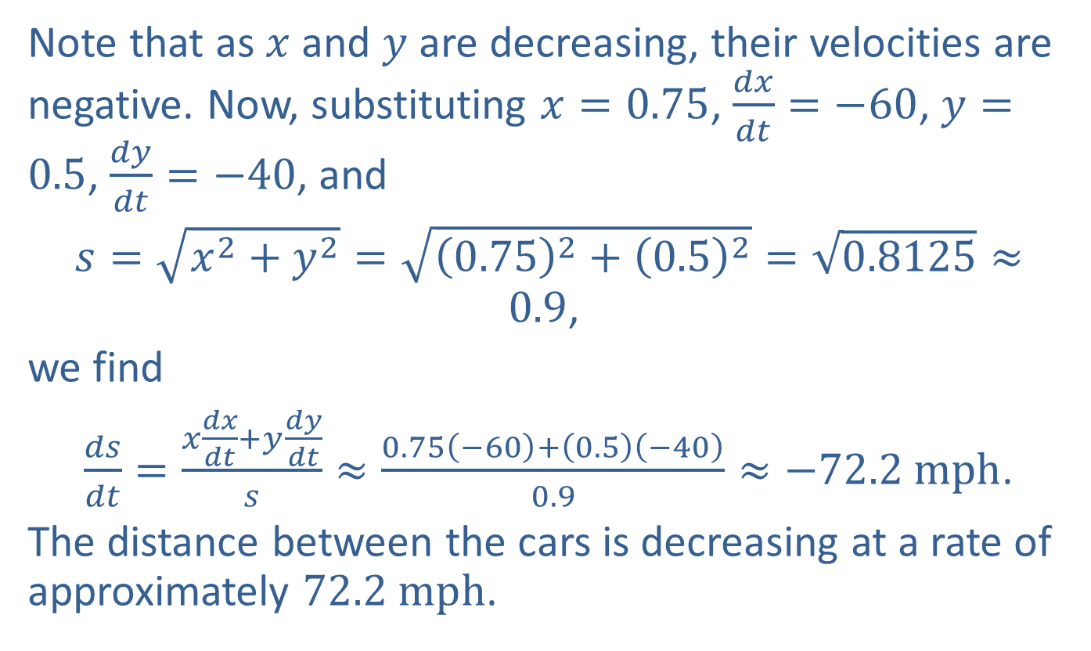
Example 6: Moving Cars (cont.)
Note that as $x$ and $y$ are decreasing, their velocities are negative. Now, substituting $x=0.75$, $\frac{dx}{dt}=−60$, $y=0.5$, $\frac{dy}{dt}=−40$, and
$s=\sqrt{x^{2}+y^{2}}=\sqrt{{\left(0.75\right)}^{2}+{\left(0.5\right)}^{2}}=\sqrt{0.8125}≈0.9$,
we find
$\frac{ds}{dt}=\frac{x\frac{dx}{dt}+y\frac{dy}{dt}}{s}≈\frac{0.75\left(−60\right)+\left(0.5\right)\left(−40\right)}{0.9}≈−72.2 mph$.
The distance between the cars is decreasing at a rate of approximately $72.2 mph$.

Slide 24
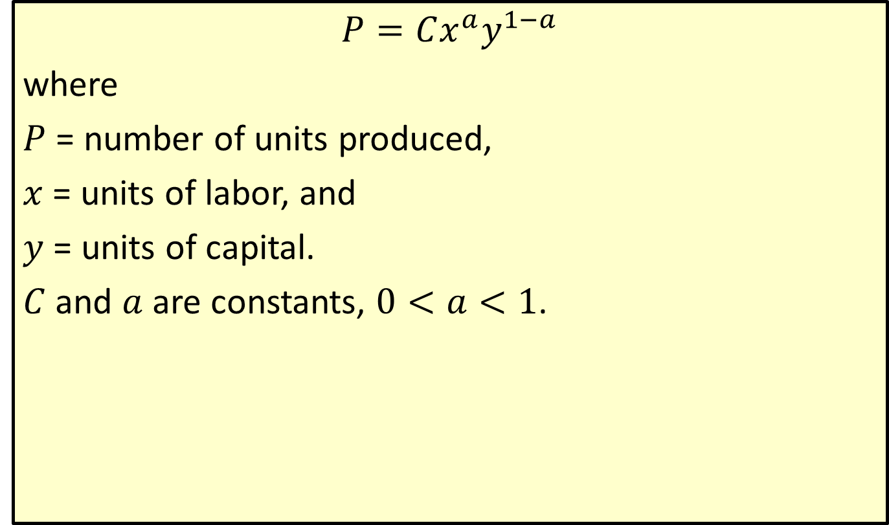
Cobb-Douglas Production Formula
$$P=Cx^{a}y^{1−a}$$
where
$P$ = number of units produced,
$x$ = units of labor, and
$y$ = units of capital.
$C$ and $a$ are constants, $0<a<1$.

Slide 25
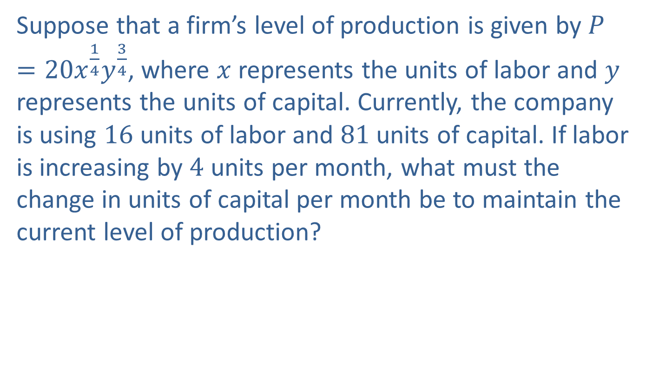
Example 7: Production
Suppose that a firm’s level of production is given by $P=20x^{\frac{1}{4}}y^{\frac{3}{4}}$, where $x$ represents the units of labor and $y$ represents the units of capital. Currently, the company is using 16 units of labor and 81 units of capital. If labor is increasing by 4 units per month, what must the change in units of capital per month be to maintain the current level of production?

Slide 26
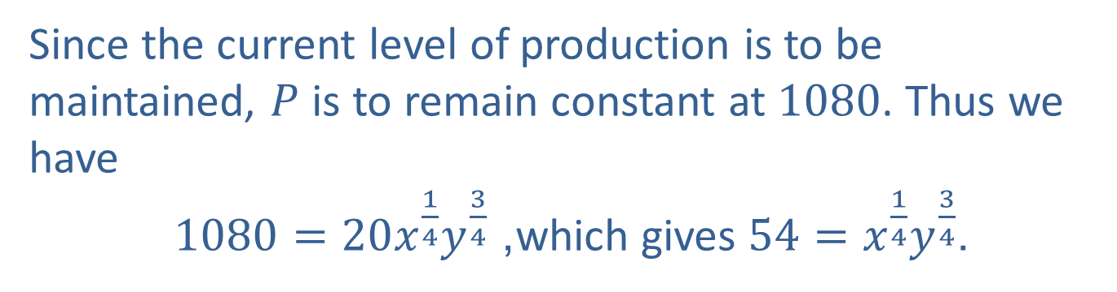
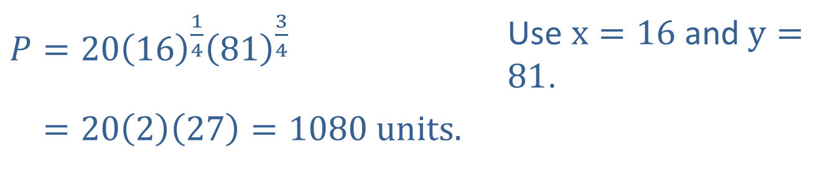
Example 7: Production (cont.)
Solution
The current level of production is
​$P=20{\left(16\right)}^{\frac{1}{4}}{\left(81\right)}^{\frac{3}{4}}$ | Use $x=16$ and $y=81$.
​𝑃=20227=1080 units.
Since the current level of production is to be maintained, $P$ is to remain constant at 1080. Thus we have
$1080=20x^{\frac{1}{4}}y^{\frac{3}{4}}$, which gives $54=x^{\frac{1}{4}}y^{\frac{3}{4}}$.

Slide 27
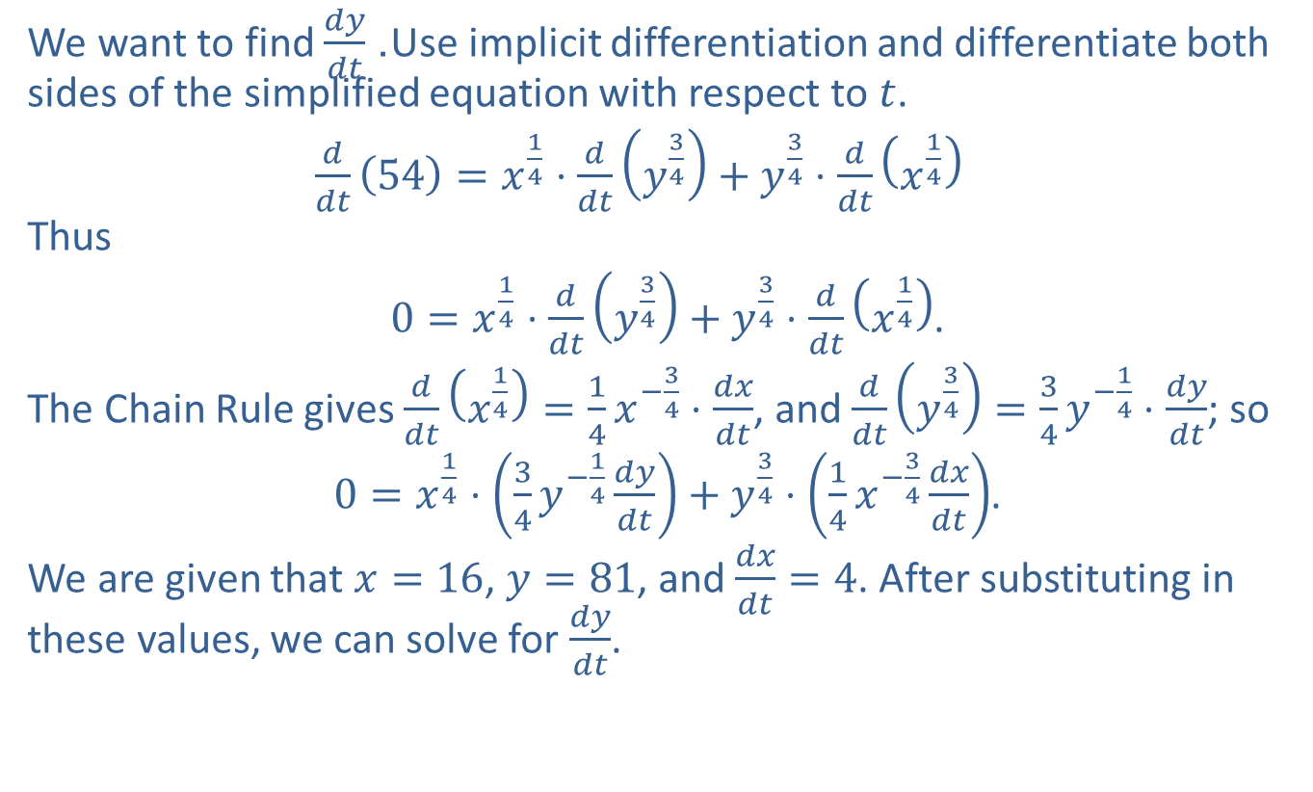
Example 7: Production (cont.)
We want to find $\frac{dy}{dt}$. Use implicit differentiation and differentiate both sides of the simplified equation with respect to $t$.
$\frac{d}{dt}\left(54\right)=x^{\frac{1}{4}}⋅\frac{d}{dt}\left(y^{\frac{3}{4}}\right)+y^{\frac{3}{4}}⋅\frac{d}{dt}\left(x^{\frac{1}{4}}\right)$
Thus
$0=x^{\frac{1}{4}}⋅\frac{d}{dt}\left(y^{\frac{3}{4}}\right)+y^{\frac{3}{4}}⋅\frac{d}{dt}\left(x^{\frac{1}{4}}\right)$.
The Chain Rule gives $\frac{d}{dt}\left(x^{\frac{1}{4}}\right)=\frac{1}{4}x^{−\frac{3}{4}}⋅\frac{dx}{dt}$, and $\frac{d}{dt}\left(y^{\frac{3}{4}}\right)=\frac{3}{4}y^{−\frac{1}{4}}⋅\frac{dy}{dt}$; so
$0=x^{\frac{1}{4}}⋅\left(\frac{3}{4}y^{−\frac{1}{4}}\frac{dy}{dt}\right)+y^{\frac{3}{4}}⋅\left(\frac{1}{4}x^{−\frac{3}{4}}\frac{dx}{dt}\right)$.
We are given that $x=16$, $y=81$, and $\frac{dx}{dt}=4$. After substituting in these values, we can solve for $\frac{dy}{dt}$.

Slide 28
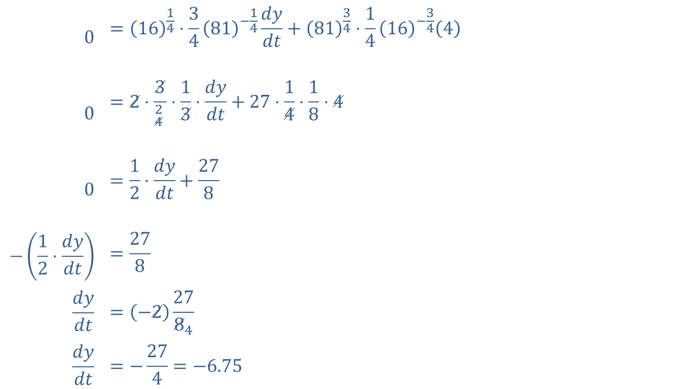
Example 7: Production (cont.)
$$0$$ | $$={\left(16\right)}^{\frac{1}{4}}⋅\frac{3}{4}{\left(81\right)}^{−\frac{1}{4}}\frac{dy}{dt}+{\left(81\right)}^{\frac{3}{4}}⋅\frac{1}{4}{\left(16\right)}^{−\frac{3}{4}}\left(4\right)$$
$$0$$ | $$=2⋅\frac{3}{{}_{4}^{2} }⋅\frac{1}{3}⋅\frac{dy}{dt}+27⋅\frac{1}{4}⋅\frac{1}{8}⋅4$$
$$0$$ | $$=\frac{1}{2}⋅\frac{dy}{dt}+\frac{27}{8}$$
$$−\left(\frac{1}{2}⋅\frac{dy}{dt}\right)$$ | $$=\frac{27}{8}$$
$$\frac{dy}{dt}$$ | $$=\left(−2\right)\frac{27}{8_{4}}$$
$$\frac{dy}{dt}$$ | $$=−\frac{27}{4}=−6.75$$

Slide 29

Example 7: Production (cont.)
Because the derivative is negative, the capital must decrease at a rate of $\frac{27}{4}=6.75$ units per month to keep the current level of production.

