Slide 1
Section 3.4
Increasing and Decreasing Intervals

Slide 2
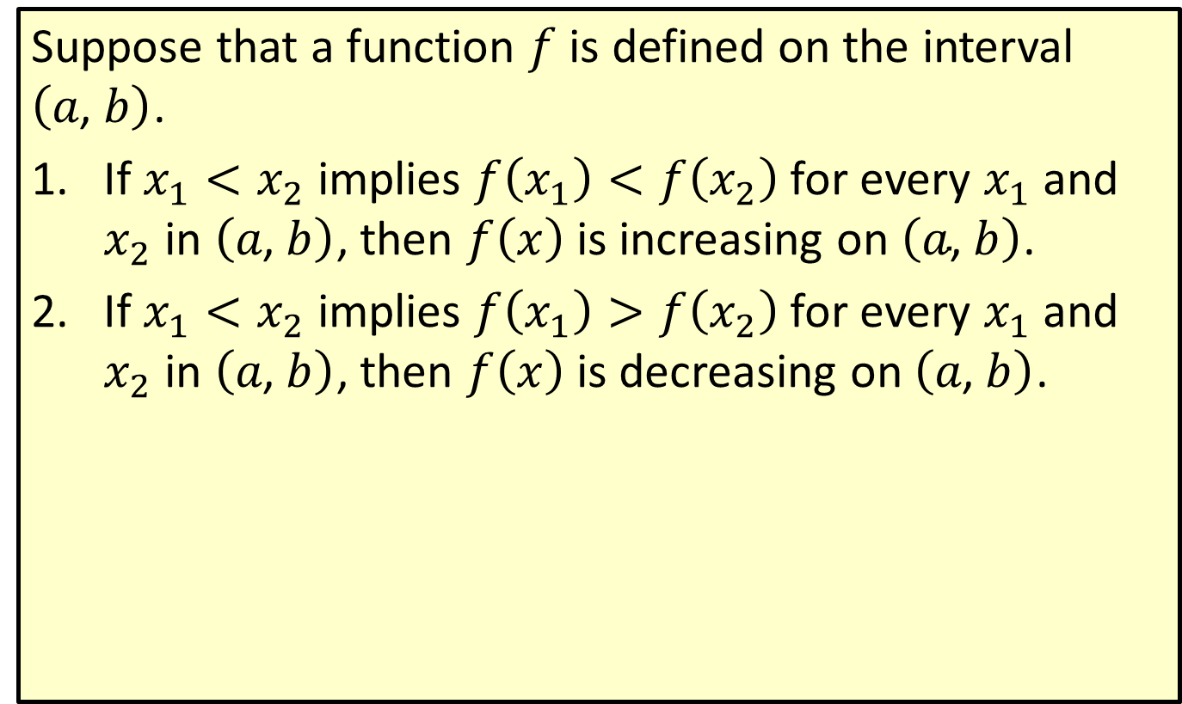
Increasing and Decreasing Intervals of a Function
Suppose that a function $f$ is defined on the interval $\left(a\text{, }b\right)$.
​If $x_{1}<x_{2}$ implies $f\left(x_{1}\right)<f\left(x_{2}\right)$ for every $x_{1}$ and $x_{2}$ in $\left(a\text{, }b\right)$, then $f⁡\left(x\right)$ is increasing on $\left(a\text{, }b\right)$.
​If $x_{1}<x_{2}$ implies $f\left(x_{1}\right)>f\left(x_{2}\right)$ for every $x_{1}$ and $x_{2}$ in $\left(a\text{, }b\right)$, then $f⁡\left(x\right)$ is decreasing on $\left(a\text{, }b\right)$.

Slide 3
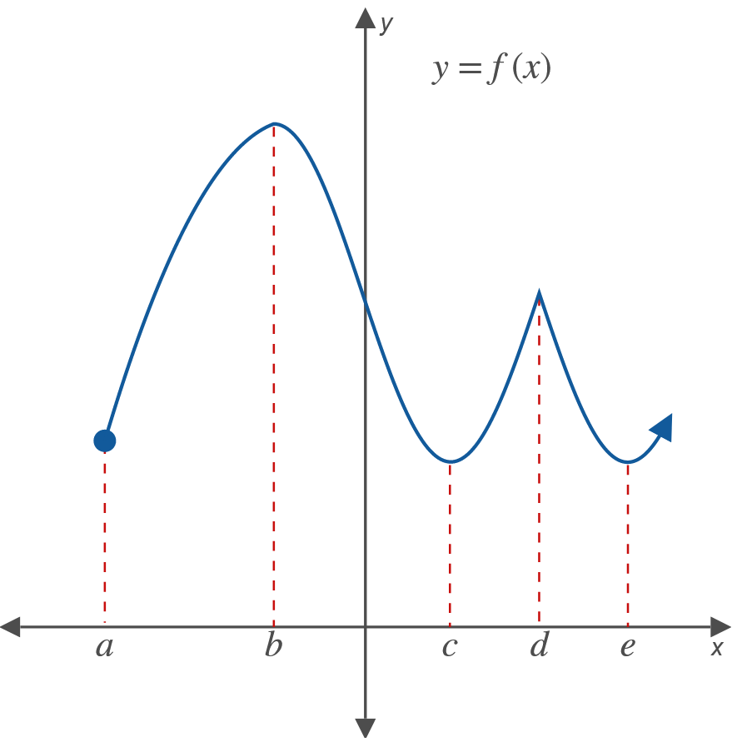
Example 1: Increasing and Decreasing Intervals (cont.)

Slide 4


Example 1: Increasing and Decreasing Intervals (cont.)
The graph of $y=f\left(x\right)$ is given. Find the intervals on which a. $f$ is increasing, and b. $f$ is decreasing.
Solution
​The function $f$ is increasing on the intervals $\left(a\text{, }b\right)$, $\left(c\text{, }d\right)$, and $\left(e\text{, }+∞\right)$.
​The function $f$ is decreasing on the intervals $\left(b\text{, }c\right)$ and $\left(d\text{, }e\right)$.

Slide 5
Note:
Positive values for the derivative indicate positive slopes for the tangent lines which in turn imply that the function is increasing. Negative values for the derivative indicate negative slopes for the tangent lines which imply that the function is decreasing.

Slide 6
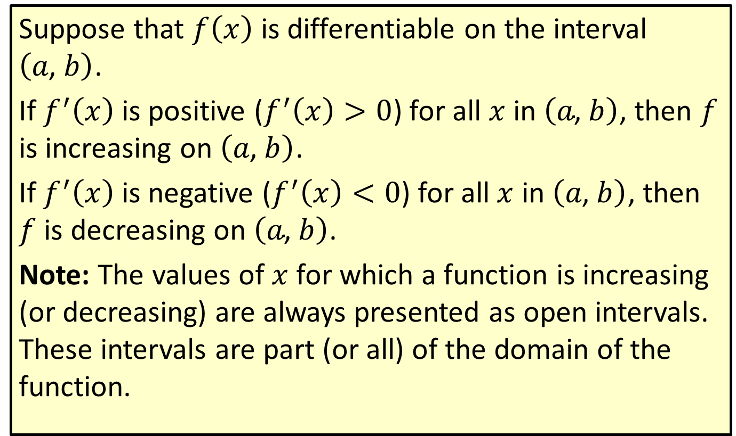
Increasing and Decreasing Intervals of a Differentiable Function
Suppose that $f⁡\left(x\right)$ is differentiable on the interval $\left(a\text{, }b\right)$.
If $f^{′}⁡\left(x\right)$ is positive ($f^{′}\left(x\right)>0$) for all $x$ in $\left(a\text{, }b\right)$, then $f$ is increasing on $\left(a\text{, }b\right)$.
If $f^{′}⁡\left(x\right)$ is negative ($f^{′}\left(x\right)<0$) for all $x$ in $\left(a\text{, }b\right)$, then $f$ is decreasing on $\left(a\text{, }b\right)$.
Note: The values of $x$ for which a function is increasing (or decreasing) are always presented as open intervals. These intervals are part (or all) of the domain of the function.

Slide 7
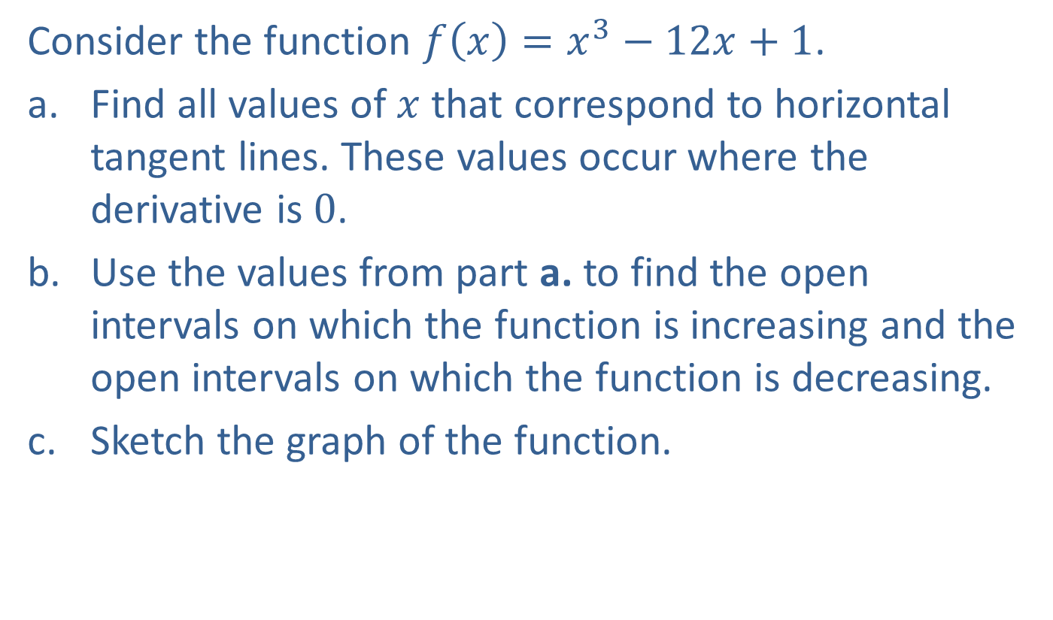
Example 2: Graphing a Function
Consider the function $f\left(x\right)=x^{3}−12x+1$.
​Find all values of $x$ that correspond to horizontal tangent lines. These values occur where the derivative is 0.
​Use the values from part a. to find the open intervals on which the function is increasing and the open intervals on which the function is decreasing.
​Sketch the graph of the function.

Slide 8
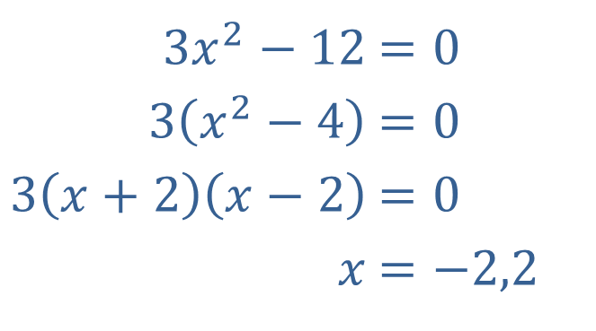

Example 2: Graphing a Function (cont.)
Solution
​$f^{′}\left(x\right)=3x^{2}−12$ Find the derivative of $f⁡\left(x\right)$.
​We set $f^{′}\left(x\right)=0$ and solve for $x$.
​
​
Horizontal tangent lines occur at $x=−2$ and $x=2$.
​$3x^{2}−12$ | ​$=0$
​$3\left(x^{2}−4\right)$ | ​$=0$
​$3\left(x+2\right)\left(x−2\right)$ | ​$=0$
​$x$ | ​$=−2,2$

Slide 9
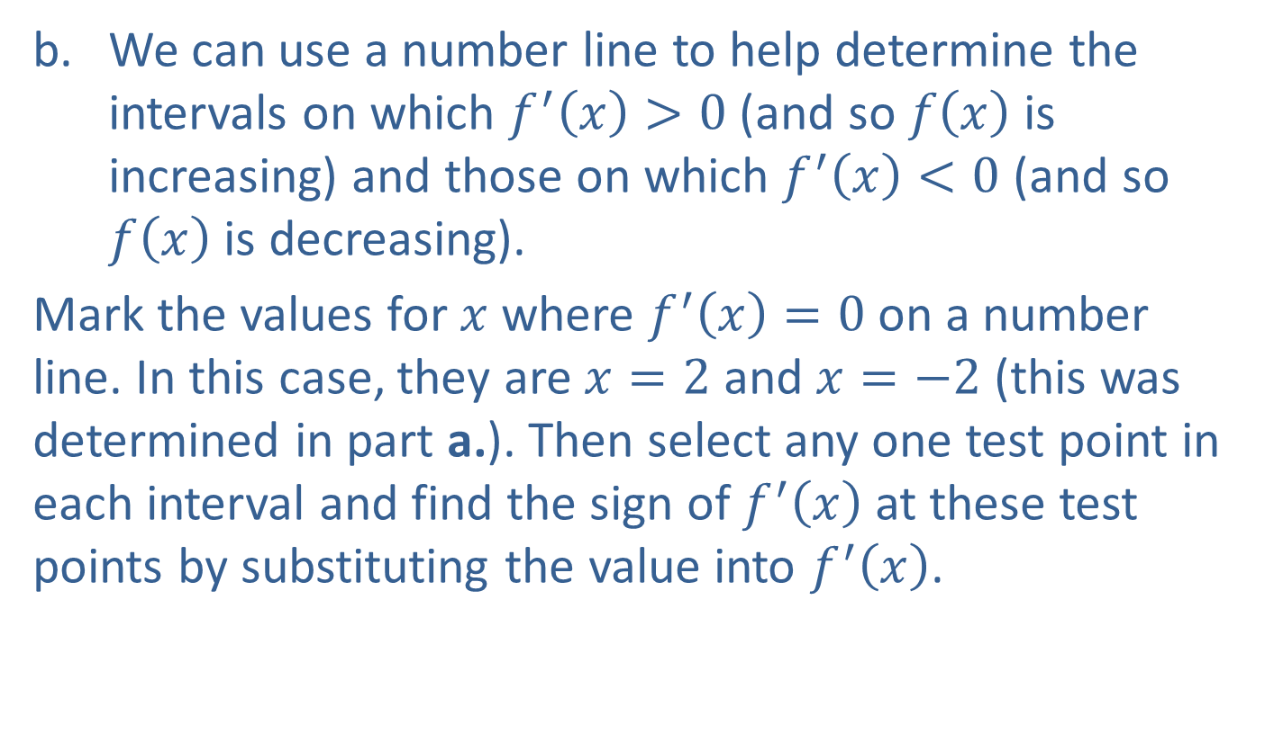
Example 2: Graphing a Function (cont.)
​We can use a number line to help determine the intervals on which $f^{′}\left(x\right)>0$ (and so $f⁡\left(x\right)$ is increasing) and those on which $f^{′}\left(x\right)<0$ (and so $f⁡\left(x\right)$ is decreasing).
​Mark the values for $x$ where $f^{′}\left(x\right)=0$ on a number line. In this case, they are $x=2$ and $x=−2$ (this was determined in part a.). Then select any one test point in each interval and find the sign of $f^{′}⁡\left(x\right)$ at these test points by substituting the value into $f^{′}⁡\left(x\right)$.
​

Slide 10
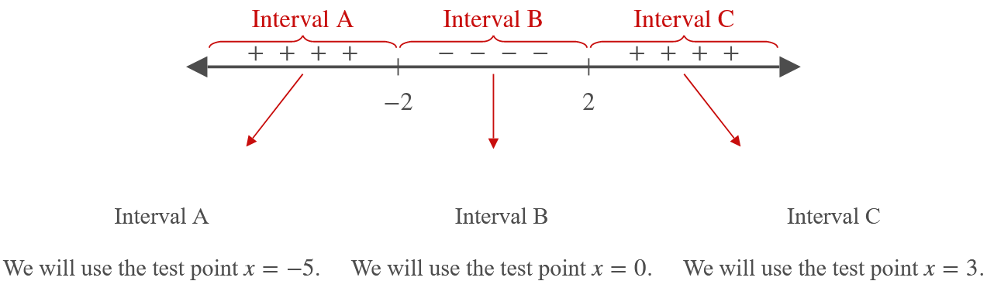



Example 2: Graphing a Function (cont.)
𝑓′−5=3−52−12𝑓′⁡−5=75−12𝑓′⁡−5=63
𝑓′0=302−12𝑓′⁡0=0−12𝑓′⁡0=−12
𝑓′3=332−12𝑓′⁡3=27−12𝑓′⁡3=15
$$63>0$$ | $$−12<0$$ | $$15>0$$

Slide 11
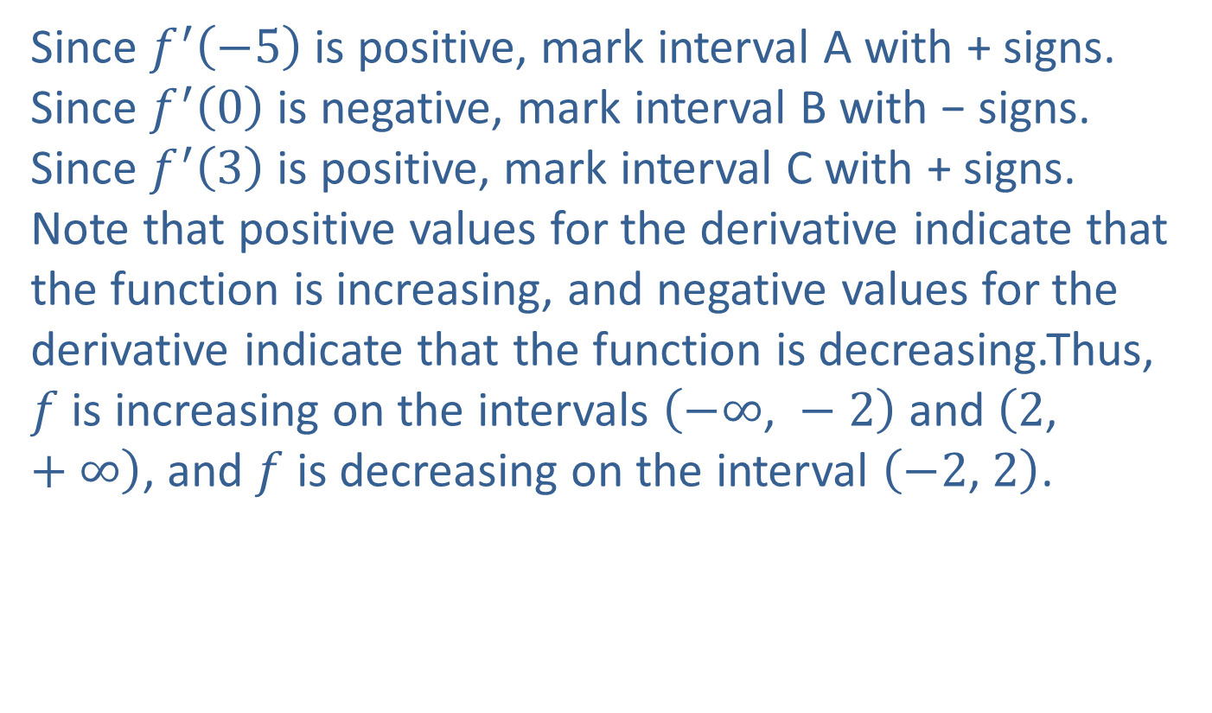
Example 2: Graphing a Function (cont.)
​Since $f^{′}⁡\left(−5\right)$ is positive, mark interval A with + signs. Since $f^{′}⁡\left(0\right)$ is negative, mark interval B with − signs. Since $f^{′}⁡\left(3\right)$ is positive, mark interval C with + signs. Note that positive values for the derivative indicate that the function is increasing, and negative values for the derivative indicate that the function is decreasing.Thus, $f$ is increasing on the intervals $\left(−∞\text{, }−2\right)$ and $\left(2\text{, }+∞\right)$, and $f$ is decreasing on the interval $\left(−2\text{, }2\right)$.

Slide 12
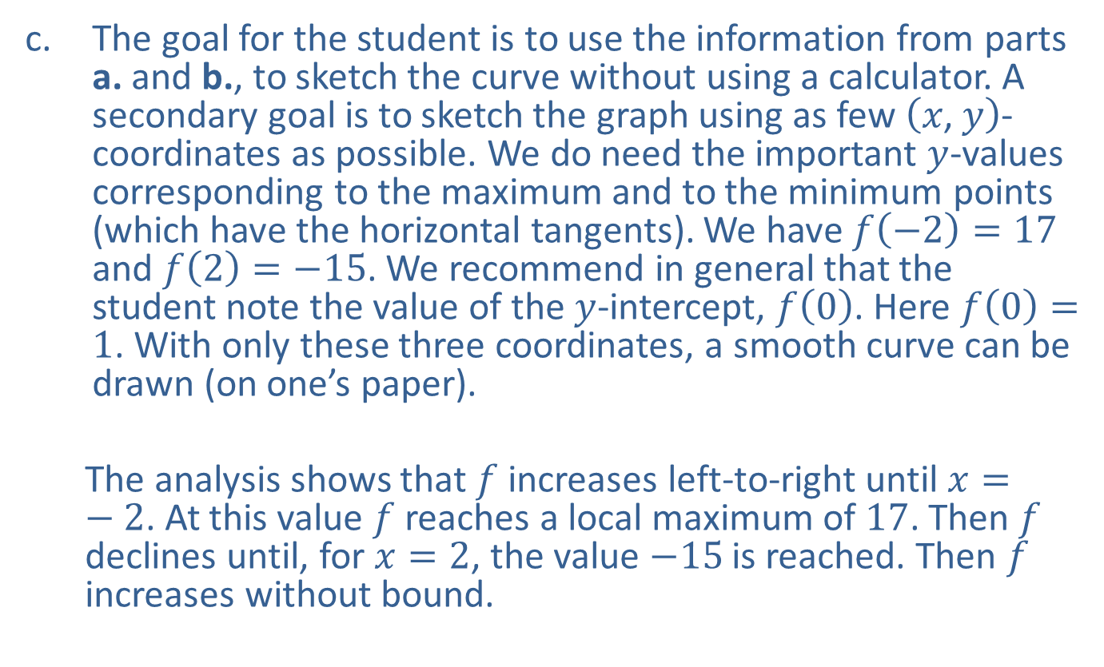
Example 2: Graphing a Function (cont.)
​The goal for the student is to use the information from parts a. and b., to sketch the curve without using a calculator. A secondary goal is to sketch the graph using as few $\left(x\text{, }y\right)$-coordinates as possible. We do need the important $y$-values corresponding to the maximum and to the minimum points (which have the horizontal tangents). We have $f\left(−2\right)=17$ and $f\left(2\right)=−15$. We recommend in general that the student note the value of the $y$-intercept, $f⁡\left(0\right)$. Here $f\left(0\right)=1$. With only these three coordinates, a smooth curve can be drawn (on one’s paper).
  ​The analysis shows that $f$ increases left-to-right until $x=−2$. At this value $f$ reaches a local maximum of 17. Then $f$ declines until, for $x=2$, the value $−15$ is reached. Then $f$ increases without bound.​

Slide 13
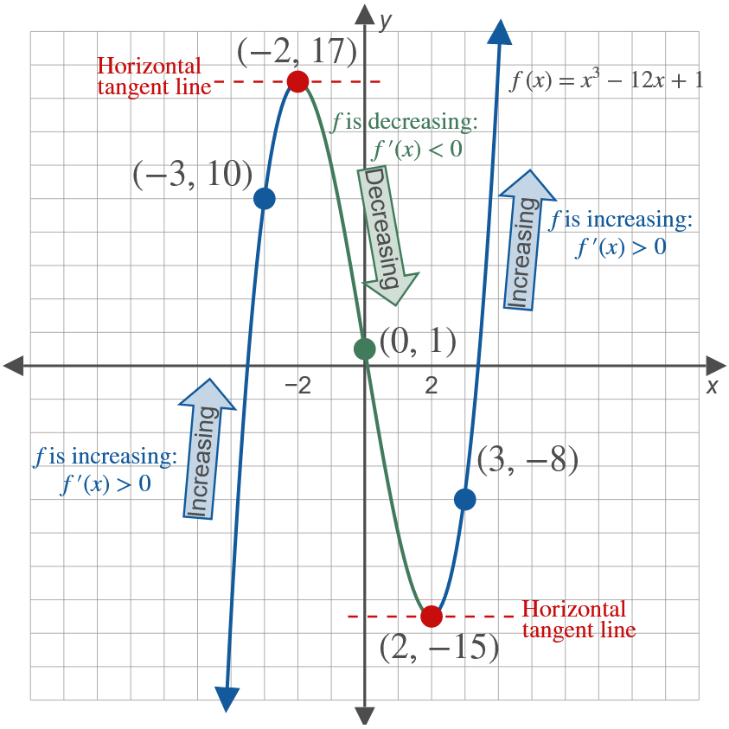
Example 2: Graphing a Function (cont.)

Slide 14

Example 3: Graphing a Function
Consider the function $y=x^{3}+1$.
​Find all values of $x$ where the derivative is 0.
​Determine where the function is increasing and where it is decreasing.
​Sketch its graph.

Slide 15
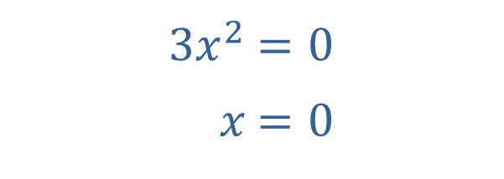

Example 3: Graphing a Function (cont.)
Solution
​$\frac{dy}{dx}=3x^{2}$ Find the derivative of $y$.
​Set $\frac{dy}{dx}=0$ and solve for $x$.
​
​
A horizontal tangent line occurs at $x=0$.
​$3x^{2}$ | ​$=0$
​$x$ | ​$=0$

Slide 16
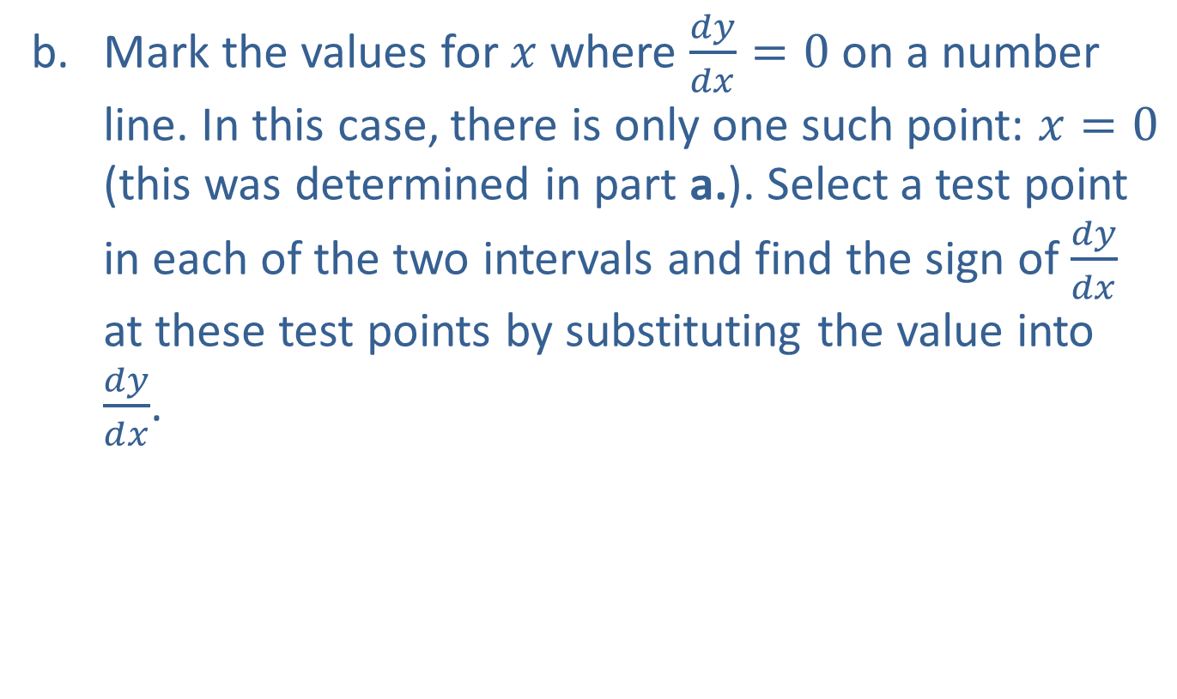
Example 3: Graphing a Function (cont.)
​Mark the values for $x$ where $\frac{dy}{dx}=0$ on a number line. In this case, there is only one such point: $x=0$ (this was determined in part a.). Select a test point in each of the two intervals and find the sign of $\frac{dy}{dx}$ at these test points by substituting the value into $\frac{dy}{dx}$.
​

Slide 17
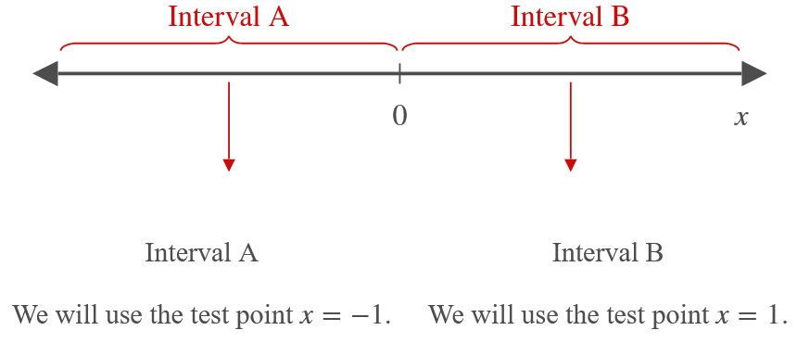


Example 3: Graphing a Function (cont.)
𝑑𝑦𝑑𝑥𝑥=−1=3−12𝑑𝑦𝑑𝑥𝑥=−1=3
𝑑𝑦𝑑𝑥𝑥=1=312𝑑𝑦𝑑𝑥𝑥=1=3
$$3>0$$ | $$3>0$$

Slide 18
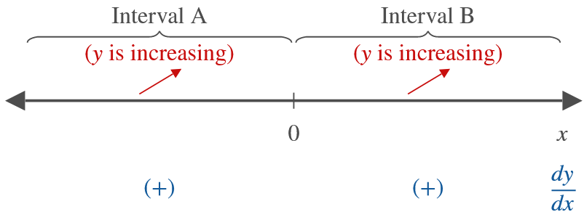

Example 3: Graphing a Function (cont.)
Since $\frac{dy}{dx}=3x^{2}≥0$ for all $x$, $y$ is increasing on
$\left(−∞\text{, }+∞\right)$.

Slide 19

Example 3: Graphing a Function (cont.)
​Part a. determined a horizontal tangent at $x=0$, and part b. showed that $y$ is increasing on the interval $\left(−∞\text{, }+∞\right)$. (Note: Since $y$ is increasing on either side of 0, it is also increasing on any interval that contains 0.)
​

Slide 20
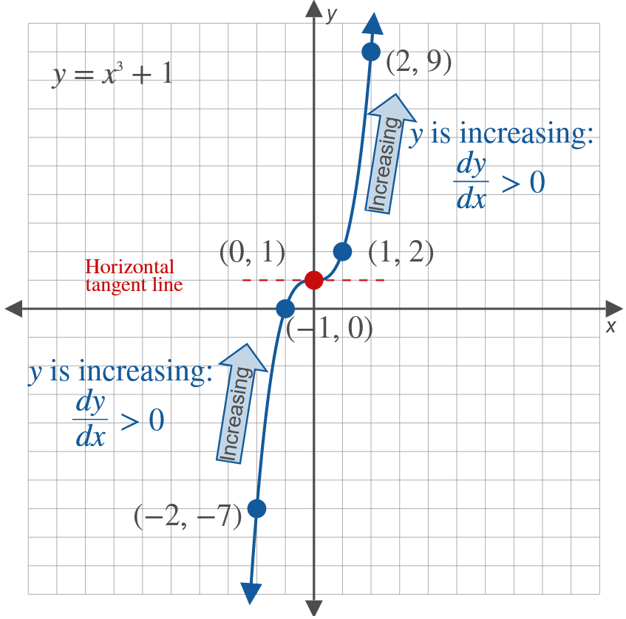
Example 3: Graphing a Function (cont.)

Slide 21
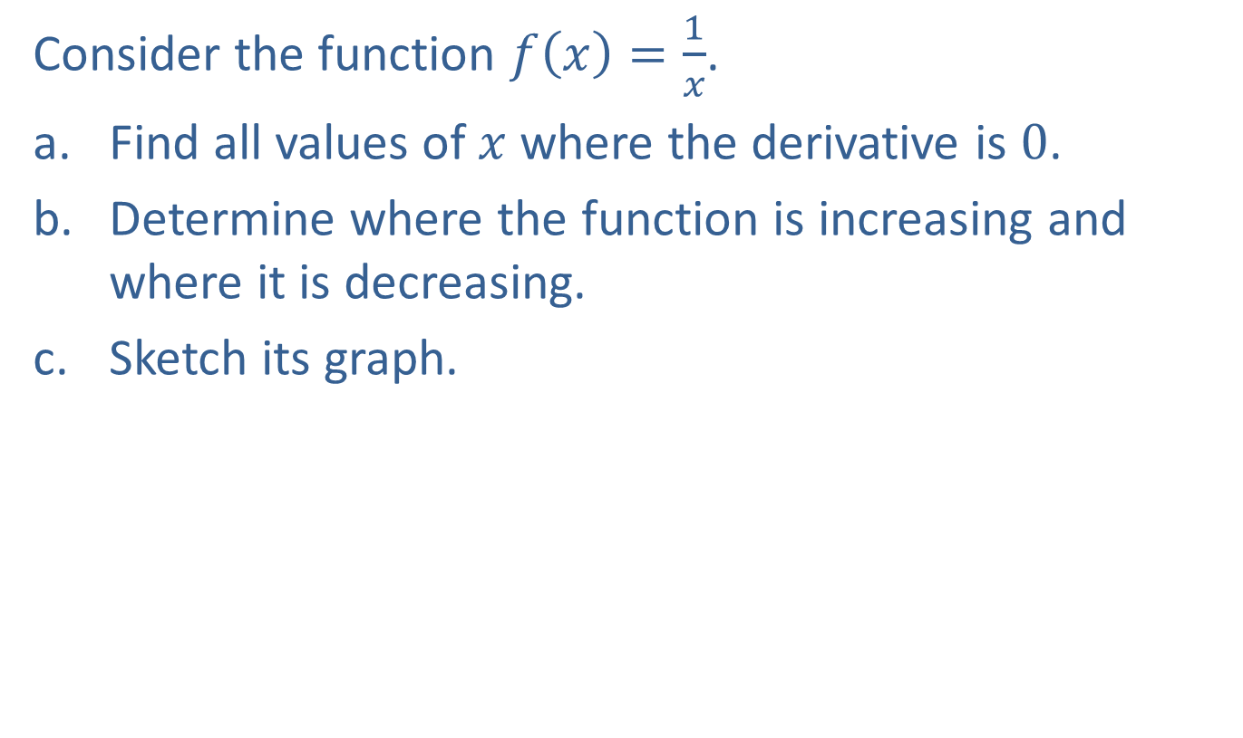
Example 4: Graphing a Function
Consider the function $f\left(x\right)=\frac{1}{x}$.
​Find all values of $x$ where the derivative is 0.
​Determine where the function is increasing and where it is decreasing.
​Sketch its graph.

Slide 22
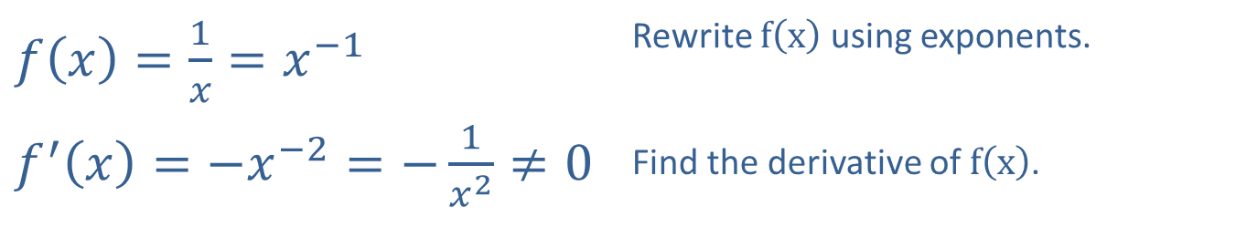
Example 4: Graphing a Function (cont.)
Solution
​
​$f\left(x\right)=\frac{1}{x}=x^{−1}$ | Rewrite $f⁡\left(x\right)$ using exponents.
​$f^{′}\left(x\right)=−x^{−2}=−\frac{1}{x^{2}}≠0$ | Find the derivative of $f⁡\left(x\right)$.

Slide 23
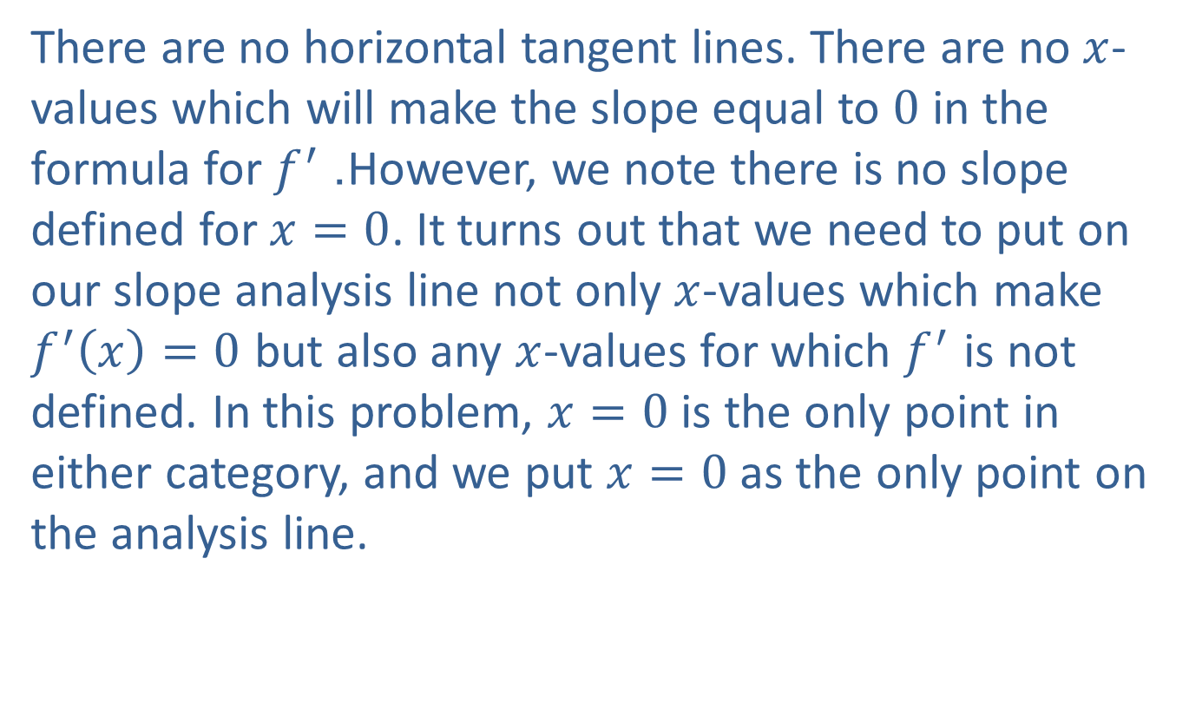
Example 4: Graphing a Function (cont.)
​There are no horizontal tangent lines. There are no $x$-values which will make the slope equal to 0 in the formula for $f^{′}$. However, we note there is no slope defined for $x=0$. It turns out that we need to put on our slope analysis line not only $x$-values which make $f^{′}\left(x\right)=0$ but also any $x$-values for which $f^{′}$ is not defined. In this problem, $x=0$ is the only point in either category, and we put $x=0$ as the only point on the analysis line.

Slide 24
Example 4: Graphing a Function (cont.)
​Note that we still investigate the derivative on either side of 0 to help determine the nature of the graph.
​

Slide 25
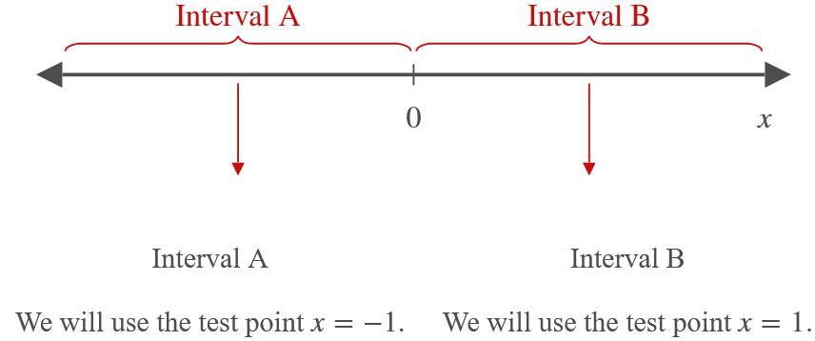


Example 4: Graphing a Function (cont.)
​
𝑓′−1=−1−12𝑓′⁡−1=−1
𝑓′1=−112𝑓′⁡1=−1
$$−1<0$$ | $$−1<0$$

Slide 26
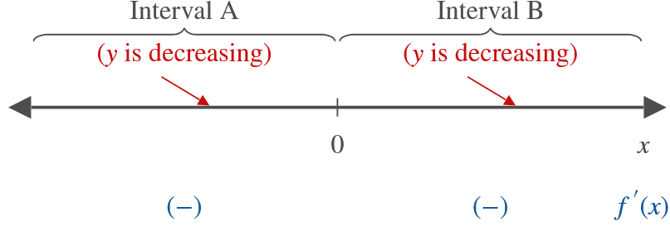
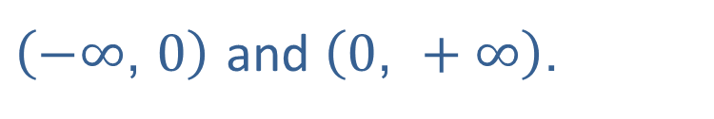
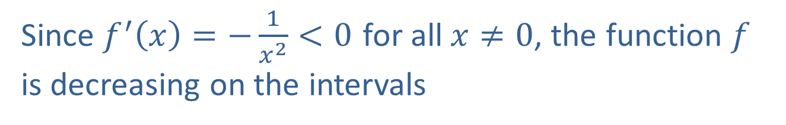
Example 4: Graphing a Function (cont.)
Since $f^{′}\left(x\right)=−\frac{1}{x^{2}}<0$ for all $x≠0$, the function $f$ is decreasing on the intervals
$\left(−∞\text{, }0\right)$ and $\left(0\text{, }+∞\right)$.

Slide 27

Example 4: Graphing a Function (cont.)
​The line $x=0$ is a vertical asymptote. The curve approaches this line without touching it. There is also a horizontal asymptote at $y=0$.
​

Slide 28
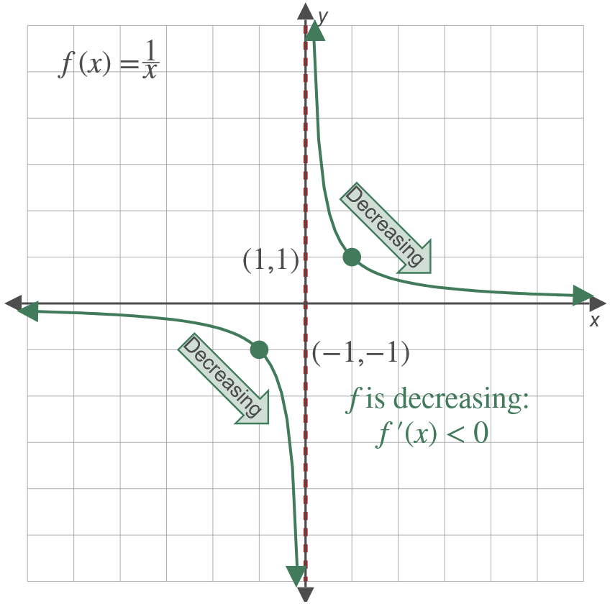
Example 4: Graphing a Function (cont.)

Slide 29


Example 5: Graphing $f$ ′($x$)
The graph for $y=f\left(x\right)$ is given below. Mark the portions which show where $f^{′}⁡\left(x\right)$ is negative, positive, or zero. Draw a possible $f^{′}⁡\left(x\right)$ by estimating the absolute values of the slopes on $f⁡\left(x\right)$.

Slide 30
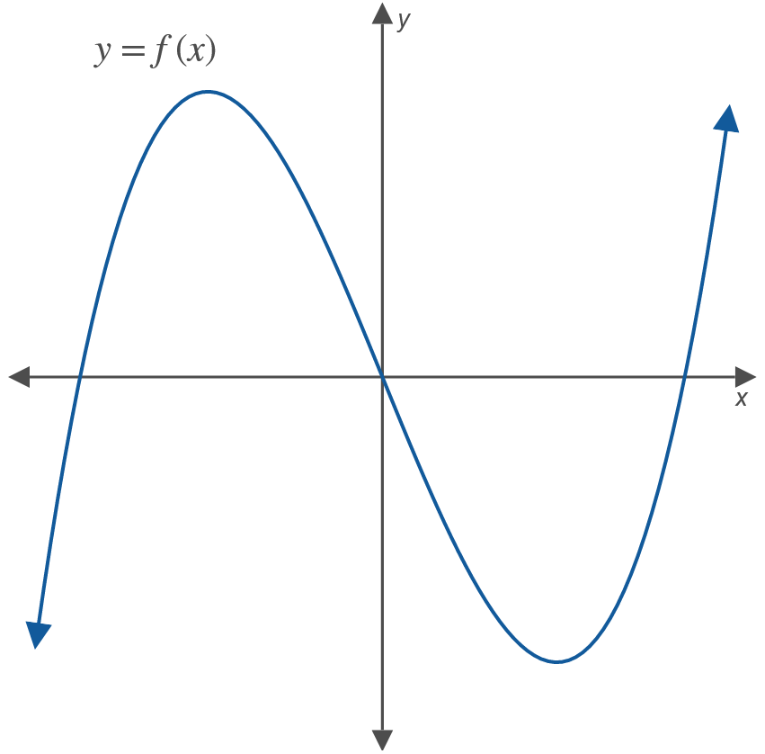

Example 5: Graphing $f$ ′($x$) (cont.)

Slide 31
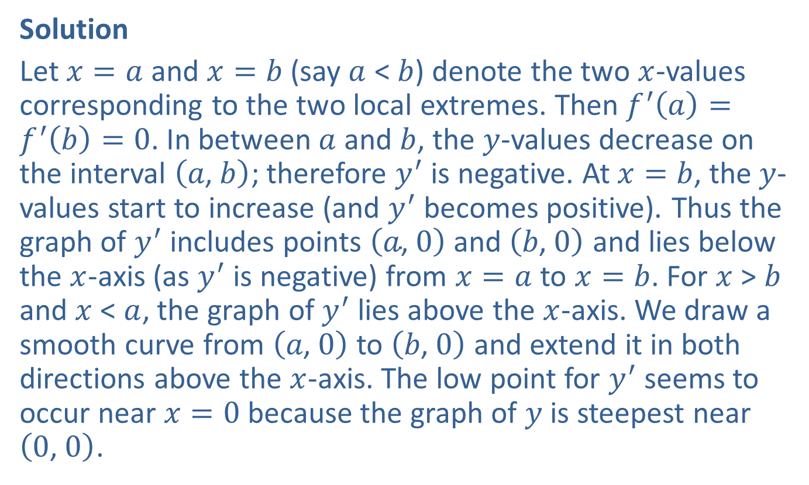
Example 5: Graphing $f$ ′($x$) (cont.)
Solution
Let $x=a$ and $x=b$ (say $a$ < $b$) denote the two $x$-values corresponding to the two local extremes. Then $f^{′}\left(a\right)=f^{′}\left(b\right)=0$. In between $a$ and $b$, the $y$-values decrease on the interval $\left(a\text{, }b\right)$; therefore $y^{′}$ is negative. At $x=b$, the $y$-values start to increase (and $y^{′}$ becomes positive). Thus the graph of $y^{′}$ includes points $\left(a\text{, }0\right)$ and $\left(b\text{, }0\right)$ and lies below the $x$-axis (as $y^{′}$ is negative) from $x=a$ to $x=b$. For $x$ > $b$ and $x$ < $a$, the graph of $y^{′}$ lies above the $x$-axis. We draw a smooth curve from $\left(a\text{, }0\right)$ to $\left(b\text{, }0\right)$ and extend it in both directions above the $x$-axis. The low point for $y^{′}$ seems to occur near $x=0$ because the graph of $y$ is steepest near $\left(0\text{, }0\right)$.

Slide 32
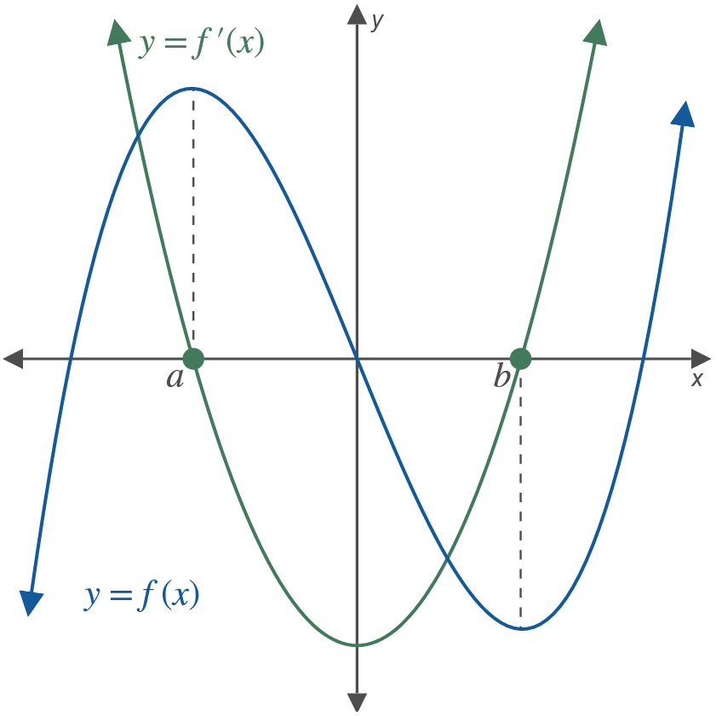
Example 5: Graphing $f$ ′($x$) (cont.)

