Slide 1
Section 3.5
Critical Values and the First Derivative Test

Slide 2
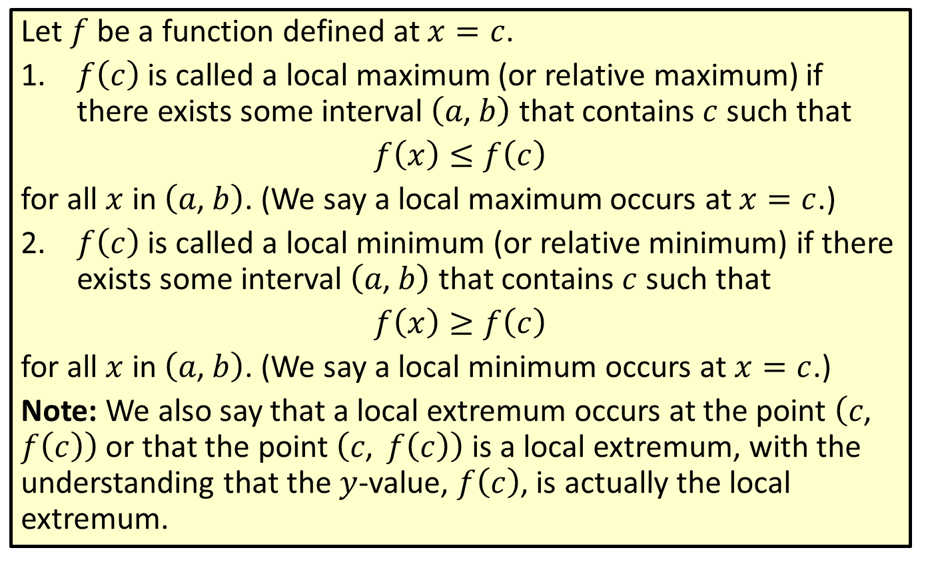
Local Maximum and Local Minimum
Let $f$ be a function defined at $x=c$.
​$f⁡\left(c\right)$ is called a local maximum (or relative maximum) if there exists some interval $\left(a\text{, }b\right)$ that contains $c$ such that
​$f\left(x\right)≤f\left(c\right)$
​for all $x$ in $\left(a\text{, }b\right)$. (We say a local maximum occurs at $x=c$.)
​$f⁡\left(c\right)$ is called a local minimum (or relative minimum) if there exists some interval $\left(a\text{, }b\right)$ that contains $c$ such that
​$f\left(x\right)≥f\left(c\right)$
​for all $x$ in $\left(a\text{, }b\right)$. (We say a local minimum occurs at $x=c$.)
Note: We also say that a local extremum occurs at the point $\left(c\text{, }f\left(c\right)\right)$ or that the point $\left(c\text{, }f\left(c\right)\right)$ is a local extremum, with the understanding that the $y$-value, $f⁡\left(c\right)$, is actually the local extremum.

Slide 3
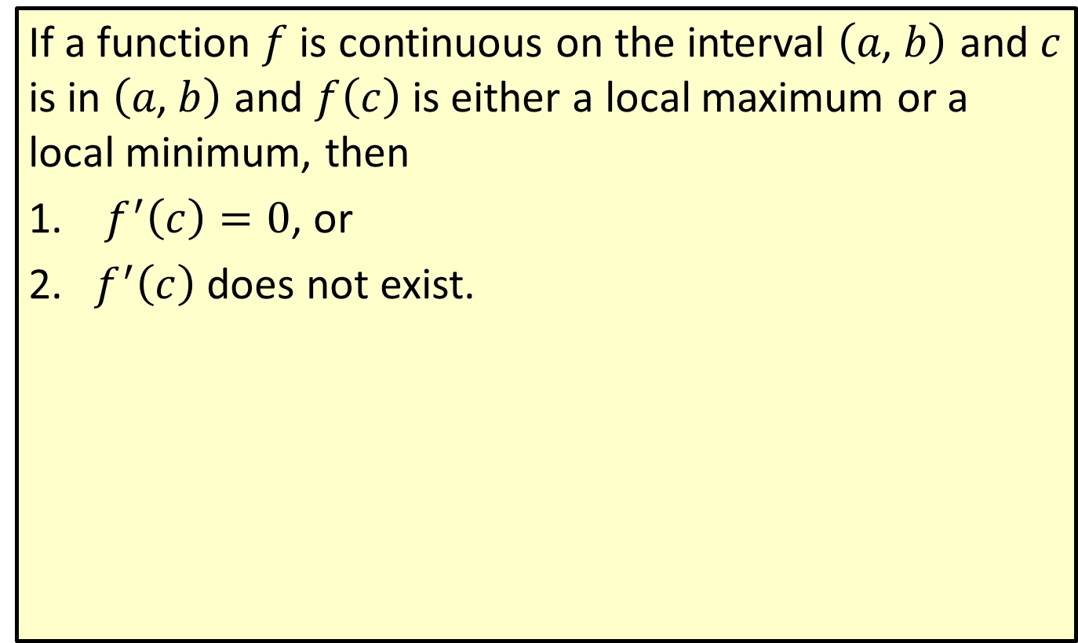
Theorem of Local Extrema
If a function $f$ is continuous on the interval $\left(a\text{, }b\right)$ and $c$ is in $\left(a\text{, }b\right)$ and $f⁡\left(c\right)$ is either a local maximum or a local minimum, then
​ $f^{′}\left(c\right)=0$, or
​$f^{′}⁡\left(c\right)$ does not exist.

Slide 4
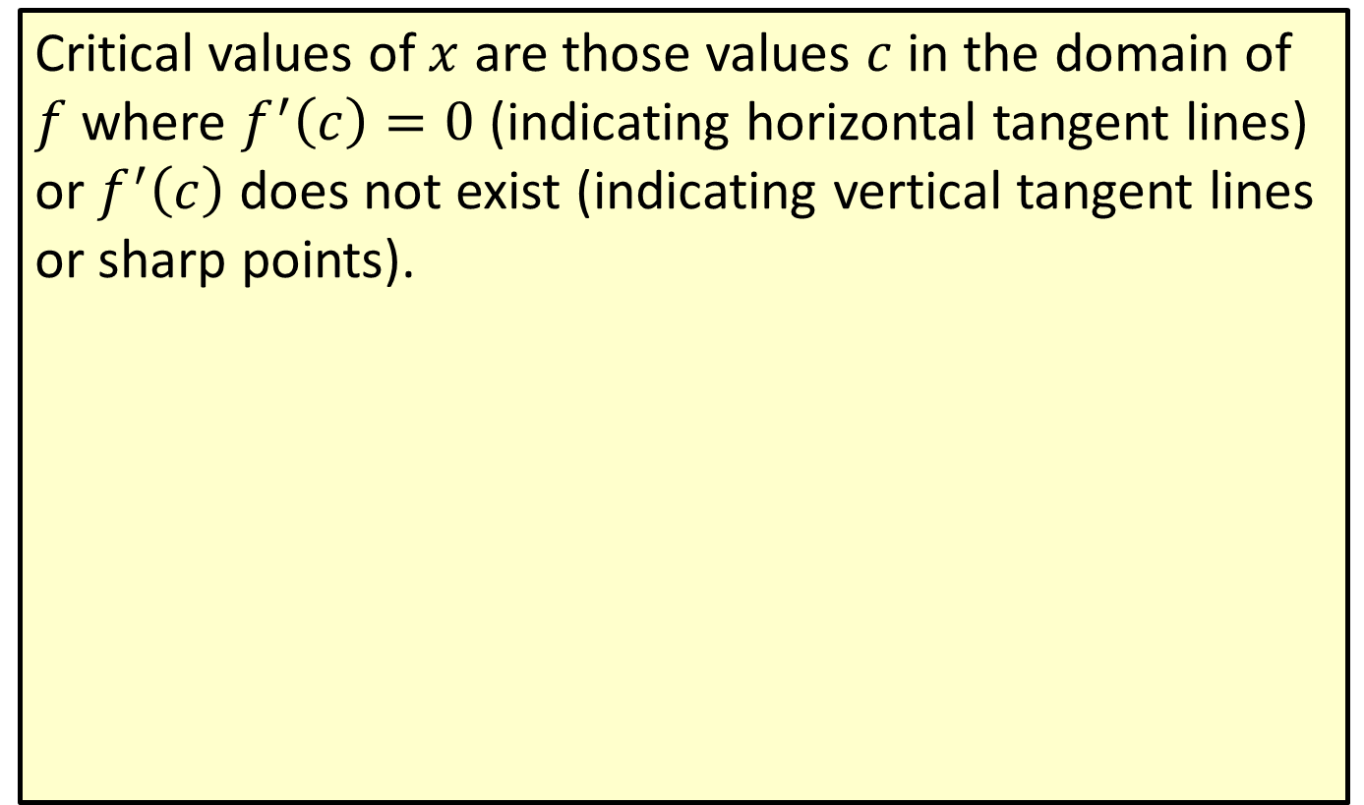
Critical Values
Critical values of $x$ are those values $c$ in the domain of $f$ where $f^{′}\left(c\right)=0$ (indicating horizontal tangent lines) or $f^{′}⁡\left(c\right)$ does not exist (indicating vertical tangent lines or sharp points).

Slide 5
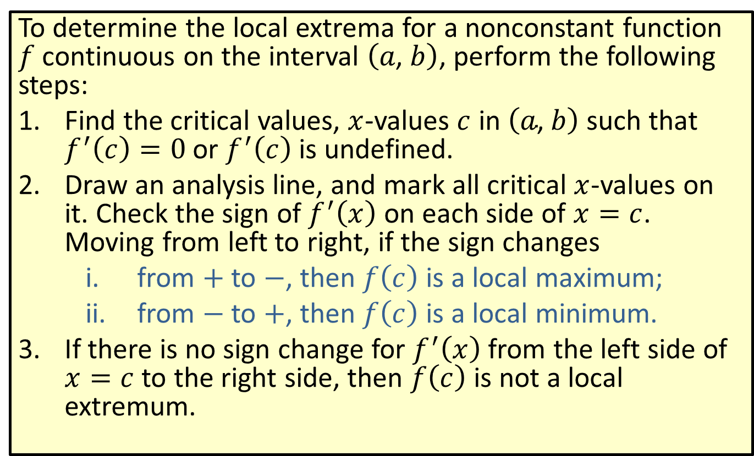
The First Derivative Test for Local Extrema
To determine the local extrema for a nonconstant function $f$ continuous on the interval $\left(a\text{, }b\right)$, perform the following steps:
​Find the critical values, $x$-values $c$ in $\left(a\text{, }b\right)$ such that $f^{′}\left(c\right)=0$ or $f^{′}⁡\left(c\right)$ is undefined.
​Draw an analysis line, and mark all critical $x$-values on it. Check the sign of $f^{′}⁡\left(x\right)$ on each side of $x=c$. Moving from left to right, if the sign changes
​from + to −, then $f⁡\left(c\right)$ is a local maximum;
​from − to +, then $f⁡\left(c\right)$ is a local minimum.
​If there is no sign change for $f^{′}⁡\left(x\right)$ from the left side of $x=c$ to the right side, then $f⁡\left(c\right)$ is not a local extremum.

Slide 6
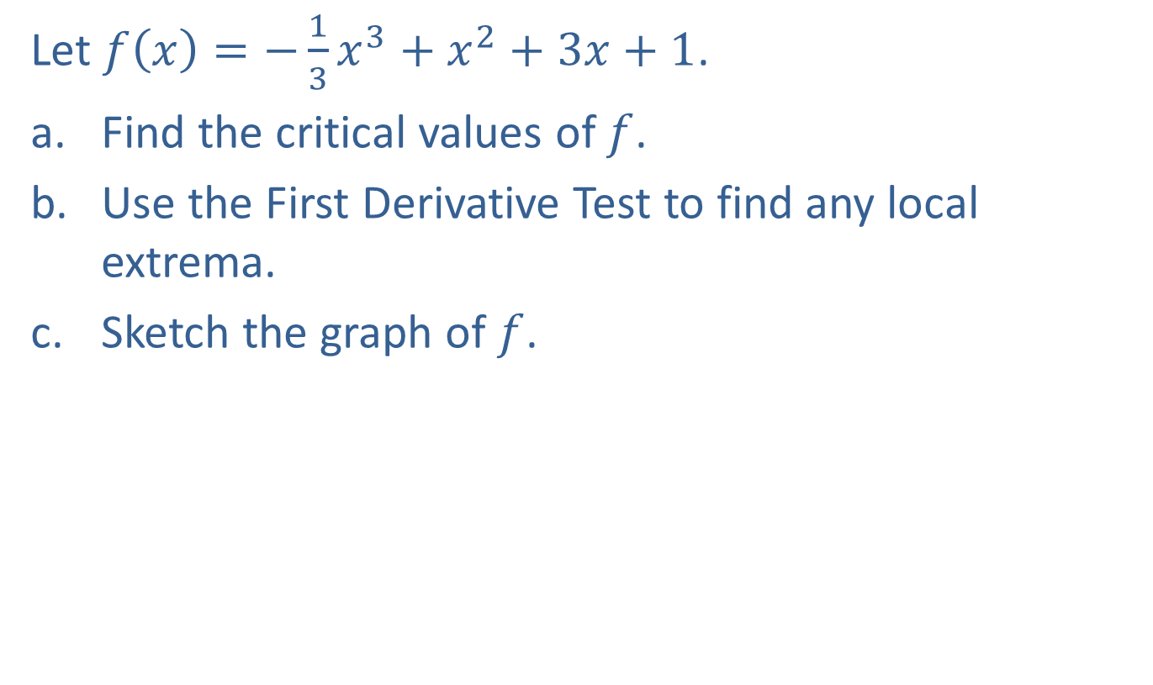
Example 1: Using the First Derivative Test
Let $f\left(x\right)=−\frac{1}{3}x^{3}+x^{2}+3x+1$.
​Find the critical values of $f$.
​Use the First Derivative Test to find any local extrema.
​Sketch the graph of $f$.

Slide 7
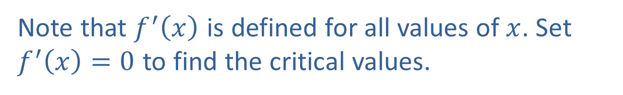
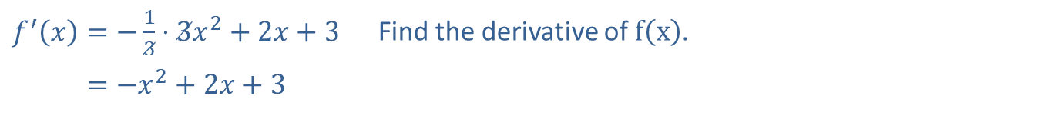
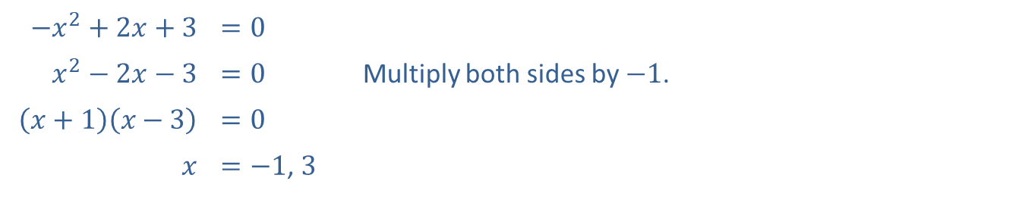
Example 1: Using the First Derivative Test (cont.)
Solution
​
​$f^{′}\left(x\right)=−\frac{1}{3}⋅3x^{2}+2x+3$ | Find the derivative of $f⁡\left(x\right)$.
​𝑓′⁡𝑥=−𝑥2+2𝑥+3
Note that $f^{′}⁡\left(x\right)$ is defined for all values of $x$. Set $f^{′}\left(x\right)=0$ to find the critical values.
​$−x^{2}+2x+3$ | ​$=0$
​$x^{2}−2x−3$ | ​$=0$ | Multiply both sides by $−1$.
​$\left(x+1\right)\left(x−3\right)$ | ​$=0$
$$x$$ | ​$=−1$, 3
​Thus the critical values are $x=−1$ and $x=3$.

Slide 8
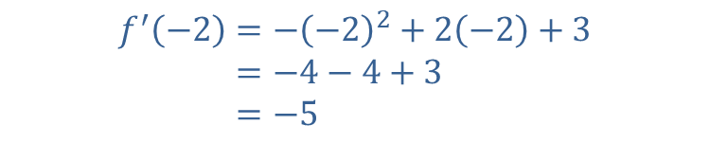




Example 1: Using the First Derivative Test (cont.)
​Step 1 of the First Derivative Test was completed in part a. Now we need to check the sign of $f^{′}⁡\left(x\right)$ on either side of each critical value (Step 2).
​
Interval A | Interval B | Interval C
We will use the test point $x=−2$. | We will use the test point $x=0$. | We will use the test point $x=5$.
𝑓′−2=−−22+2−2+3𝑓′⁡−2=−4−4+3𝑓′⁡−2=−5
𝑓′0=−02+20+3𝑓′⁡0=0+0+3𝑓′⁡0=3
𝑓′5=−52+25+3𝑓′⁡5=−25+10+3𝑓′⁡5=−12
$$−5<0$$ | $$3>0$$ | $$−12<0$$

Slide 9
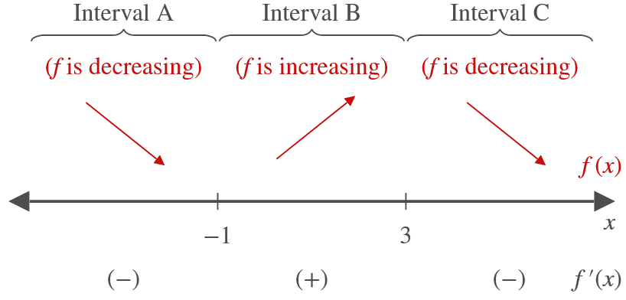
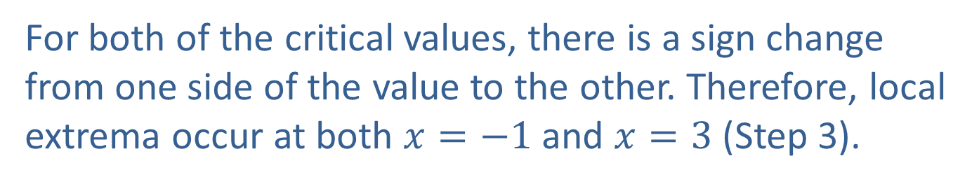
Example 1: Using the First Derivative Test (cont.)
​For both of the critical values, there is a sign change from one side of the value to the other. Therefore, local extrema occur at both $x=−1$ and $x=3$ (Step 3).

Slide 10
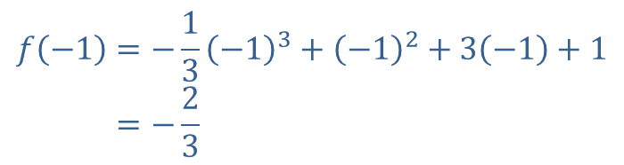

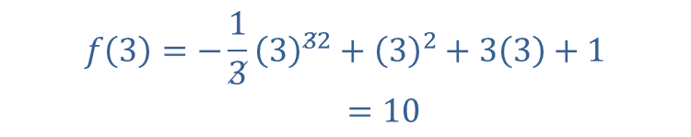
Example 1: Using the First Derivative Test (cont.)
​We compute the $y$-values as follows.
​
𝑓−1=−13−13+−12+3−1+1𝑓⁡−1=−23
𝑓3=−13332+32+33+1𝑓⁡3=10
​ $\left(−1\text{, }−\frac{2}{3}\right)$ is a local minimum. | $\left(3\text{, }10\right)$ is a local maximum.

Slide 11
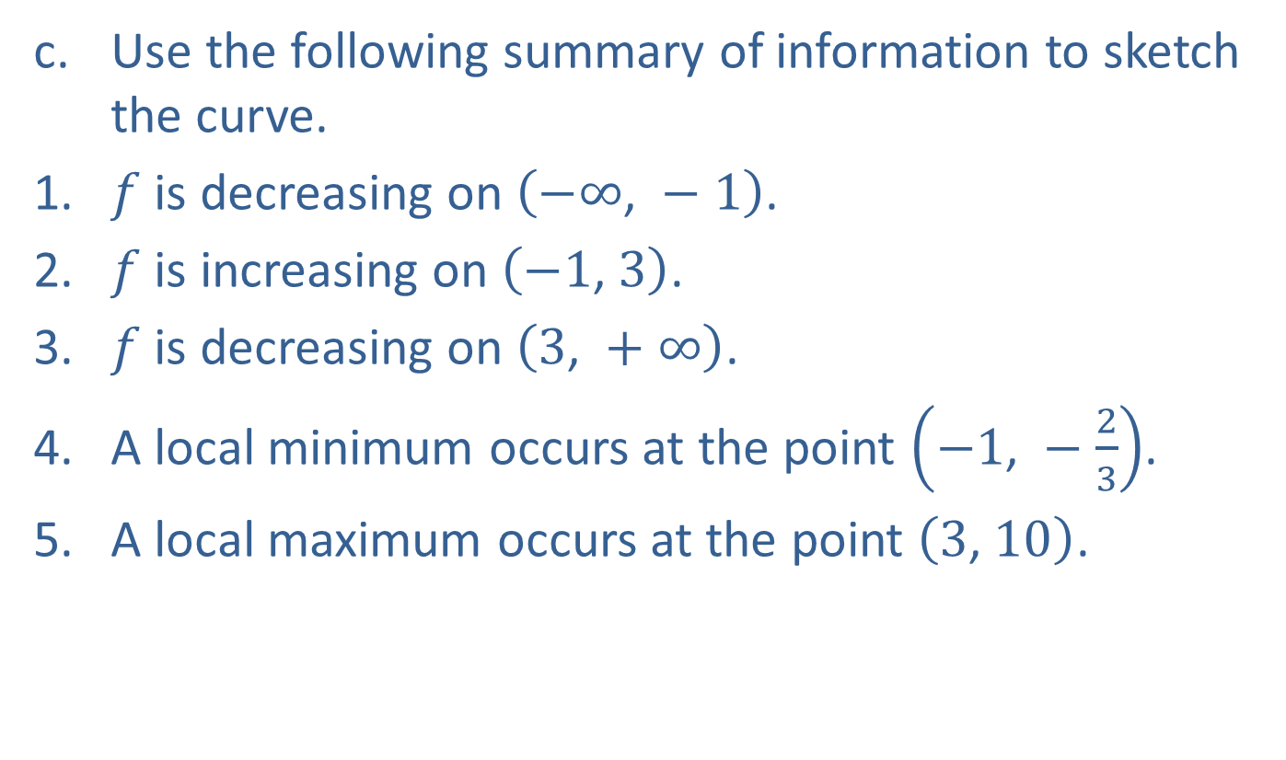
Example 1: Using the First Derivative Test (cont.)
​Use the following summary of information to sketch the curve.
​$f$ is decreasing on $\left(−∞\text{, }−1\right)$.
​$f$ is increasing on $\left(−1\text{, }3\right)$.
​$f$ is decreasing on $\left(3\text{, }+∞\right)$.
​A local minimum occurs at the point $\left(−1\text{, }−\frac{2}{3}\right)$.
​A local maximum occurs at the point $\left(3\text{, }10\right)$.

Slide 12
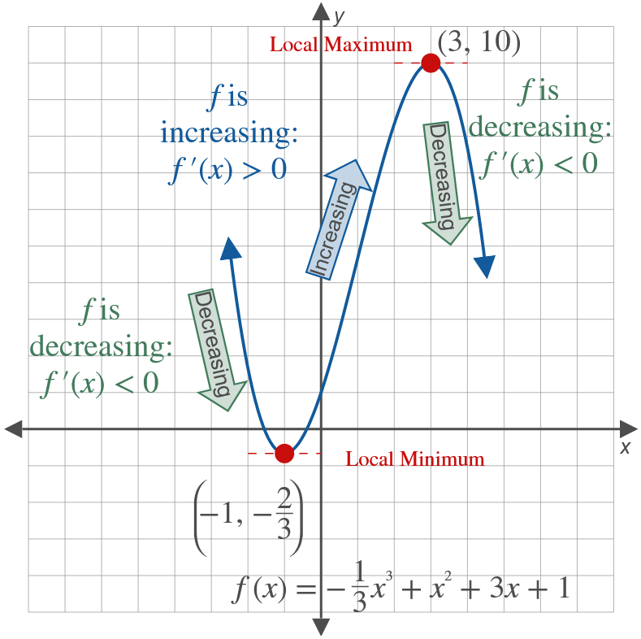
Example 1: Using the First Derivative Test (cont.)

Slide 13

Example 2: Using the First Derivative Test
Let $f\left(x\right)={\left(x−2\right)}^{3}+1$.
​Find the critical values of $f$.
​Use the First Derivative Test to find any local extrema.
​Sketch the graph of $f$.

Slide 14
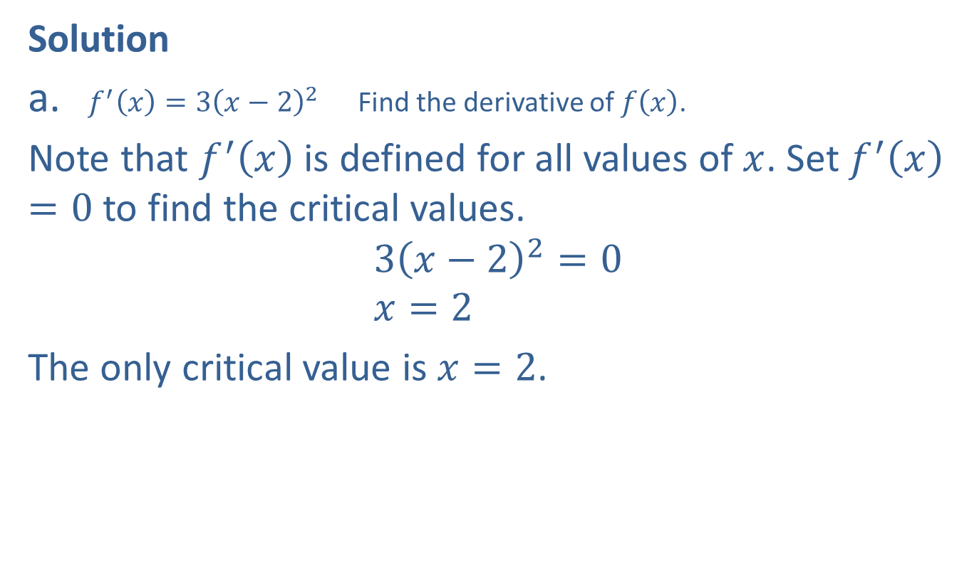
Example 2: Using the First Derivative Test (cont.)
Solution
​$f^{′}\left(x\right)=3{\left(x−2\right)}^{2}$ Find the derivative of $f⁡\left(x\right)$.
​Note that $f^{′}⁡\left(x\right)$ is defined for all values of $x$. Set $f^{′}⁡\left(x\right)=0$ to find the critical values.
$$3{\left(x−2\right)}^{2}=0 \\ x=2$$
​The only critical value is $x=2$.

Slide 15

Example 2: Using the First Derivative Test (cont.)
​Step 1 of the First Derivative Test was completed in part a. Now we need to check the sign of $f^{′}⁡\left(x\right)$ on either side of the critical value (Step 2).
​

Slide 16
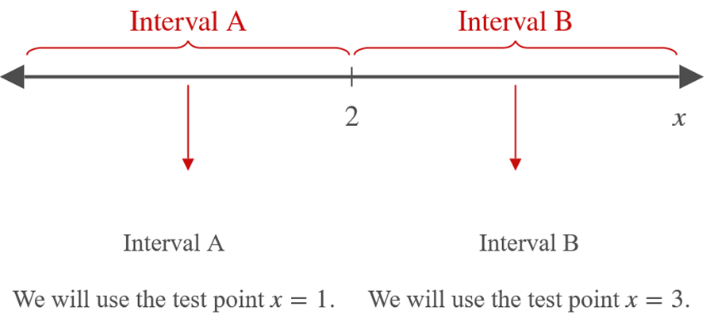


Example 2: Using the First Derivative Test (cont.)
𝑓′1=31−22𝑓′⁡1=3
𝑓′3=33−22𝑓′⁡3=3
$$3>0$$ | $$3>0$$

Slide 17
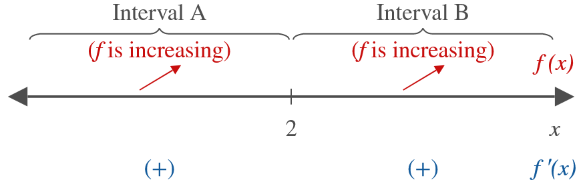
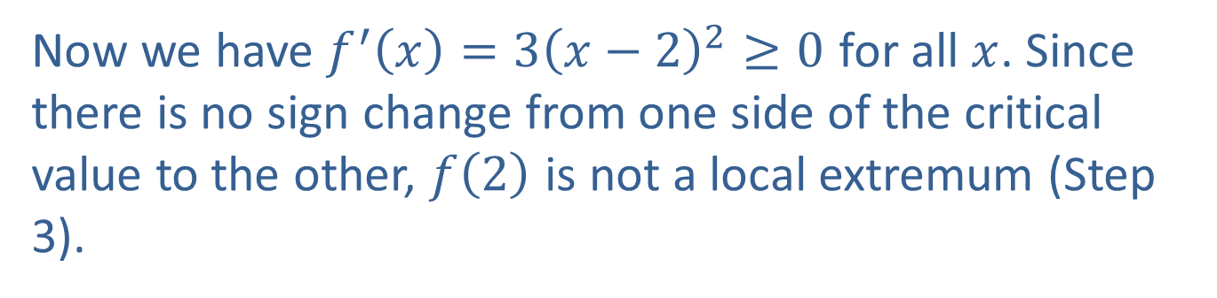
Example 2: Using the First Derivative Test (cont.)
​
​Now we have $f^{′}\left(x\right)=3{\left(x−2\right)}^{2}≥0$ for all $x$. Since there is no sign change from one side of the critical value to the other, $f⁡\left(2\right)$ is not a local extremum (Step 3).

Slide 18

Example 2: Using the First Derivative Test (cont.)
​Use the following summary of information to sketch the curve.
​$f$ is increasing on $\left(−∞\text{, }+∞\right)$.
​ $f^{′}\left(2\right)=0$, but the point $\left(2\text{, }1\right)$ is not a local extremum.

Slide 19
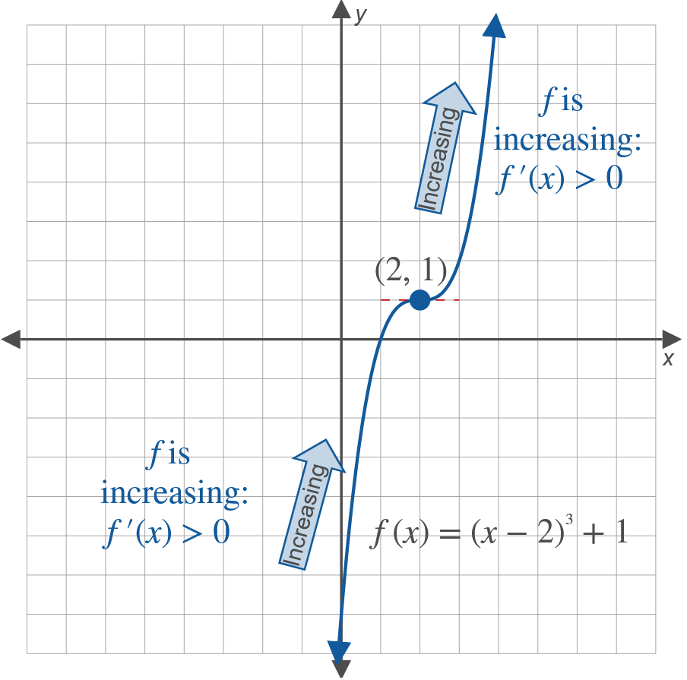
Example 2: Using the First Derivative Test (cont.)

Slide 20
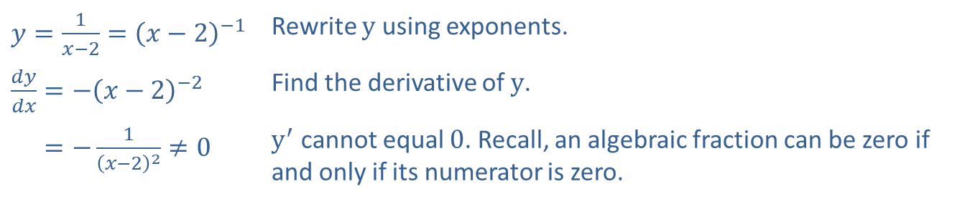

Example 3: Critical Values
Find the critical values for the function $y=\frac{1}{x−2}$.
Solution
​$y=\frac{1}{x−2}={\left(x−2\right)}^{−1}$ | Rewrite $y$ using exponents.
​$\frac{dy}{dx}=−{\left(x−2\right)}^{−2}$ | Find the derivative of $y$.
​𝑑𝑦𝑑𝑥=−1𝑥−22≠0 | $y^{′}$ cannot equal 0. Recall, an algebraic fraction can be zero if and only if its numerator is zero.

Slide 21
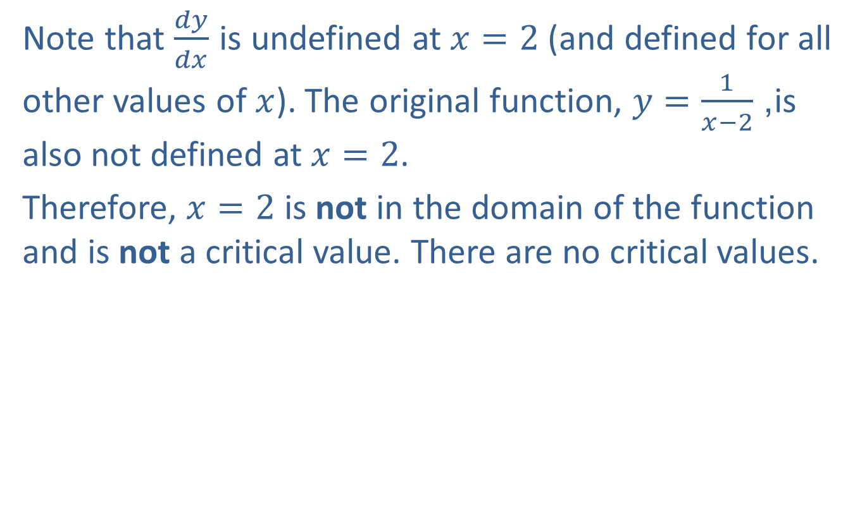
Example 3: Critical Values (cont.)
Note that $\frac{dy}{dx}$ is undefined at $x=2$ (and defined for all other values of $x$). The original function, $y=\frac{1}{x−2}$, is also not defined at $x=2$.
Therefore, $x=2$ is not in the domain of the function and is not a critical value. There are no critical values.

Slide 22
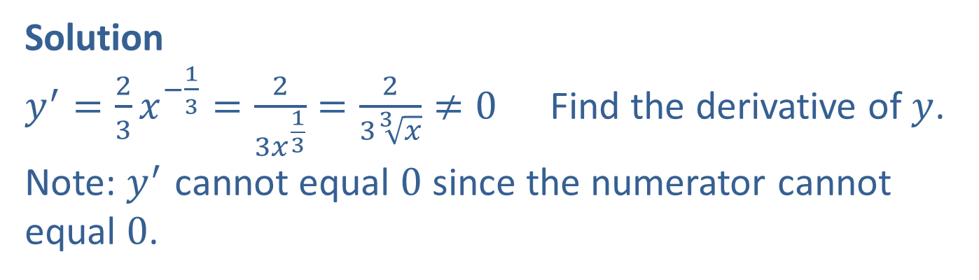

Example 4: Critical Values
Find the critical values for the function $y=x^{\frac{2}{3}}$.
Solution
$y^{′}=\frac{2}{3}x^{−\frac{1}{3}}=\frac{2}{3x^{\frac{1}{3}}}=\frac{2}{3\sqrt[3]{x}}≠0$ Find the derivative of $y$. Note: $y^{′}$ cannot equal 0 since the numerator cannot equal 0.

Slide 23
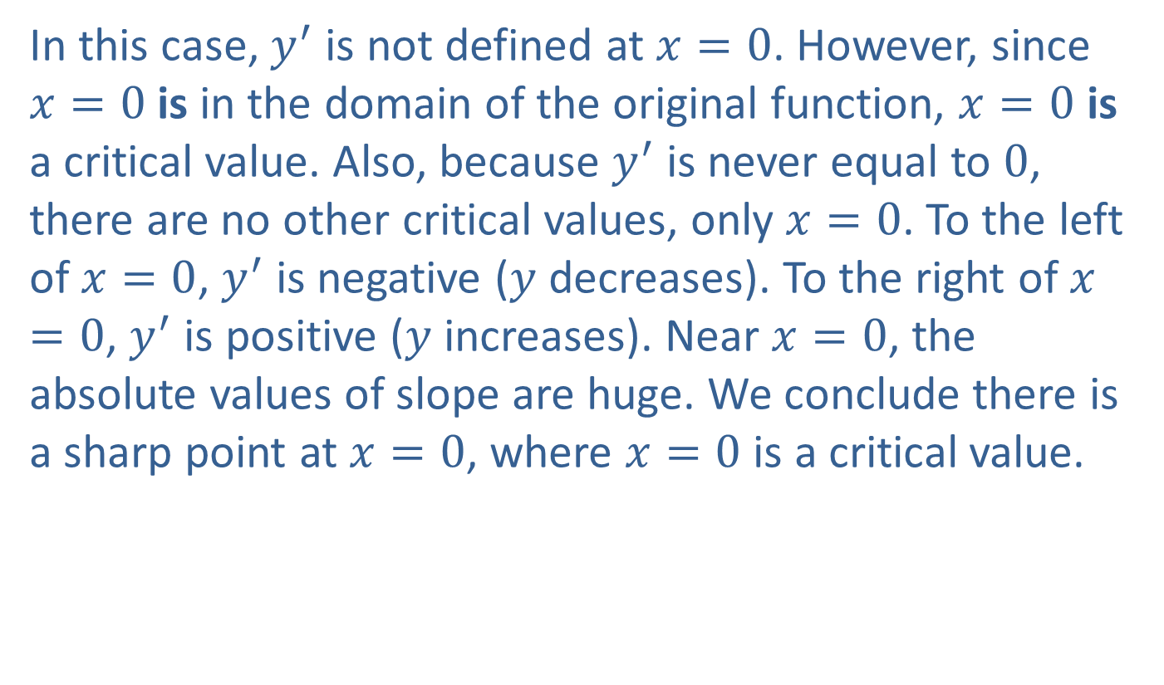
Example 4: Critical Values (cont.)
In this case, $y^{′}$ is not defined at $x=0$. However, since $x=0$ is in the domain of the original function, $x=0$ is a critical value. Also, because $y^{′}$ is never equal to 0, there are no other critical values, only $x=0$. To the left of $x=0$, $y^{′}$ is negative ($y$ decreases). To the right of $x=0$, $y^{′}$ is positive ($y$ increases). Near $x=0$, the absolute values of slope are huge. We conclude there is a sharp point at $x=0$, where $x=0$ is a critical value.

Slide 24
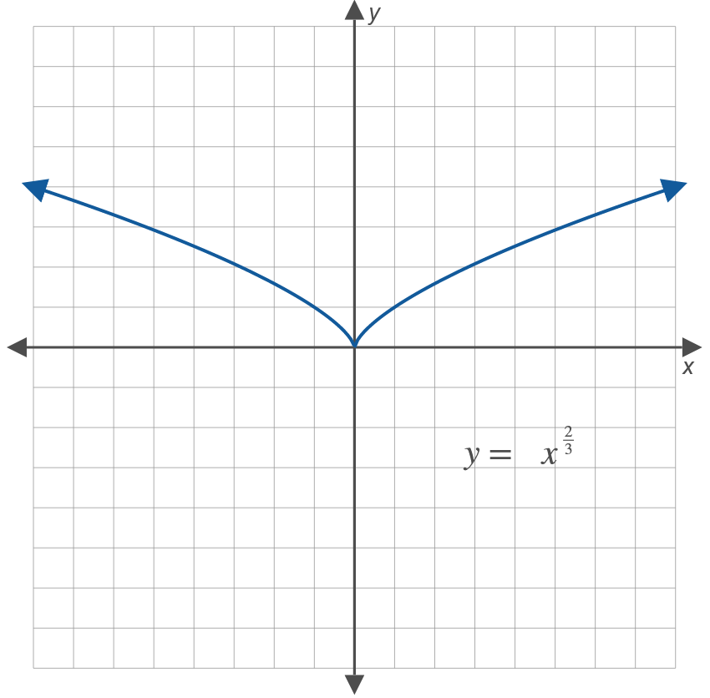
Example 4: Critical Values (cont.)

