Slide 1
Section 3.6
Absolute Maximum and Minimum

Slide 2
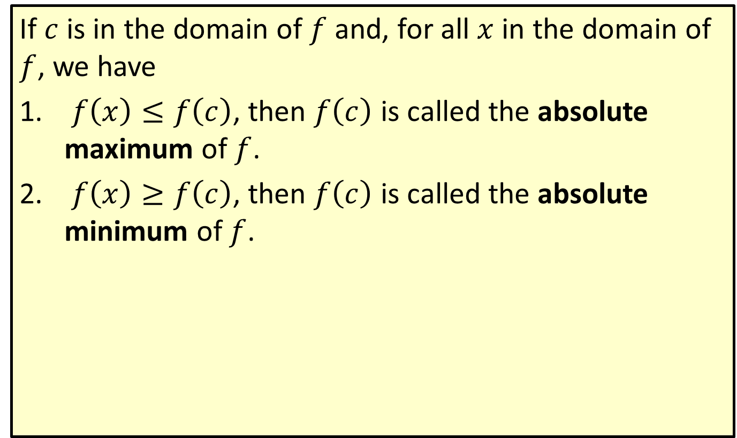
Absolute Extrema
If $c$ is in the domain of $f$ and, for all $x$ in the domain of $f$, we have
​ $f\left(x\right)≤f\left(c\right)$, then $f⁡\left(c\right)$ is called the absolute maximum of $f$.
​ $f\left(x\right)≥f\left(c\right)$, then $f⁡\left(c\right)$ is called the absolute minimum of $f$.

Slide 3
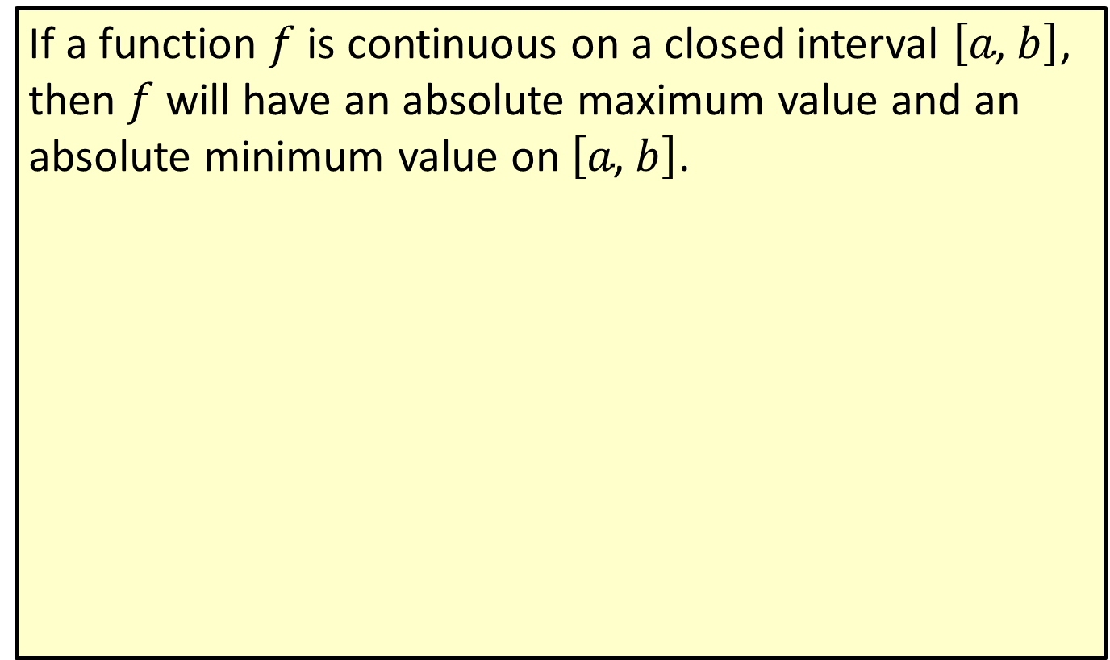
Theorem of Absolute Extrema of a Continuous Function
If a function $f$ is continuous on a closed interval $\left[a\text{, }b\right]$, then $f$ will have an absolute maximum value and an absolute minimum value on $\left[a\text{, }b\right]$.

Slide 4
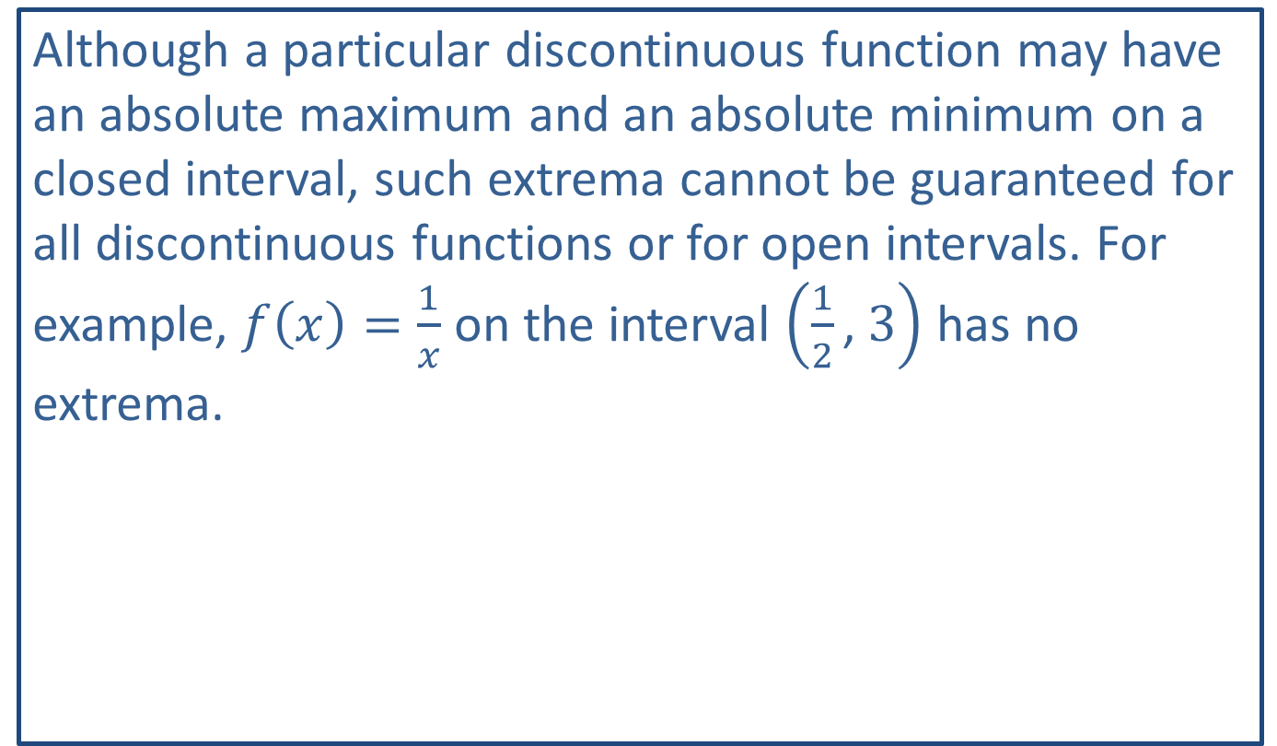
Note:
Although a particular discontinuous function may have an absolute maximum and an absolute minimum on a closed interval, such extrema cannot be guaranteed for all discontinuous functions or for open intervals. For example, $f\left(x\right)=\frac{1}{x}$ on the interval $\left(\frac{1}{2}\text{, }3\right)$ has no extrema.

Slide 5
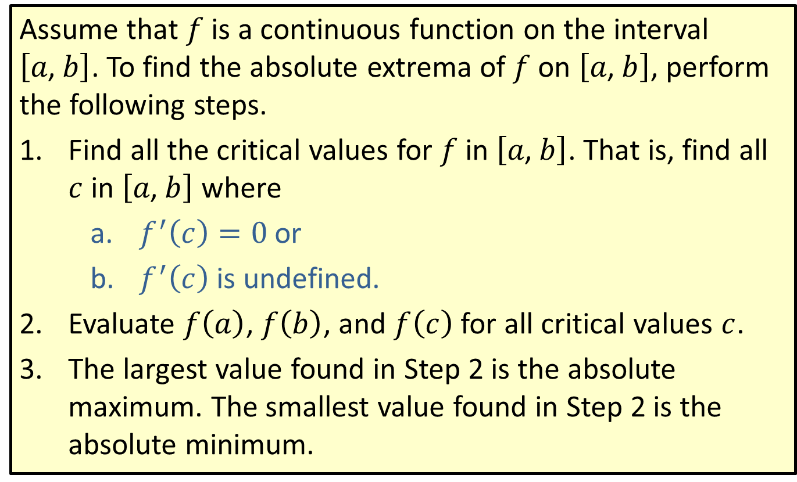
Finding Absolute Extrema
Assume that $f$ is a continuous function on the interval $\left[a\text{, }b\right]$. To find the absolute extrema of $f$ on $\left[a\text{, }b\right]$, perform the following steps.
​Find all the critical values for $f$ in $\left[a\text{, }b\right]$. That is, find all $c$ in $\left[a\text{, }b\right]$ where
  ​$f^{′}\left(c\right)=0$ or
  ​$f^{′}⁡\left(c\right)$ is undefined.
​Evaluate $f⁡\left(a\right)$, $f⁡\left(b\right)$, and $f⁡\left(c\right)$ for all critical values $c$.
​The largest value found in Step 2 is the absolute maximum. The smallest value found in Step 2 is the absolute minimum.

Slide 6

Example 1: Finding Absolute Extrema
Find the absolute extrema for $f\left(x\right)=2x^{3}−15x^{2}+24x+6$ on the interval $\left[0\text{, }5\right]$.

Slide 7
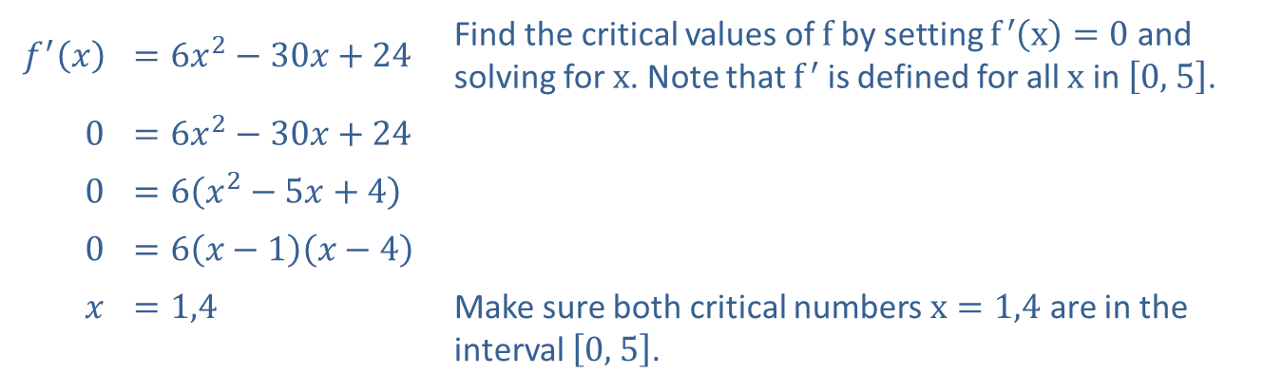

Example 1: Finding Absolute Extrema (cont.)
Solution
Step 1: Find all the critical values for $f⁡\left(x\right)$ in $\left[0\text{, }5\right]$.
​$f^{′}⁡\left(x\right)$ | ​$=6x^{2}−30x+24$ | Find the critical values of $f$ by setting $f^{′}\left(x\right)=0$ and solving for $x$. Note that $f^{′}$ is defined for all $x$ in $\left[0\text{, }5\right]$.
​0 | ​$=6x^{2}−30x+24$
​0 | ​$=6\left(x^{2}−5x+4\right)$
​0 | ​$=6\left(x−1\right)\left(x−4\right)$
$$x$$ | ​$=1,4$ | Make sure both critical numbers $x=1,4$ are in the interval $\left[0\text{, }5\right]$.

Slide 8
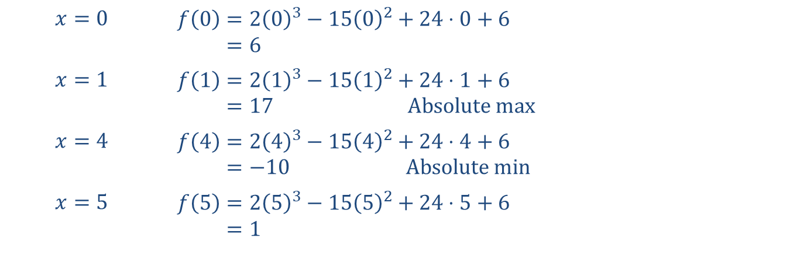

Example 1: Finding Absolute Extrema (cont.)
Step 2: Evaluate $f⁡\left(a\right)$, $f⁡\left(b\right)$, and $f⁡\left(c\right)$ for all $c$ in the given interval.
Both the critical values, $x=1$ and $x=4$, are in the interval $\left[0\text{, }5\right]$. Therefore, evaluate $f⁡\left(x\right)$ at $x=0$, $x=1$, $x=4$, and $x=5$.
$$x=0$$ | $$f\left(0\right)=2{\left(0\right)}^{3}−15{\left(0\right)}^{2}+24⋅0+6$$ 𝑓⁡0=6​
$$x=1$$ | $$f\left(1\right)=2{\left(1\right)}^{3}−15{\left(1\right)}^{2}+24⋅1+6$$ 𝑓⁡1=17 Absolute max​
$$x=4$$ | $$f\left(4\right)=2{\left(4\right)}^{3}−15{\left(4\right)}^{2}+24⋅4+6$$ 𝑓⁡4=−10 Absolute min​
$$x=5$$ | $$f⁡\left(5\right)=2{\left(5\right)}^{3}−15{\left(5\right)}^{2}+24⋅5+6$$ 𝑓5=1​

Slide 9
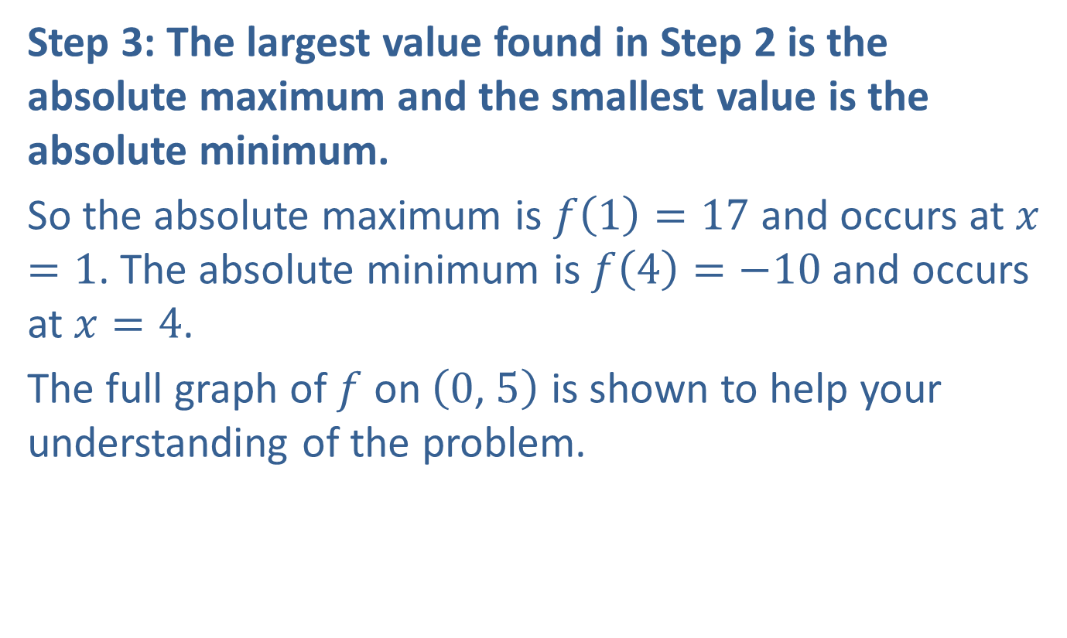
Example 1: Finding Absolute Extrema (cont.)
Step 3: The largest value found in Step 2 is the absolute maximum and the smallest value is the absolute minimum.
So the absolute maximum is $f⁡\left(1\right)=17$ and occurs at $x=1$. The absolute minimum is $f⁡\left(4\right)=−10$ and occurs at $x=4$.
The full graph of $f$ on $\left(0\text{, }5\right)$ is shown to help your understanding of the problem.

Slide 10
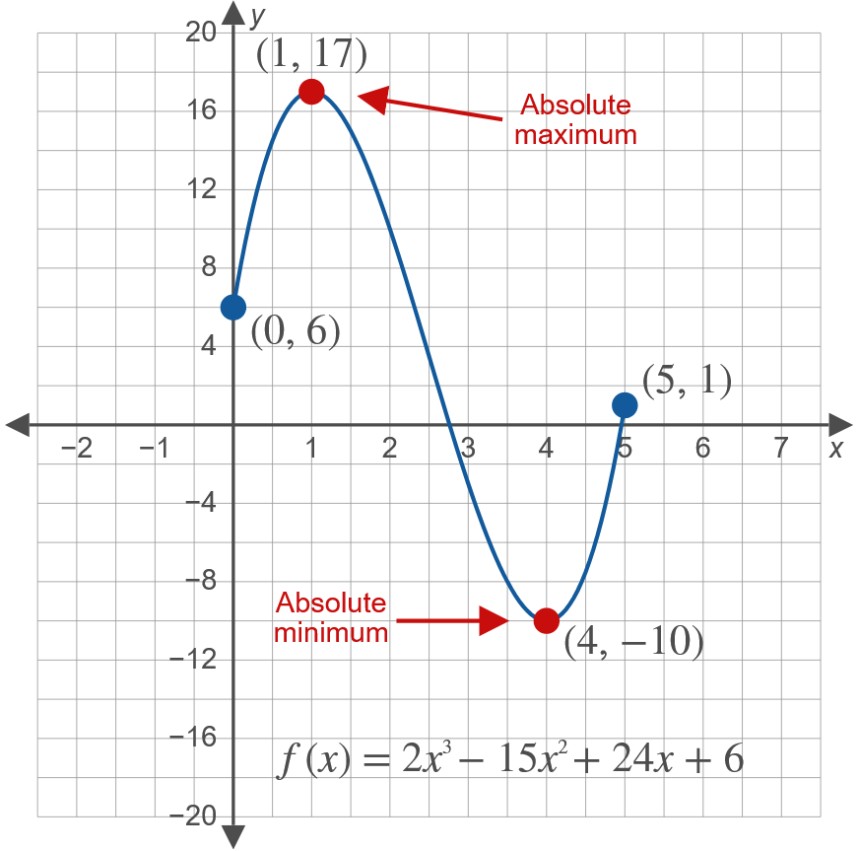
Example 1: Finding Absolute Extrema (cont.)

Slide 11
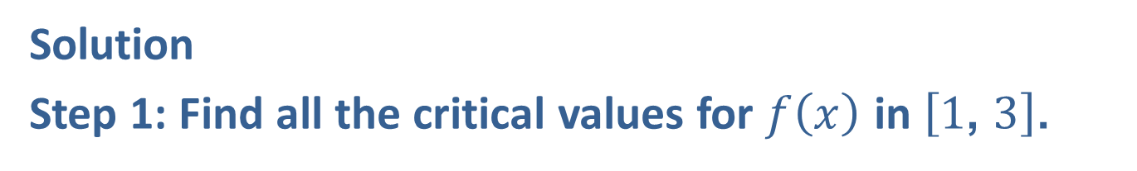

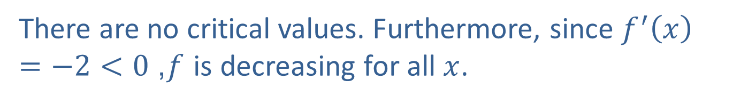
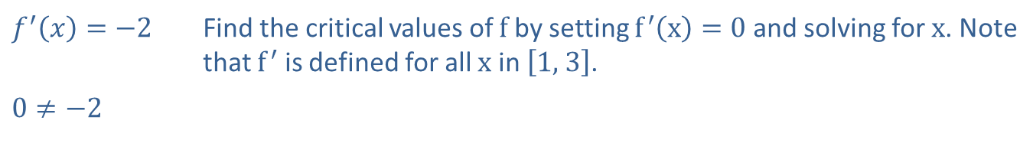
Example 2: Finding Absolute Extrema
Find the absolute extrema for $f\left(x\right)=−2x+10$ on the interval $\left[1\text{, }3\right]$.
Solution
Step 1: Find all the critical values for $f⁡\left(x\right)$ in $\left[1\text{, }3\right]$.
​$f^{′}\left(x\right)=−2$ | Find the critical values of $f$ by setting $f^{′}\left(x\right)=0$ and solving for $x$. Note that $f^{′}$ is defined for all $x$ in $\left[1\text{, }3\right]$.
​$0≠−2$
There are no critical values. Furthermore, since $f^{′}\left(x\right)=−2<0$, $f$ is decreasing for all $x$.

Slide 12
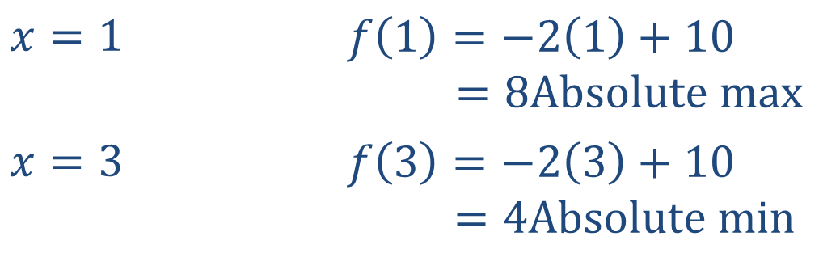

Example 2: Finding Absolute Extrema (cont.)
Step 2: Evaluate $f⁡\left(a\right)$, $f⁡\left(b\right)$, and $f⁡\left(c\right)$ for all $c$ in the given interval.
Again, there are no critical values, $c$. Therefore, only the endpoints of the interval, $x=1$ and $x=3$, need to be evaluated.
$$x=1$$ | $$f\left(1\right)=−2\left(1\right)+10$$ 𝑓⁡1 =8Absolute max​
$$x=3$$ | $$f\left(3\right)=−2\left(3\right)+10$$ 𝑓⁡3 =4Absolute min​

Slide 13
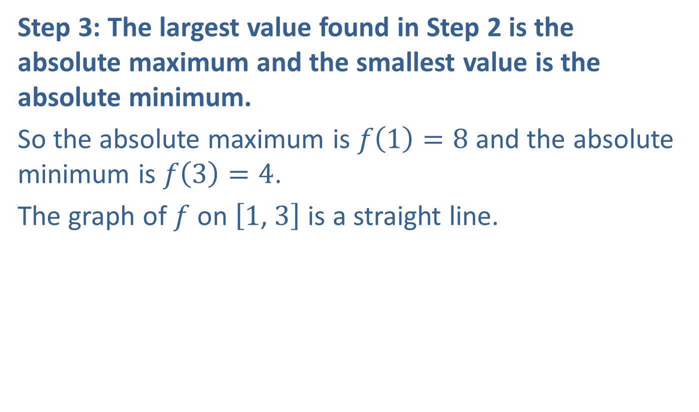
Example 2: Finding Absolute Extrema (cont.)
Step 3: The largest value found in Step 2 is the absolute maximum and the smallest value is the absolute minimum.
So the absolute maximum is $f\left(1\right)=8$ and the absolute minimum is $f\left(3\right)=4$.
The graph of $f$ on $\left[1\text{, }3\right]$ is a straight line.

Slide 14
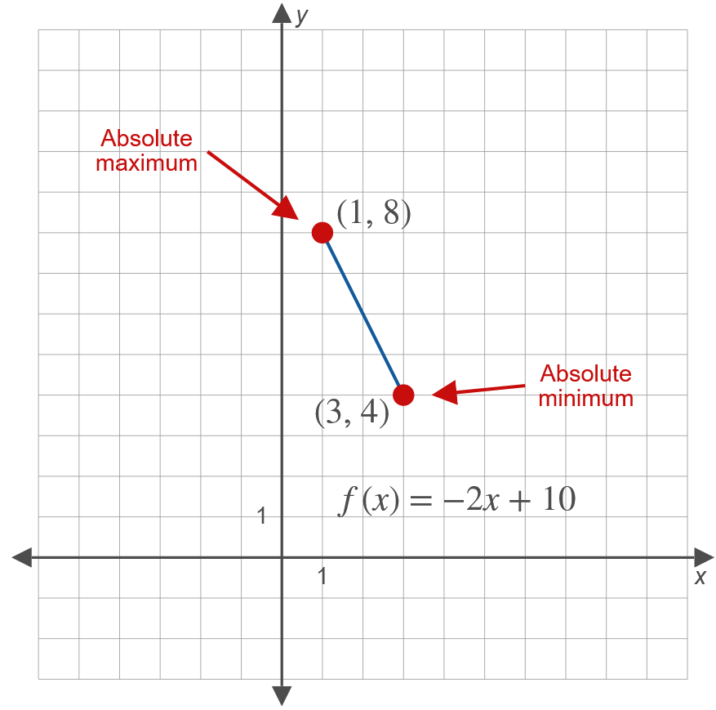
Example 2: Finding Absolute Extrema (cont.)

Slide 15
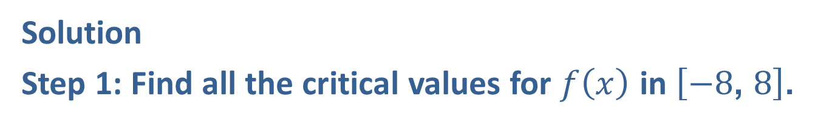


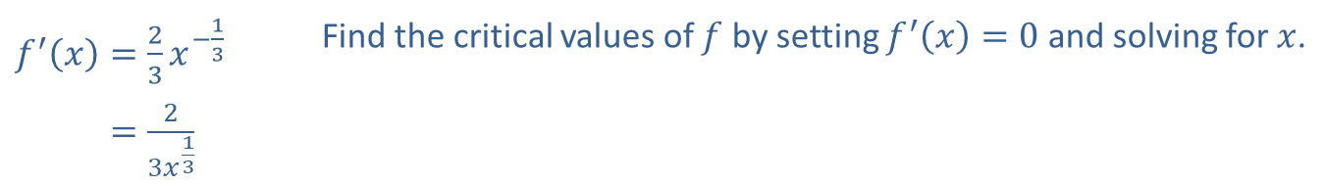
Example 3: Finding Absolute Extrema
Find the absolute extrema for $f\left(x\right)=x^{\frac{2}{3}}+1$ on the interval $\left[−8\text{, }8\right]$.
Solution
Step 1: Find all the critical values for $f⁡\left(x\right)$ in $\left[−8\text{, }8\right]$.
​$f^{′}\left(x\right)=\frac{2}{3}x^{−\frac{1}{3}}$ | Find the critical values of $f$ by setting $f^{′}\left(x\right)=0$ and solving for $x$.
​𝑓′⁡𝑥=23𝑥13
Since $f^{′}⁡\left(0\right)$ is undefined, $x=0$ is a critical value. In this case, $x=0$ is the only critical value.

Slide 16
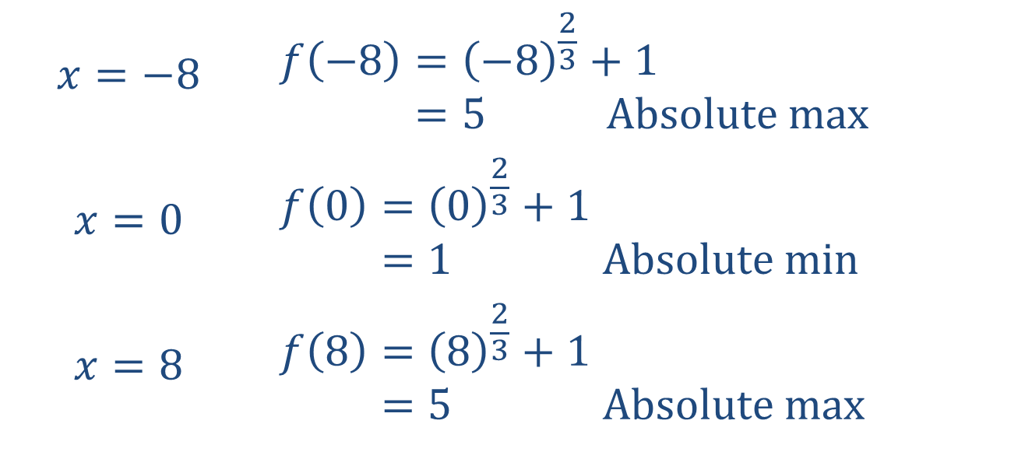

Example 3: Finding Absolute Extrema (cont.)
Step 2: Evaluate $f⁡\left(a\right)$, $f⁡\left(b\right)$, and $f⁡\left(c\right)$ for all $c$ in the given interval.
Now evaluate $f⁡\left(x\right)$ at $x=−8$, $x=0$, and $x=8$.
$$x=−8$$ | $$f\left(−8\right)={\left(−8\right)}^{\frac{2}{3}}+1$$ 𝑓⁡−8=5 Absolute max​
$$x=0$$ | $$f\left(0\right)={\left(0\right)}^{\frac{2}{3}}+1$$ 𝑓⁡0=1 Absolute min​
$$x=8$$ | $$f\left(8\right)={\left(8\right)}^{\frac{2}{3}}+1$$ 𝑓⁡8=5 Absolute max​

Slide 17
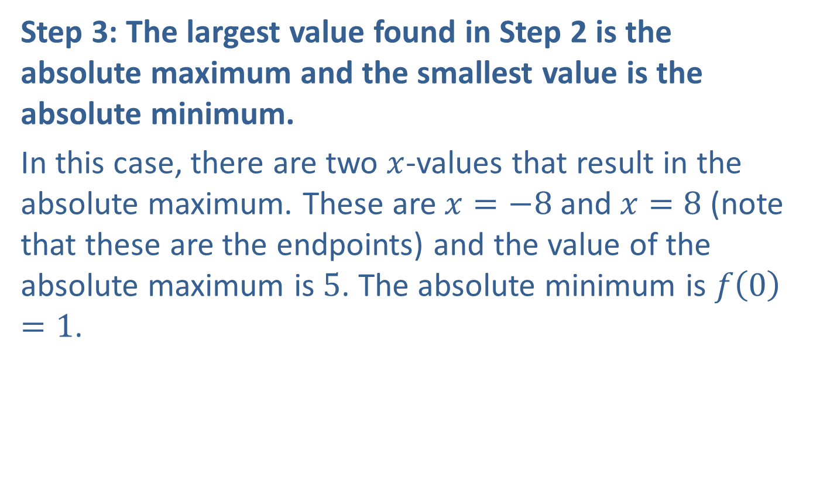
Example 3: Finding Absolute Extrema (cont.)
Step 3: The largest value found in Step 2 is the absolute maximum and the smallest value is the absolute minimum.
In this case, there are two $x$-values that result in the absolute maximum. These are $x=−8$ and $x=8$ (note that these are the endpoints) and the value of the absolute maximum is 5. The absolute minimum is $f\left(0\right)=1$.

Slide 18
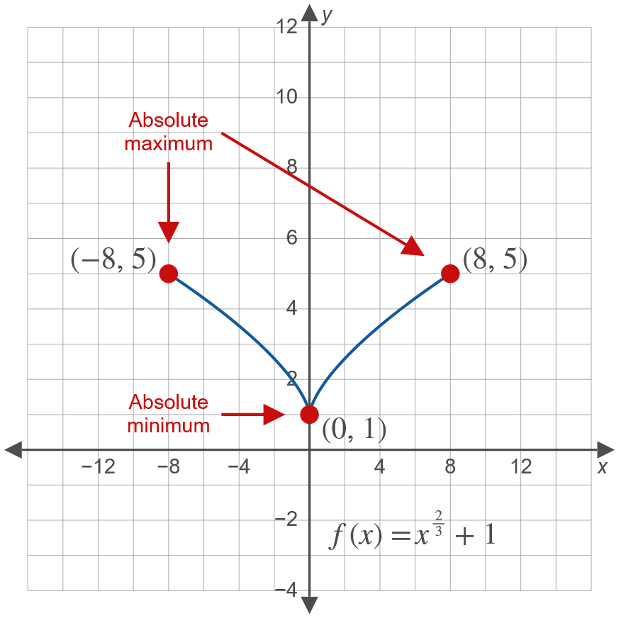
Example 3: Finding Absolute Extrema (cont.)

Slide 19
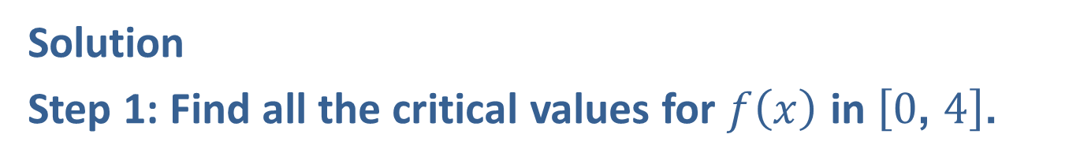

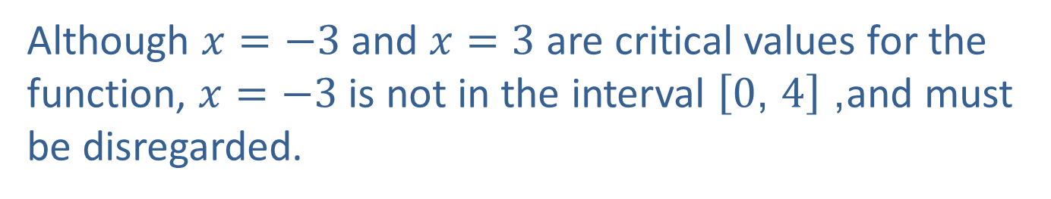
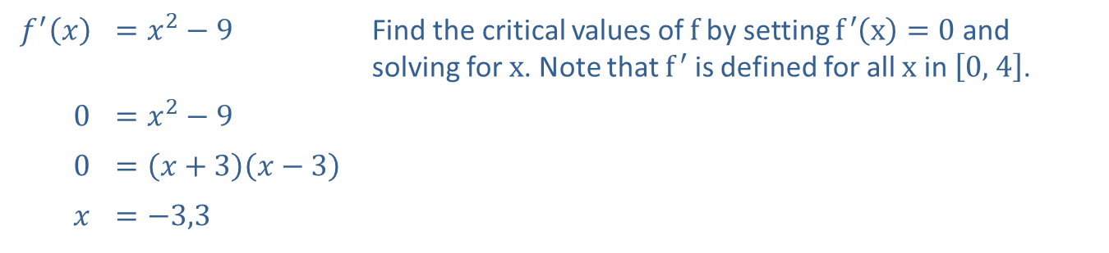
Example 4: Finding Absolute Extrema
Find the absolute extrema for $f\left(x\right)=\frac{1}{3}x^{3}−9x$ on the interval $\left[0\text{, }4\right]$.
Solution
Step 1: Find all the critical values for $f⁡\left(x\right)$ in $\left[0\text{, }4\right]$.
​$f^{′}⁡\left(x\right)$ | ​$=x^{2}−9$ | Find the critical values of $f$ by setting $f^{′}\left(x\right)=0$ and solving for $x$. Note that $f^{′}$ is defined for all $x$ in $\left[0\text{, }4\right]$.
​0 | ​$=x^{2}−9$
​0 | ​$=\left(x+3\right)\left(x−3\right)$
$$x$$ | ​$=−3\text{,}3$
Although $x=−3$ and $x=3$ are critical values for the function, $x=−3$ is not in the interval $\left[0\text{, }4\right]$, and must be disregarded.

Slide 20
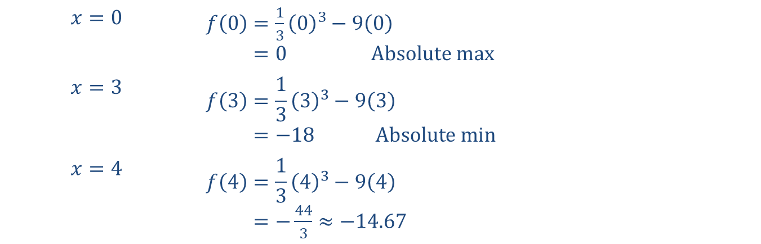

Example 4: Finding Absolute Extrema (cont.)
Step 2: Evaluate $f⁡\left(a\right)$, $f⁡\left(b\right)$, and $f⁡\left(c\right)$ for all $c$ in the given interval.
Since the critical value $x=−3$ is not in the interval, evaluate $f⁡\left(x\right)$ only at $x=0$, $x=3$, and $x=4$.
$$x=0$$ | ​$f\left(0\right)=\frac{1}{3}{\left(0\right)}^{3}−9\left(0\right)$ 𝑓⁡0=0 Absolute max
$$x=3$$ | $$f\left(3\right)=\frac{1}{3}{\left(3\right)}^{3}−9\left(3\right)$$ 𝑓⁡3=−18 Absolute min​
$$x=4$$ | $$f\left(4\right)=\frac{1}{3}{\left(4\right)}^{3}−9\left(4\right)$$ 𝑓⁡4=−443≈−14.67​

Slide 21
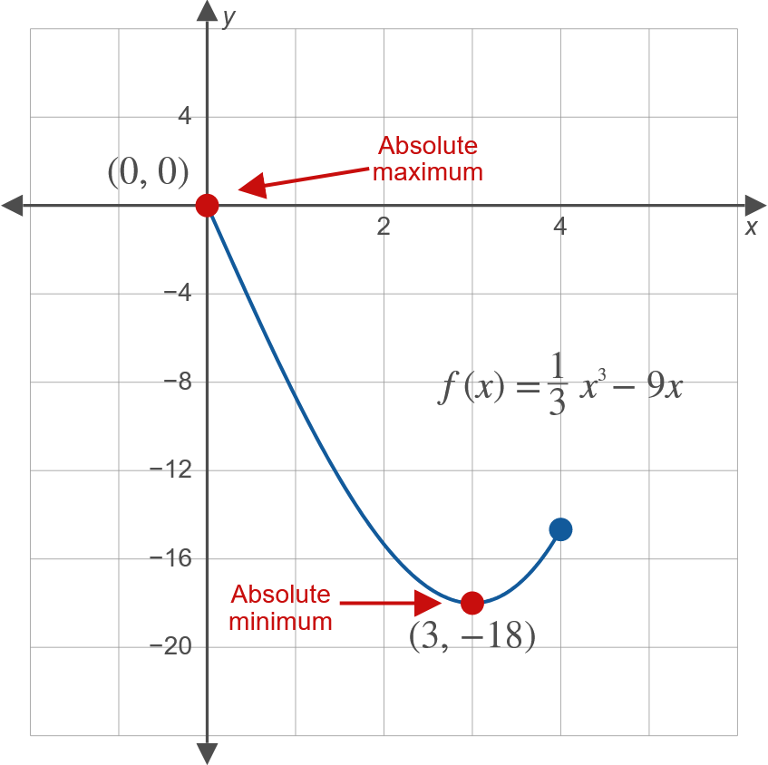
Example 4: Finding Absolute Extrema (cont.)

Slide 22

Example 4: Finding Absolute Extrema (cont.)
Step 3: The largest value found in Step 2 is the absolute maximum and the smallest value is the absolute minimum.
So the absolute maximum is $f\left(0\right)=0$ and the absolute minimum is $f\left(3\right)=−18$.

Slide 23
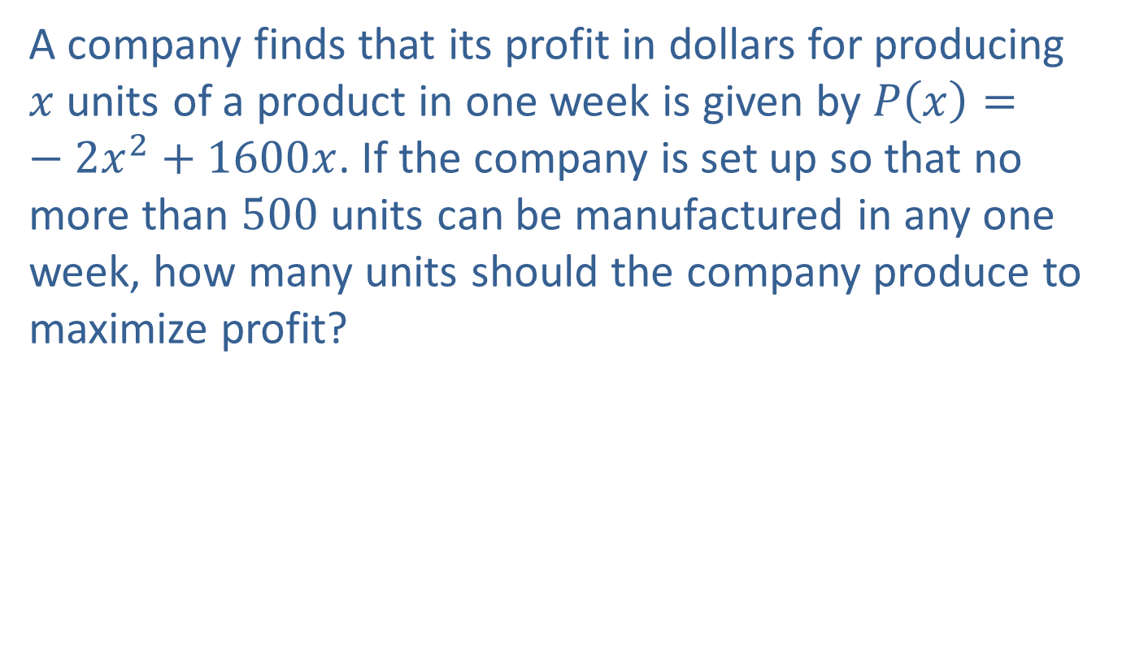
Example 5: Maximizing Profits
A company finds that its profit in dollars for producing $x$ units of a product in one week is given by $P\left(x\right)=−2x^{2}+1600x$. If the company is set up so that no more than 500 units can be manufactured in any one week, how many units should the company produce to maximize profit?

Slide 24
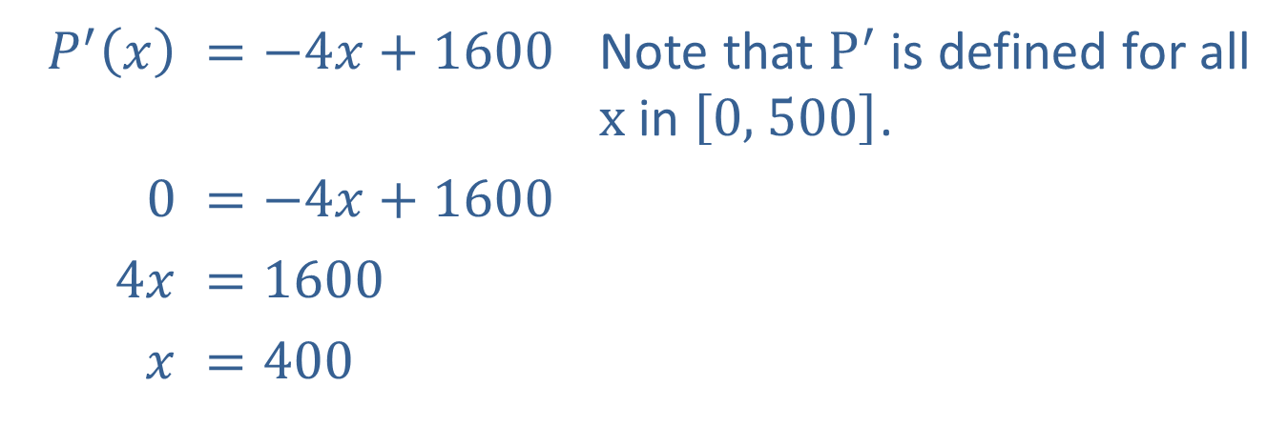

Example 5: Maximizing Profits (cont.)
Solution
The production restrictions indicate that $x$ is in the closed interval $\left[0\text{, }500\right]$. Find the critical values by setting $P^{′}\left(x\right)=0$ and solving for $x$ (Step 1).
​$P^{′}⁡\left(x\right)$ | ​$=−4x+1600$ | Note that $P^{′}$ is defined for all $x$ in $\left[0\text{, }500\right]$.
​0 | ​$=−4x+1600$
​$4x$ | ​$=1600$
​$x$ | ​$=400$

Slide 25
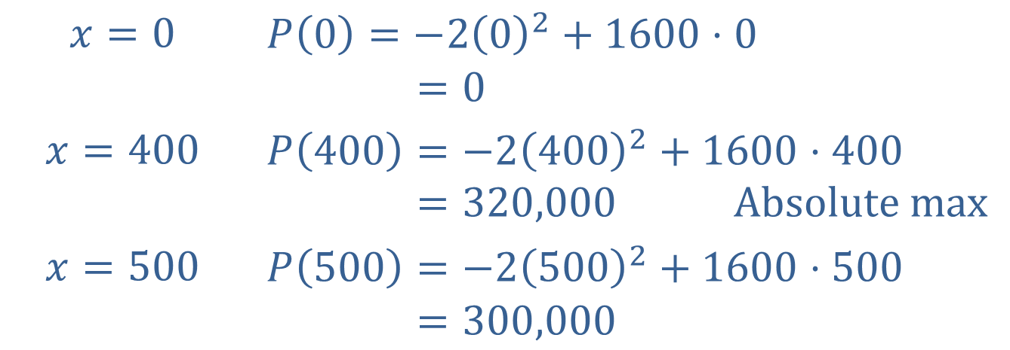


Example 5: Maximizing Profits (cont.)
Now evaluate $P⁡\left(x\right)$ for $x=0$, $x=400$, and $x=500$ (Step 2).
$$x=0$$ | $$P\left(0\right)=−2{\left(0\right)}^{2}+1600⋅0$$ 𝑃⁡000=0​
$$x=400$$ | $$P\left(400\right)=−2{\left(400\right)}^{2}+1600⋅400$$ 𝑃⁡400=320,000 Absolute max​
$$x=500$$ | $$P\left(500\right)=−2{\left(500\right)}^{2}+1600⋅500$$ 𝑃⁡500=300,000​
The profit is maximized at $\$320,000$ when 400 units are produced (Step 3).

