Slide 1
Section 4.1
Concavity and Points of Inflection

Slide 2
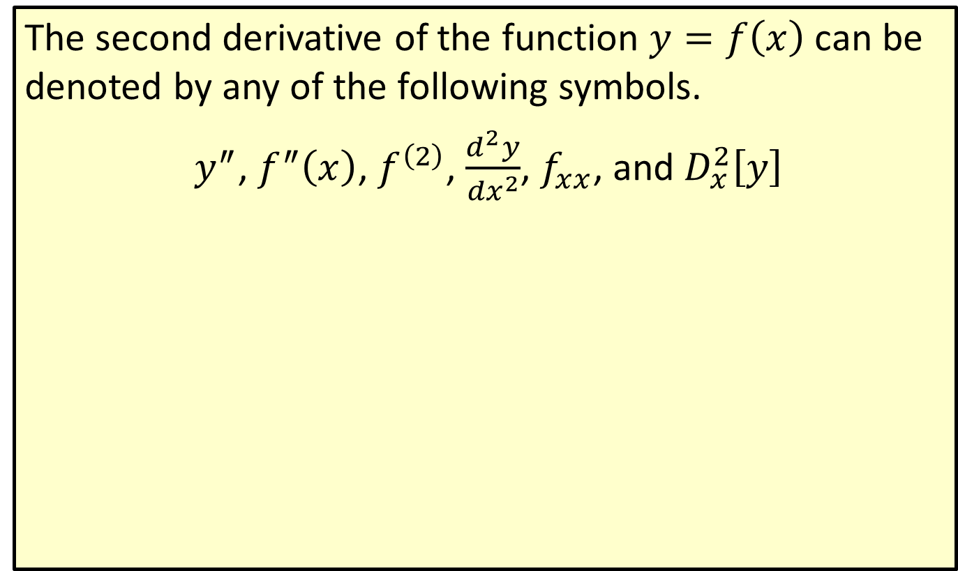
Notation for the Second Derivative
The second derivative of the function $y=f\left(x\right)$ can be denoted by any of the following symbols.
$y^{″}$, $f^{″}⁡\left(x\right)$, $f^{\left(2\right)}$, $\frac{d^{2}y}{{dx}^{2}}$, $f_{x⁣x}$, and $D_{x}^{2}⁡\left[y\right]$

Slide 3
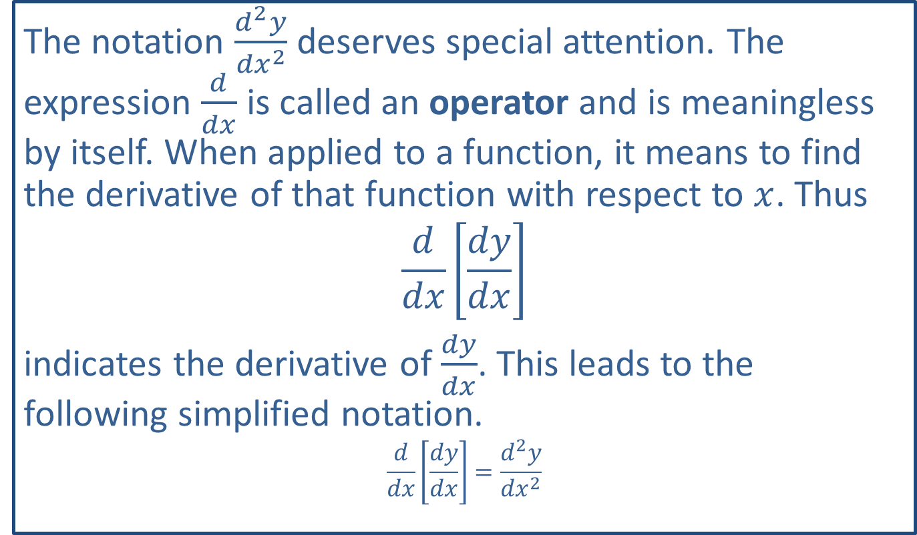
Note:
The notation $\frac{d^{2}y}{{dx}^{2}}$ deserves special attention. The expression $\frac{d}{dx}$ is called an operator and is meaningless by itself. When applied to a function, it means to find the derivative of that function with respect to $x$. Thus
$$\frac{d}{dx}\left[\frac{dy}{dx}\right]$$
indicates the derivative of $\frac{dy}{dx}$. This leads to the following simplified notation.
$$\frac{d}{dx}\left[\frac{dy}{dx}\right]=\frac{d^{2}y}{{dx}^{2}}$$

Slide 4
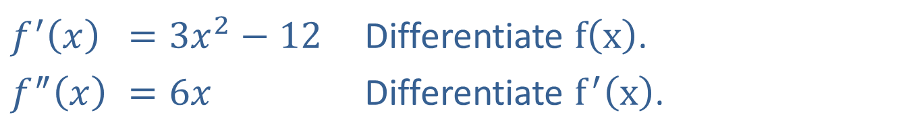

Example 1: First and Second Derivatives
Find both the first and second derivatives of the function $f\left(x\right)=x^{3}−12x+1$.
Solution
​$f^{′}⁡\left(x\right)$ | ​$=3x^{2}−12$ | Differentiate $f⁡\left(x\right)$.
​$f^{″}⁡\left(x\right)$ | ​$=6x$ | Differentiate $f^{′}⁡\left(x\right)$.

Slide 5
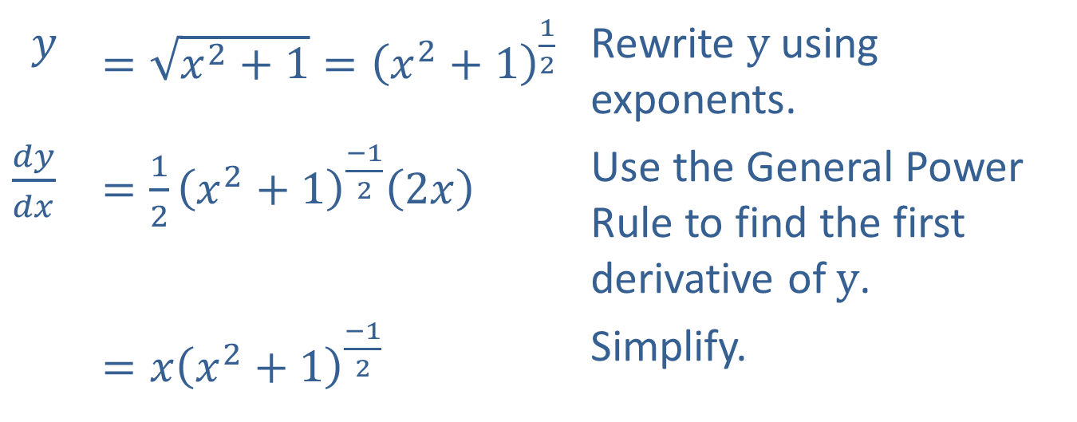

Example 2: First and Second Derivatives
Find $\frac{dy}{dx}$ and $\frac{d^{2}y}{{dx}^{2}}$ if $y=\sqrt{x^{2}+1}$.
Solution
$$y$$ | ​$=\sqrt{x^{2}+1}={\left(x^{2}+1\right)}^{\frac{1}{2}}$ | Rewrite $y$ using exponents.
​$\frac{dy}{dx}$ | ​$=\frac{1}{2}{\left(x^{2}+1\right)}^{\frac{−1}{2}}\left(2x\right)$ | Use the General Power Rule to find the first derivative of $y$.
​ | ​$=x{\left(x^{2}+1\right)}^{\frac{−1}{2}}$ | Simplify.

Slide 6
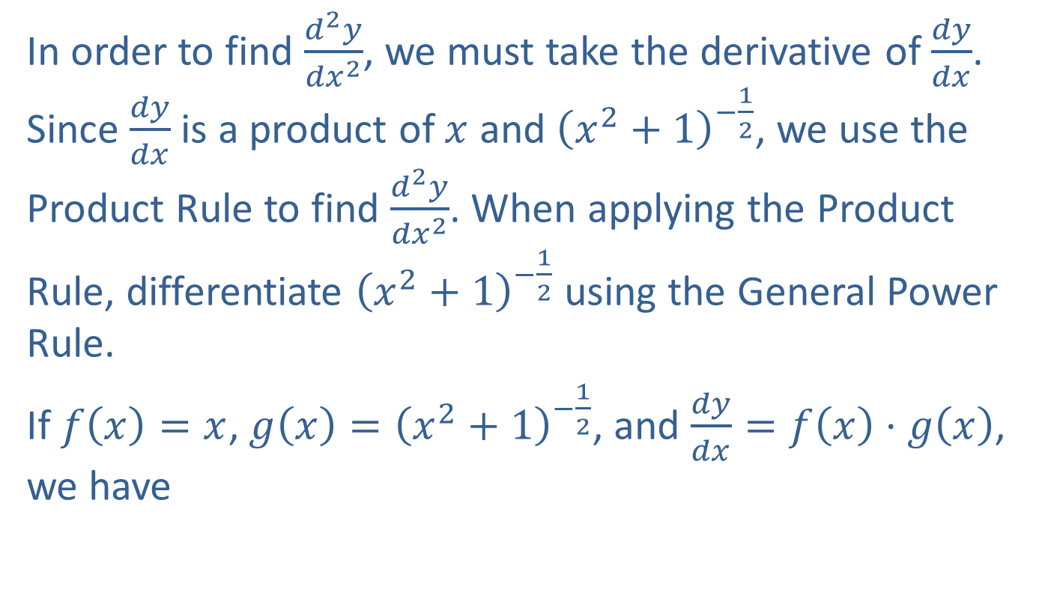
Example 2: First and Second Derivatives (cont.)
In order to find $\frac{d^{2}y}{{dx}^{2}}$, we must take the derivative of $\frac{dy}{dx}$. Since $\frac{dy}{dx}$ is a product of $x$ and ${\left(x^{2}+1\right)}^{−\frac{1}{2}}$, we use the Product Rule to find $\frac{d^{2}y}{{dx}^{2}}$. When applying the Product Rule, differentiate ${\left(x^{2}+1\right)}^{−\frac{1}{2}}$ using the General Power Rule.
If $f\left(x\right)=x$, $g\left(x\right)={\left(x^{2}+1\right)}^{−\frac{1}{2}}$, and $\frac{dy}{dx}=f\left(x\right)⋅g\left(x\right)$, we have

Slide 7
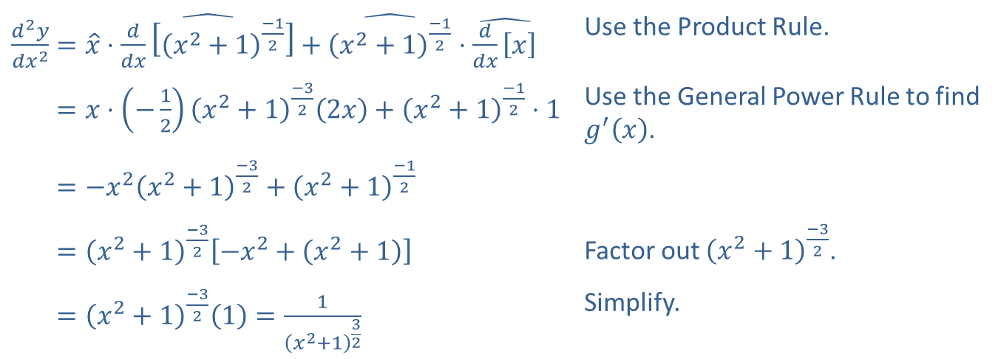
Example 2: First and Second Derivatives (cont.)
$$g′\left(x\right)$$
$$g\left(x\right)$$
$$f\left(x\right)$$
$$f′\left(x\right)$$
​$\frac{d^{2}y}{{dx}^{2}}=\hat{x}⋅\hat{\frac{d}{dx}\left[{\left(x^{2}+1\right)}^{\frac{−1}{2}}\right]}+\hat{{\left(x^{2}+1\right)}^{\frac{−1}{2}}}⋅\hat{\frac{d}{dx}\left[x\right]}$ | Use the Product Rule.
​𝑑2𝑦𝑑𝑥2=𝑥⋅−12𝑥2+1−322𝑥+𝑥2+1−12⋅1 | Use the General Power Rule to find $g^{′}⁡\left(x\right)$.
​𝑑2𝑦𝑑𝑥2=−𝑥2𝑥2+1−32+𝑥2+1−12
​𝑑2𝑦𝑑𝑥2=𝑥2+1−32−𝑥2+𝑥2+1 | Factor out ${\left(x^{2}+1\right)}^{\frac{−3}{2}}$.
​𝑑2𝑦𝑑𝑥2=𝑥2+1−321=1𝑥2+132 | Simplify.

Slide 8


Example 3: First and Second Derivatives
For the function $f\left(u\right)=\frac{u^{2}}{u^{2}−9}$, find $f^{′}⁡\left(u\right)$ and $f^{″}⁡\left(u\right)$.
Solution
In order to find $f^{′}⁡\left(u\right)$, we must use the Quotient Rule.
$$Numerator=u^{2}$$
$$Denominator=u^{2}−9$$
$${Numerator}^{′}=2u$$
$${Denominator}^{′}=2u$$

Slide 9
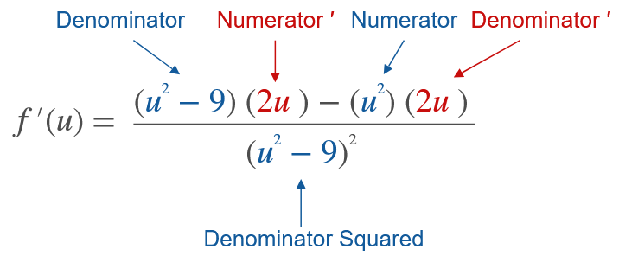
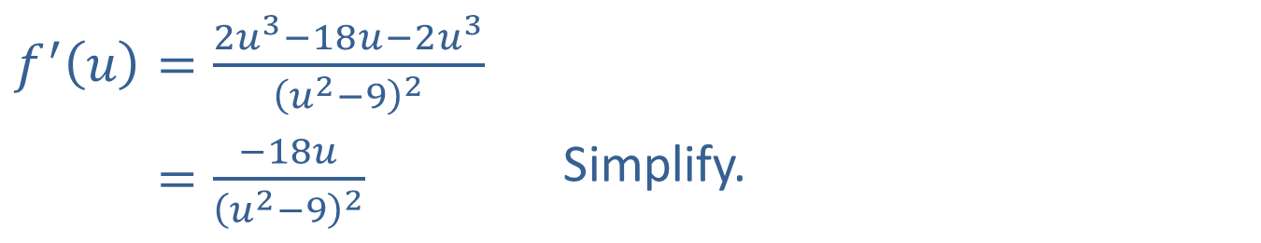
Example 3: First and Second Derivatives (cont.)
​$f^{′}\left(u\right)=\frac{2u^{3}−18u−2u^{3}}{{\left(u^{2}−9\right)}^{2}}$
​𝑓′⁡𝑢=−18𝑢𝑢2−92 | Simplify.

Slide 10
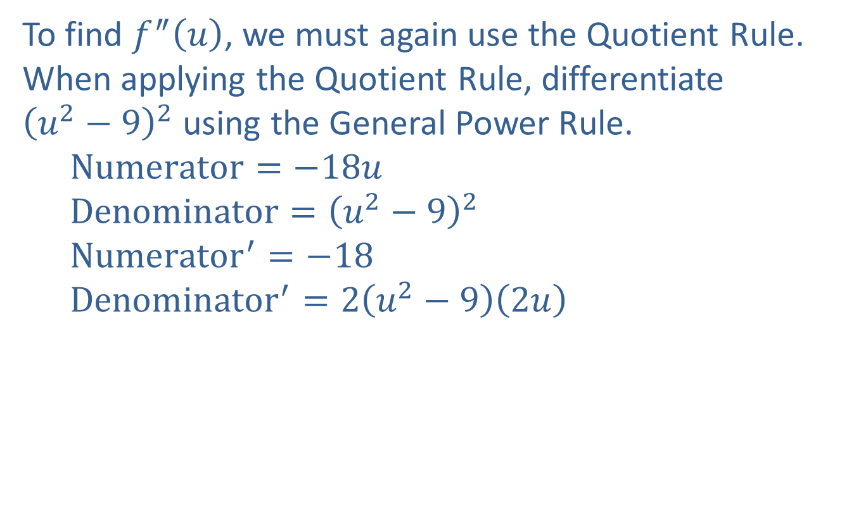
Example 3: First and Second Derivatives (cont.)
To find $f^{″}⁡\left(u\right)$, we must again use the Quotient Rule. When applying the Quotient Rule, differentiate ${\left(u^{2}−9\right)}^{2}$ using the General Power Rule.
  $$Numerator=−18u$$
  $$Denominator={\left(u^{2}−9\right)}^{2}$$
  $${Numerator}^{′}=−18$$
  $${Denominator}^{′}=2\left(u^{2}−9\right)\left(2u\right)$$

Slide 11
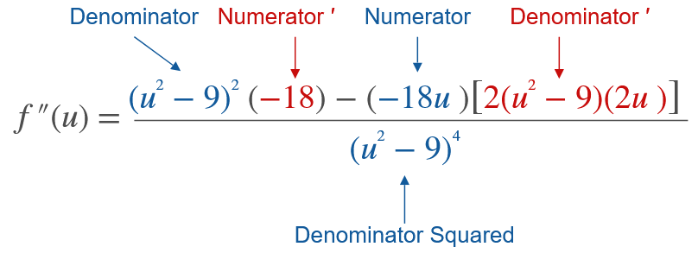
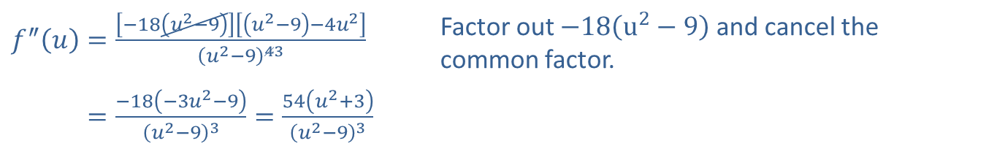
Example 3: First and Second Derivatives (cont.)
​$f^{″}\left(u\right)=\frac{\left[−18\left(u^{2}−9\right)\right]\left[\left(u^{2}−9\right)−4u^{2}\right]}{{\left(u^{2}−9\right)}^{43}}$ | Factor out $−18\left(u^{2}−9\right)$ and cancel the common factor.
​𝑓″⁡𝑢=−18−3𝑢2−9𝑢2−93=54𝑢2+3𝑢2−93

Slide 12
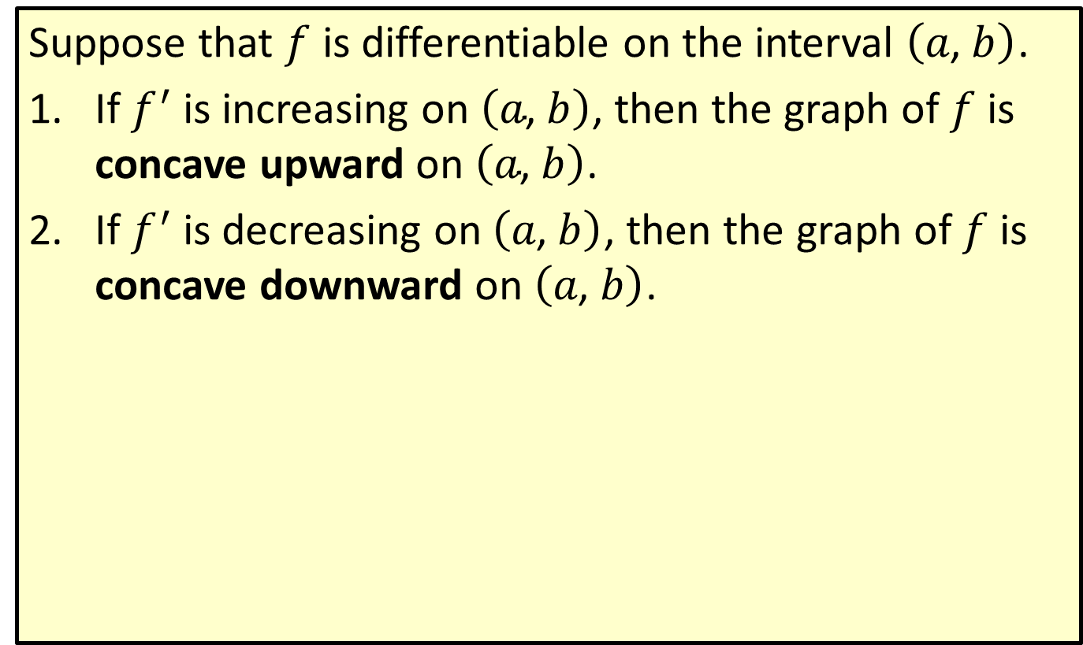
Concavity
Suppose that $f$ is differentiable on the interval $\left(a\text{, }b\right)$.
​If $f^{′}$ is increasing on $\left(a\text{, }b\right)$, then the graph of $f$ is concave upward on $\left(a\text{, }b\right)$.
​If $f^{′}$ is decreasing on $\left(a\text{, }b\right)$, then the graph of $f$ is concave downward on $\left(a\text{, }b\right)$.

Slide 13
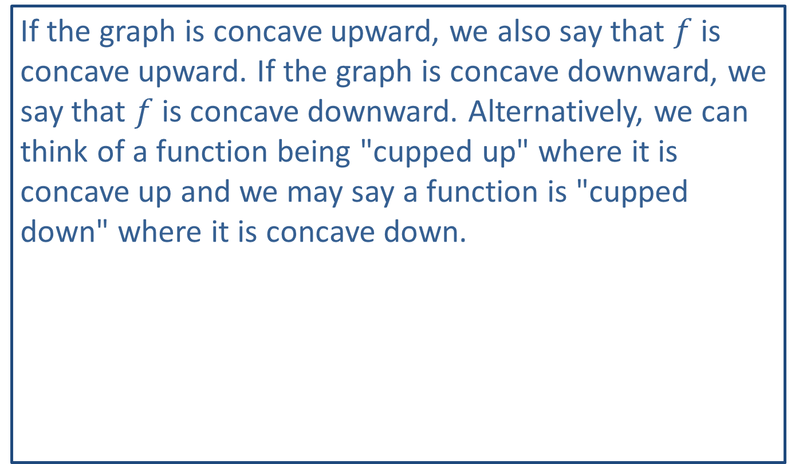
Note:
If the graph is concave upward, we also say that $f$ is concave upward. If the graph is concave downward, we say that $f$ is concave downward. Alternatively, we can think of a function being "cupped up" where it is concave up and we may say a function is "cupped down" where it is concave down.

Slide 14
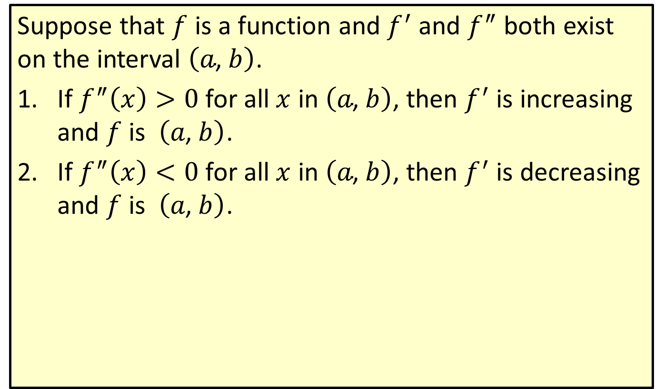

Interpreting $f^{″}⁡\left(x\right)$ to Determine Concavity
Suppose that $f$ is a function and $f^{′}$ and $f^{″}$ both exist on the interval $\left(a\text{, }b\right)$.
​If $f^{″}\left(x\right)>0$ for all $x$ in $\left(a\text{, }b\right)$, then $f^{′}$ is increasing and $f$ is $\left(a\text{, }b\right)$.
​If $f^{″}\left(x\right)<0$ for all $x$ in $\left(a\text{, }b\right)$, then $f^{′}$ is decreasing and $f$ is $\left(a\text{, }b\right)$.

Slide 15

Example 4: Determining Concavity
In the figure shown, the graph of $y=f\left(x\right)$ is given.
​List the intervals on which $f$ is concave upward.
​List the intervals on which $f$ is concave downward.

Slide 16
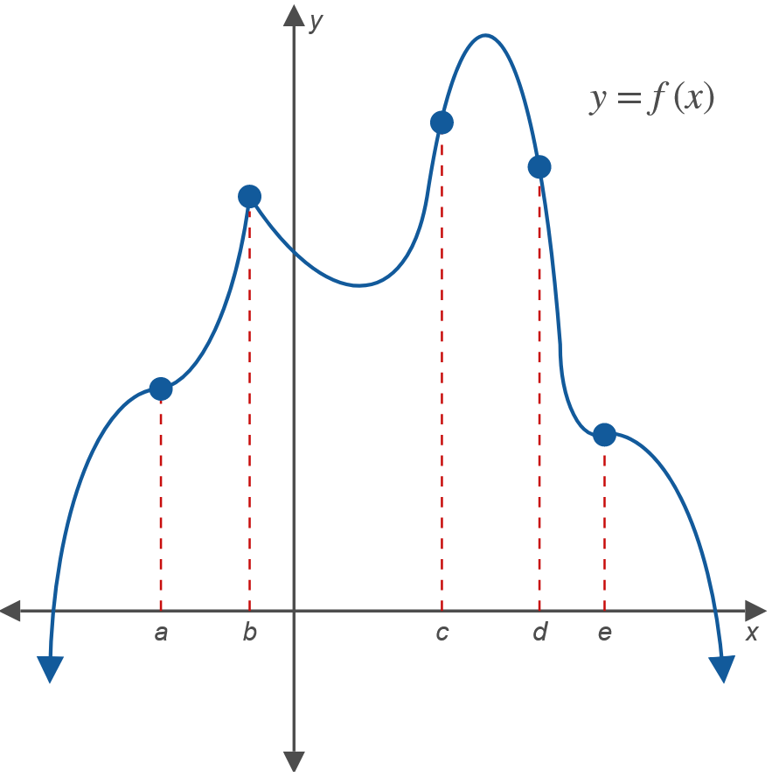
Example 4: Determining Concavity (cont.)

Slide 17

Example 4: Determining Concavity (cont.)
Solutions
​$f$ is concave upward on the intervals $\left(a\text{, }b\right)$, $\left(b\text{, }c\right)$, and $\left(d\text{, }e\right)$.
​$f$ is concave downward on the intervals $\left(−∞\text{, }a\right)$, $\left(c\text{, }d\right)$, and $\left(e\text{, }+∞\right)$.

Slide 18
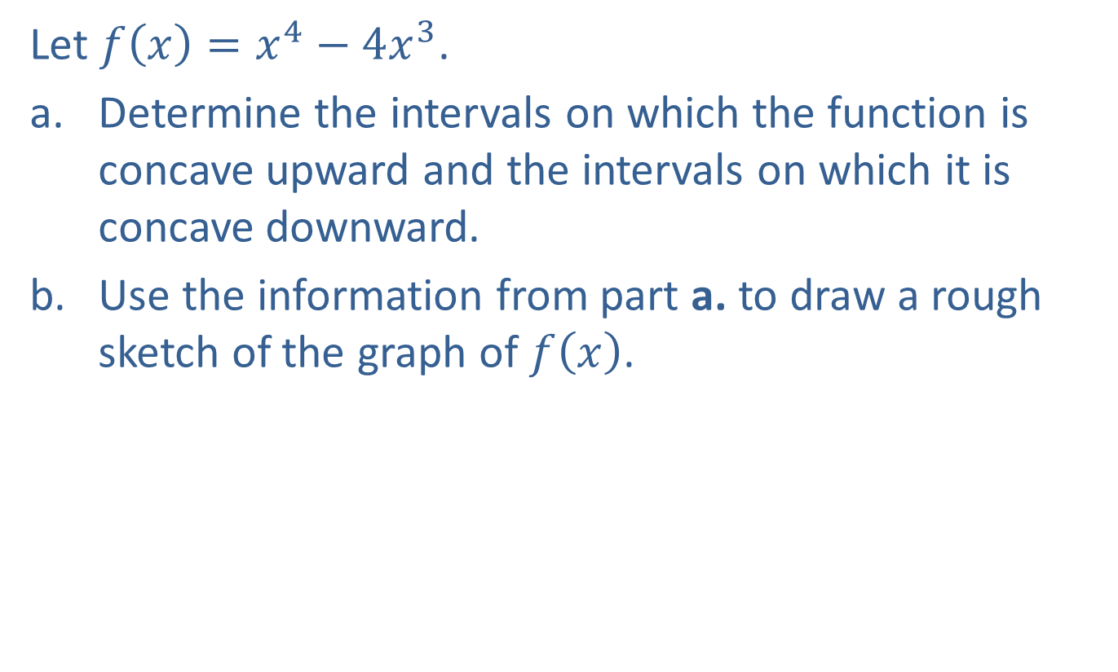
Example 5: Sketching a Curve Using Concavity
Let $f\left(x\right)=x^{4}−4x^{3}$.
​Determine the intervals on which the function is concave upward and the intervals on which it is concave downward.
​Use the information from part a. to draw a rough sketch of the graph of $f⁡\left(x\right)$.

Slide 19
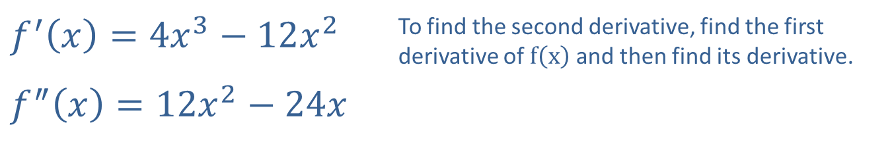

Example 5: Sketching a Curve Using Concavity (cont.)
Solution
​To determine concavity, we must interpret $f^{″}⁡\left(x\right)$. First, we find the second derivative and then determine the intervals where it is positive and the intervals where it is negative.
​
​$f^{′}\left(x\right)=4x^{3}−12x^{2}$ | To find the second derivative, find the first derivative of $f⁡\left(x\right)$ and then find its derivative.
​$f^{″}\left(x\right)=12x^{2}−24x$

Slide 20
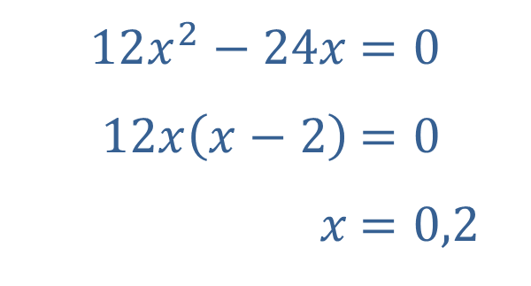
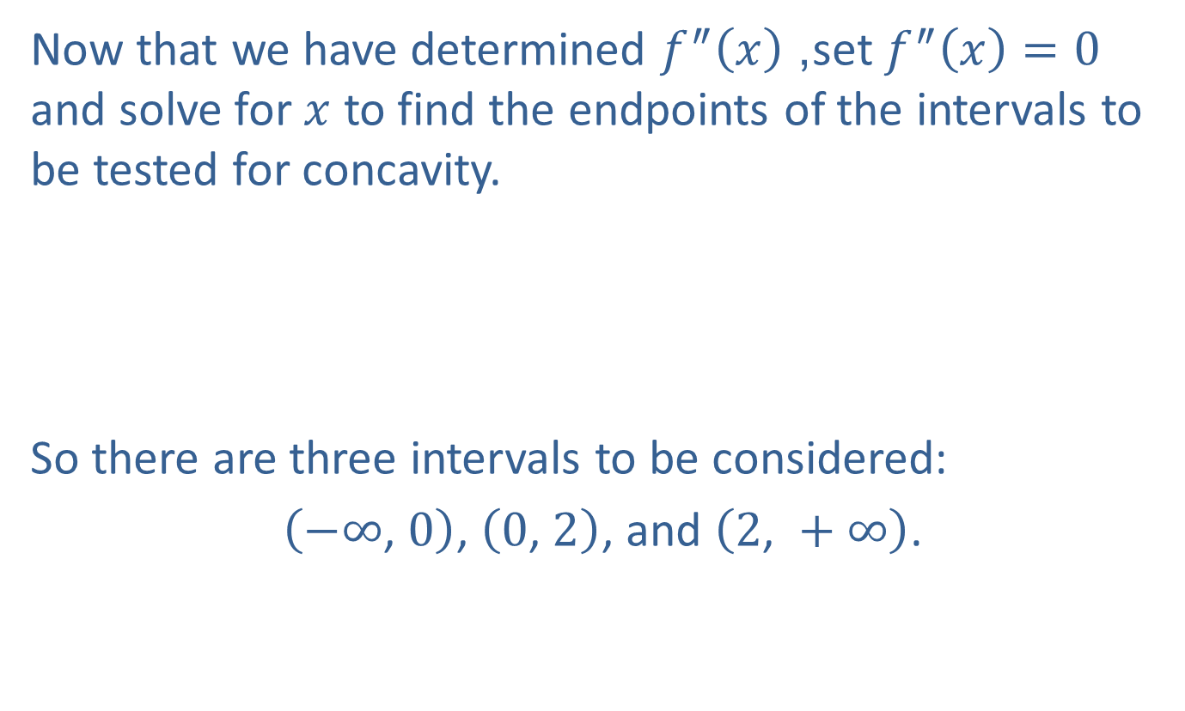
Example 5: Sketching a Curve Using Concavity (cont.)
​Now that we have determined $f^{″}⁡\left(x\right)$, set $f^{″}\left(x\right)=0$ and solve for $x$ to find the endpoints of the intervals to be tested for concavity.
​
​
So there are three intervals to be considered:
​ $\left(−∞\text{, }0\right)$, $\left(0\text{, }2\right)$, and $\left(2\text{, }+∞\right)$.
​​
​$12x^{2}−24x$ | ​$=0$
​$12x\left(x−2\right)$ | ​$=0$
​$x$ | ​$=0,2$

Slide 21
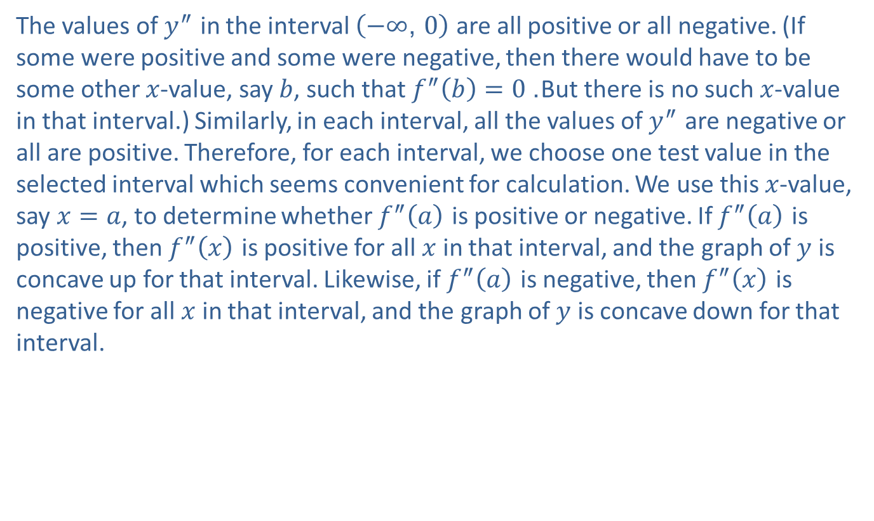
Example 5: Sketching a Curve Using Concavity (cont.)
The values of $y^{″}$ in the interval $\left(−∞\text{, }0\right)$ are all positive or all negative. (If some were positive and some were negative, then there would have to be some other $x$-value, say $b$, such that $f^{″}\left(b\right)=0$. But there is no such $x$-value in that interval.) Similarly, in each interval, all the values of $y^{″}$ are negative or all are positive. Therefore, for each interval, we choose one test value in the selected interval which seems convenient for calculation. We use this $x$-value, say $x=a$, to determine whether $f^{″}⁡\left(a\right)$ is positive or negative. If $f^{″}⁡\left(a\right)$ is positive, then $f^{″}⁡\left(x\right)$ is positive for all $x$ in that interval, and the graph of $y$ is concave up for that interval. Likewise, if $f^{″}⁡\left(a\right)$ is negative, then $f^{″}⁡\left(x\right)$ is negative for all $x$ in that interval, and the graph of $y$ is concave down for that interval.

Slide 22
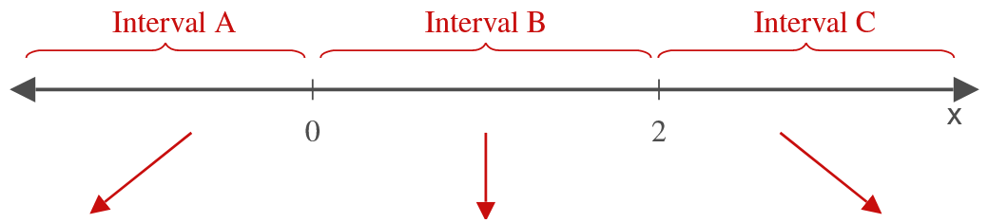
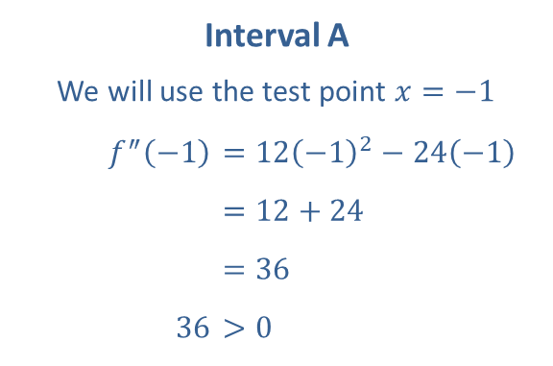
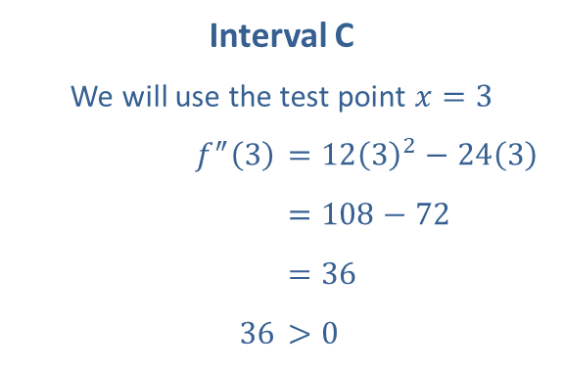
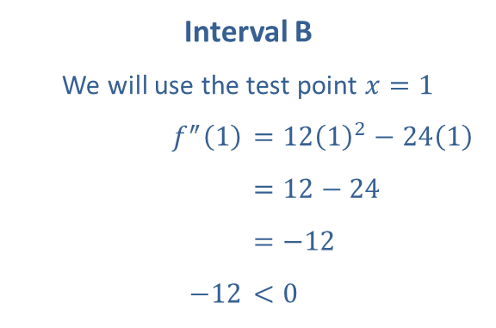
Example 5: Sketching a Curve Using Concavity (cont.)
Interval A
We will use the test point $x=−1$​
​$f^{″}⁡\left(−1\right)$ | ​$=12{\left(−1\right)}^{2}−24\left(−1\right)$
​ | ​$=12+24$
​ | ​$=36$
​$36$ | ​$>0$
Interval B
We will use the test point $x=1$​
​$f^{″}⁡\left(1\right)$ | ​$=12{\left(1\right)}^{2}−24\left(1\right)$
​ | ​$=12−24$
​ | ​$=−12$
​$−12$ | ​$<0$
Interval C
We will use the test point $x=3$​
​$f^{″}⁡\left(3\right)$ | ​$=12{\left(3\right)}^{2}−24\left(3\right)$
​ | ​$=108−72$
​ | ​$=36$
​$36$ | ​$>0$

Slide 23
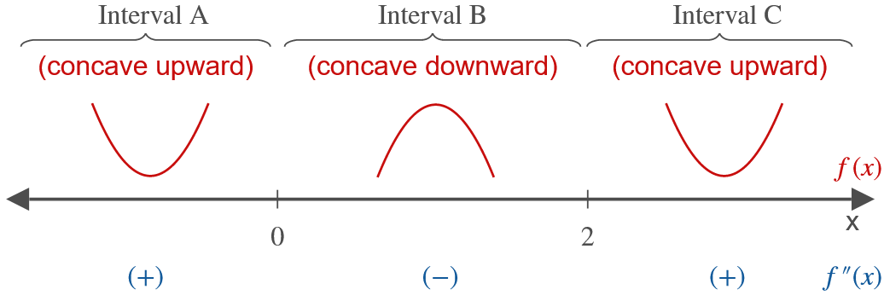
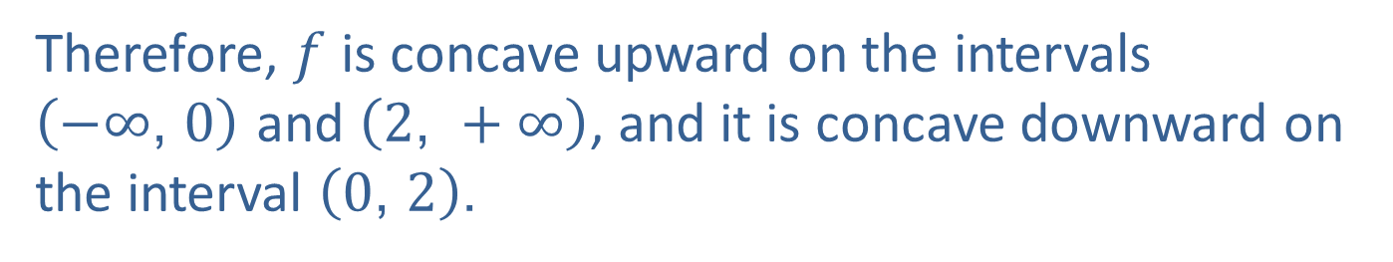
Example 5: Sketching a Curve Using Concavity (cont.)
Therefore, $f$ is concave upward on the intervals
$\left(−∞\text{, }0\right)$ and $\left(2\text{, }+∞\right)$, and it is concave downward on the interval $\left(0\text{, }2\right)$.

Slide 24
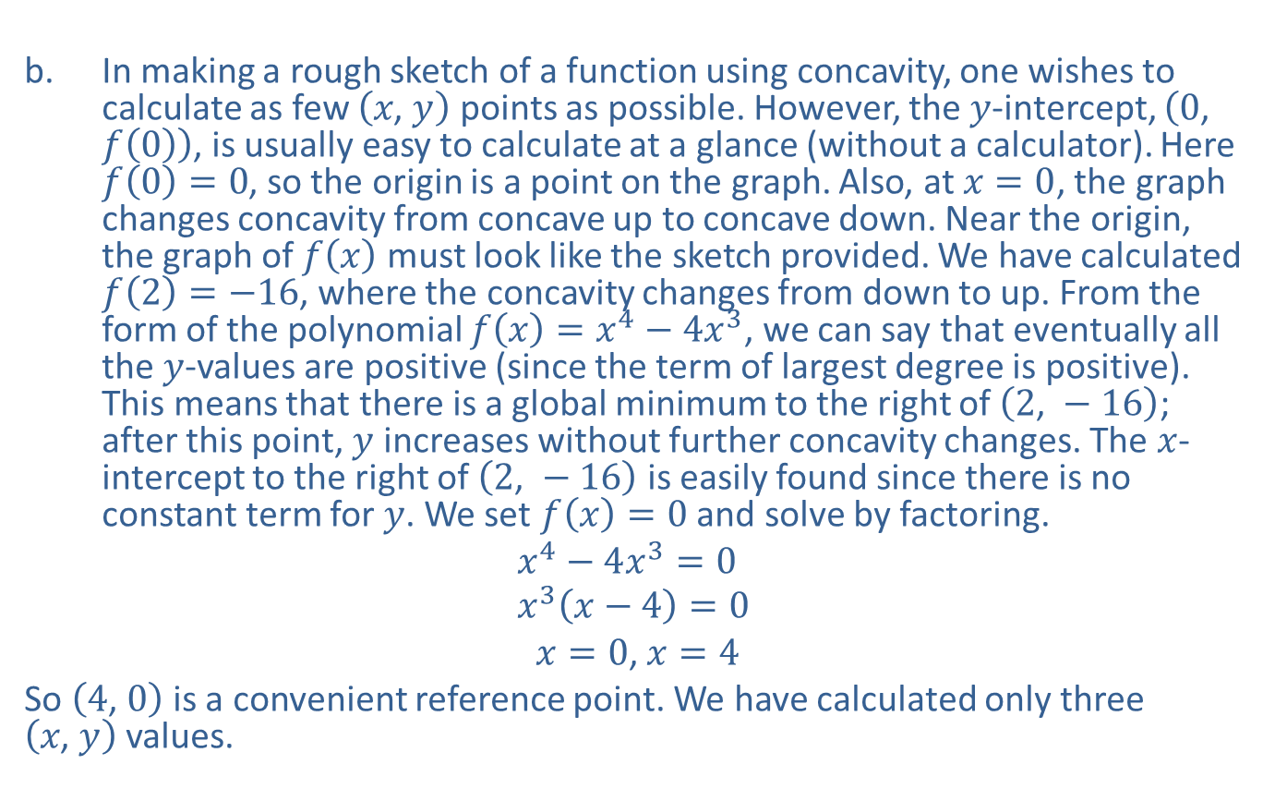
Example 5: Sketching a Curve Using Concavity (cont.)
​In making a rough sketch of a function using concavity, one wishes to calculate as few $\left(x\text{, }y\right)$ points as possible. However, the $y$-intercept, $\left(0\text{, }f\left(0\right)\right)$, is usually easy to calculate at a glance (without a calculator). Here $f\left(0\right)=0$, so the origin is a point on the graph. Also, at $x=0$, the graph changes concavity from concave up to concave down. Near the origin, the graph of $f⁡\left(x\right)$ must look like the sketch provided. We have calculated $f\left(2\right)=−16$, where the concavity changes from down to up. From the form of the polynomial $f\left(x\right)=x^{4}−4x^{3}$, we can say that eventually all the $y$-values are positive (since the term of largest degree is positive). This means that there is a global minimum to the right of $\left(2\text{, }−16\right)$; after this point, $y$ increases without further concavity changes. The $x$-intercept to the right of $\left(2\text{, }−16\right)$ is easily found since there is no constant term for $y$. We set $f\left(x\right)=0$ and solve by factoring.
$$x^{4}−4x^{3}=0 \\ x^{3}\left(x−4\right)=0$$
​ $x=0$, $x=4$
​So $\left(4\text{, }0\right)$ is a convenient reference point. We have calculated only three $\left(x\text{, }y\right)$ values.

Slide 25
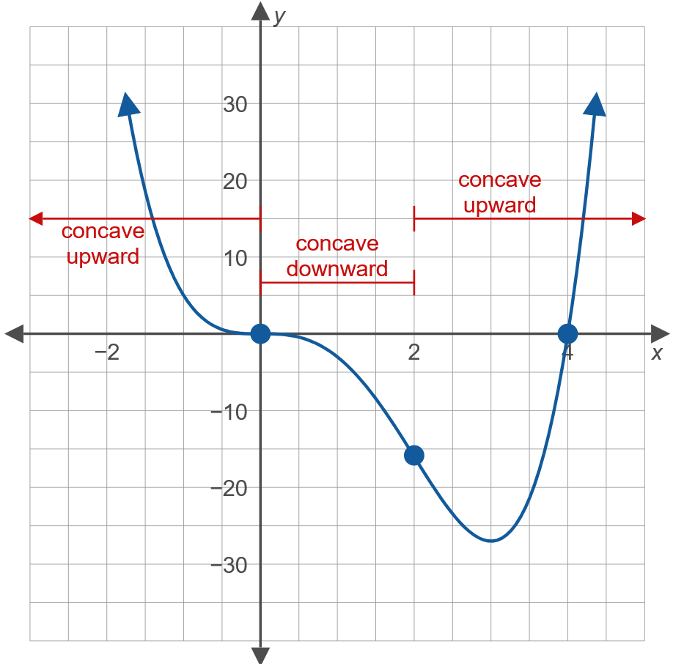
Example 5: Sketching a Curve Using Concavity (cont.)

Slide 26
Point of Inflection
If the graph of a continuous function has a tangent line at a point (possibly a vertical line) and the graph changes concavity at that point, then the point is called a point of inflection.

Slide 27
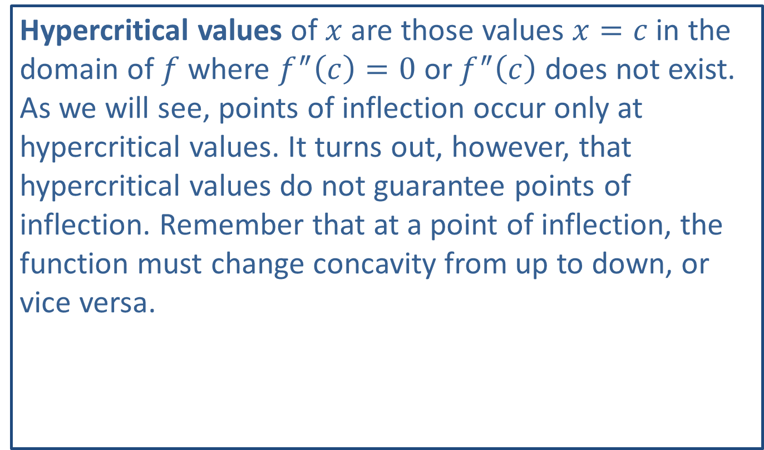
Note:
Hypercritical values of $x$ are those values $x=c$ in the domain of $f$ where $f^{″}\left(c\right)=0$ or $f^{″}⁡\left(c\right)$ does not exist. As we will see, points of inflection occur only at hypercritical values. It turns out, however, that hypercritical values do not guarantee points of inflection. Remember that at a point of inflection, the function must change concavity from up to down, or vice versa.

Slide 28
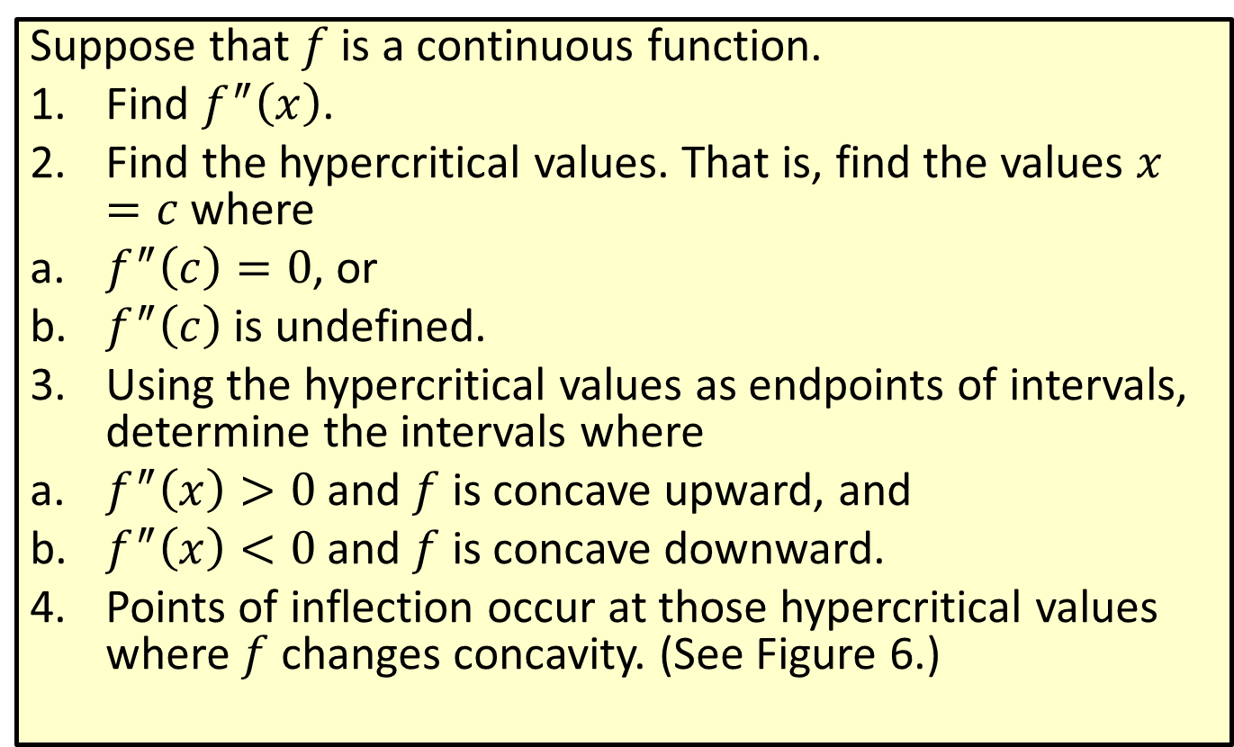
To Determine Points of Inflection
Suppose that $f$ is a continuous function.
​Find $f^{″}⁡\left(x\right)$.
​Find the hypercritical values. That is, find the values $x=c$ where
​$f^{″}\left(c\right)=0$, or
​$f^{″}⁡\left(c\right)$ is undefined.
​Using the hypercritical values as endpoints of intervals, determine the intervals where
​$f^{″}\left(x\right)>0$ and $f$ is concave upward, and
​$f^{″}\left(x\right)<0$ and $f$ is concave downward.
​Points of inflection occur at those hypercritical values where $f$ changes concavity. (See Figure 6.)

Slide 29
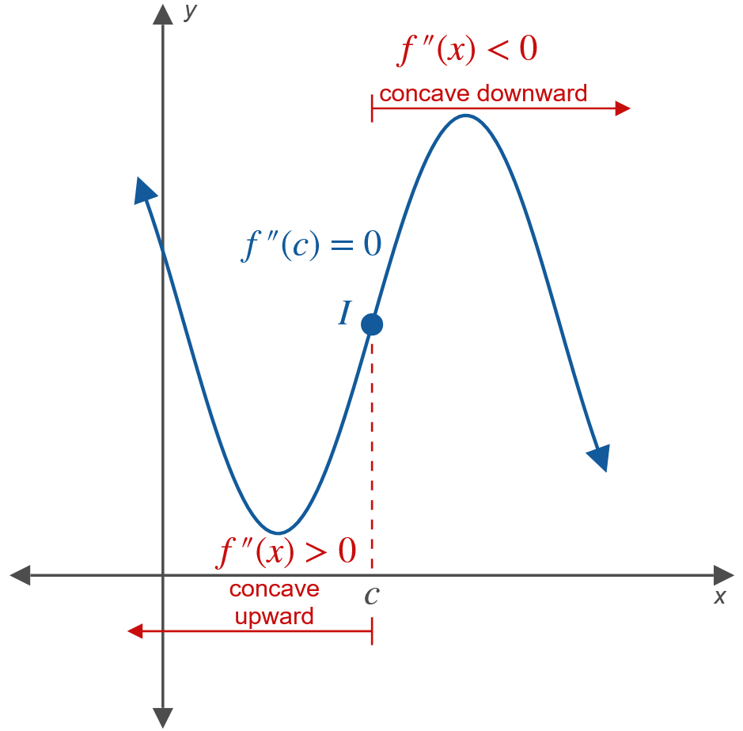
To Determine Points of Inflection (cont.)
Figure 6 (a)

Slide 30
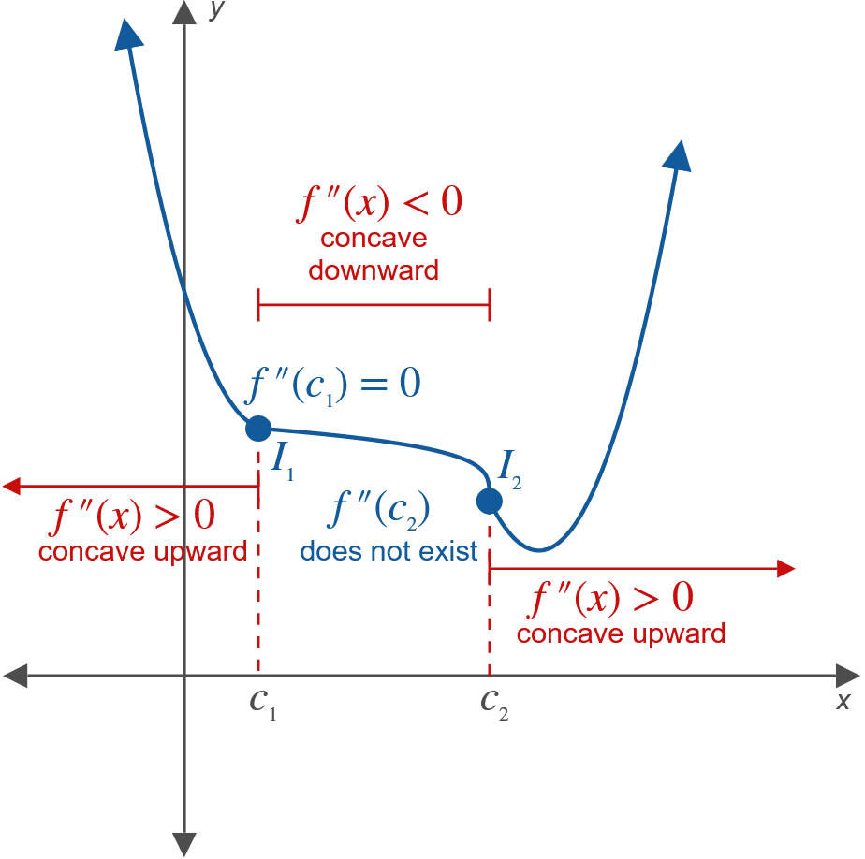
A
Figure 6 (b)

Slide 31
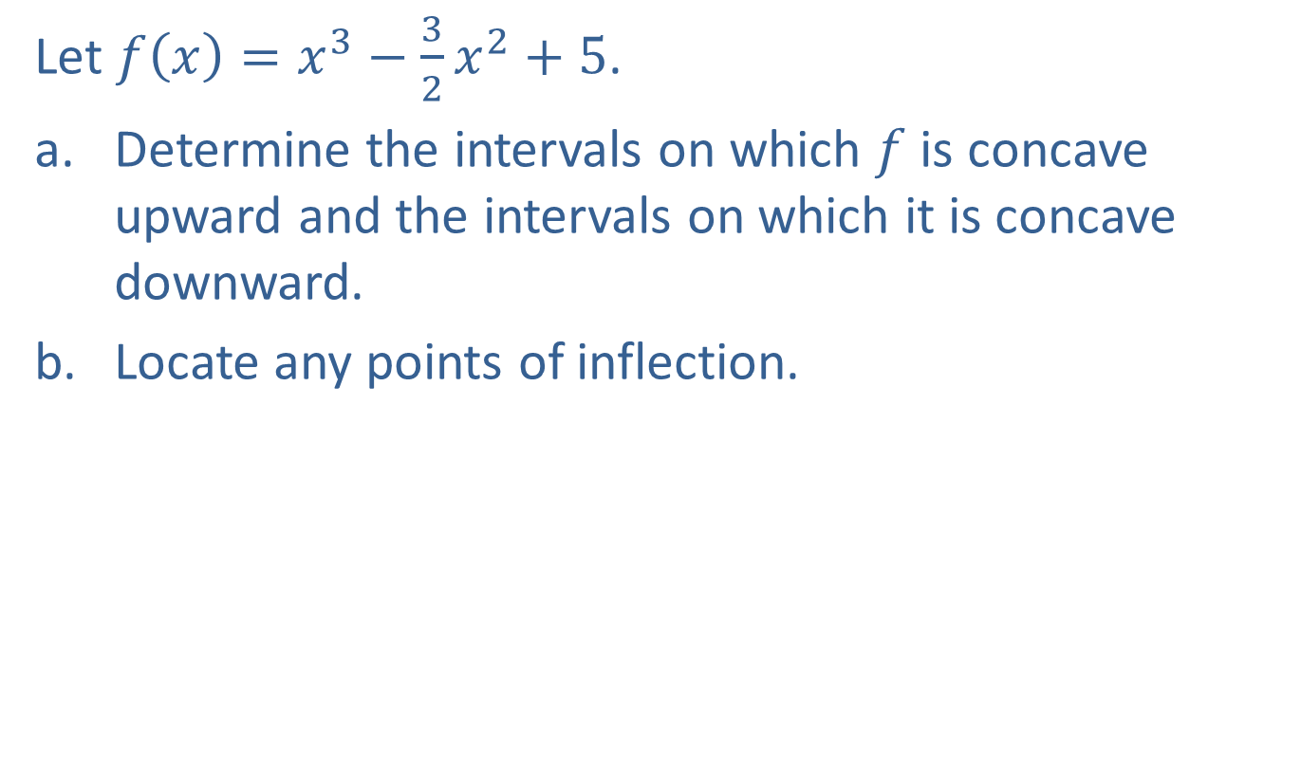
Example 6: Finding Points of Inflection
Let $f\left(x\right)=x^{3}−\frac{3}{2}x^{2}+5$.
​Determine the intervals on which $f$ is concave upward and the intervals on which it is concave downward.
​Locate any points of inflection.

Slide 32

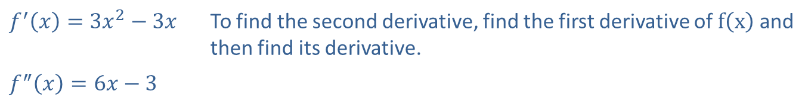
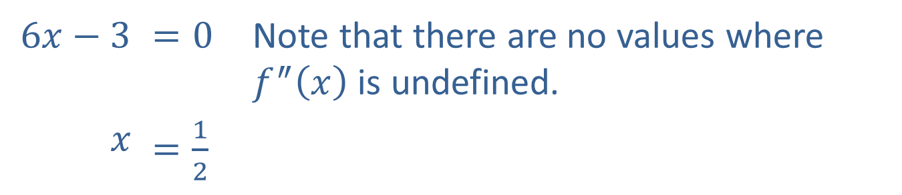
Example 6: Finding Points of Inflection (cont.)
Solution
​We find the hypercritical values and then determine the concavity on the related intervals.
​
​$f^{′}\left(x\right)=3x^{2}−3x$ | To find the second derivative, find the first derivative of $f⁡\left(x\right)$ and then find its derivative.
​$f^{″}\left(x\right)=6x−3$
Now set $f^{″}\left(x\right)=0$.
​$6x−3$ | ​$=0$ | Note that there are no values where $f^{″}⁡\left(x\right)$ is undefined.
$$x$$ | ​$=\frac{1}{2}$

Slide 33

Example 6: Finding Points of Inflection (cont.)
​There are two intervals to be considered:
​$\left(−∞\text{, }\frac{1}{2}\right)$ and $\left(\frac{1}{2}\text{, }+∞\right)$.
​

Slide 34
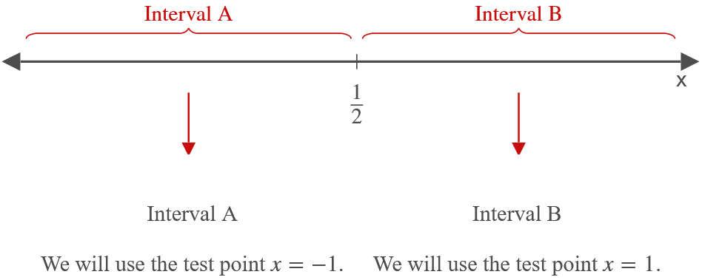
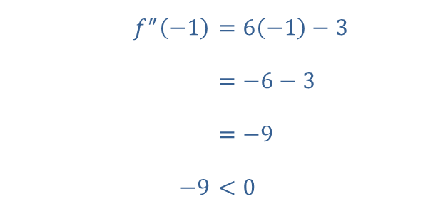
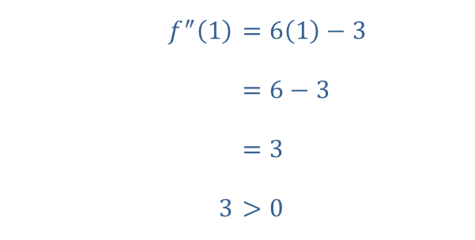
Example 6: Finding Points of Inflection (cont.)
​$f^{″}⁡\left(−1\right)$ | ​$=6\left(−1\right)−3$
​ | ​$=−6−3$
​ | ​$=−9$
​$−9$ | ​$<0$
​$f^{″}⁡\left(1\right)$ | ​$=6\left(1\right)−3$
​ | ​$=6−3$
​ | ​$=3$
​$3$ | ​$>0$

Slide 35
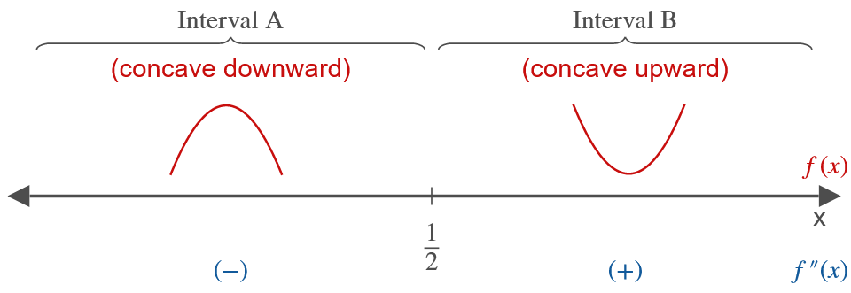
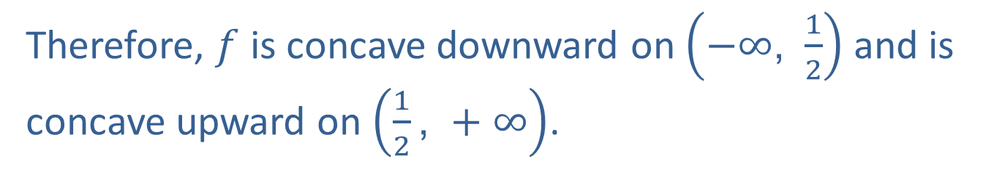
Example 6: Finding Points of Inflection (cont.)
Therefore, $f$ is concave downward on $\left(−∞\text{, }\frac{1}{2}\right)$ and is concave upward on $\left(\frac{1}{2}\text{, }+∞\right)$.

Slide 36
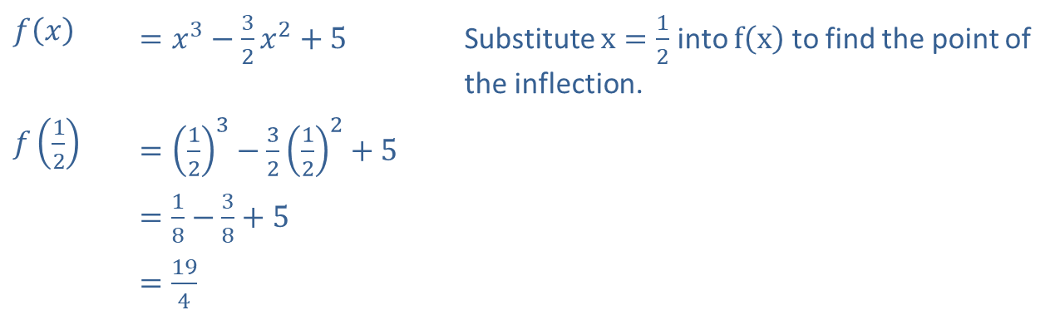


Example 6: Finding Points of Inflection (cont.)
​Since we found in part a. that $f$ changes concavity at $x=\frac{1}{2}$, there must be a point of inflection there.
​
​$f⁡\left(x\right)$ | ​$=x^{3}−\frac{3}{2}x^{2}+5$ | Substitute $x=\frac{1}{2}$ into $f⁡\left(x\right)$ to find the point of the inflection.
​$f⁡\left(\frac{1}{2}\right)$ | ​$={\left(\frac{1}{2}\right)}^{3}−\frac{3}{2}{\left(\frac{1}{2}\right)}^{2}+5$
 | ​$=\frac{1}{8}−\frac{3}{8}+5$
 | ​$=\frac{19}{4}$
So $\left(\frac{1}{2}\text{, }\frac{19}{4}\right)$ is a point of inflection of $f⁡\left(x\right)$.

Slide 37

Example 6: Finding Points of Inflection (cont.)

