Slide 1
Section 4.2
The Second Derivative Test

Slide 2
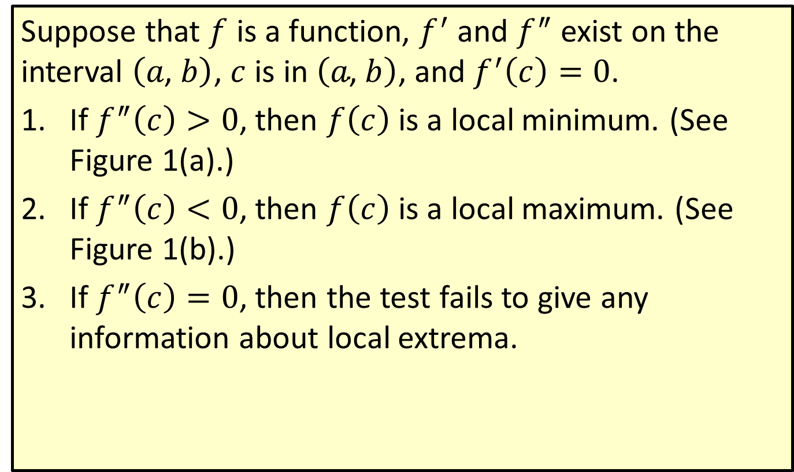
Second Derivative Test for Local Extrema
Suppose that $f$ is a function, $f^{′}$ and $f^{″}$ exist on the interval $\left(a\text{, }b\right)$, $c$ is in $\left(a\text{, }b\right)$, and $f^{′}\left(c\right)=0$.
​If $f^{″}\left(c\right)>0$, then $f⁡\left(c\right)$ is a local minimum. (See Figure 1(a).)
​If $f^{″}\left(c\right)<0$, then $f⁡\left(c\right)$ is a local maximum. (See Figure 1(b).)
​If $f^{″}\left(c\right)=0$, then the test fails to give any information about local extrema.

Slide 3
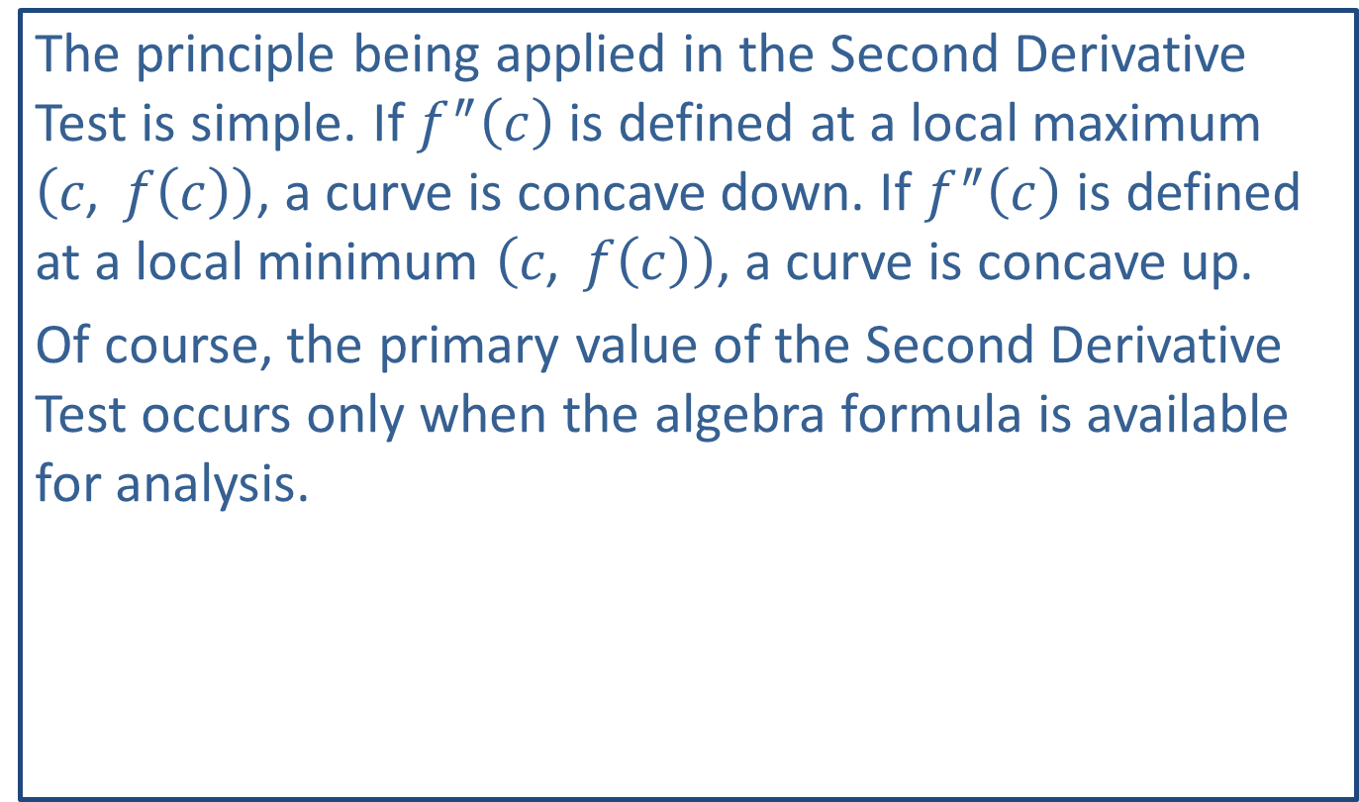
Note:
The principle being applied in the Second Derivative Test is simple. If $f^{″}⁡\left(c\right)$ is defined at a local maximum $\left(c\text{, }f\left(c\right)\right)$, a curve is concave down. If $f^{″}⁡\left(c\right)$ is defined at a local minimum $\left(c\text{, }f\left(c\right)\right)$, a curve is concave up.
Of course, the primary value of the Second Derivative Test occurs only when the algebra formula is available for analysis.

Slide 4

Example 1: Using the Second Derivative Test
Let $f\left(x\right)=x^{4}−18x^{2}$.
​Find the local extrema.
​Find the points of inflection.

Slide 5
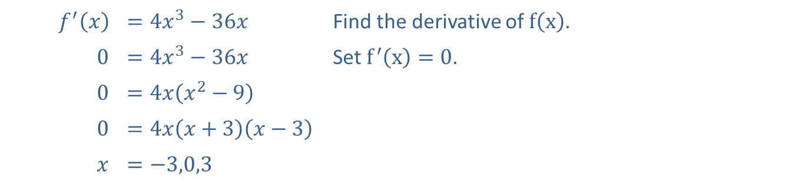

Example 1: Using the Second Derivative Test (cont.)
Solutions
​We will use the Second Derivative Test to find all local extrema of $f⁡\left(x\right)$. First, find all values $x=c$ so that $f^{′}\left(c\right)=0$.
​
​$f^{′}⁡\left(x\right)$ | ​$=4x^{3}−36x$ | Find the derivative of $f⁡\left(x\right)$.
​0 | ​$=4x^{3}−36x$ | Set $f^{′}\left(x\right)=0$.
​0 | ​$=4x\left(x^{2}−9\right)$
​0 | ​$=4x\left(x+3\right)\left(x−3\right)$
$$x$$ | ​$=−3,0,3$

Slide 6
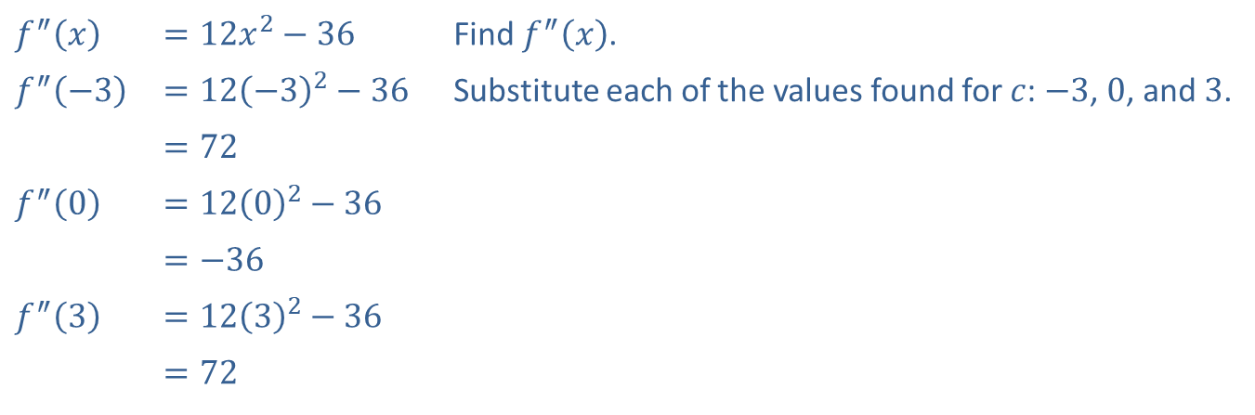

Example 1: Using the Second Derivative Test (cont.)
​Substituting these $x$-values into $f⁡\left(x\right)$, the corresponding $y$-values are $f\left(−3\right)=−81$, $f\left(0\right)=0$, and $f\left(3\right)=−81$.
​Now we need to determine how $f^{″}⁡\left(x\right)$ responds at these $x$-values.
​
​$f^{″}⁡\left(x\right)$ | ​$=12x^{2}−36$ | Find $f^{″}⁡\left(x\right)$.
​$f^{″}⁡\left(−3\right)$ | ​$=12{\left(−3\right)}^{2}−36$ | Substitute each of the values found for $c$: $−3$, 0, and 3.
 | ​$=72$
​$f^{″}⁡\left(0\right)$ | ​$=12{\left(0\right)}^{2}−36$
 | ​$=−36$
​$f^{″}⁡\left(3\right)$ | ​$=12{\left(3\right)}^{2}−36$
 | ​$=72$

Slide 7
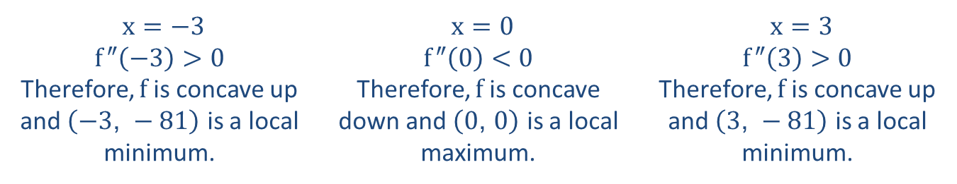
Example 1: Using the Second Derivative Test (cont.)
​Use the method for determining concavity in addition to the Second Derivative Test to interpret these results:
​
$x=−3$ $f^{″}\left(−3\right)>0$ Therefore, $f$ is concave up and $\left(−3\text{, }−81\right)$ is a local minimum. | $x=0$ $f^{″}\left(0\right)<0$ Therefore, $f$ is concave down and $\left(0\text{, }0\right)$ is a local maximum. | $x=3$ $f^{″}\left(3\right)>0$ Therefore, $f$ is concave up and $\left(3\text{, }−81\right)$ is a local minimum.

Slide 8
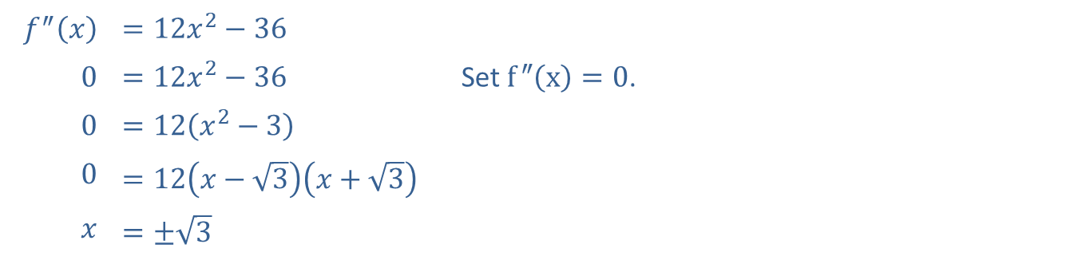

Example 1: Using the Second Derivative Test (cont.)
​The points of inflection come from setting $f^{″}\left(x\right)=0$ and solving for $x$.
​
​$f^{″}⁡\left(x\right)$ | ​$=12x^{2}−36$
​0 | ​$=12x^{2}−36$ | Set $f^{″}\left(x\right)=0$.
​0 | ​$=12\left(x^{2}−3\right)$
​0 | ​$=12\left(x−\sqrt{3}\right)\left(x+\sqrt{3}\right)$
$$x$$ | ​$=±\sqrt{3}$

Slide 9
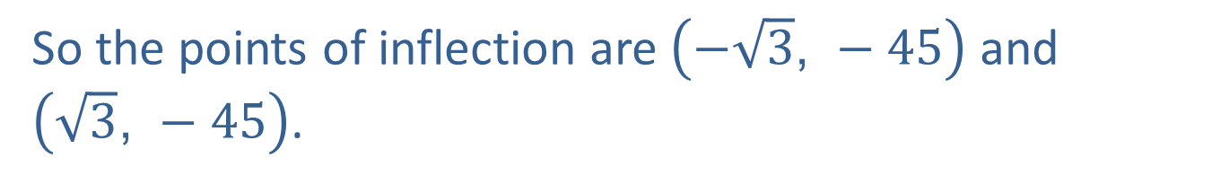

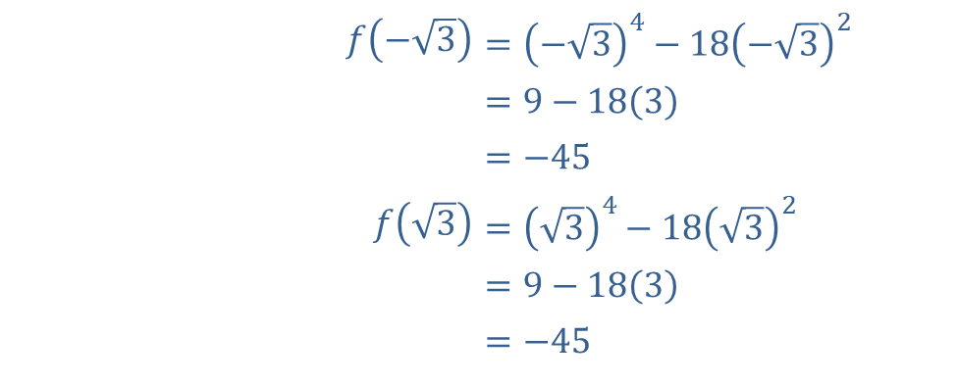
Example 1: Using the Second Derivative Test (cont.)
The corresponding $y$-values are
​$f⁡\left(−\sqrt{3}\right)$ | ​$={\left(−\sqrt{3}\right)}^{4}−18{\left(−\sqrt{3}\right)}^{2}$
​ | ​$=9−18\left(3\right)$
​ | ​$=−45$
​$f⁡\left(\sqrt{3}\right)$ | ​$={\left(\sqrt{3}\right)}^{4}−18{\left(\sqrt{3}\right)}^{2}$
​ | ​$=9−18\left(3\right)$
​ | ​$=−45$
So the points of inflection are $\left(−\sqrt{3}\text{, }−45\right)$ and
$\left(\sqrt{3}\text{, }−45\right)$.

Slide 10
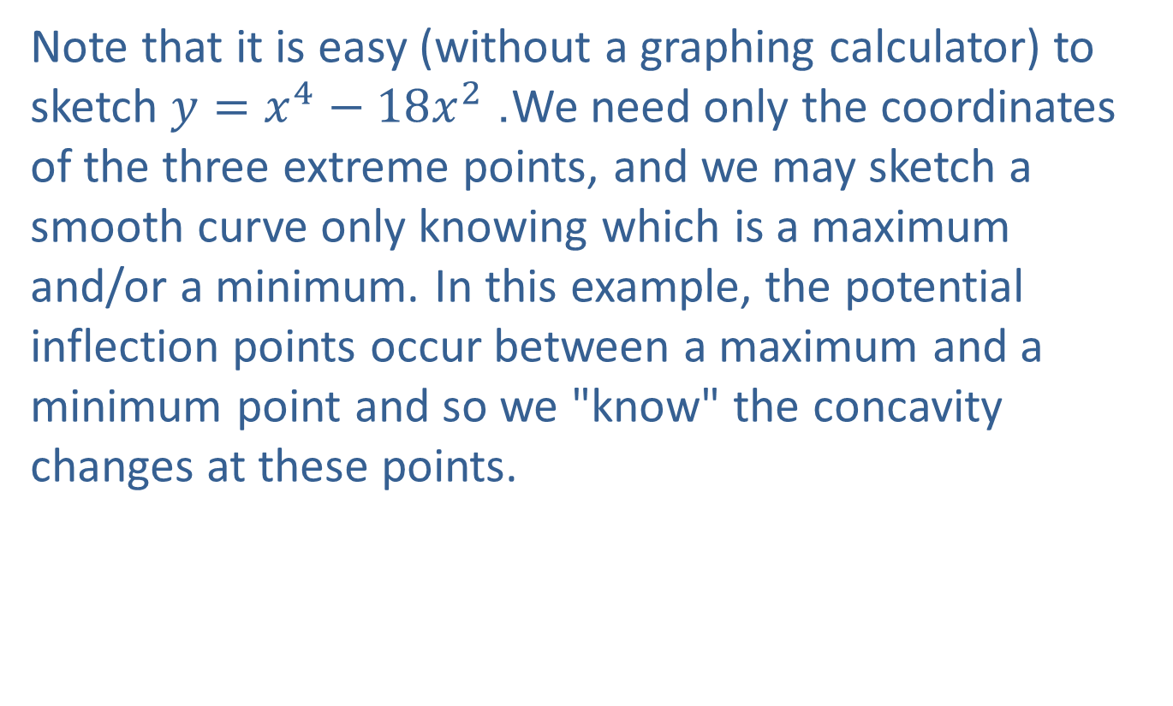
Example 1: Using the Second Derivative Test (cont.)
​​Note that it is easy (without a graphing calculator) to sketch $y=x^{4}−18x^{2}$. We need only the coordinates of the three extreme points, and we may sketch a smooth curve only knowing which is a maximum and/or a minimum. In this example, the potential inflection points occur between a maximum and a minimum point and so we "know" the concavity changes at these points.

Slide 11
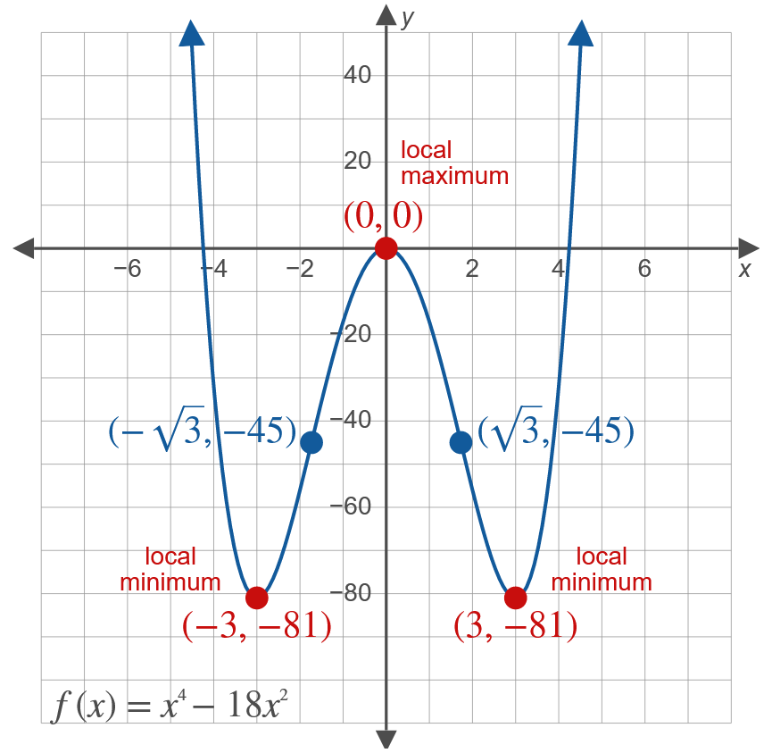
Example 1: Using the Second Derivative Test (cont.)

Slide 12
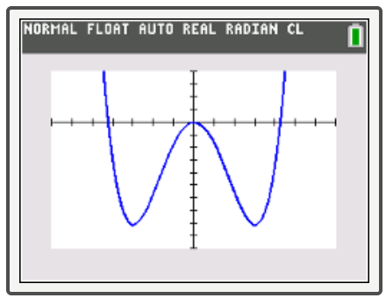
Tech Training
To verify your graph with a TI-84 Plus calculator, perform the following steps:
​Enter the given function into Y1.
​Check that your WINDOW is appropriate.
​Press GRAPH.

Slide 13
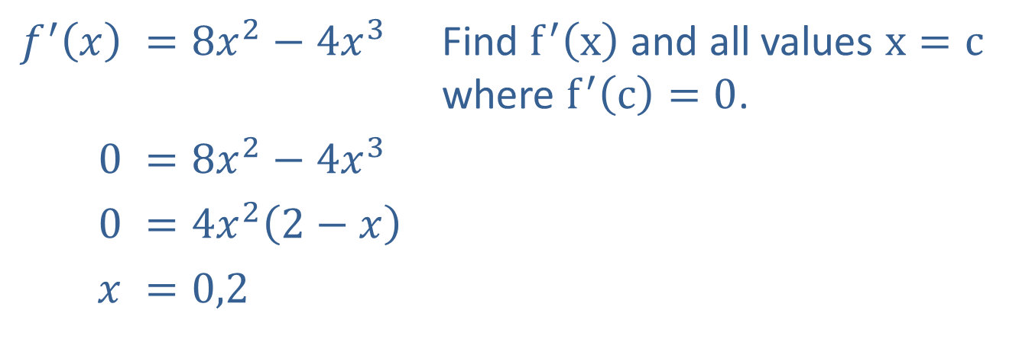

Example 2: Locating Local Extrema
Locate the local extrema for the function $f\left(x\right)=\frac{8}{3}x^{3}−x^{4}$ and sketch a graph of the function.
Solution
​$f^{′}⁡\left(x\right)$ | ​$=8x^{2}−4x^{3}$ | Find $f^{′}⁡\left(x\right)$ and all values $x=c$ where $f^{′}\left(c\right)=0$.
​0 | ​$=8x^{2}−4x^{3}$
​0 | ​$=4x^{2}\left(2−x\right)$
$$x$$ | ​$=0,2$

Slide 14
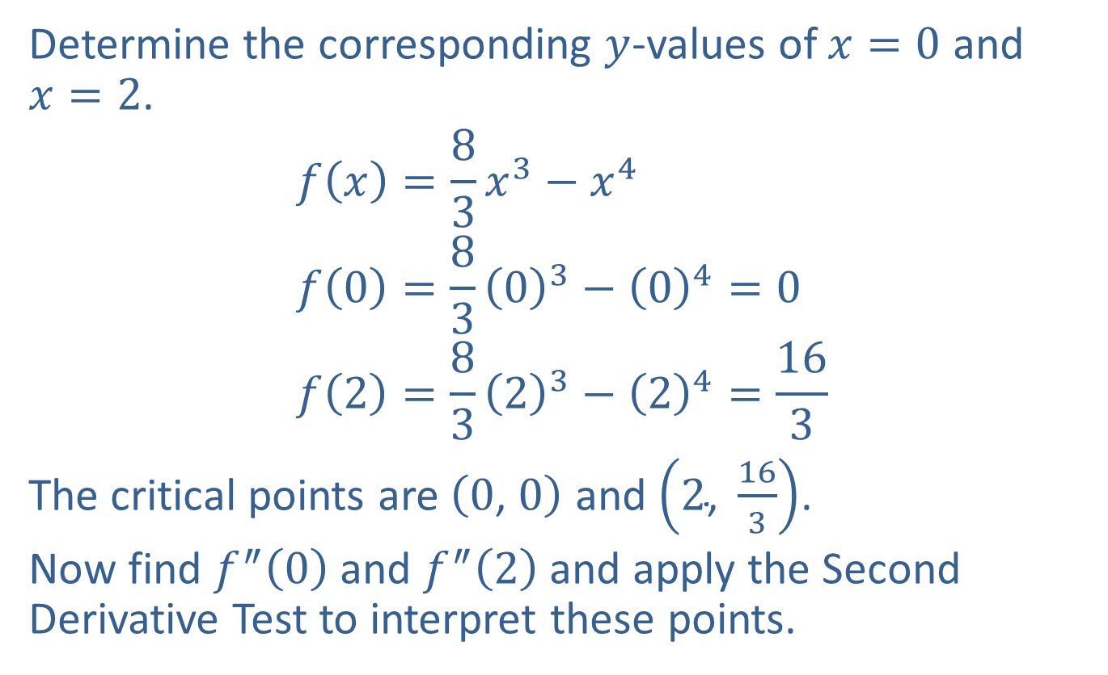
Example 2: Locating Local Extrema (cont.)
Determine the corresponding $y$-values of $x=0$ and $x=2$.
$$f\left(x\right)=\frac{8}{3}x^{3}−x^{4} \\ f\left(0\right)=\frac{8}{3}{\left(0\right)}^{3}−{\left(0\right)}^{4}=0 \\ f\left(2\right)=\frac{8}{3}{\left(2\right)}^{3}−{\left(2\right)}^{4}=\frac{16}{3}$$
The critical points are $\left(0\text{, }0\right)$ and $\left(2\text{, }\frac{16}{3}\right)$.
Now find $f^{″}⁡\left(0\right)$ and $f^{″}⁡\left(2\right)$ and apply the Second Derivative Test to interpret these points.

Slide 15
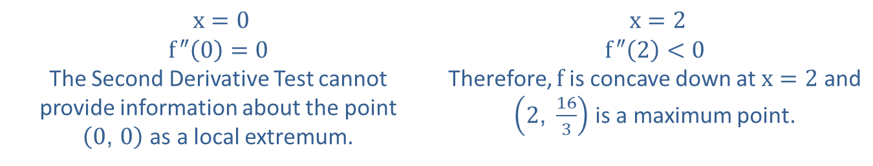
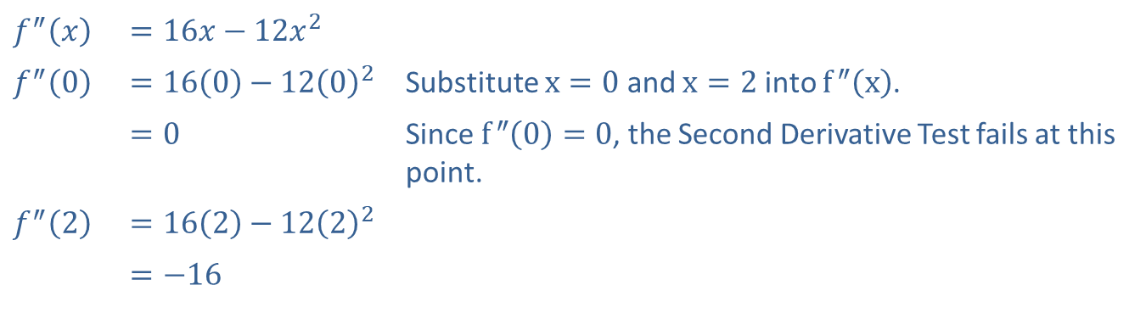
Example 2: Locating Local Extrema (cont.)
​$f^{″}⁡\left(x\right)$ | ​$=16x−12x^{2}$
​$f^{″}⁡\left(0\right)$ | ​$=16\left(0\right)−12{\left(0\right)}^{2}$ | Substitute $x=0$ and $x=2$ into $f^{″}⁡\left(x\right)$.
 | ​$=0$ | Since $f^{″}\left(0\right)=0$, the Second Derivative Test fails at this point.
​$f^{″}⁡\left(2\right)$ | ​$=16\left(2\right)−12{\left(2\right)}^{2}$
 | ​$=−16$
$x=0$ $f^{″}\left(0\right)=0$ The Second Derivative Test cannot provide information about the point $\left(0\text{, }0\right)$ as a local extremum. | $x=2$ $f^{″}\left(2\right)<0$ Therefore, $f$ is concave down at $x=2$ and $\left(2\text{, }\frac{16}{3}\right)$ is a maximum point.
A local maximum occurs at the point $\left(2\text{, }\frac{16}{3}\right)$.

Slide 16
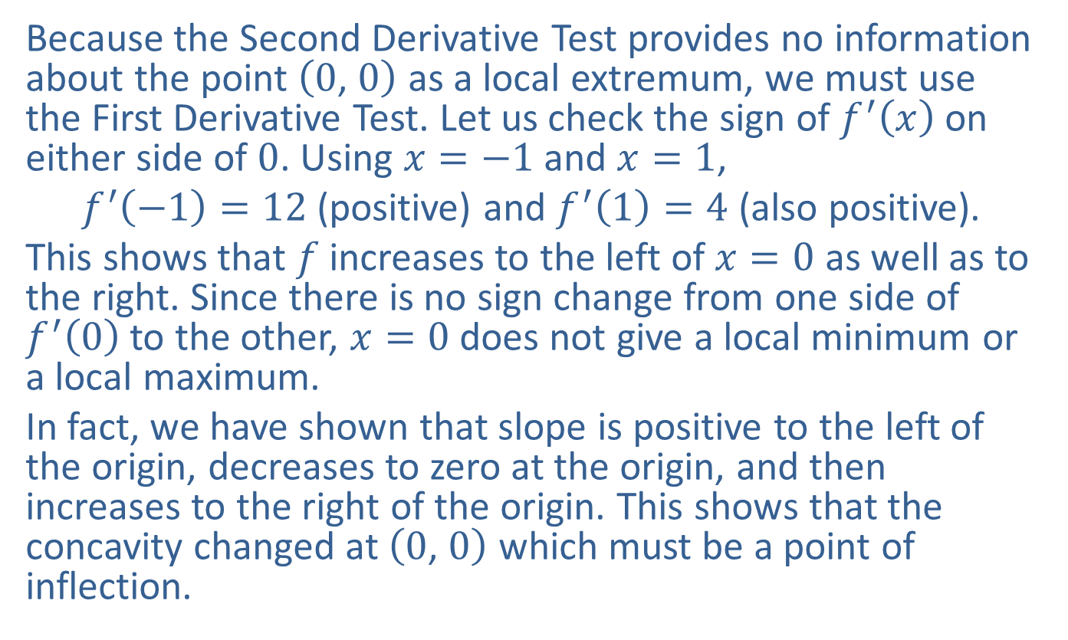
Example 2: Locating Local Extrema (cont.)
Because the Second Derivative Test provides no information about the point $\left(0\text{, }0\right)$ as a local extremum, we must use the First Derivative Test. Let us check the sign of $f^{′}⁡\left(x\right)$ on either side of 0. Using $x=−1$ and $x=1$,
$f^{′}\left(−1\right)=12$ (positive) and $f^{′}\left(1\right)=4$ (also positive).
This shows that $f$ increases to the left of $x=0$ as well as to the right. Since there is no sign change from one side of $f^{′}⁡\left(0\right)$ to the other, $x=0$ does not give a local minimum or a local maximum.
In fact, we have shown that slope is positive to the left of the origin, decreases to zero at the origin, and then increases to the right of the origin. This shows that the concavity changed at $\left(0\text{, }0\right)$ which must be a point of inflection.

Slide 17
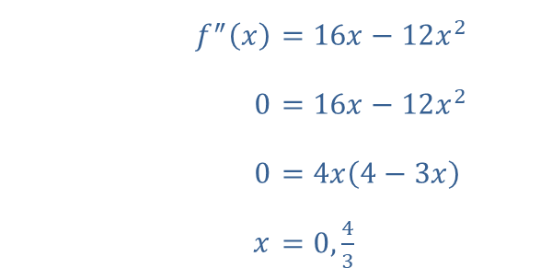
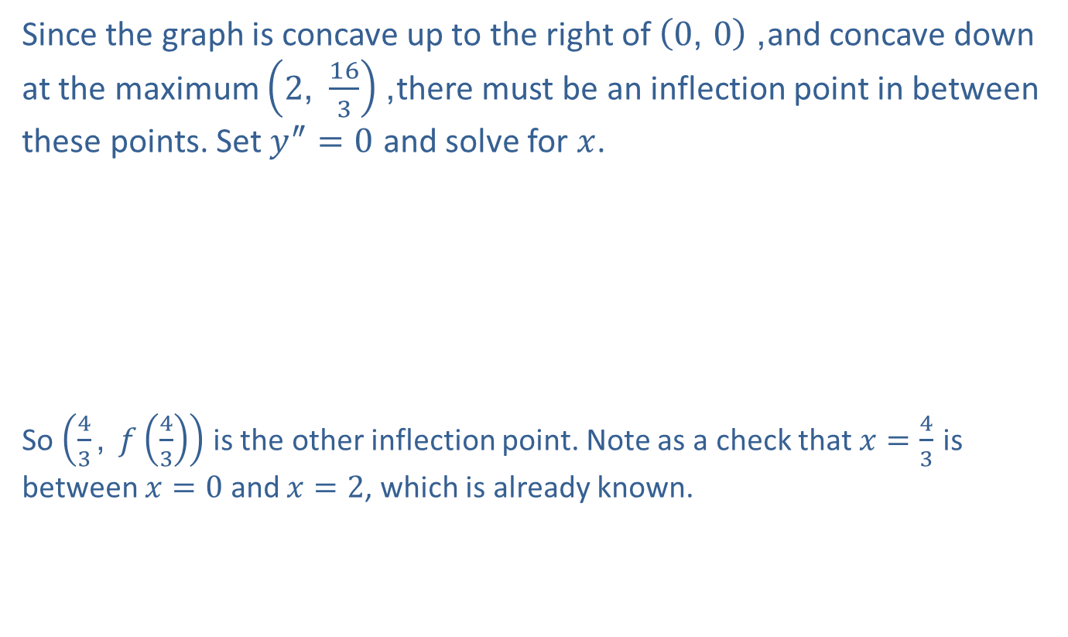
Example 2: Locating Local Extrema (cont.)
Since the graph is concave up to the right of $\left(0\text{, }0\right)$, and concave down at the maximum $\left(2\text{, }\frac{16}{3}\right)$, there must be an inflection point in between these points. Set $y^{″}=0$ and solve for $x$.
​
So $\left(\frac{4}{3}\text{, }f\left(\frac{4}{3}\right)\right)$ is the other inflection point. Note as a check that $x=\frac{4}{3}$ is between $x=0$ and $x=2$, which is already known.
​$f^{″}⁡\left(x\right)$ | ​$=16x−12x^{2}$
​$0$ | ​$=16x−12x^{2}$
​$0$ | ​$=4x\left(4−3x\right)$
​$x$ | ​$=0,\frac{4}{3}$

Slide 18
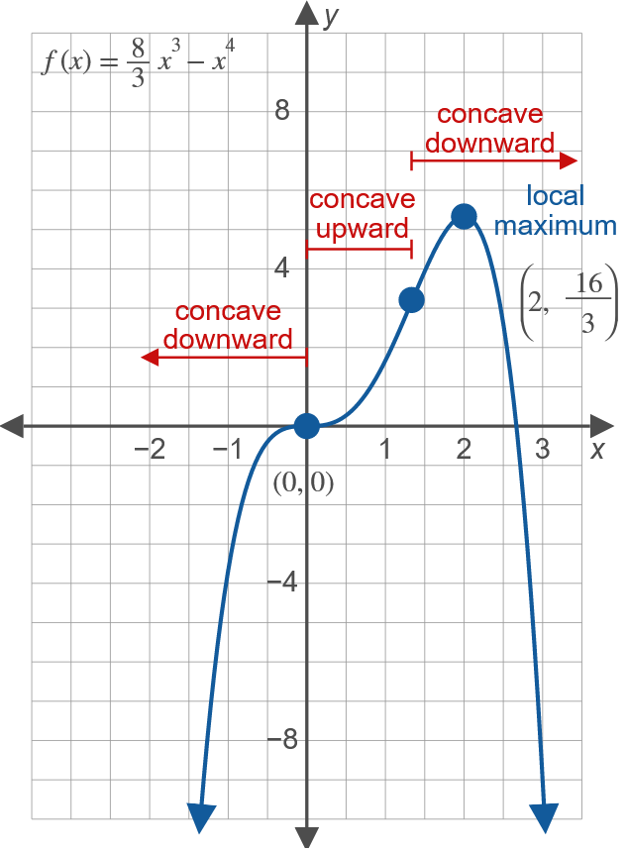
Example 2: Locating Local Extrema (cont.)

Slide 19
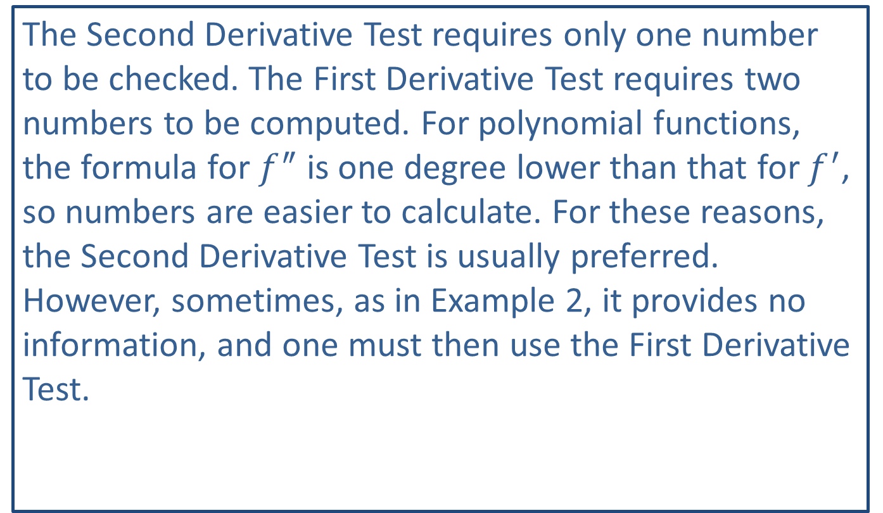
Note:
The Second Derivative Test requires only one number to be checked. The First Derivative Test requires two numbers to be computed. For polynomial functions, the formula for $f^{″}$ is one degree lower than that for $f^{′}$, so numbers are easier to calculate. For these reasons, the Second Derivative Test is usually preferred. However, sometimes, as in Example 2, it provides no information, and one must then use the First Derivative Test.

Slide 20
Point of Diminishing Returns
The point of diminishing returns occurs at a point of inflection where the sales curve changes from concave upward to concave downward.

Slide 21
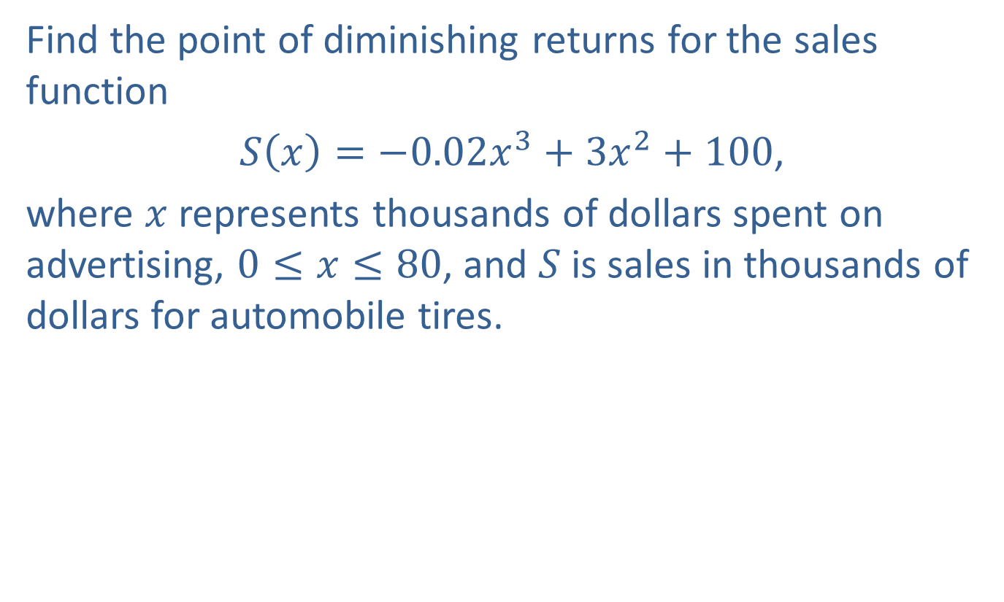
Example 3: Point of Diminishing Returns
Find the point of diminishing returns for the sales function
$S\left(x\right)=−0.02x^{3}+3x^{2}+100$,
where $x$ represents thousands of dollars spent on advertising, $0≤x≤80$, and $S$ is sales in thousands of dollars for automobile tires.

Slide 22
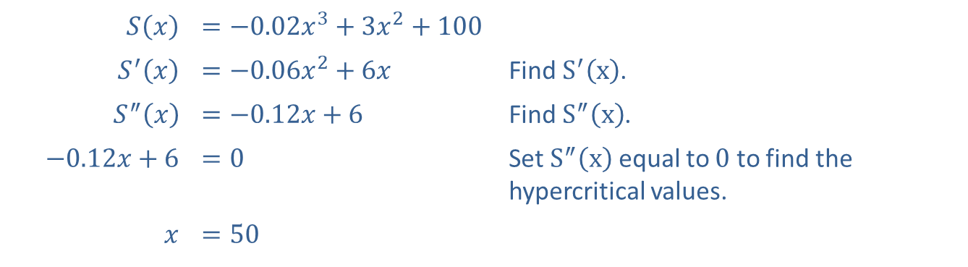

Example 3: Point of Diminishing Returns (cont.)
Solution
To find the point at which concavity changes from concave upward to concave downward, we must first find the hypercritical values of $x$ between 0 and 80. Then we determine whether these points are points of inflection.
​$S⁡\left(x\right)$ | ​$=−0.02x^{3}+3x^{2}+100$
​$S^{′}⁡\left(x\right)$ | ​$=−0.06x^{2}+6x$ | Find $S^{′}⁡\left(x\right)$.
​$S^{″}⁡\left(x\right)$ | ​$=−0.12x+6$ | Find $S^{″}⁡\left(x\right)$.
​$−0.12x+6$ | ​$=0$ | Set $S^{″}⁡\left(x\right)$ equal to 0 to find the hypercritical values.
$$x$$ | ​$=50$

Slide 23
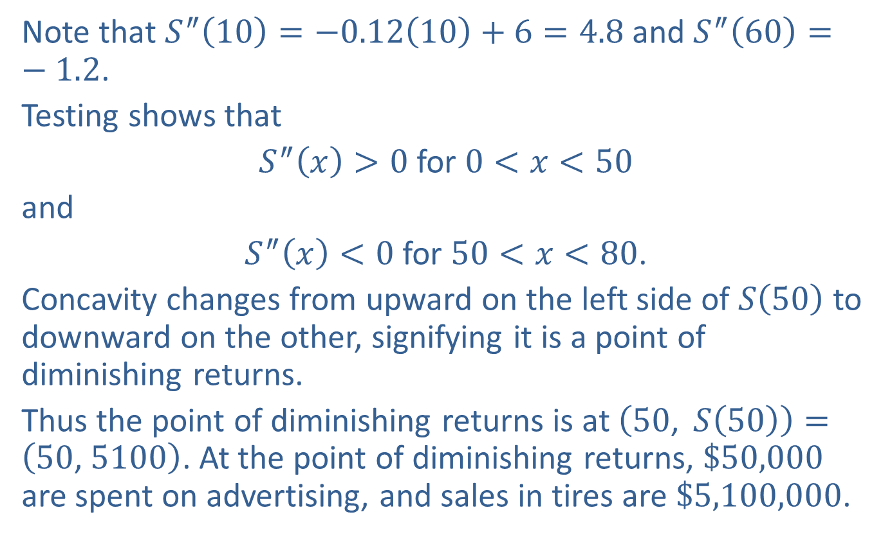
Example 3: Point of Diminishing Returns (cont.)
Note that $S^{″}\left(10\right)=−0.12\left(10\right)+6=4.8$ and $S^{″}\left(60\right)=−1.2$.
Testing shows that
$S^{″}\left(x\right)>0$ for $0<x<50$
and
$S^{″}\left(x\right)<0$ for $50<x<80$.
Concavity changes from upward on the left side of $S⁡\left(50\right)$ to downward on the other, signifying it is a point of diminishing returns.
Thus the point of diminishing returns is at $\left(50\text{, }S\left(50\right)\right)=\left(50\text{, }5100\right)$. At the point of diminishing returns, $\$50,000$ are spent on advertising, and sales in tires are $\$5,100,000$.

