Slide 1
Section 4.3
Curve Sketching: Polynomial Functions

Slide 2

Example 1: Curve Sketching
Sketch a continuous function that satisfies all the given conditions.
List of Given Conditions
$f^{′}\left(x\right)>0$ for all $x$ $f^{″}\left(3\right)=0$ and $f\left(3\right)=4$ $f^{″}\left(x\right)<0$ on $(−∞, 3)$ $f^{″}\left(x\right)>0$ on $(3,+∞)$

Slide 3
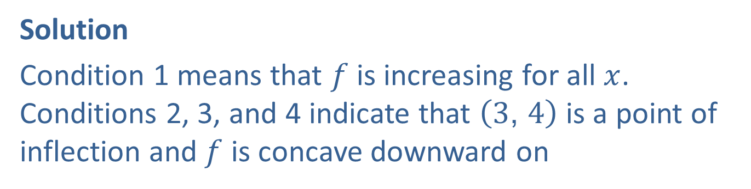

Example 1: Curve Sketching (cont.)
Solution
Condition 1 means that $f$ is increasing for all $x$. Conditions 2, 3, and 4 indicate that $\left(3\text{, }4\right)$ is a point of inflection and $f$ is concave downward on
$$\left(−∞\text{, }3\right)$$
and concave upward on $\left(3\text{, }+∞\right)$.
One possible curve that satisfies all the given conditions is shown.

Slide 4
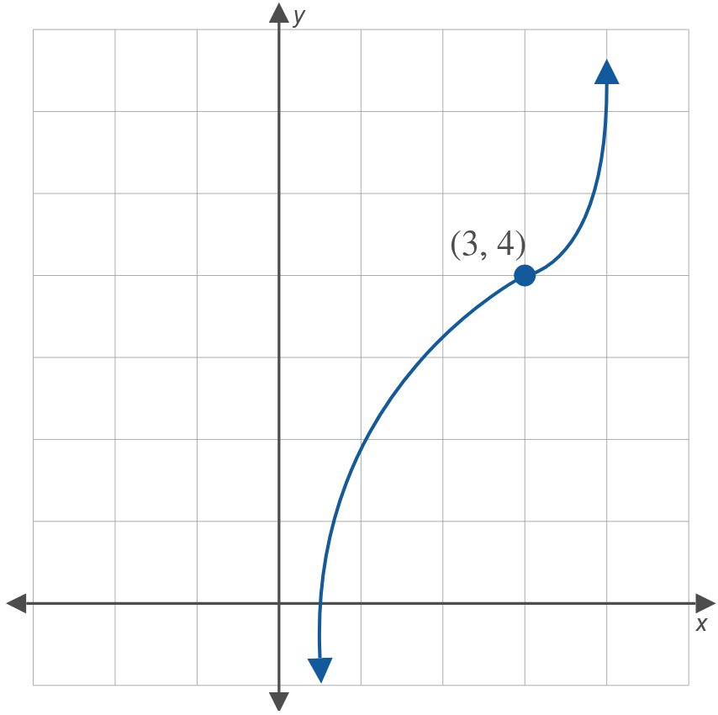
Example 1: Curve Sketching (cont.)

Slide 5

Example 2: Curve Sketching
Sketch a continuous function that satisfies all the given conditions.
List of Given Conditions
$g\left(−1\right)=2$, $g\left(0\right)=1$, $g\left(1\right)=−2$ $g^{′}\left(0\right)=0$, $g^{′}\left(1\right)=0$ $g^{″}\left(0\right)=0$, $g\left(0.5\right)=0$ $g^{″}\left(x\right)<0$ if $0<x<0.5$ $g^{″}\left(x\right)>0$ if $x<0$ or $x>0.5$

Slide 6
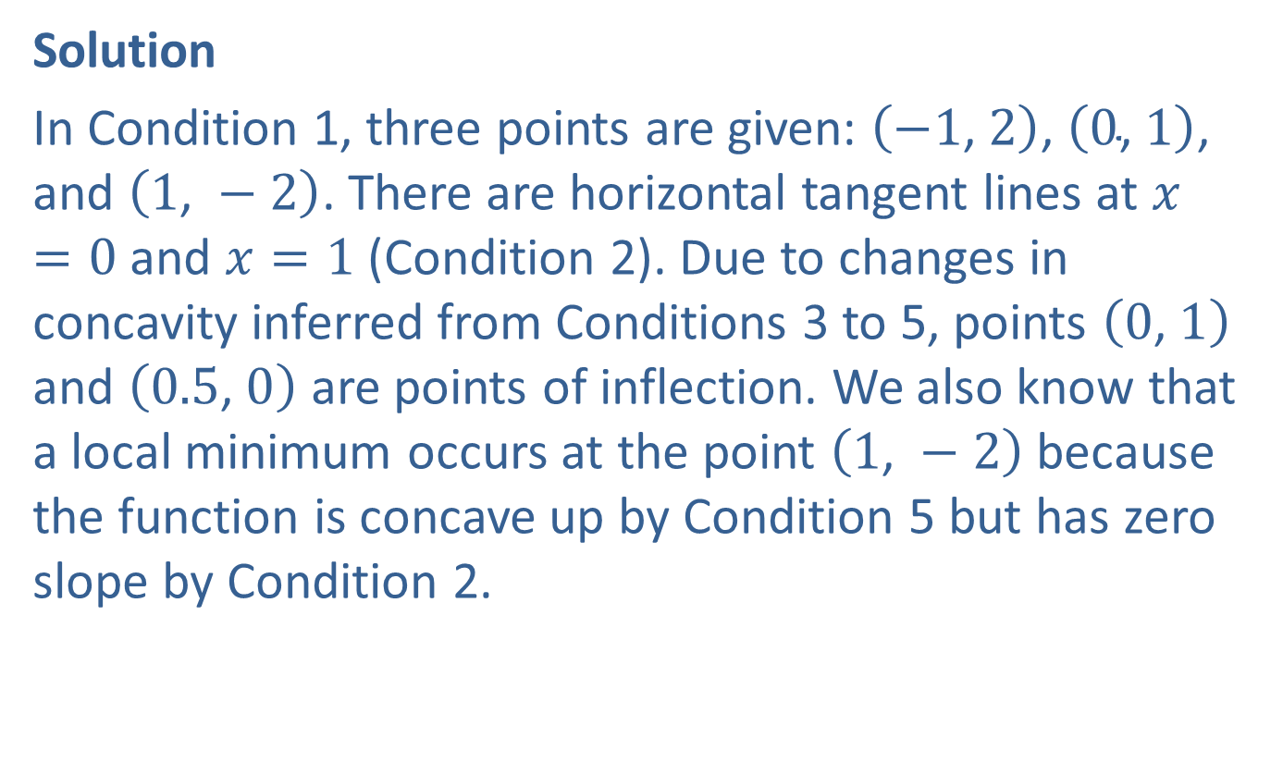
Example 2: Curve Sketching (cont.)
Solution
In Condition 1, three points are given: $\left(−1\text{, }2\right)$, $\left(0\text{, }1\right)$, and $\left(1\text{, }−2\right)$. There are horizontal tangent lines at $x=0$ and $x=1$ (Condition 2). Due to changes in concavity inferred from Conditions 3 to 5, points $\left(0\text{, }1\right)$ and $\left(0.5\text{, }0\right)$ are points of inflection. We also know that a local minimum occurs at the point $\left(1\text{, }−2\right)$ because the function is concave up by Condition 5 but has zero slope by Condition 2.

Slide 7
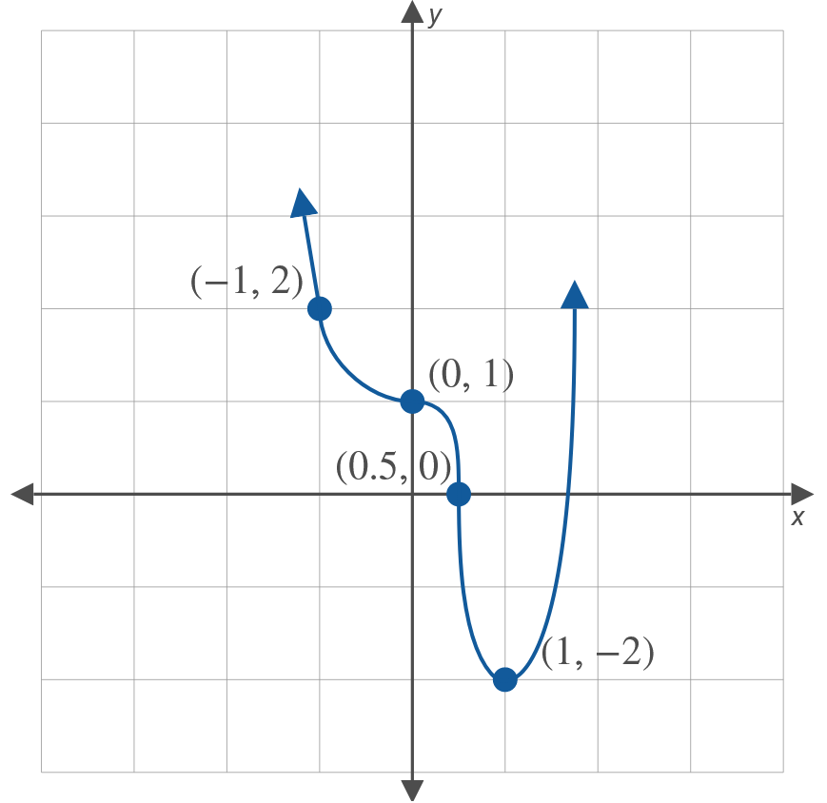
Example 2: Curve Sketching (cont.)

Slide 8
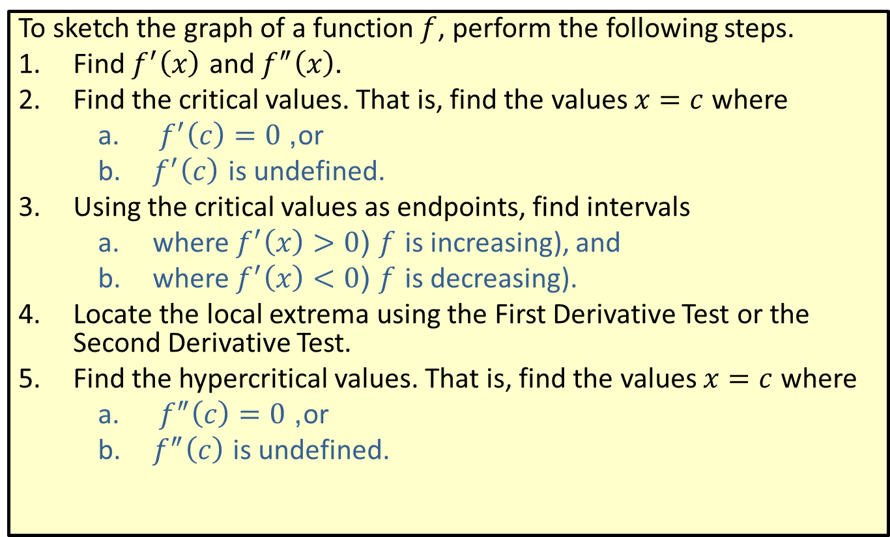

Strategy for Curve Sketching Given a Function $f$
To sketch the graph of a function $f$, perform the following steps.
​Find $f^{′}⁡\left(x\right)$ and $f^{″}⁡\left(x\right)$.
​Find the critical values. That is, find the values $x=c$ where
​ $f^{′}\left(c\right)=0$, or
​$f^{′}\left(c\right)$ is undefined.
​Using the critical values as endpoints, find intervals
​where $f^{′}\left(x\right)>0$ ($f$ is increasing), and
​where $f^{′}\left(x\right)<0$ ($f$ is decreasing).
​Locate the local extrema using the First Derivative Test or the Second Derivative Test.
​Find the hypercritical values. That is, find the values $x=c$ where
​ $f^{″}\left(c\right)=0$, or
​$f^{″}\left(c\right)$ is undefined.

Slide 9
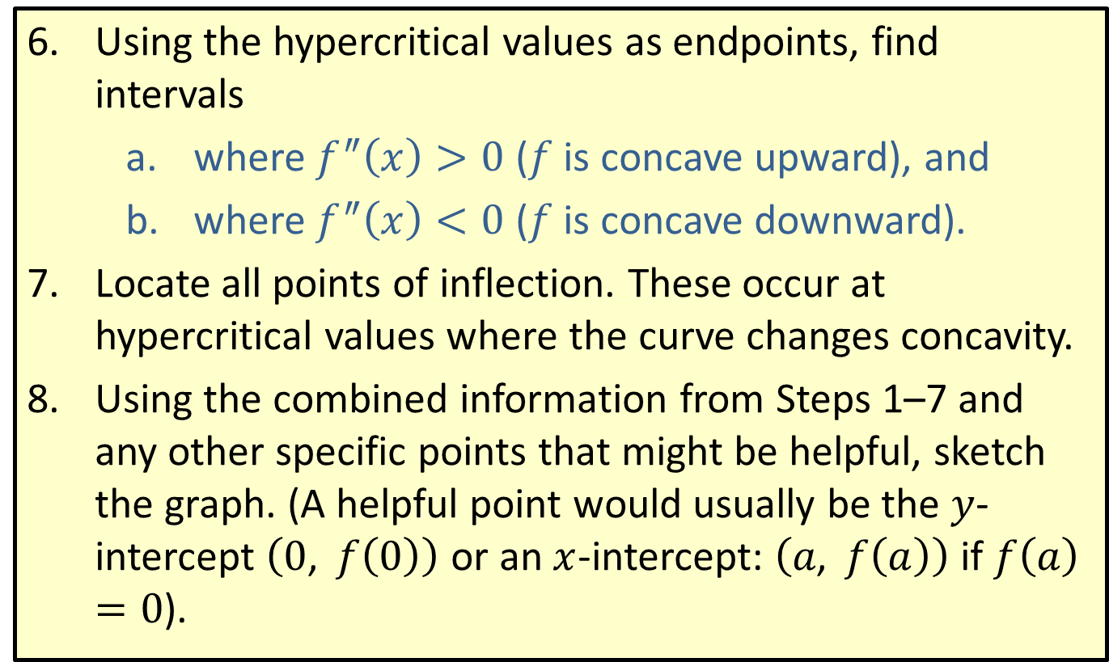

Strategy for Curve Sketching Given a Function $f$ (cont.)
​Using the hypercritical values as endpoints, find intervals
​where $f^{″}\left(x\right)>0$ ($f$ is concave upward), and
​where $f^{″}\left(x\right)<0$ ($f$ is concave downward).
​Locate all points of inflection. These occur at hypercritical values where the curve changes concavity.
​Using the combined information from Steps 1–7 and any other specific points that might be helpful, sketch the graph. (A helpful point would usually be the $y$-intercept $\left(0\text{, }f\left(0\right)\right)$ or an $x$-intercept: $\left(a\text{, }f\left(a\right)\right)$ if $f\left(a\right)=0$).

Slide 10
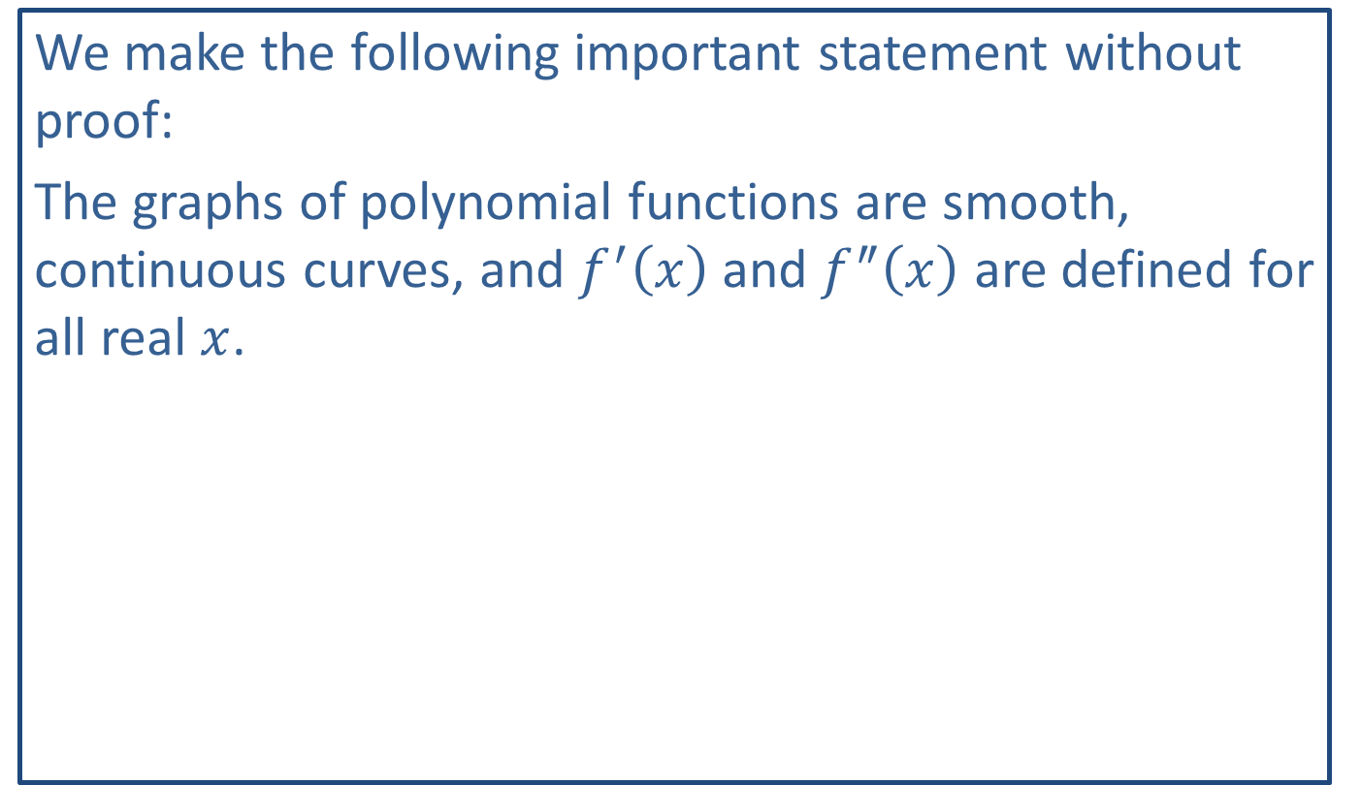
Note:
We make the following important statement without proof:
The graphs of polynomial functions are smooth, continuous curves, and $f^{′}⁡\left(x\right)$ and $f^{″}⁡\left(x\right)$ are defined for all real $x$.

Slide 11

Example 3: Using the Strategy for Curve Sketching
Sketch the graph of the polynomial function $f\left(x\right)=x^{2}−2x−3$.

Slide 12
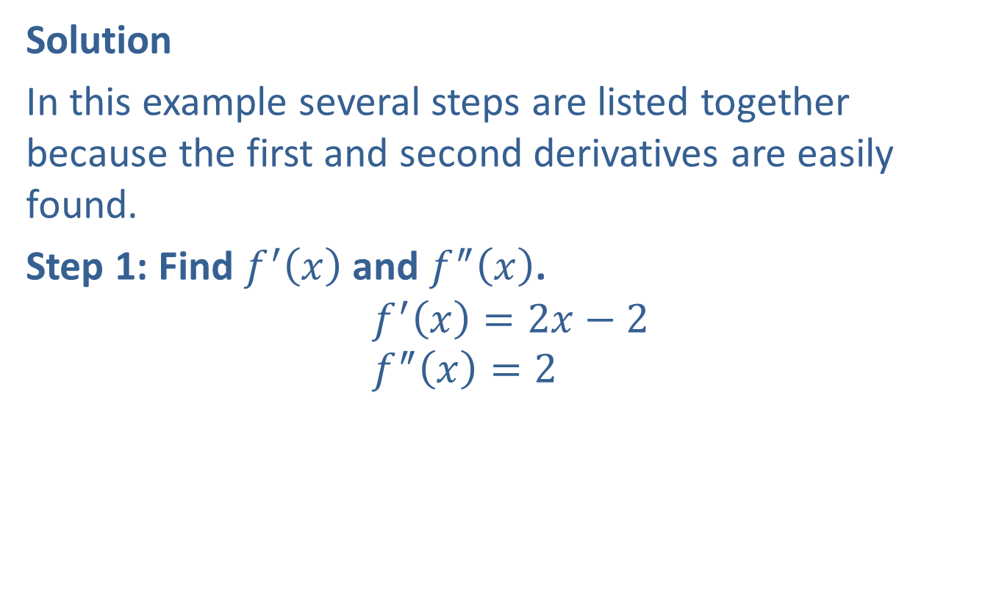
Example 3: Using the Strategy for Curve Sketching (cont.)
Solution
In this example several steps are listed together because the first and second derivatives are easily found.
Step 1: Find $f^{′}⁡\left(x\right)$ and $f^{″}⁡\left(x\right)$.
$$f^{′}\left(x\right)=2x−2 \\ f^{″}\left(x\right)=2$$

Slide 13
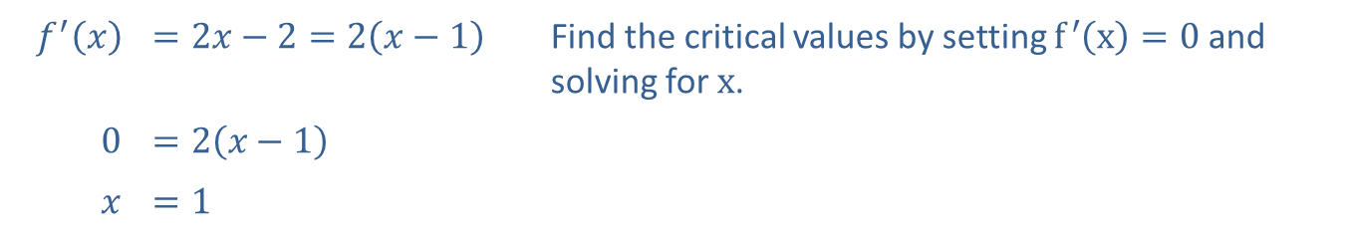

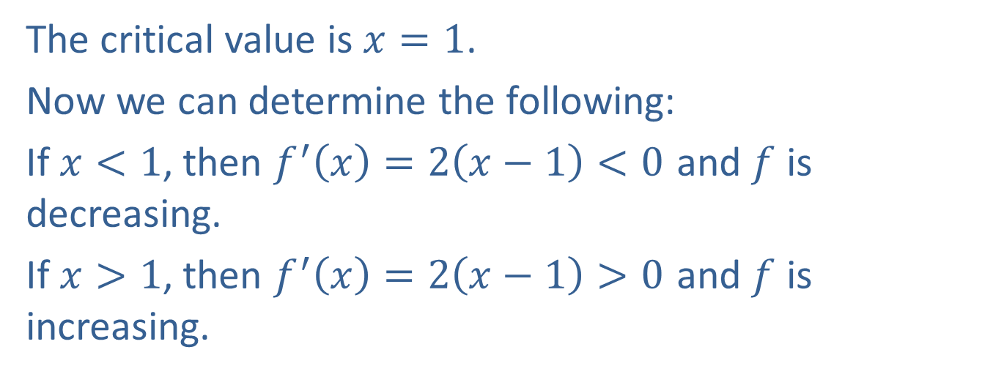
Example 3: Using the Strategy for Curve Sketching (cont.)
Steps 2 and 3: Find the critical values and the intervals where $f^{′}\left(x\right)>0$ and where $f^{′}\left(x\right)<0$.
​$f^{′}⁡\left(x\right)$ | ​$=2x−2=2\left(x−1\right)$ | Find the critical values by setting $f^{′}\left(x\right)=0$ and solving for $x$.
​0 | ​$=2\left(x−1\right)$
$$x$$ | ​$=1$
The critical value is $x=1$.
Now we can determine the following:
If $x<1$, then $f^{′}\left(x\right)=2\left(x−1\right)<0$ and $f$ is decreasing.
If $x>1$, then $f^{′}\left(x\right)=2\left(x−1\right)>0$ and $f$ is increasing.

Slide 14
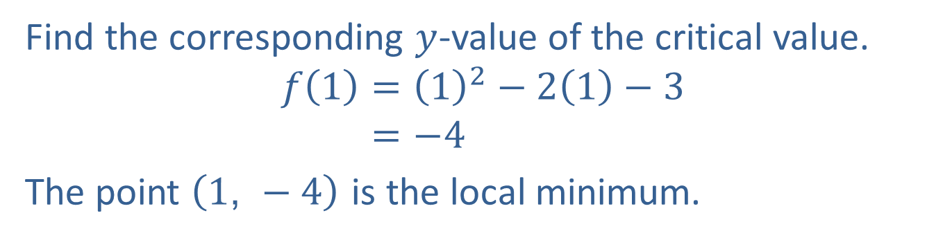
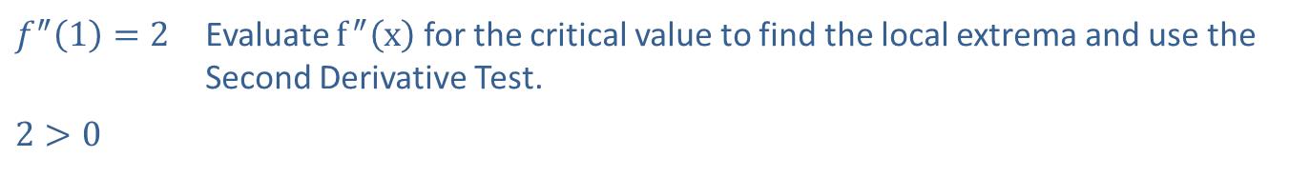
Example 3: Using the Strategy for Curve Sketching (cont.)
Step 4: Find all local extrema.
​$f^{″}\left(1\right)=2$ | Evaluate $f^{″}⁡\left(x\right)$ for the critical value to find the local extrema and use the Second Derivative Test.
​$2>0$
Find the corresponding $y$-value of the critical value.
𝑓1=12−21−3𝑓⁡1=−4
The point $\left(1\text{, }−4\right)$ is the local minimum.

Slide 15
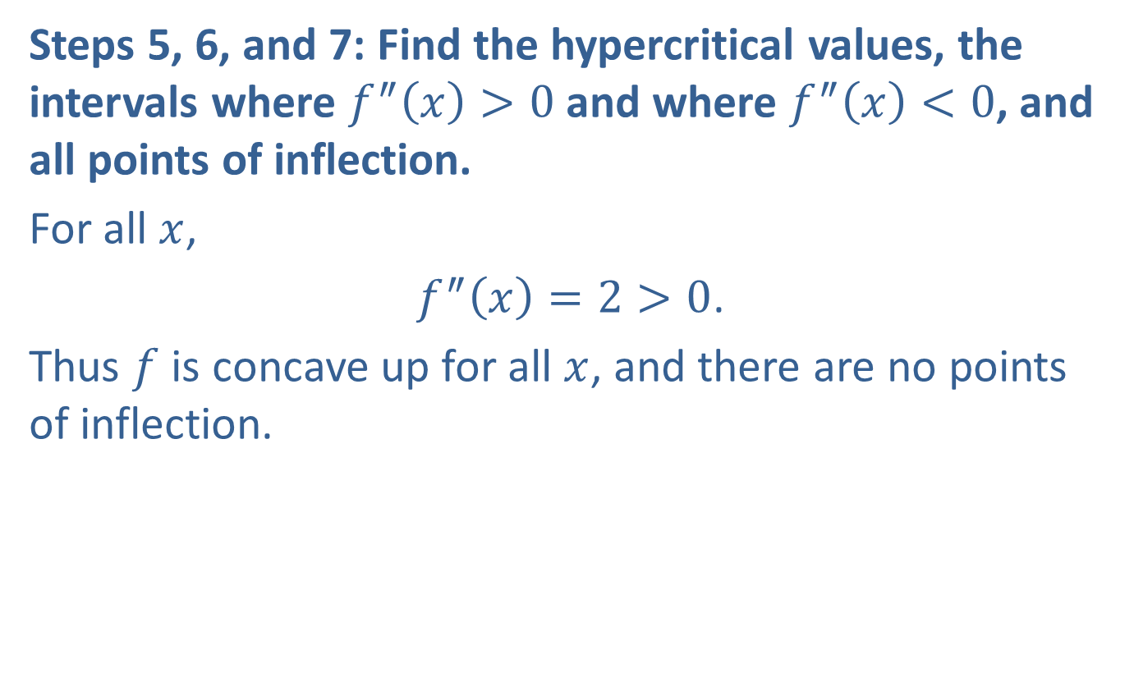
Example 3: Using the Strategy for Curve Sketching (cont.)
Steps 5, 6, and 7: Find the hypercritical values, the intervals where $f^{″}\left(x\right)>0$ and where $f^{″}\left(x\right)<0$, and all points of inflection.
For all $x$,
$f^{″}\left(x\right)=2>0$.
Thus $f$ is concave up for all $x$, and there are no points of inflection.

Slide 16
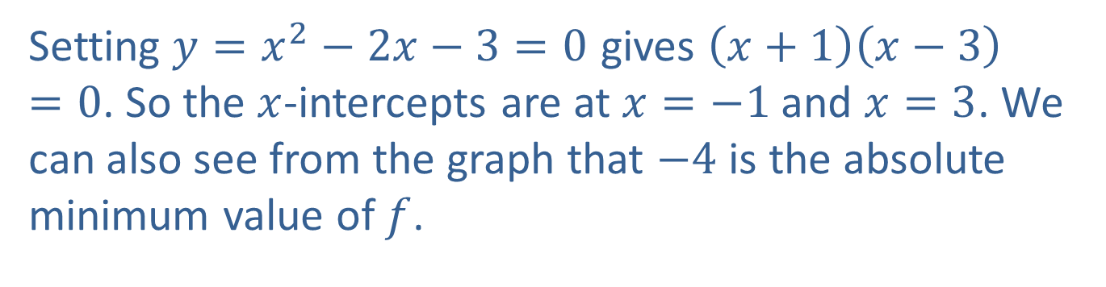
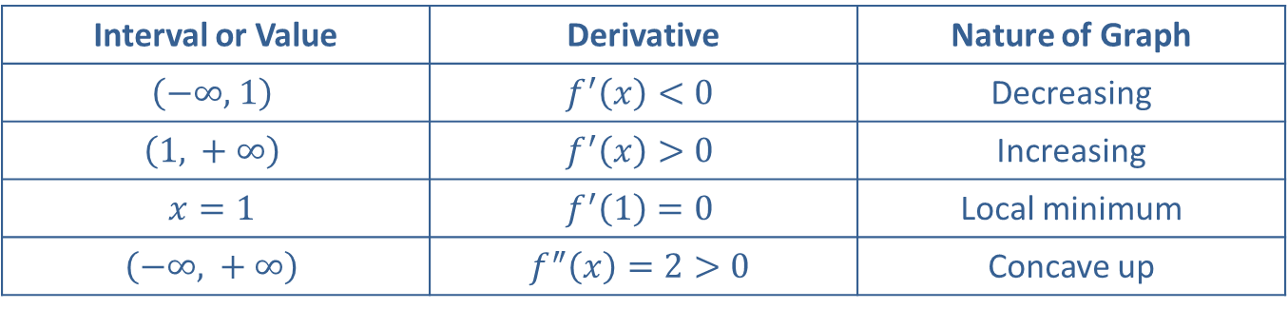
Example 3: Using the Strategy for Curve Sketching (cont.)
Step 8: Sketch the graph.
Interval or Value | Derivative | Nature of Graph
$$\left(−∞\text{, }1\right)$$ | $$f^{′}\left(x\right)<0$$ | Decreasing
$$\left(1\text{, }+∞\right)$$ | $$f^{′}\left(x\right)>0$$ | Increasing
$$x=1$$ | $$f^{′}\left(1\right)=0$$ | Local minimum
$$\left(−∞\text{, }+∞\right)$$ | $$f^{″}\left(x\right)=2>0$$ | Concave up
Setting $y=x^{2}−2x−3=0$ gives $\left(x+1\right)\left(x−3\right)=0$. So the $x$-intercepts are at $x=−1$ and $x=3$. We can also see from the graph that $−4$ is the absolute minimum value of $f$.

Slide 17
Example 3: Using the Strategy for Curve Sketching (cont.)
The graph is a parabola, which agrees with the fact that the graph of every second-degree polynomial function is a parabola.

Slide 18
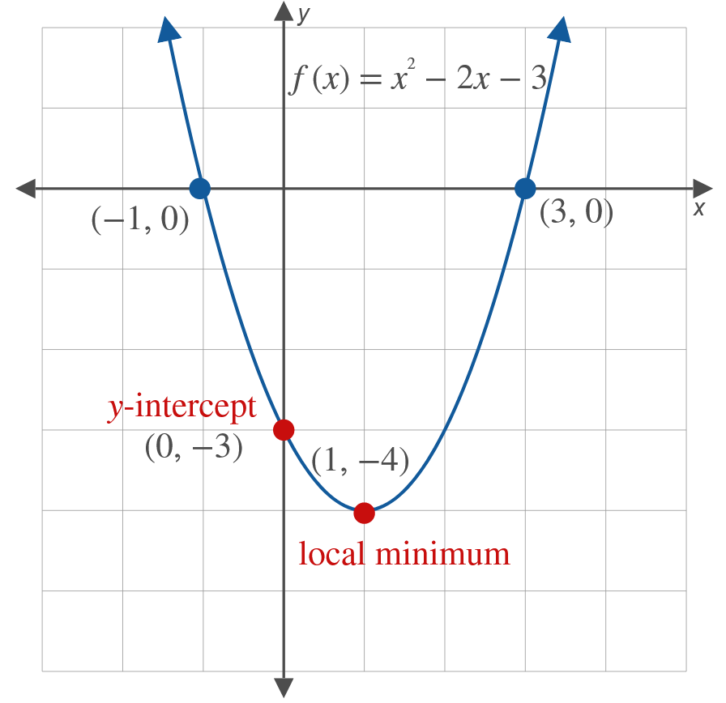
Example 3: Using the Strategy for Curve Sketching (cont.)

Slide 19


Example 4: Using the Strategy for Curve Sketching
Use the curve-sketching strategy to sketch the graph of the function
$f\left(x\right)=\frac{1}{3}x^{3}−2x^{2}+3x+1$.
Solution
Step 1: Find $f^{′}⁡\left(x\right)$ and $f^{″}⁡\left(x\right)$.
$$f^{′}\left(x\right)=x^{2}−4x+3 \\ f^{″}\left(x\right)=2x−4$$

Slide 20
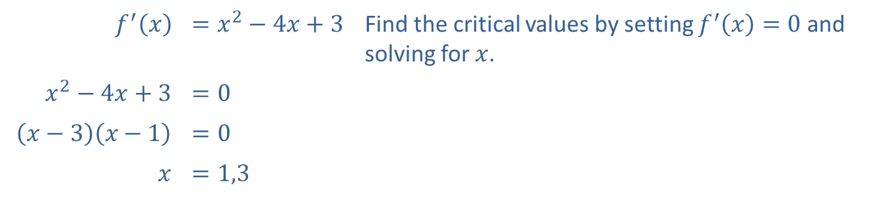
Example 4: Using the Strategy for Curve Sketching (cont.)
Step 2: Find the critical values.
​$f^{′}⁡\left(x\right)$ | ​$=x^{2}−4x+3$ | Find the critical values by setting $f^{′}\left(x\right)=0$ and solving for $x$.
​$x^{2}−4x+3$ | ​$=0$
​$\left(x−3\right)\left(x−1\right)$ | ​$=0$
$$x$$ | ​$=1,3$
The critical values are $x=1$ and $x=3$.

Slide 21
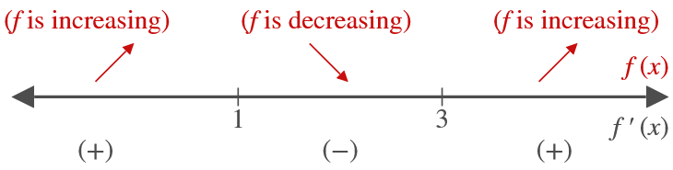

Example 4: Using the Strategy for Curve Sketching (cont.)
Step 3: Use the critical values $x=1$ and $x=3$ as endpoints of intervals where $f^{′}\left(x\right)>0$ and where $f^{′}\left(x\right)<0$.

Slide 22
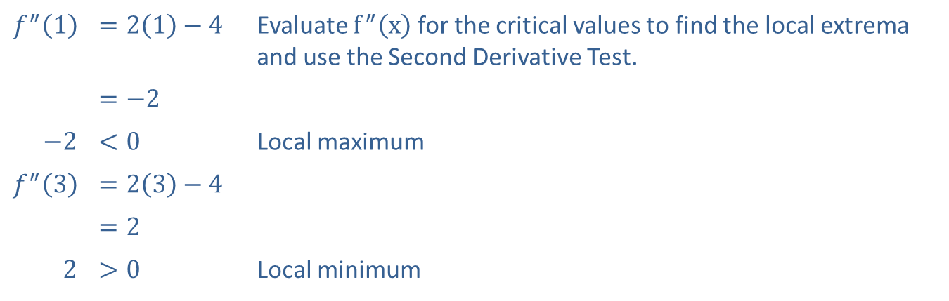
Example 4: Using the Strategy for Curve Sketching (cont.)
Step 4: Find all local extrema.
​$f^{″}⁡\left(1\right)$ | ​$=2\left(1\right)−4$ | Evaluate $f^{″}⁡\left(x\right)$ for the critical values to find the local extrema and use the Second Derivative Test.
 | ​$=−2$
​$−2$ | ​$<0$ | Local maximum
​$f^{″}⁡\left(3\right)$ | ​$=2\left(3\right)−4$
 | ​$=2$
​2 | ​$>0$ | Local minimum

Slide 23
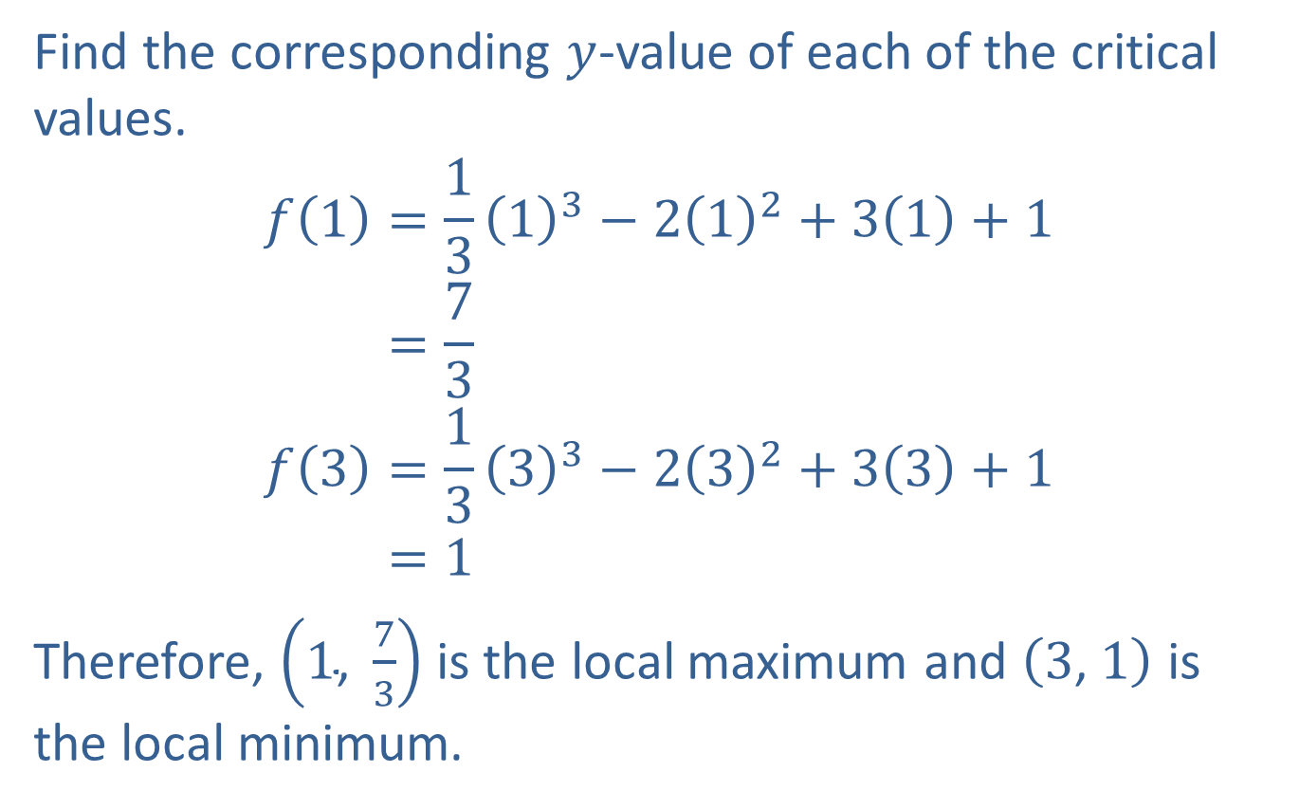
Example 4: Using the Strategy for Curve Sketching (cont.)
Find the corresponding $y$-value of each of the critical values.
𝑓1=1313−212+31+1𝑓⁡1=73𝑓3=1333−232+33+1𝑓⁡3=1
Therefore, $\left(1\text{, }\frac{7}{3}\right)$ is the local maximum and $\left(3\text{, }1\right)$ is the local minimum.

Slide 24
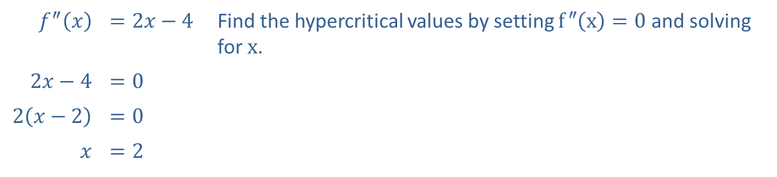
Example 4: Using the Strategy for Curve Sketching (cont.)
Step 5: Find all hypercritical values.
​$f^{″}⁡\left(x\right)$ | ​$=2x−4$ | Find the hypercritical values by setting $f^{″}\left(x\right)=0$ and solving for $x$.
​$2x−4$ | ​$=0$
​$2\left(x−2\right)$ | ​$=0$
$$x$$ | ​$=2$
There is one hypercritical value, $x=2$.

Slide 25
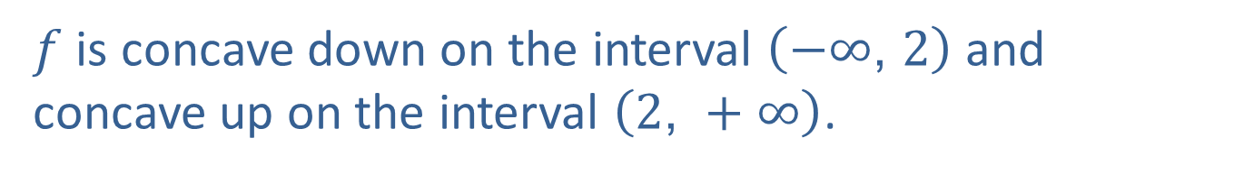

Example 4: Using the Strategy for Curve Sketching (cont.)
Step 6: Using the hypercritical value $x=2$ as an endpoint of intervals, find the intervals where $f^{″}\left(x\right)>0$ and where $f^{″}\left(x\right)<0$.
$f$ is concave down on the interval $\left(−∞\text{, }2\right)$ and concave up on the interval $\left(2\text{, }+∞\right)$.

Slide 26
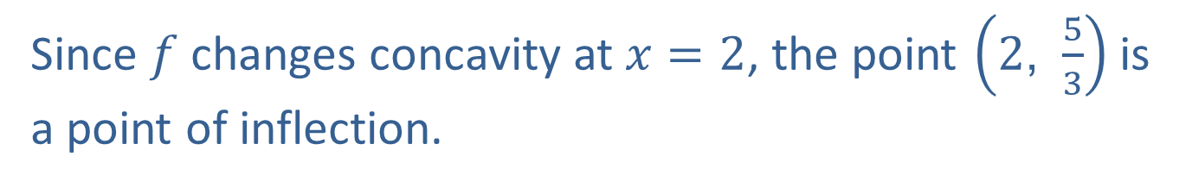
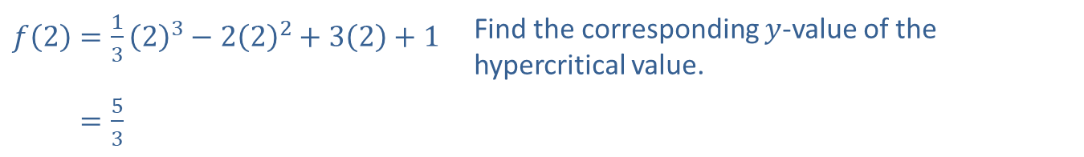
Example 4: Using the Strategy for Curve Sketching (cont.)
Step 7: Find all points of inflection.
​$f\left(2\right)=\frac{1}{3}{\left(2\right)}^{3}−2{\left(2\right)}^{2}+3\left(2\right)+1$ | Find the corresponding $y$-value of the hypercritical value.
​𝑓⁡2=53
Since $f$ changes concavity at $x=2$, the point $\left(2\text{, }\frac{5}{3}\right)$ is a point of inflection.

Slide 27
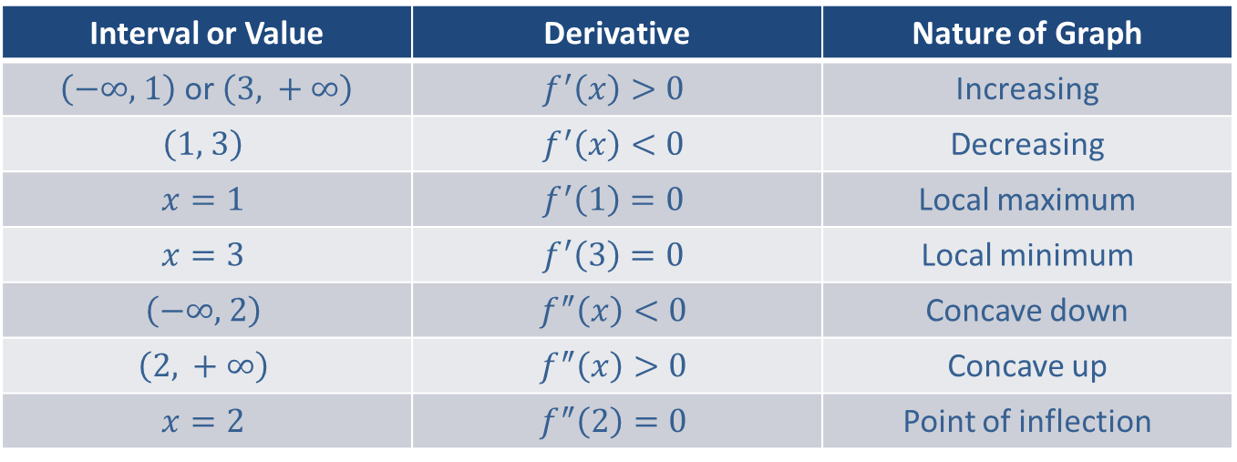
Example 4: Using the Strategy for Curve Sketching (cont.)
Step 8: Sketch the graph.
The following table summarizes the information found in Steps 1–7.
Interval or Value | Derivative | Nature of Graph
$\left(−∞\text{, }1\right)$ or $\left(3\text{, }+∞\right)$ | $$f^{′}\left(x\right)>0$$ | Increasing
$$\left(1\text{, }3\right)$$ | $$f^{′}\left(x\right)<0$$ | Decreasing
$$x=1$$ | $$f^{′}\left(1\right)=0$$ | Local maximum
$$x=3$$ | $$f^{′}\left(3\right)=0$$ | Local minimum
$$\left(−∞\text{, }2\right)$$ | $$f^{″}\left(x\right)<0$$ | Concave down
$$\left(2\text{, }+∞\right)$$ | $$f^{″}\left(x\right)>0$$ | Concave up
$$x=2$$ | $$f^{″}\left(2\right)=0$$ | Point of inflection

Slide 28
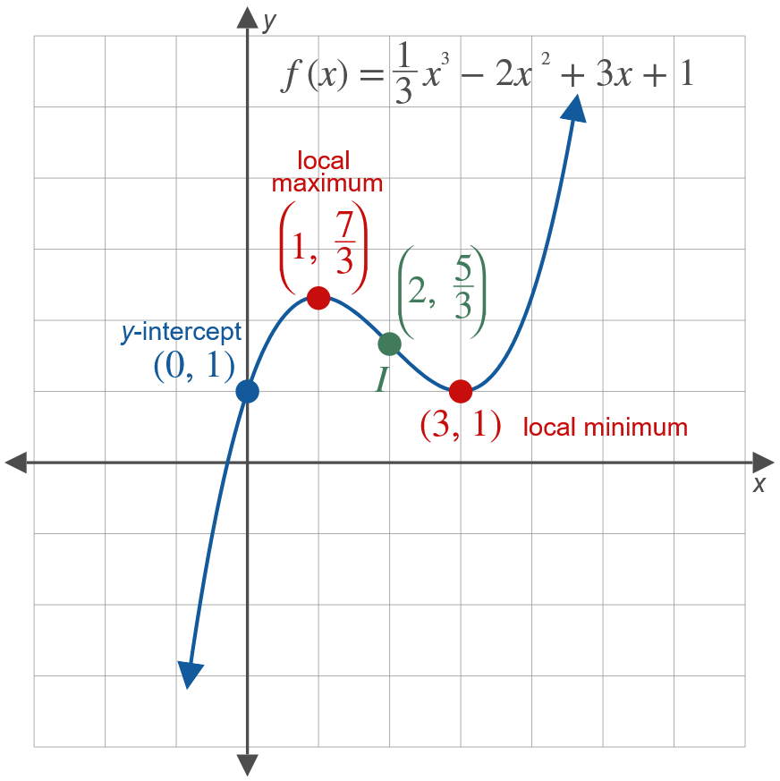
Example 4: Using the Strategy for Curve Sketching (cont.)

Slide 29
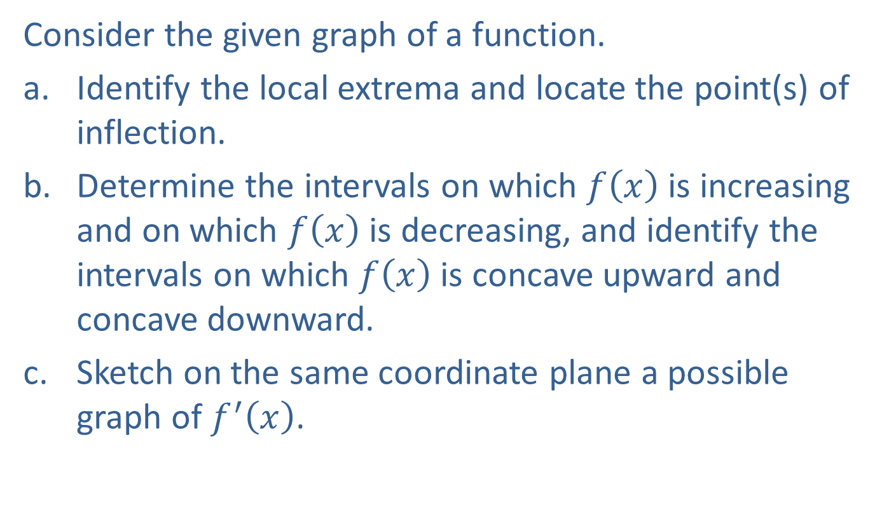
Example 5: Graphing the Derivative
Consider the given graph of a function.
​Identify the local extrema and locate the point(s) of inflection.
​Determine the intervals on which $f⁡\left(x\right)$ is increasing and on which $f⁡\left(x\right)$ is decreasing, and identify the intervals on which $f⁡\left(x\right)$ is concave upward and concave downward.
​Sketch on the same coordinate plane a possible graph of $f^{′}⁡\left(x\right)$.

Slide 30
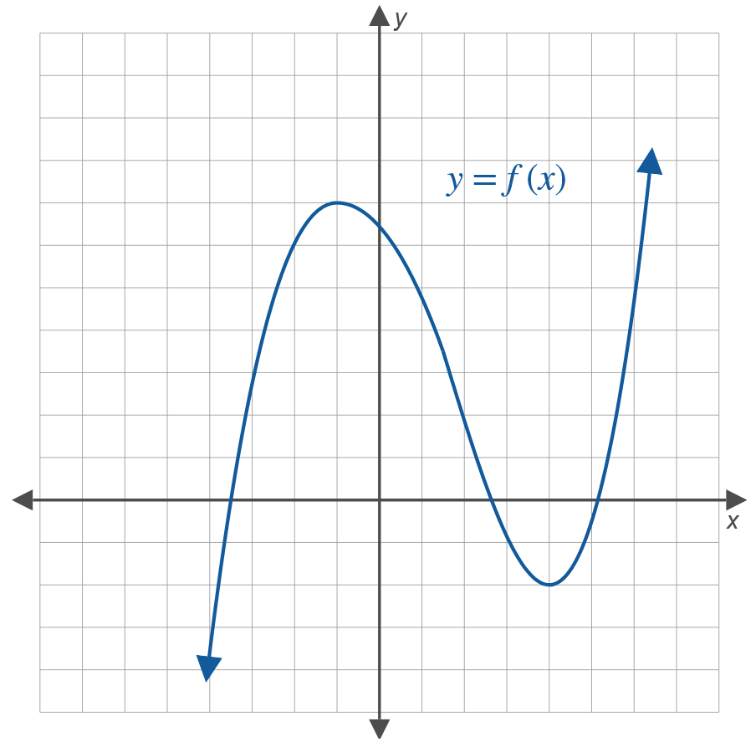
Example 5: Graphing the Derivative (cont.)

Slide 31
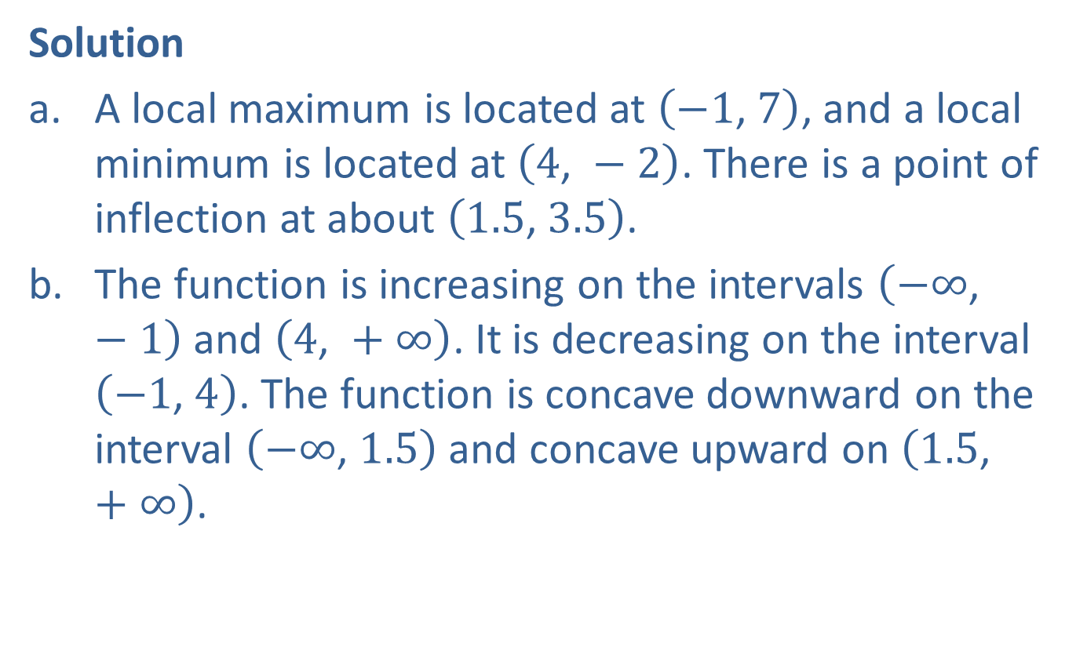
Example 5: Graphing the Derivative (cont.)
Solution
​A local maximum is located at $\left(−1\text{, }7\right)$, and a local minimum is located at $\left(4\text{, }−2\right)$. There is a point of inflection at about $\left(1.5\text{, }3.5\right)$.
​The function is increasing on the intervals $\left(−∞\text{, }−1\right)$ and $\left(4\text{, }+∞\right)$. It is decreasing on the interval $\left(−1\text{, }4\right)$. The function is concave downward on the interval $\left(−∞\text{, }1.5\right)$ and concave upward on $\left(1.5\text{, }+∞\right)$.

Slide 32
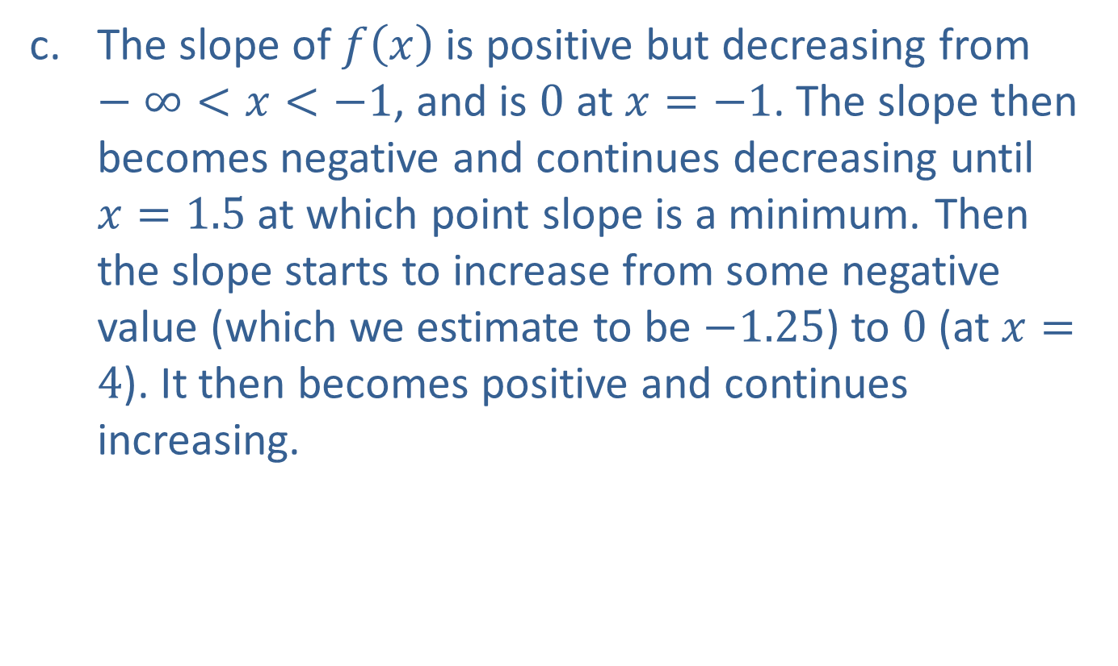
Example 5: Graphing the Derivative (cont.)
​The slope of $f⁡\left(x\right)$ is positive but decreasing from $−∞<x<−1$, and is 0 at $x=−1$. The slope then becomes negative and continues decreasing until $x=1.5$ at which point slope is a minimum. Then the slope starts to increase from some negative value (which we estimate to be $−1.25$) to 0 (at $x=4$). It then becomes positive and continues increasing.

Slide 33
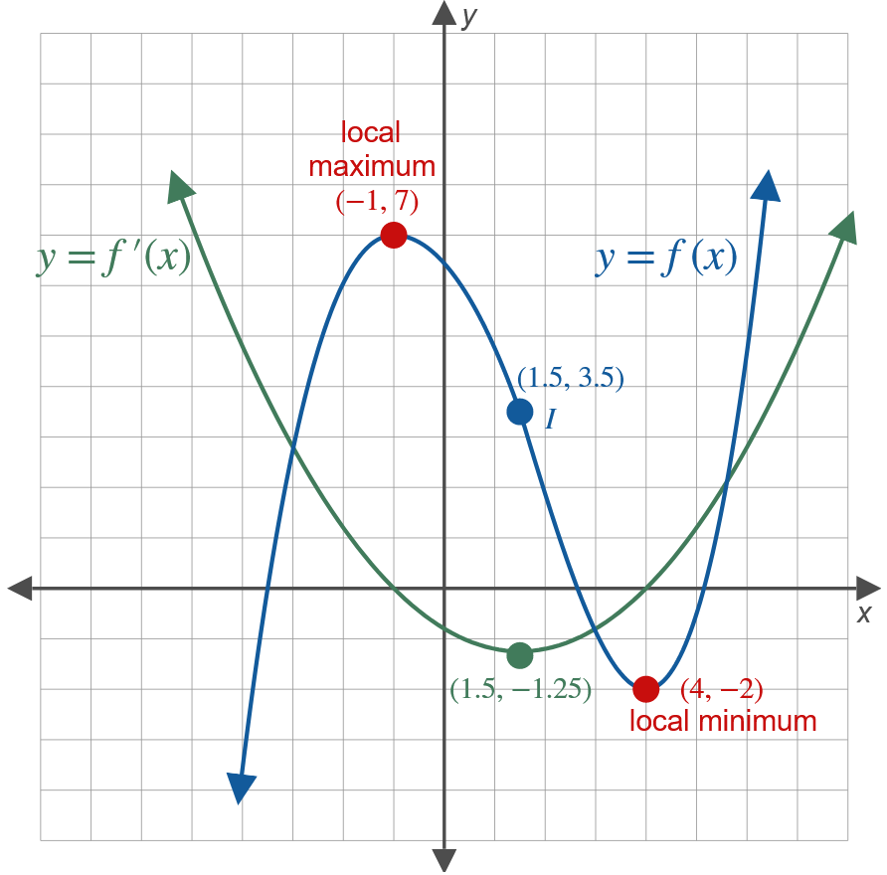
Example 5: Graphing the Derivative (cont.)

