Slide 1
Section 4.4
Curve Sketching: Rational Functions

Slide 2
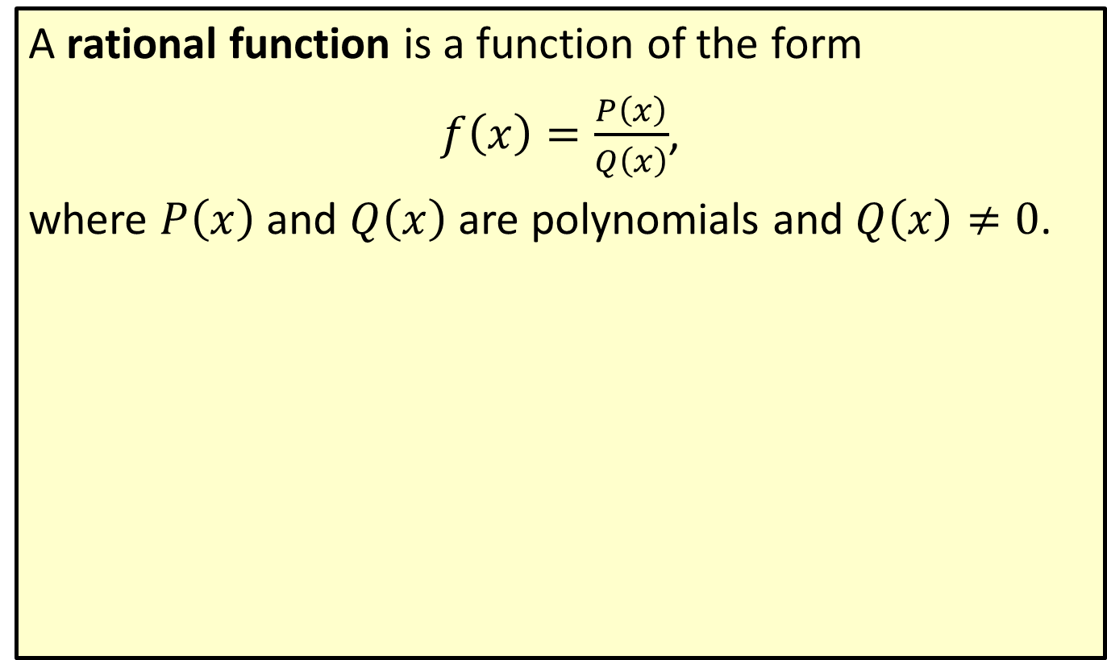
Rational Function
A rational function is a function of the form
$f\left(x\right)=\frac{P\left(x\right)}{Q\left(x\right)}$,
where $P⁡\left(x\right)$ and $Q⁡\left(x\right)$ are polynomials and $Q\left(x\right)≠0$.

Slide 3
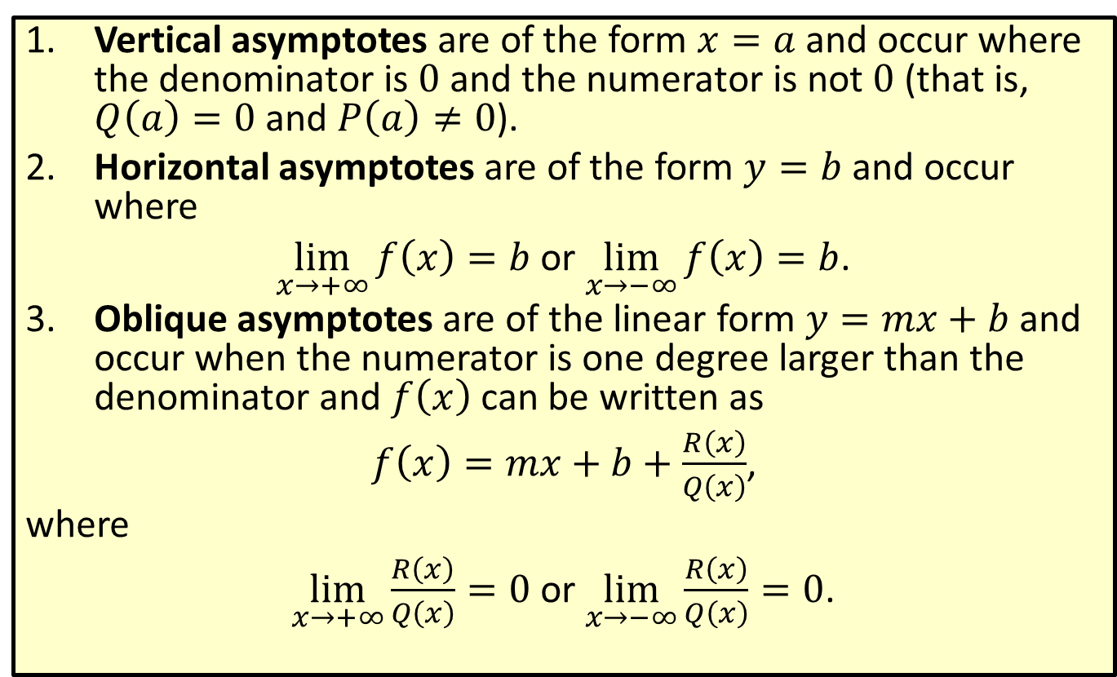
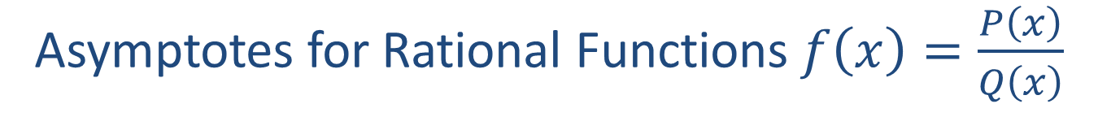
Asymptotes for Rational Functions $f\left(x\right)=\frac{P\left(x\right)}{Q\left(x\right)}$
​Vertical asymptotes are of the form $x=a$ and occur where the denominator is 0 and the numerator is not 0 (that is, $Q\left(a\right)=0$ and $P\left(a\right)≠0$).
​Horizontal asymptotes are of the form $y=b$ and occur where
​$\lim_{x→+∞}f\left(x\right)=b$ or $\lim_{x→−∞}f\left(x\right)=b$.
​Oblique asymptotes are of the linear form $y=mx+b$ and occur when the numerator is one degree larger than the denominator and $f⁡\left(x\right)$ can be written as
​$f\left(x\right)=mx+b+\frac{R\left(x\right)}{Q\left(x\right)}$,
​where
​$\lim_{x→+∞}\frac{R\left(x\right)}{Q\left(x\right)}=0$ or $\lim_{x→−∞}\frac{R\left(x\right)}{Q\left(x\right)}=0$.

Slide 4

Example 1: Locating Vertical and Horizontal Asymptotes
For the function $f\left(x\right)=\frac{2x}{x−5}$, find
​the vertical asymptotes and
​the horizontal asymptotes.

Slide 5
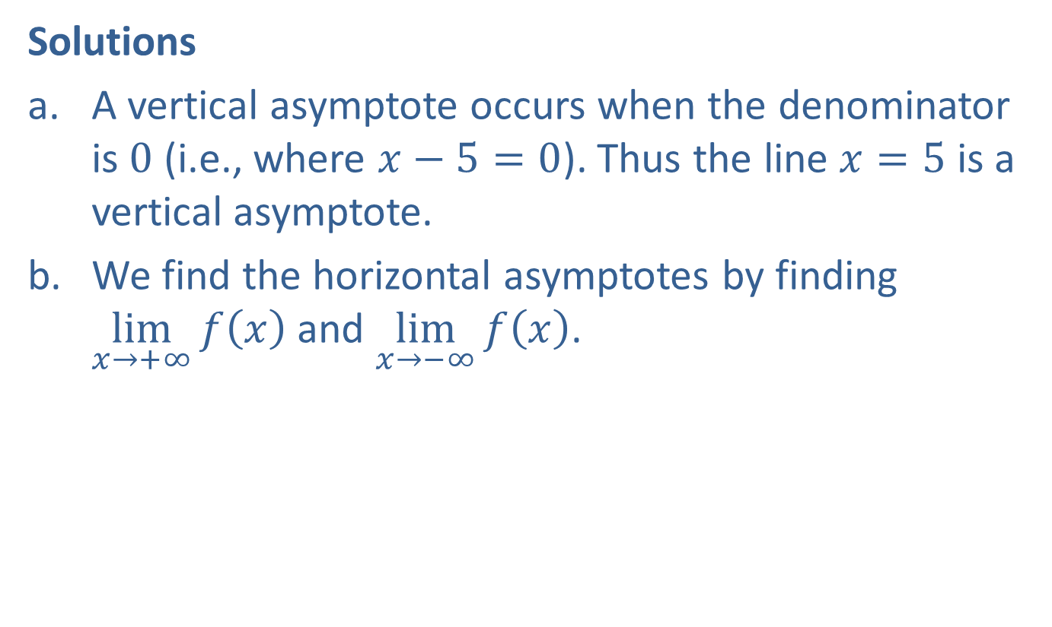
Example 1: Locating Vertical and Horizontal Asymptotes (cont.)
Solutions
​A vertical asymptote occurs when the denominator is 0 (i.e., where $x−5=0$). Thus the line $x=5$ is a vertical asymptote.
​We find the horizontal asymptotes by finding $\lim_{x→+∞}f\left(x\right)$ and $\lim_{x→−∞}f\left(x\right)$.
​

Slide 6
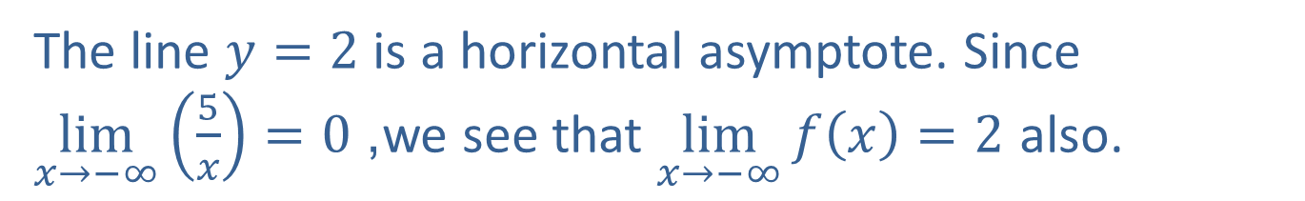
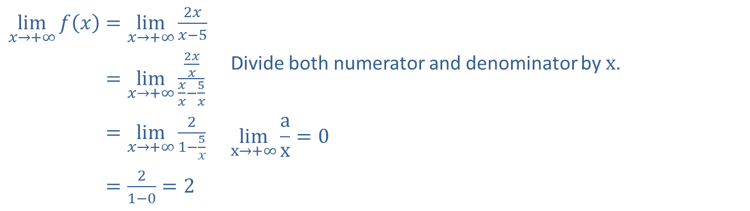
Example 1: Locating Vertical and Horizontal Asymptotes (cont.)
​$\lim_{x→+∞}f\left(x\right)=\lim_{x→+∞}\frac{2x}{x−5}$
​lim𝑥→+∞𝑓𝑥=lim𝑥→+∞2𝑥𝑥𝑥𝑥−5𝑥 | Divide both numerator and denominator by $x$.
​lim𝑥→+∞𝑓𝑥=lim𝑥→+∞21−5𝑥 | $$\lim_{x→+∞}\frac{a}{x}=0$$
​lim𝑥→+∞𝑓𝑥=21−0=2
​The line $y=2$ is a horizontal asymptote. Since $\lim_{x→−∞}\left(\frac{5}{x}\right)=0$, we see that $\lim_{x→−∞}f\left(x\right)=2$ also.

Slide 7

Example 2: Locating Vertical and Horizontal Asymptotes
For the function $f\left(x\right)=\frac{1}{x^{2}+3}$, find
​the vertical asymptotes and
​the horizontal asymptotes.

Slide 8
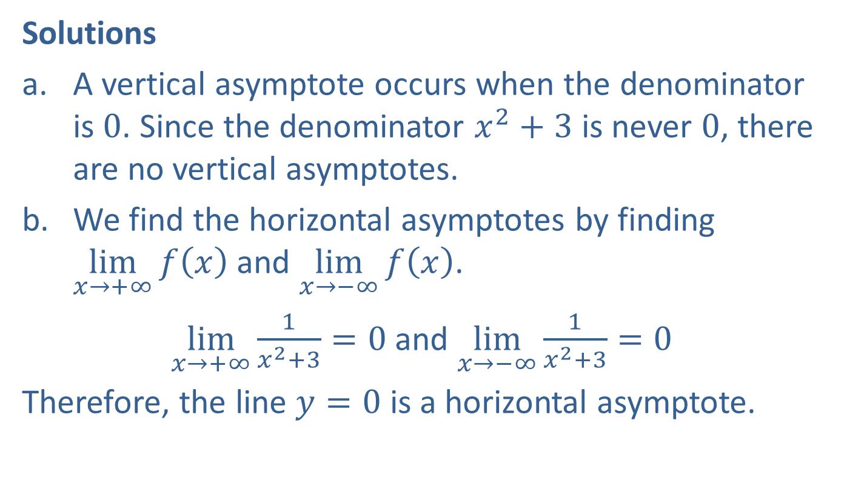
Example 2: Locating Vertical and Horizontal Asymptotes (cont.)
Solutions
​A vertical asymptote occurs when the denominator is 0. Since the denominator $x^{2}+3$ is never 0, there are no vertical asymptotes.
​We find the horizontal asymptotes by finding $\lim_{x→+∞}f\left(x\right)$ and $\lim_{x→−∞}f\left(x\right)$.
​$\lim_{x→+∞}\frac{1}{x^{2}+3}=0$ and $\lim_{x→−∞}\frac{1}{x^{2}+3}=0$
​Therefore, the line $y=0$ is a horizontal asymptote.

Slide 9
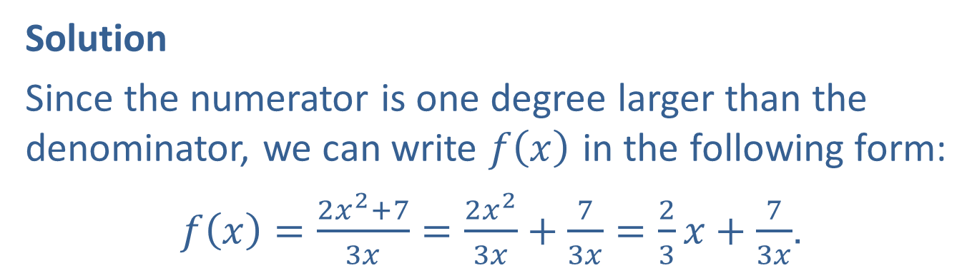

Example 3: Locating Oblique Asymptotes
Find the oblique asymptote for the function $f\left(x\right)=\frac{2x^{2}+7}{3x}$.
Solution
Since the numerator is one degree larger than the denominator, we can write $f⁡\left(x\right)$ in the following form:
$f\left(x\right)=\frac{2x^{2}+7}{3x}=\frac{2x^{2}}{3x}+\frac{7}{3x}=\frac{2}{3}x+\frac{7}{3x}$.

Slide 10

Example 3: Locating Oblique Asymptotes (cont.)
Now we find that $\lim_{x→+∞}\frac{7}{3x}=0$.
So the remaining term gives the oblique asymptote:
$y=\frac{2}{3}x$.

Slide 11
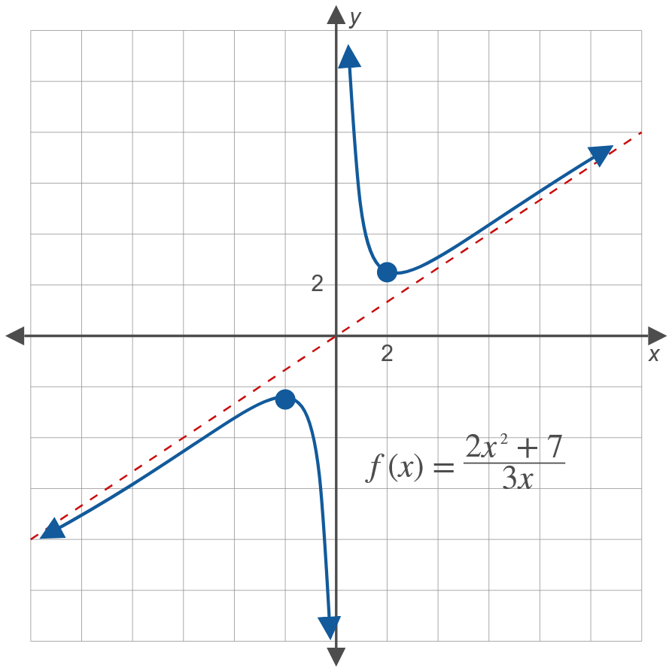
Example 3: Locating Oblique Asymptotes (cont.)

Slide 12

Example 4: Sketching the Graph of a Rational Function
Sketch the graph of the rational function $f\left(x\right)=\frac{x−1}{x−2}$. Include any asymptotes.

Slide 13
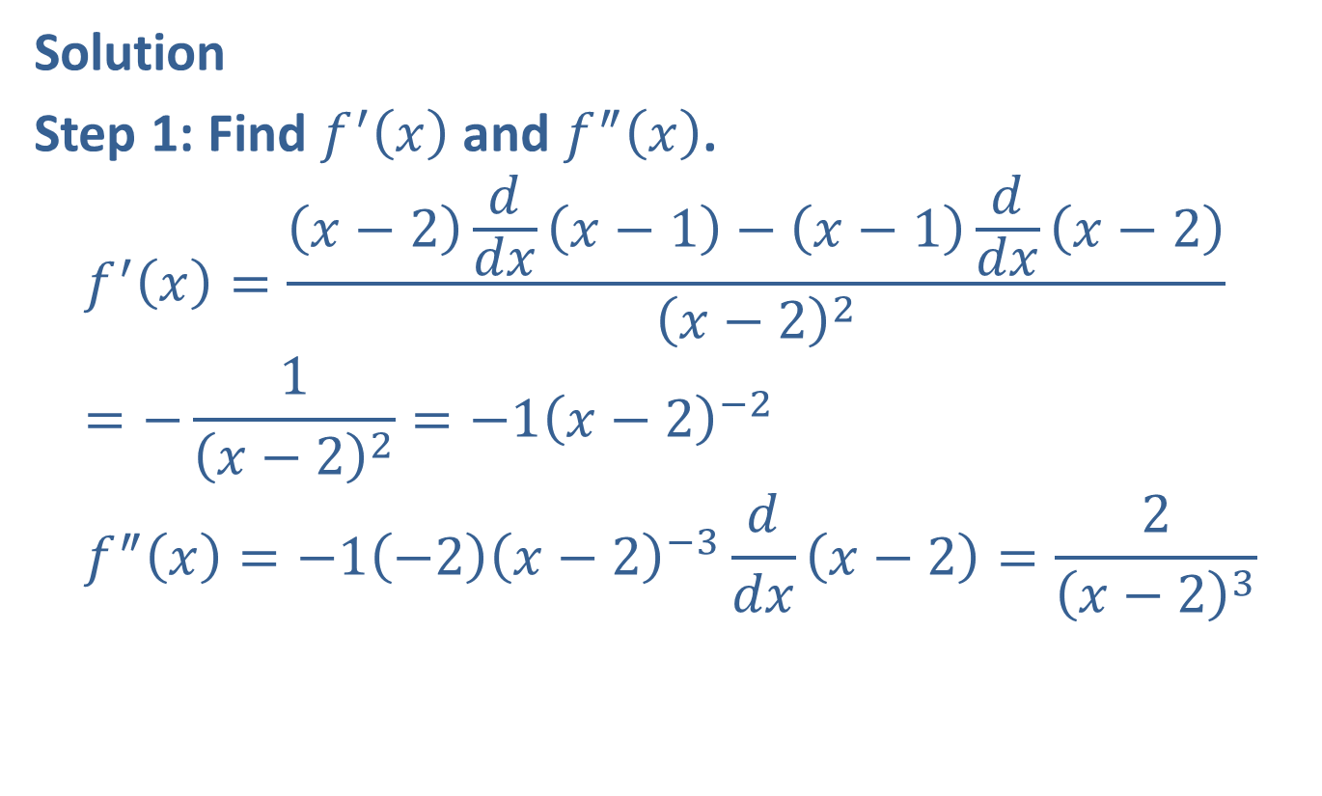
Example 4: Sketching the Graph of a Rational Function (cont.)
Solution
Step 1: Find $f^{′}⁡\left(x\right)$ and $f^{″}⁡\left(x\right)$.
$$f^{′}\left(x\right)=\frac{\left(x−2\right)\frac{d}{dx}\left(x−1\right)−\left(x−1\right)\frac{d}{dx}\left(x−2\right)}{{\left(x−2\right)}^{2}}=−\frac{1}{{\left(x−2\right)}^{2}}=−1{\left(x−2\right)}^{−2} \\ f^{″}\left(x\right)=−1\left(−2\right){\left(x−2\right)}^{−3}\frac{d}{dx}\left(x−2\right)=\frac{2}{{\left(x−2\right)}^{3}}$$

Slide 14
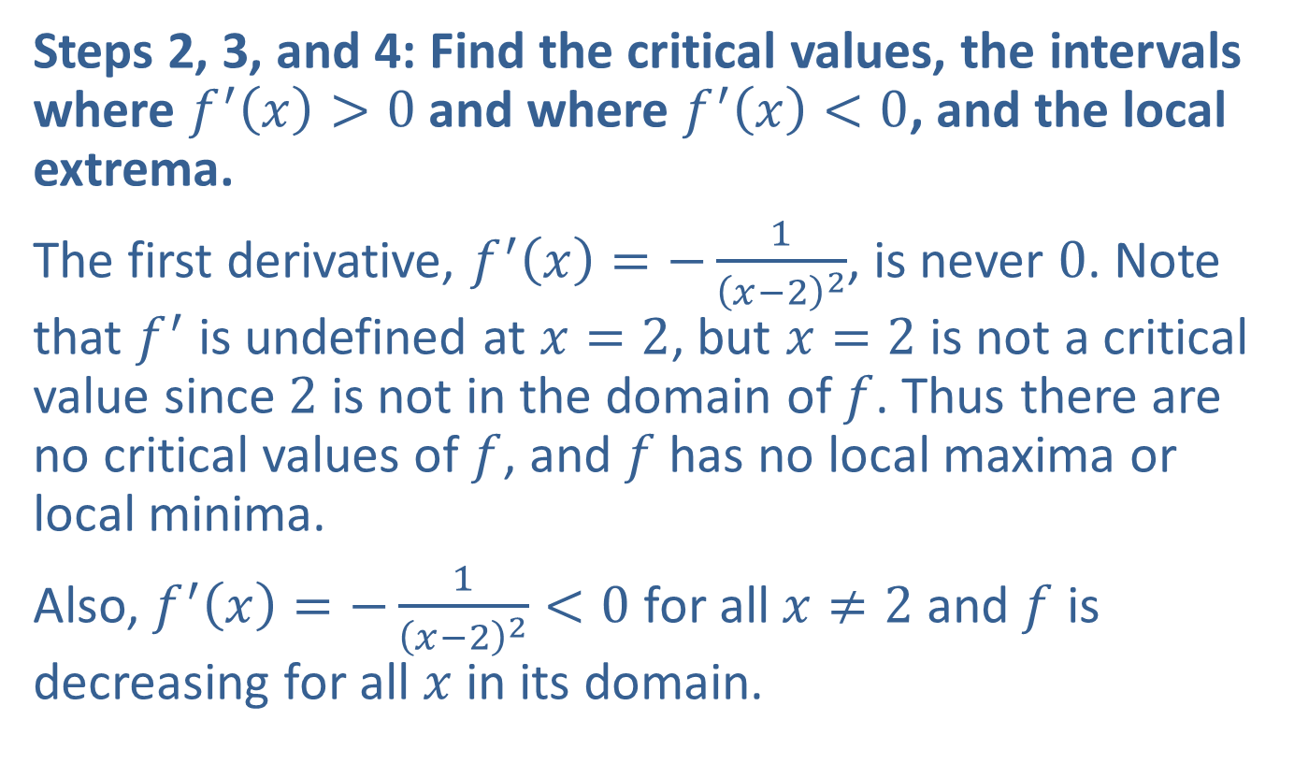
Example 4: Sketching the Graph of a Rational Function (cont.)
Steps 2, 3, and 4: Find the critical values, the intervals where $f^{′}\left(x\right)>0$ and where $f^{′}\left(x\right)<0$, and the local extrema.
The first derivative, $f^{′}\left(x\right)=−\frac{1}{{\left(x−2\right)}^{2}}$, is never 0. Note that $f^{′}$ is undefined at $x=2$, but $x=2$ is not a critical value since 2 is not in the domain of $f$. Thus there are no critical values of $f$, and $f$ has no local maxima or local minima.
Also, $f^{′}\left(x\right)=−\frac{1}{{\left(x−2\right)}^{2}}<0$ for all $x≠2$ and $f$ is decreasing for all $x$ in its domain.

Slide 15
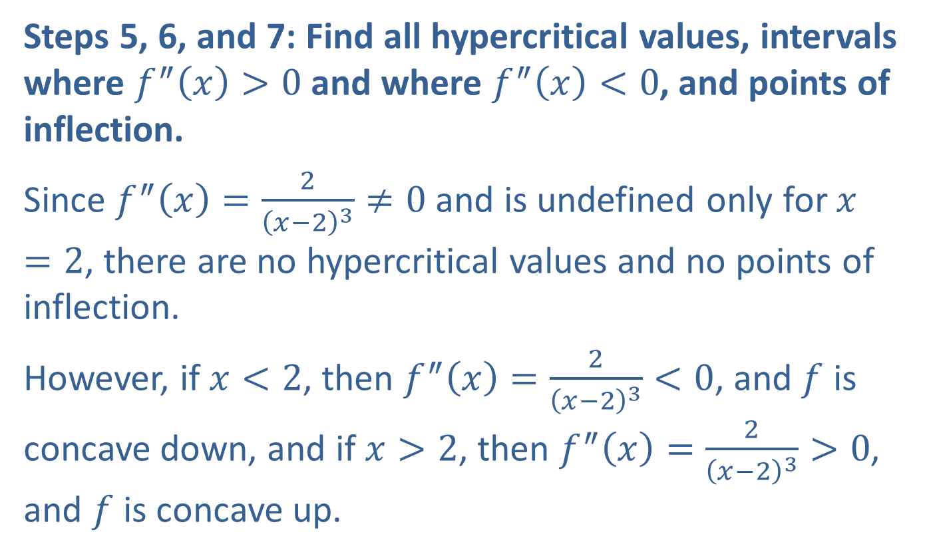
Example 4: Sketching the Graph of a Rational Function (cont.)
Steps 5, 6, and 7: Find all hypercritical values, intervals where $f^{″}\left(x\right)>0$ and where $f^{″}\left(x\right)<0$, and points of inflection.
Since $f^{″}\left(x\right)=\frac{2}{{\left(x−2\right)}^{3}}≠0$ and is undefined only for $x=2$, there are no hypercritical values and no points of inflection.
However, if $x<2$, then $f^{″}\left(x\right)=\frac{2}{{\left(x−2\right)}^{3}}<0$, and $f$ is concave down, and if $x>2$, then $f^{″}\left(x\right)=\frac{2}{{\left(x−2\right)}^{3}}>0$, and $f$ is concave up.

Slide 16
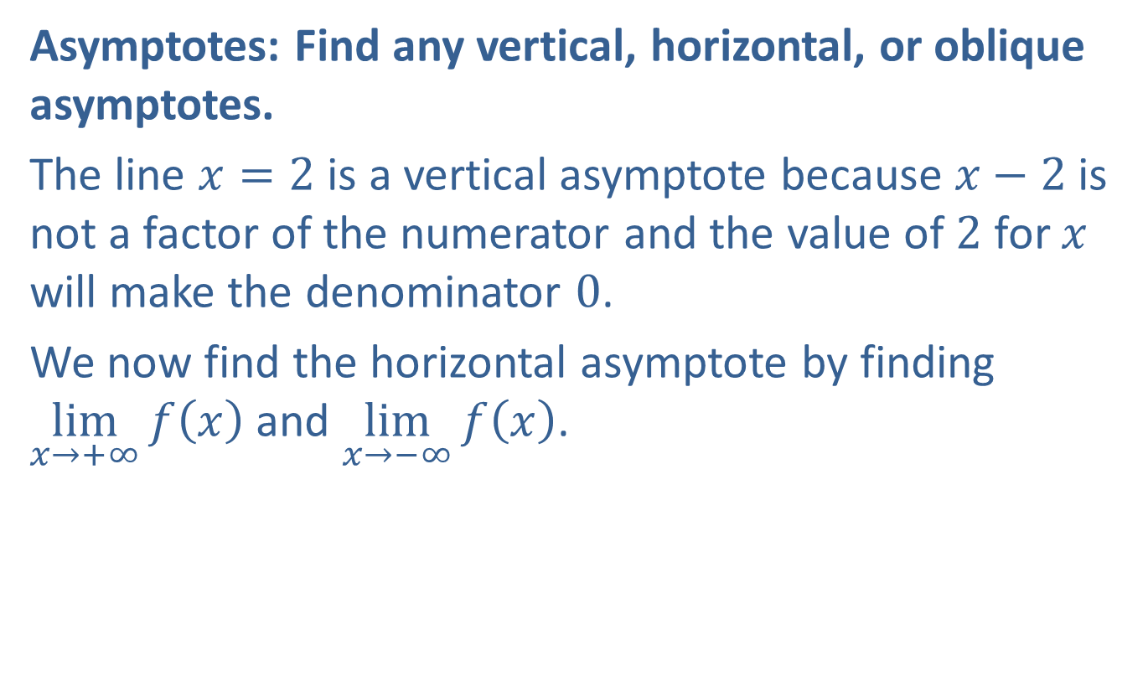
Example 4: Sketching the Graph of a Rational Function (cont.)
Asymptotes: Find any vertical, horizontal, or oblique asymptotes.
The line $x=2$ is a vertical asymptote because $x−2$ is not a factor of the numerator and the value of 2 for $x$ will make the denominator 0.
We now find the horizontal asymptote by finding $\lim_{x→+∞}f\left(x\right)$ and $\lim_{x→−∞}f\left(x\right)$.

Slide 17
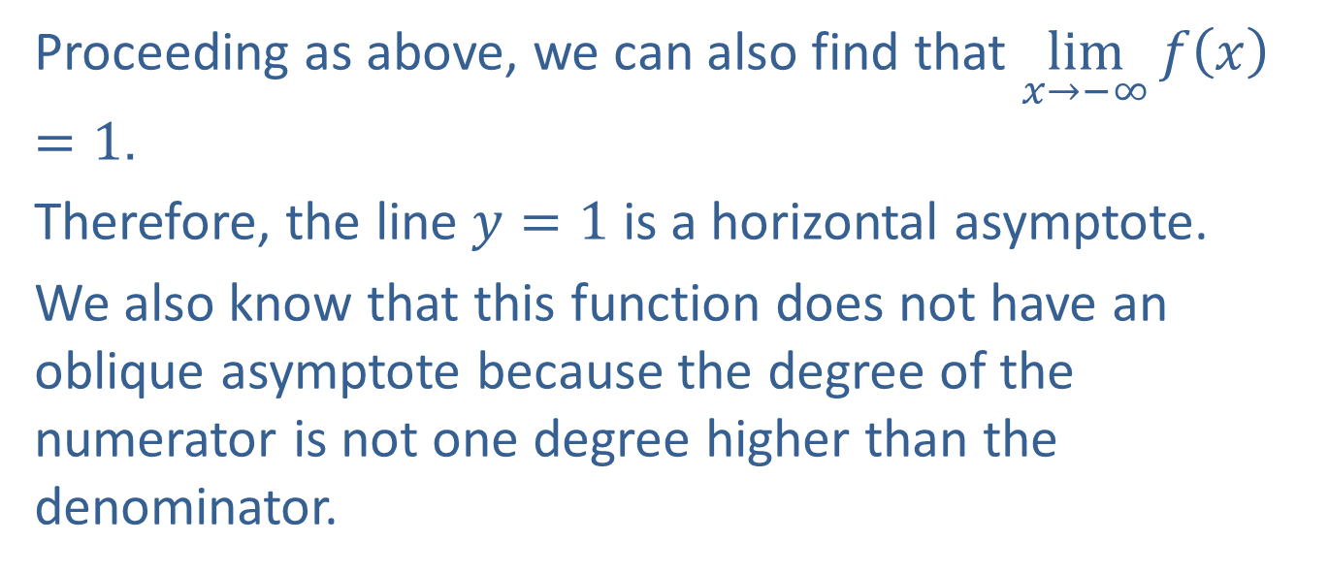
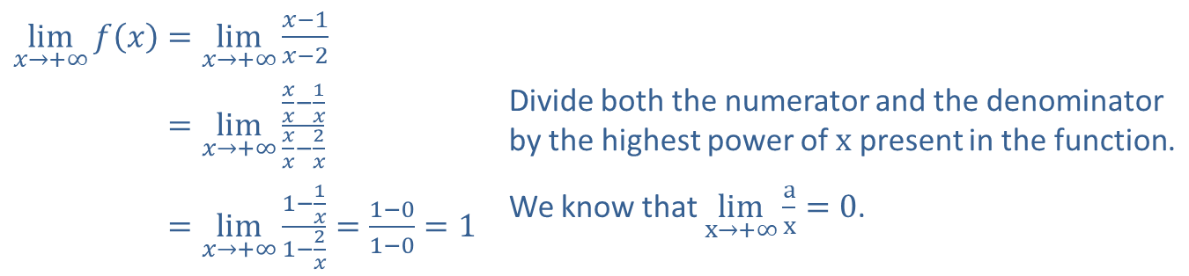
Example 4: Sketching the Graph of a Rational Function (cont.)
​$\lim_{x→+∞}f\left(x\right)=\lim_{x→+∞}\frac{x−1}{x−2}$
​lim𝑥→+∞𝑓𝑥=lim𝑥→+∞𝑥𝑥−1𝑥𝑥𝑥−2𝑥 | Divide both the numerator and the denominator by the highest power of $x$ present in the function.
​lim𝑥→+∞𝑓𝑥=lim𝑥→+∞1−1𝑥1−2𝑥=1−01−0=1 | We know that $\lim_{x→+∞}\frac{a}{x}=0$.
Proceeding as above, we can also find that $\lim_{x→−∞}f\left(x\right)=1$.
Therefore, the line $y=1$ is a horizontal asymptote.
We also know that this function does not have an oblique asymptote because the degree of the numerator is not one degree higher than the denominator.

Slide 18
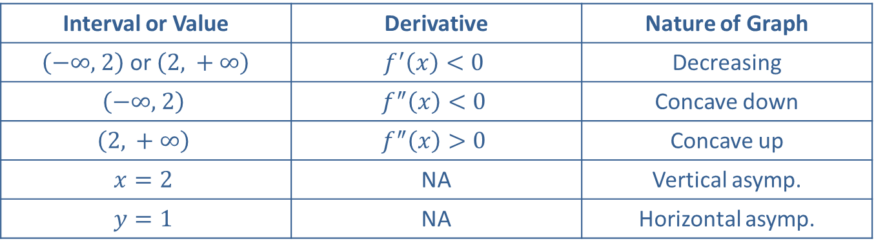
Example 4: Sketching the Graph of a Rational Function (cont.)
Step 8: Sketch the graph.
Interval or Value | Derivative | Nature of Graph
$\left(−∞\text{, }2\right)$ or $\left(2\text{, }+∞\right)$ | $$f^{′}\left(x\right)<0$$ | Decreasing
$$\left(−∞\text{, }2\right)$$ | $$f^{″}\left(x\right)<0$$ | Concave down
$$\left(2\text{, }+∞\right)$$ | $$f^{″}\left(x\right)>0$$ | Concave up
$$x=2$$ | NA | Vertical asymp.
$$y=1$$ | NA | Horizontal asymp.

Slide 19
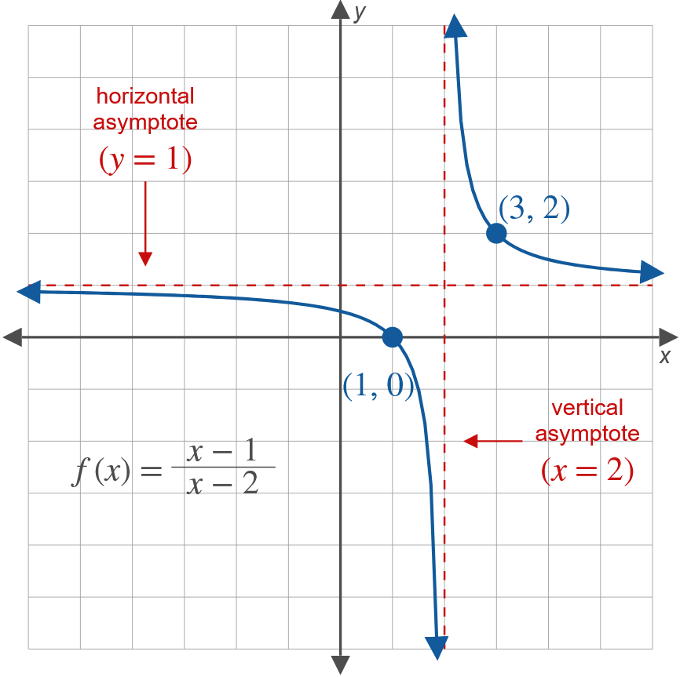
Example 4: Sketching the Graph of a Rational Function (cont.)

Slide 20
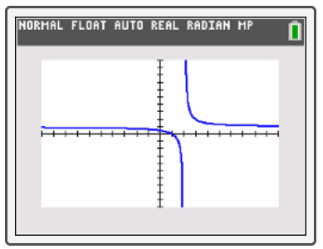
Tech Training
To verify your graph with a TI-84 Plus calculator, perform the following steps:
​Enter the given function into Y1.
​Check that your WINDOW is appropriate.
​Press GRAPH.

Slide 21
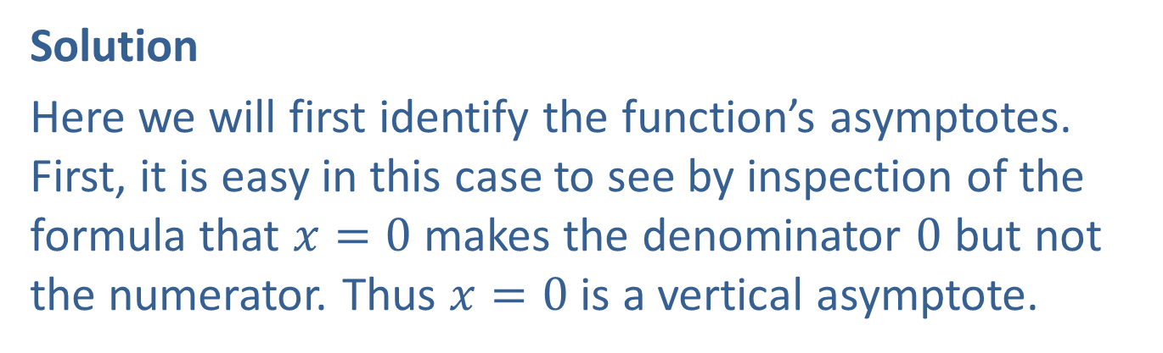

Example 5: Sketching the Graph of a Rational Function
Sketch the graph of the rational function $f\left(x\right)=\frac{100+x^{2}}{2x}$.
Solution
Here we will first identify the function’s asymptotes. First, it is easy in this case to see by inspection of the formula that $x=0$ makes the denominator 0 but not the numerator. Thus $x=0$ is a vertical asymptote.

Slide 22
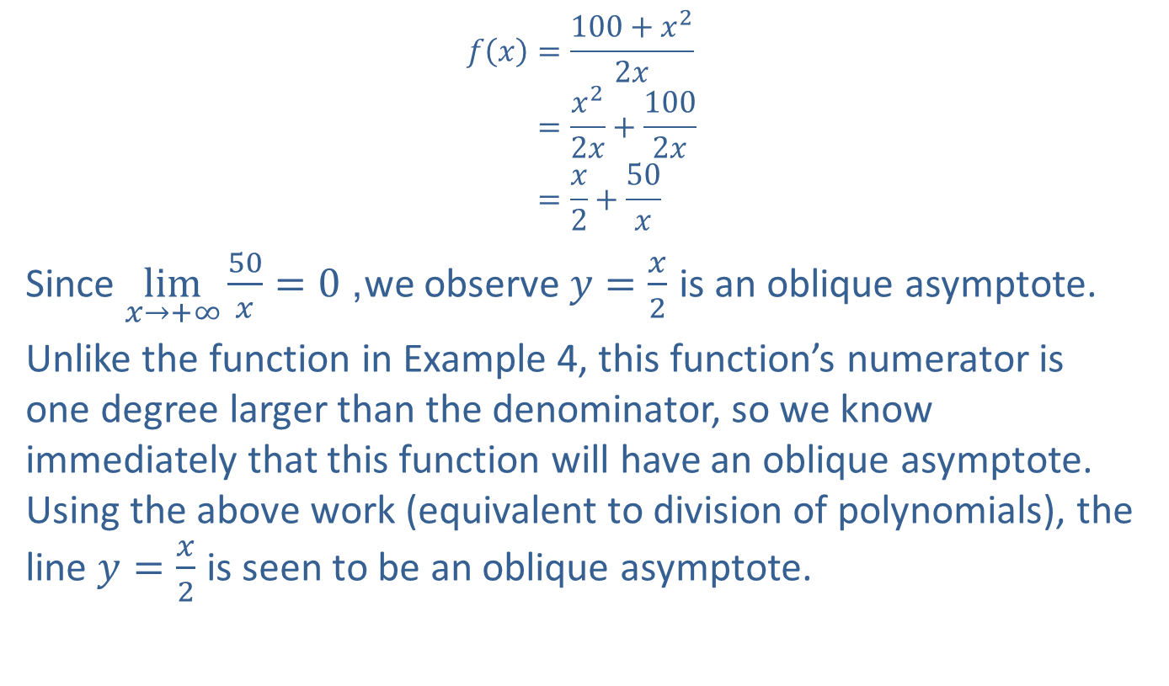
Example 5: Sketching the Graph of a Rational Function (cont.)
𝑓𝑥=100+𝑥22𝑥𝑓⁡𝑥=𝑥22𝑥+1002𝑥𝑓⁡𝑥=𝑥2+50𝑥
Since $\lim_{x→+∞}\frac{50}{x}=0$, we observe $y=\frac{x}{2}$ is an oblique asymptote.
Unlike the function in Example 4, this function’s numerator is one degree larger than the denominator, so we know immediately that this function will have an oblique asymptote. Using the above work (equivalent to division of polynomials), the line $y=\frac{x}{2}$ is seen to be an oblique asymptote.

Slide 23
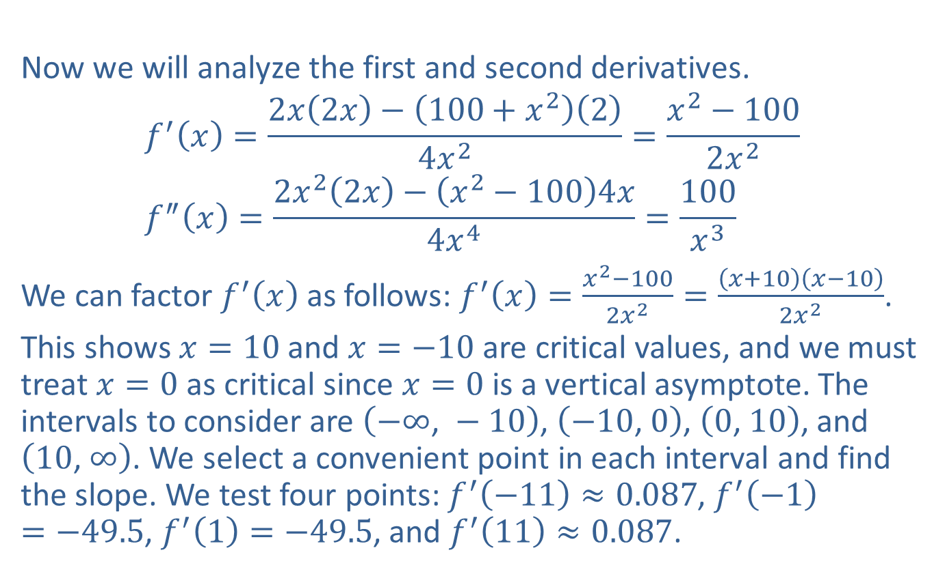
Example 5: Sketching the Graph of a Rational Function (cont.)
Now we will analyze the first and second derivatives.
$$f^{′}\left(x\right)=\frac{2x\left(2x\right)−\left(100+x^{2}\right)\left(2\right)}{4x^{2}}=\frac{x^{2}−100}{2x^{2}} \\ f^{″}\left(x\right)=\frac{2x^{2}\left(2x\right)−\left(x^{2}−100\right)4x}{4x^{4}}=\frac{100}{x^{3}}$$
We can factor $f^{′}⁡\left(x\right)$ as follows: $f^{′}\left(x\right)=\frac{x^{2}−100}{2x^{2}}=\frac{\left(x+10\right)\left(x−10\right)}{2x^{2}}$.
This shows $x=10$ and $x=−10$ are critical values, and we must treat $x=0$ as critical since $x=0$ is a vertical asymptote. The intervals to consider are $\left(−∞\text{, }−10\right)$, $\left(−10\text{, }0\right)$, $\left(0\text{, }10\right)$, and $\left(10\text{, }∞\right)$. We select a convenient point in each interval and find the slope. We test four points: $f^{′}\left(−11\right)≈0.087$, $f^{′}\left(−1\right)=−49.5$, $f^{′}\left(1\right)=−49.5$, and $f^{′}\left(11\right)≈0.087$.

Slide 24
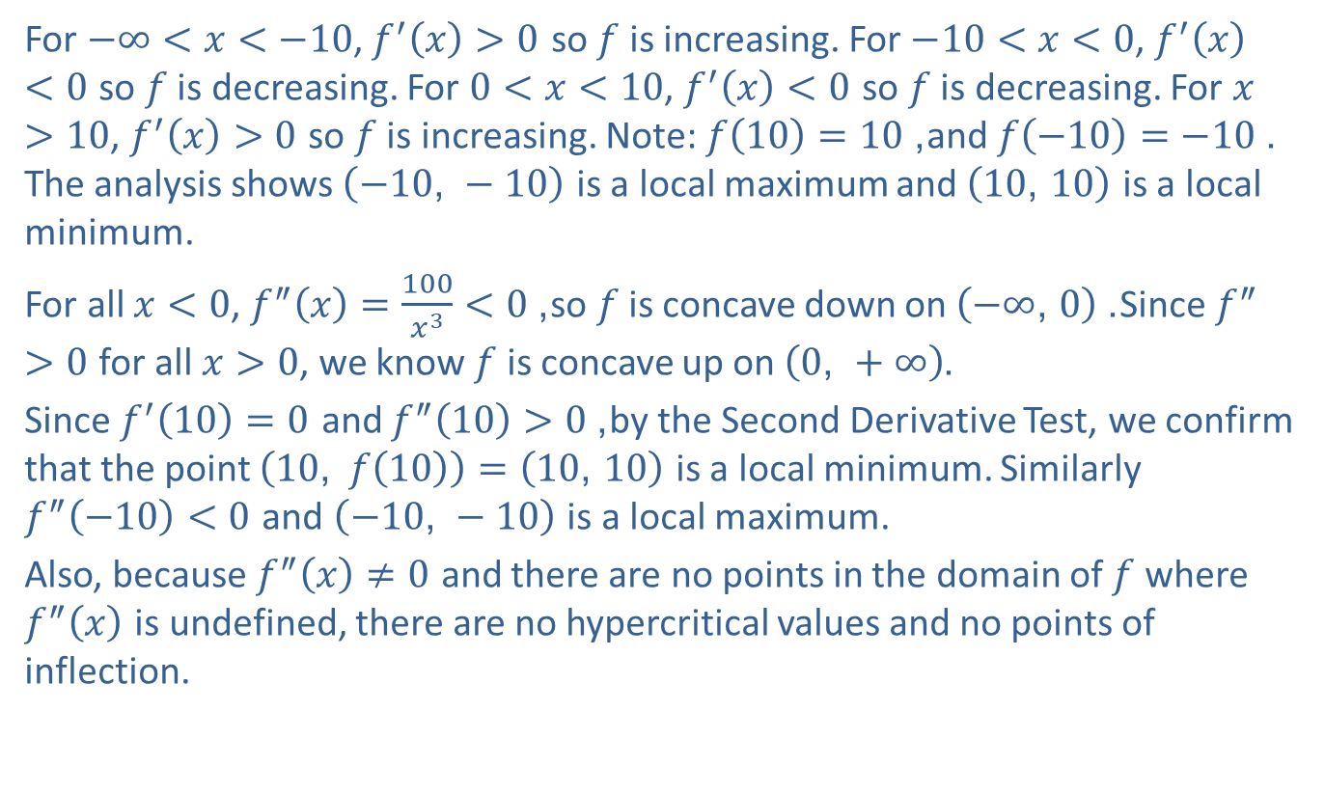
Example 5: Sketching the Graph of a Rational Function (cont.)
For $−∞<x<−10$, $f^{′}\left(x\right)>0$ so $f$ is increasing. For $−10<x<0$, $f^{′}\left(x\right)<0$ so $f$ is decreasing. For $0<x<10$, $f^{′}\left(x\right)<0$ so $f$ is decreasing. For $x>10$, $f^{′}\left(x\right)>0$ so $f$ is increasing. Note: $f\left(10\right)=10$, and $f\left(−10\right)=−10$. The analysis shows $\left(−10\text{, }−10\right)$ is a local maximum and $\left(10\text{, }10\right)$ is a local minimum.
For all $x<0$, $f^{″}\left(x\right)=\frac{100}{x^{3}}<0$, so $f$ is concave down on $\left(−∞\text{, }0\right)$. Since $f^{″}>0$ for all $x>0$, we know $f$ is concave up on $\left(0\text{, }+∞\right)$.
Since $f^{′}\left(10\right)=0$ and $f^{″}\left(10\right)>0$, by the Second Derivative Test, we confirm that the point $\left(10\text{, }f\left(10\right)\right)=\left(10\text{, }10\right)$ is a local minimum. Similarly $f^{″}\left(−10\right)<0$ and $\left(−10\text{, }−10\right)$ is a local maximum.
Also, because $f^{″}\left(x\right)≠0$ and there are no points in the domain of $f$ where $f^{″}⁡\left(x\right)$ is undefined, there are no hypercritical values and no points of inflection.

Slide 25
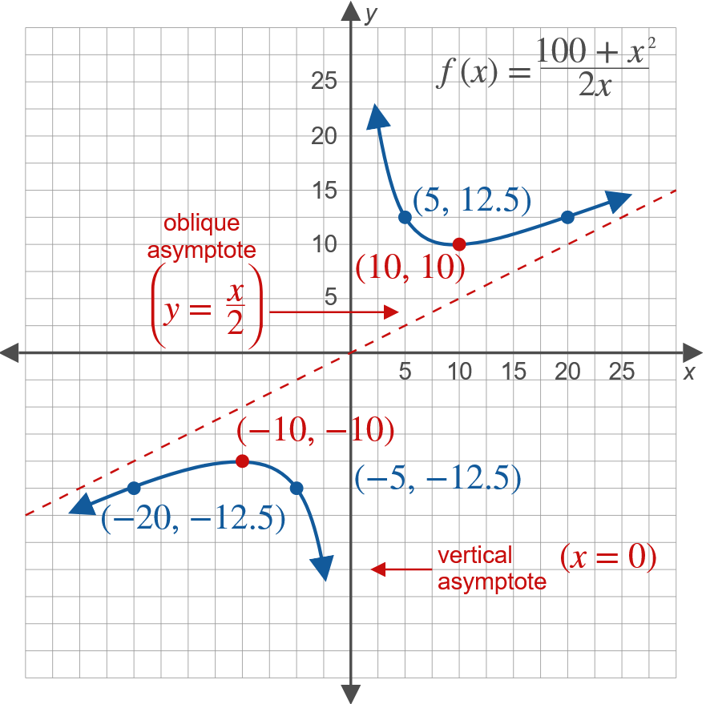
Example 5: Sketching the Graph of a Rational Function (cont.)

