Slide 1
Section 4.5
Business Applications

Slide 2
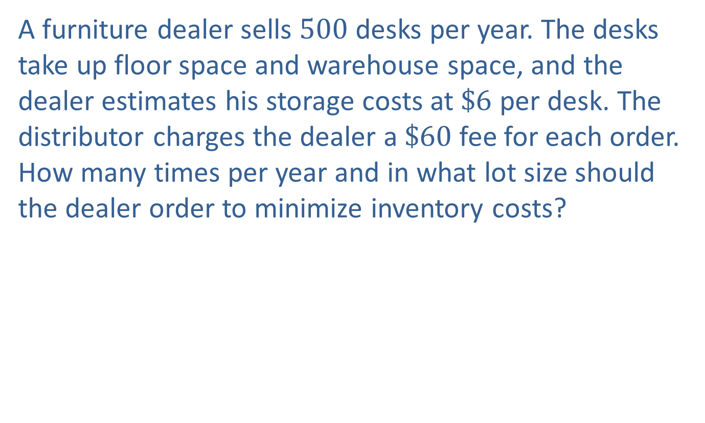
Example 1: Minimizing Inventory Costs
A furniture dealer sells 500 desks per year. The desks take up floor space and warehouse space, and the dealer estimates his storage costs at $\$6$ per desk. The distributor charges the dealer a $\$60$ fee for each order. How many times per year and in what lot size should the dealer order to minimize inventory costs?

Slide 3
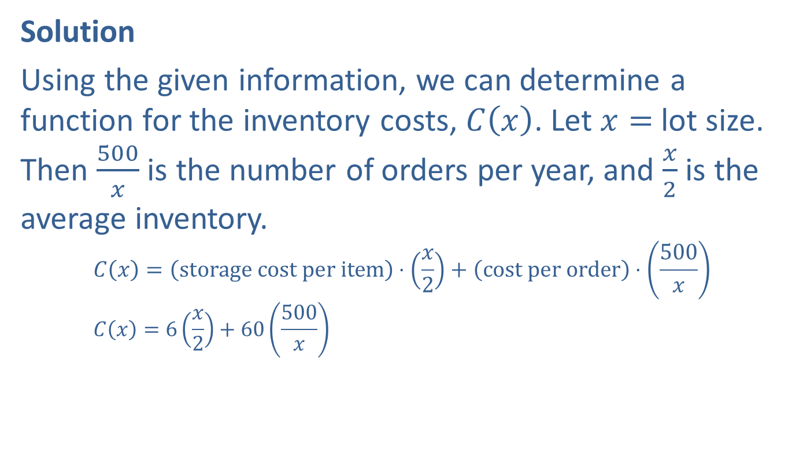
Example 1: Minimizing Inventory Costs (cont.)
Solution
Using the given information, we can determine a function for the inventory costs, $C⁡\left(x\right)$. Let $x=$ lot size. Then $\frac{500}{x}$ is the number of orders per year, and $\frac{x}{2}$ is the average inventory.
$$C\left(x\right)=\left(storage cost per item\right)⋅\left(\frac{x}{2}\right)+\left(cost per order\right)⋅\left(\frac{500}{x}\right) \\ C\left(x\right)=6\left(\frac{x}{2}\right)+60\left(\frac{500}{x}\right)$$

Slide 4
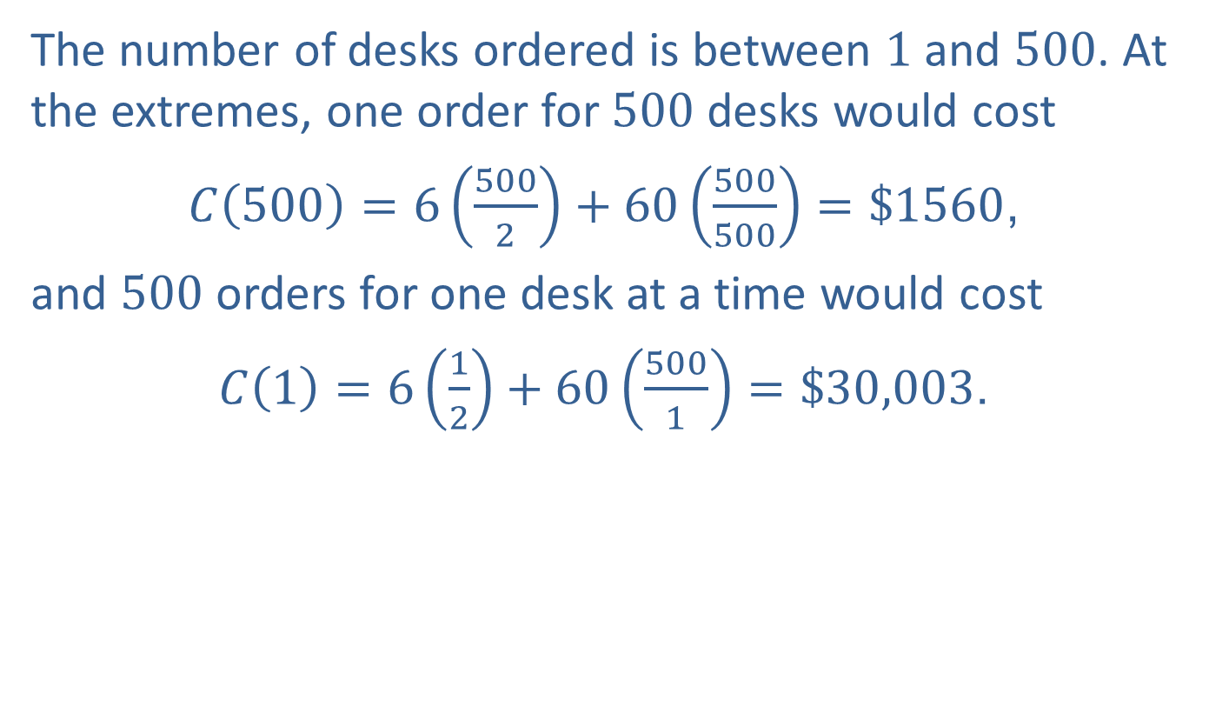
Example 1: Minimizing Inventory Costs (cont.)
The number of desks ordered is between 1 and 500. At the extremes, one order for 500 desks would cost
$C\left(500\right)=6\left(\frac{500}{2}\right)+60\left(\frac{500}{500}\right)=\$1560$,
and 500 orders for one desk at a time would cost
$C\left(1\right)=6\left(\frac{1}{2}\right)+60\left(\frac{500}{1}\right)=\$30,003$.

Slide 5
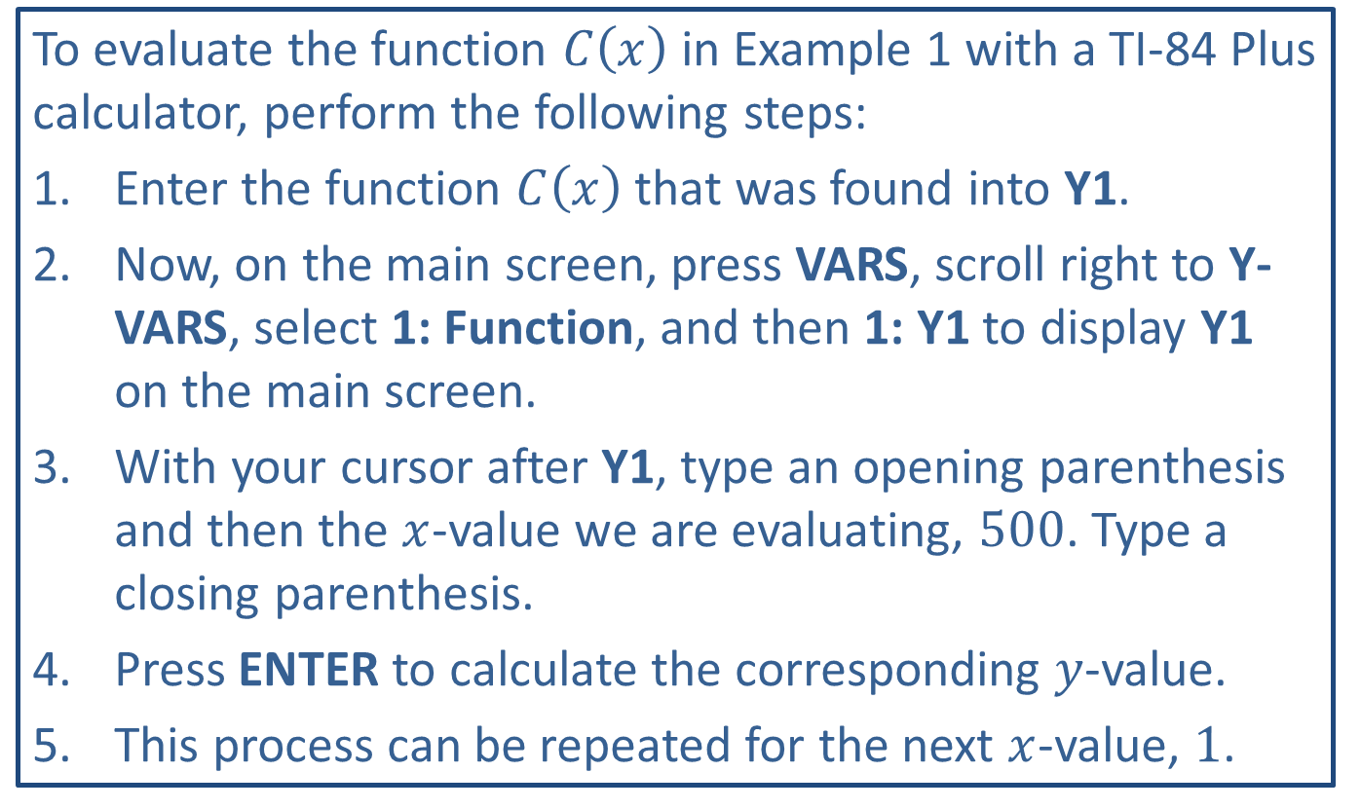
Tech Training
To evaluate the function $C⁡\left(x\right)$ in Example 1 with a TI-84 Plus calculator, perform the following steps:
​Enter the function $C⁡\left(x\right)$ that was found into Y1.
​Now, on the main screen, press VARS, scroll right to Y-VARS, select 1: Function, and then 1: Y1 to display Y1 on the main screen.
​With your cursor after Y1, type an opening parenthesis and then the $x$-value we are evaluating, 500. Type a closing parenthesis.
​Press ENTER to calculate the corresponding $y$-value.
​This process can be repeated for the next $x$-value, 1.

Slide 6
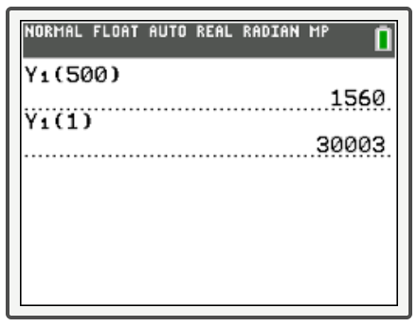
Tech Training (cont.)

Slide 7

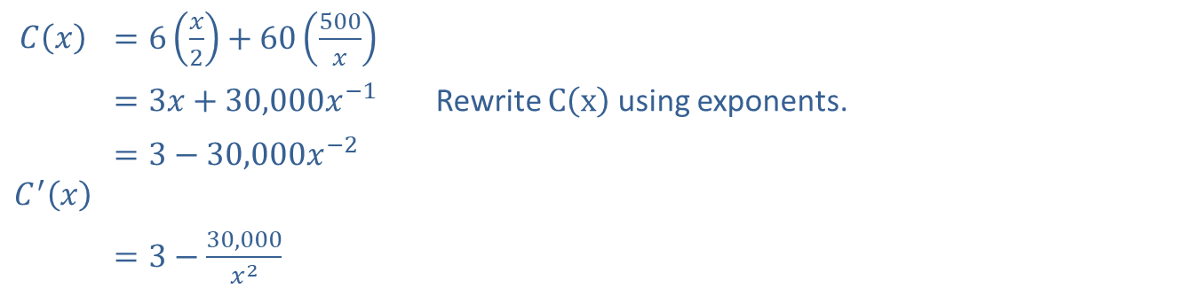
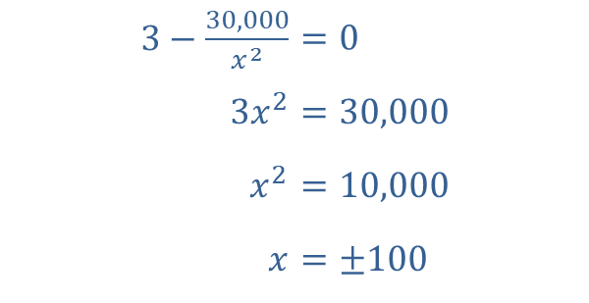
Example 1: Minimizing Inventory Costs (cont.)
Now we need to differentiate $C⁡\left(x\right)$ so we can determine the local minima.
​$C⁡\left(x\right)$ | ​$=6\left(\frac{x}{2}\right)+60\left(\frac{500}{x}\right)$
 | ​$=3x+30,000x^{−1}$ | Rewrite $C⁡\left(x\right)$ using exponents.
​$C^{′}⁡\left(x\right)$ | ​$=3−30,000x^{−2}$
 | ​$=3−\frac{30,000}{x^{2}}$
We set $C^{′}\left(x\right)=0$ and solve for $x$.
​$3−\frac{30,000}{x^{2}}$ | ​$=0$
​$3x^{2}$ | ​$=30,000$
​$x^{2}$ | ​$=10,000$
​$x$ | ​$=±100$

Slide 8
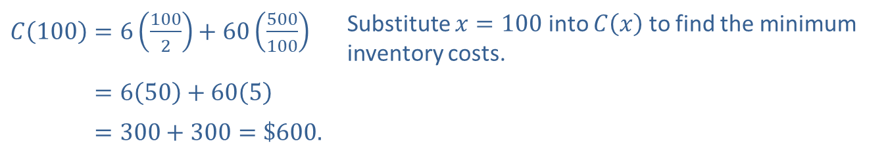
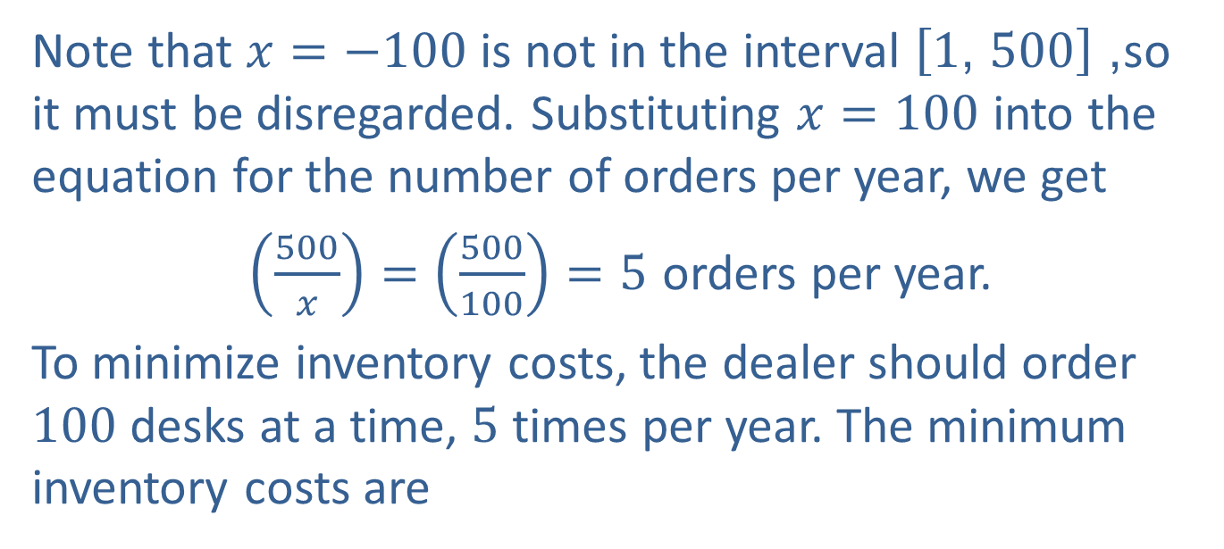
Example 1: Minimizing Inventory Costs (cont.)
Note that $x=−100$ is not in the interval $\left[1\text{, }500\right]$, so it must be disregarded. Substituting $x=100$ into the equation for the number of orders per year, we get
$\left(\frac{500}{x}\right)=\left(\frac{500}{100}\right)=5$ orders per year.
To minimize inventory costs, the dealer should order 100 desks at a time, 5 times per year. The minimum inventory costs are
​$C\left(100\right)=6\left(\frac{100}{2}\right)+60\left(\frac{500}{100}\right)$ | Substitute $x=100$ into $C⁡\left(x\right)$ to find the minimum inventory costs.
​𝐶⁡100=650+605
​𝐶⁡100=300+300=$600.

Slide 9

Example 1: Minimizing Inventory Costs (cont.)
Since we are dealing with the closed interval $\left[1\text{, }500\right]$ and $C\left(1\right)=\$30,003$ and $C\left(500\right)=\$1560$, $C\left(100\right)=\$600$ is also the absolute minimum.

Slide 10
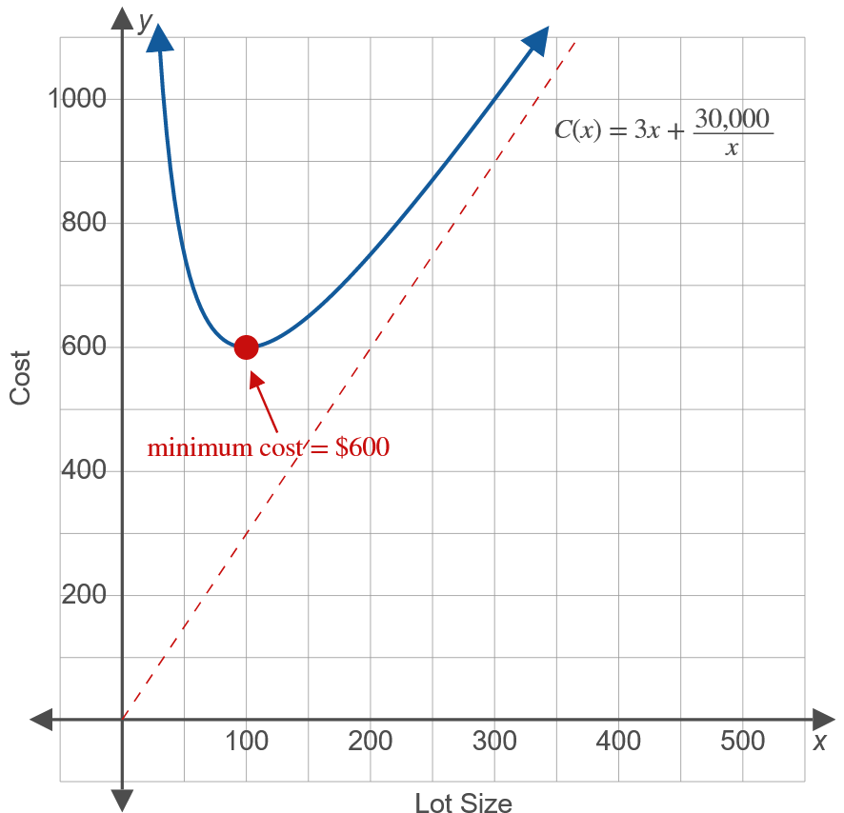
Example 1: Minimizing Inventory Costs (cont.)

Slide 11
Example 2: Maximizing Revenue
Susan knows that she can sell 440 donuts a day at 50 cents per donut. What price should she charge to maximize her revenue if, for every increase of 10 cents in price, she sells 40 fewer donuts? What will this revenue be?

Slide 12
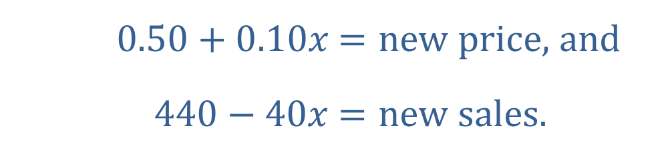

Example 2: Maximizing Revenue (cont.)
Solution
Let $x=$ number of 10-cent increases in price. (The choice of $x$ here does not represent the unknown price but the number of price increases. This choice for $x$ makes the equation relatively easy to set up.) Then
​
​
​$0.50+0.10x$ | ​$=new price\text{, }\text{and}$
​$440−40x$ | ​$=new sales\text{.}$

Slide 13
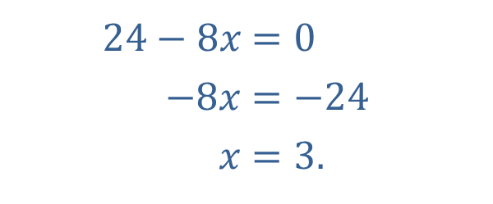
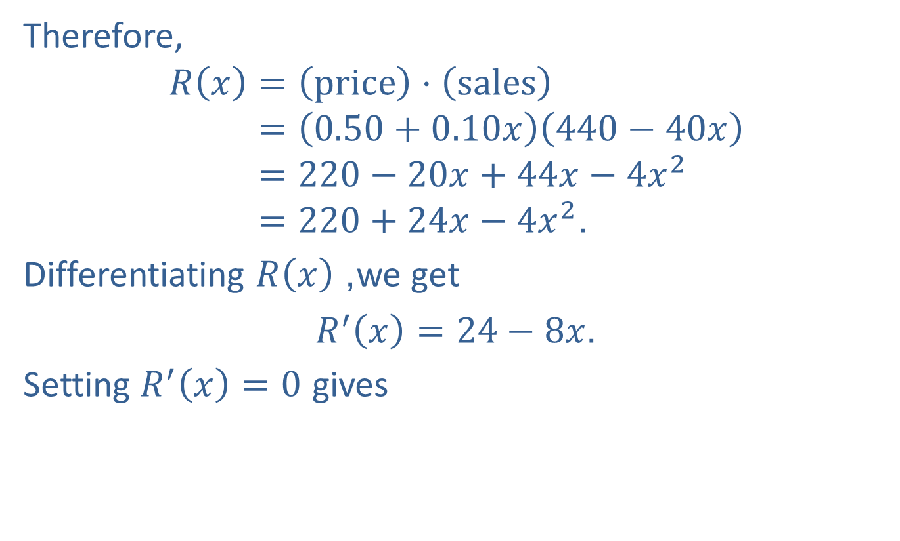
Example 2: Maximizing Revenue (cont.)
Therefore,
𝑅𝑥=price⋅sales𝑅⁡𝑥=0.50+0.10𝑥440−40𝑥𝑅⁡𝑥=220−20𝑥+44𝑥−4𝑥2𝑅⁡𝑥=220+24𝑥−4𝑥2.
Differentiating $R⁡\left(x\right)$, we get
$R^{′}\left(x\right)=24−8x$.
Setting $R^{′}\left(x\right)=0$ gives
​$24−8x$ | ​$=0$
​$−8x$ | ​$=−24$
​$x$ | ​$=3\text{.}$

Slide 14
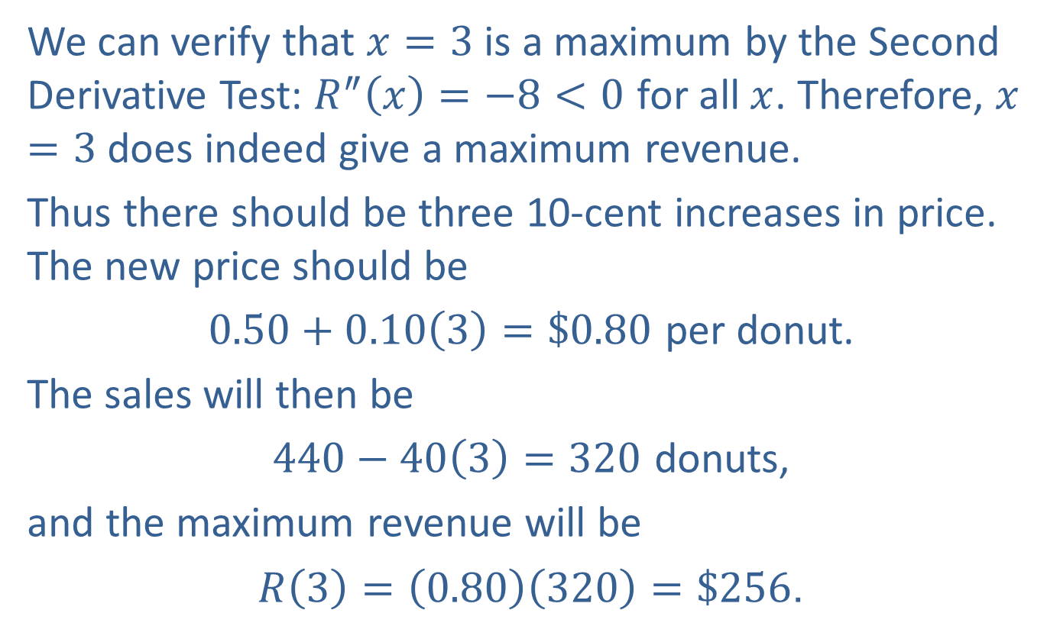
Example 2: Maximizing Revenue (cont.)
We can verify that $x=3$ is a maximum by the Second Derivative Test: $R^{″}\left(x\right)=−8<0$ for all $x$. Therefore, $x=3$ does indeed give a maximum revenue.
Thus there should be three 10-cent increases in price. The new price should be
$0.50+0.10\left(3\right)=\$0.80$ per donut.
The sales will then be
$440−40\left(3\right)=320$ donuts,
and the maximum revenue will be
$R\left(3\right)=\left(0.80\right)\left(320\right)=\$256$.

Slide 15
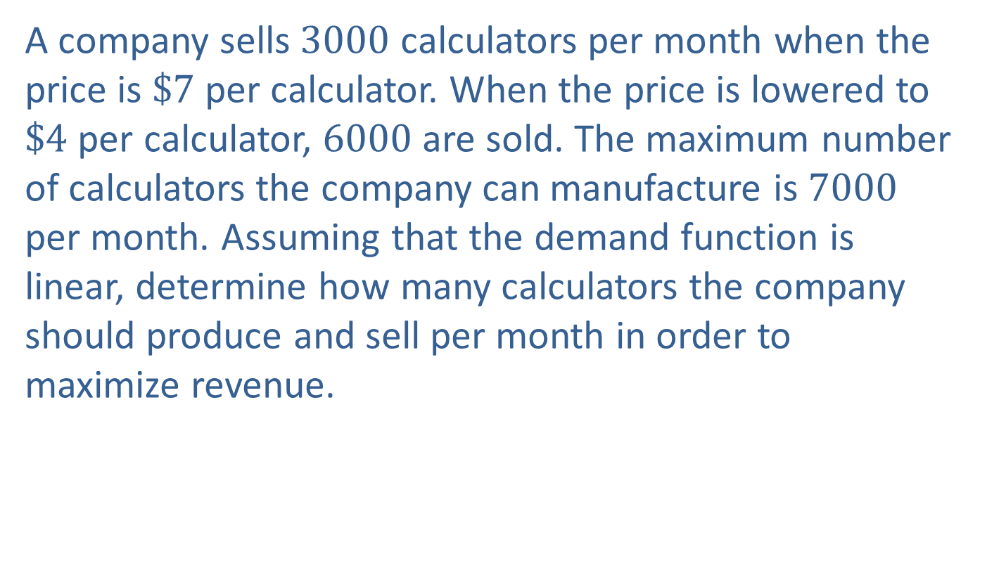
Example 3: Finding Maximum Revenue with a Linear Demand Function
A company sells 3000 calculators per month when the price is $\$7$ per calculator. When the price is lowered to $\$4$ per calculator, 6000 are sold. The maximum number of calculators the company can manufacture is 7000 per month. Assuming that the demand function is linear, determine how many calculators the company should produce and sell per month in order to maximize revenue.

Slide 16
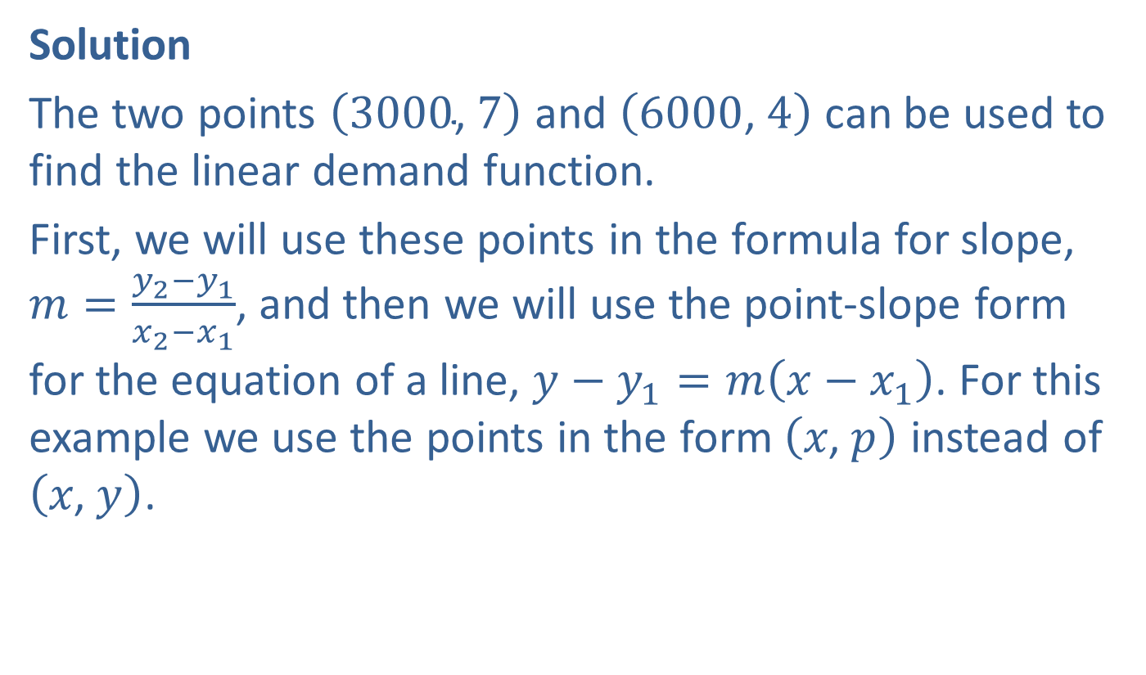
Example 3: Finding Maximum Revenue with a Linear Demand Function (cont.)
Solution
The two points $\left(3000\text{, }7\right)$ and $\left(6000\text{, }4\right)$ can be used to find the linear demand function.
First, we will use these points in the formula for slope, $m=\frac{y_{2}−y_{1}}{x_{2}−x_{1}}$, and then we will use the point-slope form for the equation of a line, $y−y_{1}=m\left(x−x_{1}\right)$. For this example we use the points in the form $\left(x\text{, }p\right)$ instead of $\left(x\text{, }y\right)$.
​

Slide 17
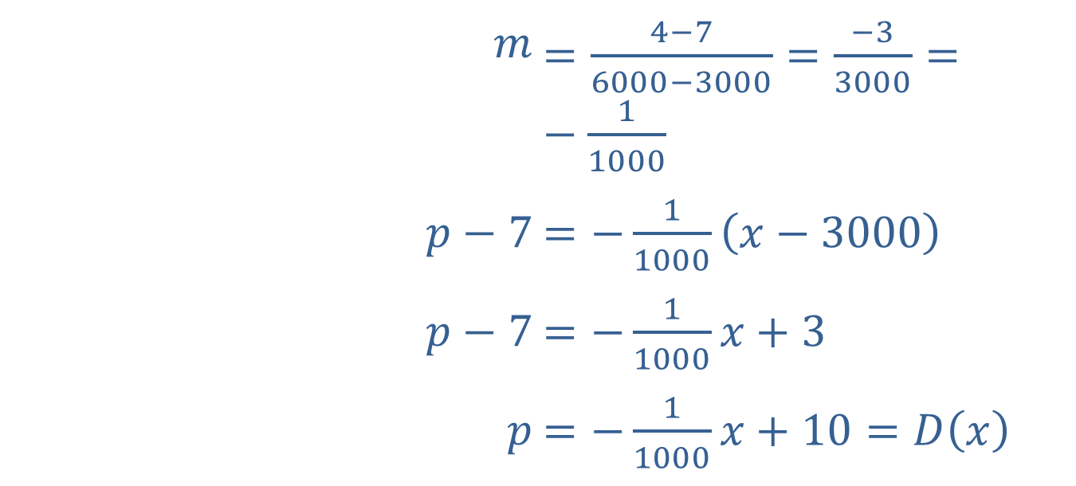
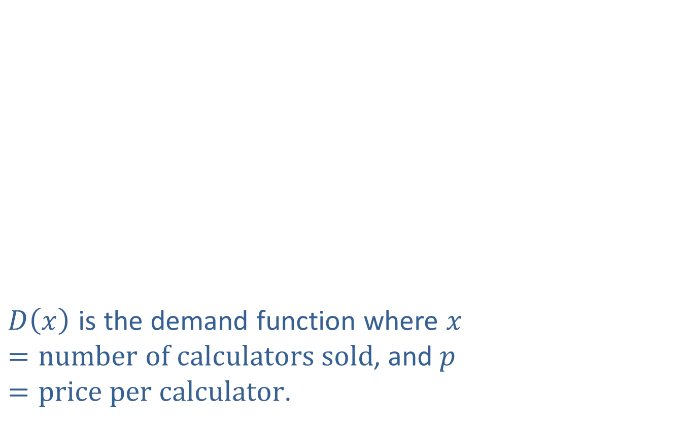
Example 3: Finding Maximum Revenue with a Linear Demand Function (cont.)
​$m$ | ​$=\frac{4−7}{6000−3000}=\frac{−3}{3000}=−\frac{1}{1000}$
​$p−7$ | ​$=−\frac{1}{1000}\left(x−3000\right)$
​$p−7$ | ​$=−\frac{1}{1000}x+3$
​$p$ | ​$=−\frac{1}{1000}x+10=D\left(x\right)$
$D⁡\left(x\right)$ is the demand function where $x=number of calculators sold$, and $p=price per calculator$.

Slide 18
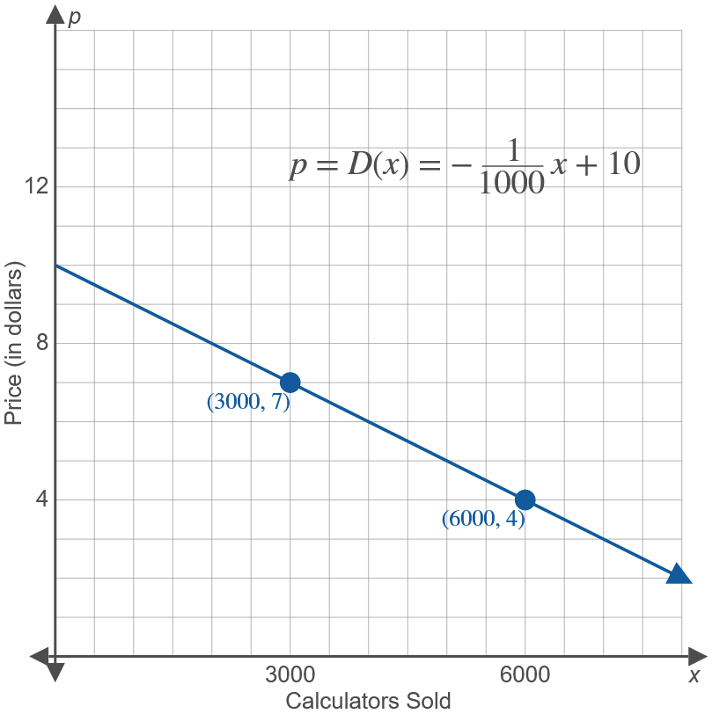
Example 3: Finding Maximum Revenue with a Linear Demand Function (cont.)

Slide 19
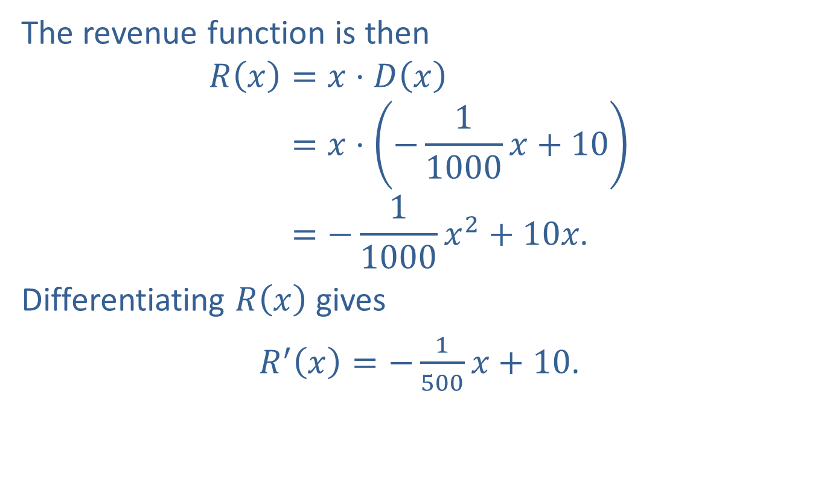
Example 3: Finding Maximum Revenue with a Linear Demand Function (cont.)
The revenue function is then
𝑅𝑥=𝑥⋅𝐷𝑥𝑅⁡𝑥=𝑥⋅−11000𝑥+10𝑅⁡𝑥=−11000𝑥2+10𝑥.
Differentiating $R⁡\left(x\right)$ gives
$R^{′}\left(x\right)=−\frac{1}{500}x+10$.
​

Slide 20
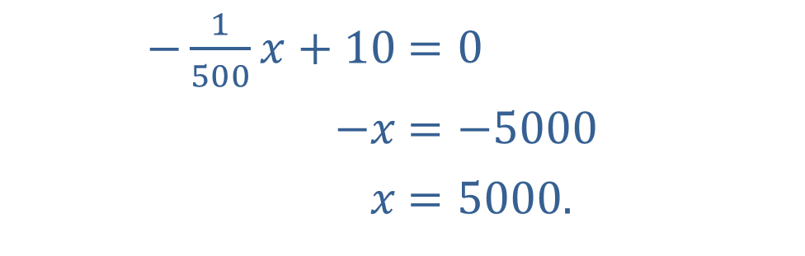
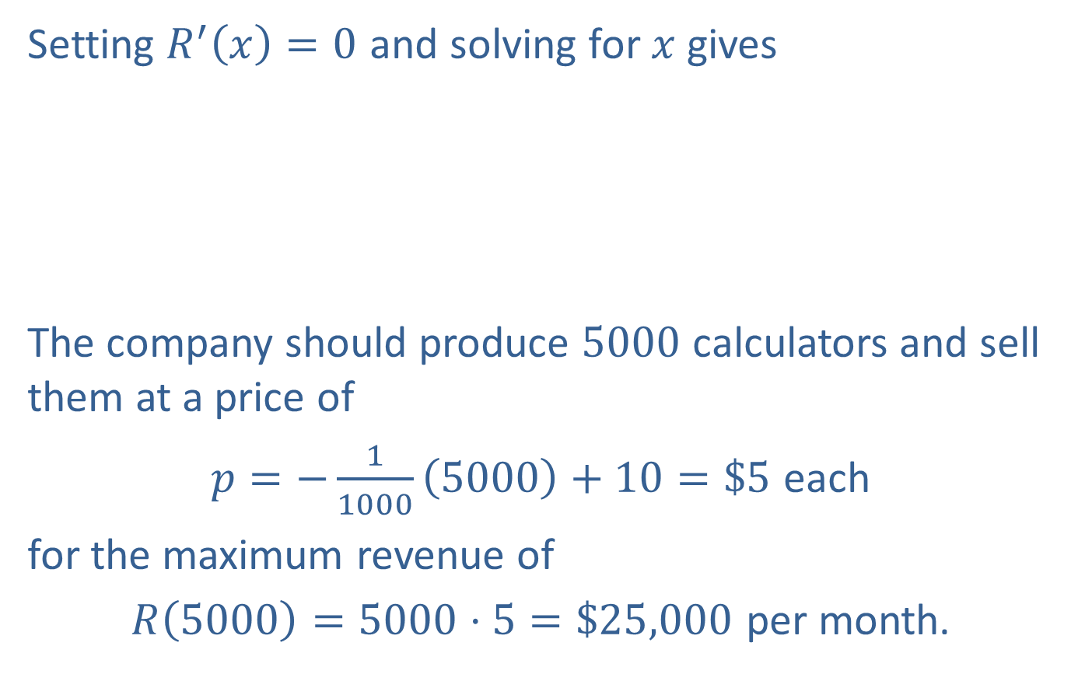
Example 3: Finding Maximum Revenue with a Linear Demand Function (cont.)
Setting $R^{′}\left(x\right)=0$ and solving for $x$ gives
The company should produce 5000 calculators and sell them at a price of
$p=−\frac{1}{1000}\left(5000\right)+10=\$5$ each
for the maximum revenue of
$R\left(5000\right)=5000⋅5=\$25,000$ per month.
​$−\frac{1}{500}x+10$ | ​$=0$
​$−x$ | ​$=−5000$
​$x$ | ​$=5000\text{.}$

Slide 21
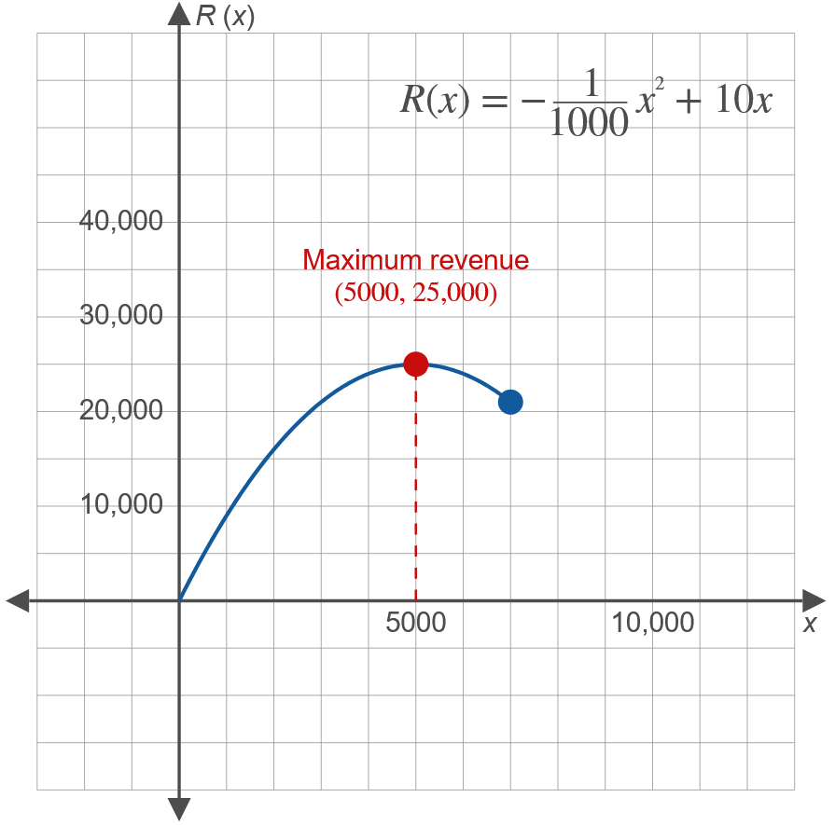
Example 3: Finding Maximum Revenue with a Linear Demand Function (cont.)

Slide 22

Example 4: Finding Maximum Profit with a Linear Demand Function
Suppose that the company in Example 3 has a cost function $C\left(x\right)=5000+3x$. How many calculators should the company produce and sell to maximize profit?

Slide 23
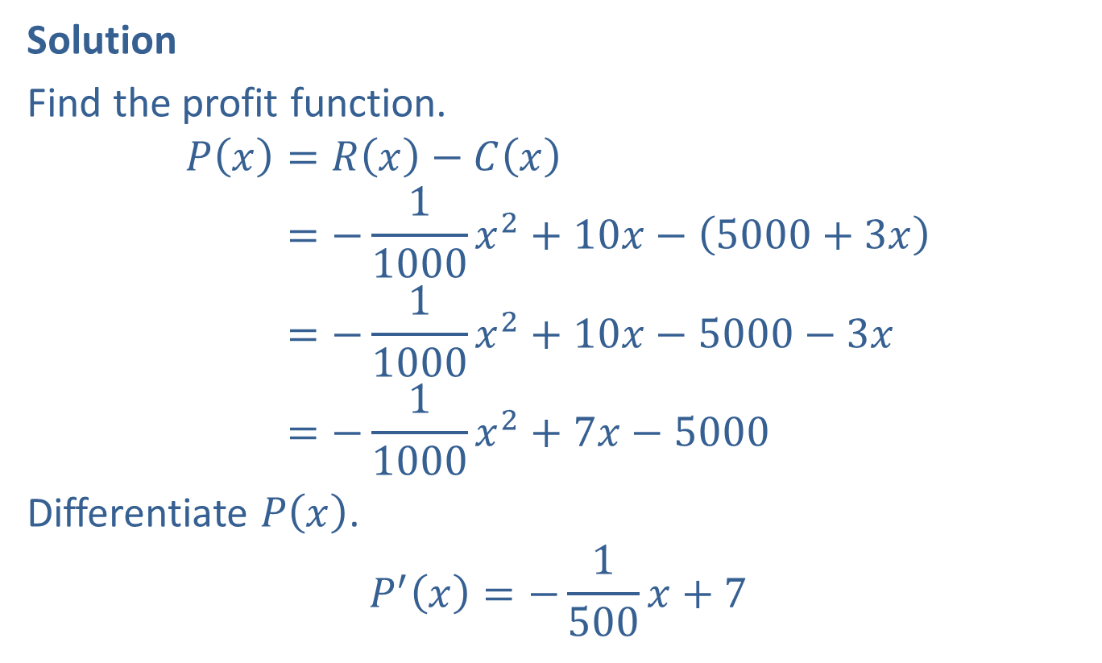
Example 4: Finding Maximum Profit with a Linear Demand Function (cont.)
Solution
Find the profit function.
𝑃𝑥=𝑅𝑥−𝐶𝑥𝑃⁡𝑥=−11000𝑥2+10𝑥−5000+3𝑥𝑃⁡𝑥=−11000𝑥2+10𝑥−5000−3𝑥𝑃⁡𝑥=−11000𝑥2+7𝑥−5000
Differentiate $P⁡\left(x\right)$.
$$P^{′}\left(x\right)=−\frac{1}{500}x+7$$

Slide 24
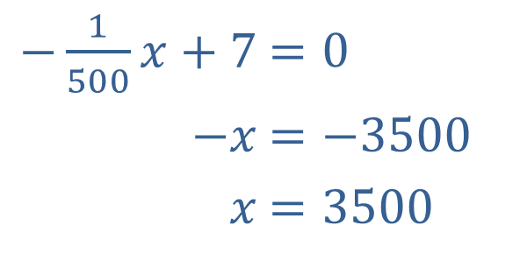

Example 4: Finding Maximum Profit with a Linear Demand Function (cont.)
Set $P^{′}⁡\left(x\right)$ equal to 0, and solve for $x$.
​
​$−\frac{1}{500}x+7$ | ​$=0$
​$−x$ | ​$=−3500$
​$x$ | ​$=3500$

Slide 25
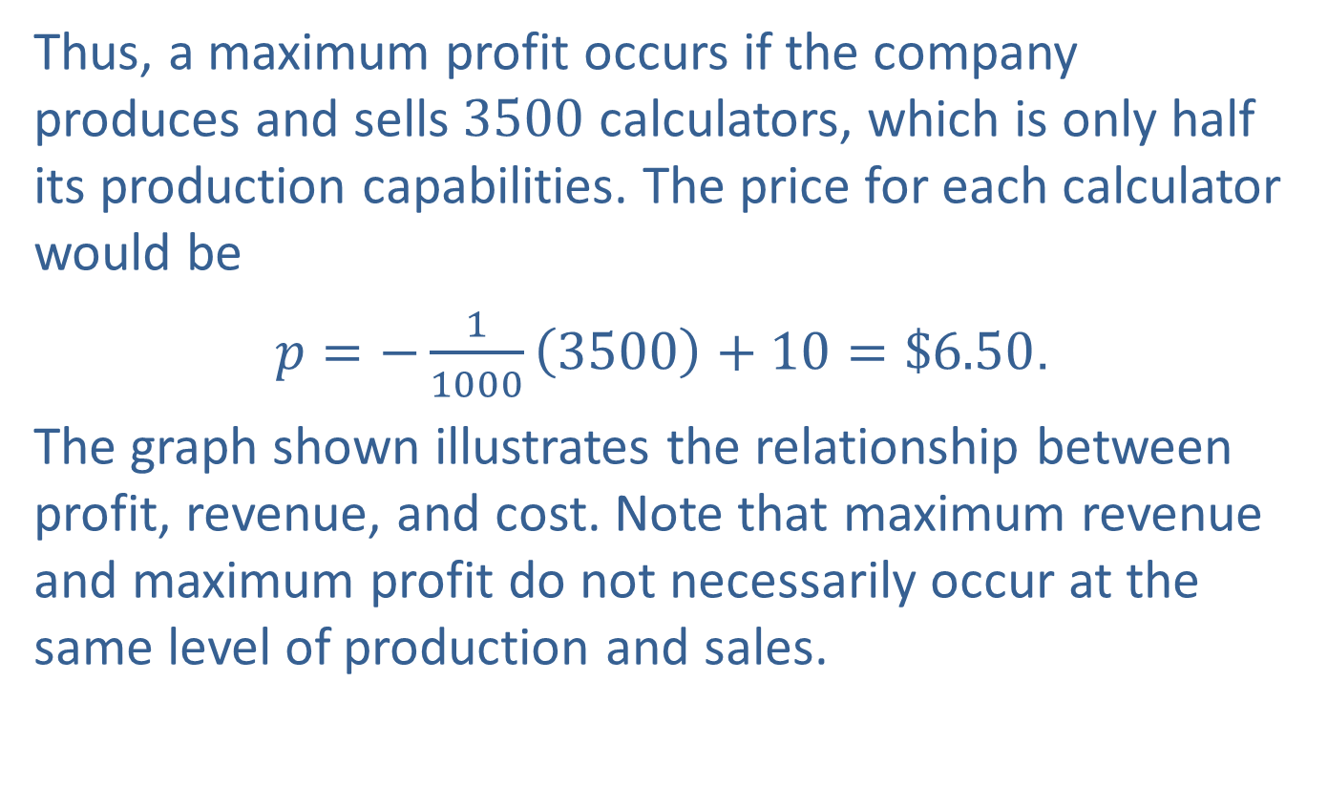
Example 4: Finding Maximum Profit with a Linear Demand Function (cont.)
Thus, a maximum profit occurs if the company produces and sells 3500 calculators, which is only half its production capabilities. The price for each calculator would be
$p=−\frac{1}{1000}\left(3500\right)+10=\$6.50$.
The graph shown illustrates the relationship between profit, revenue, and cost. Note that maximum revenue and maximum profit do not necessarily occur at the same level of production and sales.

Slide 26
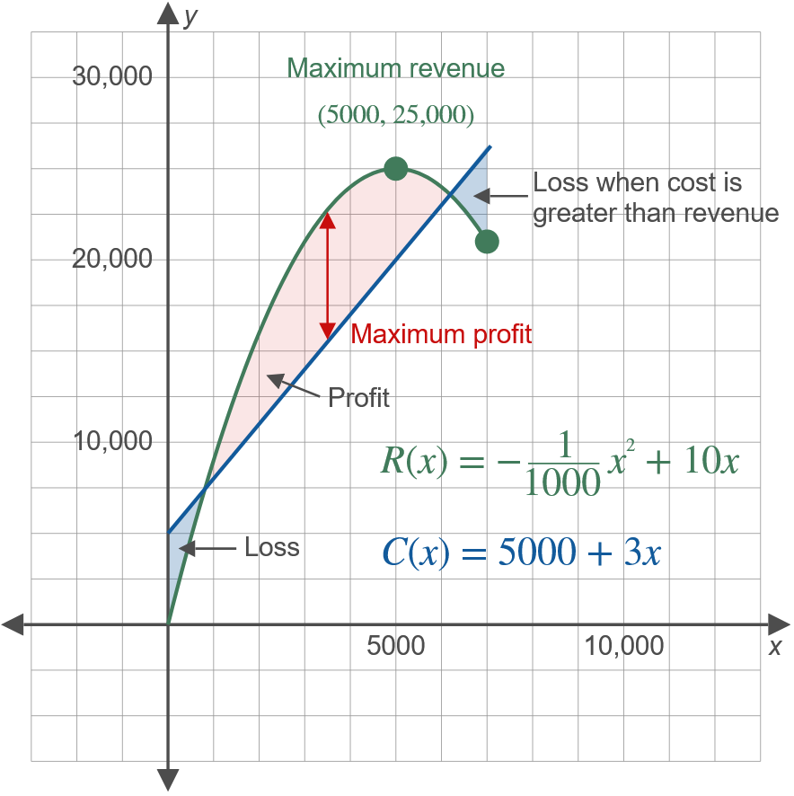
Example 4: Finding Maximum Profit with a Linear Demand Function (cont.)

