Slide 1
Section 4.6
Other Applications: Optimization, Distance, and Velocity

Slide 2
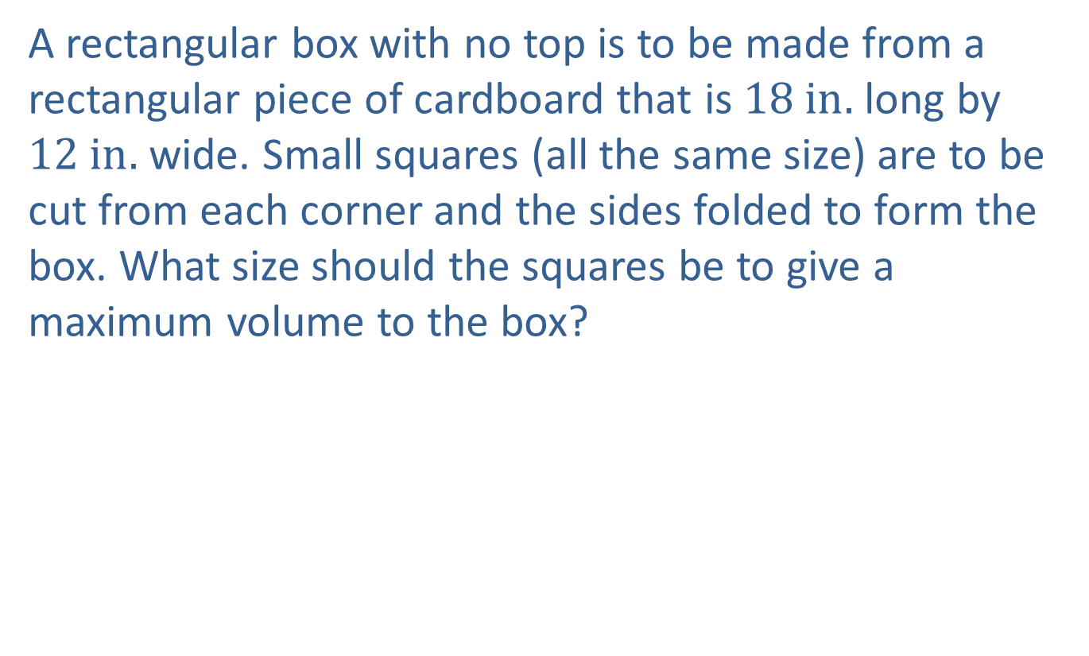
Example 1: Volume of a Box
A rectangular box with no top is to be made from a rectangular piece of cardboard that is $18 in.$ long by $12 in.$ wide. Small squares (all the same size) are to be cut from each corner and the sides folded to form the box. What size should the squares be to give a maximum volume to the box?

Slide 3

Example 1: Volume of a Box (cont.)
Solution
Let $x=$ length of one side of the square to be cut.

Slide 4
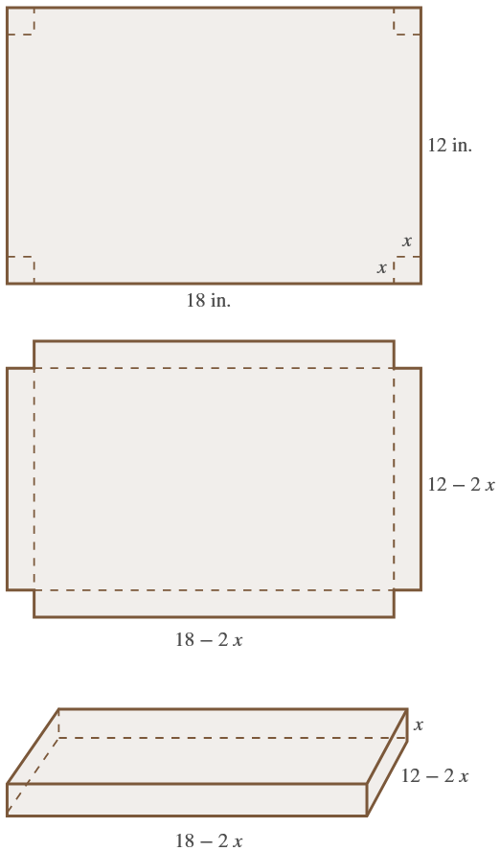
Example 1: Volume of a Box (cont.)

Slide 5


Example 1: Volume of a Box (cont.)
​$Volume$ | ​$=length⋅width⋅height$
​$V$ | ​$=\left(18−2x\right)⋅\left(12−2x\right)⋅x$
​𝑉 | ​$=216x−60x^{2}+4x^{3}$
Differentiating $V$, we obtain
𝑑𝑉𝑑𝑥=216−120𝑥+12𝑥2𝑑𝑉𝑑𝑥=12𝑥2−10𝑥+18.

Slide 6
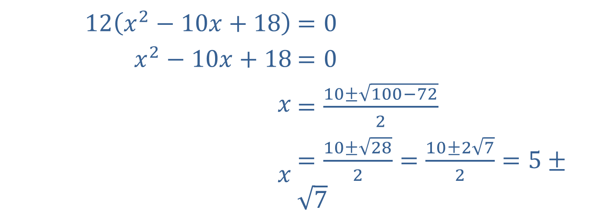
Example 1: Volume of a Box (cont.)
Now we set $\frac{dV}{dx}=0$ and solve for $x$.
​$12\left(x^{2}−10x+18\right)$ | ​$=0$
​$x^{2}−10x+18$ | ​$=0$
​$x$ | ​$=\frac{10±\sqrt{100−72}}{2}$
​$x$ | ​$=\frac{10±\sqrt{28}}{2}=\frac{10±2\sqrt{7}}{2}=5±\sqrt{7}$

Slide 7
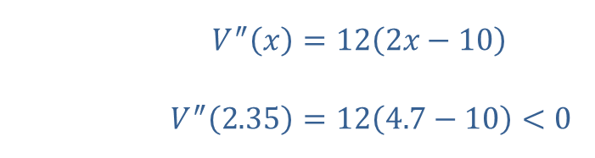
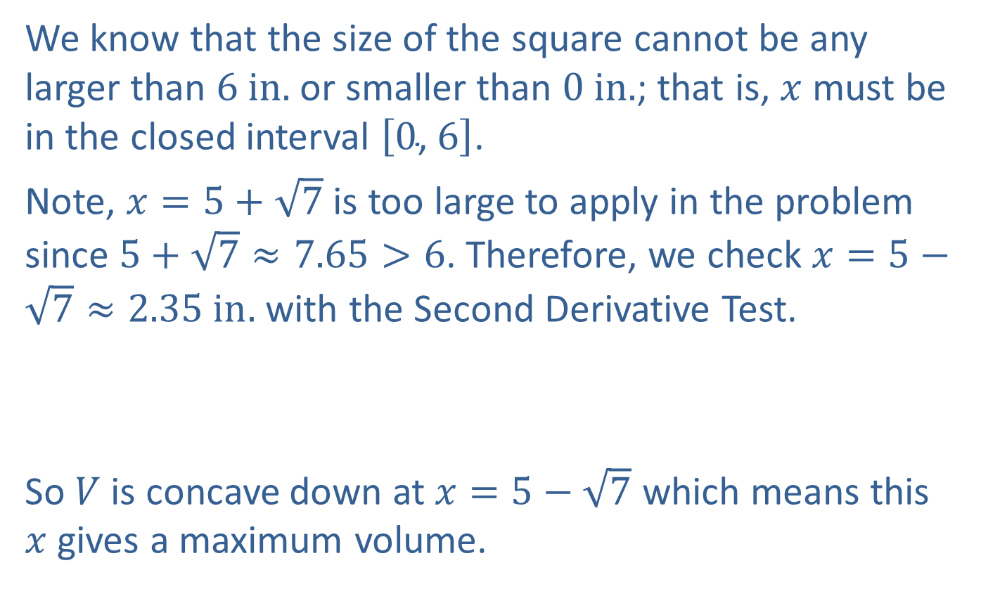
Example 1: Volume of a Box (cont.)
We know that the size of the square cannot be any larger than $6 in.$ or smaller than $0 in.$; that is, $x$ must be in the closed interval $\left[0\text{, }6\right]$.
Note, $x=5+\sqrt{7}$ is too large to apply in the problem since $5+\sqrt{7}≈7.65>6$. Therefore, we check $x=5−\sqrt{7}≈2.35 in.$ with the Second Derivative Test.
​
So $V$ is concave down at $x=5−\sqrt{7}$ which means this $x$ gives a maximum volume.
​$V^{″}⁡\left(x\right)$ | ​$=12\left(2x−10\right)$
​$V^{″}⁡\left(2.35\right)$ | ​$=12\left(4.7−10\right)<0$

Slide 8
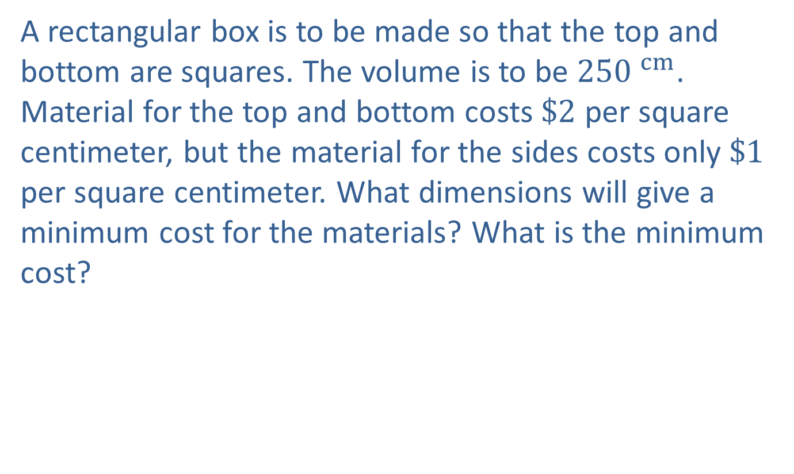
Example 2: Surface Area of a Box
A rectangular box is to be made so that the top and bottom are squares. The volume is to be $250 ^{cm}$. Material for the top and bottom costs $\$2$ per square centimeter, but the material for the sides costs only $\$1$ per square centimeter. What dimensions will give a minimum cost for the materials? What is the minimum cost?

Slide 9

Example 2: Surface Area of a Box (cont.)
Solution
Let $x=$ length of an edge along the square bottom.
Let $y=$ length of a vertical edge.

Slide 10
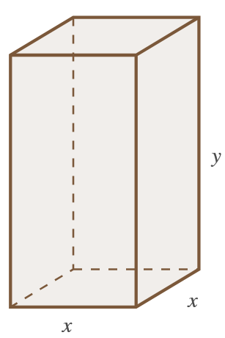

Example 2: Surface Area of a Box (cont.)
$$Volume=x^{2}y=250 ^{cm}$$

Slide 11
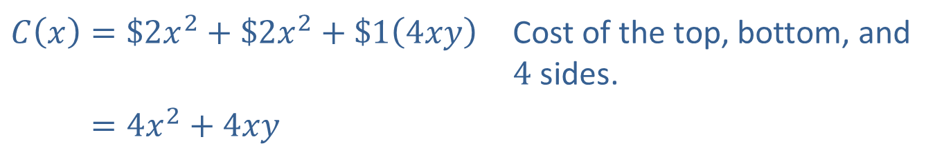

Example 2: Surface Area of a Box (cont.)
We are assuming that cost only depends on surface area. The cost, $C⁡\left(x\right)$, of the materials is found by multiplying the areas of the faces of the box by $\$2$ and $\$1$ as follows.
​$C\left(x\right)=\$2x^{2}+\$2x^{2}+\$1\left(4xy\right)$ | Cost of the top, bottom, and 4 sides.
​𝐶⁡𝑥=4𝑥2+4𝑥𝑦

Slide 12
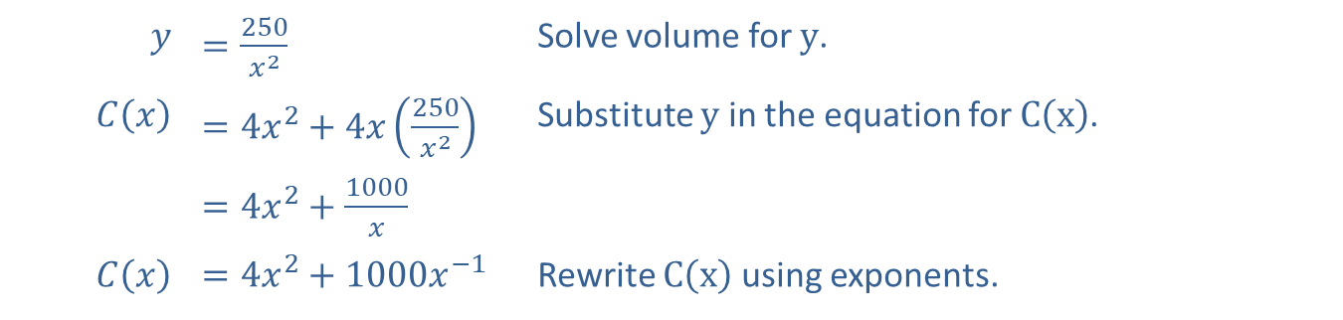


Example 2: Surface Area of a Box (cont.)
Now, using the volume, solve for $y$ and substitute into the cost function.
$$y$$ | ​$=\frac{250}{x^{2}}$ | Solve volume for $y$.
​$C⁡\left(x\right)$ | ​$=4x^{2}+4x\left(\frac{250}{x^{2}}\right)$ | Substitute $y$ in the equation for $C⁡\left(x\right)$.
​ | ​$=4x^{2}+\frac{1000}{x}$
​$C⁡\left(x\right)$ | ​$=4x^{2}+1000x^{−1}$ | Rewrite $C⁡\left(x\right)$ using exponents.
Differentiating $C⁡\left(x\right)$, we have
$C^{′}\left(x\right)=8x−1000x^{−2}$.

Slide 13
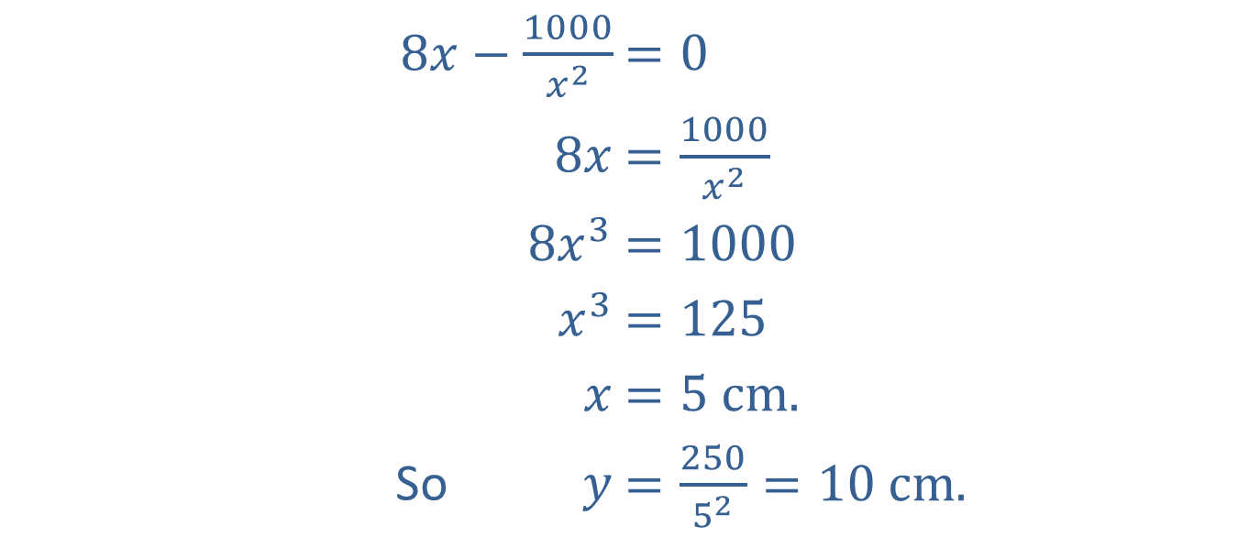

Example 2: Surface Area of a Box (cont.)
Setting $C^{′}\left(x\right)=0$ and solving for $x$ gives
​$8x−\frac{1000}{x^{2}}$ | ​$=0$
​$8x$ | ​$=\frac{1000}{x^{2}}$
​$8x^{3}$ | ​$=1000$
​$x^{3}$ | ​$=125$
​$x$ | ​$=5 cm\text{.}$
So ​$y$ | ​$=\frac{250}{5^{2}}=10 cm\text{.}$

Slide 14
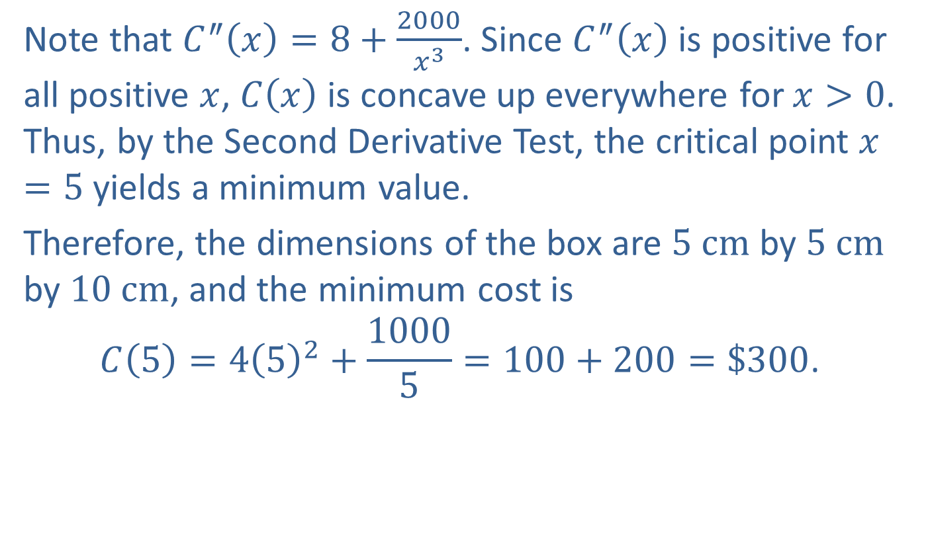
Example 2: Surface Area of a Box (cont.)
Note that $C^{″}\left(x\right)=8+\frac{2000}{x^{3}}$. Since $C^{″}⁡\left(x\right)$ is positive for all positive $x$, $C⁡\left(x\right)$ is concave up everywhere for $x>0$. Thus, by the Second Derivative Test, the critical point $x=5$ yields a minimum value.
Therefore, the dimensions of the box are $5 cm$ by $5 cm$ by $10 cm$, and the minimum cost is
$$C\left(5\right)=4{\left(5\right)}^{2}+\frac{1000}{5}=100+200=\$300\text{.}$$

Slide 15
Example 3: Fencing
A farmer wants to enclose a rectangular area next to his barn. If he has 200 feet of fencing to use, what dimensions of the rectangle will maximize the area? What is the maximum area? (Note that the fence is only three sides of the rectangle, since the barn serves as the fourth side of the enclosure.)

Slide 16

Example 3: Fencing (cont.)
Solution
Let $x=$ length of one of the two equal sides of the fence.
Then, since there are only 200 feet of fencing available, the length of the third side is $200−2x$.

Slide 17
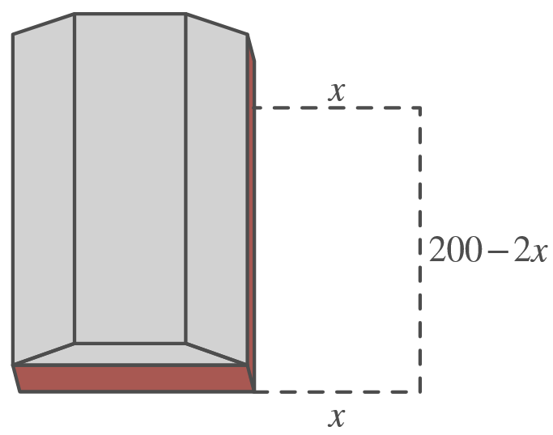
Example 3: Fencing (cont.)

Slide 18
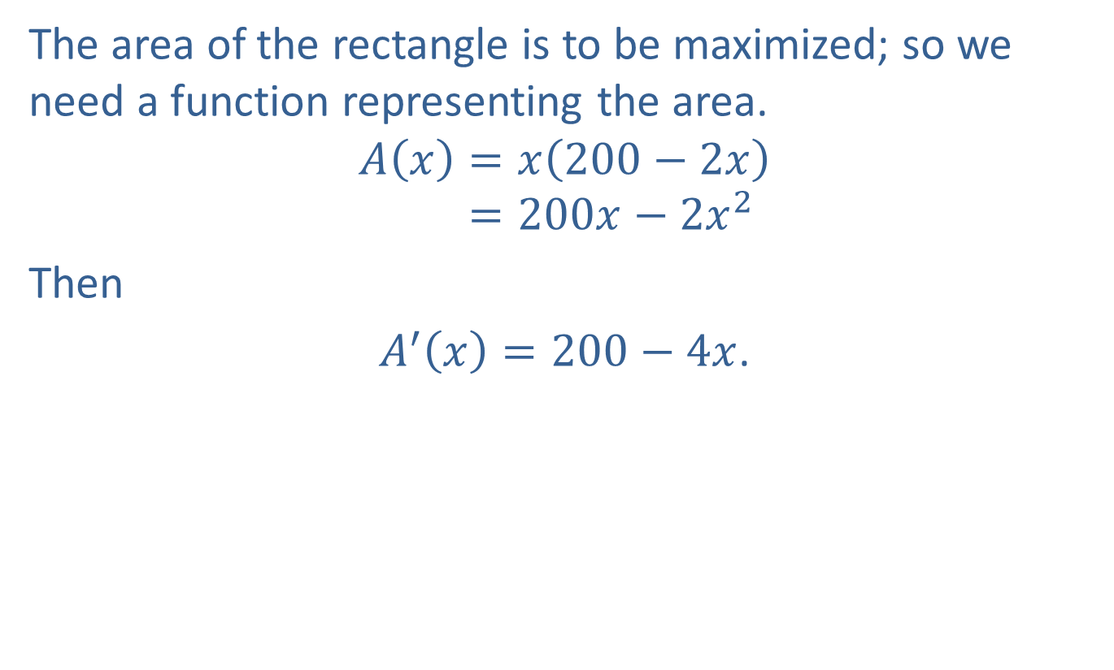
Example 3: Fencing (cont.)
The area of the rectangle is to be maximized; so we need a function representing the area.
𝐴𝑥=𝑥200−2𝑥𝐴⁡𝑥=200𝑥−2𝑥2
Then
$A^{′}\left(x\right)=200−4x$.

Slide 19
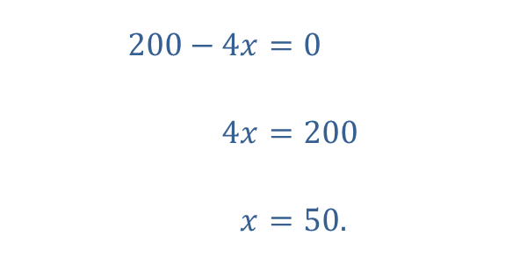
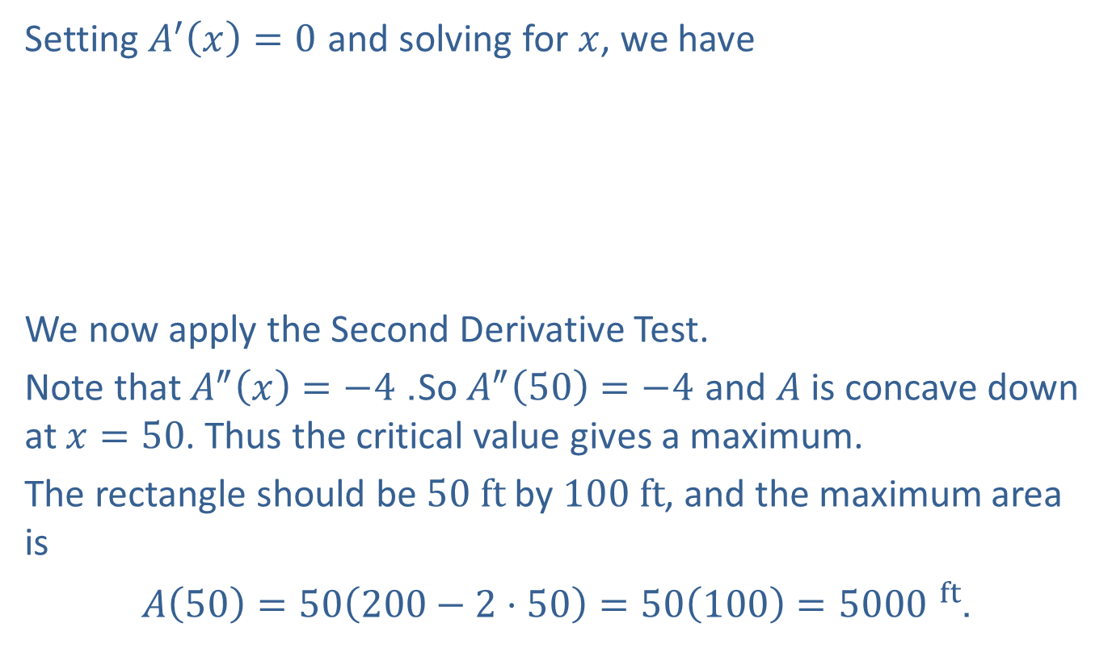
Setting $A^{′}\left(x\right)=0$ and solving for $x$, we have
​
We now apply the Second Derivative Test.
Note that $A^{″}\left(x\right)=−4$. So $A^{″}\left(50\right)=−4$ and $A$ is concave down at $x=50$. Thus the critical value gives a maximum.
The rectangle should be $50 ft$ by $100 ft$, and the maximum area is
$A\left(50\right)=50\left(200−2⋅50\right)=50\left(100\right)=5000 ^{ft}$.
​$200−4x$ | ​$=0$
​$4x$ | ​$=200$
​$x$ | ​$=50\text{.}$

Slide 20
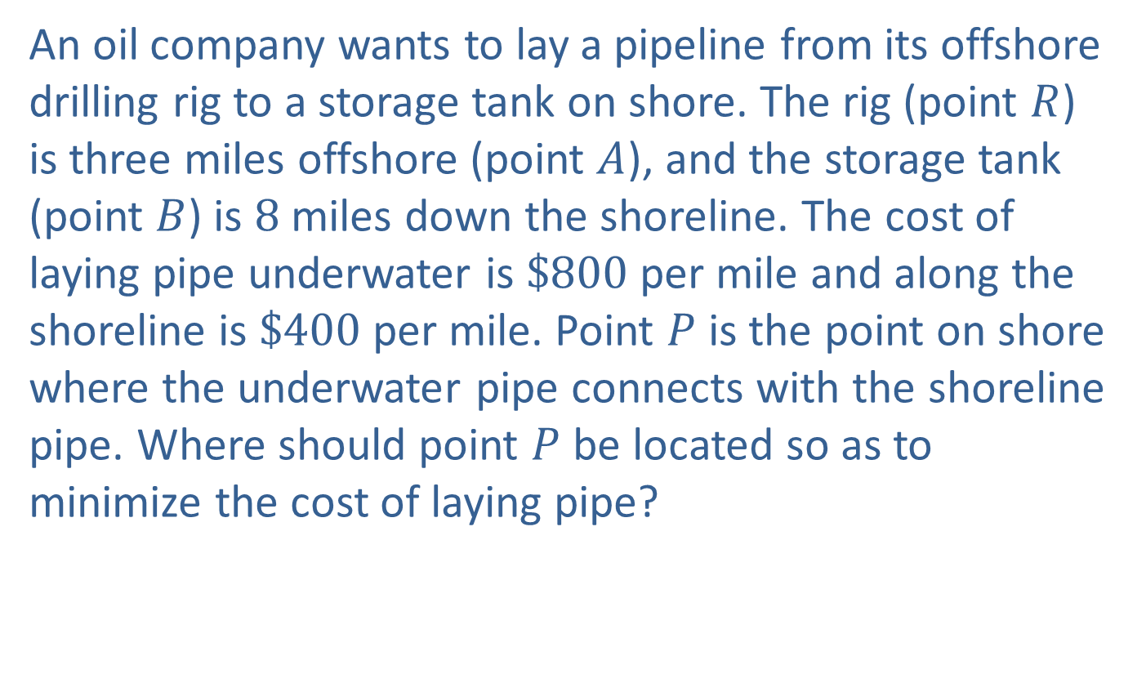
Example 4: Oil Pipeline
An oil company wants to lay a pipeline from its offshore drilling rig to a storage tank on shore. The rig (point $R$) is three miles offshore (point $A$), and the storage tank (point $B$) is 8 miles down the shoreline. The cost of laying pipe underwater is $\$800$ per mile and along the shoreline is $\$400$ per mile. Point $P$ is the point on shore where the underwater pipe connects with the shoreline pipe. Where should point $P$ be located so as to minimize the cost of laying pipe?

Slide 21
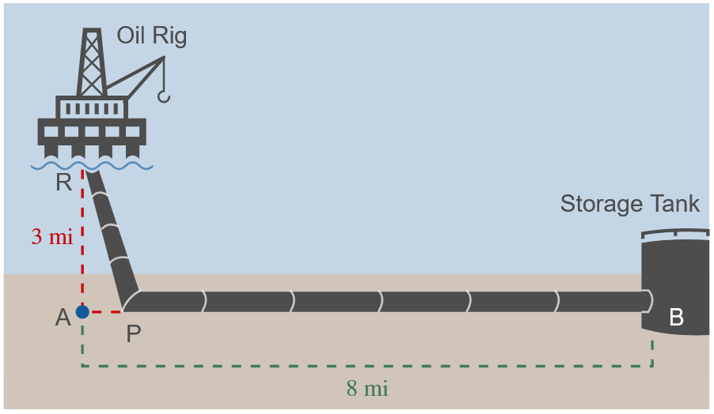
Example 4: Oil Pipeline (cont.)

Slide 22

Example 4: Oil Pipeline (cont.)
Solution
Let $x$ be the distance from $A$ to $P$.
Since $\overline{AB}=8$, $\overline{PB}=8−x$.
By the Pythagorean Theorem,
$\overline{RP}=\sqrt{x^{2}+9}$.

Slide 23
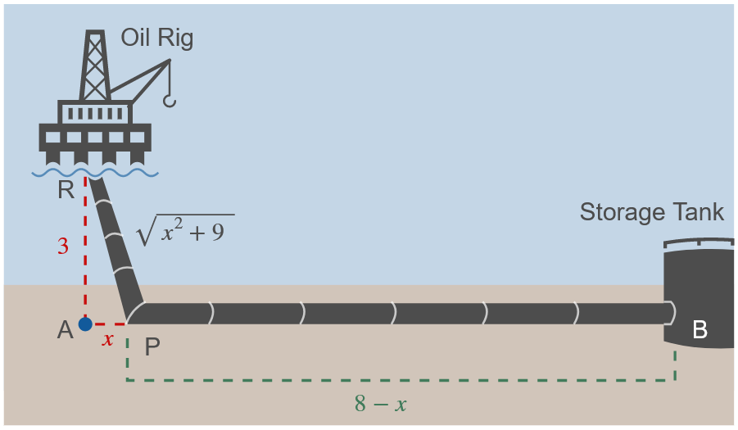
Example 4: Oil Pipeline (cont.)

Slide 24
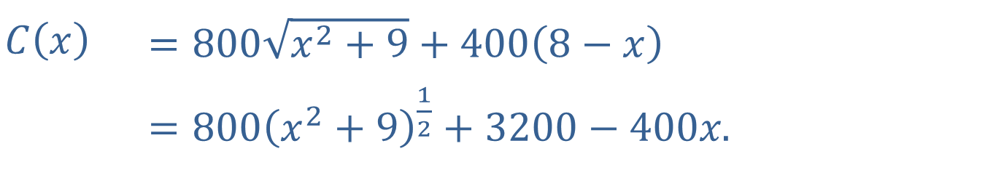

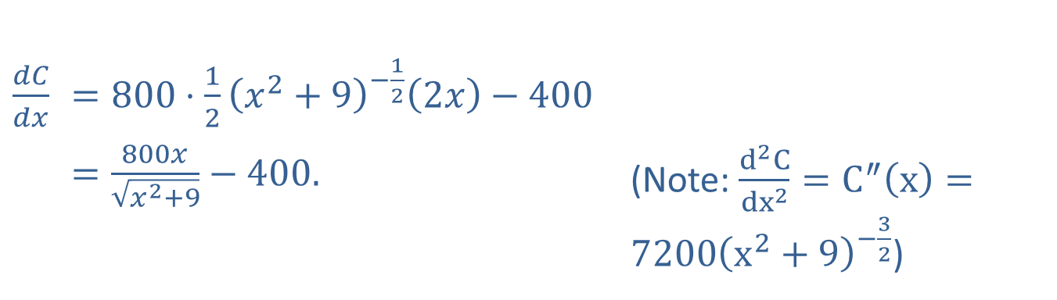
Example 4: Oil Pipeline (cont.)
The total cost of laying pipe is
​
Differentiating $C⁡\left(x\right)$ gives
​$C⁡\left(x\right)$ | ​$=800\sqrt{x^{2}+9}+400\left(8−x\right)$
​𝐶⁡𝑥 | ​$=800{\left(x^{2}+9\right)}^{\frac{1}{2}}+3200−400x\text{.}$
​$\frac{dC}{dx}$ | ​$=800⋅\frac{1}{2}{\left(x^{2}+9\right)}^{−\frac{1}{2}}\left(2x\right)−400$
​ | ​$=\frac{800x}{\sqrt{x^{2}+9}}−400\text{.}$ | (Note: $\frac{d^{2}C}{{dx}^{2}}=C^{″}\left(x\right)=7200{\left(x^{2}+9\right)}^{−\frac{3}{2}}$)

Slide 25
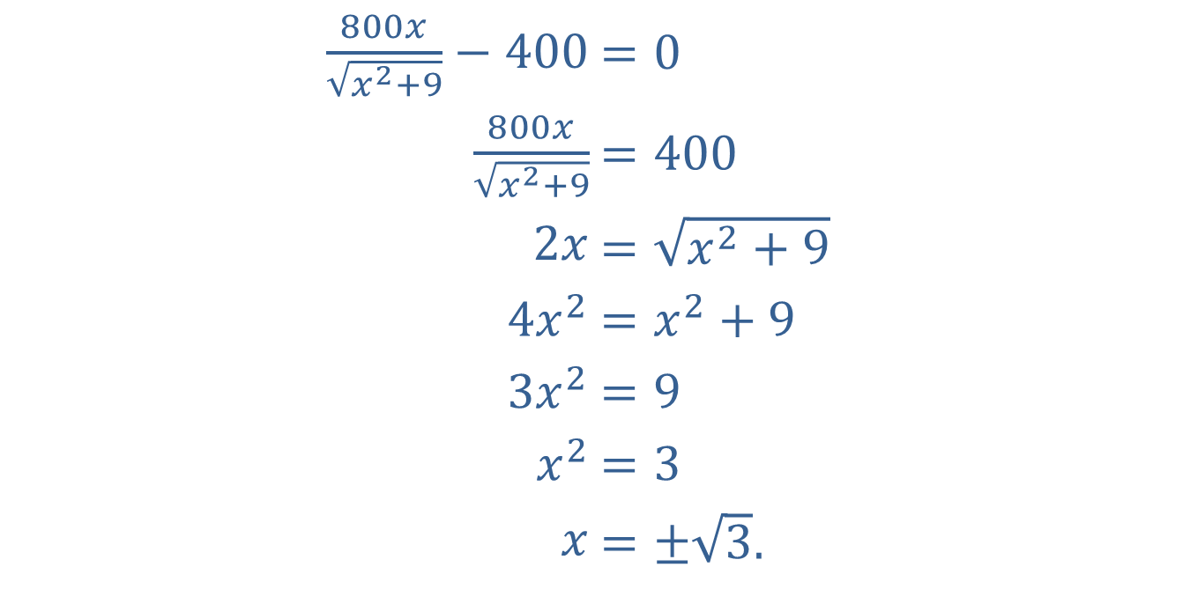
Example 4: Oil Pipeline (cont.)
Setting $\frac{dC}{dx}=0$ and solving for $x$, we have
​$\frac{800x}{\sqrt{x^{2}+9}}−400$ | ​$=0$
​$\frac{800x}{\sqrt{x^{2}+9}}$ | ​$=400$
​$2x$ | ​$=\sqrt{x^{2}+9}$
​$4x^{2}$ | ​$=x^{2}+9$
​$3x^{2}$ | ​$=9$
​$x^{2}$ | ​$=3$
​$x$ | ​$=±\sqrt{3}\text{.}$

Slide 26
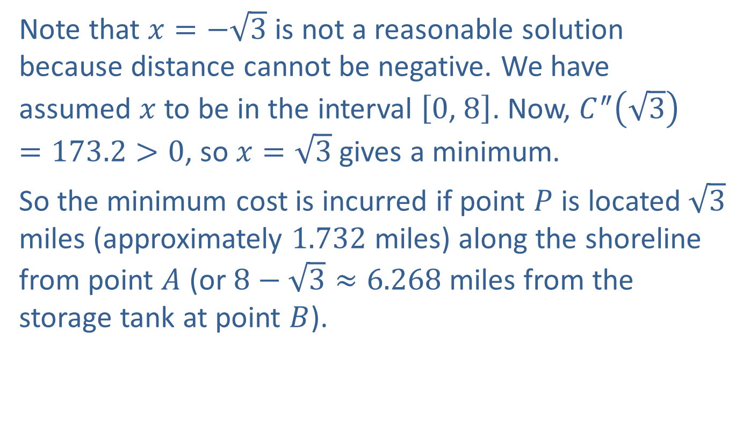
Example 4: Oil Pipeline (cont.)
Note that $x=−\sqrt{3}$ is not a reasonable solution because distance cannot be negative. We have assumed $x$ to be in the interval $\left[0\text{, }8\right]$. Now, $C^{″}\left(\sqrt{3}\right)=173.2>0$, so $x=\sqrt{3}$ gives a minimum.
So the minimum cost is incurred if point $P$ is located $\sqrt{3}$ miles (approximately 1.732 miles) along the shoreline from point $A$ (or $8−\sqrt{3}≈6.268$ miles from the storage tank at point $B$).

Slide 27
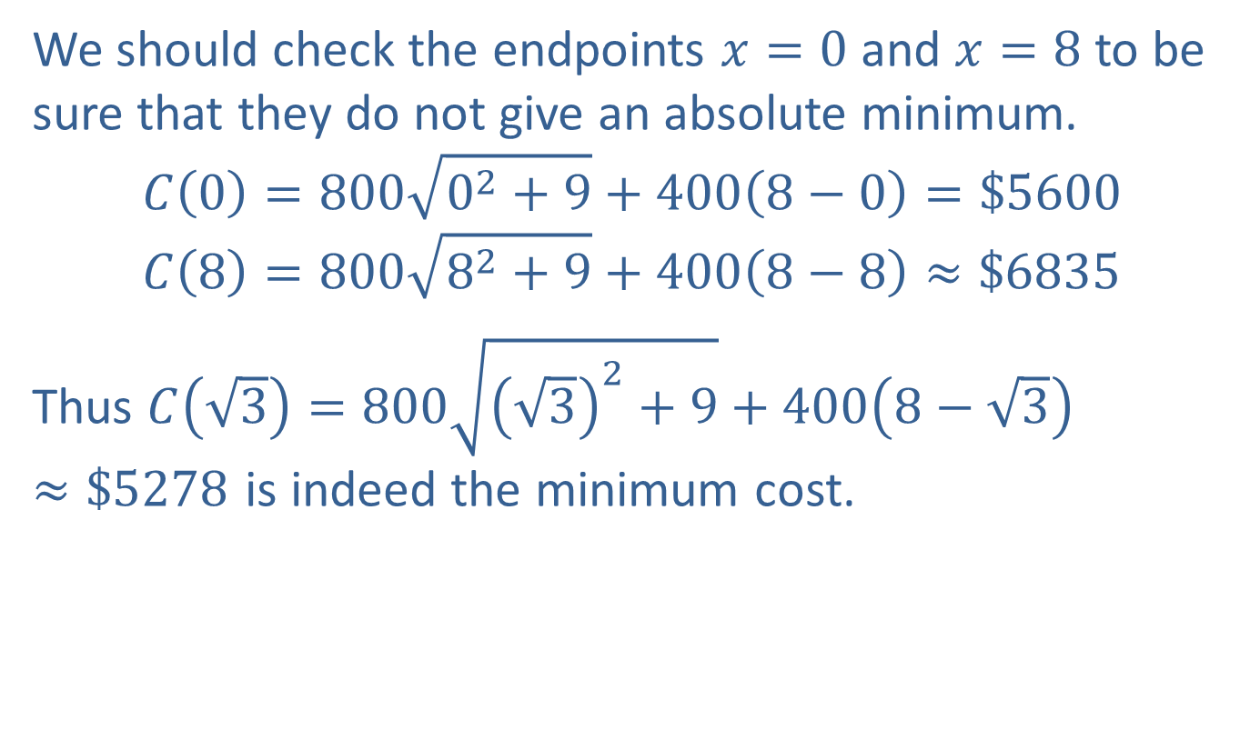
Example 4: Oil Pipeline (cont.)
We should check the endpoints $x=0$ and $x=8$ to be sure that they do not give an absolute minimum.
$$C\left(0\right)=800\sqrt{0^{2}+9}+400\left(8−0\right)=\$5600 \\ C\left(8\right)=800\sqrt{8^{2}+9}+400\left(8−8\right)≈\$6835$$
Thus $C\left(\sqrt{3}\right)=800\sqrt{{\left(\sqrt{3}\right)}^{2}+9}+400\left(8−\sqrt{3}\right)≈\$5278$ is indeed the minimum cost.

Slide 28
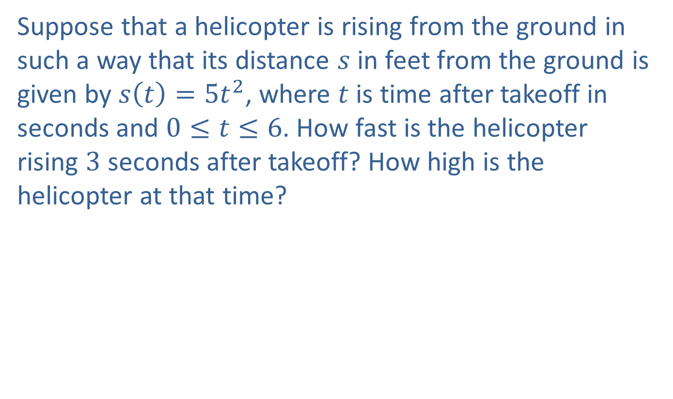
Example 5: Helicopter Takeoff
Suppose that a helicopter is rising from the ground in such a way that its distance $s$ in feet from the ground is given by $s\left(t\right)=5t^{2}$, where $t$ is time after takeoff in seconds and $0≤t≤6$. How fast is the helicopter rising 3 seconds after takeoff? How high is the helicopter at that time?

Slide 29
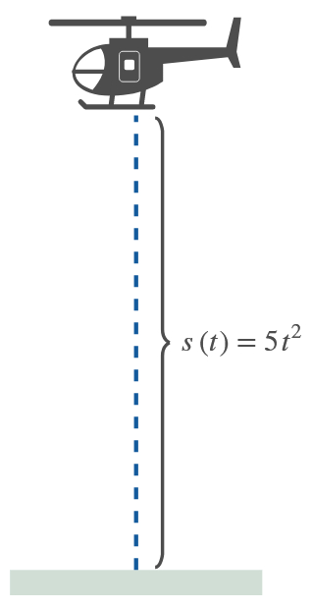
Example 5: Helicopter Takeoff (cont.)

Slide 30
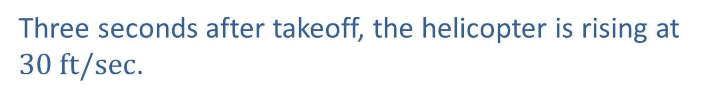
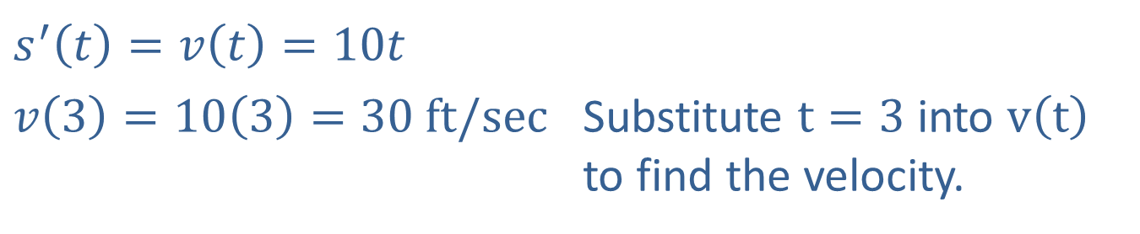
Example 5: Helicopter Takeoff (cont.)
Solution
Differentiating the distance function with respect to time gives the velocity function.
​$s^{′}\left(t\right)=v\left(t\right)=10t$
​$v\left(3\right)=10\left(3\right)=30 ft/sec$ | Substitute $t=3$ into $v⁡\left(t\right)$ to find the velocity.
Three seconds after takeoff, the helicopter is rising at $30 ft/sec$.

Slide 31

Example 5: Helicopter Takeoff (cont.)
To find the height of the helicopter after $3 \text{seconds}$, substitute $t=3$ into $s⁡\left(t\right)$.
$$s\left(3\right)=5{\left(3\right)}^{2}=45 ft$$
In 3 seconds the helicopter has risen to an altitude of $45 feet$.

Slide 32
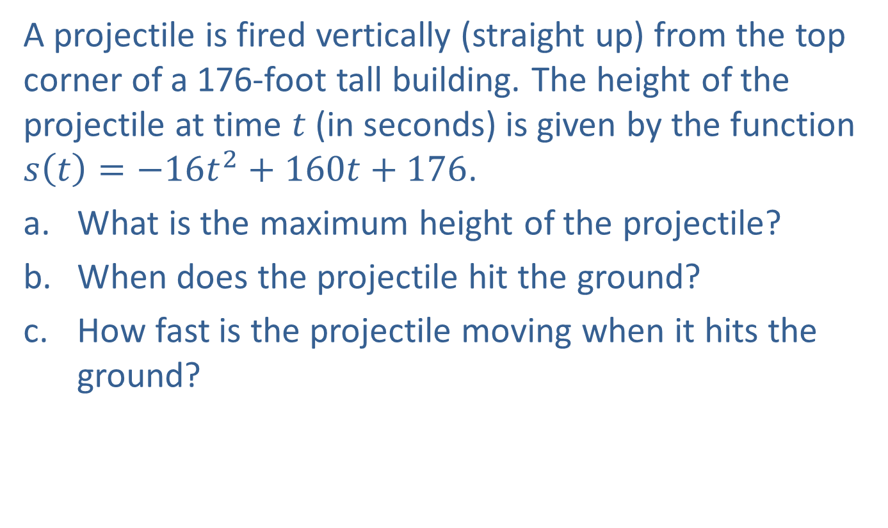
Example 6: Vertical Projectile
A projectile is fired vertically (straight up) from the top corner of a 176-foot tall building. The height of the projectile at time $t$ (in seconds) is given by the function $s\left(t\right)=−16t^{2}+160t+176$.
​What is the maximum height of the projectile?
​When does the projectile hit the ground?
​How fast is the projectile moving when it hits the ground?

Slide 33
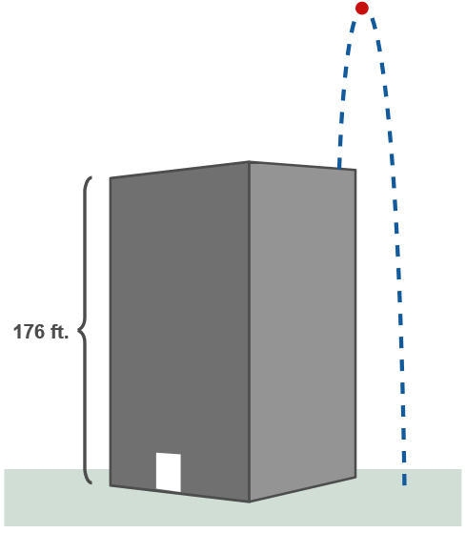
Example 6: Vertical Projectile (cont.)

Slide 34
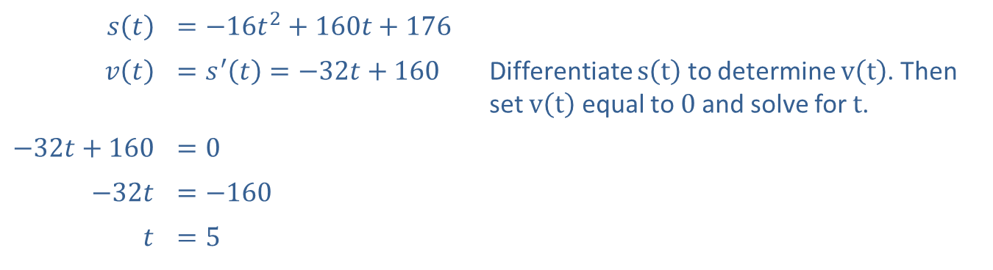
Example 6: Vertical Projectile (cont.)
Solution
​The maximum height of the projectile occurs at the point where its velocity is 0.
​
​$s⁡\left(t\right)$ | ​$=−16t^{2}+160t+176$
​$v⁡\left(t\right)$ | ​$=s^{′}\left(t\right)=−32t+160$ | Differentiate $s⁡\left(t\right)$ to determine $v⁡\left(t\right)$. Then set $v⁡\left(t\right)$ equal to 0 and solve for $t$.
​$−32t+160$ | ​$=0$
​$−32t$ | ​$=−160$
$$t$$ | ​$=5$

Slide 35
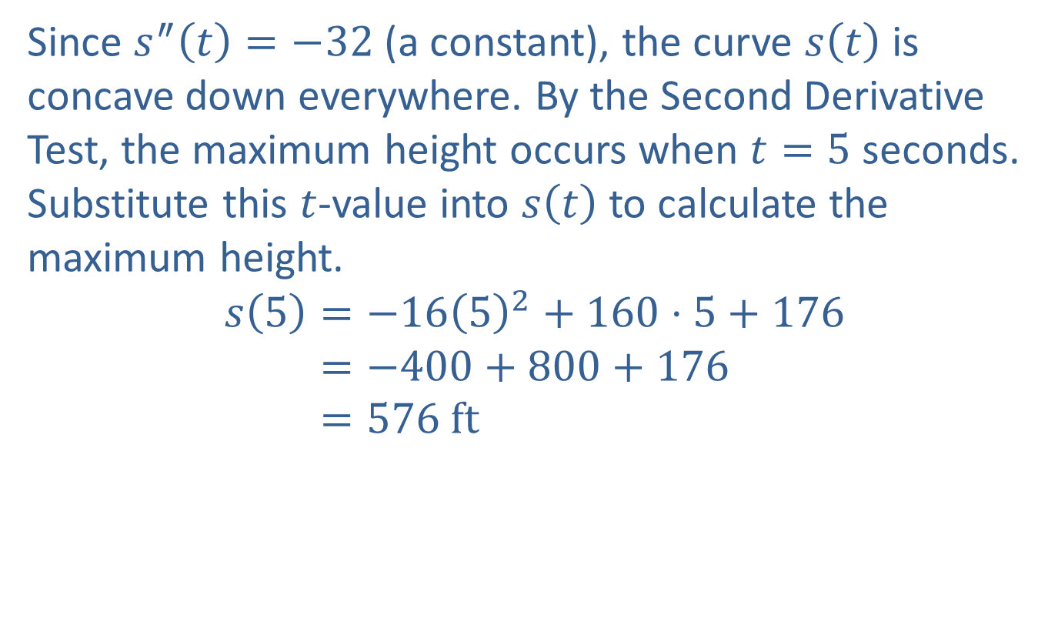
Example 6: Vertical Projectile (cont.)
​Since $s^{″}\left(t\right)=−32$ (a constant), the curve $s⁡\left(t\right)$ is concave down everywhere. By the Second Derivative Test, the maximum height occurs when $t=5$ seconds. Substitute this $t$-value into $s⁡\left(t\right)$ to calculate the maximum height.
𝑠⁡5=−1652+160⋅5+176𝑠⁡5=−400+800+176𝑠⁡5=576 ft

Slide 36
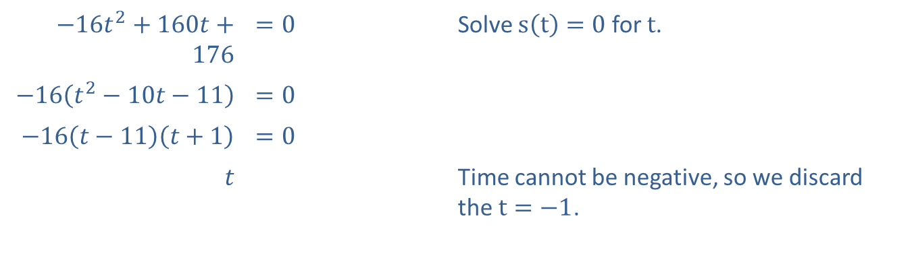

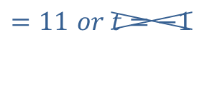
Example 6: Vertical Projectile (cont.)
​The projectile hits the ground when $s\left(t\right)=0$.
​
​$−16t^{2}+160t+176$ | ​$=0$ | Solve $s\left(t\right)=0$ for $t$.
​$−16\left(t^{2}−10t−11\right)$ | ​$=0$
​$−16\left(t−11\right)\left(t+1\right)$ | ​$=0$
$$t$$ | ​ | Time cannot be negative, so we discard the $t=−1$.
$$=11 or t=−1$$
​Thus the projectile hits the ground 11 seconds after it is fired.

Slide 37
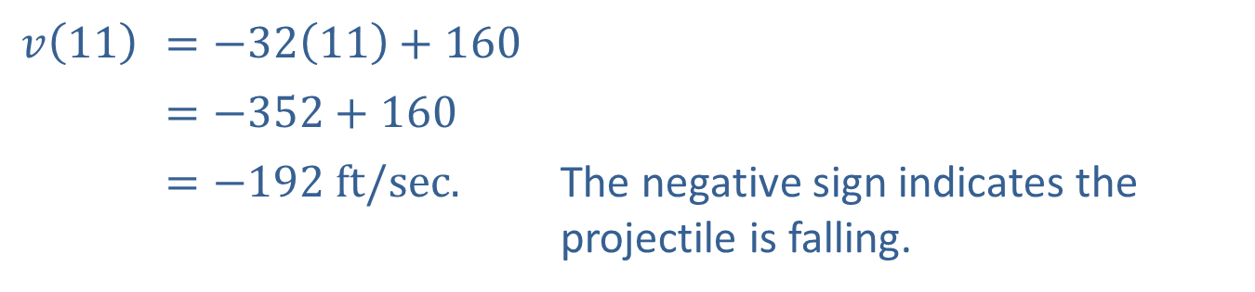

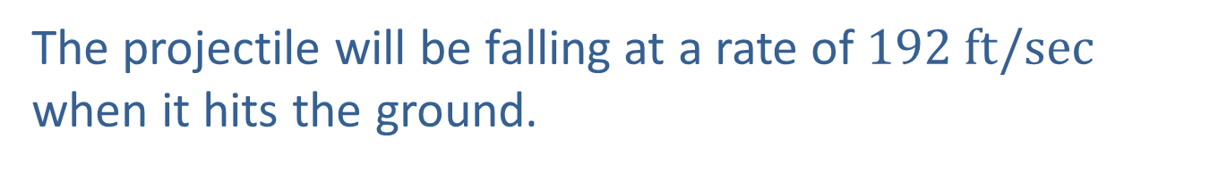
Example 6: Vertical Projectile (cont.)
​The projectile’s velocity when it hits the ground is $v⁡\left(11\right)$. From part a. we know
​$v⁡\left(t\right)=−32t+160$.
​So
​
​$v⁡\left(11\right)$ | ​$=−32\left(11\right)+160$
​ | ​$=−352+160$
​ | ​$=−192 ft/sec\text{.}$ | The negative sign indicates the projectile is falling.
The projectile will be falling at a rate of $192 ft/sec$ when it hits the ground.

