Slide 1
Section 4.7
Differentials

Slide 2
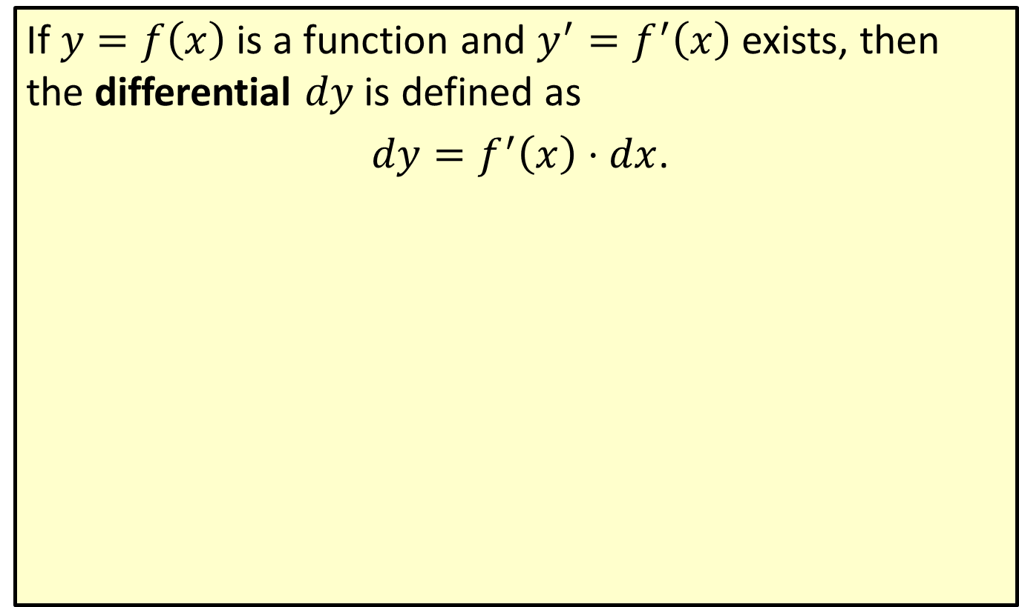
Differential
If $y=f\left(x\right)$ is a function and $y^{′}=f^{′}\left(x\right)$ exists, then the differential $dy$ is defined as
$dy=f^{′}\left(x\right)⋅dx$.

Slide 3
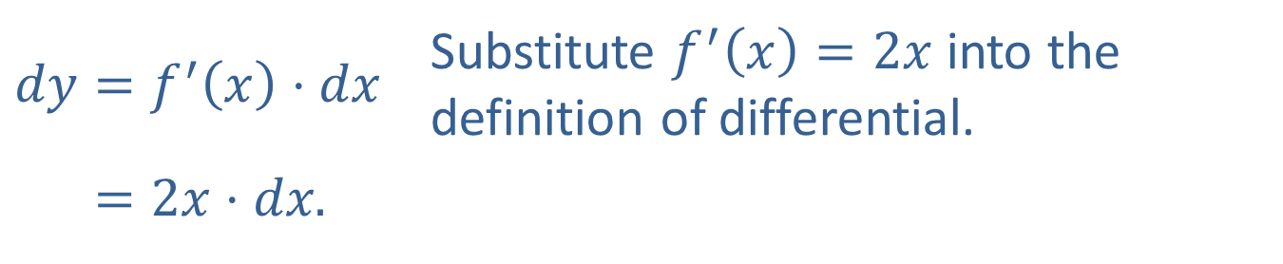

Example 1: Finding Differentials
​Find $dy$ for $y=x^{2}$.
​Solution
​$f\left(x\right)=x^{2}$ and $f^{′}\left(x\right)=2x$ Find the derivative of $y$.
​So
​
​$dy=f^{′}\left(x\right)⋅dx$ | Substitute $f^{′}\left(x\right)=2x$ into the definition of differential.
​𝑑𝑦=2𝑥⋅𝑑𝑥.

Slide 4
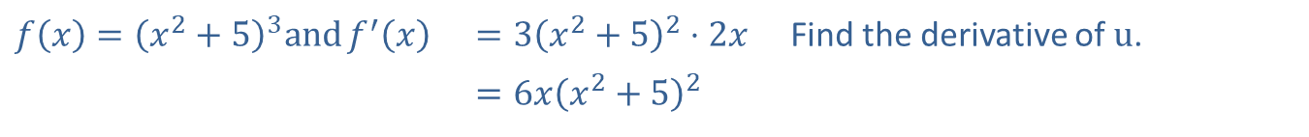

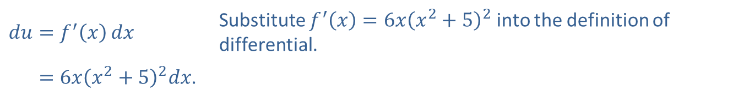
Example 1: Finding Differentials (cont.)
​Find $du$ for $u={\left(x^{2}+5\right)}^{3}$.
​Solution
​The differential $du$ is found in the same way as $dy$.
So
​$f\left(x\right)={\left(x^{2}+5\right)}^{3}\text{and}f^{′}\left(x\right)$ | ​$=3{\left(x^{2}+5\right)}^{2}⋅2x$ | Find the derivative of $u$.
 | ​$=6x{\left(x^{2}+5\right)}^{2}$
​$du=f^{′}\left(x\right)dx$ | Substitute $f^{′}\left(x\right)=6x{\left(x^{2}+5\right)}^{2}$ into the definition of differential.
​𝑑𝑢=6𝑥𝑥2+52𝑑𝑥.

Slide 5
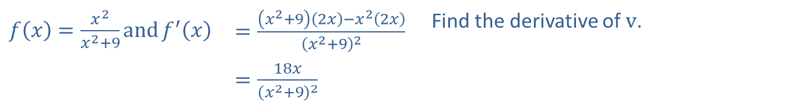

Example 1: Finding Differentials (cont.)
​Find $dv$ if $v=\frac{x^{2}}{x^{2}+9}$.
​Solution
​
​$f\left(x\right)=\frac{x^{2}}{x^{2}+9}\text{and}f^{′}\left(x\right)$ | ​$=\frac{\left(x^{2}+9\right)\left(2x\right)−x^{2}\left(2x\right)}{{\left(x^{2}+9\right)}^{2}}$ | Find the derivative of $v$.
 | ​$=\frac{18x}{{\left(x^{2}+9\right)}^{2}}$
So
$dv=\frac{18x}{{\left(x^{2}+9\right)}^{2}}dx$. | Substitute $f^{′}\left(x\right)=\frac{18x}{{\left(x^{2}+9\right)}^{2}}$ into the definition of differential.

Slide 6

Example 2: Using Differentials
For $y=x^{2}$, $x=9$, $Δx=0.1$, find
​ $Δy$,
​$dy$, and
​ $Δy−dy$.

Slide 7
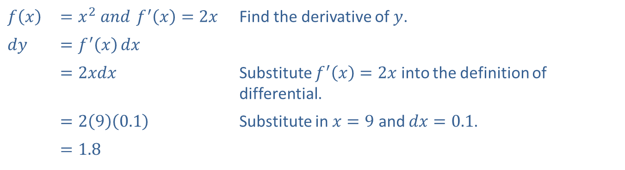
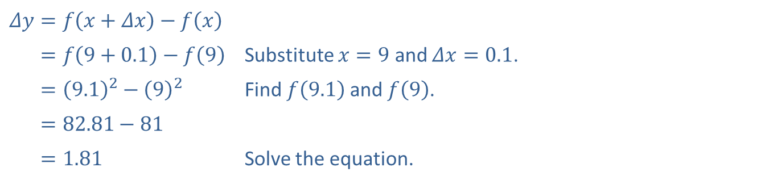
Example 2: Using Differentials (cont.)
Solution
​
​$Δy=f\left(x+Δx\right)−f\left(x\right)$
​𝛥𝑦=𝑓9+0.1−𝑓9 | Substitute $x=9$ and $Δx=0.1$.
​𝛥𝑦=9.12−92 | Find $f⁡\left(9.1\right)$ and $f⁡\left(9\right)$.
​𝛥𝑦=82.81−81
​𝛥𝑦=1.81 | Solve the equation.
​$f⁡\left(x\right)$ | ​$=x^{2} and f^{′}\left(x\right)=2x$ | Find the derivative of $y$.
​$dy$ | ​$=f^{′}\left(x\right)dx$
 | ​$=2xdx$ | Substitute $f^{′}\left(x\right)=2x$ into the definition of differential.
 | ​$=2\left(9\right)\left(0.1\right)$ | Substitute in $x=9$ and $dx=0.1$.
 | ​$=1.8$

Slide 8

Example 2: Using Differentials (cont.)
​$Δy−dy=1.81−1.8=0.01$ Substitute the values found in parts a. and b. into the equation and solve.

Slide 9
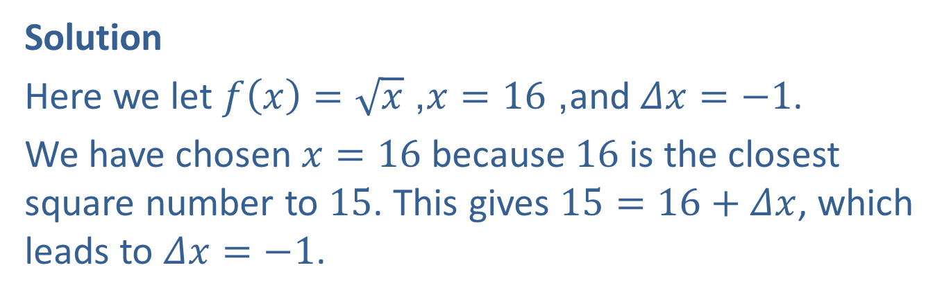

Example 3: Estimating Square Roots
Using differentials, estimate $\sqrt{15}$.
Solution
Here we let $f\left(x\right)=\sqrt{x}$, $x=16$, and $Δx=−1$.
We have chosen $x=16$ because 16 is the closest square number to 15. This gives $15=16+Δx$, which leads to $Δx=−1$.

Slide 10
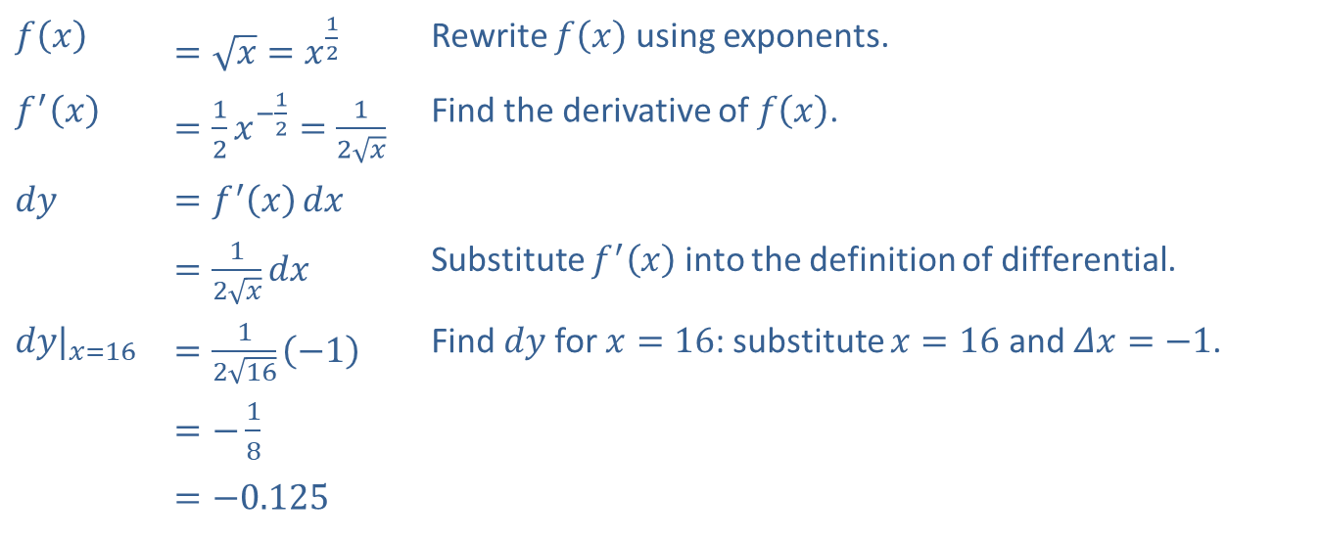
Example 3: Estimating Square Roots (cont.)
​$f⁡\left(x\right)$ | ​$=\sqrt{x}=x^{\frac{1}{2}}$ | Rewrite $f⁡\left(x\right)$ using exponents.
​$f^{′}⁡\left(x\right)$ | ​$=\frac{1}{2}x^{−\frac{1}{2}}=\frac{1}{2\sqrt{x}}$ | Find the derivative of $f⁡\left(x\right)$.
​$dy$ | ​$=f^{′}\left(x\right)dx$
 | ​$=\frac{1}{2\sqrt{x}}dx$ | Substitute $f^{′}⁡\left(x\right)$ into the definition of differential.
​${dy|}_{x=16}$ | ​$=\frac{1}{2\sqrt{16}}\left(−1\right)$ | Find $dy$ for $x=16$: substitute $x=16$ and $Δx=−1$.
 | ​$=−\frac{1}{8}$
 | ​$=−0.125$

Slide 11
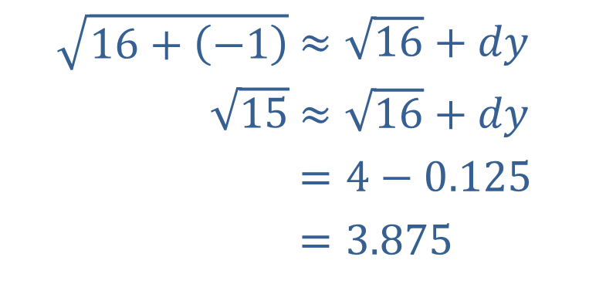

Example 3: Estimating Square Roots (cont.)
Now using $dy≈Δy=f\left(x+Δx\right)−f\left(x\right)$, we obtain that $f\left(x+Δx\right)≈f\left(x\right)+dy$ or $\sqrt{x+Δx}≈\sqrt{x}+dy$.
​
Your calculator will give $\sqrt{15}≈3.872983346$.
​$\sqrt{16+\left(−1\right)}$ | ​$≈\sqrt{16}+dy$
​$\sqrt{15}$ | ​$≈\sqrt{16}+dy$
​ | ​$=4−0.125$
​ | ​$=3.875$

Slide 12

Example 4: Change in Volume
The volume of a cube with edge $x$ is given by $V=x^{3}$. Using differentials, approximate the change in $V$ if $x$ is
​changed from $5 cm$ to $5.01 cm$;
​changed from $5 cm$ to $4.99 cm$.

Slide 13
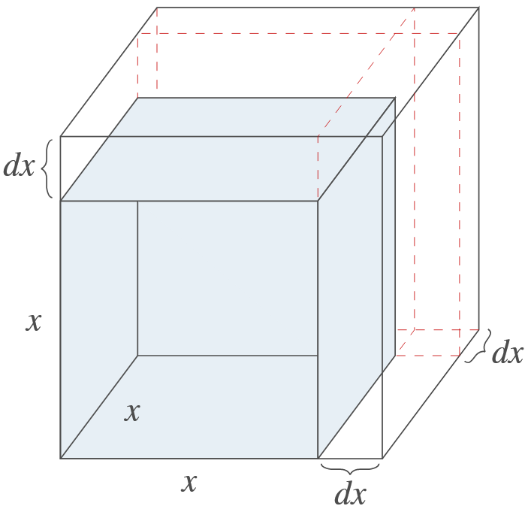
Example 4: Change in Volume (cont.)

Slide 14
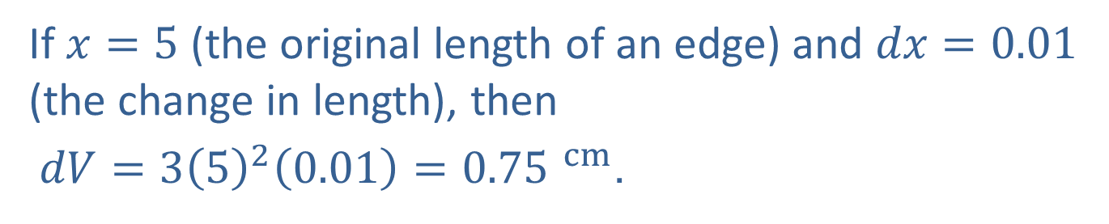
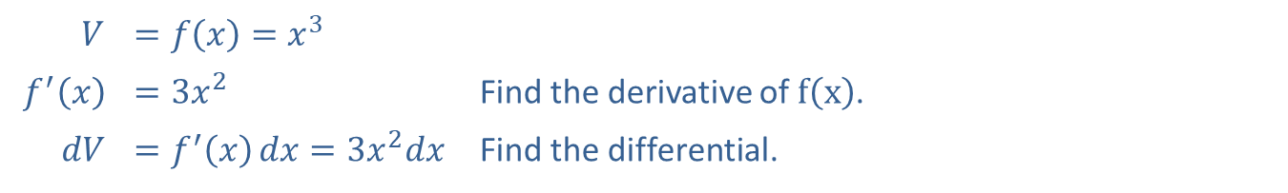
Example 4: Change in Volume (cont.)
Solution
​
$$V$$ | ​$=f\left(x\right)=x^{3}$
​$f^{′}⁡\left(x\right)$ | ​$=3x^{2}$ | Find the derivative of $f⁡\left(x\right)$.
​$dV$ | ​$=f^{′}\left(x\right)dx=3x^{2}dx$ | Find the differential.
If $x=5$ (the original length of an edge) and $dx=0.01$ (the change in length), then
​ $dV=3{\left(5\right)}^{2}\left(0.01\right)=0.75 ^{cm}$.

Slide 15
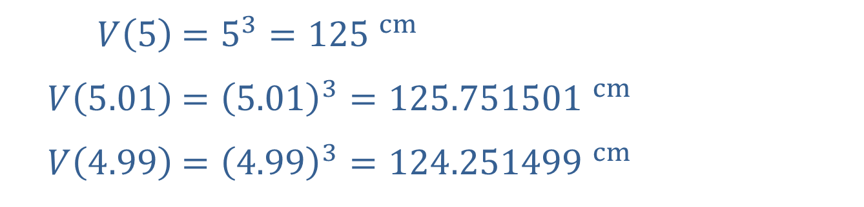
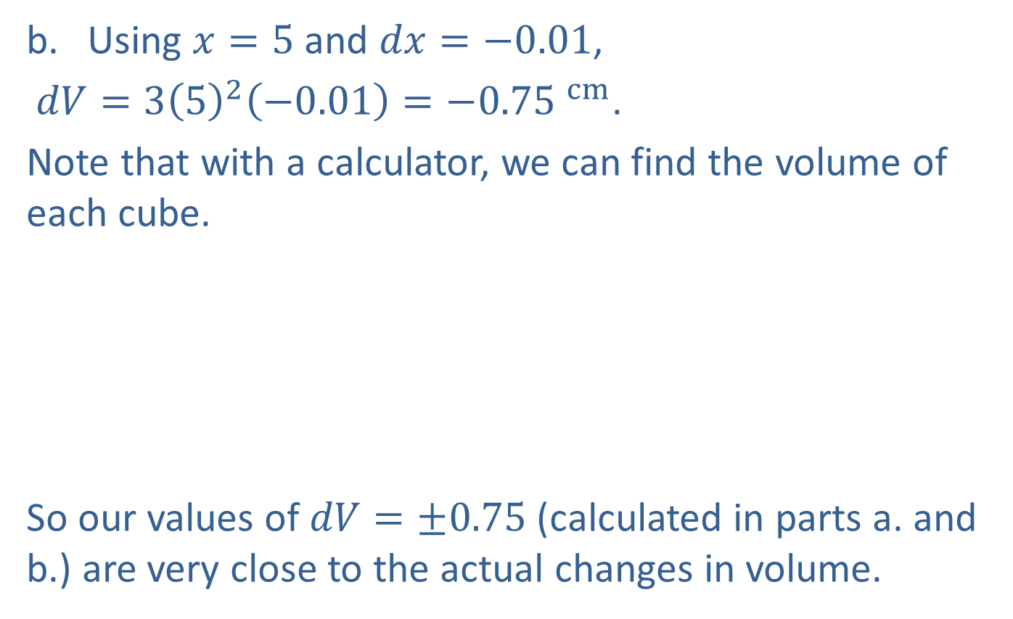
Example 4: Change in Volume (cont.)
​​Using $x=5$ and $dx=−0.01$,
​ $dV=3{\left(5\right)}^{2}\left(−0.01\right)=−0.75 ^{cm}$.
​Note that with a calculator, we can find the volume of each cube.
​
​
So our values of $dV=±0.75$ (calculated in parts a. and b.) are very close to the actual changes in volume.
​$V⁡\left(5\right)$ | ​$=5^{3}=125 ^{cm}$
​$V⁡\left(5.01\right)$ | ​$={\left(5.01\right)}^{3}=125.751501 ^{cm}$
​$V⁡\left(4.99\right)$ | ​$={\left(4.99\right)}^{3}=124.251499 ^{cm}$

Slide 16
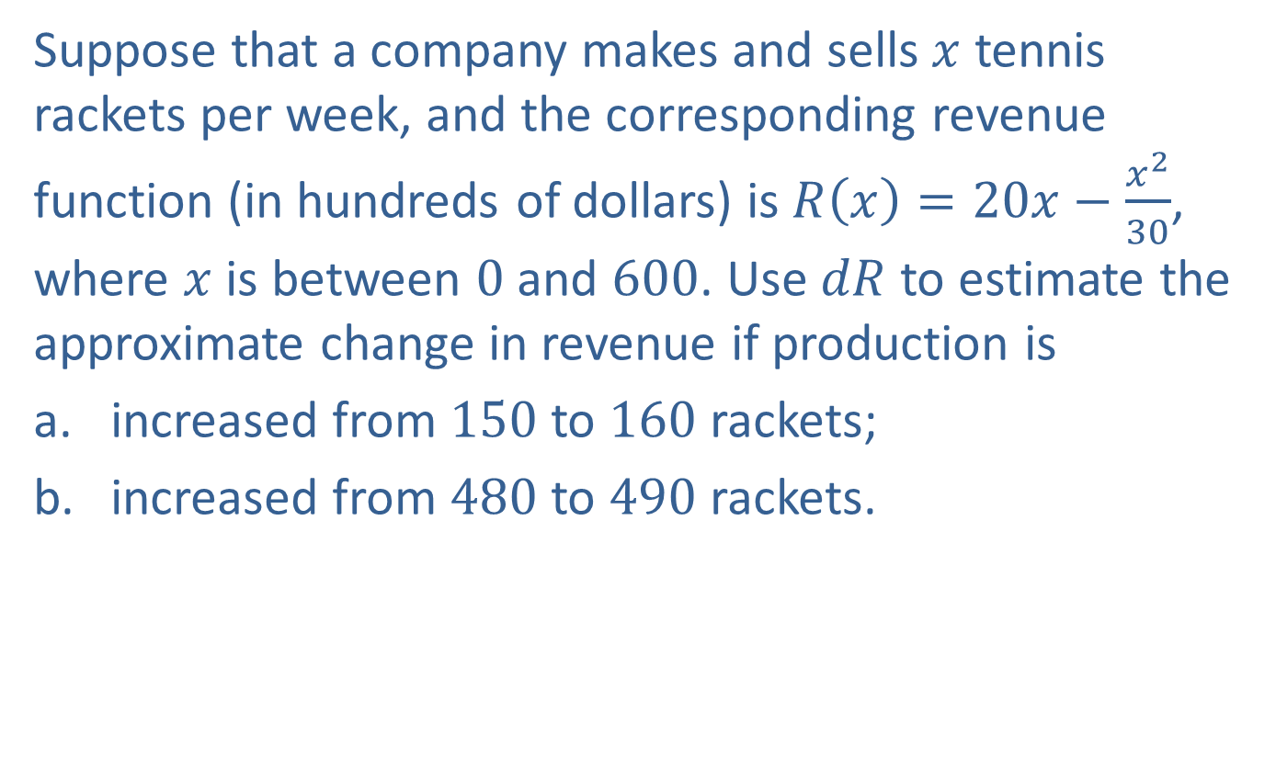
Example 5: Change in Revenue
Suppose that a company makes and sells $x$ tennis rackets per week, and the corresponding revenue function (in hundreds of dollars) is $R\left(x\right)=20x−\frac{x^{2}}{30}$, where $x$ is between 0 and 600. Use $dR$ to estimate the approximate change in revenue if production is
​increased from 150 to 160 rackets;
​increased from 480 to 490 rackets.

Slide 17
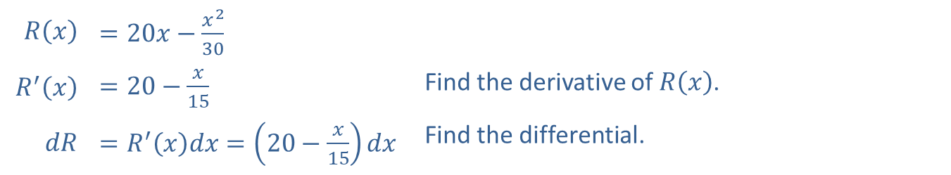
Example 5: Change in Revenue (cont.)
Solution
​
​$R⁡\left(x\right)$ | ​$=20x−\frac{x^{2}}{30}$
​$R^{′}⁡\left(x\right)$ | ​$=20−\frac{x}{15}$ | Find the derivative of $R⁡\left(x\right)$.
​$dR$ | ​$=R^{′}⁡\left(x\right)dx=\left(20−\frac{x}{15}\right)dx$ | Find the differential.

Slide 18
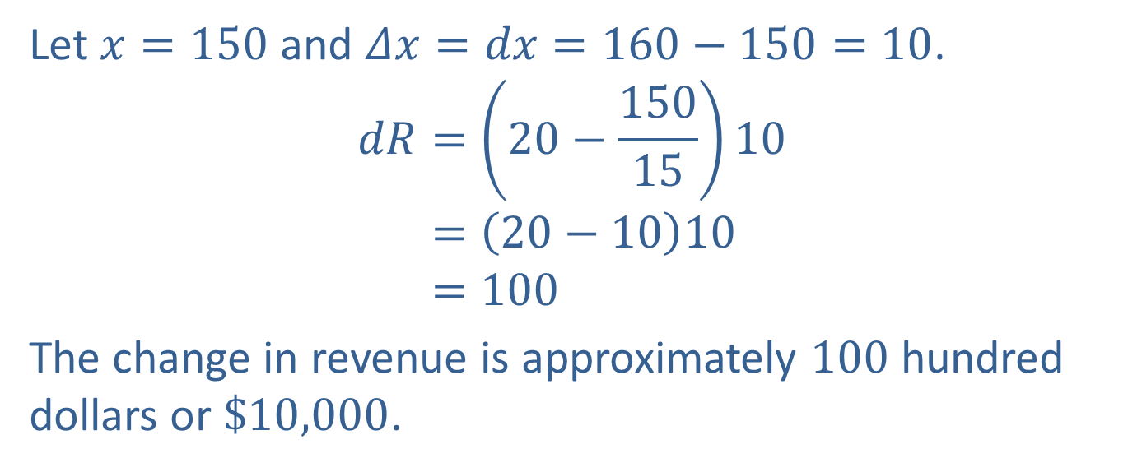
Example 5: Change in Revenue (cont.)
Let $x=150$ and $Δx=dx=160−150=10$.
𝑑𝑅=20−1501510𝑑𝑅=20−1010𝑑𝑅=100
​The change in revenue is approximately 100 hundred dollars or $\$10,000$.

Slide 19
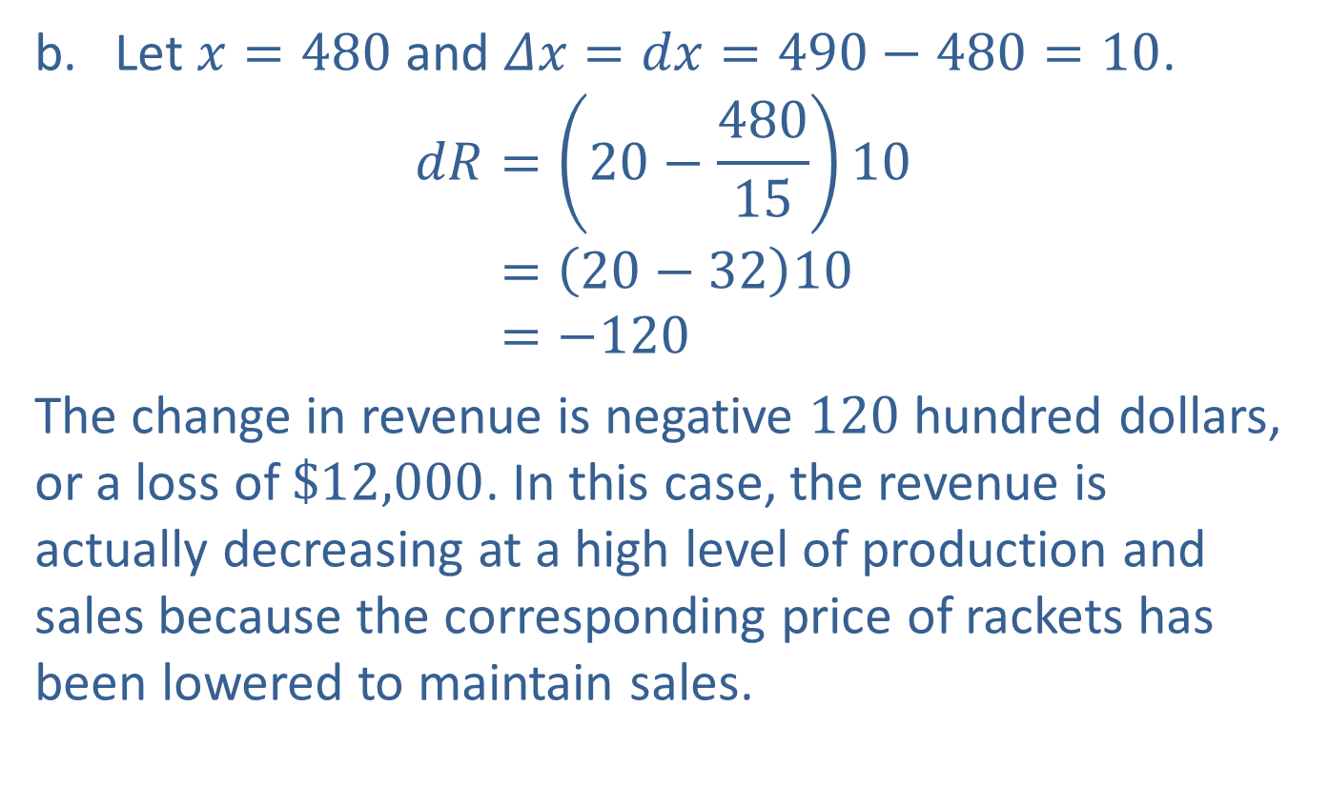
Example 5: Change in Revenue (cont.)
​Let $x=480$ and $Δx=dx=490−480=10$.
𝑑𝑅=20−4801510𝑑𝑅=20−3210𝑑𝑅=−120
​The change in revenue is negative 120 hundred dollars, or a loss of $\$12,000$. In this case, the revenue is actually decreasing at a high level of production and sales because the corresponding price of rackets has been lowered to maintain sales.

