Slide 1
Section 5.1
Exponential Functions

Slide 2
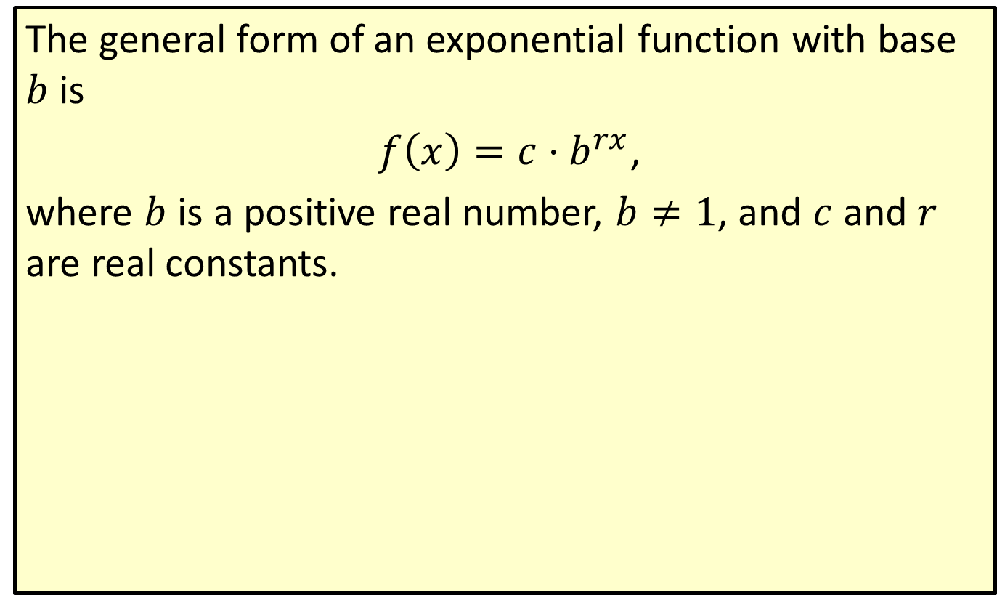

Exponential Function with Base $b$
The general form of an exponential function with base $b$ is
$f\left(x\right)=c⋅b^{rx}$,
where $b$ is a positive real number, $b≠1$, and $c$ and $r$ are real constants.

Slide 3
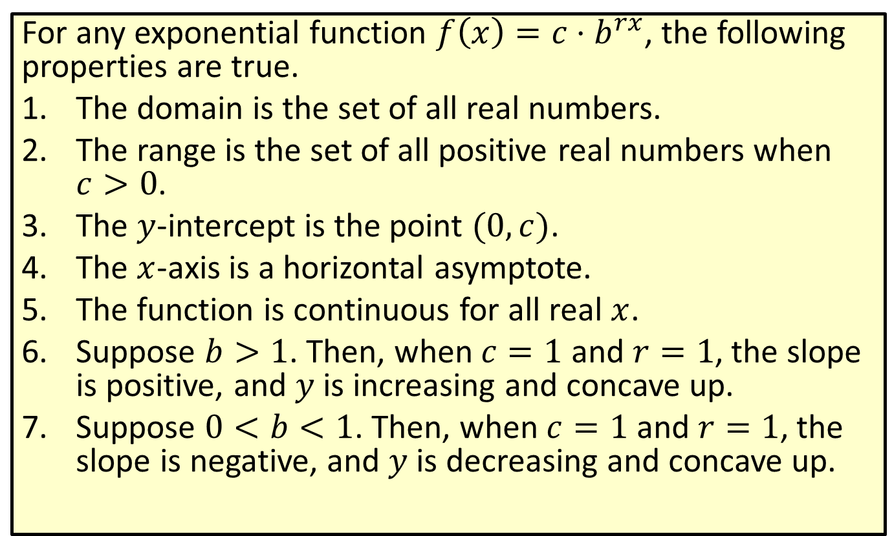
Properties of Exponential Functions
For any exponential function $f\left(x\right)=c⋅b^{rx}$, the following properties are true.
​The domain is the set of all real numbers.
​The range is the set of all positive real numbers when $c>0$.
​The $y$-intercept is the point $(0,c)$.
​The $x$-axis is a horizontal asymptote.
​The function is continuous for all real $x$.
​Suppose $b>1$. Then, when $c=1$ and $r=1$, the slope is positive, and $y$ is increasing and concave up.
​Suppose $0<b<1$. Then, when $c=1$ and $r=1$, the slope is negative, and $y$ is decreasing and concave up.

Slide 4

Example 1: Graphing an Exponential Function
Suppose $f\left(x\right)=2^{3x}$ and $g\left(x\right)=\frac{1}{3}\left(2^{3x}\right)$.
​Find $f⁡\left(−1\right)$, $f⁡\left(0\right)$, and $f⁡\left(1\right)$.
​Find $g⁡\left(−1\right)$, $g⁡\left(0\right)$, and $g⁡\left(1\right)$.
​Sketch the graphs of both functions.

Slide 5
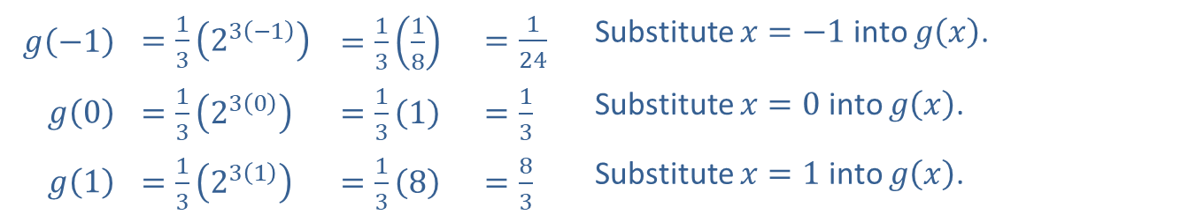
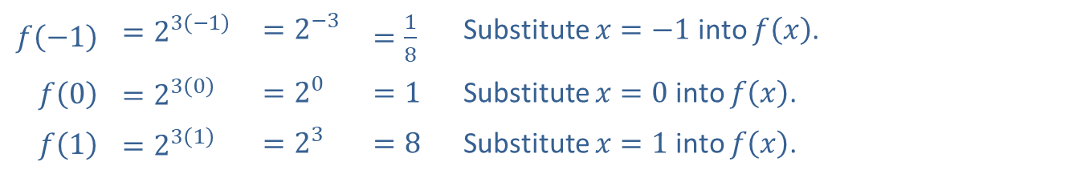
Example 1: Graphing an Exponential Function (cont.)
Solution
​
​$f⁡\left(−1\right)$ | ​$=2^{3\left(−1\right)}$ | ​$=2^{−3}$ | ​$=\frac{1}{8}$ | Substitute $x=−1$ into $f⁡\left(x\right)$.
​$f⁡\left(0\right)$ | ​$=2^{3\left(0\right)}$ | ​$=2^{0}$ | ​$=1$ | Substitute $x=0$ into $f⁡\left(x\right)$.
​$f⁡\left(1\right)$ | ​$=2^{3\left(1\right)}$ | ​$=2^{3}$ | ​$=8$ | Substitute $x=1$ into $f⁡\left(x\right)$.
​$g⁡\left(−1\right)$ | ​$=\frac{1}{3}\left(2^{3\left(−1\right)}\right)$ | ​$=\frac{1}{3}\left(\frac{1}{8}\right)$ | ​$=\frac{1}{24}$ | Substitute $x=−1$ into $g⁡\left(x\right)$.
​$g⁡\left(0\right)$ | ​$=\frac{1}{3}\left(2^{3\left(0\right)}\right)$ | ​$=\frac{1}{3}\left(1\right)$ | ​$=\frac{1}{3}$ | Substitute $x=0$ into $g⁡\left(x\right)$.
​$g⁡\left(1\right)$ | ​$=\frac{1}{3}\left(2^{3\left(1\right)}\right)$ | ​$=\frac{1}{3}\left(8\right)$ | ​$=\frac{8}{3}$ | Substitute $x=1$ into $g⁡\left(x\right)$.

Slide 6
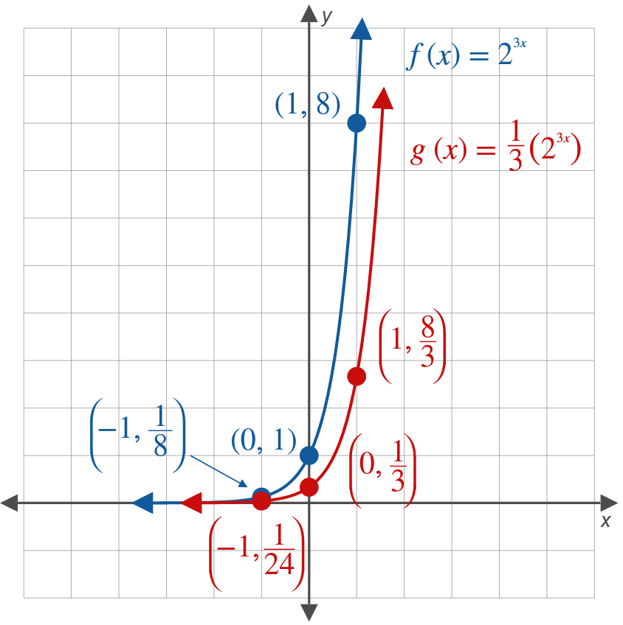
Example 1: Graphing an Exponential Function (cont.)
​

Slide 7
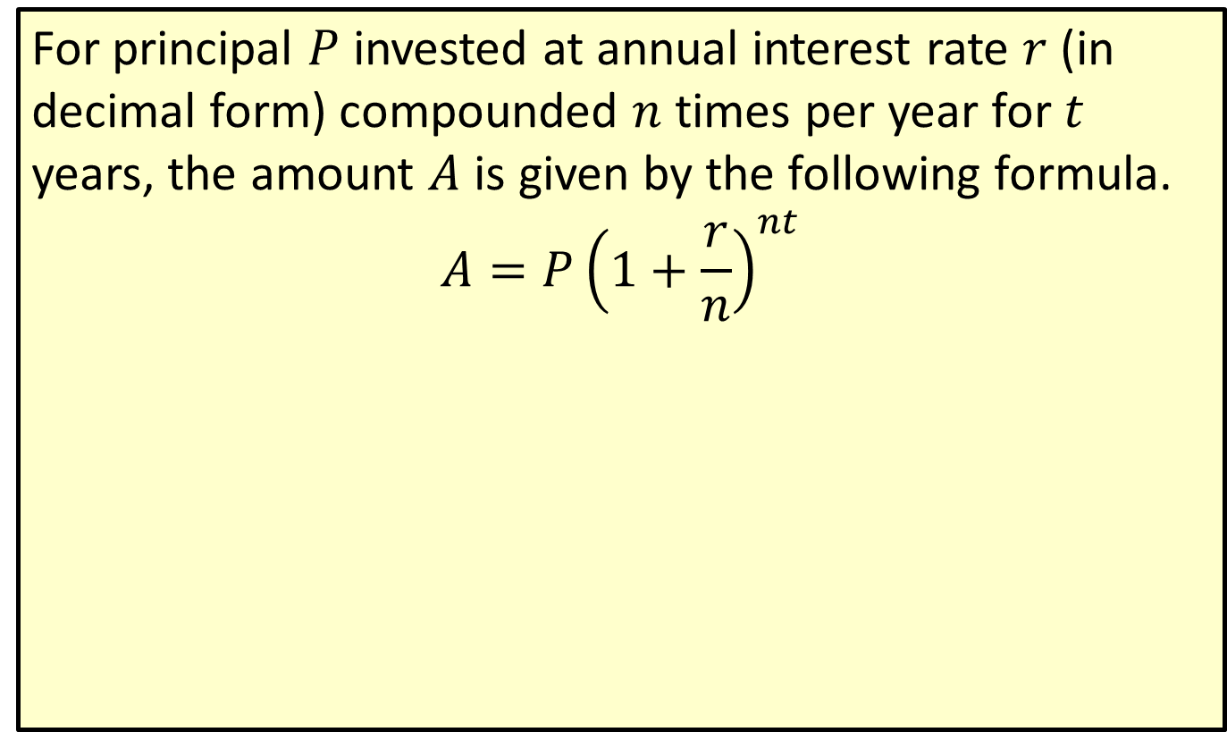
Compound Interest Formula
For principal $P$ invested at annual interest rate $r$ (in decimal form) compounded $n$ times per year for $t$ years, the amount $A$ is given by the following formula.
$$A=P{\left(1+\frac{r}{n}\right)}^{nt}$$

Slide 8

Example 2: Compound Interest
Suppose that $\$1000$ is invested at 12 percent compounded quarterly. What will be the value of the investment in
​1 year,
​3 years?

Slide 9
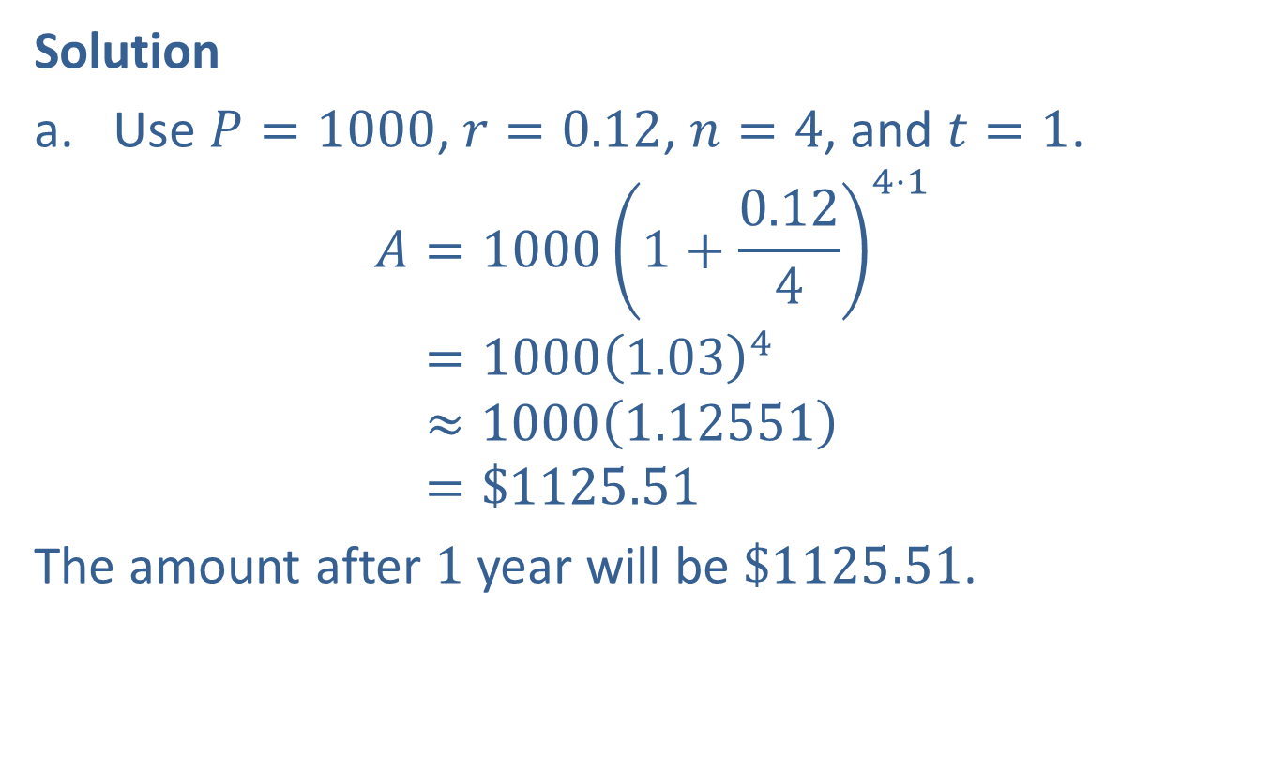
Example 2: Compound Interest (cont.)
Solution
​Use $P=1000$, $r=0.12$, $n=4$, and $t=1$.
𝐴=10001+0.1244⋅1𝐴=10001.034𝐴≈10001.12551𝐴=$1125.51
​The amount after 1 year will be $\$1125.51$.

Slide 10
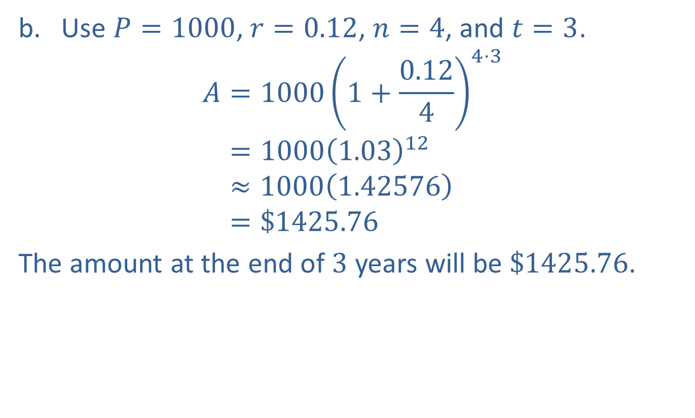
Example 2: Compound Interest (cont.)
​Use $P=1000$, $r=0.12$, $n=4$, and $t=3$.
𝐴=10001+0.1244⋅3𝐴=10001.0312𝐴≈10001.42576𝐴=$1425.76
​The amount at the end of 3 years will be $\$1425.76$.

Slide 11
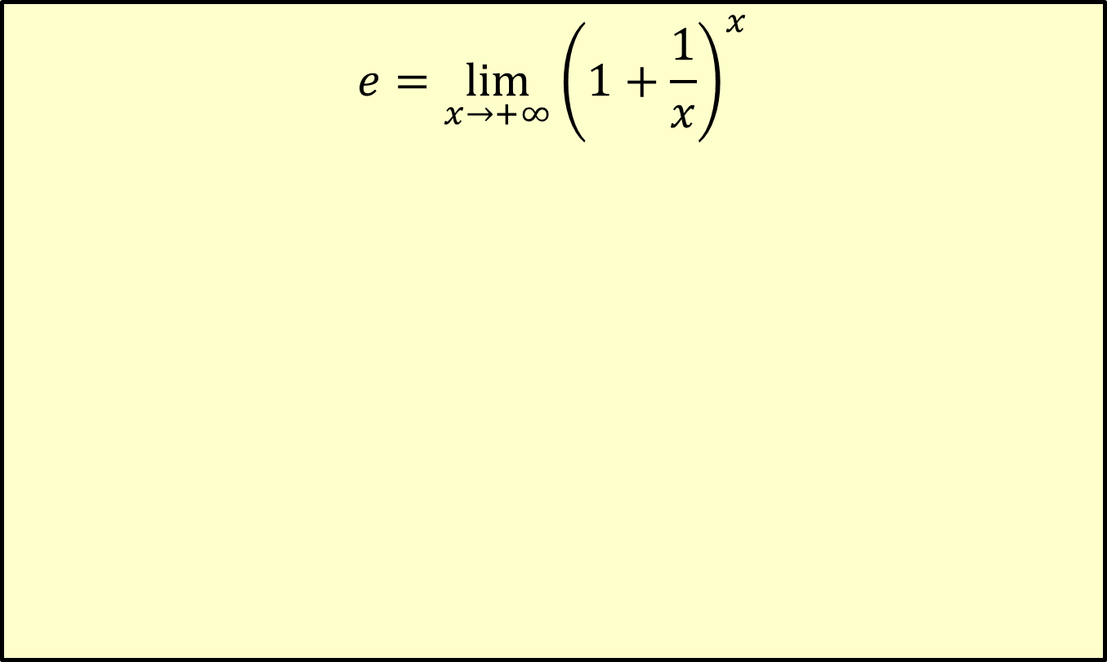

Definition of $e$
$$e=\lim_{x→+∞}{\left(1+\frac{1}{x}\right)}^{x}$$

Slide 12
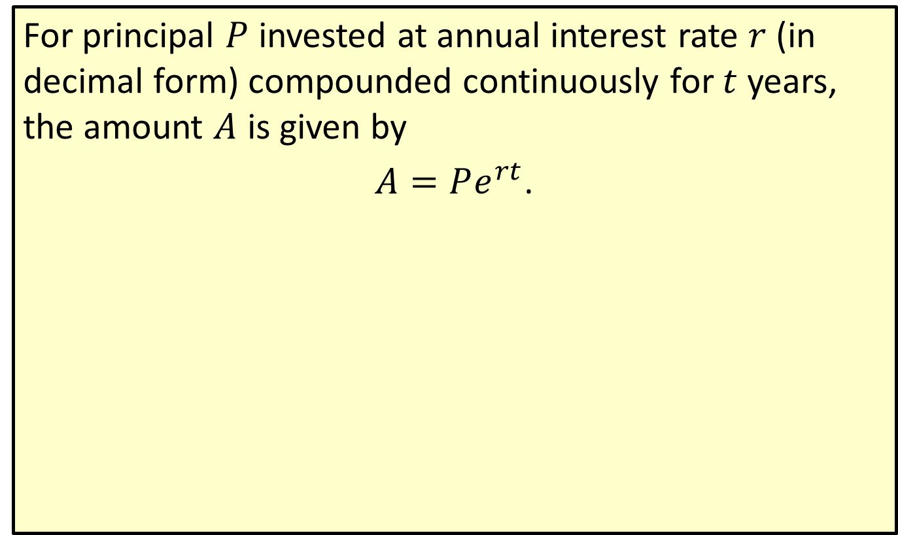
Continuous Compound Interest Formula
For principal $P$ invested at annual interest rate $r$ (in decimal form) compounded continuously for $t$ years, the amount $A$ is given by
$A=Pe^{rt}$.

Slide 13

Example 3: Investment Value
If $\$5000$ is invested at 8 percent, what will be the value of the investment at the end of 5 years if the interest is
​compounded quarterly,
​compounded continuously?

Slide 14
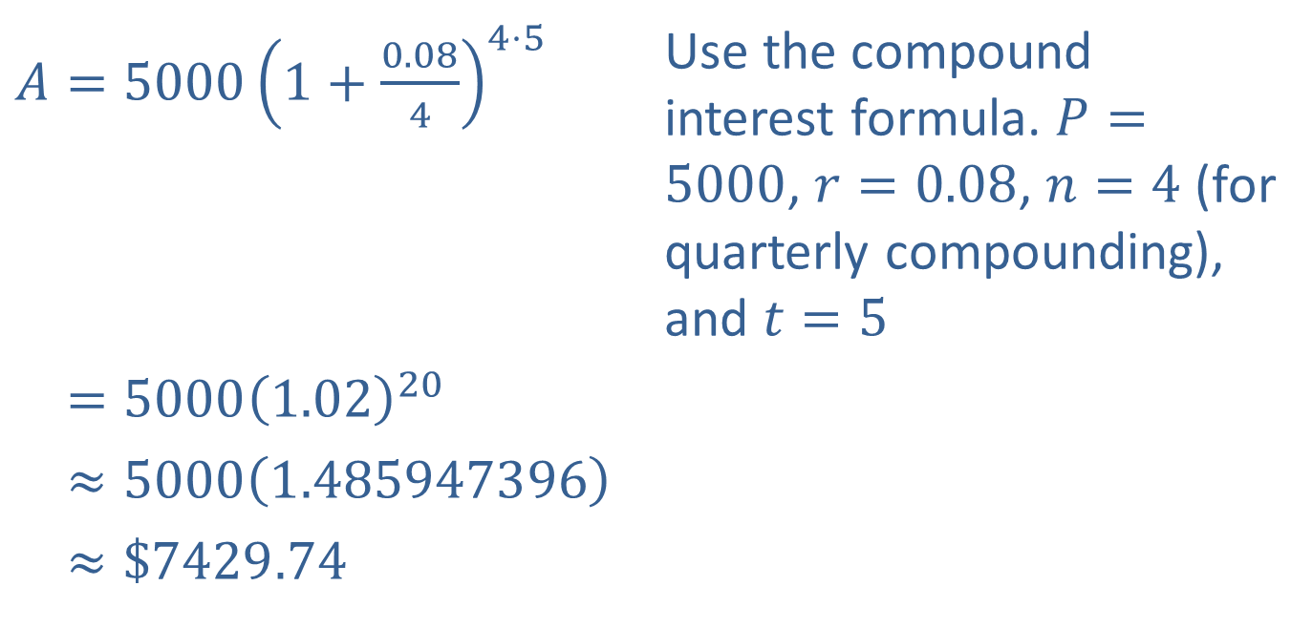
Example 3: Investment Value (cont.)
Solution
​
​$A=5000{\left(1+\frac{0.08}{4}\right)}^{4⋅5}$ | Use the compound interest formula. $P=5000$, $r=0.08$, $n=4$ (for quarterly compounding), and $t=5$
​𝐴=50001.0220
​𝐴≈50001.485947396
​𝐴≈$7429.74

Slide 15
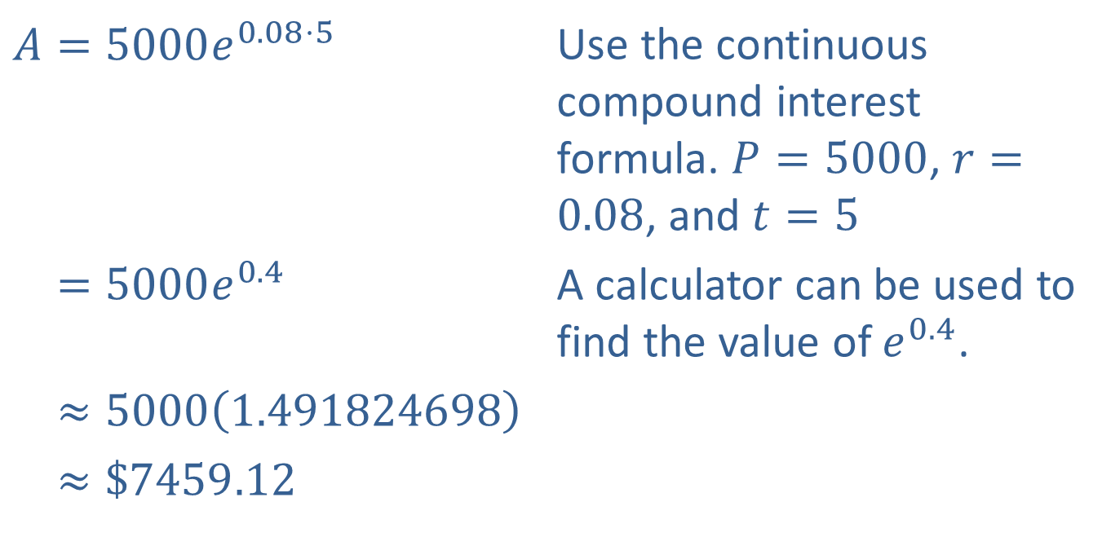
Example 3: Investment Value (cont.)
​
​$A=5000e^{0.08⋅5}$ | Use the continuous compound interest formula. $P=5000$, $r=0.08$, and $t=5$
​𝐴=5000𝑒0.4 | A calculator can be used to find the value of $e^{0.4}$.
​𝐴≈50001.491824698
​𝐴≈$7459.12

Slide 16
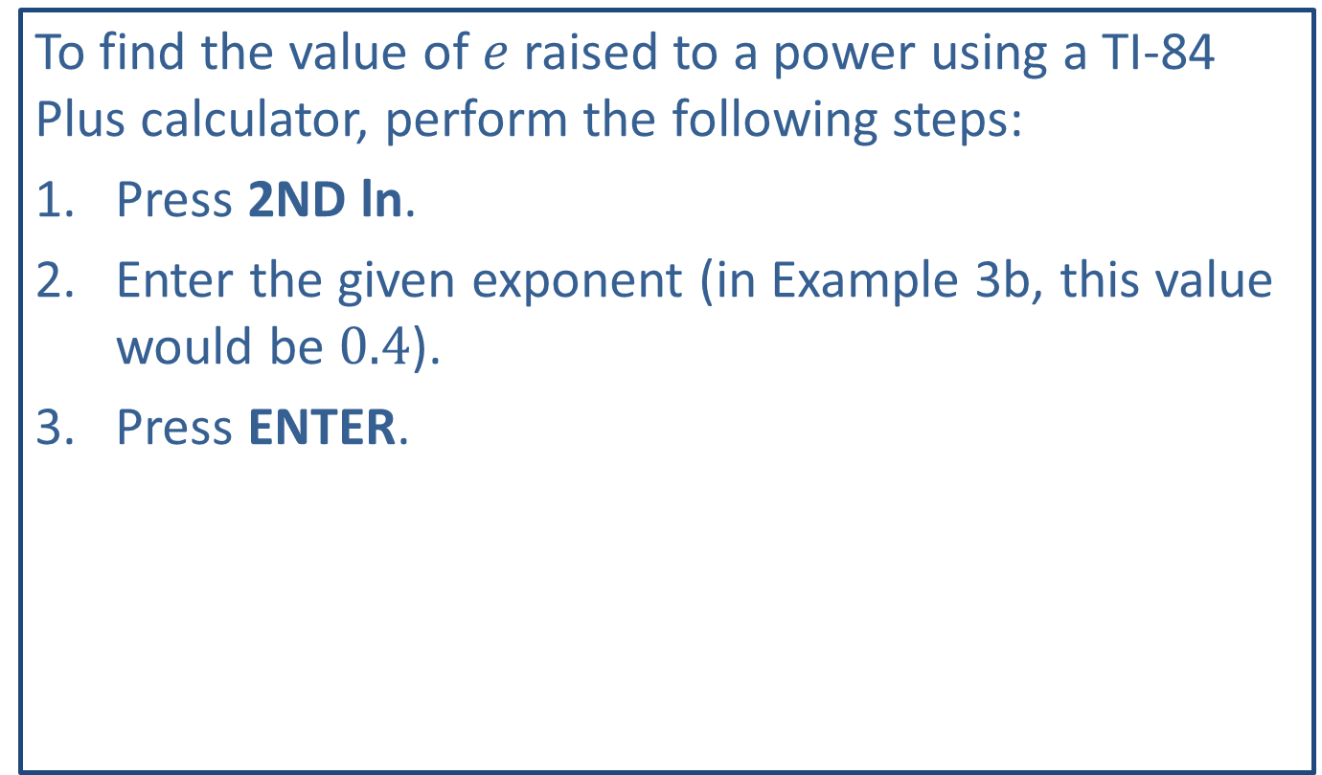
Tech Training
To find the value of $e$ raised to a power using a TI-84 Plus calculator, perform the following steps:
​Press 2ND ln.
​Enter the given exponent (in Example 3b, this value would be 0.4).
​Press ENTER.

Slide 17

Example 3: Investment Value (cont.)
You may find it interesting to note that the difference in interest is only about $\$30$, even after 5 years.

Slide 18
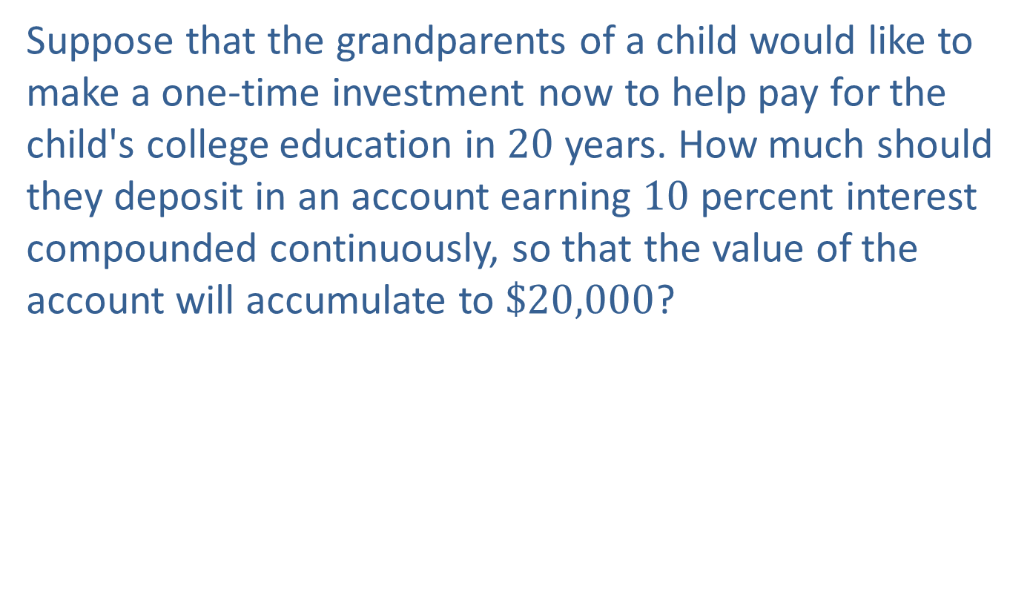
Example 4: Initial Deposit Amount
Suppose that the grandparents of a child would like to make a one-time investment now to help pay for the child's college education in 20 years. How much should they deposit in an account earning 10 percent interest compounded continuously, so that the value of the account will accumulate to $\$20,000$?

Slide 19
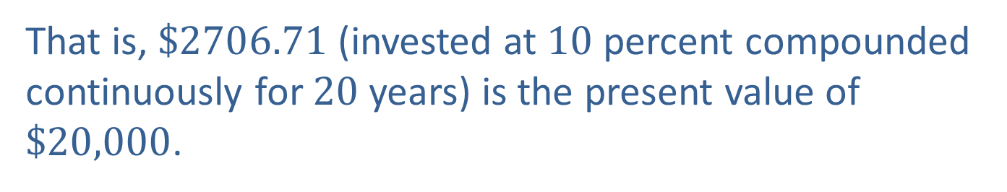
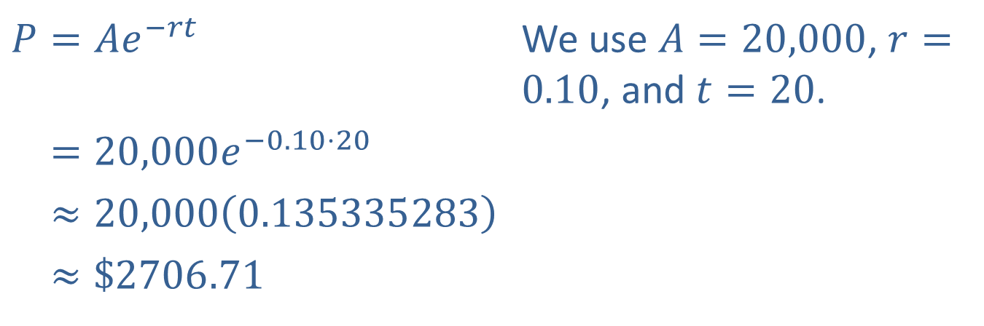
Example 4: Initial Deposit Amount (cont.)
Solution
​$P=Ae^{−rt}$ | We use $A=20,000$, $r=0.10$, and $t=20$.
​𝐴=20,000𝑒−0.10⋅20
​𝐴≈20,0000.135335283
​𝐴≈$2706.71
That is, $\$2706.71$ (invested at 10 percent compounded continuously for 20 years) is the present value of $\$20,000$.

