Slide 1
Section 5.2
The Natural Logarithm

Slide 2
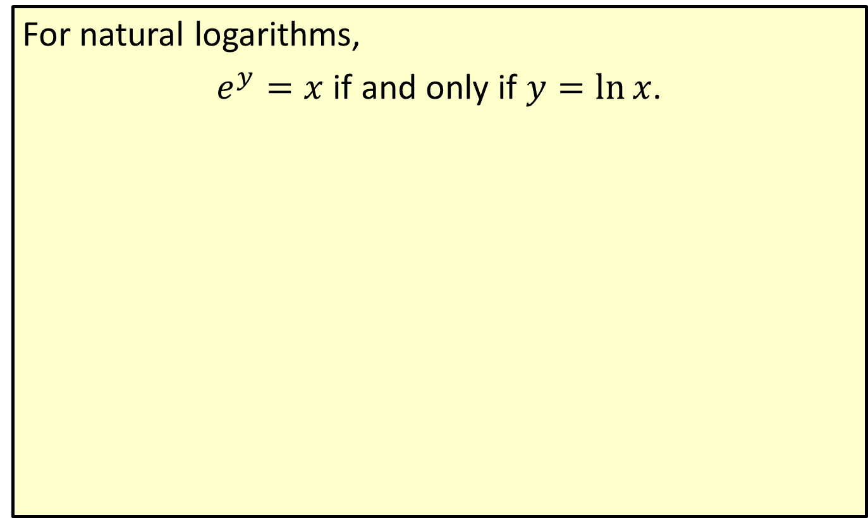
Natural Logarithm
For natural logarithms,
$e^{y}=x$ if and only if $y=\ln{x}$.

Slide 3
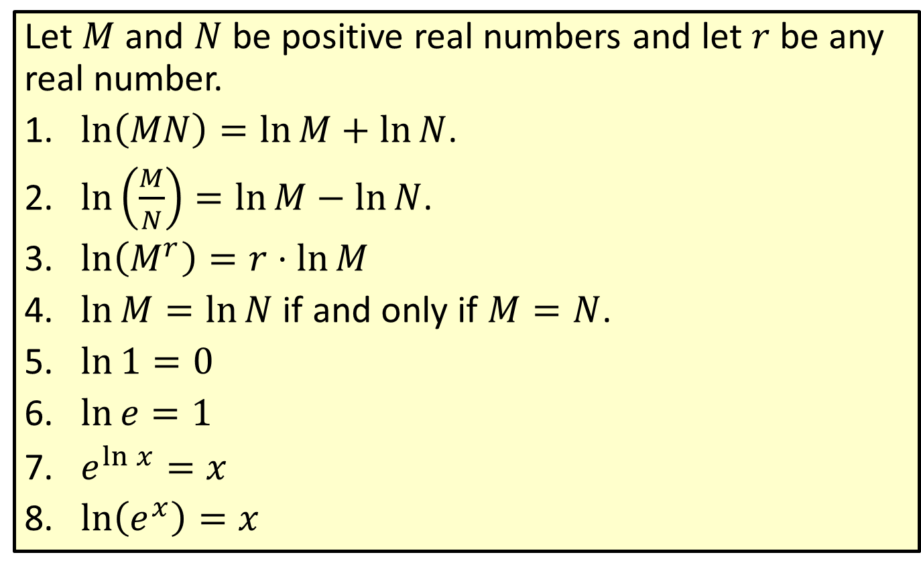
Properties of Natural Logarithms
Let $M$ and $N$ be positive real numbers and let $r$ be any real number.
​$\ln\left(MN\right)=\ln{M}+\ln{N}$.
​$\ln\left(\frac{M}{N}\right)=\ln{M}−\ln{N}$.
​$\ln\left(M^{r}\right)=r⋅\ln{M}$
​$\ln{M}=\ln{N}$ if and only if $M=N$.
​$\ln{1}=0$
​$\ln{e}=1$
​$e^{\ln{x}}=x$
​$\ln\left(e^{x}\right)=x$

Slide 4
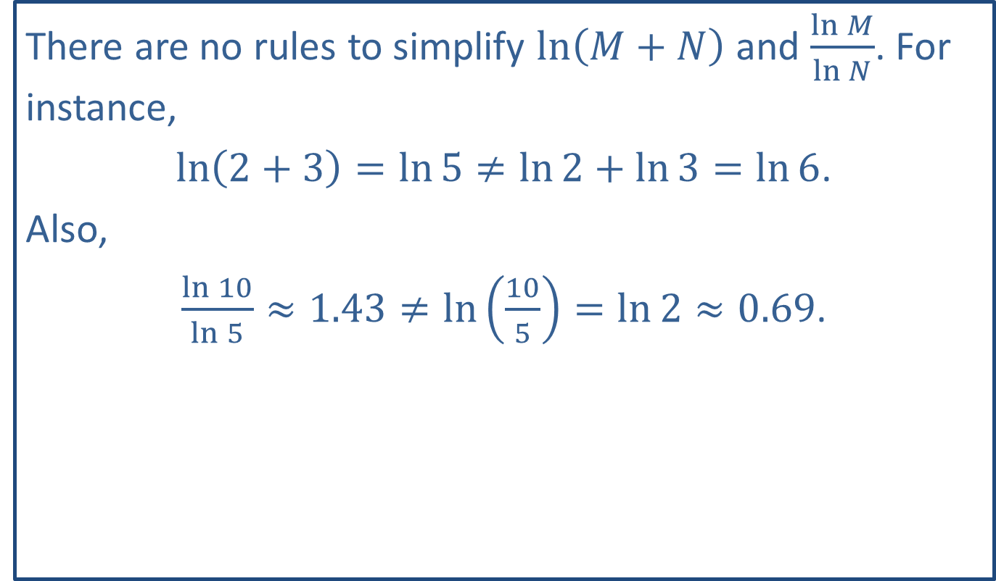
CAUTION!
There are no rules to simplify $ln⁡\left(M+N\right)$ and $\frac{\ln{M}}{\ln{N}}$. For instance,
$\ln\left(2+3\right)=\ln{5}≠\ln{2}+\ln{3}=\ln{6}$.
Also,
$\frac{\ln{10}}{\ln{5}}≈1.43≠\ln\left(\frac{10}{5}\right)=\ln{2}≈0.69$.

Slide 5
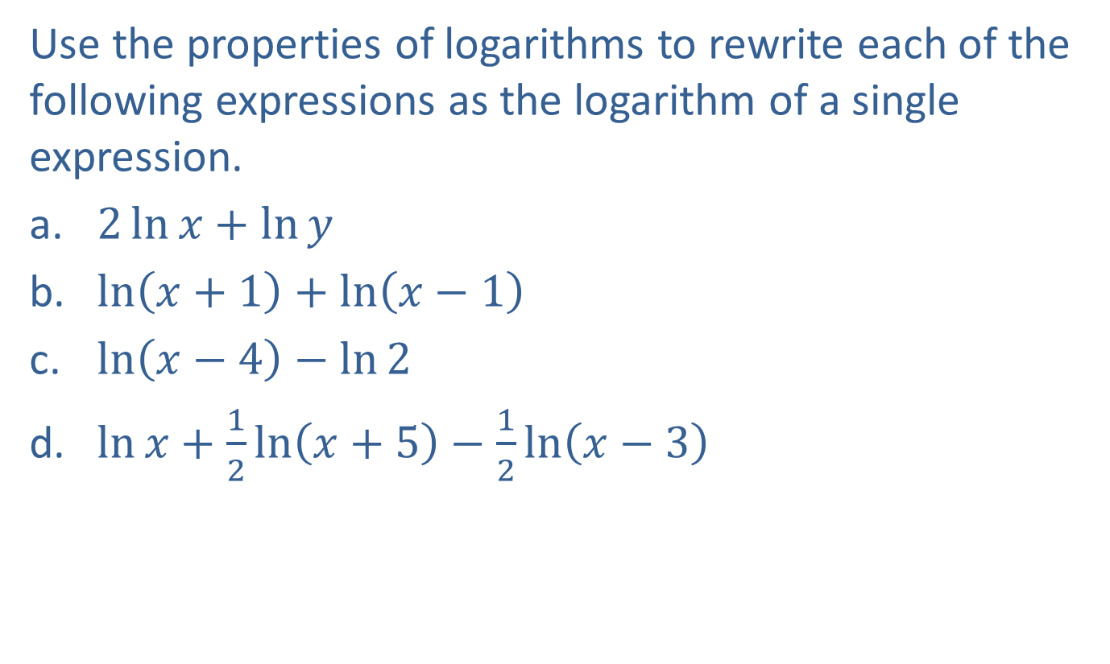
Example 1: Properties of Natural Logarithms
Use the properties of logarithms to rewrite each of the following expressions as the logarithm of a single expression.
​$2\ln{x}+\ln{y}$
​$\ln\left(x+1\right)+\ln\left(x−1\right)$
​$\ln\left(x−4\right)−\ln{2}$
​$\ln{x}+\frac{1}{2}\ln\left(x+5\right)−\frac{1}{2}\ln\left(x−3\right)$

Slide 6
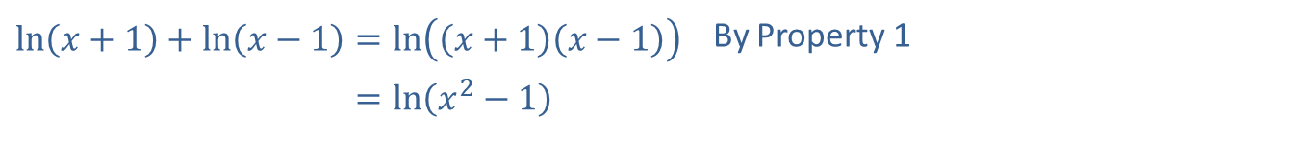
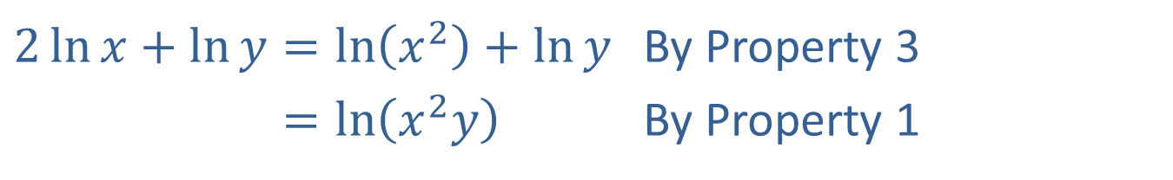
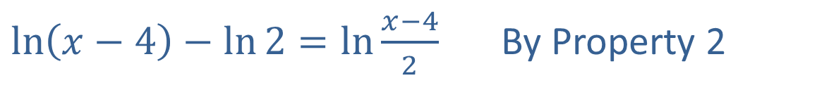
Example 1: Properties of Natural Logarithms (cont.)
Solution
​
​$2\ln{x}+\ln{y}=\ln\left(x^{2}\right)+\ln{y}$ | By Property 3
​2ln𝑥+ln𝑦=ln𝑥2𝑦 | By Property 1
​$\ln\left(x+1\right)+\ln\left(x−1\right)=\ln\left(\left(x+1\right)\left(x−1\right)\right)$ | By Property 1
​ln𝑥+1+ln𝑥−1=ln𝑥2−1
​$\ln\left(x−4\right)−\ln{2}=\ln{\frac{x−4}{2}}$ By Property 2

Slide 7
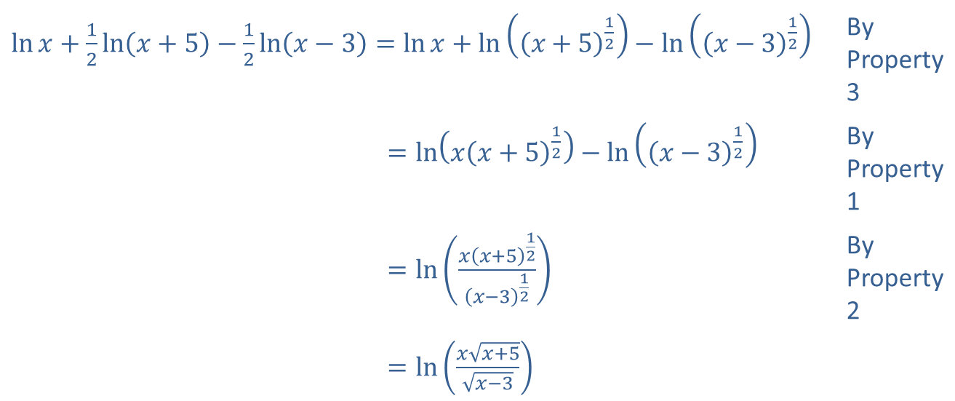
Example 1: Properties of Natural Logarithms (cont.)
​$\ln{x}+\frac{1}{2}\ln\left(x+5\right)−\frac{1}{2}\ln\left(x−3\right)=\ln{x}+\ln\left({\left(x+5\right)}^{\frac{1}{2}}\right)−\ln\left({\left(x−3\right)}^{\frac{1}{2}}\right)$ | By Property 3
​ln𝑥+12 ln⁡𝑥+5−12 ln⁡𝑥−3=ln𝑥𝑥+512−ln𝑥−312 | By Property 1
​ln𝑥+12 ln⁡𝑥+5−12 ln⁡𝑥−3=ln𝑥𝑥+512𝑥−312 | By Property 2
​ln𝑥+12 ln⁡𝑥+5−12 ln⁡𝑥−3=ln𝑥𝑥+5𝑥−3
​

Slide 8
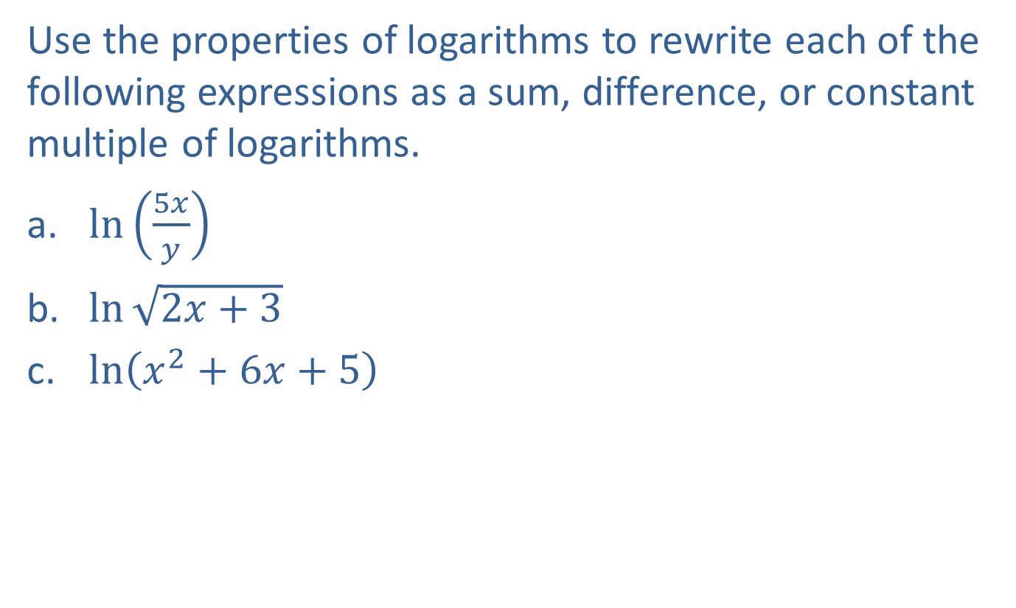
Example 2: Properties of Natural Logarithms
Use the properties of logarithms to rewrite each of the following expressions as a sum, difference, or constant multiple of logarithms.
​$ln⁡\left(\frac{5x}{y}\right)$
​$ln⁡\sqrt{2x+3}$
​$ln⁡\left(x^{2}+6x+5\right)$

Slide 9
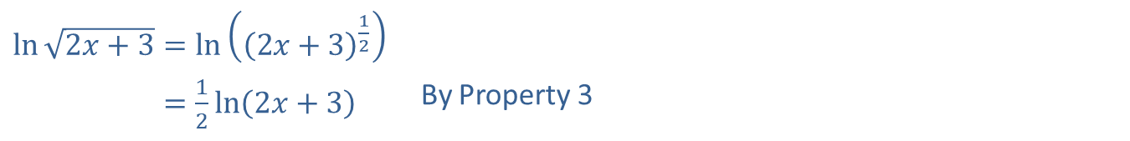
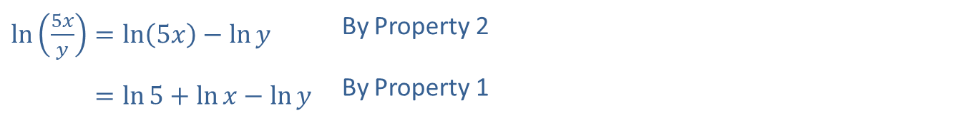
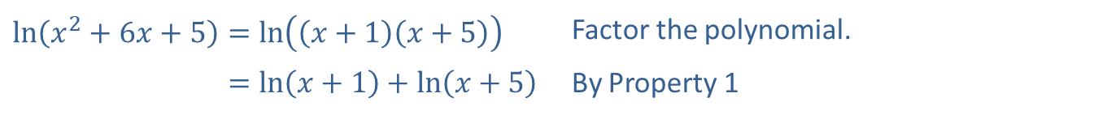
Example 2: Properties of Natural Logarithms (cont.)
Solutions
​
​$\ln\left(\frac{5x}{y}\right)=\ln\left(5x\right)−\ln{y}$ | By Property 2
​ln⁡5𝑥𝑦=ln5+ln𝑥−ln𝑦 | By Property 1
​$\ln{\sqrt{2x+3}}=\ln\left({\left(2x+3\right)}^{\frac{1}{2}}\right)$
​ln⁡2𝑥+3=12ln2𝑥+3 | By Property 3
​$\ln\left(x^{2}+6x+5\right)=\ln\left(\left(x+1\right)\left(x+5\right)\right)$ | Factor the polynomial.
​ln⁡𝑥2+6𝑥+5=ln𝑥+1+ln𝑥+5 | By Property 1

Slide 10
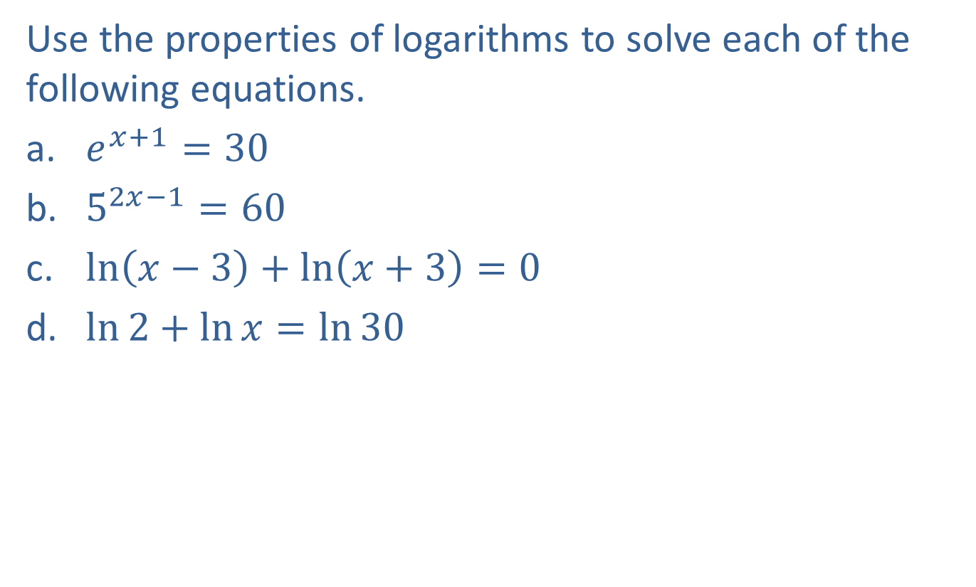
Example 3: Solving Equations
Use the properties of logarithms to solve each of the following equations.
​$e^{x+1}=30$
​$5^{2x−1}=60$
​$\ln\left(x−3\right)+\ln\left(x+3\right)=0$
​$\ln{2}+\ln{x}=\ln{30}$

Slide 11

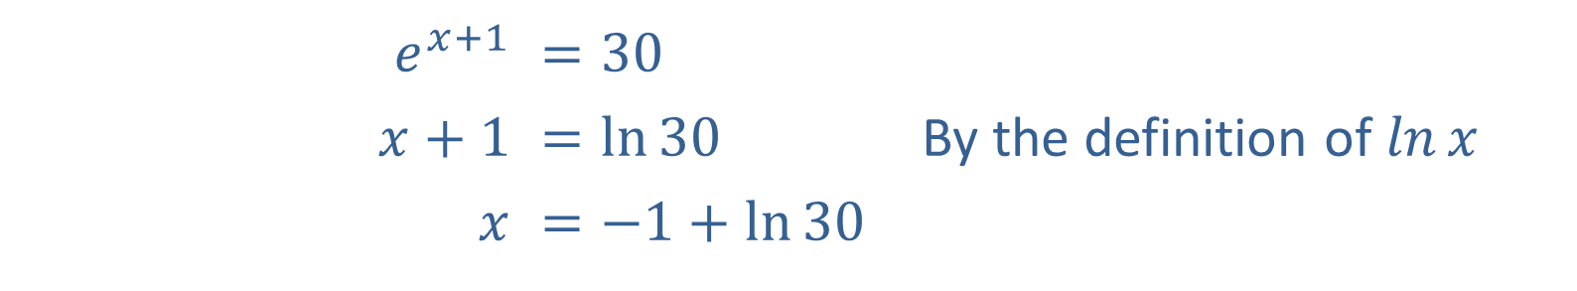
Example 3: Solving Equations (cont.)
Solution
​
​$e^{x+1}$ | ​$=30$
​$x+1$ | ​$=\ln{30}$ | By the definition of $ln⁡x$
$$x$$ | ​$=−1+\ln{30}$
In decimal form, we can write
𝑥=−1+ln30𝑥≈−1+3.4012=2.4012.

Slide 12

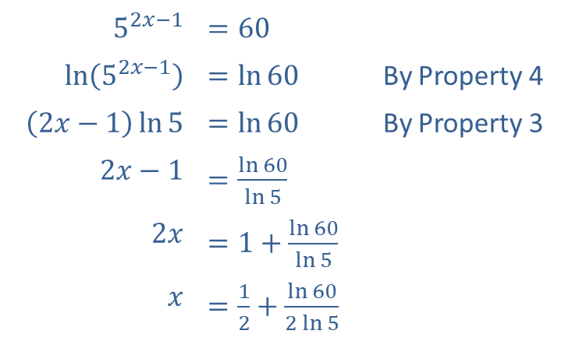
Example 3: Solving Equations (cont.)
​​
​$5^{2x−1}$ | ​$=60$
​$ln⁡\left(5^{2x−1}\right)$ | ​$=\ln{60}$ | By Property 4
​$\left(2x−1\right)\ln{5}$ | ​$=\ln{60}$ | By Property 3
​$2x−1$ | ​$=\frac{\ln{60}}{\ln{5}}$
​$2x$ | ​$=1+\frac{\ln{60}}{\ln{5}}$
$$x$$ | ​$=\frac{1}{2}+\frac{\ln{60}}{2\ln{5}}$
In decimal form, we can write
​$x≈0.5+\frac{4.0943}{3.2189}≈1.7720$.

Slide 13
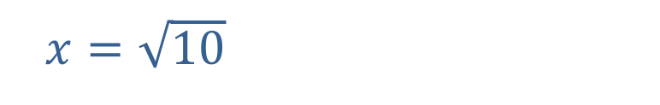
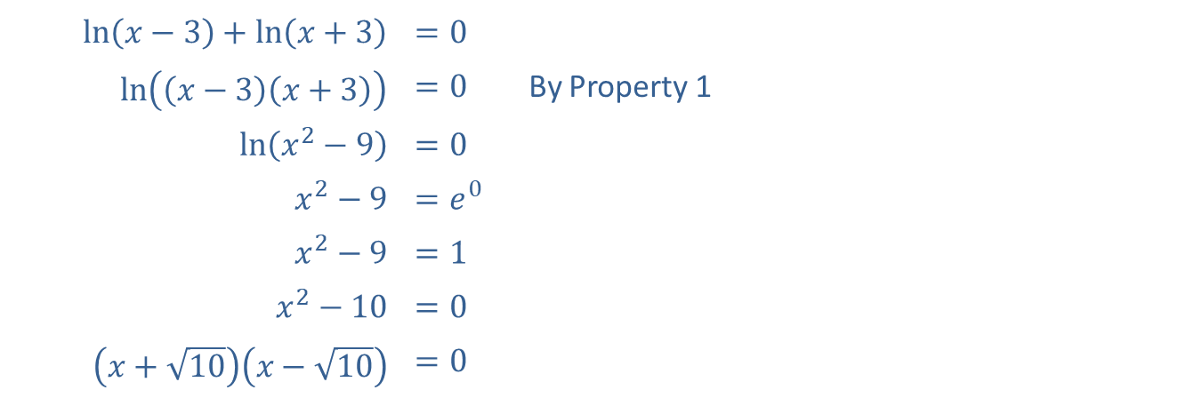
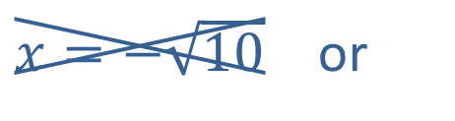
Example 3: Solving Equations (cont.)
​
​$\ln\left(x−3\right)+\ln\left(x+3\right)$ | ​$=0$
​$ln⁡\left(\left(x−3\right)\left(x+3\right)\right)$ | ​$=0$ | By Property 1
​$ln⁡\left(x^{2}−9\right)$ | ​$=0$
​$x^{2}−9$ | ​$=e^{0}$
​$x^{2}−9$ | ​$=1$
​$x^{2}−10$ | ​$=0$
​$\left(x+\sqrt{10}\right)\left(x−\sqrt{10}\right)$ | ​$=0$
$x=−\sqrt{10}$ or
​ $x=\sqrt{10}$

Slide 14

Example 3: Solving Equations (cont.)
​If $x=−\sqrt{10}$, then $−\sqrt{10}−3<0$, that is, the argument of the first logarithm in the original equation is negative, and thus the expression $ln⁡\left(−\sqrt{10}−3\right)$ is not defined. Therefore, $x=−\sqrt{10}$ is not a solution, and the only solution is $x=\sqrt{10}$.​

Slide 15
Note:
When solving equations involving natural logarithms, it is important to remember to check the solutions in the original equation. Keep in mind that the natural logarithm is defined only for the positive real numbers.

Slide 16

Example 3: Solving Equations (cont.)
​$\ln{2}+\ln{x}$ | ​$=\ln{30}$
​$ln⁡\left(2x\right)$ | ​$=\ln{30}$ | By Property 1
​$2x$ | ​$=30$ | By Property 4
$$x$$ | ​$=15$

Slide 17

Example 4: Rate of Inflation
Suppose the price of a box of popcorn at a movie theatre was $\$0.75$ in 1980 and $\$6.60$ in 2020. Assuming the cost of a box of popcorn increased continuously at a constant rate $r$, determine this rate.

Slide 18
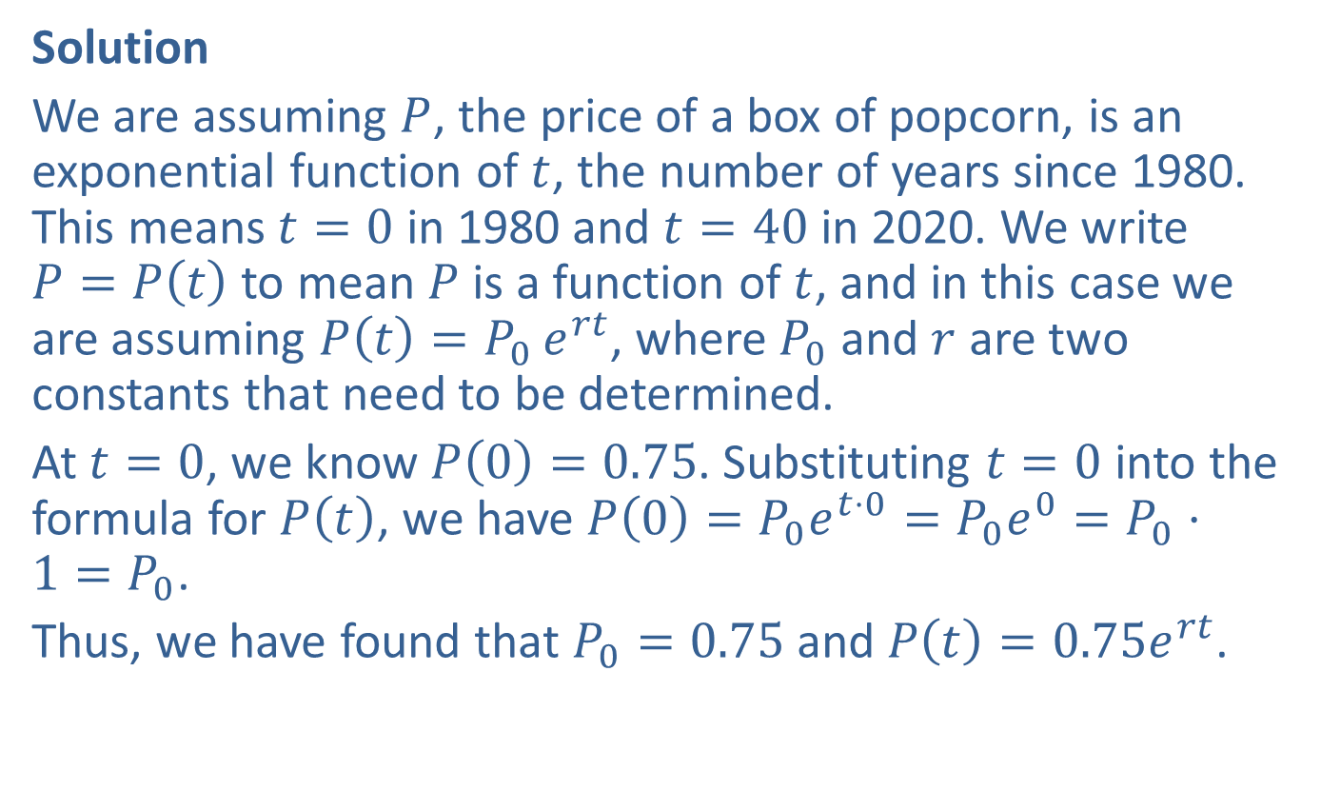
Example 4: Rate of Inflation (cont.)
Solution
We are assuming $P$, the price of a box of popcorn, is an exponential function of $t$, the number of years since 1980. This means $t=0$ in 1980 and $t=40$ in 2020. We write $P=P\left(t\right)$ to mean $P$ is a function of $t$, and in this case we are assuming $P\left(t\right)=P_{0}{e^{rt}}$, where $P_{0}$ and $r$ are two constants that need to be determined.
At $t=0$, we know $P\left(0\right)=0.75$. Substituting $t=0$ into the formula for $P\left(t\right)$, we have $P\left(0\right)=P_{0}e^{t⋅0}=P_{0}e^{0}=P_{0}⋅1=P_{0}$.
Thus, we have found that $P_{0}=0.75$ and $P\left(t\right)=0.75e^{rt}$.
​

Slide 19
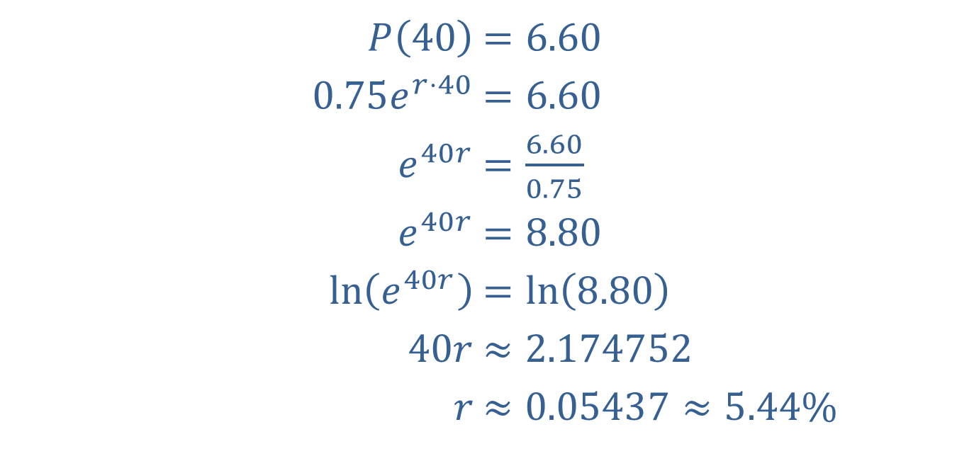

Example 4: Rate of Inflation (cont.)
Now, we can determine $r$, using $t=40$.
​$P\left(40\right)$ | ​$=6.60$
​$0.75e^{r⋅40}$ | ​$=6.60$
​$e^{40r}$ | ​$=\frac{6.60}{0.75}$
​$e^{40r}$ | ​$=8.80$
​$ln⁡\left(e^{40r}\right)$ | ​$=\ln\left(8.80\right)$
​$40r$ | ​$≈2.174752$
​$r$ | ​$≈0.05437≈5.44\%$

Slide 20

Example 5: Continuous Compounding Interest
The formula $A=Pe^{rt}$ represents the amount accumulated when a principal is compounded continuously (as discussed in Section 5.1). How long will it take a principal $P$ to double if interest is compounded continuously at 10 percent?

Slide 21
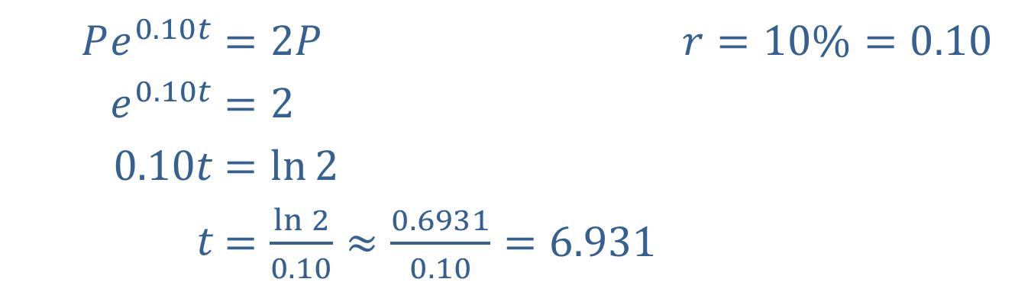

Example 5: Continuous Compounding Interest (cont.)
Solution
If $P$ is doubled, then the amount $A$ is $2P$.
​
The principal will double in approximately 6.9 years.
​$Pe^{0.10t}$ | ​$=2P$ | ​$r=10\%=0.10$
​$e^{0.10t}$ | ​$=2$ | ​
​$0.10t$ | ​$=\ln{2}$ | ​
​$t$ | ​$=\frac{\ln{2}}{0.10}≈\frac{0.6931}{0.10}=6.931$ | ​

