Slide 1
Section 5.3
Derivatives of Logarithmic Functions

Slide 2
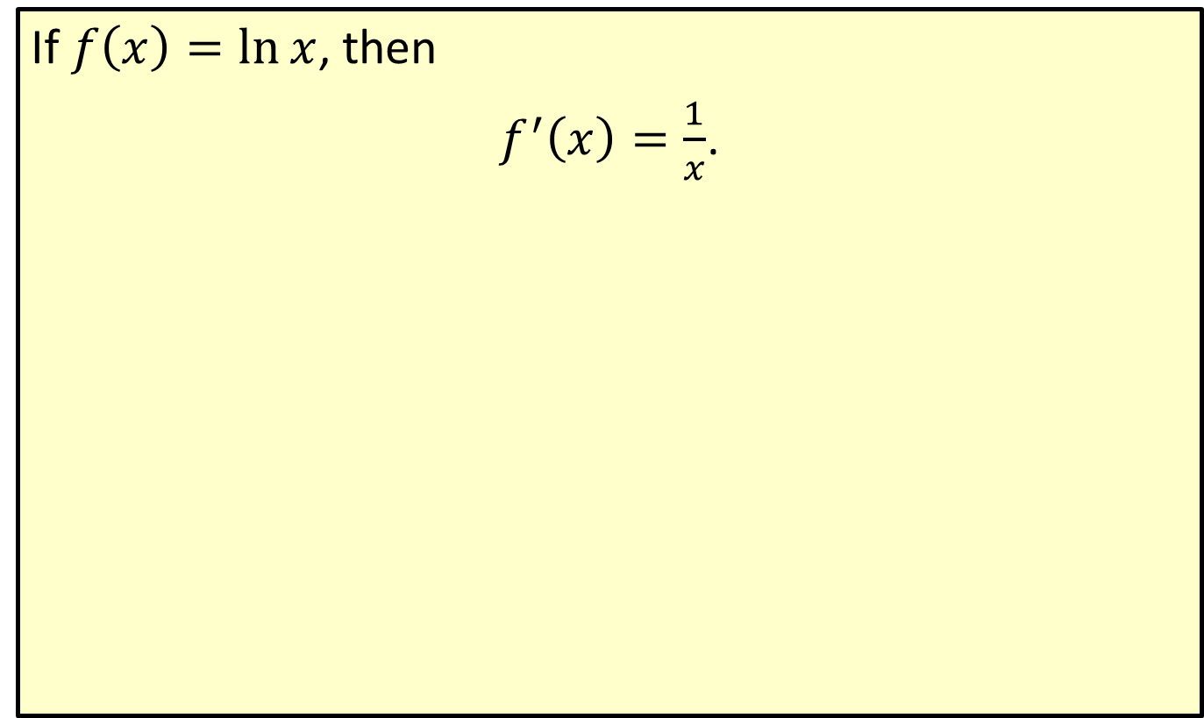

Derivative of $ln⁡x$
If $f\left(x\right)=\ln{x}$, then
$f^{′}\left(x\right)=\frac{1}{x}$.

Slide 3
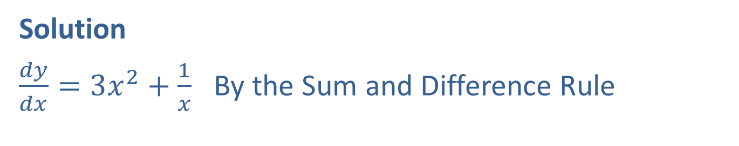

Example 1: Finding the Derivative
Find $\frac{dy}{dx}$ for $y=x^{3}+\ln{x}$.
Solution
$\frac{dy}{dx}=3x^{2}+\frac{1}{x}$ By the Sum and Difference Rule

Slide 4
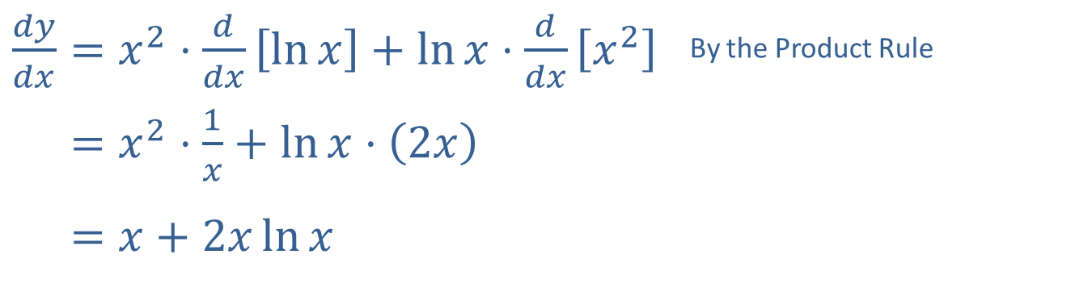

Example 2: Finding the Derivative
Find $\frac{dy}{dx}$ for $y=x^{2}\ln{x}$.
Solution
​$\frac{dy}{dx}=x^{2}⋅\frac{d}{dx}\left[\ln{x}\right]+\ln{x}⋅\frac{d}{dx}\left[x^{2}\right]$ | By the Product Rule
​𝑑𝑦𝑑𝑥=𝑥2⋅1𝑥+ln𝑥⋅2𝑥
​𝑑𝑦𝑑𝑥=𝑥+2𝑥ln𝑥

Slide 5

Example 3: Equation of a Tangent Line
Find the equation of the tangent line to $y=\ln{x}$ at the point $\left(5\text{, }1.61\right)$. (Note that $ln⁡5$ is actually equal to $1.609437912…$, but we round to two decimal places here.)

Slide 6
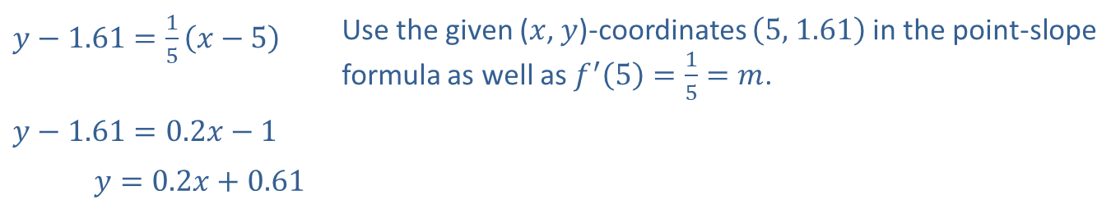

Example 3: Equation of a Tangent Line (cont.)
Solution
For $f\left(x\right)=\ln{x}$, the slope we need is $f^{′}\left(5\right)=\frac{1}{5}$. In point-slope form, we write the equation of the tangent line as follows.
​$y−1.61=\frac{1}{5}\left(x−5\right)$ | Use the given ($x$, $y$)-coordinates $\left(5\text{, }1.61\right)$ in the point-slope formula as well as $f^{′}\left(5\right)=\frac{1}{5}=m$.
​$y−1.61=0.2x−1$
​−1.61𝑦=0.2𝑥+0.61

Slide 7
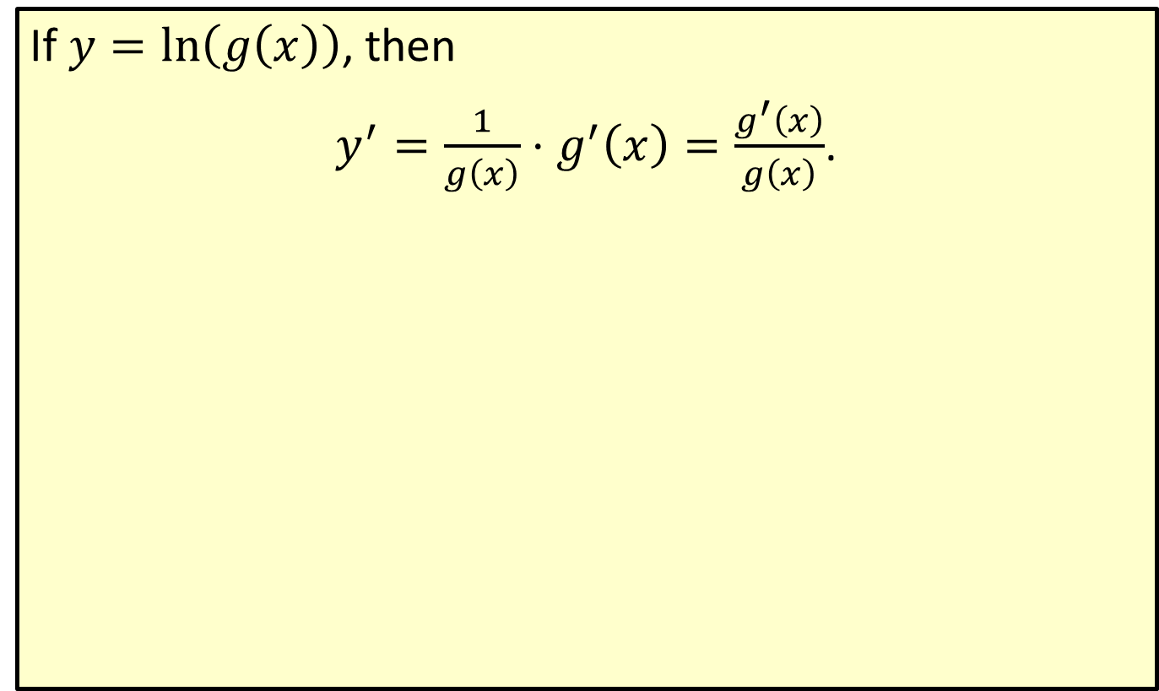

Derivative of $ln⁡\left(g\left(x\right)\right)$
If $y=\ln\left(g\left(x\right)\right)$, then
$y^{′}=\frac{1}{g\left(x\right)}⋅g^{′}\left(x\right)=\frac{g^{′}\left(x\right)}{g\left(x\right)}$.

Slide 8
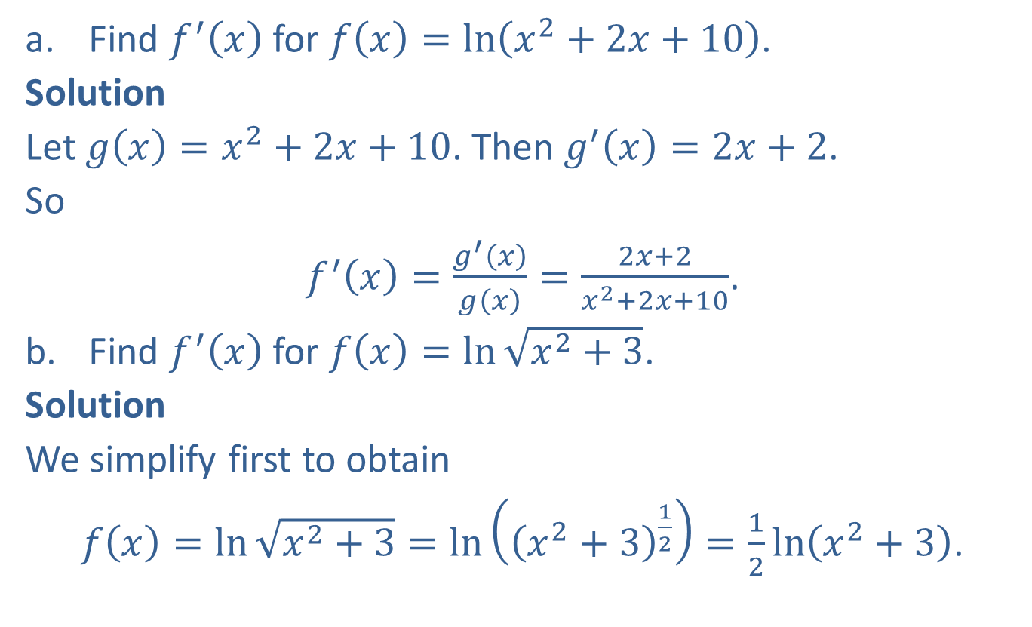
Example 4: Finding the Derivative
​Find $f^{′}⁡\left(x\right)$ for $f\left(x\right)=\ln\left(x^{2}+2x+10\right)$.
​Solution
​Let $g\left(x\right)=x^{2}+2x+10$. Then $g^{′}\left(x\right)=2x+2$.
So
$f^{′}\left(x\right)=\frac{g^{′}⁡\left(x\right)}{g⁡\left(x\right)}=\frac{2x+2}{x^{2}+2x+10}$.
​Find $f^{′}\left(x\right)$ for $f\left(x\right)=\ln{\sqrt{x^{2}+3}}$.
​Solution
​We simplify first to obtain
$f\left(x\right)=\ln{\sqrt{x^{2}+3}}=\ln\left({\left(x^{2}+3\right)}^{\frac{1}{2}}\right)=\frac{1}{2}\ln\left(x^{2}+3\right)$.

Slide 9


Example 4: Finding the Derivative
Now, differentiating with $g\left(x\right)=x^{2}+3$ and $g^{′}\left(x\right)=2x$, we have
$$f^{′}\left(x\right)=\frac{1}{2}⋅\frac{g^{′}⁡\left(x\right)}{g⁡\left(x\right)}=\frac{1}{2}⋅\frac{2x}{x^{2}+3}=\frac{x}{x^{2}+3}$$

Slide 10

Example 5: Using Logarithmic Differentiation
Use logarithmic differentiation to find $f^{′}⁡\left(x\right)$, given that $f\left(x\right)=\frac{{\left(x^{2}+1\right)}^{3}\sqrt{x^{2}−2x}}{x−5}$.

Slide 11
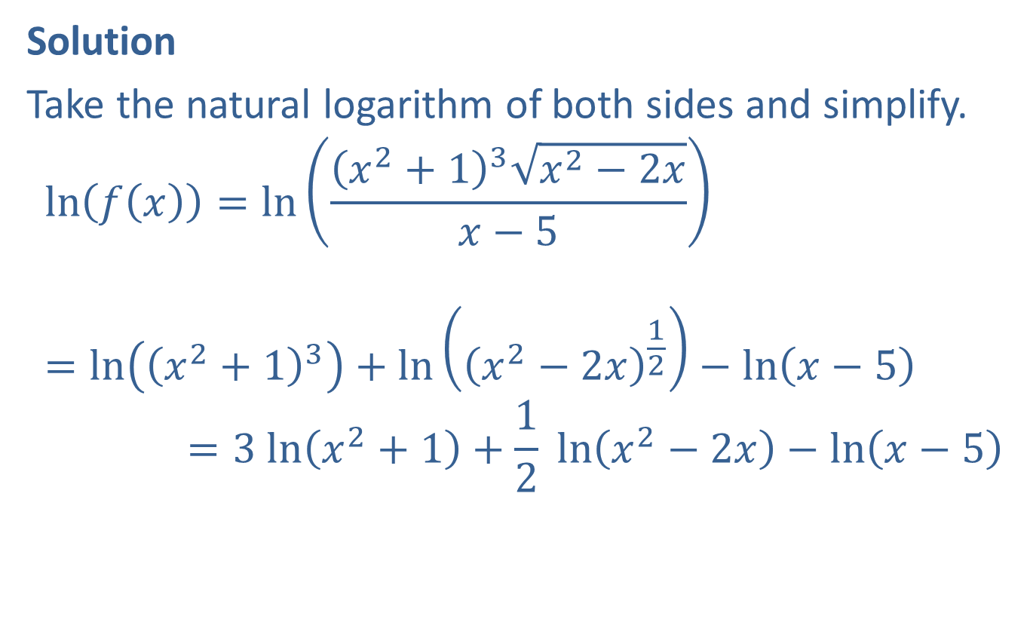
Example 5: Using Logarithmic Differentiation (cont.)
Solution
Take the natural logarithm of both sides and simplify.
ln𝑓𝑥=ln𝑥2+13𝑥2−2𝑥𝑥−5ln⁡𝑓𝑥=ln𝑥2+13+ln𝑥2−2𝑥12−ln𝑥−5ln⁡𝑓𝑥=3 ln⁡𝑥2+1+12 ln⁡𝑥2−2𝑥−ln⁡𝑥−5
​

Slide 12
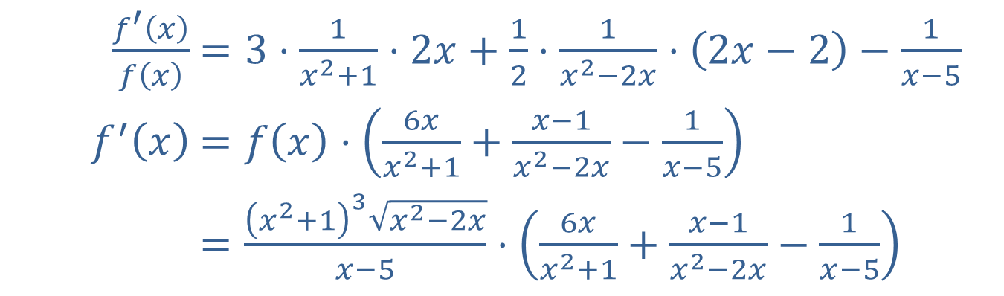
Example 5: Using Logarithmic Differentiation (cont.)
Now differentiate both sides.
​$\frac{f^{′}\left(x\right)}{f\left(x\right)}$ | ​$=3⋅\frac{1}{x^{2}+1}⋅2x+\frac{1}{2}⋅\frac{1}{x^{2}−2x}⋅\left(2x−2\right)−\frac{1}{x−5}$
​$f^{′}⁡\left(x\right)$ | ​$=f\left(x\right)⋅\left(\frac{6x}{x^{2}+1}+\frac{x−1}{x^{2}−2x}−\frac{1}{x−5}\right)$
​ | ​$=\frac{{\left(x^{2}+1\right)}^{3}\sqrt{x^{2}−2x}}{x−5}⋅\left(\frac{6x}{x^{2}+1}+\frac{x−1}{x^{2}−2x}−\frac{1}{x−5}\right)$

Slide 13
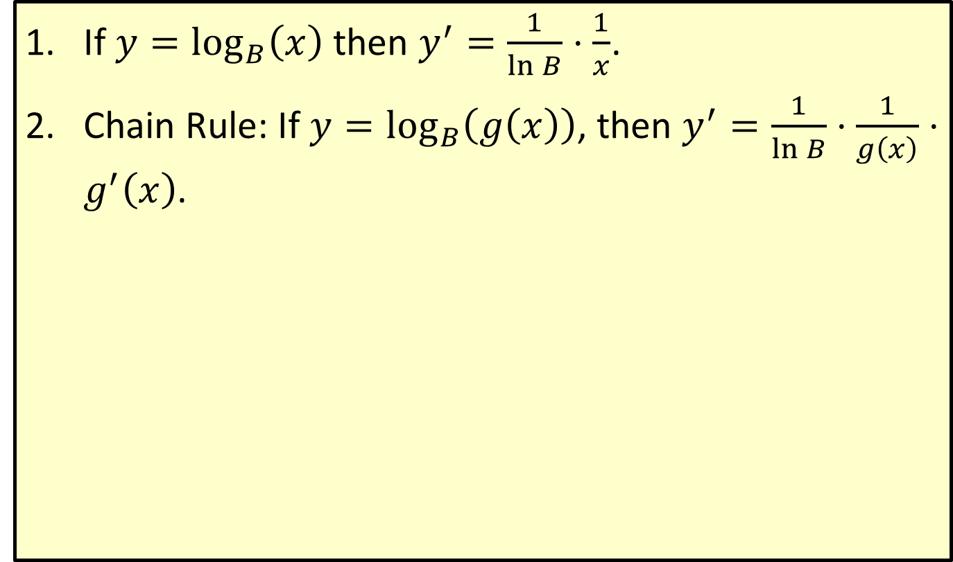
General Logarithmic Derivative
​If $y=\log_{B}\left(x\right)$ then $y^{′}=\frac{1}{\ln{B}}⋅\frac{1}{x}$.
​Chain Rule: If $y=\log_{B}\left(g\left(x\right)\right)$, then $y^{′}=\frac{1}{\ln{B}}⋅\frac{1}{g\left(x\right)}⋅g^{′}\left(x\right)$.

Slide 14
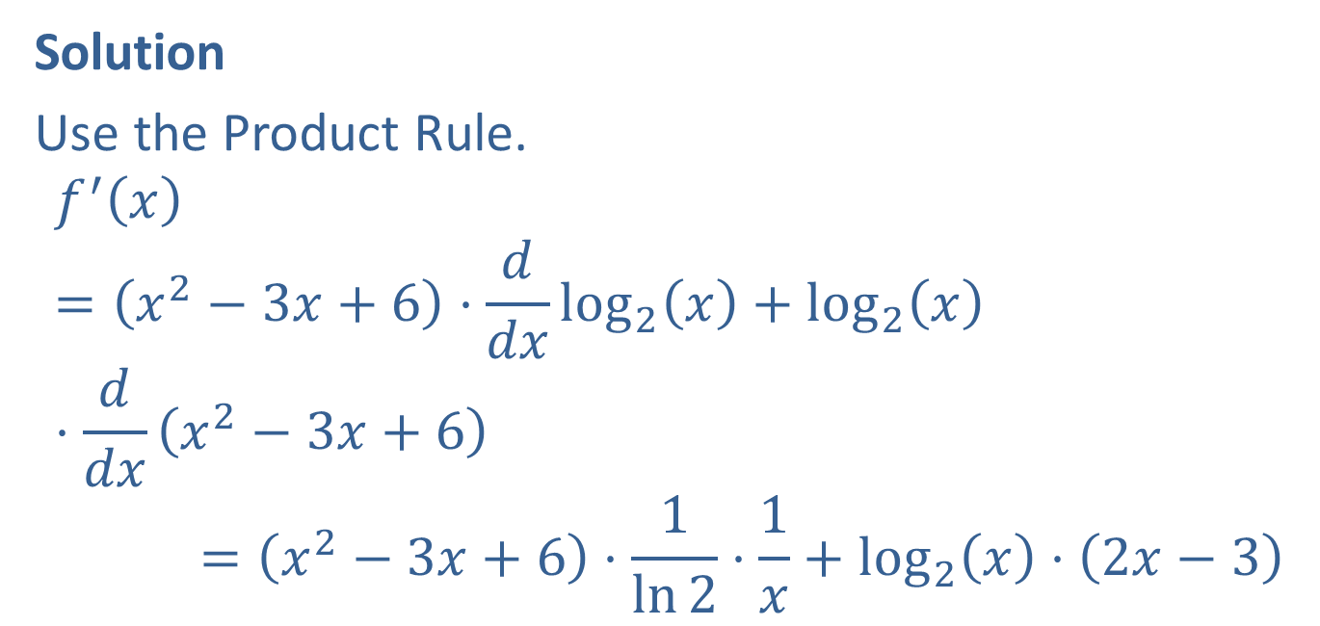

Example 6: Finding the Derivative
Given $f\left(x\right)=\left(x^{2}−3x+6\right)\log_{2}\left(x\right)$, determine $f^{′}⁡\left(x\right)$.
Solution
Use the Product Rule.
𝑓′𝑥=𝑥2−3𝑥+6⋅𝑑𝑑𝑥log2𝑥+log2𝑥⋅𝑑𝑑𝑥𝑥2−3𝑥+6𝑓′𝑥=𝑥2−3𝑥+6⋅1ln2⋅1𝑥+log2𝑥⋅2𝑥−3

Slide 15

Example 7: Locating Absolute Extrema
Find the absolute extrema for the function $f\left(x\right)=x^{2}\ln{x}$ on the interval $\left[0.1\text{, }2.0\right]$.

Slide 16
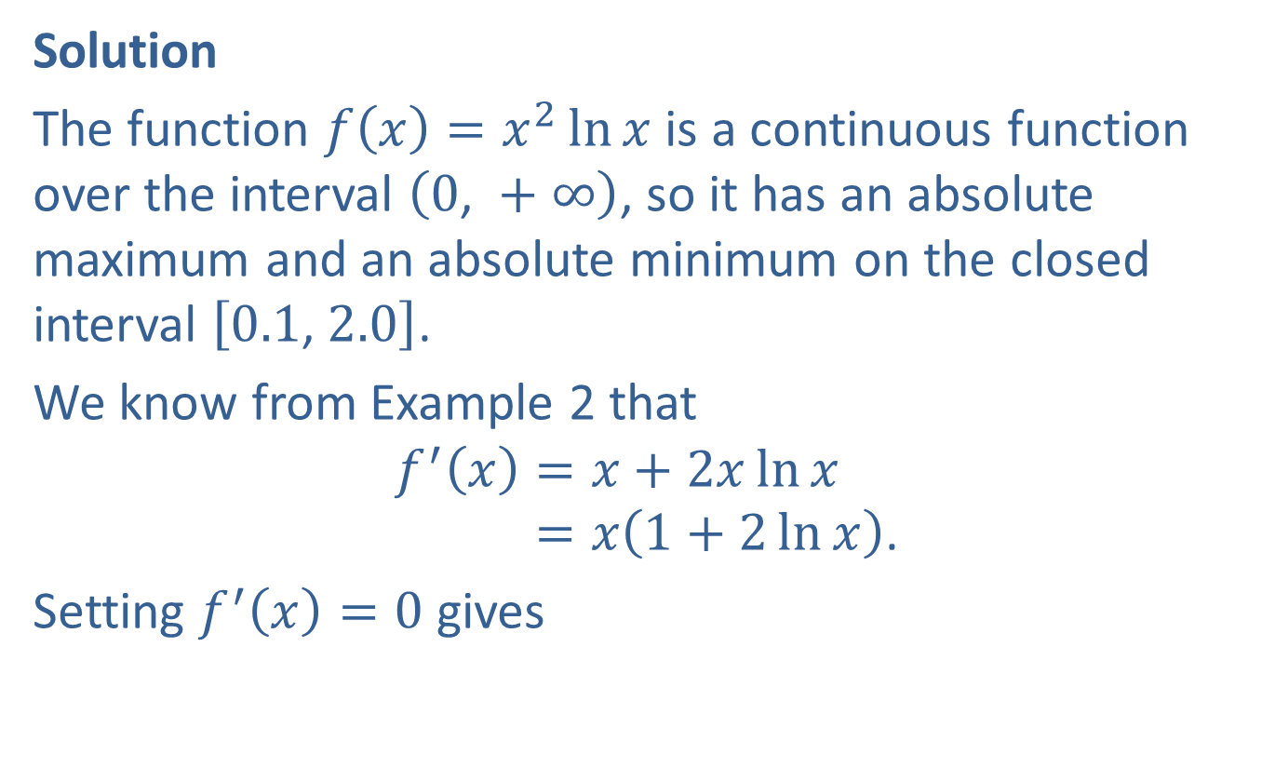
Example 7: Locating Absolute Extrema (cont.)
Solution
The function $f\left(x\right)=x^{2}\ln{x}$ is a continuous function over the interval $\left(0\text{, }+∞\right)$, so it has an absolute maximum and an absolute minimum on the closed interval $\left[0.1\text{, }2.0\right]$.
We know from Example 2 that
𝑓′𝑥=𝑥+2𝑥ln𝑥𝑓′⁡𝑥=𝑥1+2ln𝑥.
Setting $f^{′}\left(x\right)=0$ gives

Slide 17

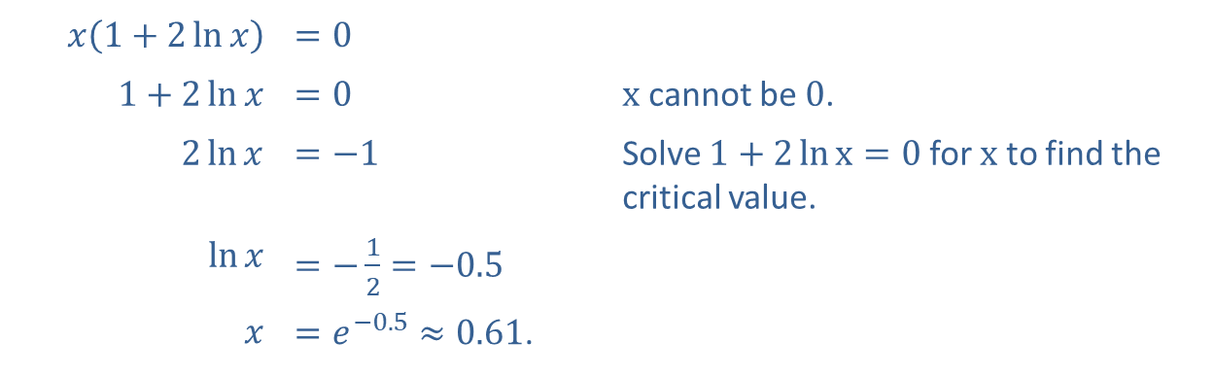
Example 7: Locating Absolute Extrema (cont.)
​$x\left(1+2\ln{x}\right)$ | ​$=0$
​ $1+2\ln{x}$ | ​$=0$ | $x$ cannot be 0.
​$2\ln{x}$ | ​$=−1$ | Solve $1+2\ln{x}=0$ for $x$ to find the critical value.
​$ln⁡x$ | ​$=−\frac{1}{2}=−0.5$
$$x$$ | ​$=e^{−0.5}≈0.61$.
$x=0$ or

Slide 18
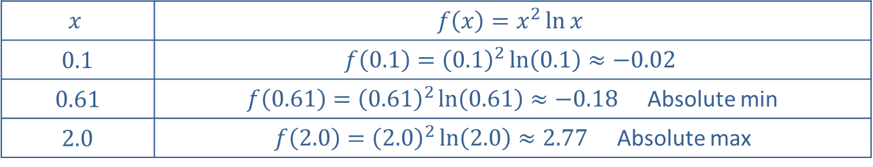

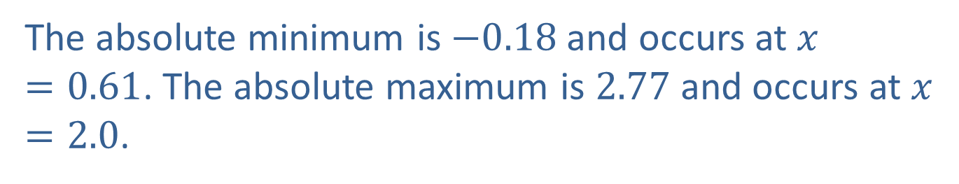
Example 7: Locating Absolute Extrema (cont.)
Evaluate $f⁡\left(x\right)$ at the critical values. (Remember, these include the endpoints of the function’s interval.)
$$x$$ | $$f\left(x\right)=x^{2}\ln{x}$$
0.1 | $$f\left(0.1\right)={\left(0.1\right)}^{2}\ln\left(0.1\right)≈−0.02$$
0.61 | $f\left(0.61\right)={\left(0.61\right)}^{2}\ln\left(0.61\right)≈−0.18$ Absolute min
2.0 | $f\left(2.0\right)={\left(2.0\right)}^{2}\ln\left(2.0\right)≈2.77$ Absolute max
The absolute minimum is $−0.18$ and occurs at $x=0.61$. The absolute maximum is 2.77 and occurs at $x=2.0$.

Slide 19
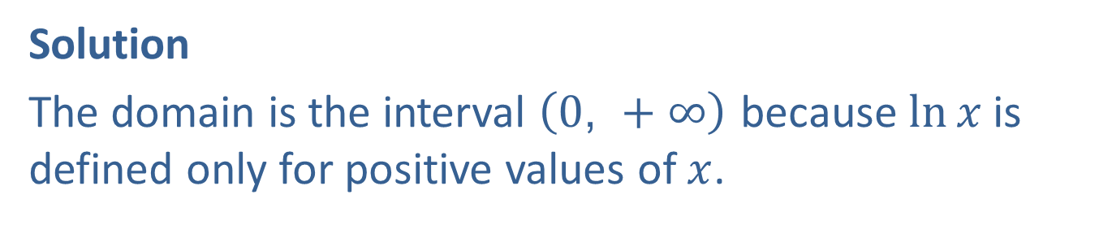

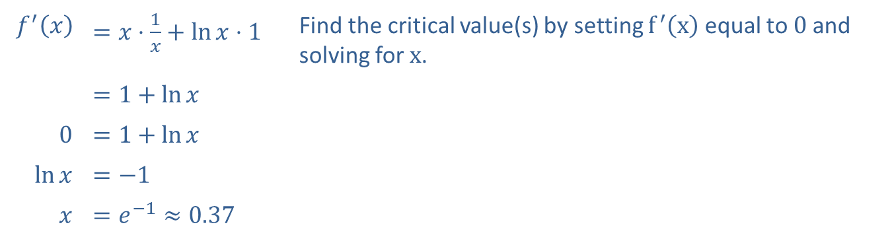
Example 8: Graphing Logarithmic Functions
Using curve-sketching techniques, sketch the graph of the function $f\left(x\right)=x\ln{x}$.
Solution
The domain is the interval $\left(0\text{, }+∞\right)$ because $ln⁡x$ is defined only for positive values of $x$.
​$f^{′}⁡\left(x\right)$ | ​$=x⋅\frac{1}{x}+\ln{x}⋅1$ | Find the critical value(s) by setting $f^{′}⁡\left(x\right)$ equal to 0 and solving for $x$.
 | ​$=1+\ln{x}$
​0 | ​$=1+\ln{x}$
​$ln⁡x$ | ​$=−1$
$$x$$ | ​$=e^{−1}≈0.37$

Slide 20
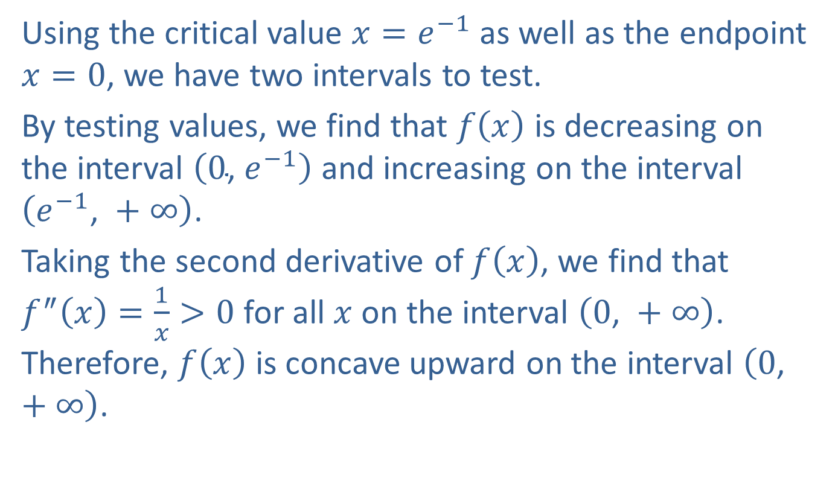
Example 8: Graphing Logarithmic Functions (cont.)
Using the critical value $x=e^{−1}$ as well as the endpoint $x=0$, we have two intervals to test.
By testing values, we find that $f⁡\left(x\right)$ is decreasing on the interval $\left(0\text{, }e^{−1}\right)$ and increasing on the interval $\left(e^{−1}\text{, }+∞\right)$.
Taking the second derivative of $f⁡\left(x\right)$, we find that $f^{″}\left(x\right)=\frac{1}{x}>0$ for all $x$ on the interval $\left(0\text{, }+∞\right)$. Therefore, $f⁡\left(x\right)$ is concave upward on the interval $\left(0\text{, }+∞\right)$.

Slide 21
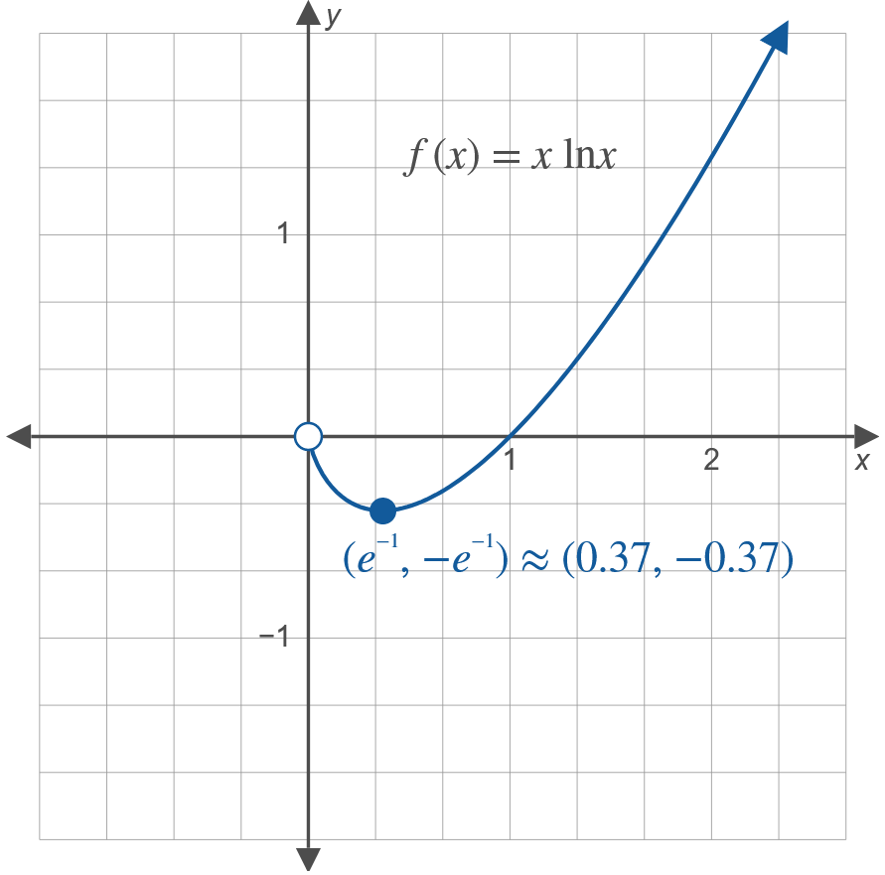
Example 8: Graphing Logarithmic Functions (cont.)

Slide 22
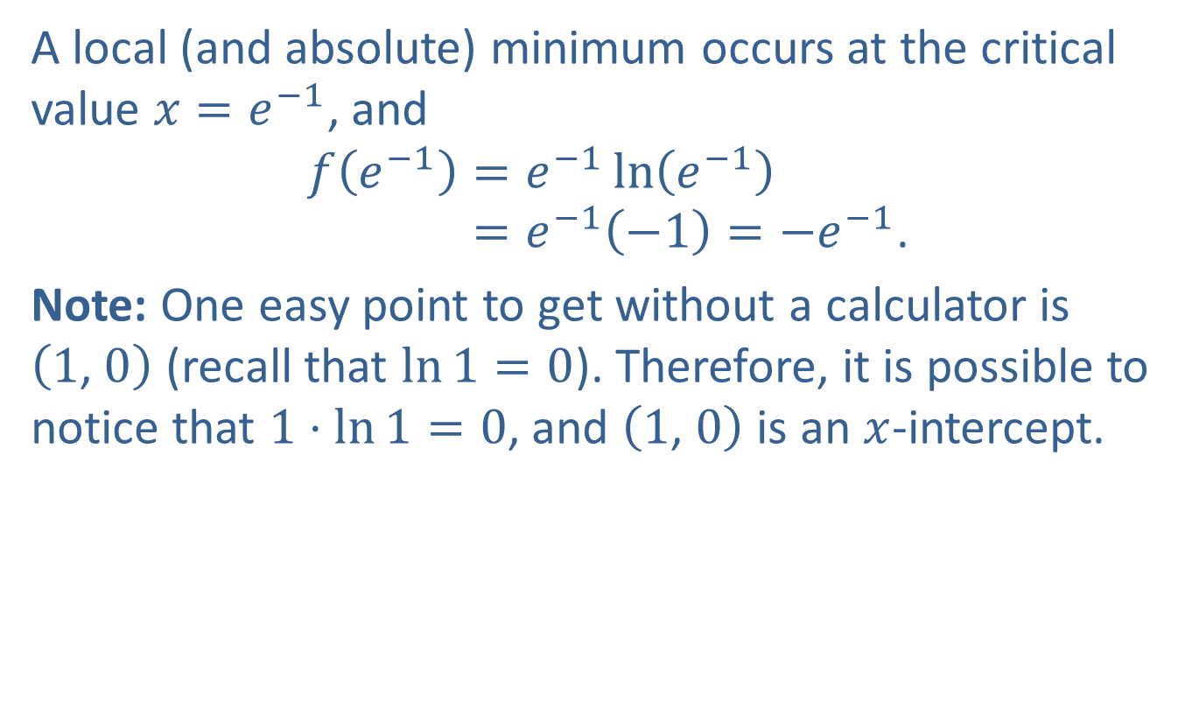
Example 8: Graphing Logarithmic Functions (cont.)
A local (and absolute) minimum occurs at the critical value $x=e^{−1}$, and
𝑓𝑒−1=𝑒−1ln𝑒−1𝑓⁡𝑒−1=𝑒−1−1=−𝑒−1.
Note: One easy point to get without a calculator is $\left(1\text{, }0\right)$ (recall that $\ln{1}=0$). Therefore, it is possible to notice that $1⋅\ln{1}=0$, and $\left(1\text{, }0\right)$ is an $x$-intercept.

